Slide 1
New Trends in Web Dissemination
Developments mainly in response to the feedback received at the
Notre Dame Workshop for Nuclear Data Needs and Capabilities for Basic Science,
August 19-11, 2016
meetings.nscl.msu.edu/2016ND_workshop/html/program.html
Some of the new features are preliminarily available for testing at
www.nndc.bnl.gov/nudat2b
New features will be officially released in a few months.

Slide 2
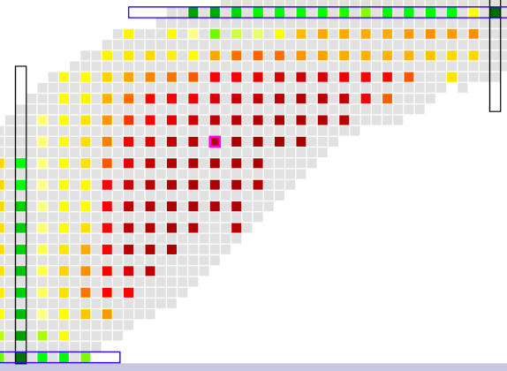
From Rick Casten’s presentation
R_{4/2}=E(4)/E(2)
Nice !
Different perspectives yield different insights
Would also be nice(r) !

Slide 3
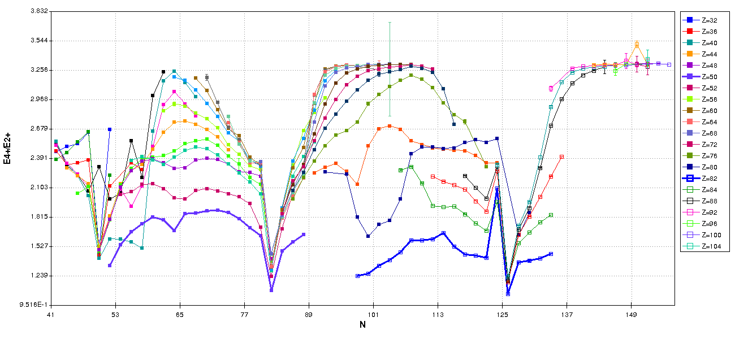
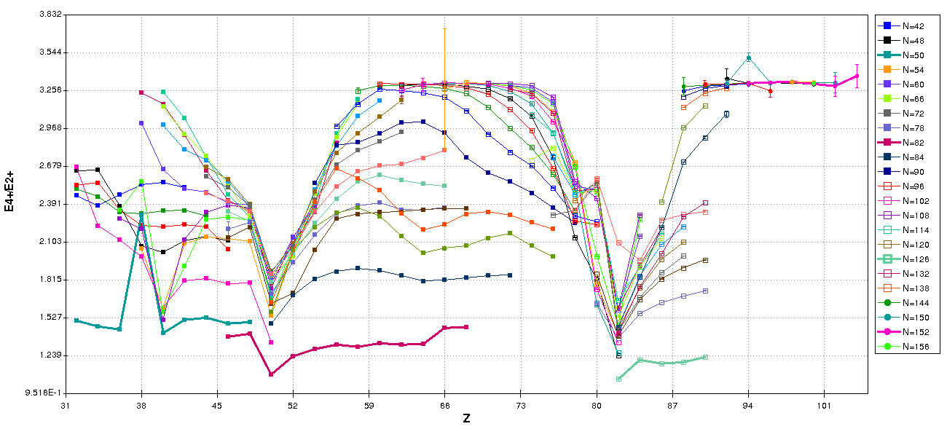
R4/2 vs N, Z plots are now available

Slide 4
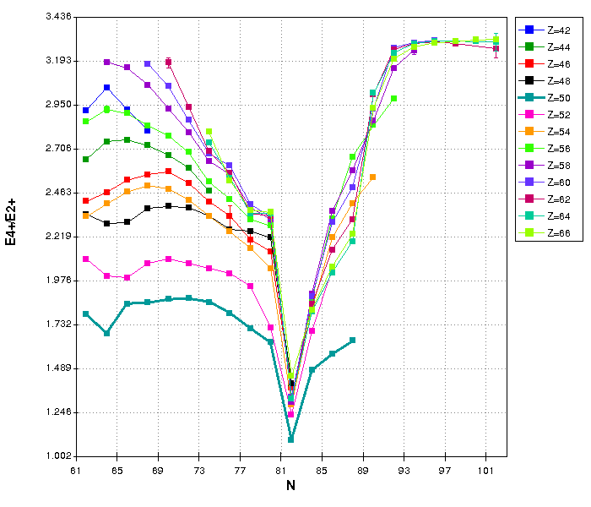
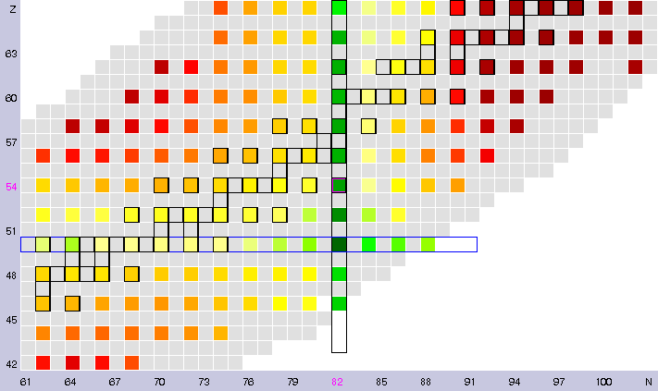
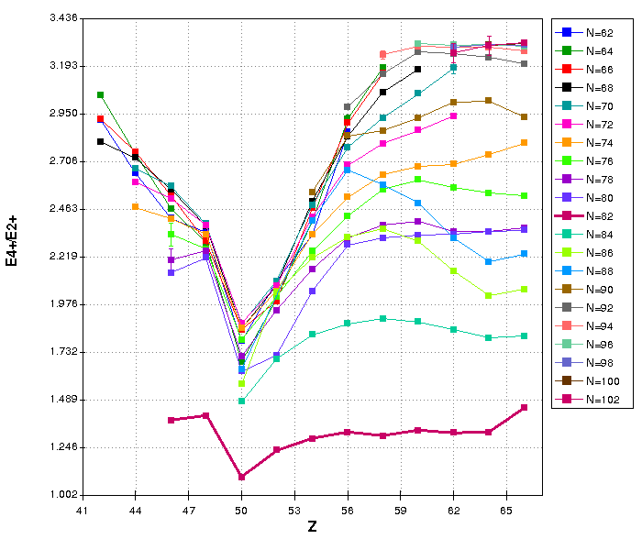
The plots are interactive

Slide 5
Another slide from Rick Casten’s presentation
Normal behavior: ~ linear segments with drops after closed shells
Discontinuities at first order phase transitions

Slide 6
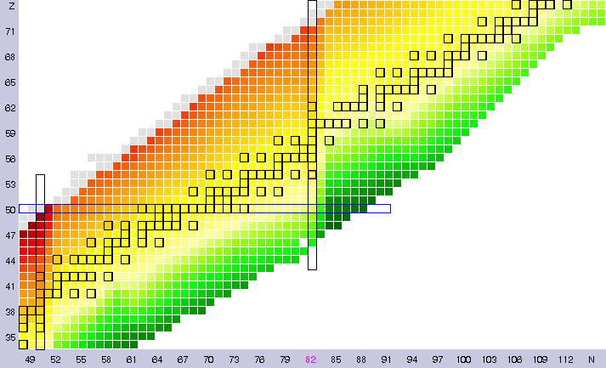
The two-neutron separation energy in a 2D plot is not particularly illustrative

Slide 7
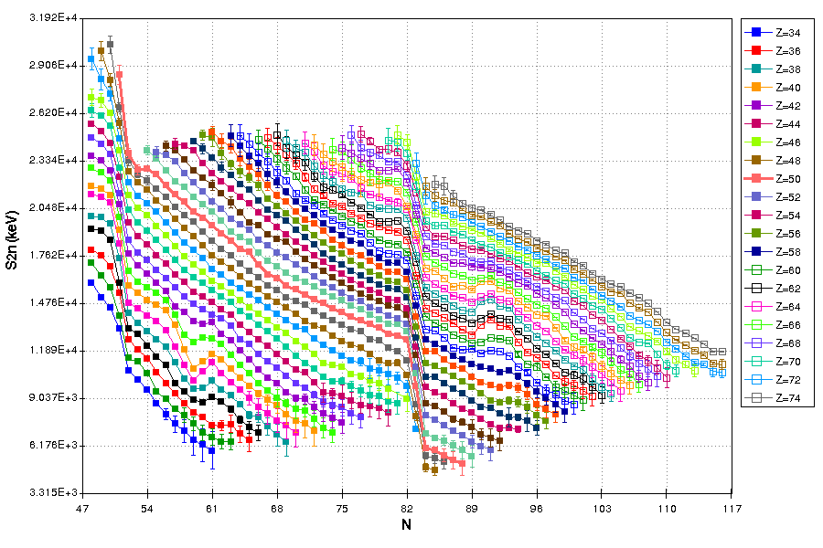
A wealth of richness is revealed when plotted as function of N

Slide 8
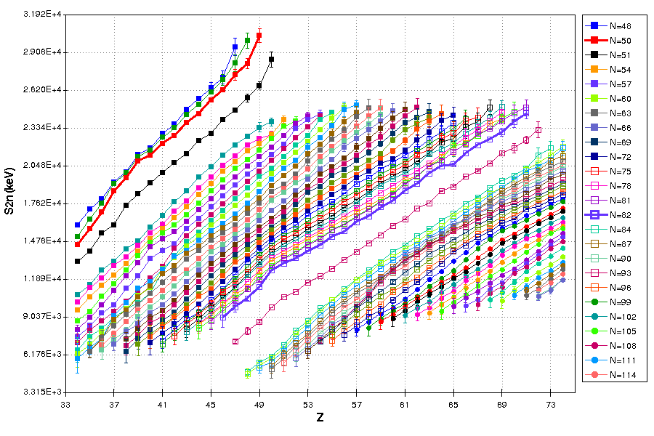
Or as function of Z

Slide 9
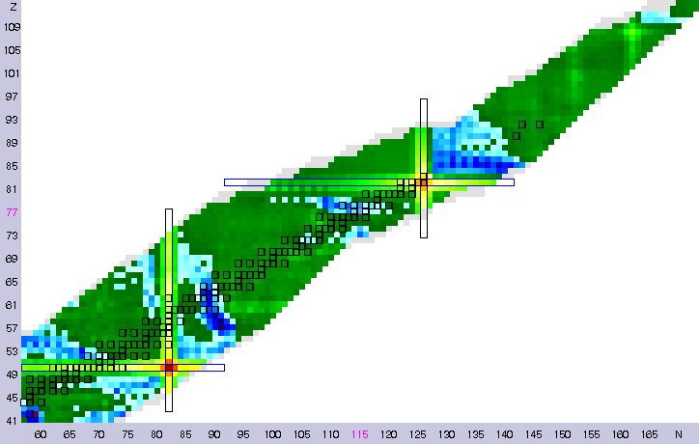
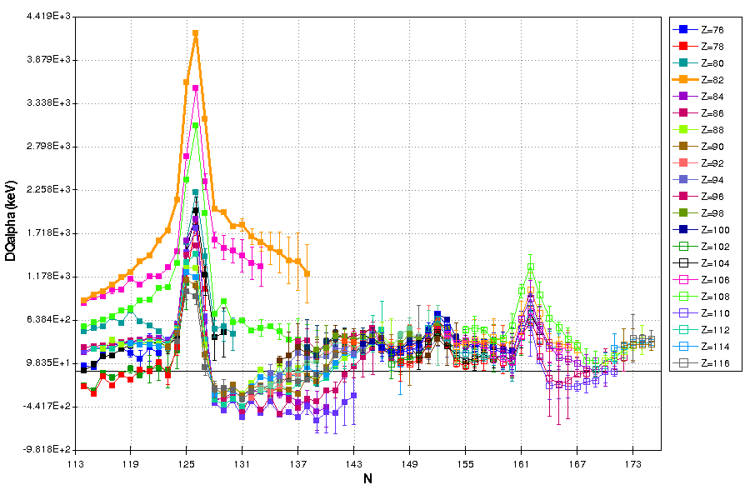
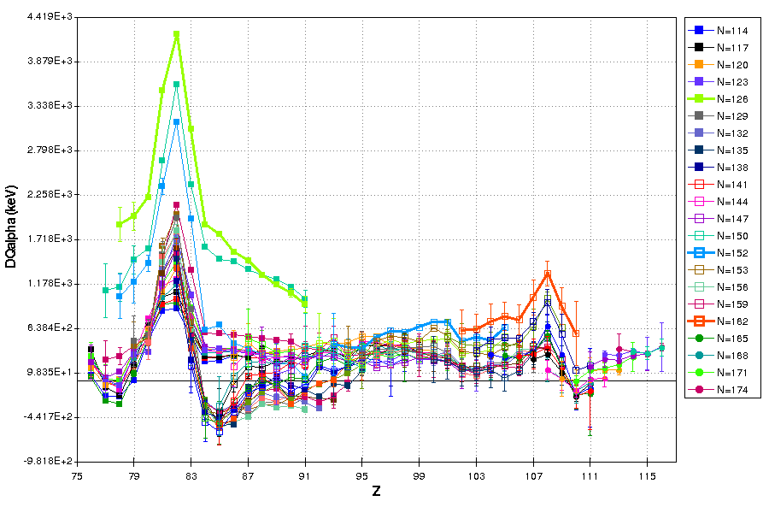
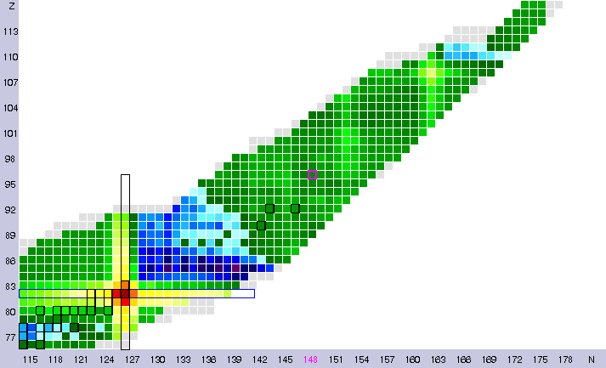
ΔQα(Z,N)=Qα(Z+2,N+2)-Qα(Z,N)

Slide 10
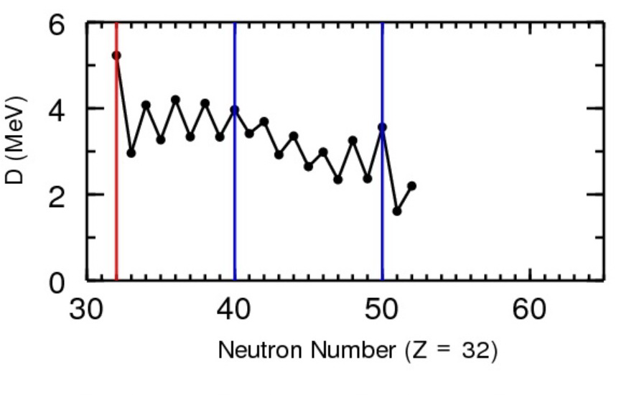
From Alex Brown’s presentation at the Notre Dame Workshop
D = 2 x pairing gap

Slide 11
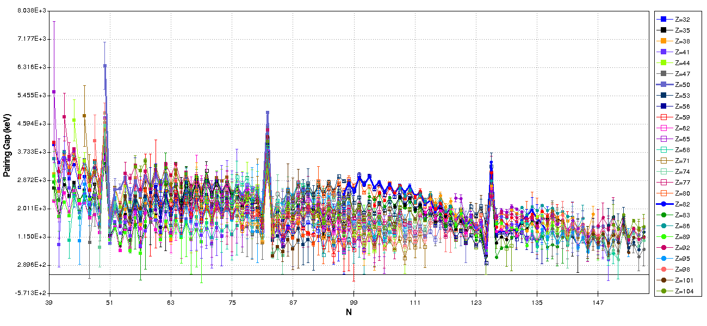
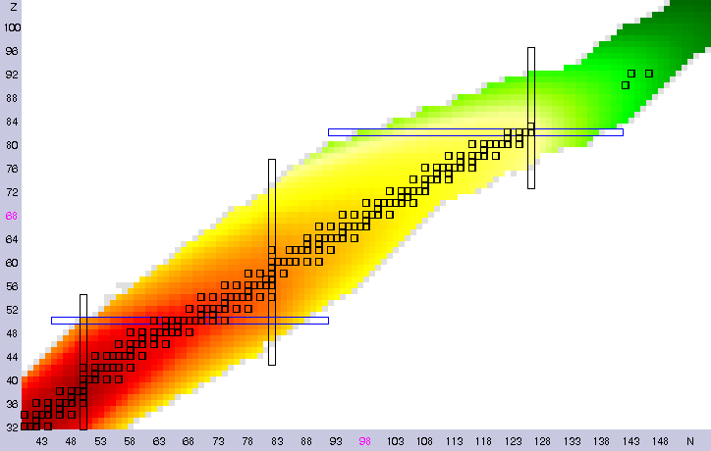
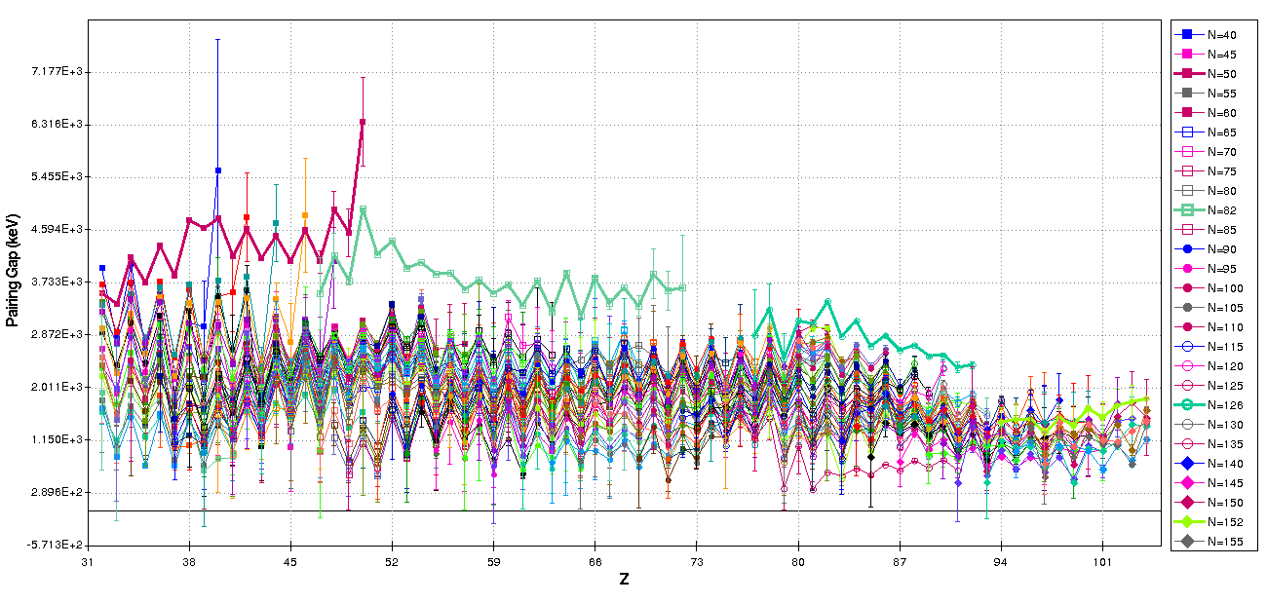
Pairing gap is now part of NuDat 2

Slide 12
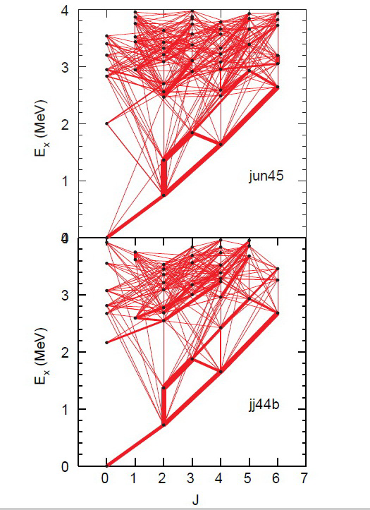
Another slide from Alex Brown’s presentation
⁷⁶Ge E2 map
Width of red line is proportional to the B(E2)

Slide 13
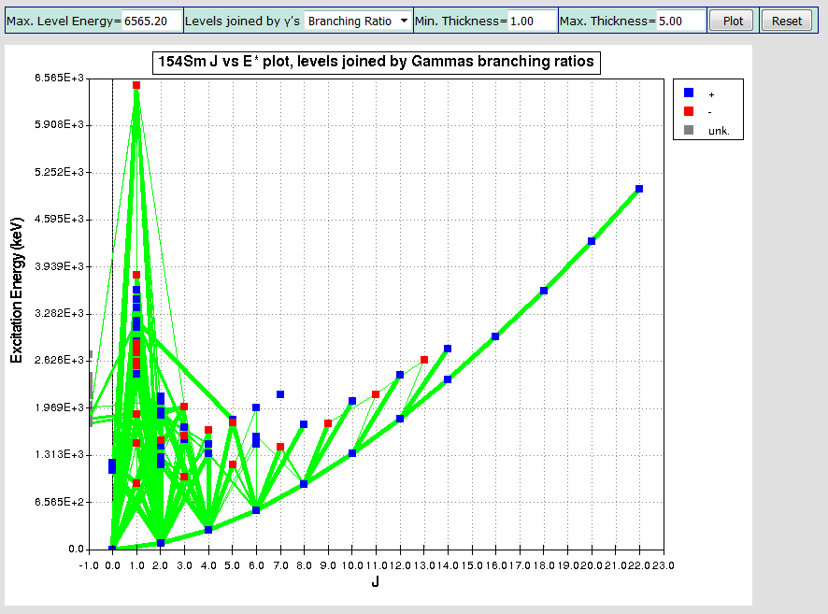
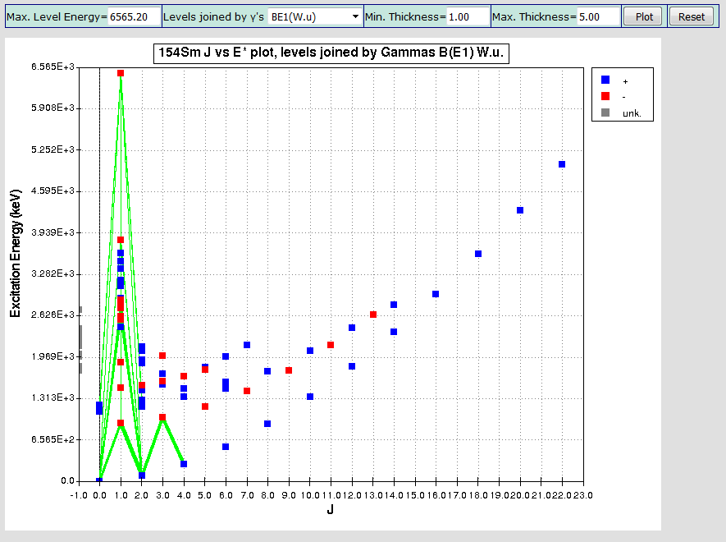
J vs E* plots are now available through NuDat

Slide 14
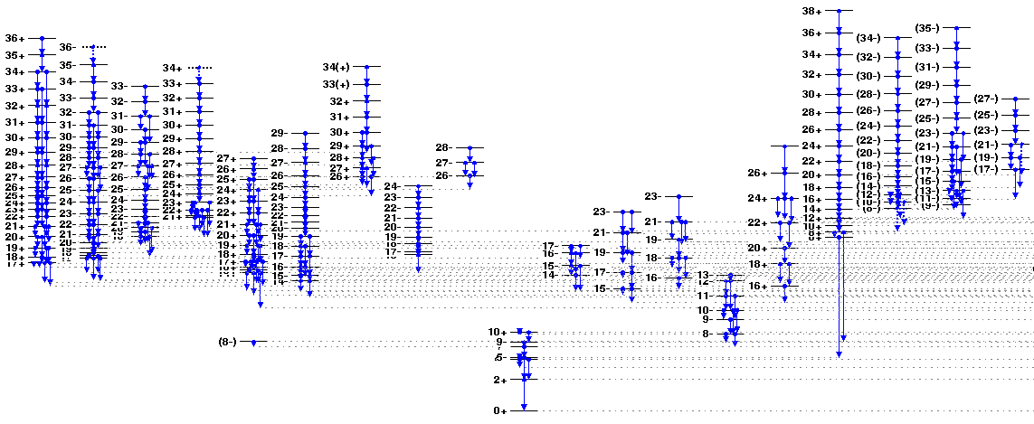
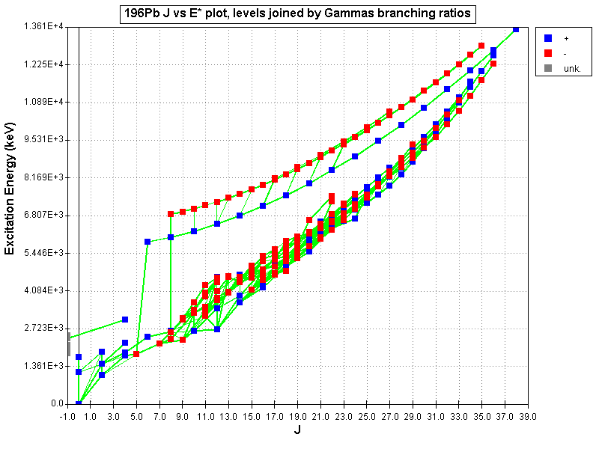
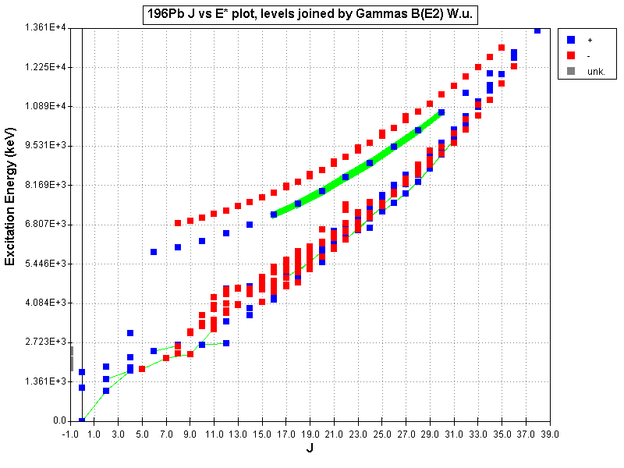
¹⁹⁶Pb, spherical at the lowest energies and super-deformed at higher energies

