Slide 1
BNL Experimental Activities
Applied – Medical Isotopes
Structure – Light and Heavy Nuclei

Slide 2
Data in Support of Medical Isotope Production

Slide 3
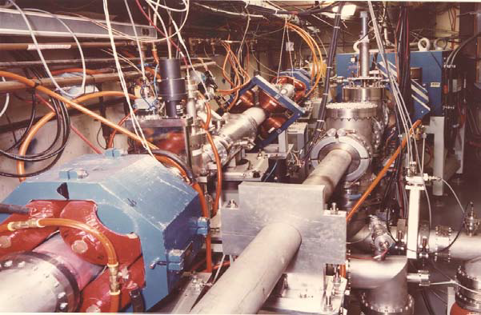
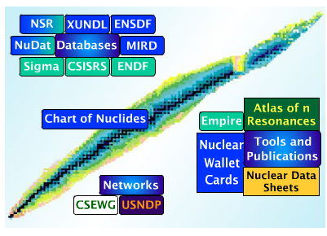
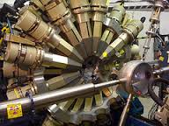
Use a “best-practice”, synergistic approach
Combine expertize in all skills needed to develop a world-class program to enhance production and application of radioisotopes
Target design
Radiochemistry
Medical relevance
Structure & Decay Data
Reaction Data
Reaction Modeling
γ-ray spectroscopy
State-of-the-art detector systems
BLIP
UofWisc
BLIP
USNDP
ANL
UMASS
With eager participation from all collaborators, we have made substantial progress in past year with ZERO additional funding
With eager participation from all collaborators, we have made substantial progress in past year with $30K additional funding

Slide 4

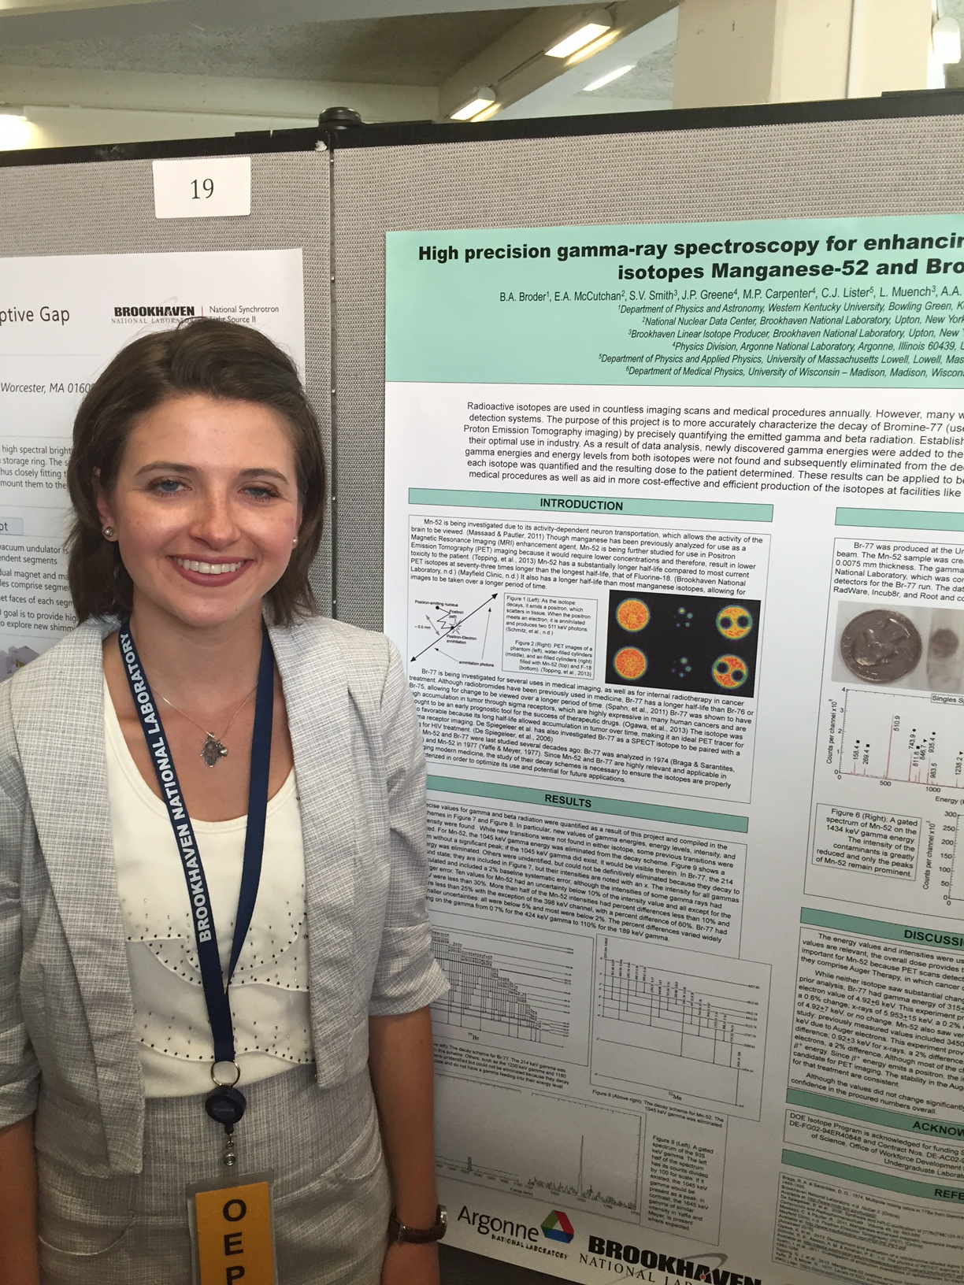
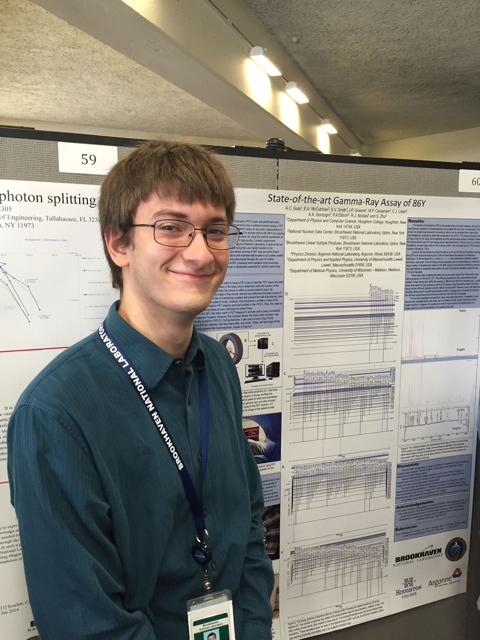
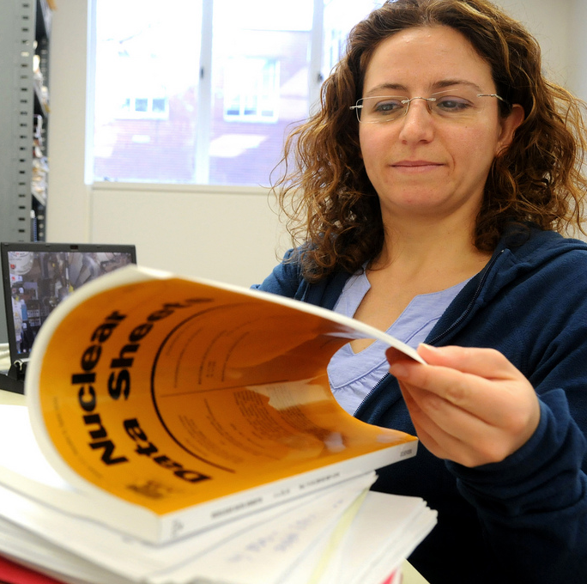
The Team
PhD Student
SULI Students
Kati Moran:
⁷⁶Br decay
Brittany Broder:
⁵⁵Mn, ⁷⁷Br decay
Visiting Faculty Program
August Gula:
⁸⁶Y decay
Gulhan Gurdal:
BLIP cross sections

Slide 5

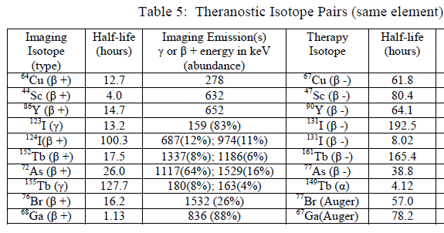
Why Decay Data ?
Essential for determining:
Overall dose
Specific dose
Imaging background
Gamma-ray intensities usually used to determine cross sections
Over half were last studied >30 years ago !!

Slide 6
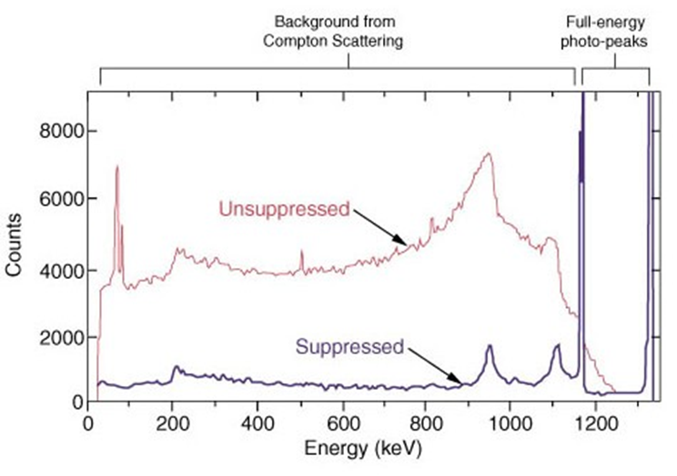
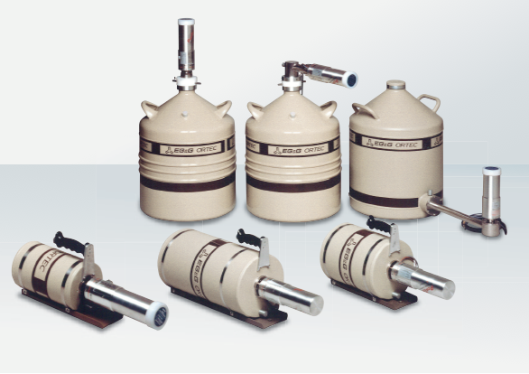
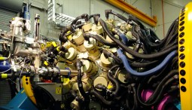
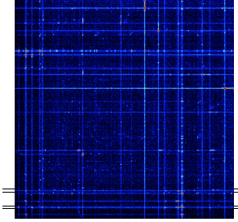
Capitalizing on advances in γ-ray spectroscopy
Compton suppression
30 Years ago: 1-2 small detectors
Present: 10-100 detectors
γγ coincidences

Slide 7
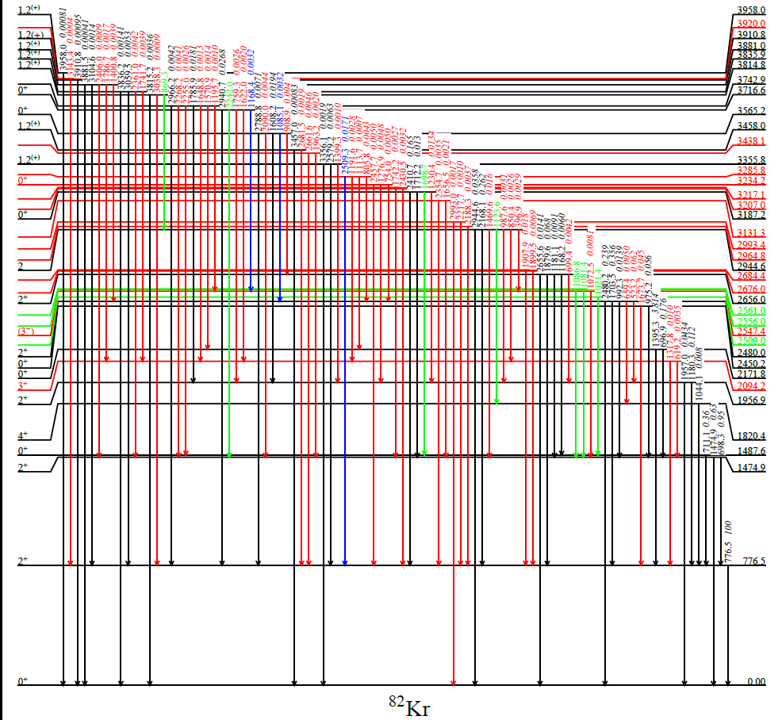
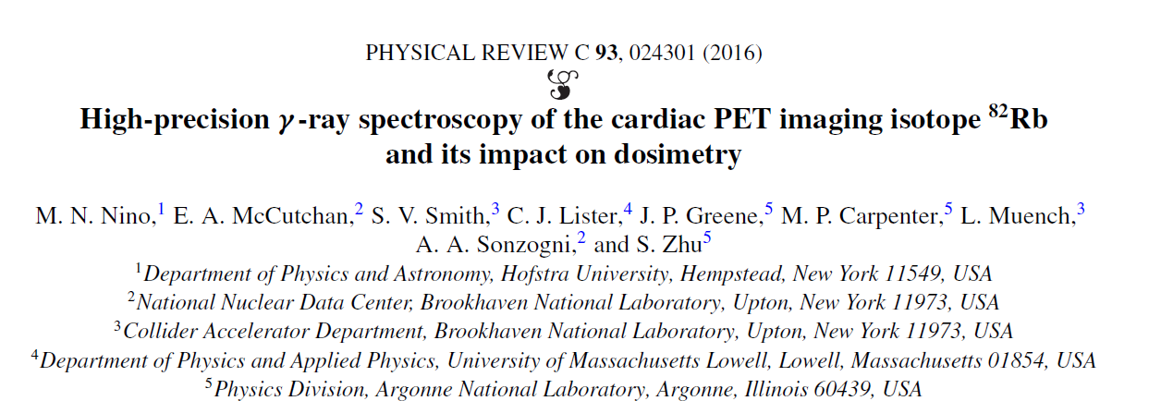
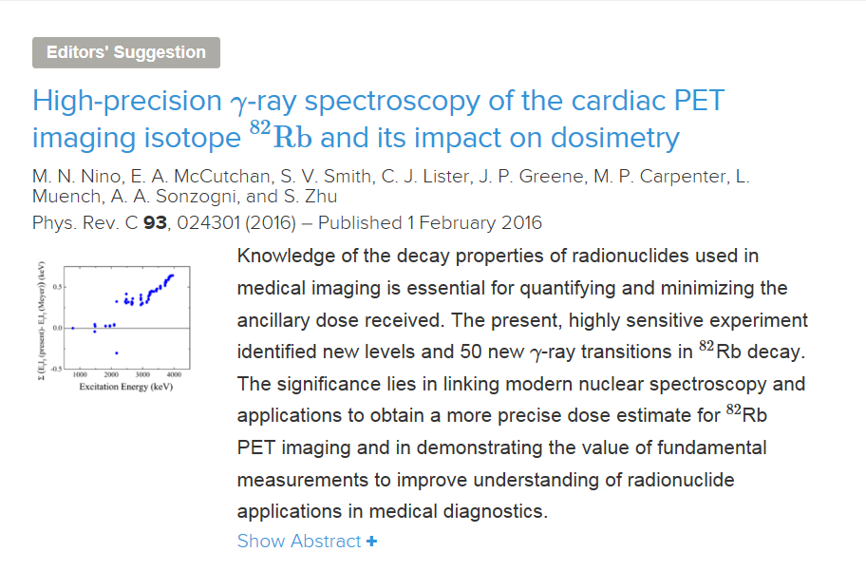
Revised decay scheme for ⁸²Rb

Slide 8
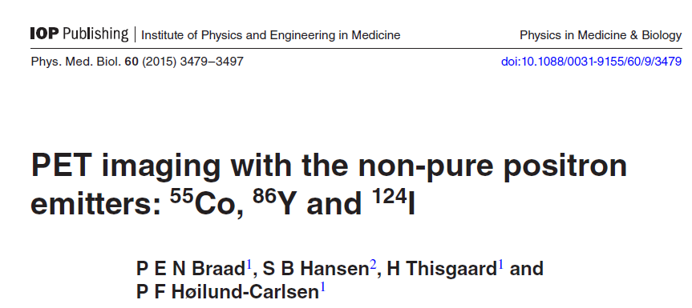
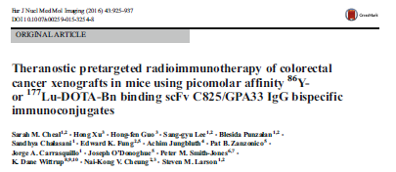
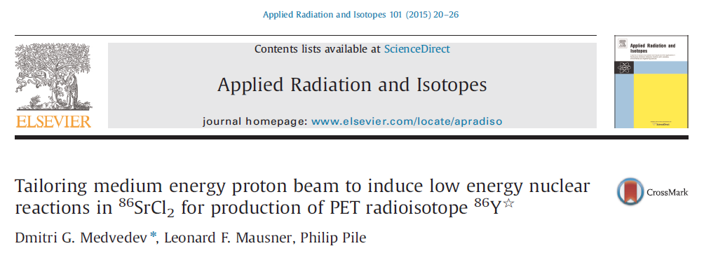
Non-conventional PET agents : ⁸⁶Y

Slide 9
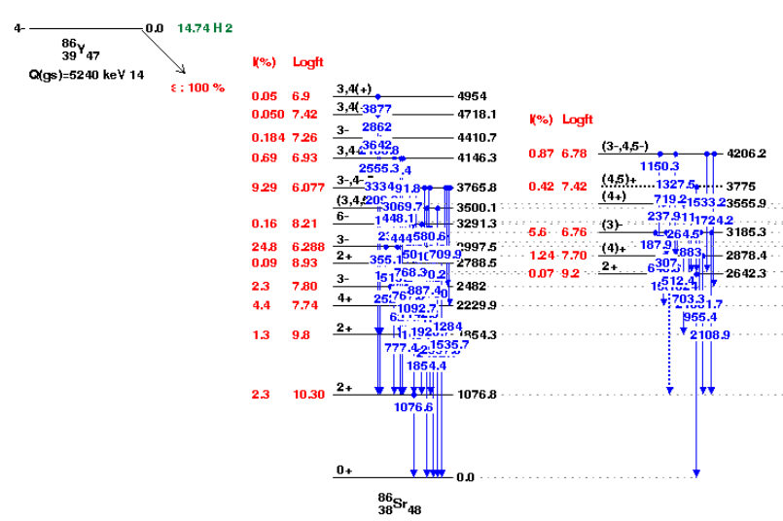
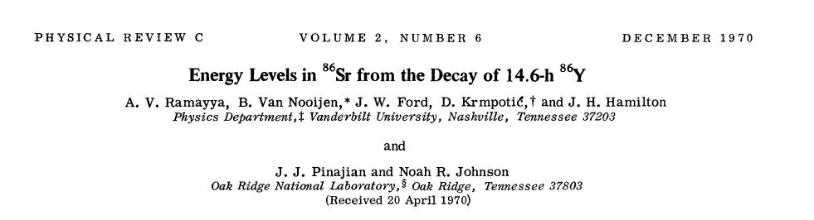
Non-conventional PET agents : ⁸⁶Y
And more!

Slide 10
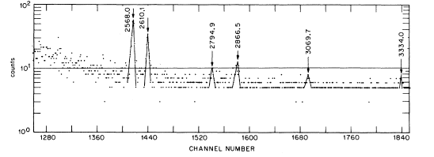
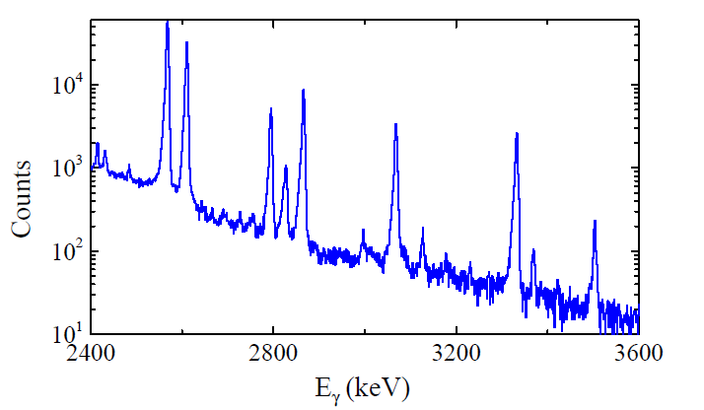
Results on ⁸⁶Y
Gate on 2⁺→0⁺

Slide 11
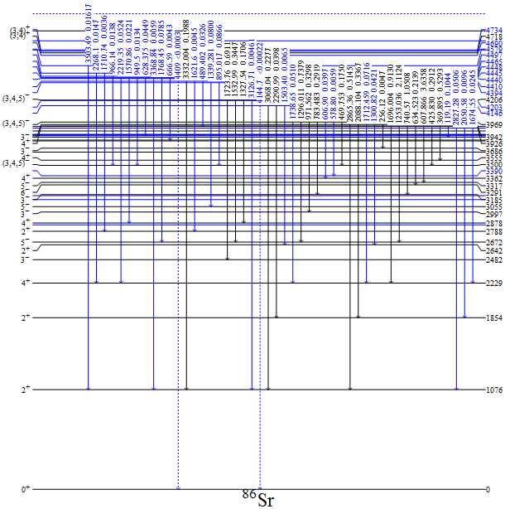
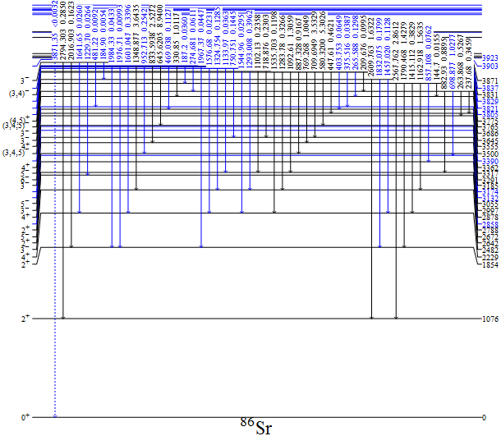
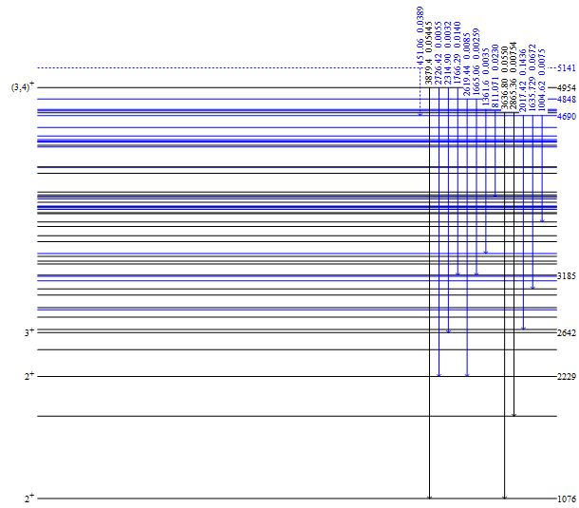
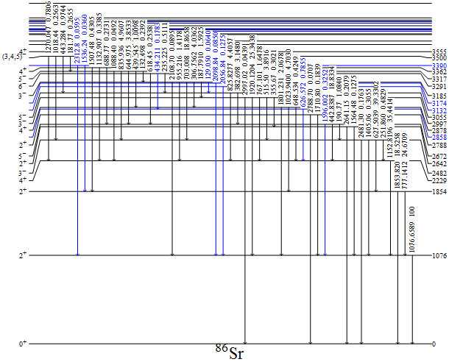
Revised decay for ⁸⁶Y
60 new gamma-ray transitions
12 new excited levels

Slide 12
Improved dose assessment for ⁸⁶Y
 | ΣE_{γ}I_{γ} | ΣE_{β}I_{β}
Previous | 3560 (40) | 212(22)
Present | 3620 (30) | 175(9)
Absolute Intensity
Transition | Previous | Present | % Change
511 keV | 64 (4) | 57.6 (23) | 10%
777 keV | 22.4(6) | 21.4 (4) | 5%
1076 keV | 82.5 (4) | 82.8(4) | 1%
1920 keV | 20.8 (7) | 21.9(6) | 5%

Slide 13
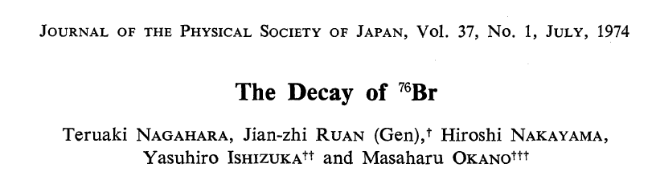
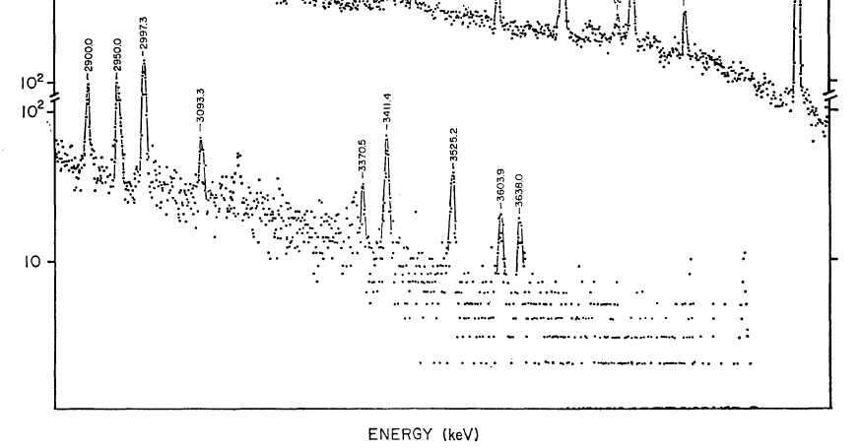
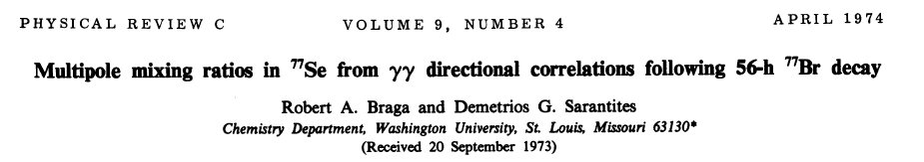
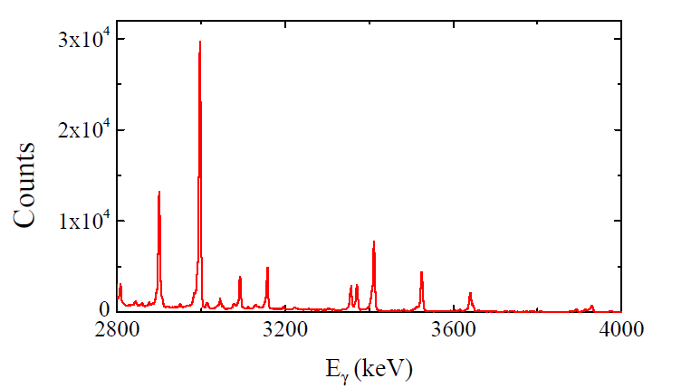
Early results on⁷⁶Br
Gate on 2⁺→0⁺

Slide 14
Summary of Decay Data Measurements
FY15
⁸²Rb – published
FY16
⁷⁷Br – analysis complete
⁸⁶Y – analysis complete
⁵⁵Mn – analysis complete
⁷⁶Br – analysis in progress
⁶¹Cu – measurement performed
⁶²Cu – measurement performed
⁷¹As,⁷³As,⁷⁴As – PAC approved

Slide 15
Cross Sections in Support of BLIP

Slide 16
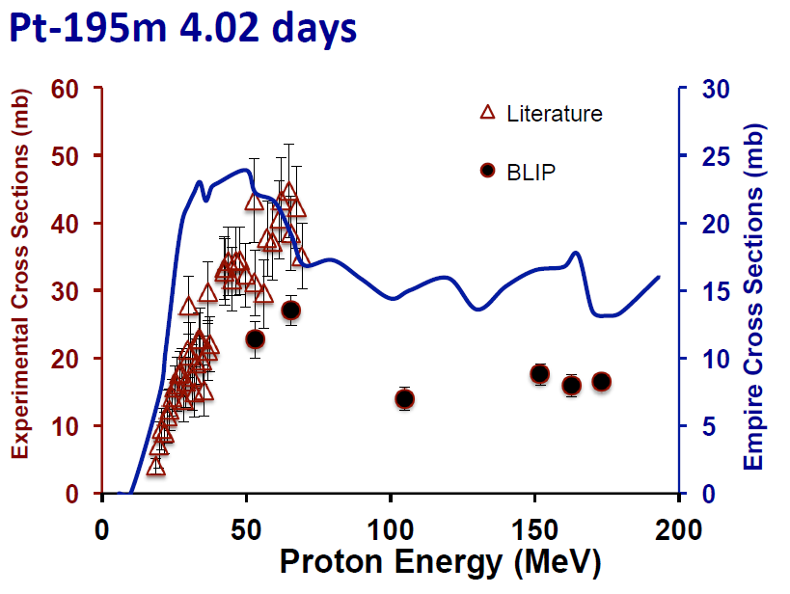
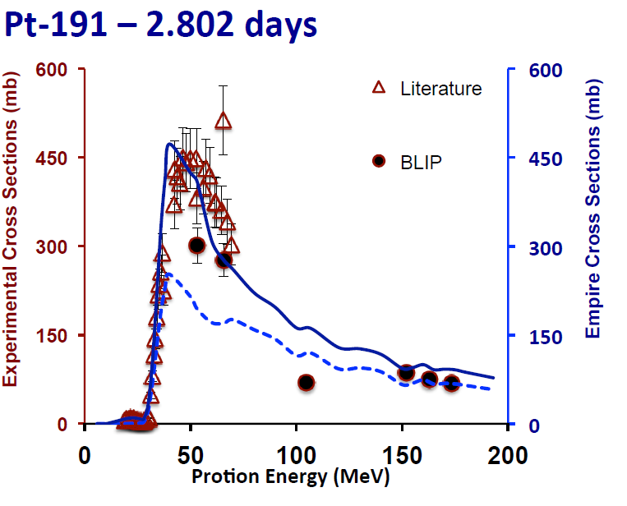
Finalizing Pt cross section measurements
~50% of chemotherapy involves platinum-based agent
Most dosing using only patient’s height and weight
Pair with imaging agent to monitor dose and tissue uptake
50-180 MeV protons on Pt foils at BLIP
Measured Au,Pt,Ir,Os cross sections
Detailed comparison with EMPIRE calculations

Slide 17
Future work focuses on NSAC recommendations
We recommend a significant increase of funding for research and development
a) Continue support for R&D on the production of α-emitting radioisotopes
With focus on ²²⁵Ac and ²¹¹At
b) Support R&D into the production of high specific activity theranostic radioistopes

Slide 18
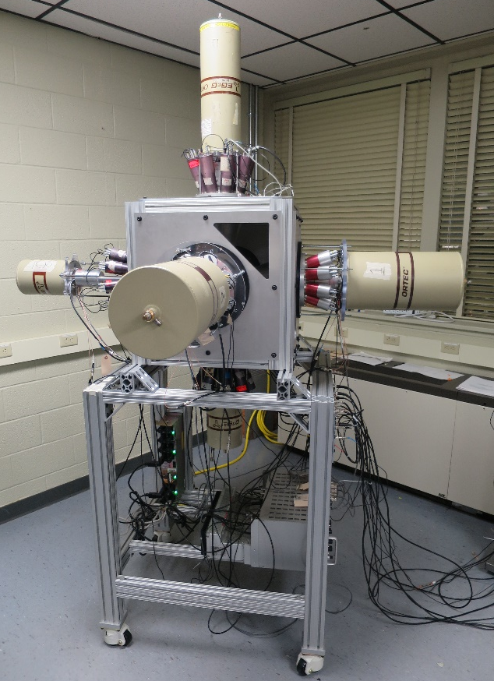
A work in progress
Need a sophisticated array, but Gammasphere is a bit overkill
Lowell’s Array for Radiological Assaying (LARA)
6 Compton-suppressed HPGe detectors

Slide 19
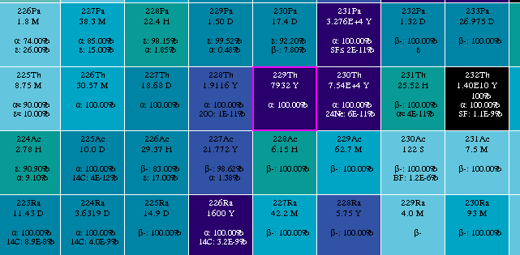
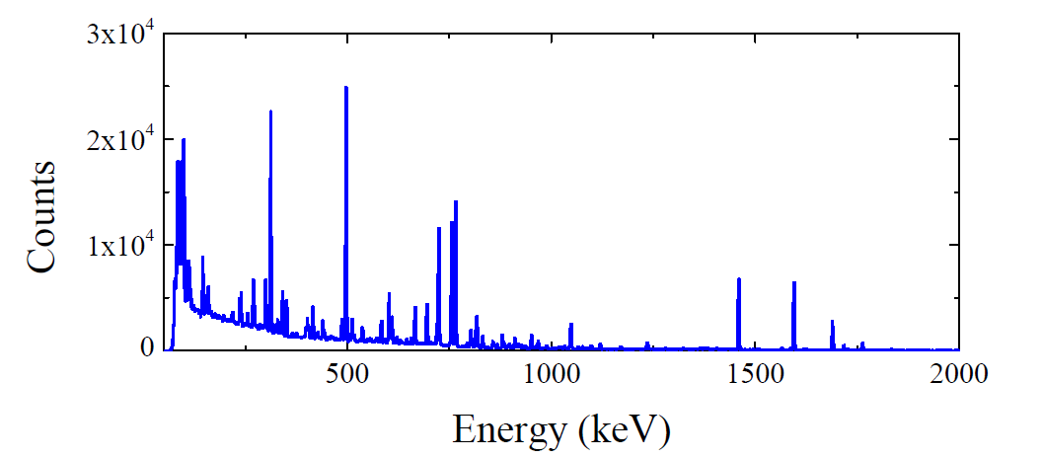
What’s in a Thorium Irradiation
High energy protons on ²³²Th
Tons of nuclei produced
Analysis would significantly benefit from γγ coincidence spectroscopy
¹⁰³Ru
²³³Pa
⁹⁵Zr
⁹⁵Nb

Slide 20
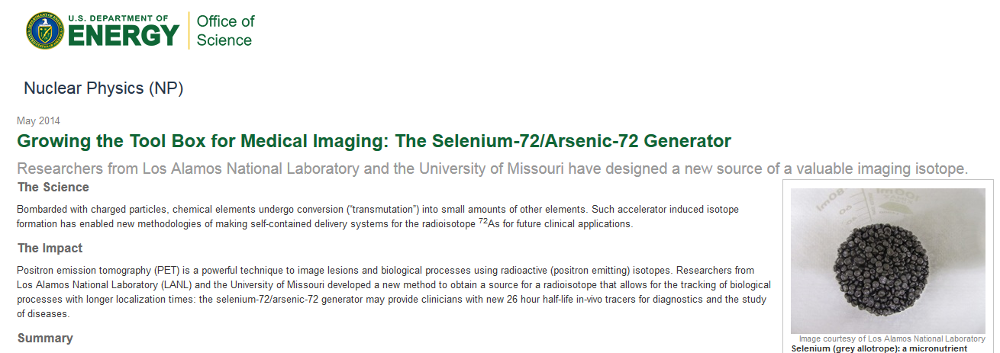
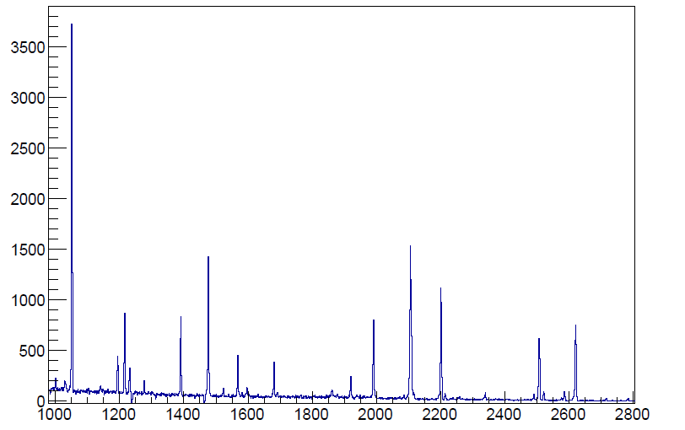
Theranostic Pairs
Combine imaging and therapy in single treatment
Gated spectrum

Slide 21
Summary and Outlook
Decay data
Very successful campaign of measurements
Helps to have well developed equipment available
Very low cost and very nice training ground for students
Cross Sections
Making progress on measurements
Ironing out issues in equipment
Very much looking forward to restart of BLIP
Very successful campaign will require more focused effort

Slide 22
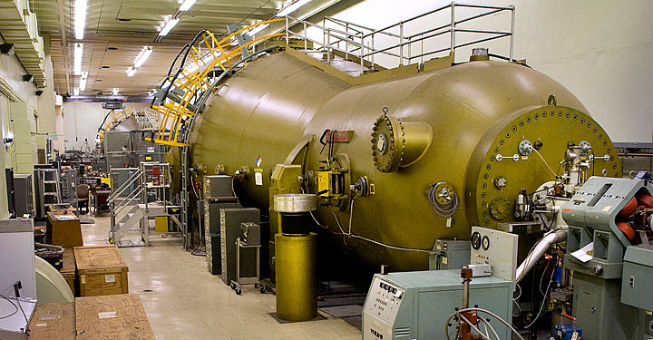
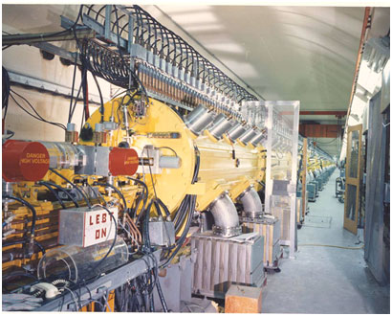
An opportunity
For a world-leading facility for cross section measurements
RHIC Injector Tandem
29 MeV protons
BLIP
200 MeV protons
LARA
Cover full range of proton energies
Paired with high-precision γγ coincidence spectroscopy
Proposal for a 50/50 postdoc working on BLIP and ENSDF

Slide 23
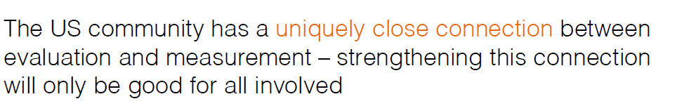
Experiments in Nuclear Structure
From FRIB talk by Heather Crawford at ND meeting
Identify key deficiencies in data and address them
Led experiments at all major facilities in North America
NSCL – ¹²Be using Gretina
TRIUMF – Li isotopes using Tigress
ANL – ²⁰⁸Pb region using Gammasphere

Slide 24
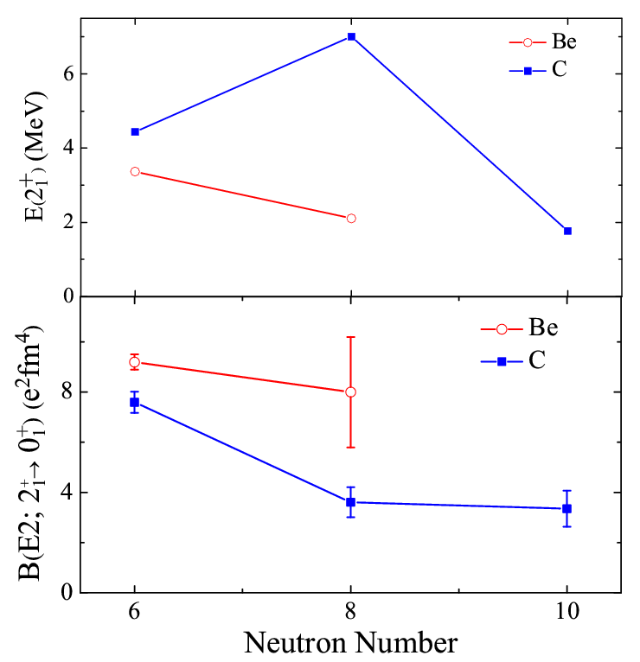
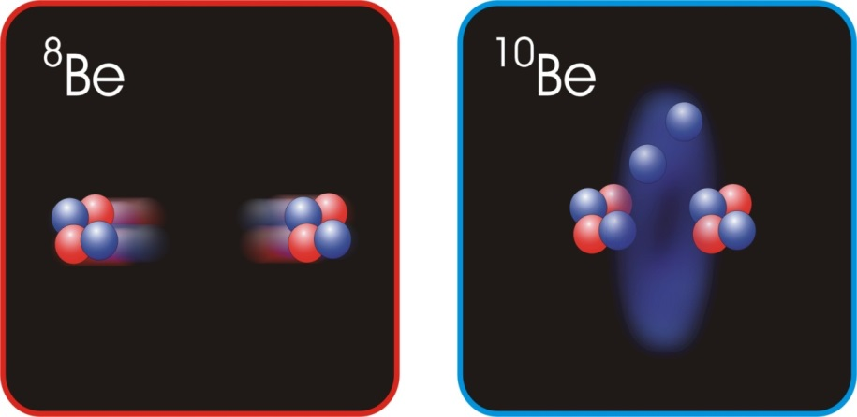
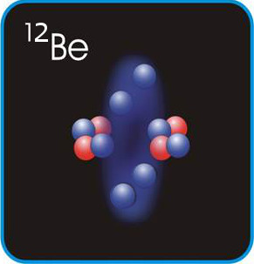
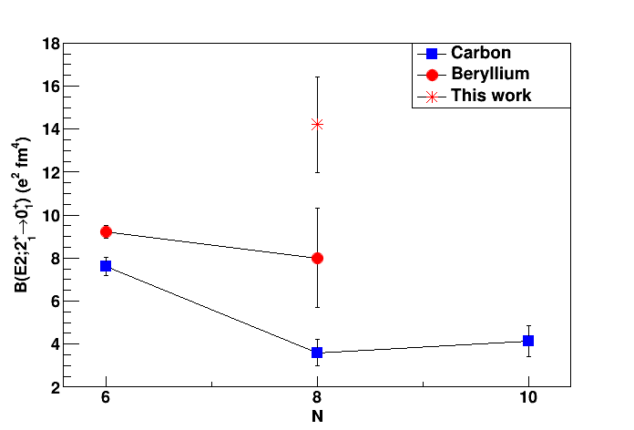
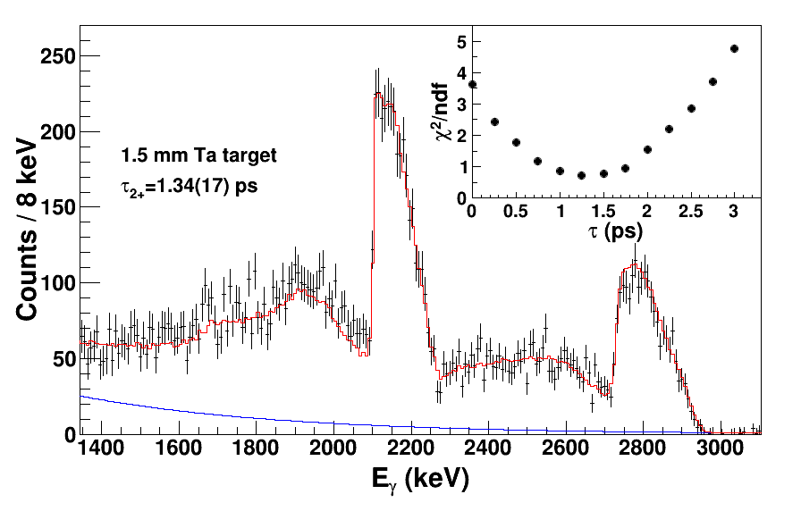
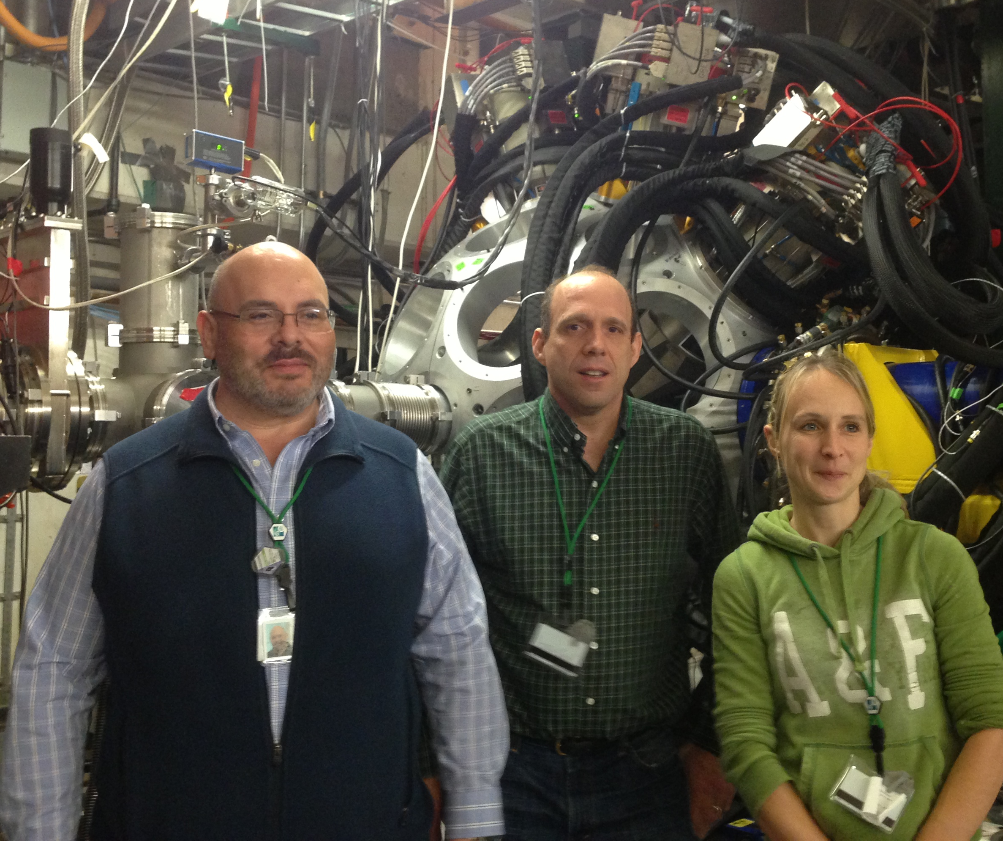
¹²Be using GRETINA at NSCL
?
Analysis by C. Morse

Slide 25
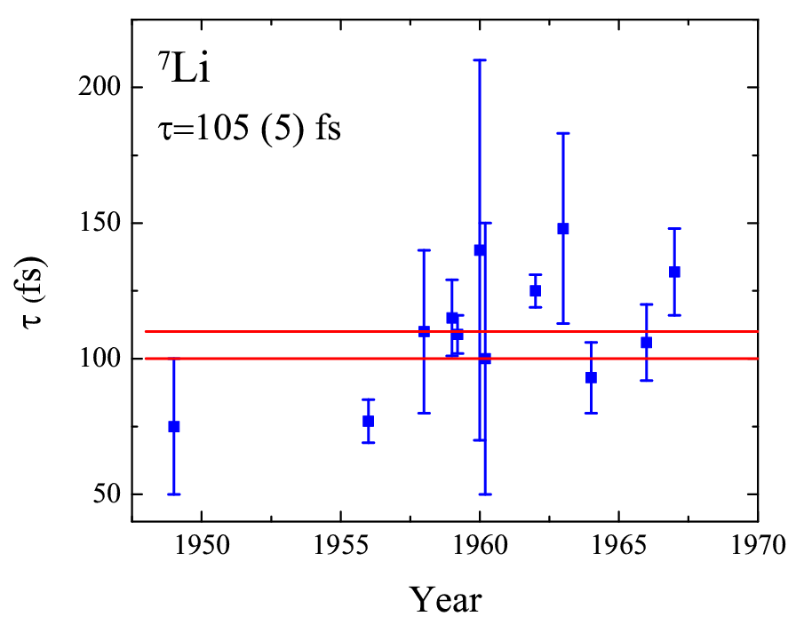
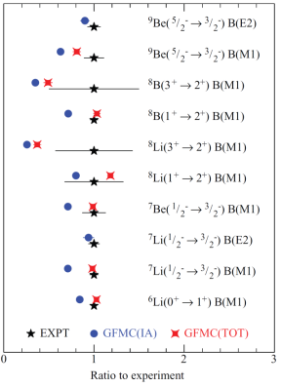
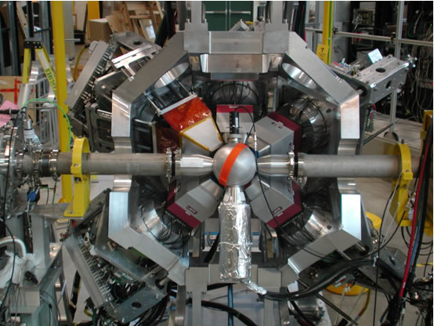
M1 strengths in Li isotopes
GFMC Ab-initio calculations
Need to precisely measure lifetimes to challenge theoretical calculations!
^{6,7,8}Li @ 2.1 MeV/u, using
(d,p) in inverse kinematics
S. Pastore et al., Phys. Rev. C 87, 035503 (2013)
Analysis by C. Morse

Slide 26
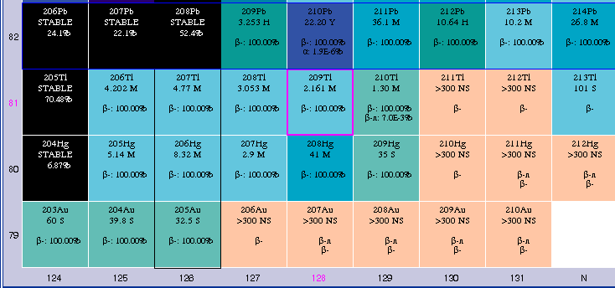
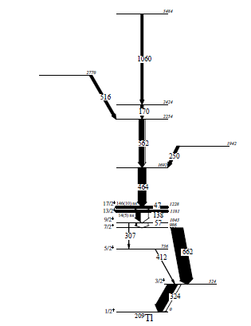


Southeast of ²⁰⁸Pb
Data below ²⁰⁸Pb get very sparse very quickly
Probe using ²⁰⁴Hg+²⁰⁸Pb, ¹³⁶Xe+²⁰⁸Pb and Gammasphere
Loveland et al., cross sections

Slide 27
BACKUPS

Slide 28

On the bright side: ⁵²Mn
100 MeV protons on natural Ni
We make a lot and some isotopes have applied uses
For example, Co-55 and Mn-52, both studied 1970’s
Singles

Slide 29


Coincidences are essential
Decay of Mn-52
744
935
511
Gate on 1434-keV

Slide 30


Results on ⁵²Mn decay
1645
1046

Slide 31

Results on ⁵²Mn decay
No evidence for 2 weak transitions
Energy | Intensity (lit) | Intensity (present)
200.6 | 0.076 | 0.18
346.0 | 0.98 | 0.86
398.1 | 0.089 | 0.004
399.6 | 0.19 | 0.16
502 | 0.21 | 0.20
600.2 | 0.39 | 0.35
647 | 0.40 | 0.38
744 | 90.0 | 88.6
848 | 3.32 | 3.43
935 | 94.5 | 94.9
1046 | 0.07 | 0.03
1246 | 4.2 | 4.2
1247.8 | 0.38 | 0.40

Slide 32

Conclusions
www.nndc.bnl.gov
National Nuclear Data Center:
We are here for you
Please contact us with ideas, questions, concerns
Active campaign of decay data measurements relating to medical isotopes is underway
Studied ⁸²Rb, ⁸⁶Y, ⁷⁶Br, ⁷⁷Br, ⁵²Mn, ¹⁸⁸Pt
Planned ⁶¹Cu, ⁶²Cu, ¹²³I, ¹²⁴I …
… and what you tell us is important

Slide 33
Collaborators
S.V. Smith, L. Muench, A.A. Sonzogni, M. Nino, B. Broder, A. Gula
Brookhaven National Laboratory
R.J. Nickles, P. Ellison
University of Wisconsin
J.P. Greene, M.P. Carpenter, and S. Zhu
Argonne National Laboratory
C.J. Lister, K. Moran
University of Massachusetts, Lowell

Slide 34



Isotope Production Experts
Brookhaven Linac Isotope Producer (BLIP)
University of Wisconsin
Institute for Medical Research
16 MeV proton GE PETrace cyclotron
11 MeV proton CTI RDS 112 cyclotron

Slide 35


Gammasphere at Argonne National Lab
100 HPGe detectors
Compton-suppressed
Digital or analog DAQ

Slide 36



Non-conventional PET agents : ⁷⁶Br

Slide 37

Non-conventional PET agents : ⁷⁶Br
And more!

Slide 38



Theranostic pairs: ^{76,77}Br
10 MeV protons on NiSe pellet (Univ. of Wisconsin)
⁷⁶Br
⁷⁷Br
⁸²Br

