Slide 1
BNL Report
A.A. Sonzogni
National Nuclear Data Center

Slide 2
NNDC Staff during FY16
7.5 Scientific FTEs and 3.0 Tech/Admin FTEs
# | Name | Primary duties
1 | Ramon Arcilla | Servers, ENDF validation
2 | David Brown | ENDF, EMPIRE
3 | Michal Herman | ENDF, EMPIRE
4 | Tim Johnson | Web, ENSDF
5 | Letty Krejci | Secretary
6 | Libby McCutchan | ENSDF, XUNDL, NDS, Experiments
7 | Gustavo Nobre | ENDF, EMPIRE
8 | Boris Pritychenko | NSR, EXFOR
9 | Alejandro Sonzogni | ENSDF, Web
10 | Joan Totans | Library, NSR
11 | Jag Tuli (retired 10/16) | ENSDF, NDS
 | Norman Holden (retired) | Abundances
 | Said Mughabghab (retired) | Neutron Resonances

Slide 3
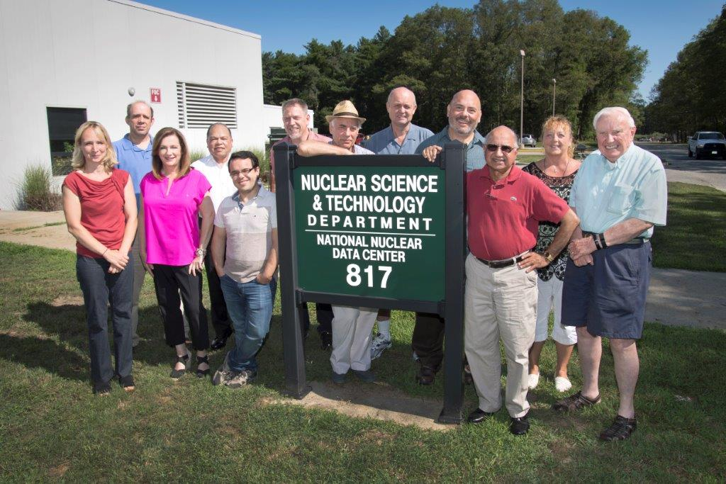
NNDC Staff during FY16

Slide 4
NNDC contractors during FY16
Name | Current/Former Affiliation | Activity
Eddy Brown | LBNL | ENSDF
Ninel Nica | Texas A&M | ENSDF
Balraj Singh | McMaster | ENSDF, XUNDL, NSR
Gulhan Gurdal (only in FY16) | Millsaps College | XUNDL
Emil Betak | Bratislava | NSR
Stanislav Hlavac | Bratislava | EXFOR
Otto Schwerer | IAEA | EXFOR
Pavel Oblozinsky | Bratislava | NDS

Slide 5
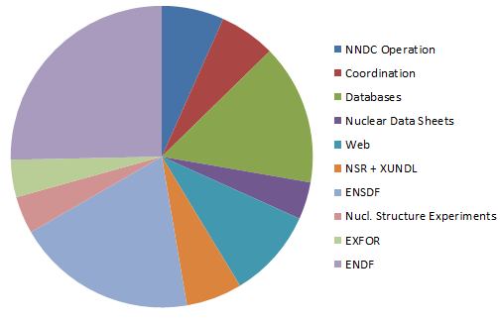
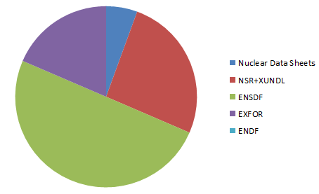
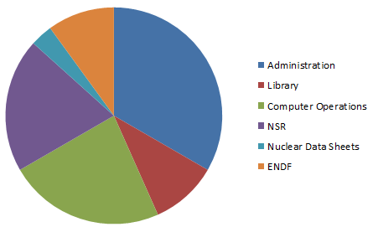
7.5 PhD staff
NNDC FY16 FTE Distribution
2.0 PhD contracts
3.0 Tech/Admin

Slide 6
In the following, some additional BNL activities on:
Medical Radioisotopes
Nuclear Reaction Model Code EMPIRE
Nuclear Reactor’s Antineutrinos
Fission Yields
Web Dissemination

