Slide 1
Current status of the EXFOR project
Boris Pritychenko
National Nuclear Data Center, BNL, Upton, NY 11973

Slide 2
Compilations & Evaluations
Compilations of experimental papers are often done once while evaluations are revisited on 5-10 year basis.
Compilations are assembled manually, block by block. It is not a push-button technology.
Compilations have to be done right during the first try because there are no periodic updates.
ENDF evaluators should pay more attention to the quality of EXFOR instead of just mechanic fitting of experimental points.
EXFOR has many issues due to scope change, lack of advanced computer technologies in the past, sloppiness and desire to exceed the performance expectations by some compilers.
We need more resources to improve EXFOR.

Slide 3
EXFOR Effort in the U.S. and Canada
NNDC EXFOR project is an integral part of the NRDC network.
EXFOR Team: B. Pritychenko, S. Hlavac, O. Schwerer and V. Zerkin (IAEA).
NNDC: Overall database and contracts management, website support, compilation and correction of missing and older references.
Bratislava: New experiment compilation.
Vienna: Overall quality assurance and transmission handling.
IAEA: Web and database development.
Contractors (S. Hlavac and O. Schwerer) are essential for the overall success of the NNDC EXFOR effort.

Slide 4
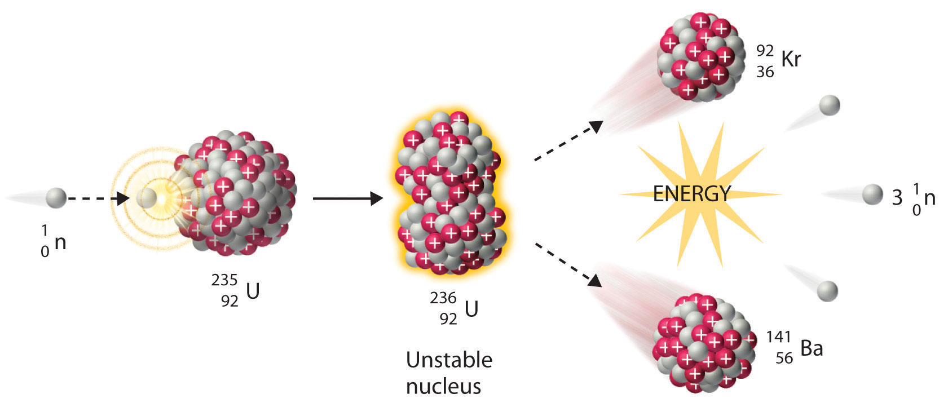
X4 Highlights
Smooth EXFOR operation between NNDC staff and contractors.
Largest NRDC contributions in recent years.
Large data sets from K. Guber’s measurements have been compiled and submitted to the database: 20MB data sets were a problem for an EXFOR editor, the editor was upgraded by the NRDC.
EXFOR Web application was upgraded in collaboration with the IAEA.
Database was updated 9 times in FY2016. We followed the IAEA releases.

Slide 5
X4 Statistics
New entries: 60 + 66 (BNL) = 126
Corrected entries: 84 + 38 (BNL) = 122
More details in the IAEA system based on calendar years: http://www-nds.iaea.org/exfor-master/x4compil/
Web retrievals using the IAEA system of counting (12 months adjusted due to summer scans)
EXFOR: 62104
ENDF: 69087
CINDA: 1537
Large numbers of the older charged particle and photonuclear experiments are still missing in EXFOR, many existing compilations are incomplete.

Slide 6
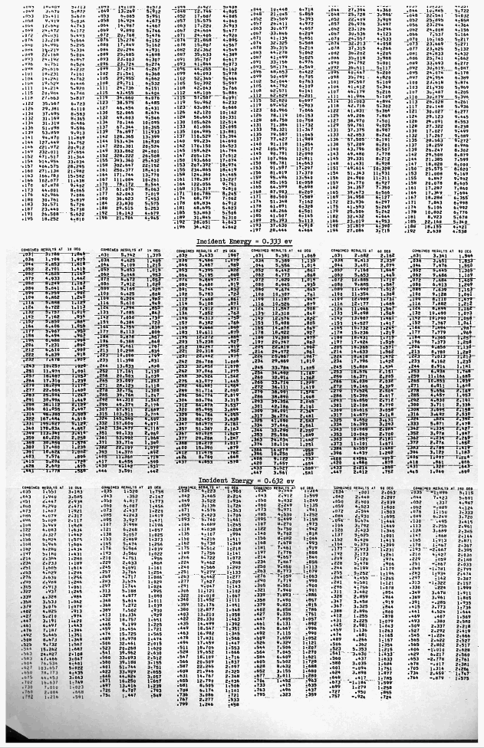
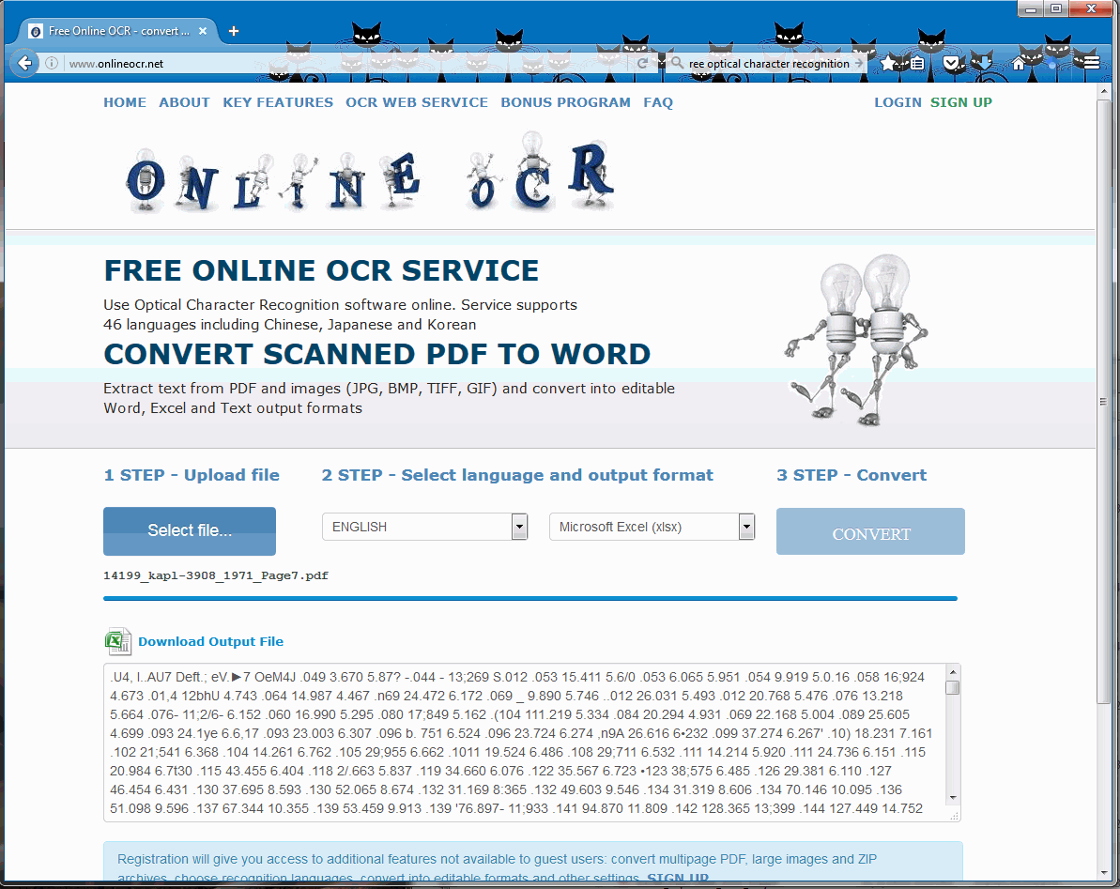
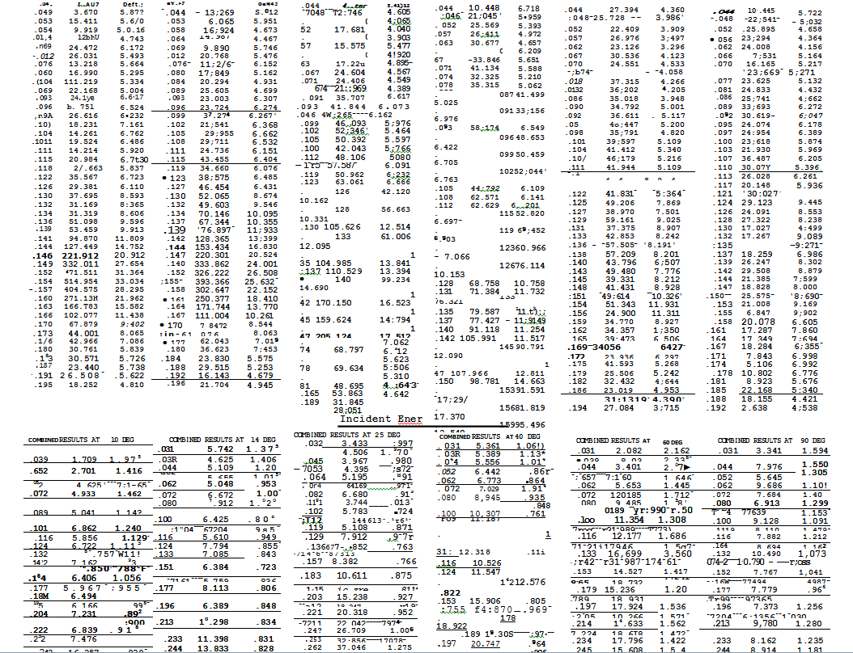
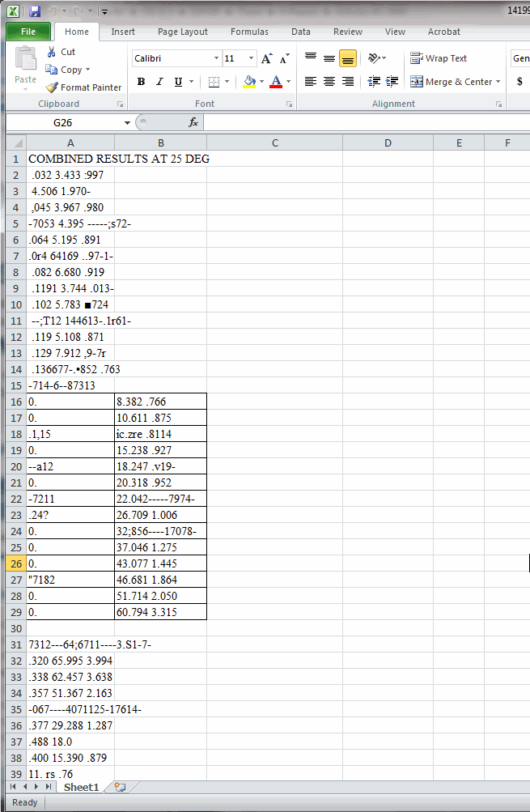
Optical Character Recognition (OCR)
The OCR technology has been used in EXFOR compilations for data recovery purposes.
Free conversion of images and PDF files: http://www.onlineocr.net/
Sometimes Microsoft Word file output has the best quality for the EXFOR entry #14199 (1971 KAPL Report, TSL Data, RPI LINAC) 7 pages have been converted.
Unfortunately, conversion quality was bad and these data were added manually ~5 days of work.

Slide 7
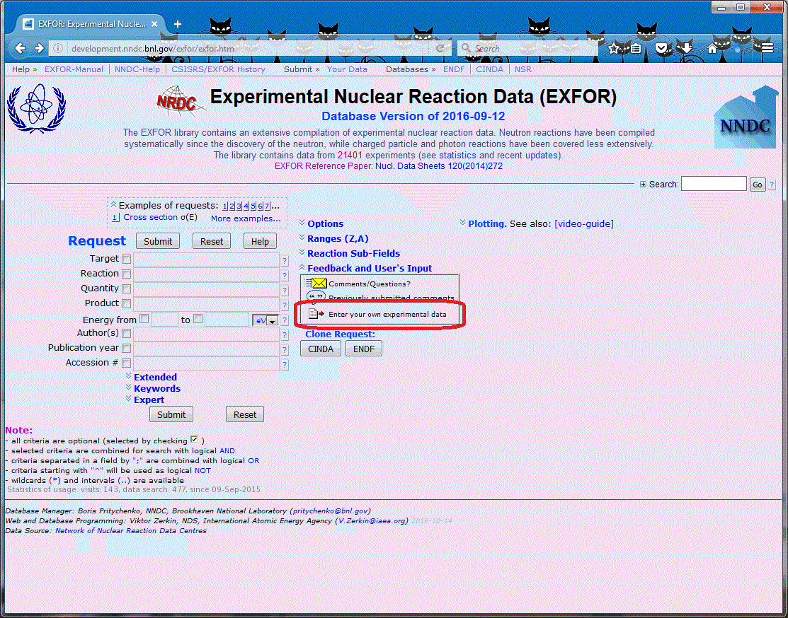
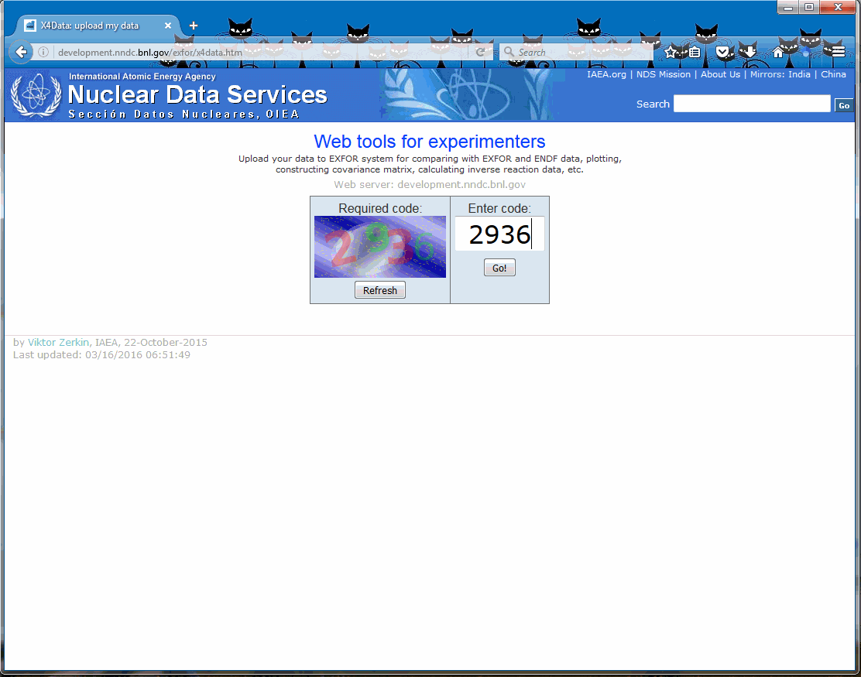
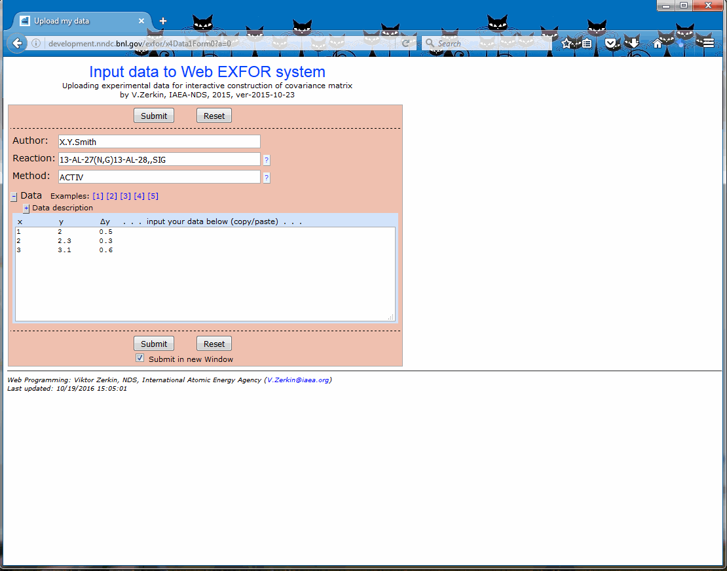
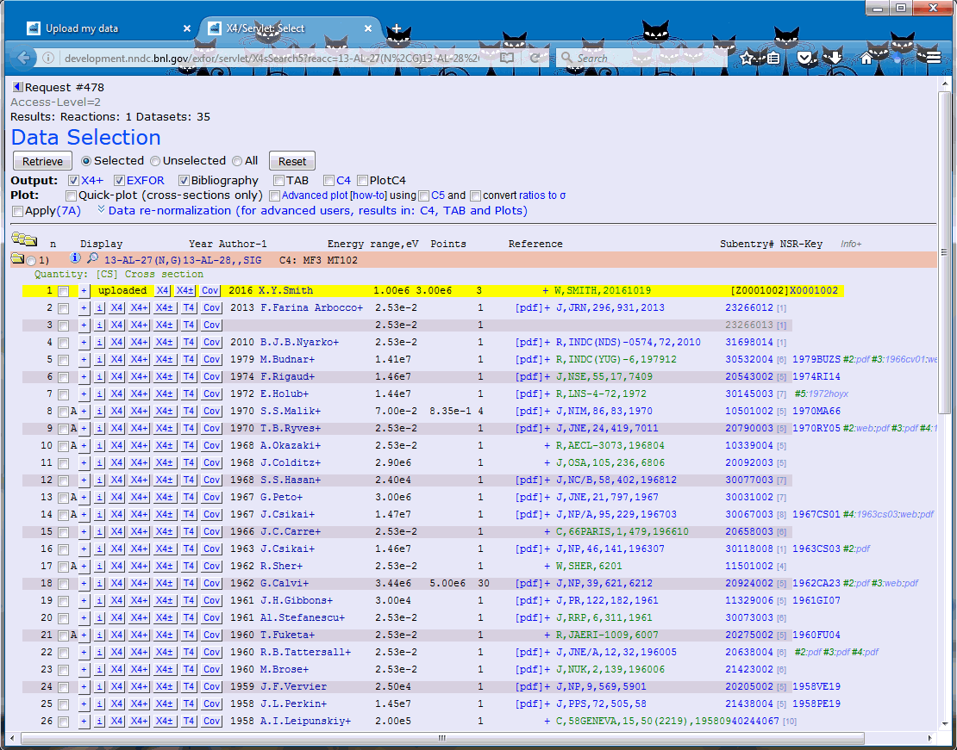
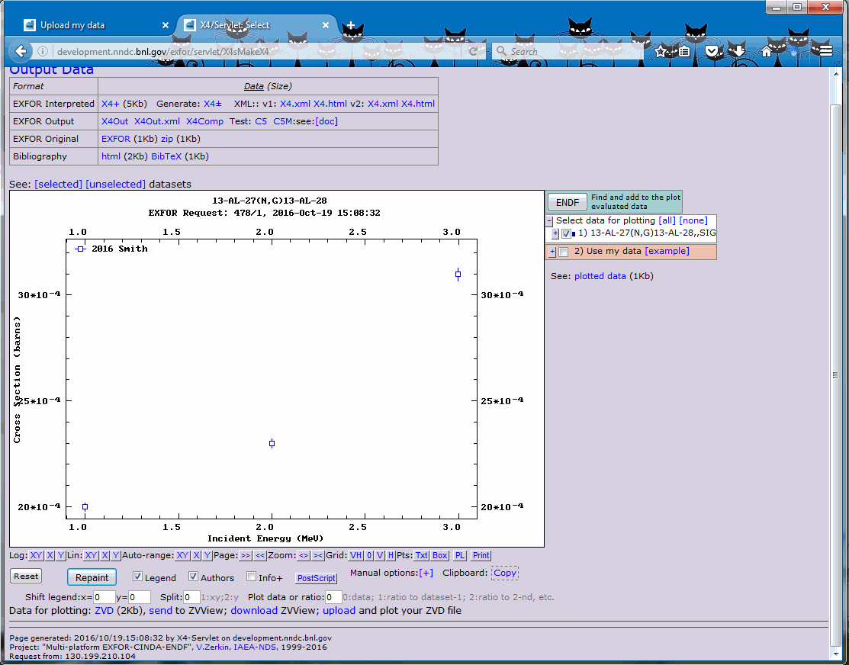
Add Your Own Data to EXFOR
New Feature of X4 Web Interface developed by V. Zerkin, IAEA.
EXFOR users can submit their results and compare with experimental and evaluated data sets.
http://www.nndc.bnl.gov/ exfor/x4data.htm

Slide 8
Conclusions & Outlook
EXFOR compilation effort is complex and well-organized.
EXFOR contractors are essential for the current operation.
We address compilation of current articles, correct previous entries and add missing articles.
EXFOR database is incomplete due to multiple historical and technological reasons. We should continue to work on compilation of missing articles, update the previous entries.
We will continue to use modern technical tools: plot digitization and optical character recognition technologies for the data recovery purposes.
It is a team effort that is conducted in close cooperation with the IAEA.

