Slide 1
Spin-parity argument: weak vs. strong
Longitudinal momentum distribution measurements and analysis
USNDP meeting, BNL, Nov 16-18, 2016

Slide 2
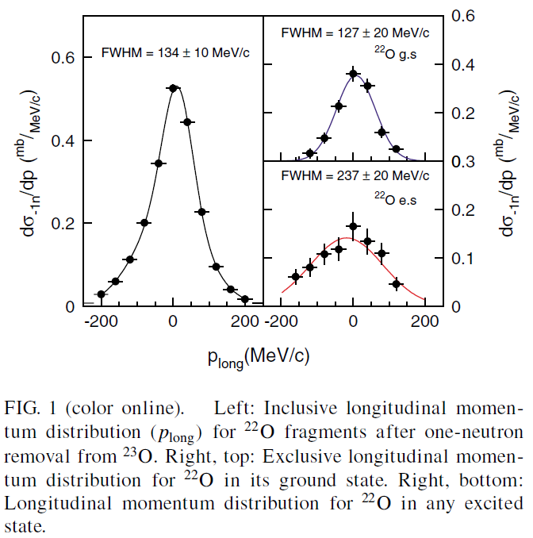
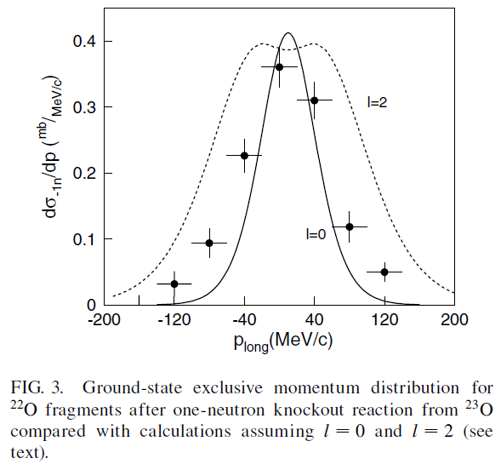
Spin-parity argument: weak vs. strong
USNDP meeting, BNL, Nov 16-18, 2016

Slide 3
Spin-parity argument: weak vs. strong
From: Murray <martinmj@bellsouth.net> Date: Mon, Nov 14, 2016 at 8:00 PM As for the paper, I'm not an expert on the experimental techniques
used in the experiment, but the work seems convincing.
I feel that we should allow "special strong argument cases"
occasionally if an evaluator trusts the result.
We probably don't need a special rule to appear in our arguments
for strong assignments for a case like this unless the technique
becomes widely used.
It can be handled on an individual case by case basis.
Note that the authors' arguments rely heavily on the shell model,
and so may not be generally applicable.
USNDP meeting, BNL, Nov 16-18, 2016

