Slide 1
US Nuclear Data Program Overview
A.A. Sonzogni
National Nuclear Data Center

Slide 2
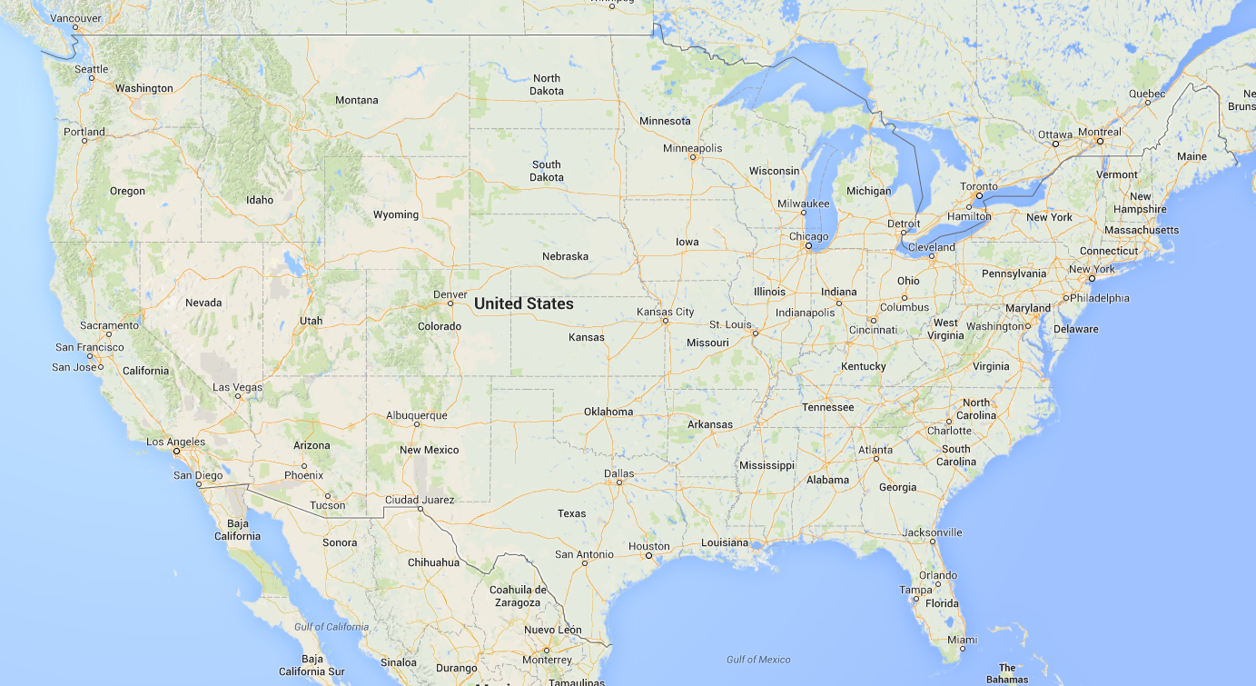
US Nuclear Data Program Groups
MSU
McMaster
LBNL
ANL
NNDC
TAMU
NIST
TUNL
LLNL
LANL
ORNL

Slide 3
Outline
USNDP Personal changes and FTE distributions.
USNDP Compilation, evaluation and dissemination metrics.
Response to NDAC recommendations and comments
More detailed metrics will be given by database managers
Additional activities will be given in the lab reports.

Slide 4
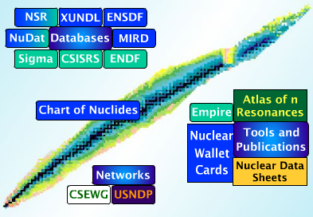
US Nuclear Data Program Main Products
Nuclear Science References (NSR)
Articles indexed according to content
EXFOR
Compiled nuclear reaction data
XUNDL
Compiled nuclear structure and decay data
Evaluated Nuclear Structure Data File (ENSDF)
Recommended nuclear structure and decay data
ENDF
Recommended particle transport and decay data, with a strong emphasis on neutron-induced reaction data
Nuclear Data Sheets
Journal devoted to the publication of nuclear data articles
Web dissemination
www.nndc.bnl.gov

Slide 5
Personnel Changes
Libby McCutchan became XUNDL manager on October 3 2015.
Libby McCutchan became ENSDF manager and Nuclear Data Sheets editor on April 30 2016.
Alejandro Sonzogni became NNDC head and Mike Herman NNDC deputy head on September 1st 2016.
Jagdish Tuli retired on October 21st 2016.
Gulhan Gurdal under contract, 0.1 FTE for XUNDL work during FY 16.
Jon Batchelder from ORNL moved to UCB in October 2015.
Aaron Hurst moved from LBNL to UCB in January 2016.
Lee Bernstein moved to LBNL in June 2016.
Charlie Dunford, former NNDC head (1991-2001), who retired in 2005, passed away in April 26 2016.

Slide 6
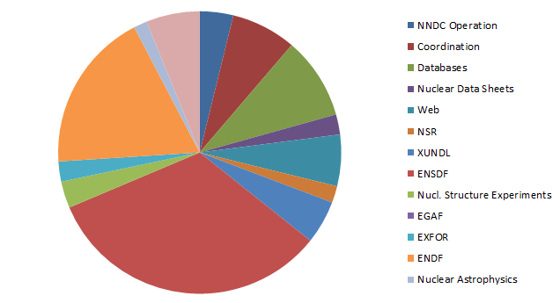
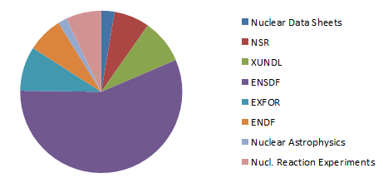
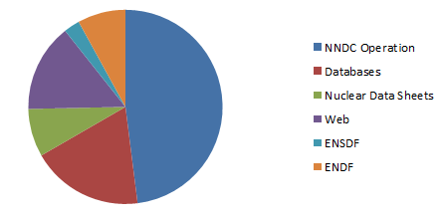
FY2016 FTE Distribution
13.07 Scientific Permanent FTEs
ENDF
ENSDF
4.15 Tech/Admin FTEs
7.55 Scientific Temp. FTEs*
ENSDF
*Includes Jun Chen and 55% of Bernstein

Slide 7
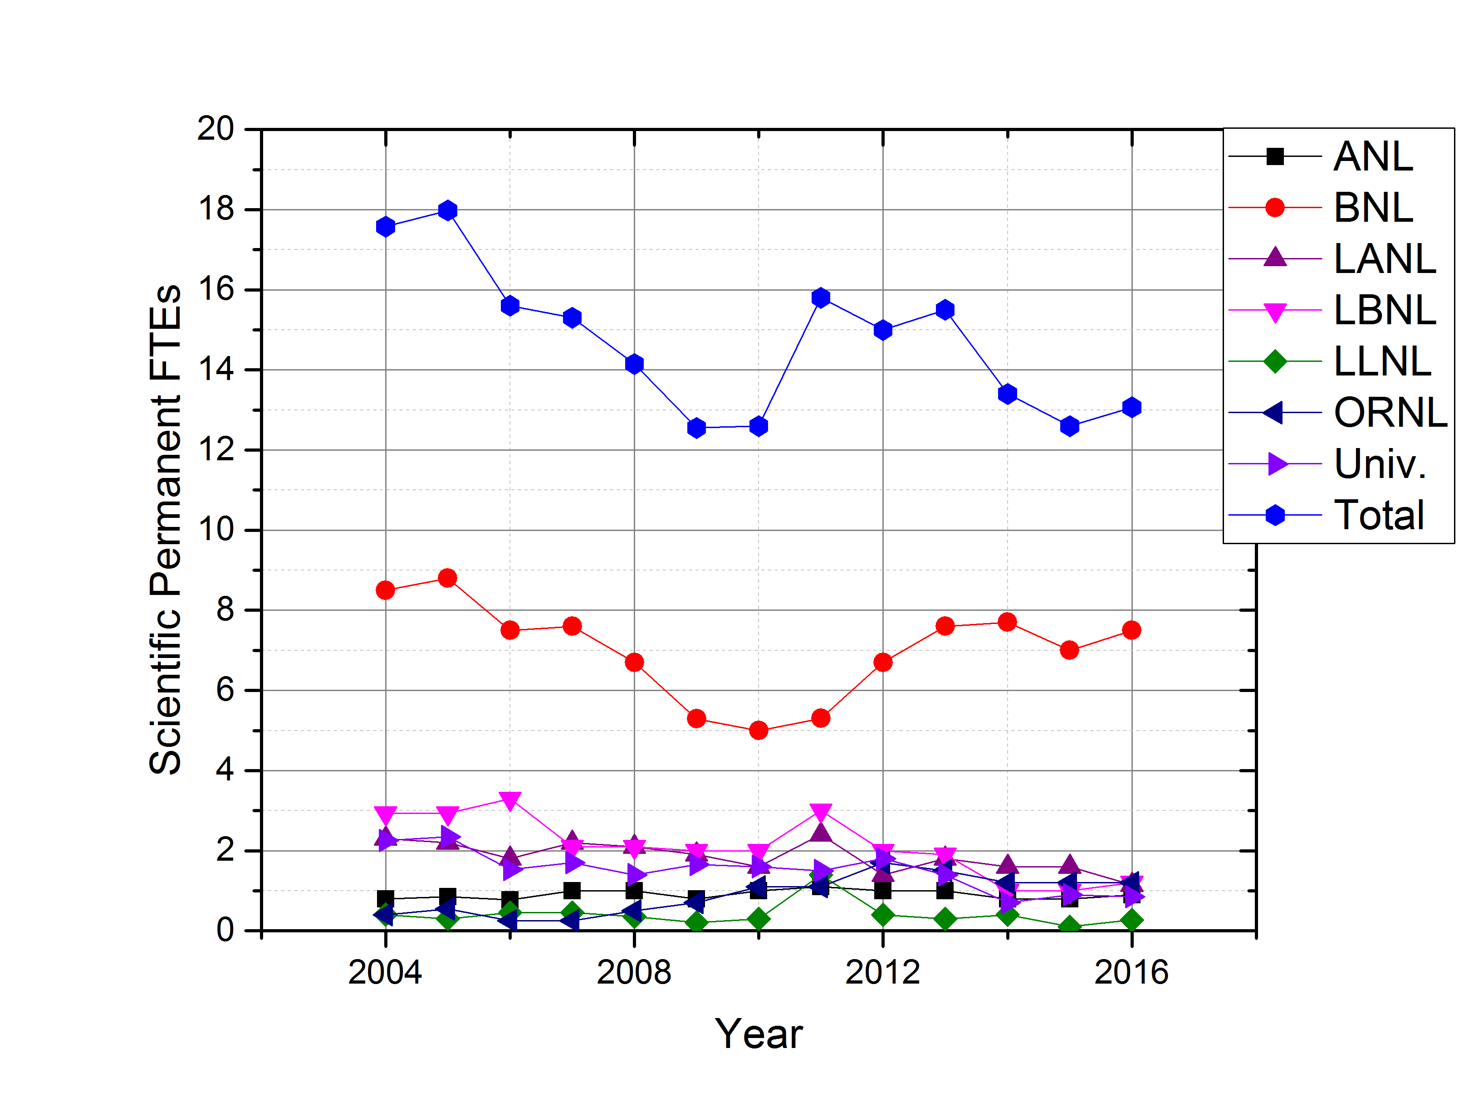
Time evolution of Sci. Perm. FTEs
The number for FY 17 will be 13.9, without J. Tuli and adding L. Bernstein and J. Chen.
About 4 fewer than in 2004.

Slide 8
Compilation metrics
NSR: 3,263 articles and 1856 key-worded
EXFOR: 126 articles.
XUNDL: 289 articles and 549 datasets
Joann Totans, NNDC librarian, spent one week in ORNL in May with the help of Caroline Nesaraja to bring back material from the physics division library, about 35 boxes. This material is slowly being integrated in the NNDC library and NSR.
Boris Pritychenko continued incorporating data from the trip to ORNL in FY15.
Compilation activity is in a healthy stage.
More details in Pritychenko and McCutchan’s talks

Slide 9
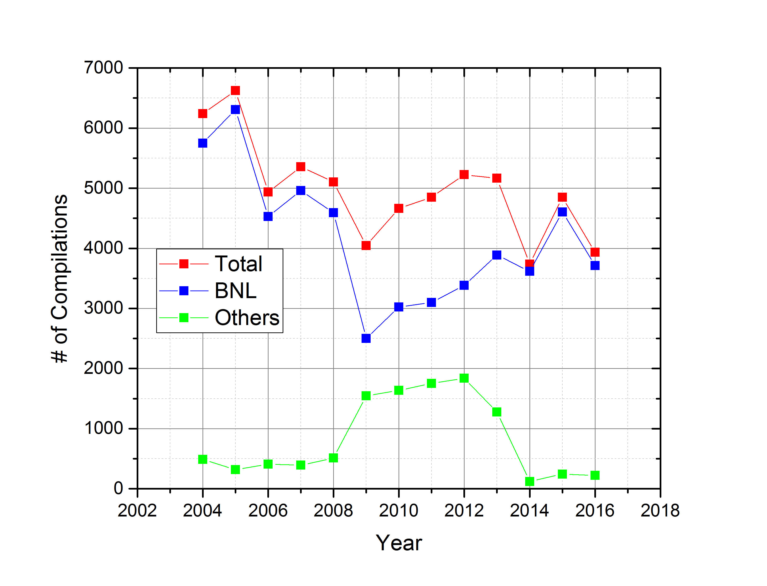
Compilations through the years
Showing Total, BNL and Others since # of compilations is dominated by # of NSR compilations which is done solely in BNL

Slide 10
ENSDF Evaluations
Laboratory | # Nuclides | # Adopted Levels | # Adopted Gammas
ANL+MSU | 32 | 2,022 | 3,303
BNL+contractors | 136.5 | 6,180 | 9,954.5
LBNL | 23 | 1,729 | 2,773
ORNL | 9.5 | 390 | 503
TUNL | 7 | 18 | 2
International | 12 | 700 | 1054
Total | 220 | 11,039 | 17,589.5
Percentage of the total | 6.6% | 6.1% | 6.4%
Metrics was expanded.
Serious concern! At this rate, it may take ~16 years to revisit an evaluation. Output is a factor of 3 too low.
Productivity dropped 15.5% in the 2011-2016 period compared with the 2005-2010 period.
More details in E. McCutchan’s talk.

Slide 11
ENDF/B Evaluations
Laboratory | Sub-library | # Materials | # Reactions
BNL | Decay | 25 TAGS data in beta intensities | 25
BNL | Neutrons | 4 ^{54,56,57,58}Fe | 52
LANL | Neutrons | 6 ⁵⁹Co, ^{63,65}Cu, ^{235,238}U, ²³⁹Pu | 90
ENDF/B-VIII.0 will be released in the summer of 2017
Previous major release was in 2011
More on D. Brown, M. Herman and T. Kawano talks
Concerns: number of ENDF/B evaluators and people performing validation worldwide is really small.

Slide 12
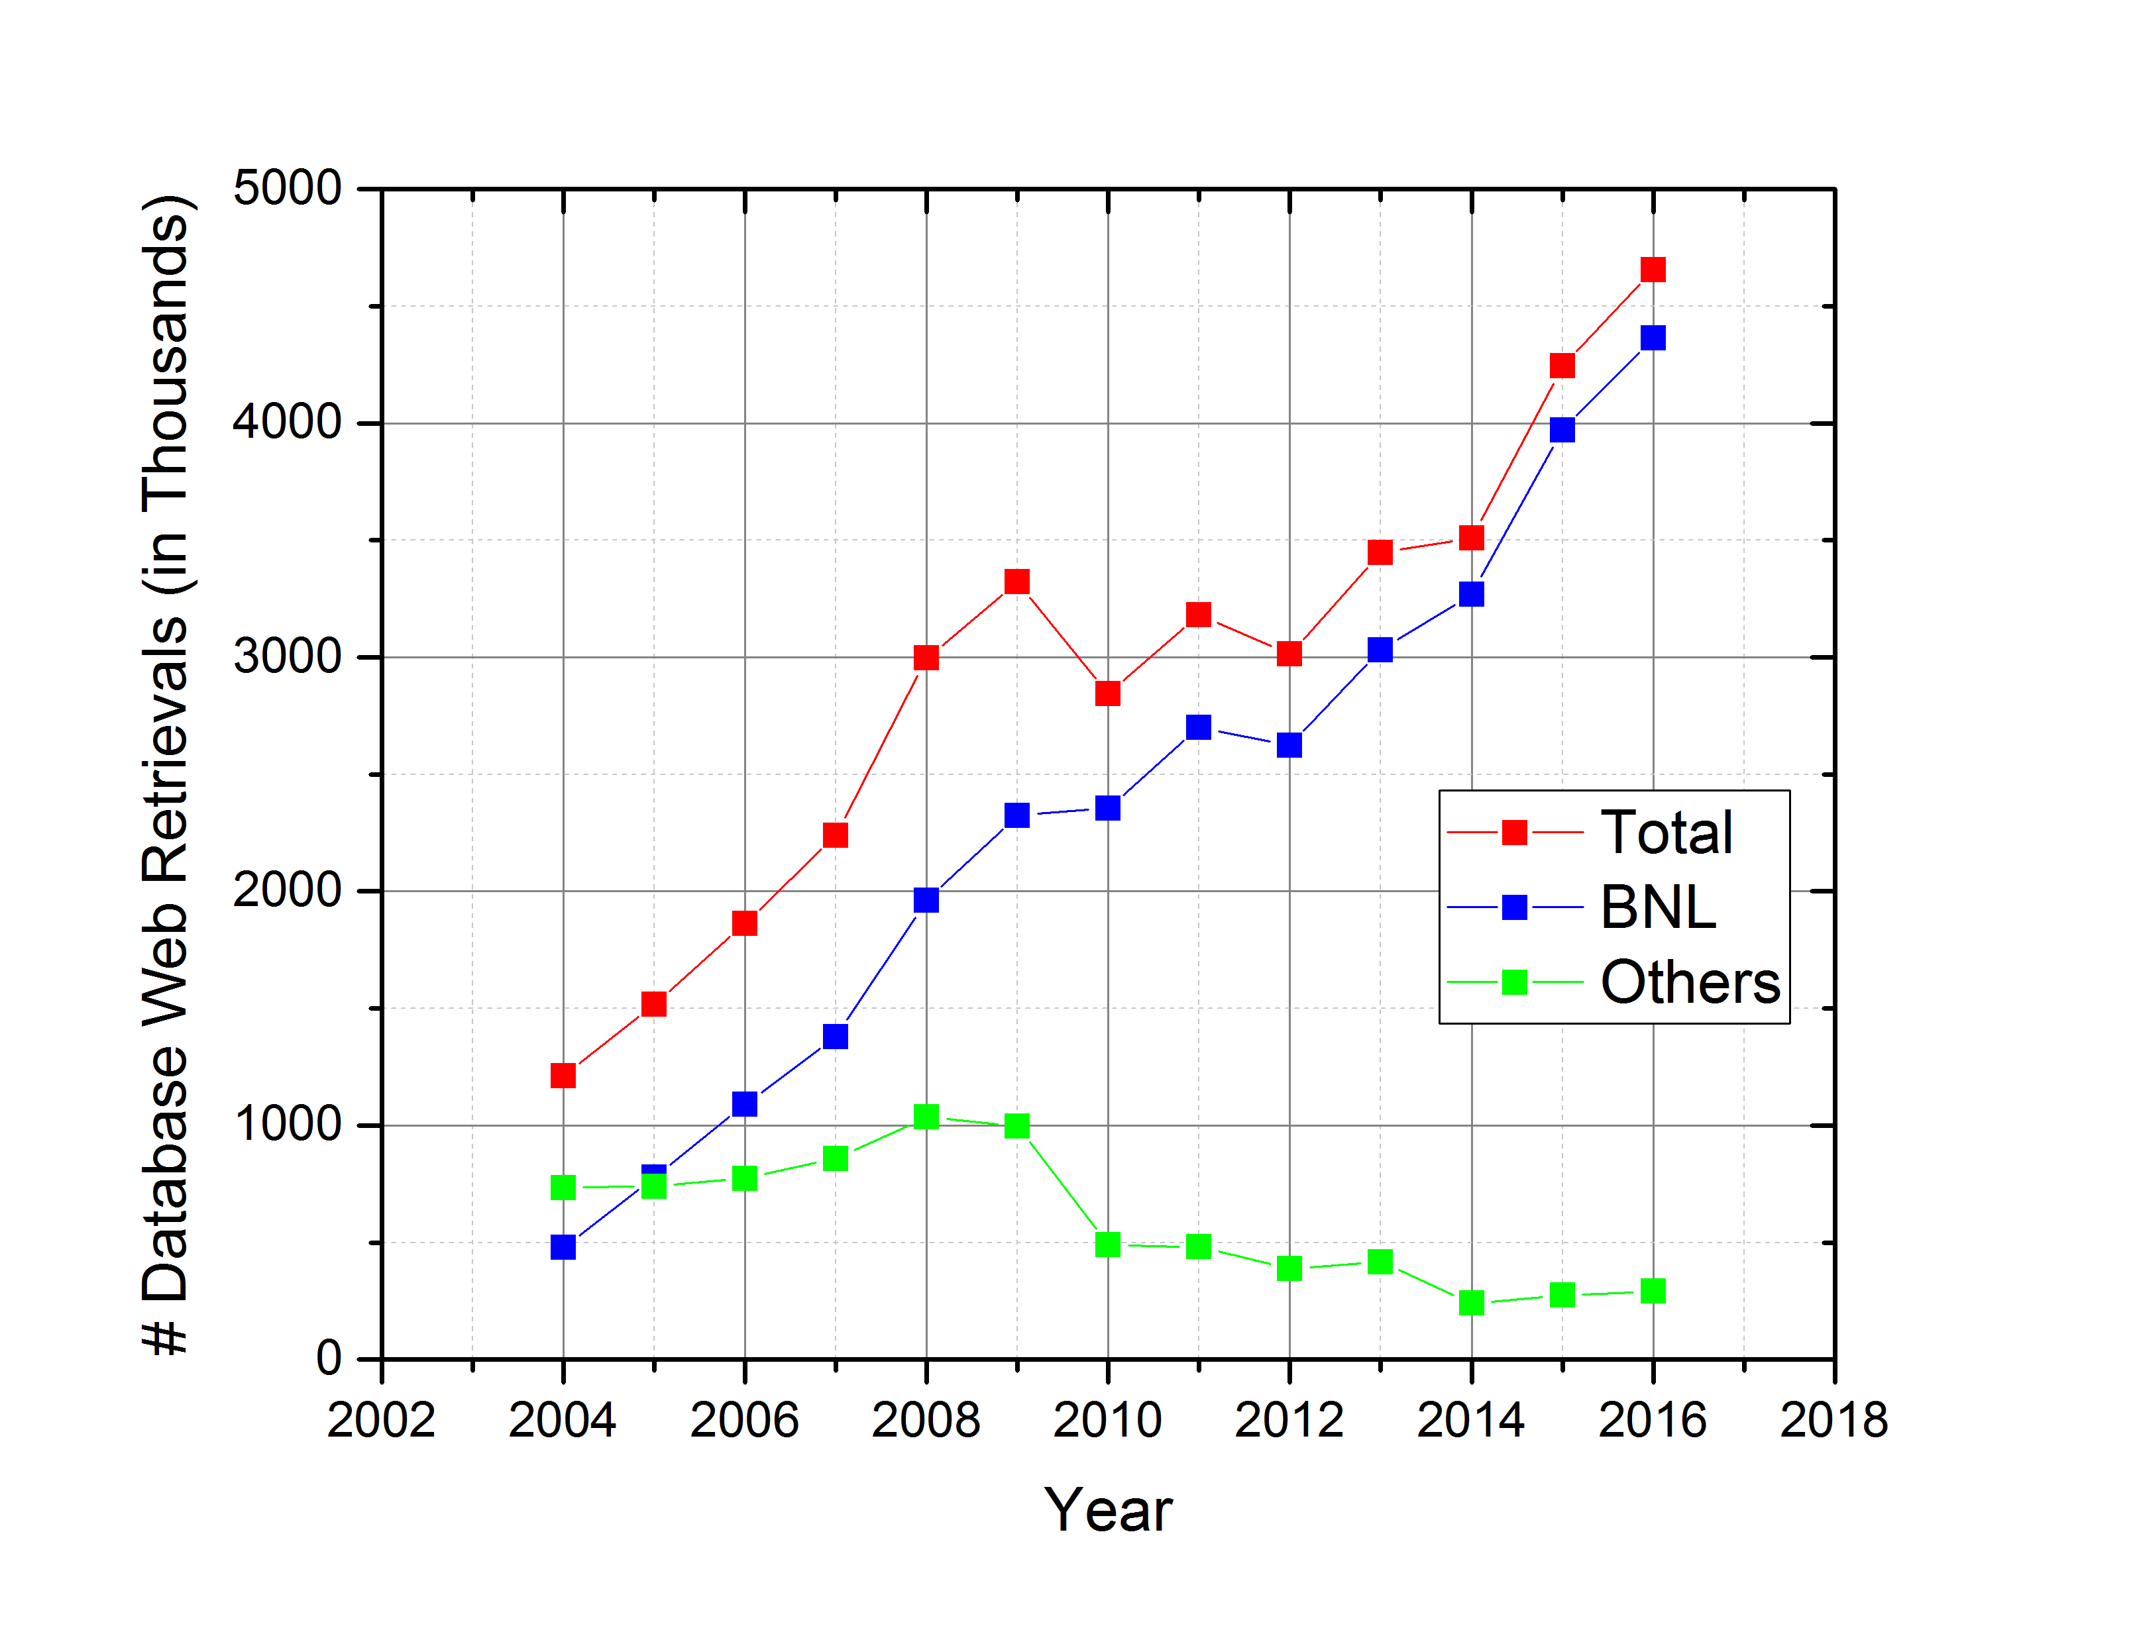
Web Disseminations
Showing Total, BNL and Others since most of USNDP web dissemination is done in BNL
Web disseminations have been growing steadily.
Servers were last installed in 2013. We expect new servers in 2018.
More in T. Johnson’s talk.
Next slides: Response to some of the NDAC recommendations

Slide 13
NDAC Recommendation #1:
Complete the process of developing a comprehensive community document summarizing USNDP strategic priorities
USNDP white paper:
Vision for the next 10 years
Priorities, new ideas, goals
Strategy and plans
Interaction with users
Starting point was the USNDP review in 2014 followed by NDAC. Additionally, we had two workshops, one on applications (Berkeley, white paper completed) and another on basic research (Notre Dame, white paper in progress).
USNDP white paper will be prepared following these two workshops. Our goal is to complete it by the end of the 2017 summer.

Slide 14
NDAC Recommendation #2
Develop ways to manage the USNDP project that provide more active feedback on productivity and provide career development opportunities for highly productive staff across the community.
Expanded ENSDF metrics
Performed a careful analysis of XUNDL and ENSDF productivity (E.A Mccutchan’s talk).
Included plots showing the time evolution of key metrics from 2004.
Added list of publications to the Annual Report.

Slide 15
NDAC Opportunity #1
Increased data measurement and evaluation in support of DOE operated high-energy accelerator isotope production facilities that serve the needs of the Isotope Program.
Results will be presented in the individual center’s reports.

Slide 16
NDAC Opportunity #2
Formation of nuclear-structure data groups with deep connections to experimental facilities makes sense. In addition to a UCB-LBNL group, a mid-west group at ANL, MSU and Notre Dame should be considered.
Status will be presented in ANL and MSU’s reports

Slide 17
NDAC Opportunity #3
Modernization of the ENSDF infrastructure, including the development of a new structure (format) that could go a long way toward providing a more efficient environment for developing and maintaining new data products.
A number of possible expansions to the current ENSDF format have been identified:
Continuum radiation, such as TAGS data and neutron spectra following beta decay
Atomic radiation following decay, such as X-rays, Auger and conversion electrons
Electron spectra following beta-minus decay or alternatively, shape factors
True numerical values instead of characters
Better integration among datasets
To be discussed in the next NSDD meeting, LBNL, May 2017.
This will require plenty of funds!

Slide 18
USNDP budget priorities
(Review Panel and NDAC Comment #3)
Goal: Develop a mechanism that will collect and rate budget needs.
Mechanism should be as democratic, open and fair as possible.
Budget needs that can affect the viability of USNDP
Funding for activities that can positively impact USNDP productivity.
Five Skype sessions. Budget needs were collected in a template and rated by PIs. Results will be presented tomorrow.

