Slide 1
XUNDL-ENSDF-NDS Overview
Libby McCutchan
National Nuclear Data Center
Brookhaven National Laboratory, NY USA

Slide 2
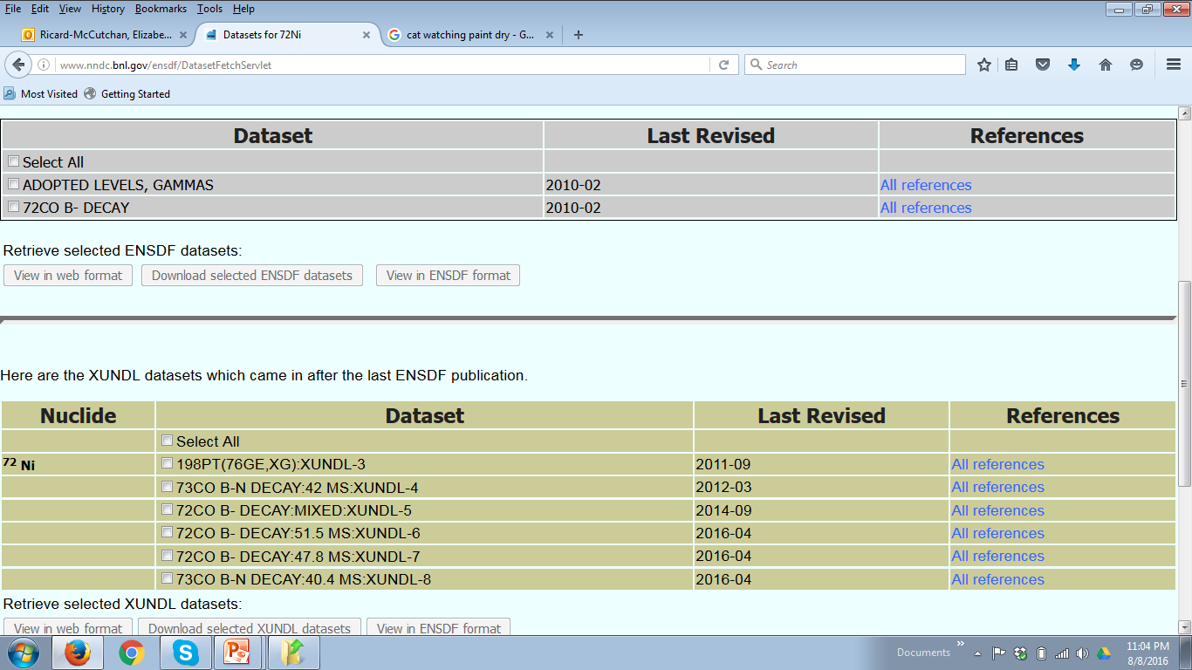
XUNDL
eXperimental Unevaluated Nuclear Data List
Critical compilation of recent nuclear structure publications
~ 1 month from publication to compilation
Frequently identifies “issues” in data
Correspondence with authors aids in future evaluation
ENSDF Search for ⁷²Ni

Slide 3
XUNDL Developments
Coordinator change, E.A. McCutchan (NNDC) for B. Singh (McMaster) as of October 2015
G. Gurdal under contract for compilations
New distribution scheme utilizing Google Drive
MSU
Coordinator Review
Coordinator Scan
Available papers
ORNL
LBNL
XUNDL compilations used as training exercise at IAEA-ICTP workshop

Slide 4
XUNDL statistics
Compiled 550 datasets from 289 papers
(FY15 was 630 datasets from 360 papers)
Center | Papers | Datasets
McMaster | 84 | 189
TUNL | 43 | 58
ORNL | 26 | 39
MSU | 29 | 57
LBNL | 11 | 34
Millsaps | 40 | 59
BNL | 39 | 75
ANL | 7 | 26
UCB | 8 | 10
International | 2 | 2
300 papers per year is reasonable estimate for effort assessment
Full database is 6956 datasets for 2406 nuclides

Slide 5
XUNDL Productivity
From NDAC Report:

Slide 6
XUNDL Productivity
Most contribute 0.1 -0.2 FTE, so 0.1 FTE is convenient unit
Compiler | Papers /0.1 FTE | Datasets/0.1 FTE
 | 43 | 58
 | 42 | 94
 | 40 | 59
 | 31 | 61
 | 29 | 57
 | 16 | 28
 | 14 | 52
 | 11 | 34
 | 8 | 10
 | 6 | 9
Contract:
0.1 FTE = 40 papers
60 papers at 0.75 FTE

Slide 7
XUNDL Effort Rearrangement
More people interested in XUNDL contract
Most notably: Chris Chiara
Well trained and highly recommended by Filip
Now at DOD, overhead is 3% !!!
Would like contract at 0.2 FTE, would cover 60 papers
Following Notre Dame meeting, additional requests to be involved in Data Program activities
Proposal: $30K to cover XUNDL contract for Chiara

Slide 8
Author Correspondences
1425+776=2201
970+409=1379
1790
We have partially reanalyzed the data on 168Yb and tried to resolve the problems. In your email you have raised two problems, concerning the levels at 1790 and 2110 KeV. Let me first start with the second level.
The main problem was the level at 1790 keV. After reanalyzing the data we came to the conclusion that this level does not exist. However, the gamma-rays which were supposed to decay from this level …
The future: Offer this critical review PRIOR to publication

Slide 9
ENSDF
Evaluated Nuclear Structure Data File
3,312 nuclides
18707 datasets
It is Unique: Only Nuclear Database continuously updated
It is Complete: All nuclei and all level and radiation properties
It is Versatile: Feeds back into both basic and applied sciences

Slide 10
ENSDF Developments
Manager change: E.A. McCutchan (NNDC) for J.K. Tuli (NNDC) as of May 2016
Status updates available on web
Streamlining evaluation process based on new JAVA-NDS software
A=217 used as training exercise at IAEA-ICTP workshop

Slide 11
The old …
I come to this page to search, why isn’t it the first thing I see??

Slide 12
And the new …
Depending on mass region, evaluation is not good enough and we would appreciate if there is some way to post feedback.

Slide 13
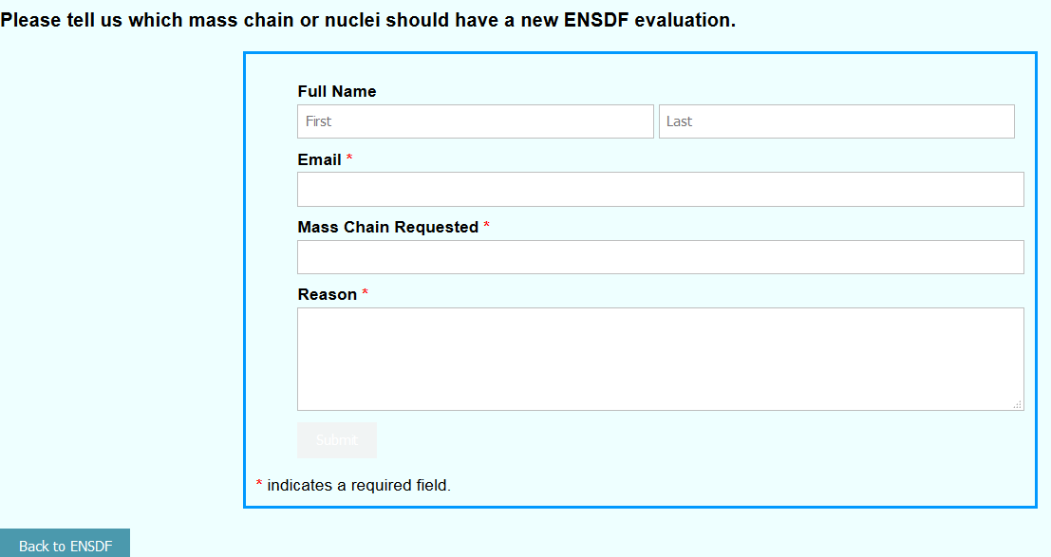
Community input to evaluation schedule
We aim for currency of 7 years on average for each mass chain

Slide 14
ENSDF statistics
Evaluated 220 nuclides, 160 from 12 mass chains
(FY15 was 268 nuclides, 167 from 13 mass chains)
Center | Nuclides | Adopted Levels | XUNDL
ANL | 16 | 890 | 30
BNL | 39 | 2114 | 65
Contractor | 7 | 515 | 7
LBNL | 18 | 1230 | 48
McMaster | 83.5 | 2260 | 41
MSU | 16 | 1130 | 35
ORNL | 9.5 | 390 | 5
TAMU | 18 | 1288 | 10
TUNL | 7 | 18 | 11
UCB | 5 | 500 | 30
International | 12 | 700 | 16
US : 11 mass chains in FY15 and 16
International: 2 MC in FY15, 1 in FY16

Slide 15
ENSDF Productivity
Average contribution to ENDSF evaluations is 0.5 FTE
Evaluator | Nuclides /0.5 FTE | Adopted Levels/0.5 FTE
 | 91 | 2600
 | 22 | 1490
 | 20 | 1110
 | 17 | 1180
 | 16 | 1135
 | 15 | 670
 | 12 | 770
 | 12 | 680
 | 9 | 500
 | 6 | 240
 | 4 | 420

Slide 16
ENSDF Productivity
Same table, with just full-time employees
Evaluator | Nuclides /0.5 FTE | Adopted Levels/0.5 FTE
 | 22 | 1490
 | 20 | 1110
 | 17 | 1180
 | 16 | 1135
 | 12 | 770
 | 12 | 680
 | 6 | 240
 | 4 | 420
We cannot judge needed effort going forward, without some indication of 1 FTE~ X mass chains and/or nuclides

Slide 17
ENSDF Looking Forward
Per 0.5 FTE, 1 “medium” sized mass chain
~15 nuclides and 1,000 levels is feasible
Age of Mass Chain
Average ~8 years
2016
2011
2006
2001
1996
To achieve 7 year average requires 5 additional mass chains/ year
→ 2 additional FTE’s, provided above productivity measure is met

Slide 18
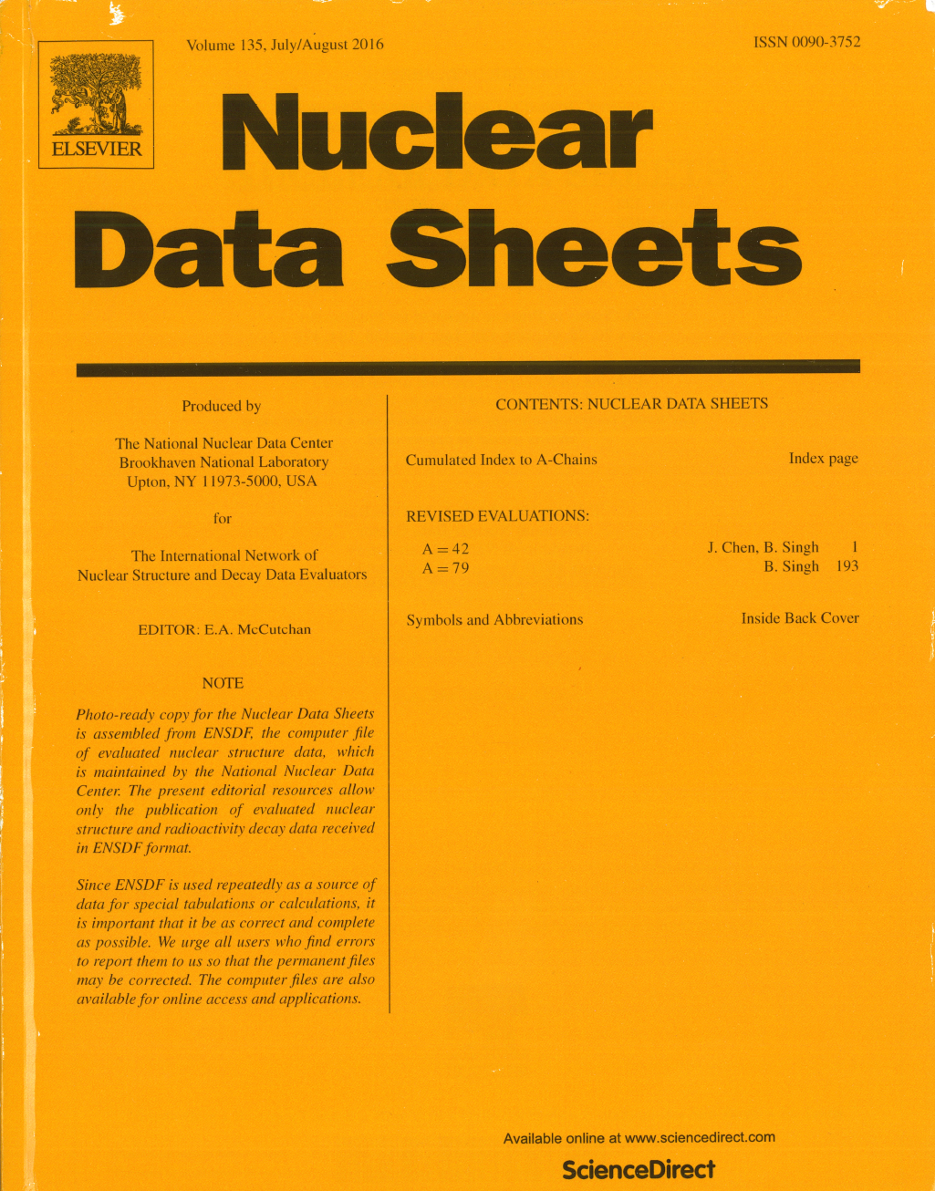
Nuclear Data Sheets Journal
Started in 1966.
Currently published by Elsevier.
Original mission: to publish ENSDF evaluations and Recent References
Starting 2006, the December issue is devoted to nuclear reactions articles
In FY2016:
Published 8 issues
16 mass chain evaluations
1 issue devoted to nuclear reactions

Slide 19
Major changes to journal publication
Two main complaints:
Too much flipping
Level properties
γ-ray properties

Slide 20
Major changes to journal publication
Two main complaints:
Some drawings are completely useless

Slide 21
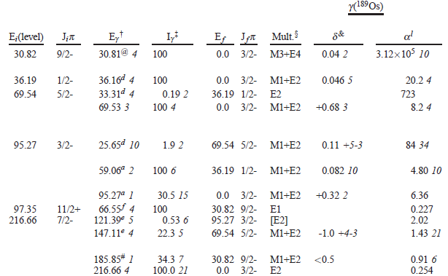
Starting January 2017
New format will be adopted in journal publication
Forms basis for web-interface improvements
Many thanks to Balraj Singh and Jun Chen

Slide 22
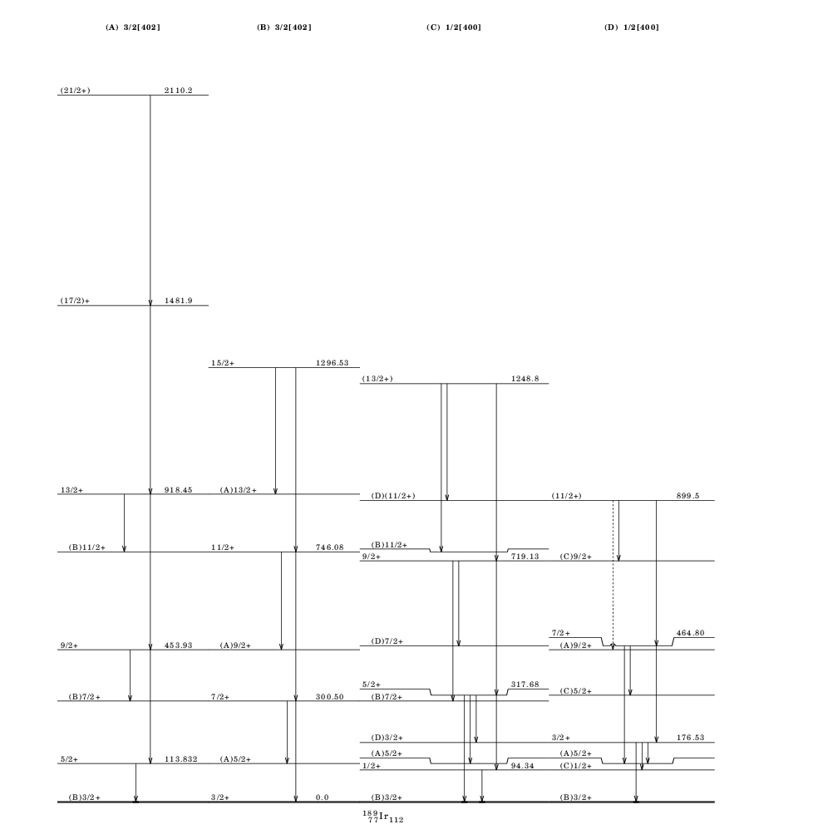
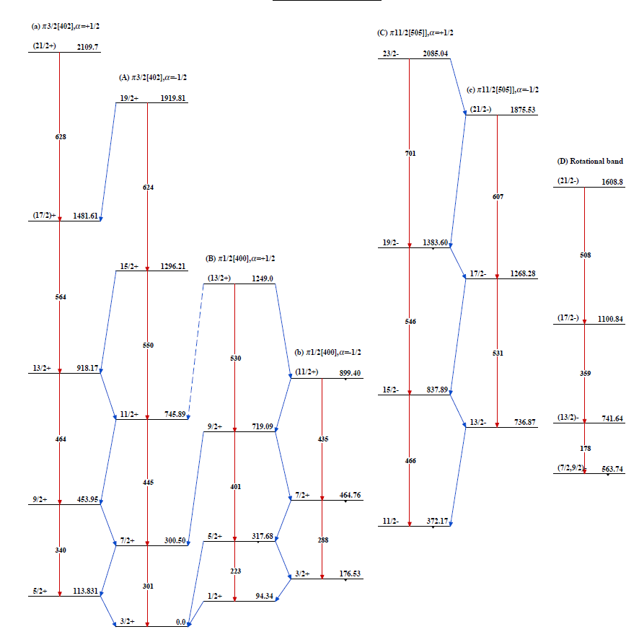
Much improved band drawings

Slide 23
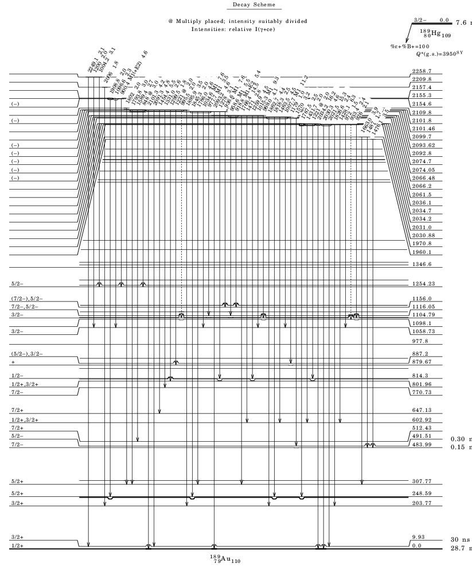
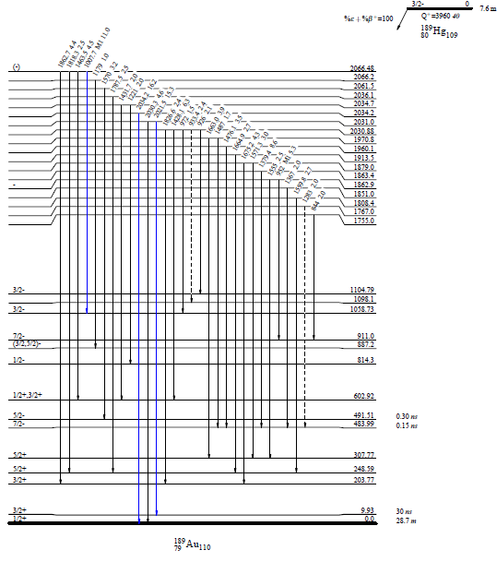
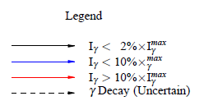
Much improved level drawings

Slide 24
Summary and Outlook
JAVA-NDS is a success
Community welcomes and appreciates changes
Challenge: incorporate changes into web interface
XUNDL operating smoothly
Opportunity (at very modest funding) to increase productivity
ENSDF effort needs further investigation
Establishing expectations would be helpful

