Slide 1
NSR & EXFOR Compilation Databases
Boris Pritychenko
National Nuclear Data Center, BNL, Upton, NY 11973

Slide 2
Compilation Databases
The major goal of compilation activities is data preservation for further dissemination and evaluation.
We will concentrate on NSR and EXFOR compilation databases:
Nuclear Science References (NSR): all low- and intermediate-energy references for a broad use, not just nuclear structure and decay as before 90ies.
Experimental Nuclear Reaction Data (EXFOR): all low- and intermediate-energy reaction data sets for neutron-, charged- and photo-induced reactions, not just neutron-induced as before 80ies.
ENDF
ENSDF
EXFOR
XUNDL
B(E2)↑
NSR
ββ
Research Operations

Slide 3
NSR Compilations in FY2016
NNDC provides coverage of current publications and we proactively recovering missing references for the USNDP and research activities.
NSR team: 1.5 NNDC, 2 contractors and 1 IAEA collaborator.
NSR Compilations:
3263 new article entries, total NSR: 222684
859 modified (bug fixes) article entries
1856 keyworded article abstracts
NSR Dictionary updates:
1750 new authors, total NSR: 96685
7 new journals, total NSR: 516
225 new reactions, total NSR: 7904
408 new nuclides, total NSR: 6415
NSR Database updates: 117 in FY 2016
NSR Web retrievals: 442175
Data evaluation support services: 120 unique publication requests.

Slide 4
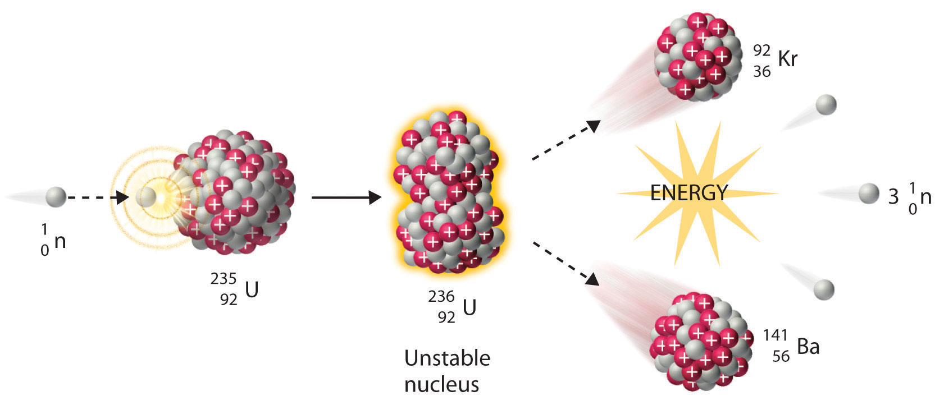
EXFOR Compilations in FY2016
This work is an integral part of the NRDC network effort. NNDC is responsible for all nuclear reaction data produced in US and Canada.
EXFOR Team: 0.5 NNDC, 2 contractors, and 1 IAEA collaborator.
New EXFOR entries (experiments): 126; corrected entries: 122.
A substantial number of charged particle and photonuclear experiments are still missing in EXFOR, some existing compilations are incomplete due to many reasons.
Missing data recovery mission at Oak Ridge lab in March of 2015 in collaboration with K. Guber. Oak Ridge data compilations have been completed in FY2016.
We are involved in a strong nuclear data dissemination effort. EXFOR Web application was upgraded in collaboration with the IAEA and the database is updated regularly.

Slide 5
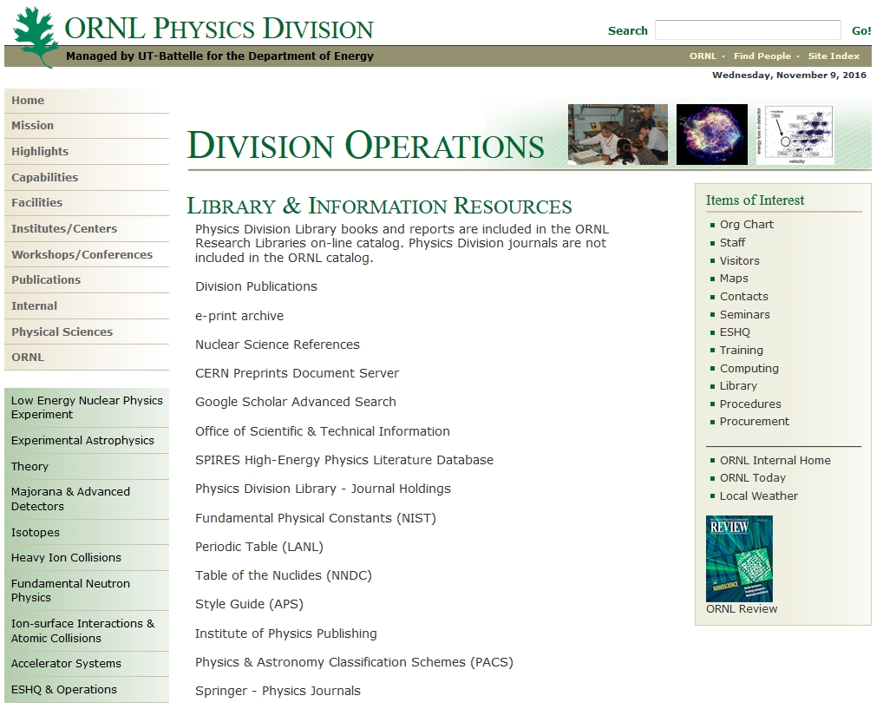
Oak Ridge Library Publications Recovery
Oak Ridge Physics library had many unique and valuable publications, and this library has been de-supported recently.
In May of 2016, NSR technical staff member Joann Totans travelled to Oak Ridge and recovered all unique publications: 35 boxes of reports, private communications and theses that have been published prior to 1980. Oak Ridge employee C. Nasaraja has assisted Joann.
These publications have been shipped to NNDC, and J. Totans is presently processing them as time permits.
We are planning to add these publications to a common Web PDF database. V. Zerkin (IAEA) is working with J. Totans.

Slide 6
Conclusions
Compilation activities are essential for nuclear data evaluations and fundamental research.
Compilation of the current nuclear science references and experimental nuclear reaction data sets is going well. NNDC is proactively recovering missing publications and data sets.
Collaboration with the IAEA and use of contractors are essential for compilation activities. It is a very cost-effective way of doing business.
NNDC has recovered the Oak Ridge data sets and library references. We would add PDF files to E-library for nuclear structure and reaction papers.
We will continue to preserve data and support nuclear data evaluators and research scientists.

