Slide 1
USNDP Dissemination
Tim Johnson
National Nuclear Data Center

Slide 2
Outline
Web Dissemination
  NNDC Web
  LBNL plans
  ORNL Web
Nuclear Data Sheets
NNDC GForge Server

Slide 3
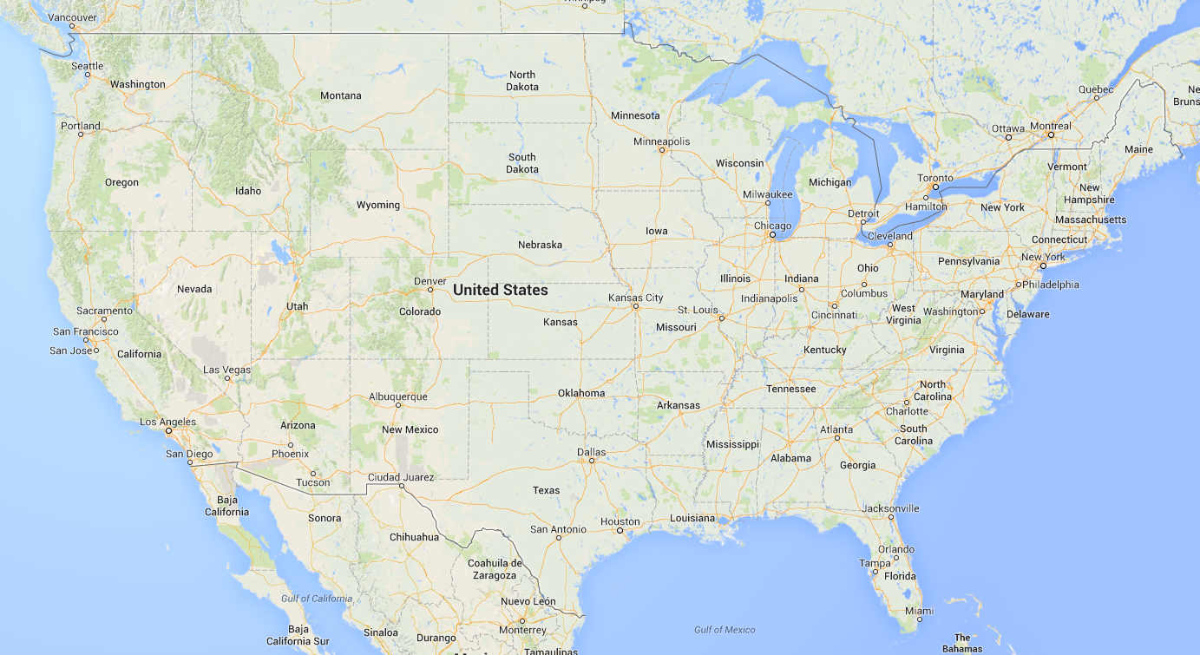
USNDP Groups Involved in Web Dissemination
ANL
NNDC
TUNL
LANL
ORNL

Slide 4
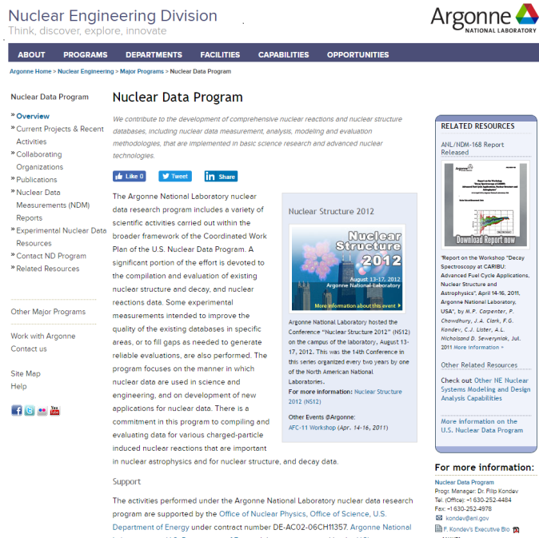
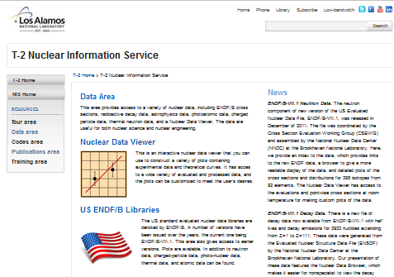
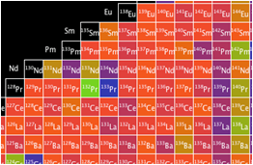
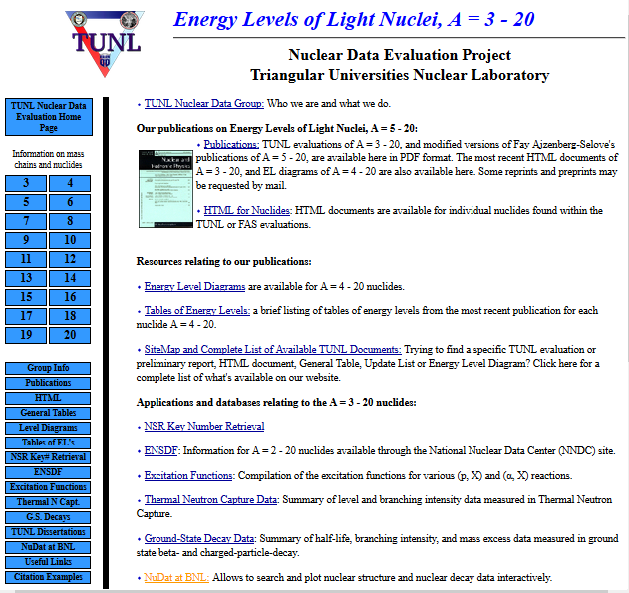




www.ne.anl.gov/capabilities/nd/
http://t2.lanl.gov/nis/data.shtml
www.phy.ornl.gov/groups/astro/data/data.html
http://www.tunl.duke.edu/nucldata/

Slide 5
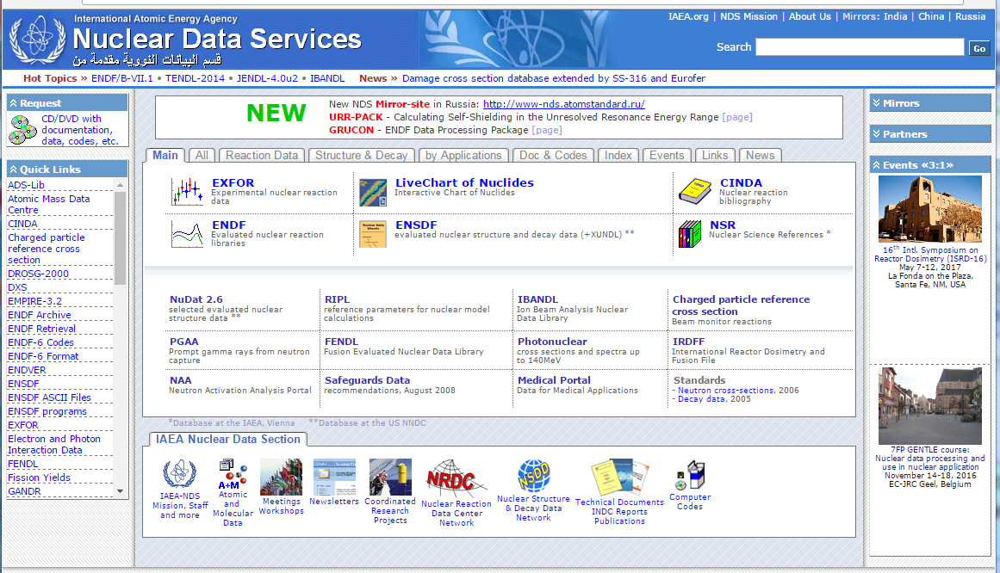
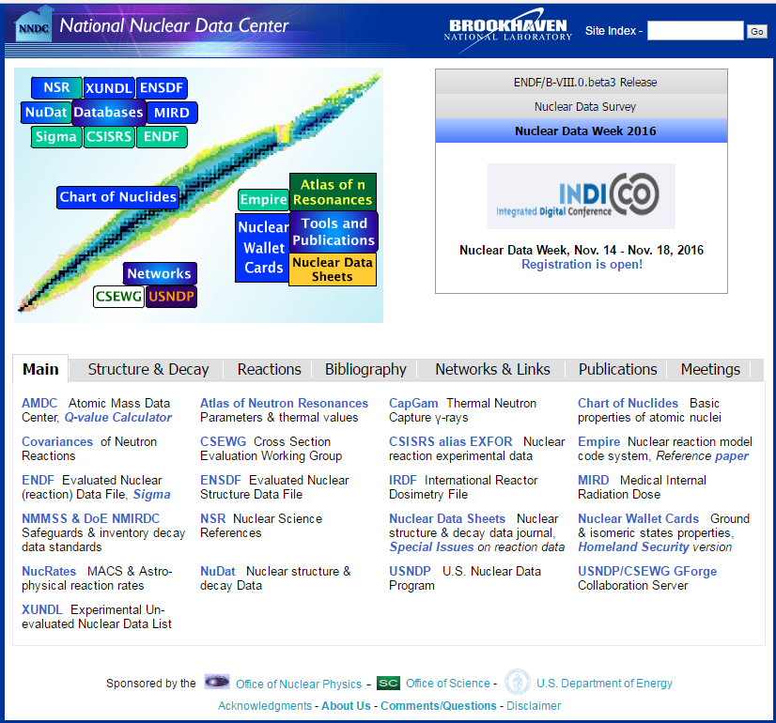
www.nndc.bnl.gov
https://www-nds.iaea.org/
There has been a strong collaboration between the IAEA and NNDC web disseminations efforts

Slide 6
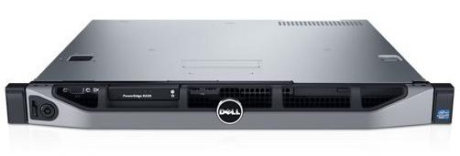
NNDC Servers
5 Dell Servers
Intel Xeon Dual 2.9 MHz 8 core
128 GB RAM
About $20K each
Dissemination and
Archival.
Load Balancer
Web Server #1
Web Server #2
Made possible by:
$150K CE DoE grants in 2003, 2008, 2013
BNL’s ITD support
Outside Database Server
Ramon Arcilla, admin.
Tim Johnson, webmaster
Programmers:
T. Johnson, B. Pritychenko, A. Sonzogni, V. Zerkin
Development & Nuclear Data Sheets Server
Inside Database Server

Slide 7
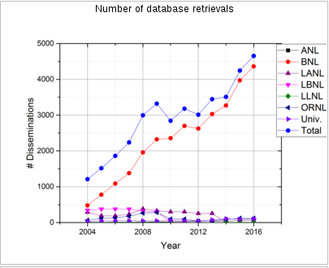
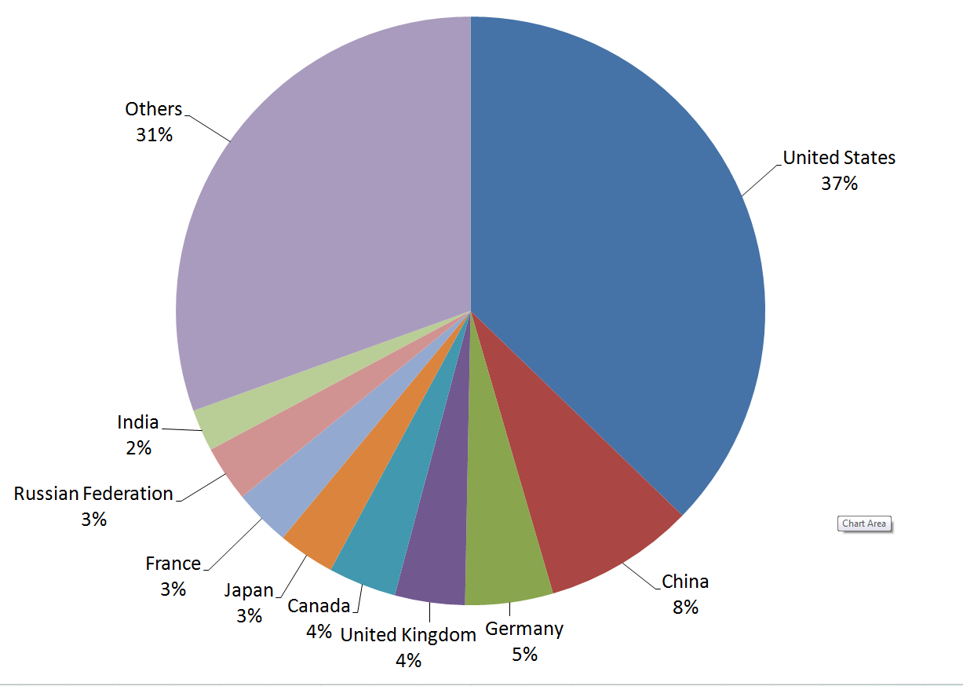
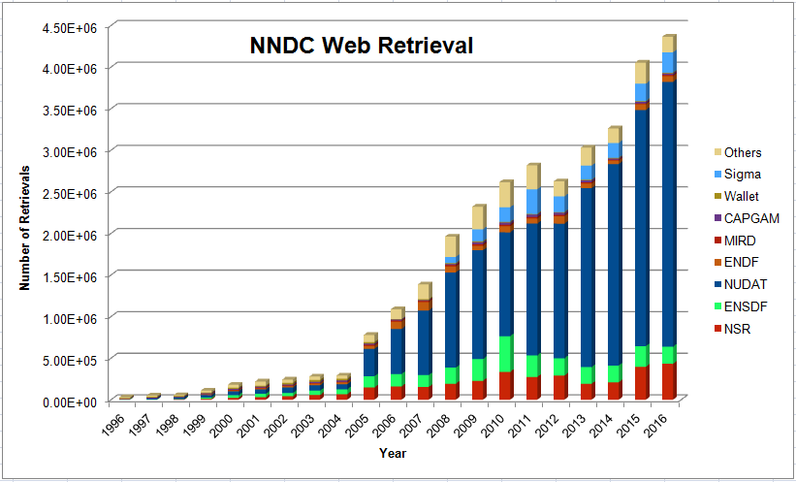
USNDP Web Retrieval Statistics
Distribution of NNDC web visitors

Slide 8

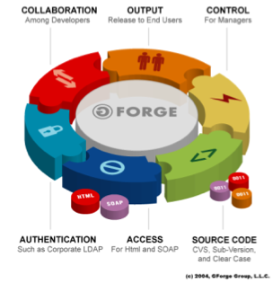
GForge site: collaborative environment for nuclear data development.
(“Facebook” of nuclear data)
Features:
File uploading/downloading
Subversion (SVN) versioning system
Management of releases
Document management
News announcements
Issue (bug) tracking
Mailing lists
Used by USNDP for development of:
codes, ENDF/B, new data structure, manuals, Web services,…
(61 projects, 150 users)
￼

Slide 9
NNDC Dissemination Challenges & Opportunities
Maintain 99.9 % reliability.
Identify and fend off hackers and cyber attacks.
Pass cyber-security audits (Lots of effort).
New servers expected in 2017.
Lots of $ saved thanks to synergy with BNL ITD (Administration and housing of the servers as well as software: Red Hat, MySQL, SSL certificate).
Update services, keep up with current technology.
Respond to user needs with enhancements and new applications.

Slide 10
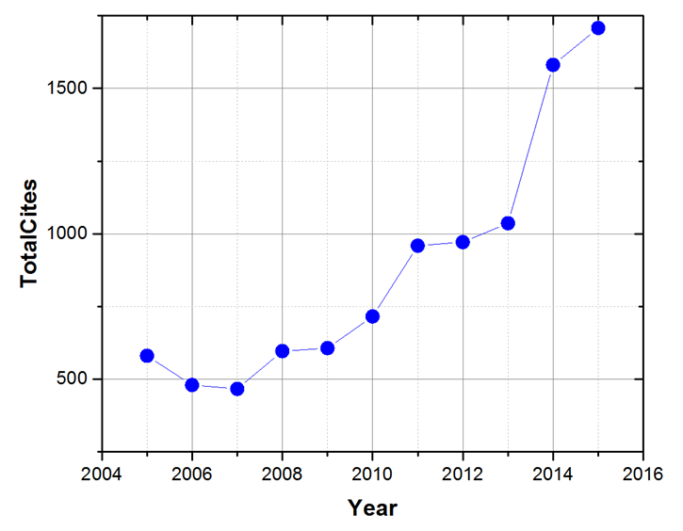
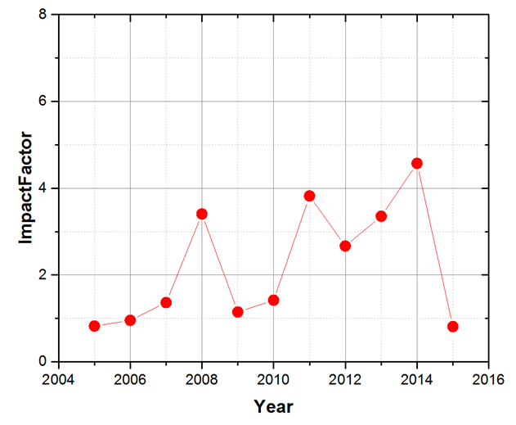
Nuclear Data Sheets
Parameters from The Journal Citation Report.
Journal | 2015 Cites | 2015 Impact Factor | 2015 Articles
PRL | 394,146 | 7.057 | 2,500
PRC | 41,426 | 3.146 | 1,067
EPJ A | 4,387 | 2.373 | 148
AD&NDT | 2,833 | 2.576 | 12

Slide 11
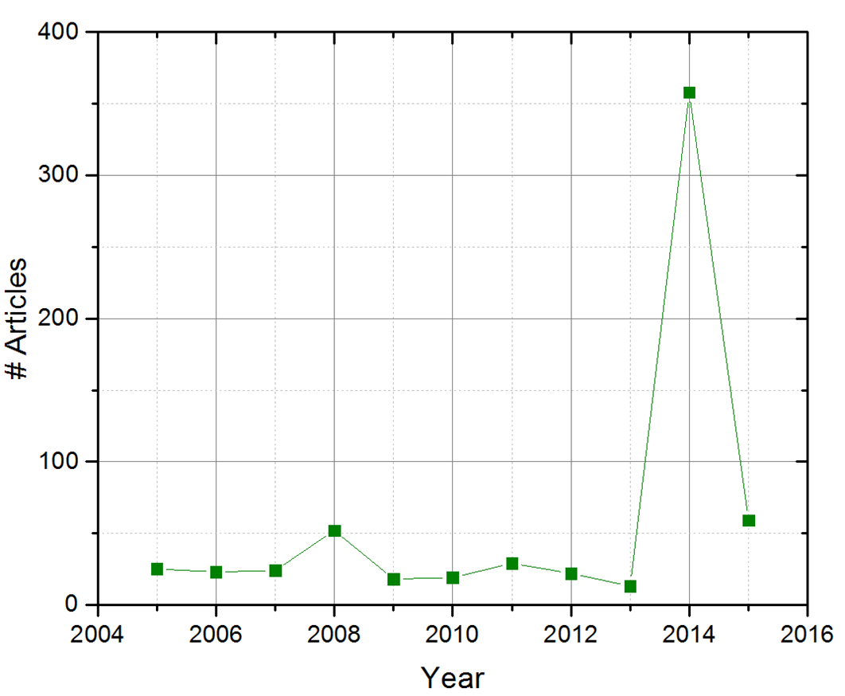
Nuclear Data Sheets
Number of Articles by Year

Slide 12
Nuclear Data Sheets Special Issues
A few selected articles
Topic | Authors | # pages | Publication Date | # citations
ENDF/B-VII.0 | Chadwick et al | 130 | 12/2006 | 1,330
EMPIRE | Herman et al | 60 | 12/2007 | 341
Standards | Carlson et al | 110 | 12/2009 | 116
RIPL | Capote et al | 107 | 12/2009 | 391
ENDF/B-VII.1 | Chadwick et al | 110 | 12/2011 | 572
NJOY | MacFarlane & Kahler | 98 | 12/2012 | 112
NDS provides a venue to publish long articles on very widely used products.
Publishing long articles represents a lot of work on the NNDC!

Slide 13
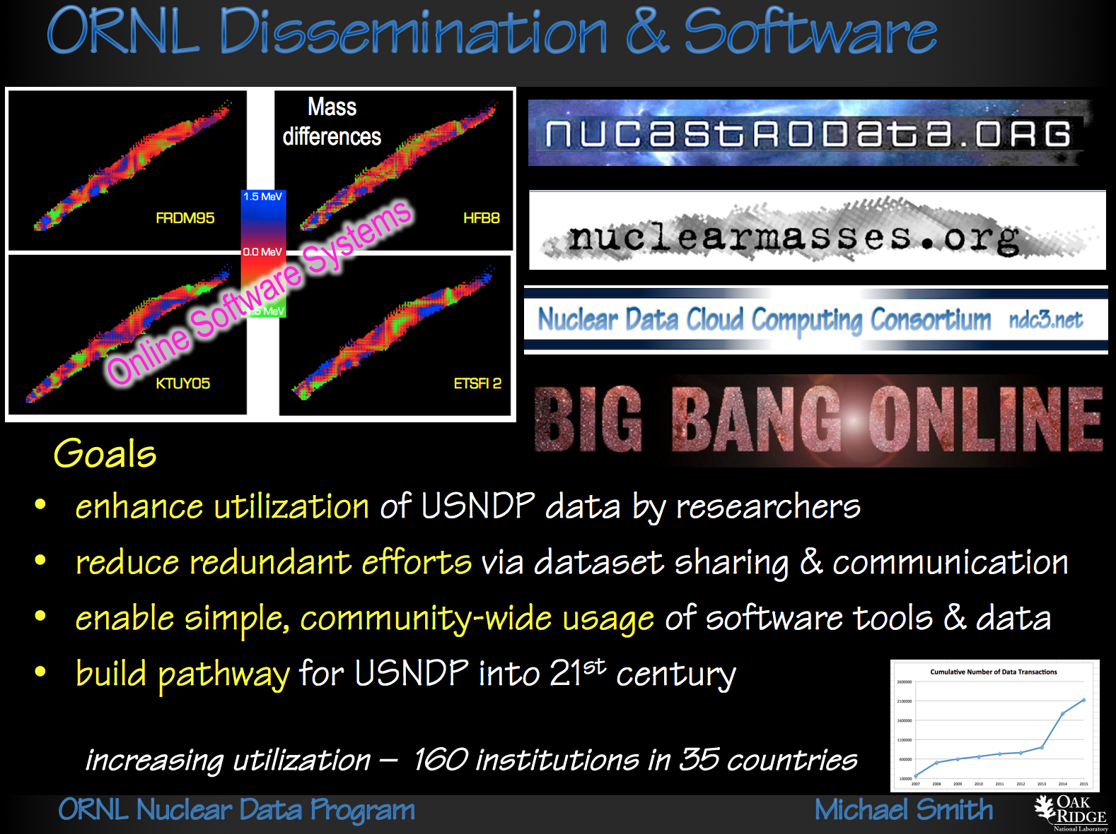

Slide 14
