Slide 1


The LBNL/UCB
Bay Area Nuclear Data (BAND) Group
Lee Bernstein
Nuclear Science Division - Lawrence Berkeley National Laboratory
Department of Nuclear Engineering – UC Berkeley

Slide 2
The BAND Group
Name | Institution | Activity | FY16 Funding (USNDP%)
L.A. Bernstein | LBNL/UCB | XUNDL/ENSDF, Teaching, Experiment | 75%
M.S. Basunia | LBNL | ENSDF, XUNDL | 100%
A.M. Hurst | UCB | EGAF, ENSDF, Database dev. | 33%
R.B. Firestone | UCB | ENSDF, EGAF, RSF CRP | 50%
C.M. Baglin | UCB | ENSDF | 10%
J.C. Batchelder | UCB | ENSDF, XUNDL, Experiment | 75%
L. Kirsch (G) | UCB | Experiment (⁵⁶Fe LD/RSF) | 0% (SSGR)
A. Voyles (G) | UCB | Experiment (Medical Cross Sections) | 0% (NRC)
A. Lewis (G) | UCB | Reaction Evaluation | 0% (Rickover)
A. Springer (G) | UCB (Karlsurhe) | Experiment (Medical Cross Sections) | 0% (UC funds)
H. Zaneb (G) | Lahore Univ. | Experiment (Medical Cross Sections) | 0% (Pakistan)
Our goal is to address the data needs of the applied nuclear science community while training the next generation of nuclear scientists and engineers in the process

Slide 3
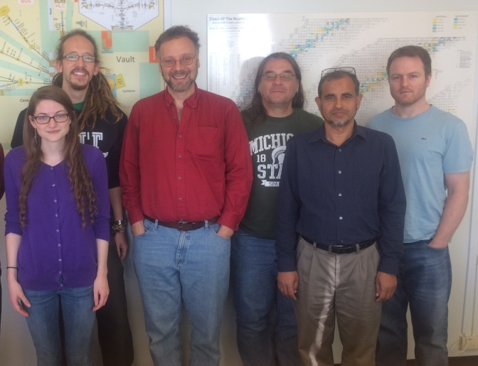
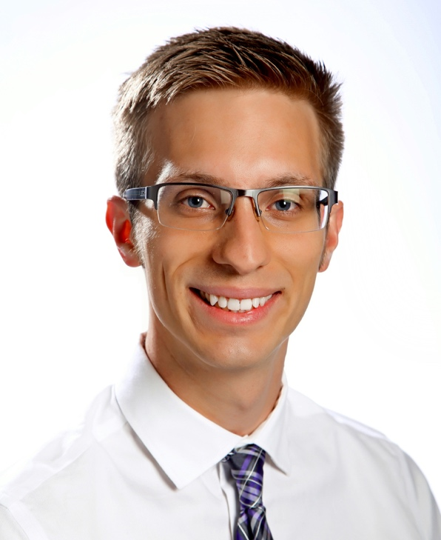
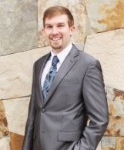
The Bay Area Nuclear Data (BAND) Group*
A. Springer
J. Batchelder
A. Hurst
L. Kirsch
A. Voyles
A. Lewis
M. Basunia
*Camera shy: R.B. Firestone, C.M. Baglin, H. Zaneb (G), N. Fajardo (UG), S. Chong (UG)

Slide 4
Nuclear data is at the core of the successful Nuclear Science & Security Consortium Proposal ($25M/5 years)
Reviewer comments:
“The nuclear data thrust is very well thought out. This is a topic that universities can
do well and it is true that nuclear data evaluators are getting rare…Improved nuclear data for safeguards is very important and sensitivity
studies help to guide the data search.”
The nuclear data cross-cutting area grew out of NDNCA and the whitepaper process
Notes:
Three LBNL-NSD staff are leading topic areas

Slide 5
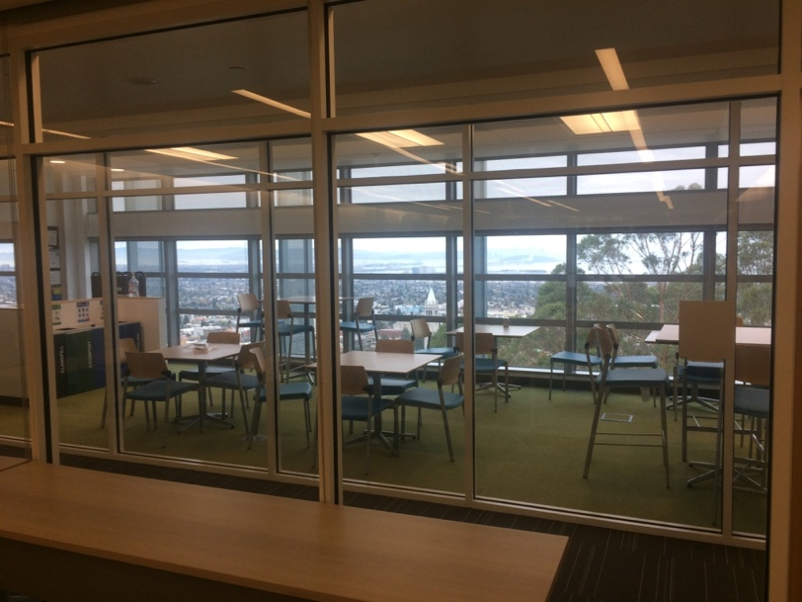
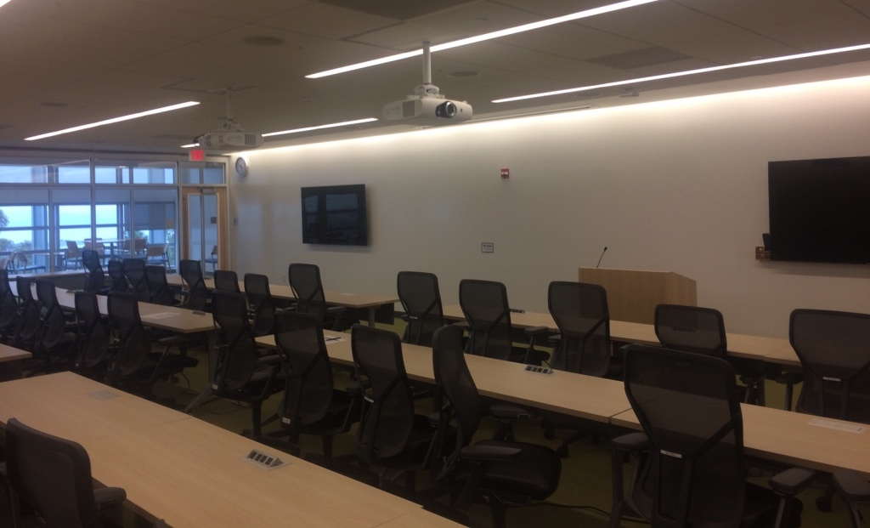
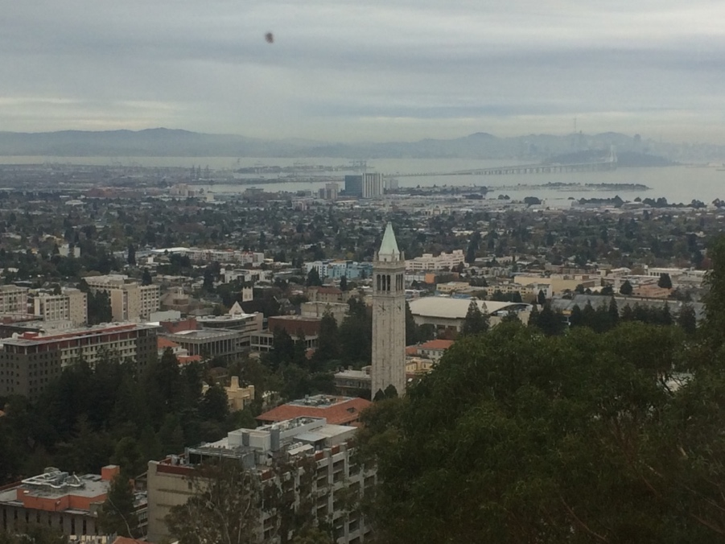
NSDD 2017 – Berkeley CA
Time/Location: May 24-27, LBNL Shyh Wang Hall
  Free Wifi, Adjacent Break Room
Catering and web hosting provided by the NSSC
Many agenda items were mentioned yesterday (policies, formats, implementation…)
Break Room
Meeting Room
Scree
View from the Break Room
Flat Screen
Monitors
Projector Screens

Slide 6
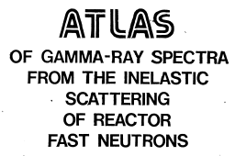
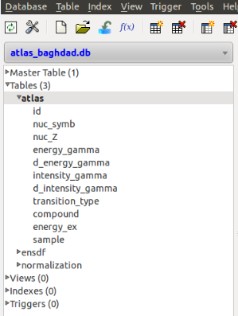
Baghdad (n,nγ) ATLAS (A.M. Hurst)
The goal of the “Baghdad Atlas” project is to produce a database of γ-rays from (n,n’γ) from reactor fast neutrons*. The Atlas contains:
  Energies and intensities for 7090 γ-rays from 105 elemental and stable targets
  Level scheme data c. 1975 (≈70% of γ-rays placed)
The ATLAS was scanned and digitized by Sleaford & Walston (LLNL)
    It was then vetted and made into a set of CSV files and an SQL database by A.M. Hurst & S. Chong.
    Two releases are planned:
  Applications Version:
    γ-ray energy & intensity (DONE)
    Corrections for doublets done using ENSDF
    Ready for dissemination
  Research Version:
    Level data will be updated from ENSDF
    (n,n’γ) data from other experiments entered.
The research version can serve as the basis of a horizontal evaluation of (n,n’γ)
Warning: 290 errors were found in the OCR file!

Slide 7
We’ve launched a medical isotope production cross section program with J. Engle (U. Wisc./LANL),
E. McCutchan (BNL) and C. Nesaraja (ORNL)
Cave 4C
p/D/α beams
≤55 MeV•A
Li(p,n) neutron
production target
Cave 5

Slide 8
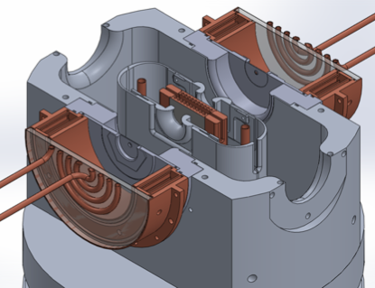
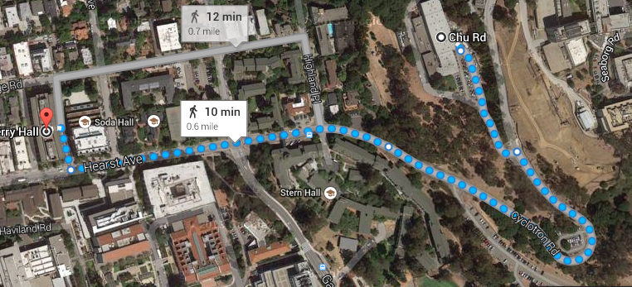
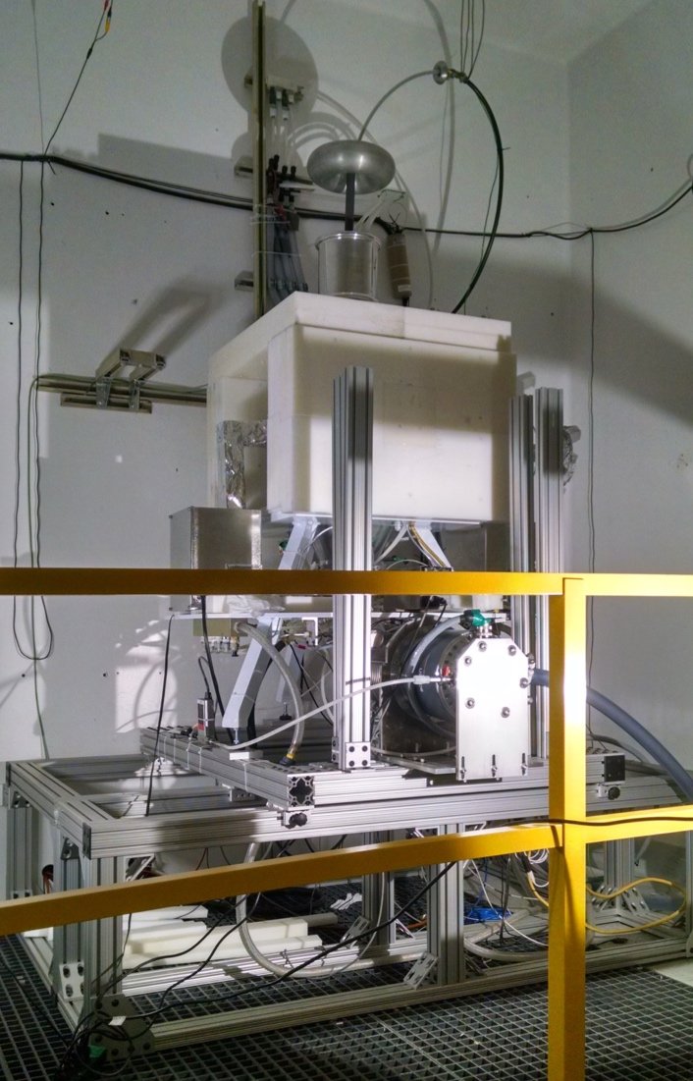
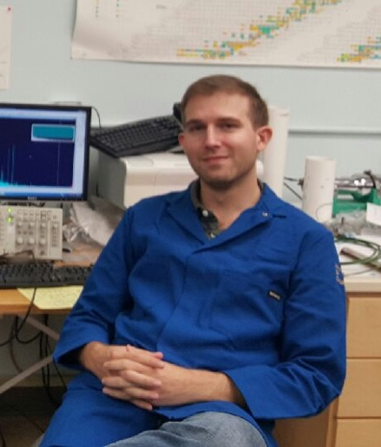
We have the first resulst from our student-led medical isotope production cross section measurements program
HFNG
88-Inch cyclotron
⁶⁴Zn(n,p)⁶⁴Cu
A. Voyles
^{nat}Cu(p,x)⁶³Zn
⁴⁷Ti(n,p)⁴⁷Sc
^{nat}Ti(p,x)⁴⁸V
Beamline calibration runs
We’ve prepared our first HFNG manuscript and will
run the the first 88-Inch experiments in December:
⁵⁴Fe(p,α)⁵¹Mn and ⁸⁶Sr(p,n)⁸⁶Y (A. Voyles CSEWG talk)

Slide 9
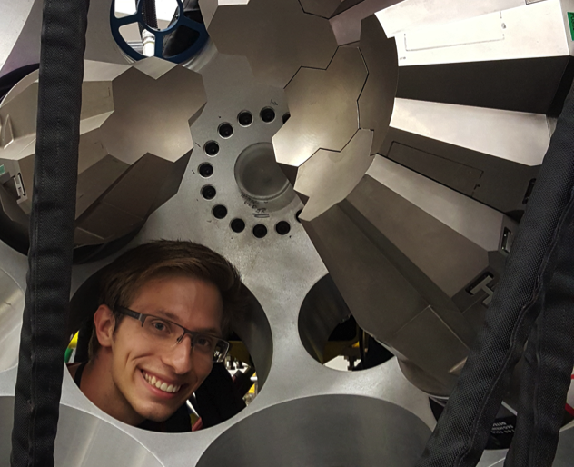
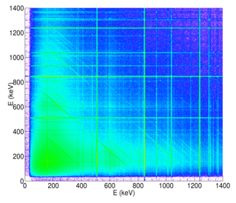
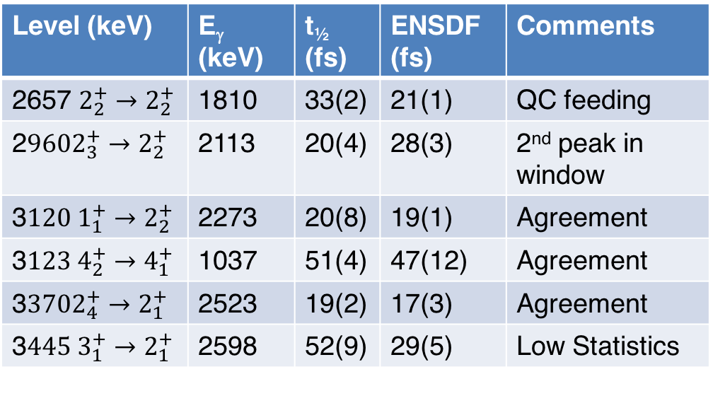
Our student Leo Kirsch is collaborating with the NSD structure group using ⁵⁶Fe(p,p’γ) GRETINA at ANL
The goals of this experiment include:
Determining E vs. M character of the RSF “up-bend” (M. Jones – LBNL)
Improving discrete structure data (6 new levels added from 5.7-6.3 MeV)
Getting Leo a Ph.D. ☺
Level (keV) | E_{γ} (keV) | t_{½} (fs) | ENSDF (fs) | Comments
2657 $2_{2}^{+}→2_{2}^{+}$ | 1810 | 33(2) | 21(1) | QC feeding
2$9602_{3}^{+}→2_{2}^{+}$ | 2113 | 20(4) | 28(3) | 2nd peak in window
3$120 1_{1}^{+}→2_{2}^{+}$ | 2273 | 20(8) | 19(1) | Agreement
3$123{ 4}_{2}^{+}→4_{1}^{+}$ | 1037 | 51(4) | 47(12) | Agreement
3$3702_{4}^{+}→2_{1}^{+}$ | 2523 | 19(2) | 17(3) | Agreement
3$445 3_{1}^{+}→2_{1}^{+}$ | 2598 | 52(9) | 29(5) | Low Statistics
GRETINA
Tracked
γ−γ data
Leo Kirsch*
(UCB Grad student)
*Stockpile Stewardship Graduate Research Fellow

Slide 10
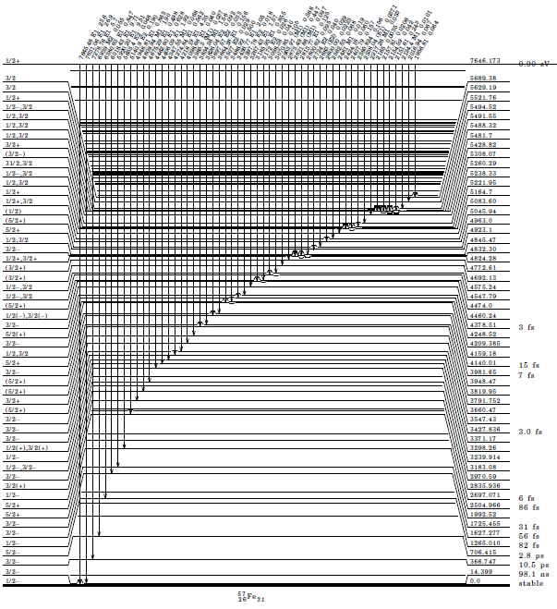
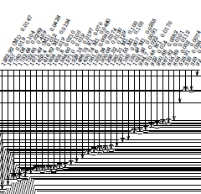
We’ve also created a near complete level scheme of ⁵⁷Fe from an ⁵⁶Fe(n,γ) experiment at Budapest
R.B. Firestone submitted to PRC
98 levels plus capture state
448 γ-rays in the level scheme
90 primary γ-rays from the capture state
Relevant to both application and basic science
The completeness of the level scheme allows us to build the radiative strength microscopically from individual γ-ray transitions

Slide 11
The ⁵⁷Fe capture gamma data supports the idea of significant low energy strength in the Quasicontinuum
Average Measured Dipole Strength in ⁵⁷Fe
(R. Firestone - 2016)
^{56,57}Fe Measured Dipole Strength
(E. Algin – 2000, A. Voinov - 2006)
E_{x} ≤ 4 MeV
E_{x} = S_{n}
E_{x} = S_{n} + 1.15 keV
This work is part of a newly-approved IAEA Coordinated Research Project to create the first evaluated database of radiative strength

Slide 12
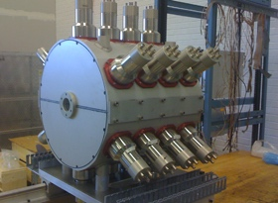
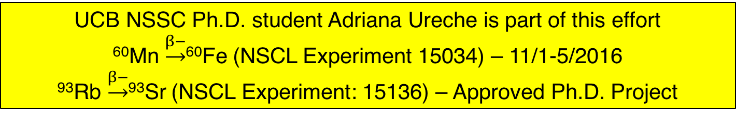
The β-Oslo method extends these studies to RIBs
A. Spyrou et al., Phys. Rev. Lett. 113, 232502 (2014).
UCB NSSC Ph.D. student Adriana Ureche is part of this effort
⁶⁰Mn $\underset{→}{β−}$⁶⁰Fe (NSCL Experiment 15034) – 11/1-5/2016
⁹³Rb $\underset{→}{β−}$⁹³Sr (NSCL Experiment: 15136) – Approved Ph.D. Project

Slide 13
Ongoing Evaluation Activities
XUNDL compilations by Basunia, Bernstein, Hurst and Batchelder
  Specialization on neutron capture papers
A-chain evaluations:
  Basunia (59)
  Bernstein (232 w/Nesaraja)
  Batchelder w/Hurst (186)
Single nuclide evaluations as follow-on to EGAF/capture gamma work (Hurst)
  ¹⁸⁶Re (with Batchelder), ¹⁴⁰La, ¹⁸¹W
Expanding the “Research Version” of the Atlas into a (n,n’γ) evaluation in its own right

Slide 14
Summary
Service to the Basic Science Community
  Providing a reliable source of evaluated nuclear structure and decay data (ENSDF & XUNDL) for researchers worldwide
  Helping improve our understanding of quasi-continuum nuclear structure (RSF) in reaction modeling & astrophysics
  Helping to train the next generation of nuclear scientists and engineers
Service to Applied Nuclear Science and Technology
  Addressing long-standing issues in the production of radionuclides for medicine and national security
  Improving neutron transport modeling through targeted measurements of (n,γ) and (p,p’γ)
Our group’s goal is to encourage interactions between the Basic and Applied
Nuclear Science Communities

Slide 15
USNDP in education (at least at UCB)

Slide 16
Summary
The past 2 years have seen an exciting new expansion of the nuclear data program at LBNL with a new connection to campus
The new campus component is providing a natural connection to the applications community
The NSSC renewal with its new Nuclear Data Cross-cutting Area, is bringing a new connection to Defense/Homeland Security Programs

Slide 17
Extra Slides

Slide 18
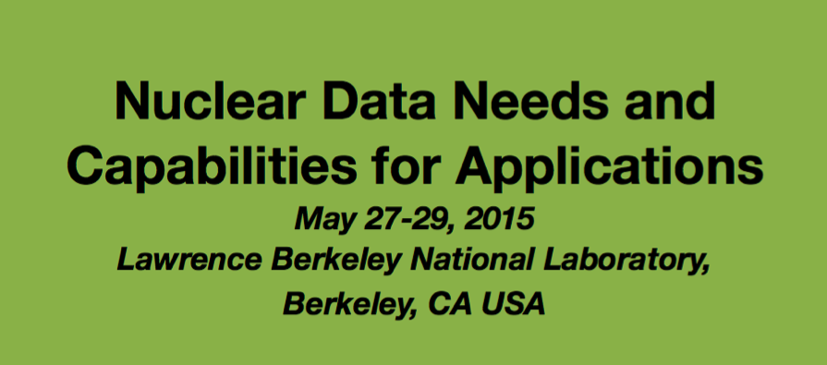
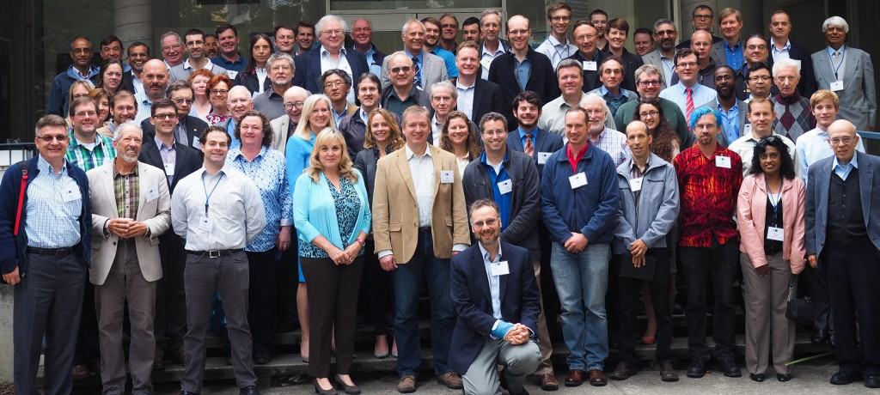
NP saw an opportunity to engage the outside community via Nuclear Data and they asked us to host a new workshop
101 Participants and registrants from 30 institutions
Days 1 & 2 features plenary talks on:
  The US Nuclear Data Program (1)
  Nuclear Energy/Dosimetry Data Needs (5)
  National Security Data Needs (6)
  Isotope Production Data Needs (4)
  Capabilities/Facilities (8)
Day 3: Topical breakout sessions

Slide 19
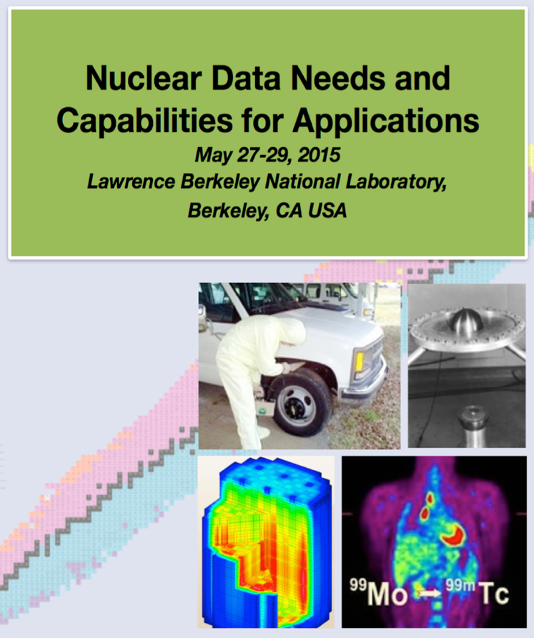
The NDNCA whitepaper guides most BAND group activities
Cross-cutting needs
Dosimetry Standards for E_{n} up to 60 MeV to support IFMIF, ADS, and spallation sources”
Fission “the ‘Mother of All Fission Experiments,’ where TKE(A), ν, γ’s fragment yields for a range of Actinides for E_{n}=thermal-20+ MeV”.
Decay Data & γ−Branching Ratios including an IAEA list of decay data for “certain medical isotopes”
Neutron Transport Covariance Reduction: Particular need for actinide (n,x) cross sections from 1-1000 keV”
Expanded Integral Validation: such as semi-integral data (e.g., pulsed sphere) to diagnose (n,n_{el}), (n,n_{inel}) shortcomings ”
Antineutrinos from Reactors: with a specific call for new data for ^{235,238}U and ^{239,241}Pu…fission yields for odd-odd nuclei and β-spectral measurements”
http://bang.berkeley.edu/events/NDNCA/whitepaper

