Slide 1
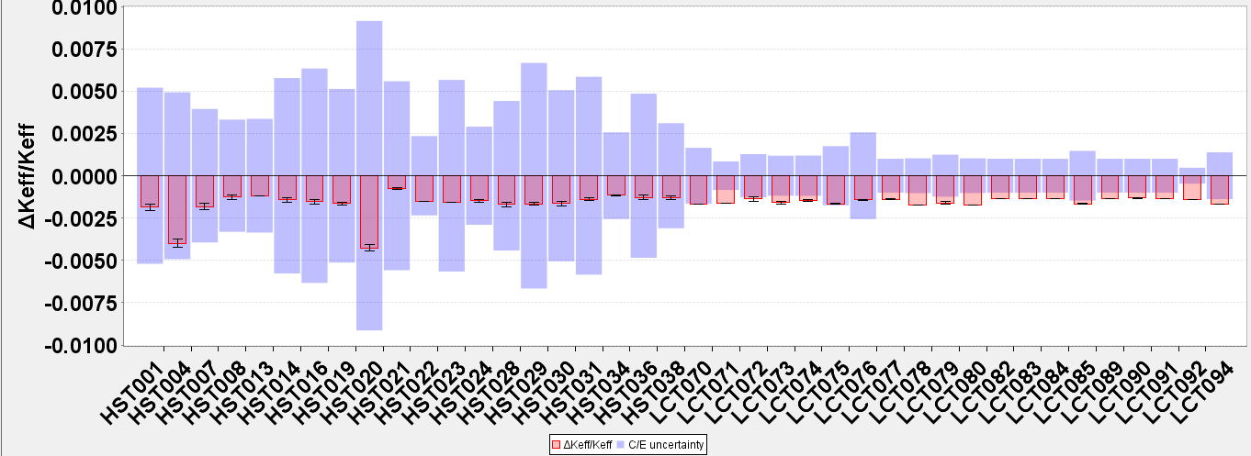
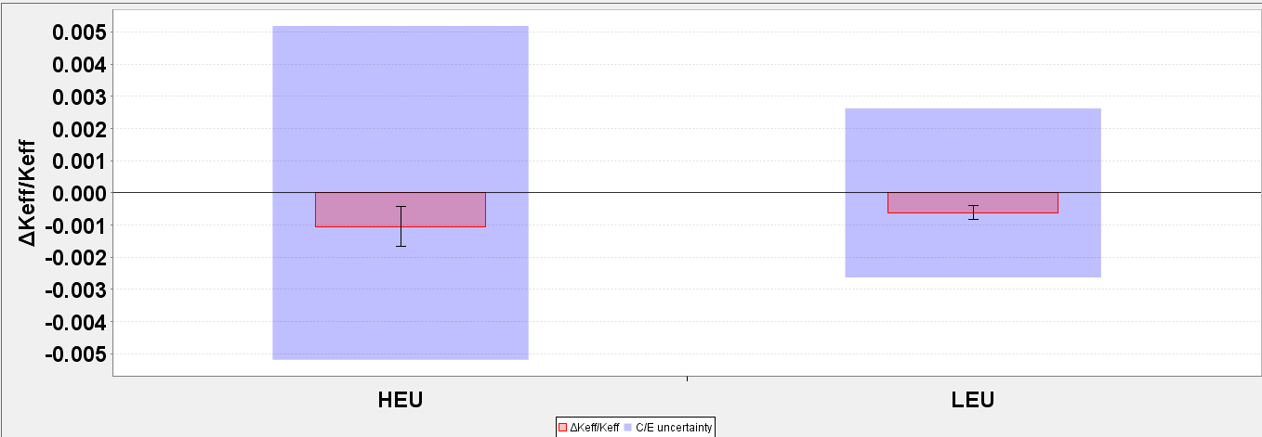
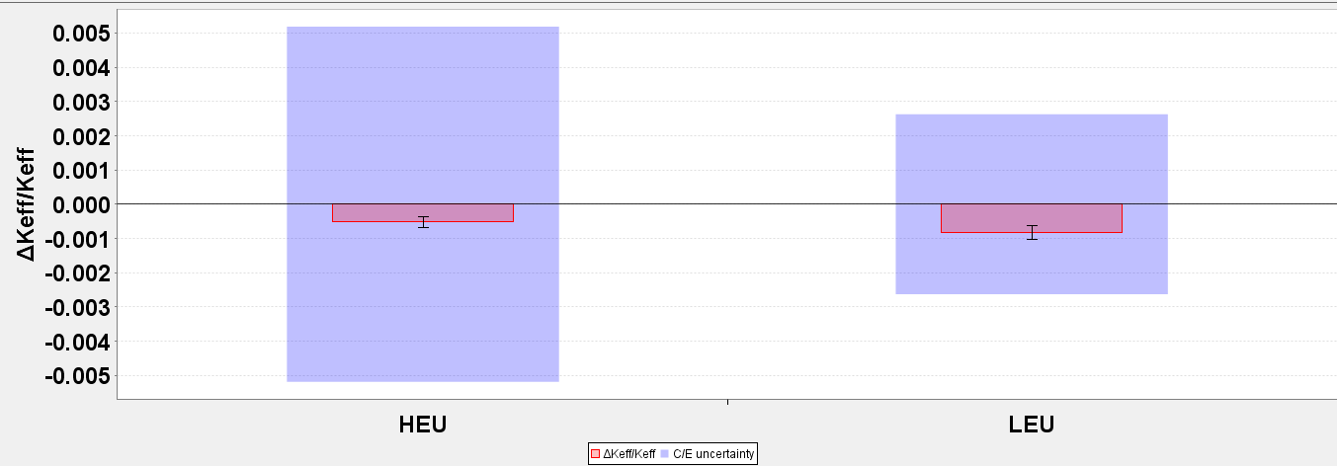
O¹⁶(elastic + n,alpha)
Sample HST and LCT Cases—perturbation X Sensitivity dk/dΣ
C/E Uncertainty (~500 pcm here mostly E)
Effect of cross section perturbation (~200 pcm here)
Uranyl-Fluoride in D2O (from elastic)
O¹⁶(elastic)
O¹⁶(n,alpha)
-100 pcm
-50 pcm
-50 pcm
-100 pcm
Average over HST
Experiments
Average over LCT
Experiments
Average over HST
Experiments
Average over LCT
Experiments
(Using http://www.oecd-nea.org/ndast/)

