Slide 1
LLNL nuclear data processing
CSEWG 2016
Bret Beck
Nov. 15, 2016

Slide 2
Outline
The “protare”
GND
LLNL nuclear data infrastructure:
FUDGE
GIDI: GND API
GND is a new nuclear data format (structure) for storing data
Caleb’s talk

Slide 3
The protare
A set of nuclear reaction data for a PROjectile hitting a TARget for an Evaluation
Examples:
Like an ENDF NSUB + MAT + NLIB
A GND file represents one protare
Protare: ‘n’, ‘O16’, ‘ENDF/B-VII.1’
Protare: ‘n’, ‘O16’, ‘ENDF/B-8_beta2’
Protare: ‘n’, ‘O16’, ‘JENDL-4.0’
‘Map’ file allows all three to be in a data library release
‘Map’ is not an official SG38 definition
n + O16 for ENDF/B-VII.0
n + Fe56 for ENDF/B-8_beta2
p + Li6 for JEFF-3.2

Slide 4
GND: Overview
Stores evaluated and/or processed data
Multiple sets of processed data can be stored in a GND file simultaneously
GND defines a structure that is hierarchical
Talk more about styles later.
Talk more about cross section per each reaction later.

Slide 5
FUDGE: Capabilities
FUDGE: For Updating Data and Generating Evaluations
Originally developed for LLNL’s ENDL format
Read and write ENDL data
Modifying, plot, check, etc.
Process ENDL data into LLNL legacy files (deterministic and Monte Carlo)
Additionally, can now handle GND data
Convert ENDF to and from GND, convert ENDL to GND
Reading/writing
Printing/plotting
Modifying
Converting units (e.g., eV to MeV)
Processing
Reconstruct cross sections and angular data from resonance parameters
Heat cross sections
Calculate cdfs for Monte Carlo transport
Multi-group for deterministic and Monte Carlo transport
Checking

Slide 6
FUDGE: general comments
Top level written in python
Has C/C++ interface for computationally intensive calculations
Some legacy ENDL support in FORTRAN
Some processing multi-threading (RR, MG but not heating)
Freely available at https://ndclx4.bnl.gov/gf/project/gnd/
For ENDF-VII.1 sub-libraries can translate:
neutrons, protons, deuterons, tritons, helium3s, gammas, standards, electrons, photoat, thermal_scatt and atomic_relax
Translated and processed the ENDF/B-8_beta3 neutron library
Still have issues with some MAT’s in some libraries that do not follow the ENDF-6 standard

Slide 7
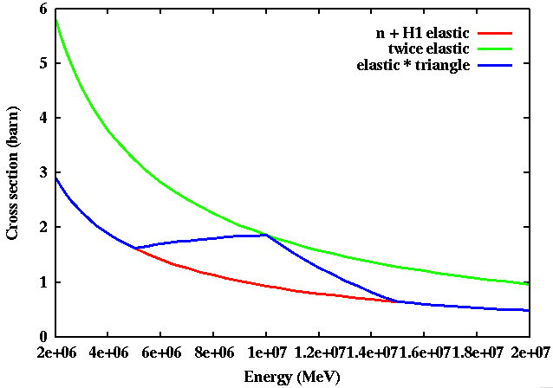
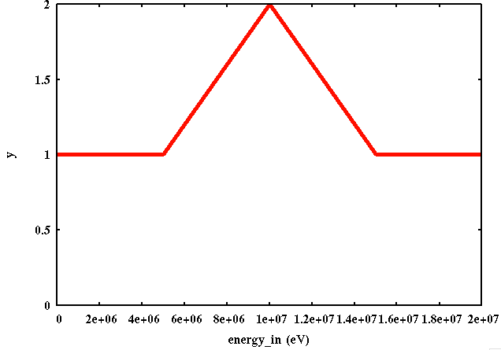
FUDGE: Manipulating and plotting
Various operations on data types are supported
Including +, -, *, /, etc. on 1d data types
h(x) = f(x) × g(x)

Slide 8
Current types of processing 1/3
Constructing pointwise cross sections from resonance parameters
Unit conversion: convertUnits( { 'eV' : 'MeV' } )
Average product data (energy and momentum unheated)
Like kerma data but more general - per particle per reaction
Available energy and momentum by reaction

Slide 9
Current types of processing 2/3
Heating cross section and average product data
Equation written in terms of relative velocity and integrated over a Maxwellian target velocity
E = incident particle energy, E’ = outgoing particle (product) energy
Subscripts: ‘r’ = relative, ‘i’ = incident particle and ‘t’ is target particle)
Glossing over this!

Slide 10
Current types of processing 3/3
For distributions calculating cdf from pdf: for Monte Carlo
Calculating multi-group data: for deterministic and Monte Carlo
Cross section
Average product data
Average available energy and momentum
Distributions (transfer, product, fission matrices)
Etc.
Calculating upscattering multi-group matrix data for elastic scattering

Slide 11
Fudge: GND processing script
Fudge/bin/processProtare.py (projectile + target + evaluation)
Read in a GND file
Convert energy units: LLNL uses MeV while GND from ENDF is in eV
Reconstruct cross sections and/or angular data from resonance parameters if needed (threaded)
Calculate average product energy and momentum data
This can be used to calculate KERMA but is more general
Preform Monte Carlo processing if requested (pdf to cdf)
Loop over each temperature
Heat cross section data
Perform multi-group processing if requested (threaded)
Write out to file: all data put into one GND file

Slide 12
GND uses ‘styles’ to handle multiple types of data
Styles include evaluated, crossSectionReconstructed, heated, multiGroup, MC, etc.
All styles except evaluated are derived from another style
Each type of data (cross section, multiplicity, distribution, etc.) can contain more than one style.
e.g. a cross section can contain ‘evaluated’, ‘crossSectionReconstructed’, and one or more ‘heated’-style data
heated_1
eval
recon
heated_2

Slide 13
Processing for Monte Carlo
processProtare.py --energyUnit MeV –mc –t 1e-7 –t 1e-6 –t 1e-5 Li6.xml
heated_002
eval
recon
apd
MonteCarlo
heated_001
heated_000

Slide 14
Processing for multi-group
processProtare.py --energyUnit MeV –mg –t 1e-7 –t 1e-6 –t 1e-5 Li6.xml
heated_002
MultiGroup_002
eval
recon
apd
MultiGroup
heated_001
MultiGroup_001
heated_000
MultiGroup_000

Slide 15
FUDGE: Contents of a “styles” element

Slide 16
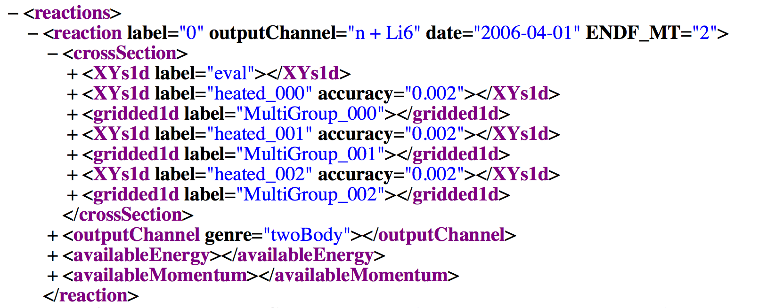
FUDGE: Contents of a “crossSection” element

Slide 17
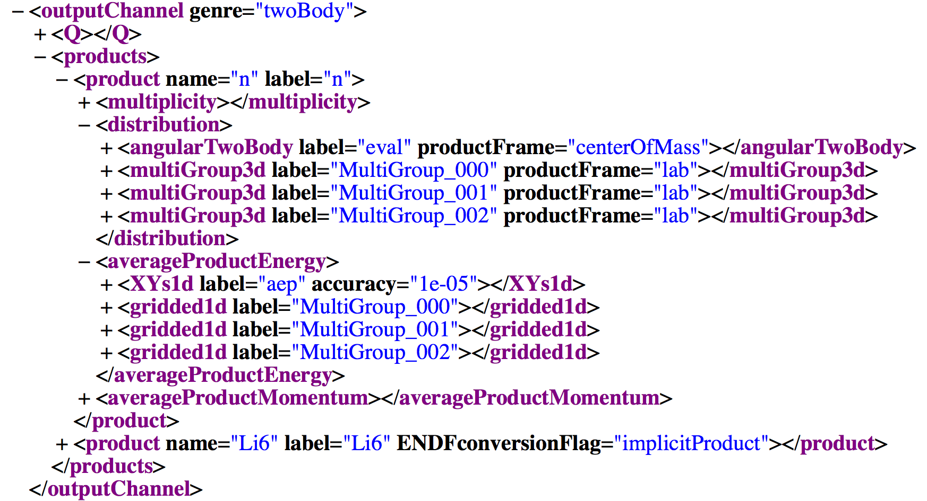
FUDGE: Contents of a “outputChannel” element

Slide 18
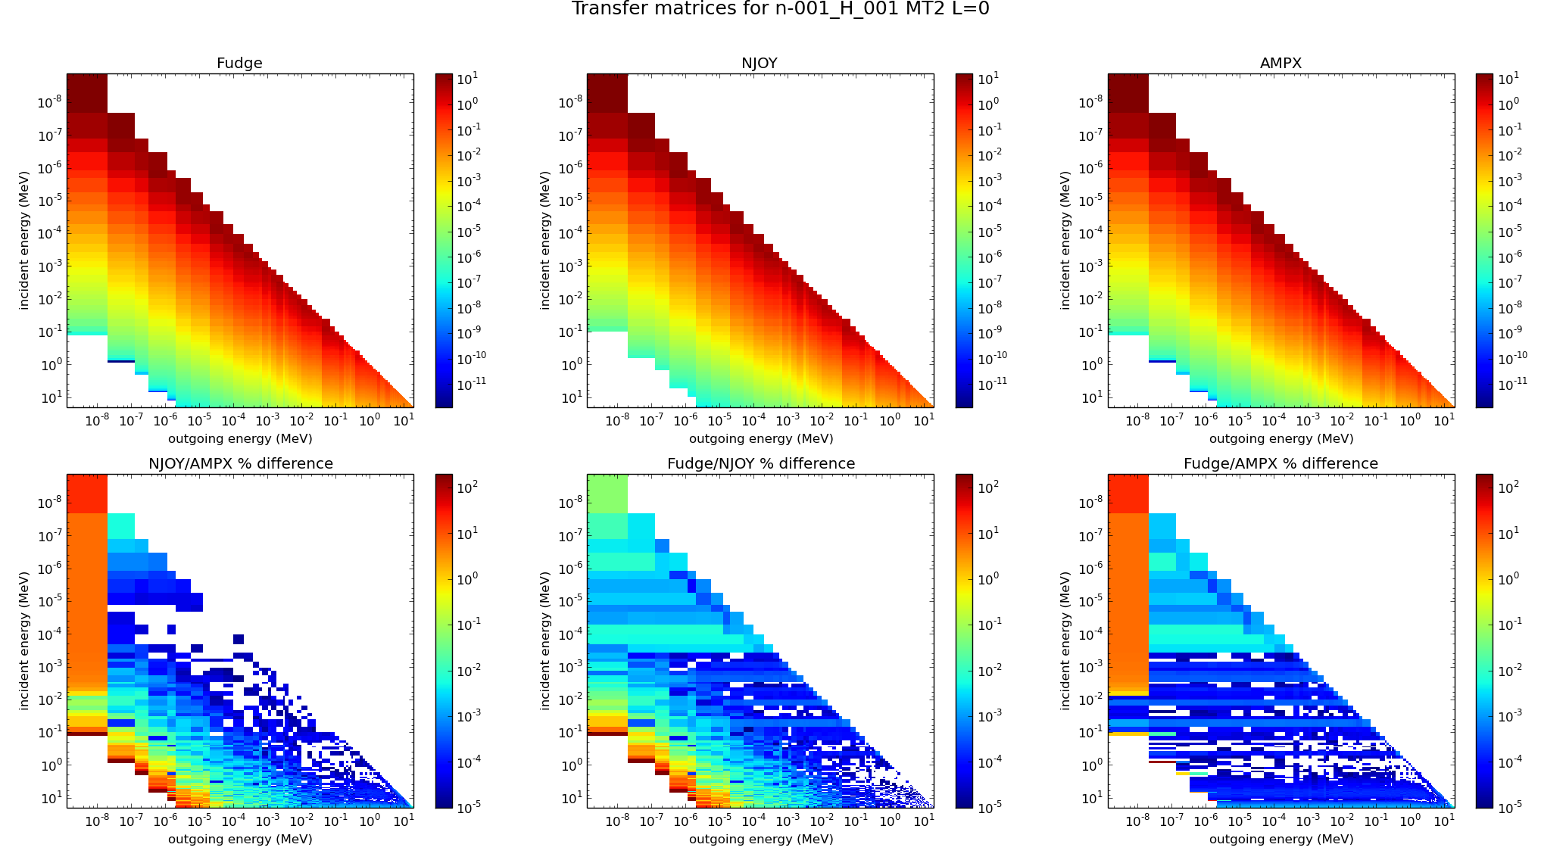
Testing processing with other codes

Slide 19
FUDGE: future work
Unresolved resonance probability table generation
This is being implemented by Dave Brown (BNL)
Multi-band
Thermal scattering generation
We need to implement something like NJOY’s LEAPR and THERMR
Have a definition in GND
Thermal upscatter for deterministic transport
Only treats elastic scattering
Have code to calculate these data, still need to hook into FUDGE
Kiwi: package that uses FUDGE to generate realizations of nuclear data from mean and covariance data.
Fix GND to ACE and maybe others
Documentation

Slide 20
GIDI: overview
GIDI: General Interaction Data Interface
Transport code API for GND
Written in C++
Update from older version that was written in C
Starting to test in an LLNL deterministic code
Uses the PoPs (Properties Of Particles) API and database
Being developed at LLNL
PoPS is part of SG38 standard
Testing in LLNL deterministic transport code Ardra
Old version used in LLNL Monte Carlo transport code Mercury
New version to test in Mercury soon
Old version also used in GEANT

Slide 21
GIDI: Future work
PoPs: Property Of Particles – a particle database
Updated to latest GND/PoPs
Deterministic
Add energy deposition support
Upscatter
Far in the future?: on the fly processing like multi-grouping
Monte Carlo
Convert C routines to C++
Add energy deposition support
Add multi-temperature support
Add angle biasing
Speed up sampling
Significant work already completed by a summer student (Nick A.)
Far in the future?: on the fly processing like heating

Slide 22
Summary
GND
I expect few changes and changes to be small
FUDGE
Nearly updated to latest GND
Freely available at https://ndclx4.bnl.gov/gf/project/gnd/
Plan to release another version before 1 Jan. 2017 with multi-group processing
GIDI
Changing to pure C++
Multi-group for all temperatures complete by 1 Jan. 2017
Multi-temperature and Monte Carlo (minus angle biasing) early 2017

