Slide 1
LLNL Evaluations: ²³⁹U, ⁷Be, ECPL
CSEWG 2016
Ian Thompson
using also evaluations of D. Brown, P. Navratil & C. Hagmann

Slide 2
New evaluations from LLNL
n + ²³⁹U: new (full) set of resonances
n + ⁷Be: extend evaluation from 8.1 to 20 MeV
Charged-particle reactions from ECPL at LLNL: conversion to ENDF via GND –
  Elastic only:
    p + a, t + a, h + a, a + a
  With also transfers/breakup/charge exchange:
    p + ⁷Li, d + ⁷Li, t + ⁷Li, h + h

Slide 3
n + ²³⁹U evaluation 1: History
²³⁹U has half-life of 23 min, so cannot be a good target. Only thermal (n,γ) and (n,f) measured inclusively
  But is essential step in
  ²³⁸U+n→²³⁹U→²³⁹Np→²³⁹Pu, so need accurate side-reactions e.g. ²³⁹U(n,γ)
Make new evaluation by copying from ²³⁷U evaluation & modify
Make ‘picket fence’ resonances. Spin 5/2⁺ * n(1/2⁺), so J=2⁺ or 3⁺
ENDF/B-VII from LANL
  See plot
  Capture ≈ Mughabghab 22±5 b
  BUT: only J=1/2+ resonances
  : simplified URR from 10²-10⁴ eV.
  AND: strange bump below thermal

Slide 4
n + ²³⁹U evaluation 2: History
²³⁹U has half-life of 23 min, so cannot be a good target. Only thermal (n,γ) and (n,f) measured inclusively
  But is essential step in
  ²³⁸U+n→²³⁹U→²³⁹Np→²³⁹Pu, so need accurate side-reactions e.g. ²³⁹U(n,γ)
Make new evaluation by copying from ²³⁷U evaluation & modify
Make ‘picket fence’ resonances. Spin 5/2⁺ * n(1/2⁺), so J=2⁺ or 3⁺
ENDF/B-VII.1 from Trkov, Brown
  See plot
  Capture ≈ Mughabghab 22±5 b
  BUT: only J=2⁺ resonances
  AND: lower in URR (up to 10 keV)

Slide 5
n + ²³⁹U evaluation 3: New resonances
²³⁹U has half-life of 23 min, so cannot be a good target. Only thermal (n,γ) and (n,f) measured inclusively
  But is essential step in
  ²³⁸U+n→²³⁹U→²³⁹Np→²³⁹Pu, so need accurate side-reactions e.g. ²³⁹U(n,γ)
Make new evaluation by copying from ²³⁷U evaluation & modify
Make ‘picket fence’ resonances. Spin 5/2⁺ * n(1/2⁺), so J=2⁺ or 3⁺
ENDF/B-VIII.b3 from LLNL
  See plot
  Capture ≈ Mughabghab 22±5 b
  NOW both J=2⁺ or 3⁺ resonances
  NOTE higher capture up to 60 keV. Closer to original

Slide 6
⁷Be evaluation: extend 8.1 to 20 MeV
ENDF/B-VII evaluation only extends to 8.1 MeV
ENDF/B-VIII: elastic, (n,p) and (n,α) extended to 20 MeV.
- by rescaling the results of a default TALYS 1.6 calculation (without pre-equilibrium) to match the previous curves at 8.1 MeV.
Total resummed.
Better then straight lines.

Slide 7
ECPL: ‘Evaluated Charged-Particle Library’
A Thermonuclear Reaction Library
Legacy ECPL/ENDL99 evaluations
  Incident charged particles (p,d,t,He3,He4), light targets Z<=3 (p,d,t,He3,He4,Li6,Li7)
  R.M. White, D.A. Resler, S.I. Warshaw 'Evaluation of Charged-Particle Reactions for Fusion Applications,' Proc. from Nuclear Data for Sci. and Tech., Ed. S.M. Qaim, Juelich, Fed. Rep. Germany, 13-17 May (1991)
  S.T. Perkins, D.E. Cullen, 'Elastic Nuclear plus Interference cross sections for light-charge particles' Nucl. Sci. Eng. 77, 20-39 (1981)
New evaluations at LLNL by Petr Navratil, David Brown & Chris Hagmann
  Main sources for new evaluations
    Descouvemont R-Matrix analysis
      P. Descouvemont, A. Adahchour, C. Angulo, A. Coc, E. Vangioni-Flam, Atomic Data & Nucl. Data Tables 88, 203 (2004)
    NACRE (Nuclear Astrophysics Compilation of REaction rate)
      C. Angulo et al., Nucl. Phys. A656 (1999)3-187
    Experimental data not in EXFOR
LANL n+n evaluation by Gerry Hale
  JENDL-4 n+d, n+He3 evaluations
Inverse kinematics used for remaining evaluations

Slide 8
Evaluations in ENDF/B-VII.1
Evaluations in ENDL2011.0
Awaiting LCT=4 option, in October 2016 submitted from LLNL the ENDF files for a+a, d+7Li, h+h, h+a, p+a, p+7Li, t+a, t+7Li

Slide 9
First Tranche of ENDL evaluations
Following slides list the ENDL evaluations, highlight differences with ENDF
Simplest evaluations first
  Proposed ENDF format LCT=4 needed for 2-step decays via resonances in residual nuclei. These later!
Now elastic only:
  p + a, t + a, h + a, a + a
With also transfers/breakup/charge exchange:
  p + ⁷Li, d + ⁷Li, t + ⁷Li, h + h

Slide 10
p+Li7 evaluation
ENDF/B-VII.1 (Page 2004)
  (p,el), (p,n’₀), (p,d₀), (p,α₀)
ENDF/B-VIII.b3 (ENDL2011, Navratil 2008)
  7Li(p,n)
  Both ECPL and ENDF/B-VII.0 cross-sections were discarded. Evaluation is based purely on data
  (p,n₀) [ground state]:
    NIMPR 133, 253 (1976) for 0-2.35 MeV
    PRC 10, 1299 (1974) for 2.4-3.6 MeV
    VANT YK 4, 17 (1984) for 3.6-25 MeV
    PRC 14, 438 (1976) for 25-26 MeV
    Datasets matched with splines.
  (p,n₁) [0.4291 MeV excited state):
    NPA 182, 2, 321 (1972) for 2.3-5 MeV
    VANT YK 4, 17 (1984) for 5-25 MeV
    PRC 14, 438 (1976) for 25-26 MeV
    Datasets matched with splines
  Angular distributions
    Taken from Page's ENDF/B-VII.0 evaluation
    Distribution for excited state is same as ground state, but threshold is shifted.

Slide 11
p+Li7 evaluation
ENDF/B-VII.1 (Page 2004)
  (p,el), (p,n’₀), (p,d₀), (p,α₀)
ENDF/B-VIII.b3 (ENDL2011, Navratil 2008)
  (p,el) from ECPL
  (p,a)
  Cross-section
    < 2.6 MeV : Descouvemont [3] S-factor
    2.6 - 3.15 MeV : three experimental points from the Rice measurement
    > 3.15 MeV : Page evaluation
    Note EXFOR file with the NP 33, 449 (1962) data is wrong as there was an erratum in NP 41, 176 (1963) (data needs to be multiplied by 10/7), divided by 2 as normalization based on 1958 measurement that counted alphas
  Angular distributions from ENDF/B-VII.0
Decouvemont 2004
  [3] P. Descouvemont, A. Adahchour, C. Angulo, A. Coc, E. Vangioni-Flam, Atomic Data and Nuclear Data Tables 88, 203 (2004).

Slide 12
p+Li7 evaluation
ENDF/B-VII.1 (Page 2004)
  (p,el), (p,n’₀), (p,d₀), (p,α₀)
ENDF/B-VIII.b3
(ENDL2009, Navratil 2008)
  7Li(p,d)
  Cross-section
    < 10 MeV from ENDF/B-VII.0
    To extrapolate to 30 MeV, integrated the cross section from Fig. 6 of PR 163,4,1066 (1967) and got 24 mb. Measurement was at 33.6 MeV proton energy. Recommend to use 24 mb at 30 MeV and make a linear interpolation to the 10 MeV point of Page
  Angular distributions from ENDF/B-VII.0

Slide 13
d+Li7 evaluation
ENDF/B-VII.0 (Hale 2003)
  (d,el), (d,na), (d,t₀)
ENDF/B-VIII.b3
(ENDL2011.0, Navratil 2010)
  (d,el) from ENDF, extended up to 30 MeV
  (d,na) from ECPL (but ENDF better fit to data)
  (d,t) from R.L. Macklin [5] data up to 4 MeV; at higher energies scaled ENDF
    Angular distributions: ENDF/B-VII.0
[5] R.L. Macklin, H.E. Banta, Phys. Rev., 97, 753 (1955)

Slide 14
d+Li7 evaluation
ENDF/B-VII.0 (Hale 2003)
  (d,el), (d,na), (d,t₀)
ENDL2011.0 (Navratil 2010)
  (d,2n) from ECPL
  (d,p)
    < 0.7 MeV from Ref. [3]
    0.7 - 3.4 MeV from Ref. [4]
    > 3.4 MeV educated guess
    Angular distributions: from (d,na) neutron dist.
[3] B.W. Filippone, A.J. Elwyn, W. Ray Jr., D.D. Koetke, Phys. Rev. C, 25, 2174 (1982)
[4] D.W.Mingay, J, SAP, 2, (3), 107 (1979)

Slide 15
He3+He3 evaluation
ENDF/B-VII.0 (Hale 2001)
  (He3,el), (He3,2p)
ENDF/B-VIII.b3
(ENDL2011.0, Navratil 2010)
  (He3,el) from ENDF
  (He3,2p)
    NACRE S-factor evaluation [4] that includes LUNA data [5]
    Angle and energy distributions: from ENDF
[4] C. Angulo et al. (NACRE Collaboration), Nucl. Phys. A656 (1999)3-187
[5] The LUNA Collaboration, M. Junker, et al., The cross section of 3He(3He,2p)4He measured at solar energies, Nuclear Physics B - Proceedings Supplements, Volume 70, Issues 1-3, Proceedings of the Fifth International Workshop on topics in Astroparticle and Underground Physics, January 1999, Pages 382-385, ISSN 0920-5632.

Slide 16
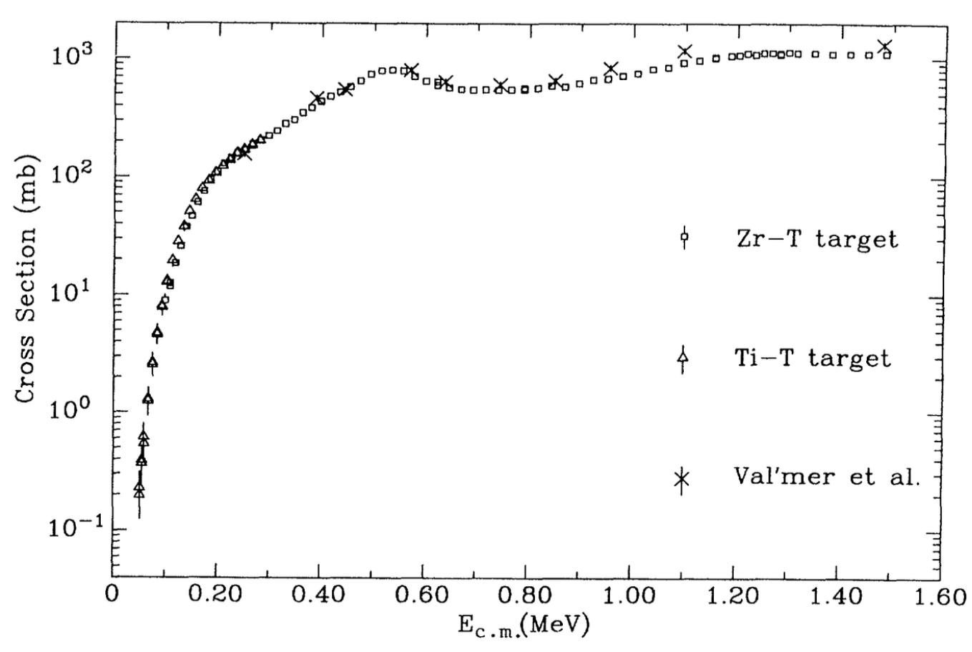
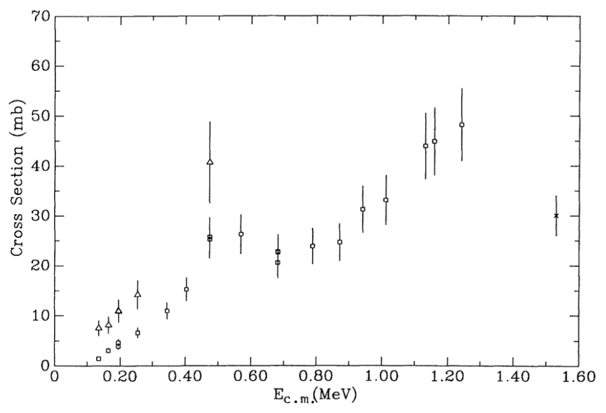
t+Li7 evaluation
Dispute over channel ⁷Li(t,n)⁹Be
in competition with ⁷Li(t,n)nαα
using results from Brune et al [1]
Channels: n₀ and n_{tot} –
endf MT=50, 24 or endl c=11, 33
Problem: Fig 9 (above) for n_{tot} used for n₀ in LLNL evaluations since 1999. Should be Fig 7 (below).
We needed to re-evaluate this cross section!
[1] C. R. Brune et al, Phys. Rev. C 43, 875 (1991)
Brune n_{tot}
Brune n₀ (squares)

Slide 17
t+Li7 evaluation
Inverse reaction ⁹Be(n,t)⁷Li has been measured [2], and can confirm the n₀ cross section to the ground state.
Also use data of [2] to extend Brune data to higher incident energies.
Extra cross section (n_{tot} – n₀) moved to 2nα inclusive channel (MT=24, c=33).
[1] C. R. Brune et al, Phys. Rev. C 43, 875 (1991)
[2] F.S. Dietrich et al, Nucl. Sci. Eng. 61, 267 (1976).
Proposed n₀
Proposed 2nα + α

Slide 18
Translation from ENDL to ENDF
New LLNL evaluations developed using ENDL format from variety of sources
When translating from ENDF into ENDL, information was lost
  Reformatted ENDF parameterized forms to pointwise data for ENDL
    such as phase space representation
  Rebuild evaluations in ENDF format using GND/fudge to do this.
Here are first evaluations built using new fudge/GND
  Develop framework in fudge for cut/paste evaluations from different sources
Documentation needs to be re-written for all evaluations
  Currently too much ENDL speak

Slide 19
Future for cp evaluations
All the charged-particle evaluations here are over 5 years old
  Delays to ENDF from GND and ENDF format changes (still underway for two-step decays)
Future evaluations can & will be full R-matrix calculations,
at least up to energies of statistical models
  No cp R-matrix parameters in ENDF yet
    Need to extend ENDF infrastructure (GND, PREPRO) for cp reconstructions!
  Consistent cross sections and angular distributions
  LANL, LLNL, Notre Dame, ORNL evaluations underway
    Needed for astrophysics, fusion, and ion-beam analysis.
    Consultants’ meetings at IAEA on R-matrix Data and Codes (Dec 2015 and Dec 2016)
  I foresee many R-matrix fits for cp on targets up to A ≲ 40
Still need R-matrix developments for
  Two-step decays (Hale and Brune demonstrate for t+t→⁵He*+n)
  ‘Democratic breakup’ (discretized continuum) [Sofia Quaglioni at LLNL]
  Especially if future formats can describe exit correlations.

