Slide 1
CSEWG 2016
November 13-17, 2016 • Brookhaven, NY USA
Progress on the Evaluation of the
Thermal Scattering Law for
Heavy Paraffinic Molecular Materials
Cole A. Manring, A. I. Hawari
Department of Nuclear Engineering
North Carolina State University
Raleigh, North Carolina, USA
Notes:
Good evening everyone.
I’m Cole Manring and I’m going to talk to you about our progress on the evaluation of the thermal scattering law for heavy paraffinic materials.

Slide 2

Acknowledgements
Funding by the NCSP and NR programs
  Collaboration with David Heinrichs (LLNL), Mike Zerkle and Jesse Holmes (BAPL)
This material is based upon work supported under an Integrated University Program Graduate Fellowship.
Any opinions, findings, conclusions or recommendations expressed in this publication are those of the author(s) and do not necessarily reflect the views of the Department of Energy Office of Nuclear Energy.
Notes:
I’d like to start by recognizing both our sponsors and collaborators in the NCSP and NR programs as well as from Bettis and Lawrence Livermore.

Slide 3
Objective
Use a classical molecular dynamics approach to calculate the thermal scattering law and generate the thermal neutron scattering cross section libraries of a representative heavy paraffinic oil material
Work on this material is motivated by a request from NR to support criticality safety applications
Notes:
(Okay) In this work, we set out to calculate the thermal scattering law for heavy paraffinic oil and to use this to generate the thermal neutron scattering cross sections for hydrogen in this material.

Slide 4
Outline
Introduction
Thermal Neutron Scattering in Matter
Molecular Dynamics Model of heavy paraffinic oil
Thermal Neutron Scattering Cross Sections of heavy paraffinic oil
Summary
Notes:
To begin, I will give a brief introduction about the material itself… as well as some details on thermal scattering.
Then, I will highlight the MD model used to generate the thermal neutron scattering cross sections.
These will be followed by a short summary.

Slide 5
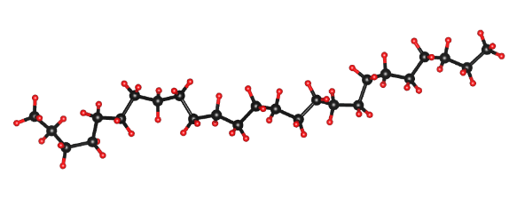
Introduction
Heavy paraffinic oil :
Material classification: liquid lubricant (more specifically known as a solvent-dewaxed heavy paraffinic oil)
  Common uses:
    Circulating oil systems
    Compressors
    Gear casing
  Characteristics:
    High viscosity index
    High film strength
    Excellent stability
    Long lubricant life
Pale appearance with a petroleum oil odor
Paraffin hydrocarbon Alkane general formula: C_{n}H_{2n+2}
Notes:
Heavy paraffinic oil exhibits unique neutronic characteristics which are of interest in reactor physics calculations.
It is generally used as a lubricant in many types of mechanical systems, and it has an alkane structure with the formula CnH2n+2.
This saturated structure is illustrated by the long chain molecule shown here.
Due to their makeup, paraffinic oils exhibit high viscosity indexes and high film strengths, as well as excellent stability.

Slide 6
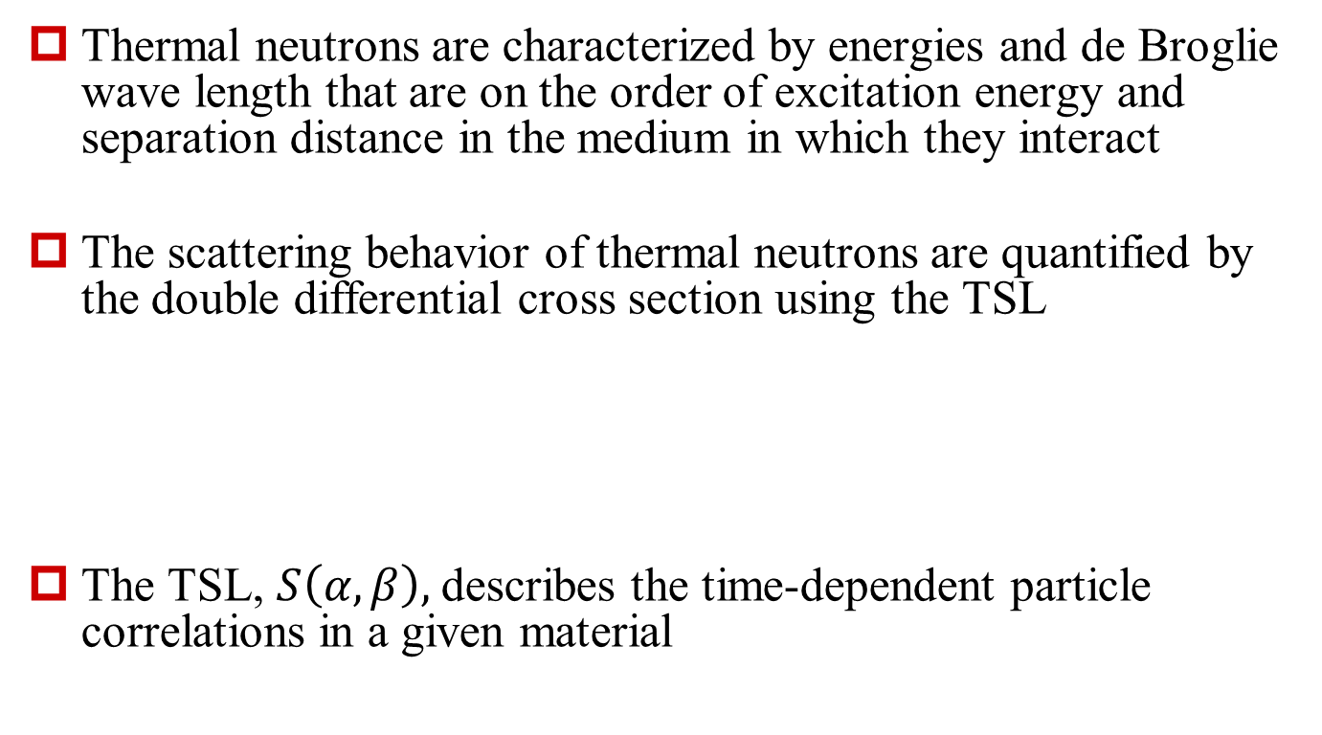
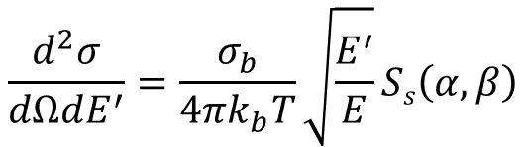
Thermal Neutron
Scattering in Matter
Thermal neutrons are characterized by energies and de Broglie wave length that are on the order of excitation energy and separation distance in the medium in which they interact
The scattering behavior of thermal neutrons are quantified by the double differential cross section using the TSL
The TSL, $S\left(α,β\right),$describes the time-dependent particle correlations in a given material
$$\frac{d^{2}σ}{dΩdE^{′}}=\frac{σ_{b}}{4πk_{b}T}\sqrt{\frac{E^{′}}{E}}Ss\left(α,β\right)$$
Notes:
Given this unique material, we want to understand how neutrons thermalize within it.
So we turn to the double differential cross section, where the thermal scattering law is the material dependent component related to the time dependent particle positions.

Slide 7





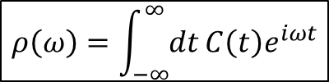
Generation of Inelastic Thermal Neutron Scattering Cross-sections
$$G(r,t)$$
Molecular Dynamics
VACF
Fourier Transform
DOS $ρ$(β)
NJOY
$$S(α,β)$$
Ab Initio
Hellmann-Feynman Forces
Lattice Dynamics
Scattering Cross Section $σ(E)$
$$C\left(t\right)=\frac{1}{N}\sum_{i=1}^{N}{\frac{\left\langle v_{i}(t)∙v_{i}(0)\right\rangle }{\left\langle v_{i}(0)∙v_{i}(0)\right\rangle }}$$
$$ρ\left(ω\right)=\int_{−∞}^{∞}{dt}C\left(t\right)e^{iωt}$$
Notes:
So how do we calculate the thermal scattering law?
Well, there are several ways.
In this work, we focused on generating the needed input from molecular dynamics, from which we can extract the velocity autocorrelation function shown here.
The vacf simply reveals the correlation of atom velocities in time.
If we take the fourier transform of this, we can obtain the density of states in frequency space, which reveals the distribution of available states in a given system.
If we look at S alpha beta, we can see the dependence on the density of states circled in red.
And, once we have s alpha beta, we can generate the cross sections.
(The DOS (Density of States) reveals the distribution of available states in a given system. The DOS may be calculated from the Fourier transform of the VACF (Velocity Auto-correlation Function) from the time domain to the frequency (energy) domain.
The VACF reveals the correlation of atom velocities in time.
Thermal neutron scattering cross-section is determined by self-part of scattering law
Phonon expansion may be used to estimate S(α,β)
Phonon expansion is a series of convolution of phonon density of states representing increasing orders of phonon processes (1-ph, 2-ph, 3-ph, etc.)
Fundamental input is vibrational (phonon) density of states, ρ(ω))

Slide 8

Molecular Dynamics
LAMMPS (Large-scale Atomic/Molecular Massively Parallel Simulator)
  Equilibrium Molecular Dynamics (EMD)
  Non-equilibrium Molecular Dynamics (NEMD): imposed control element (e.g. shear stress) that allows for the calculation of various fluid transport properties (e.g. viscosity)
MD uses semi-empirical forcefields to capture interatomic interactions
PCFF+ potential
  Used to model organic systems comprised of C, H, and O
y
$τ$ shear stress
u
Notes:
Before we can generate the cross sections, we need to develop an MD model that exhibits the same behavior as the oil.
This was accomplished using the LAMMPS code, where Equilibrium MD was used to calculate the density, a static property, and non-equilibrium MD was used to calculate the viscosity, a dynamic property.
MD uses semi-empirical pseudopotentials to capture interatomic interactions, and this work utilized the PCFF+ potential to describe the interactions in an organic system.

Slide 9
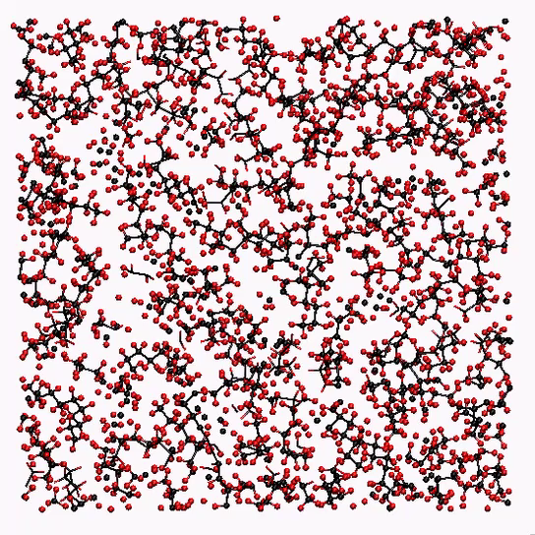
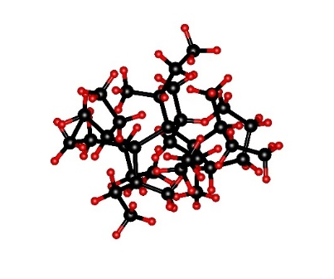
Heavy-Paraffinic Oil Model
10775 atoms
100 molecules
46x46x46 Å³ supercell
Equilibration:
Notes:
In order to capture the correct behavior of the oil, a model was developed with a distribution of 100 molecules, where the average number of atoms per molecule was about 108 …. So pretty big…
The animation shown here, ignoring boundary effects, illustrates the molecular behavior in the system.

Slide 10
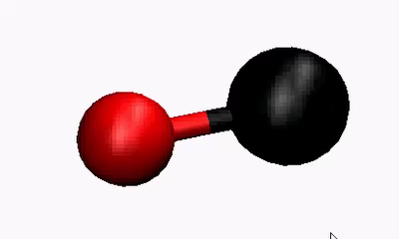
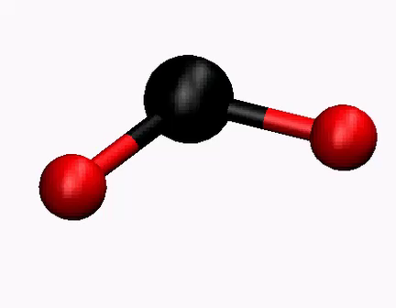
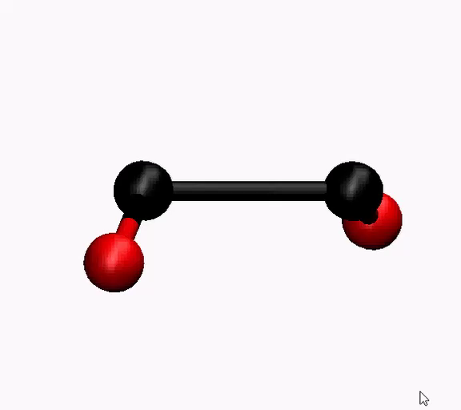
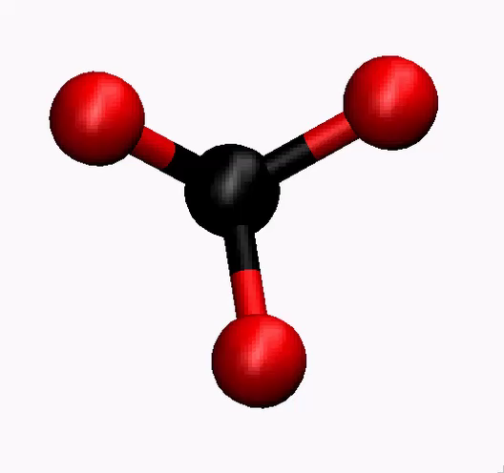
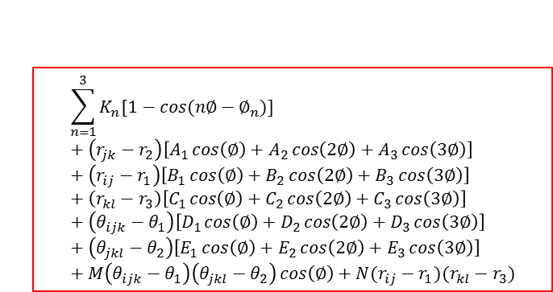
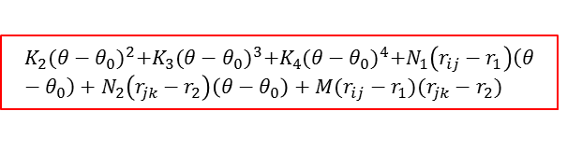



PCFF+ Potential
$$ε\left[2{\left(\frac{σ}{r}\right)}^{9}−3{\left(\frac{σ}{r}\right)}^{6}\right]+\frac{{Cq}_{i}q_{j}}{εr}$$
Pair term (intermolecular) with
Lenard Jones and Coulombic components
$$r$$
$$K_{2}{(r−r_{0})}^{2}+K_{3}{(r−r_{0})}^{3}+K_{4}{(r−r_{0})}^{4}$$
Bond term (intramolecular)
Symmetric/asymmetric stretching
$$r$$
$$K_{2}{(θ−θ_{0})}^{2}+K_{3}{(θ−θ_{0})}^{3}+K_{4}{(θ−θ_{0})}^{4}+N_{1}\left(r_{ij}−r_{1}\right)\left(θ−θ_{0}\right)+N_{2}\left(r_{jk}−r_{2}\right)\left(θ−θ_{0}\right)+M(r_{ij}−r_{1})(r_{jk}−r_{2})$$
Angle term (intramolecular)
Twist (out of plane)
Scissor (in plane)
$$θ$$
$$\sum_{n=1}^{3}{K_{n}[1−cos⁡(n∅−∅_{n})]}+\left(r_{jk}−r_{2}\right)\left[A_{1}\cos\left(∅\right)+A_{2}\cos\left(2∅\right)+A_{3}\cos\left(3∅\right)\right]+\left(r_{ij}−r_{1}\right)\left[B_{1}\cos\left(∅\right)+B_{2}\cos\left(2∅\right)+B_{3}\cos\left(3∅\right)\right]+\left(r_{kl}−r_{3}\right)\left[C_{1}\cos\left(∅\right)+C_{2}\cos\left(2∅\right)+C_{3}\cos\left(3∅\right)\right]+\left(θ_{ijk}−θ_{1}\right)\left[D_{1}\cos\left(∅\right)+D_{2}\cos\left(2∅\right)+D_{3}\cos\left(3∅\right)\right]+\left(θ_{jkl}−θ_{2}\right)\left[E_{1}\cos\left(∅\right)+E_{2}\cos\left(2∅\right)+E_{3}\cos\left(3∅\right)\right]+M\left(θ_{ijk}−θ_{1}\right)\left(θ_{jkl}−θ_{2}\right)\cos\left(∅\right)+N(r_{ij}−r_{1})(r_{kl}−r_{3})$$
Dihedral term (intramolecular)
Rock (in plane)
Wag (out of plane)
Twist
Scissor
$$φ$$
$$K{[\frac{χ_{ijkl}−χ_{kjli}−χ_{ljik}}{3}−χ_{0}]}^{2}+M_{1}\left(θ_{ijk}−θ_{1}\right)\left(θ_{kjl}−θ_{3}\right)+M_{2}\left(θ_{ijk}−θ_{1}\right)\left(θ_{ijl}−θ_{2}\right)+M_{1}(θ_{ijl}−θ_{2})(θ_{kjl}−θ_{3})$$
Improper term (intramolecular)
Twist
Wag
$$χ$$
Notes:
In addition to the molecular structure, the heart of the model lies in the potential.
This potential contains a pair term, comprised of Lenard Jones and Coulombic components, to describe the intermolecular motion, and four intramolecular terms to describe atomic motion within molecules.
The bond term consists of several terms describing both the harmonic and an-harmonic bond behavior.
Similarly, the angle term consists of both harmonic and an-harmonic components as well as additional coupling terms.
The dihedral and improper terms both consist primarily of coupling terms describing the behavior of four atoms bonded together.
If you watch the animations, you will notice some of the in and out-of-plane movements listed beneath each associated term.
We actually used these pseudomolecules to gain insight into the potential and to compare mode energies with the complete model.
(Discuss groups of terms and how they relate to physical motion.)

Slide 11
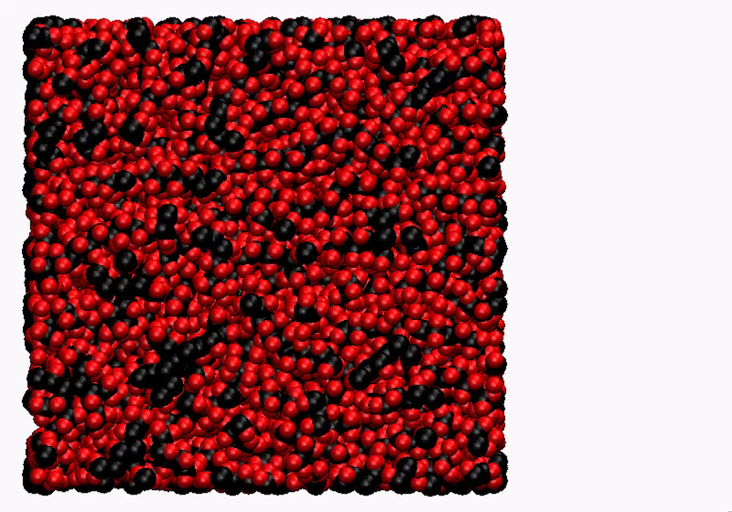

Density and Viscosity
Property | Target Value | Current Simulation Results
Density (300K) [g/cc] | 0.86 | 0.8602 +/- 0.0014
Viscosity (373K) [cSt] | 4 | 3 *work in progress
Shearing Simulation:
$$η=\frac{−τ}{\dot{γ}}$$
Notes:
Once we developed an understanding of the potential, we proceeded to calculate macroscopic properties.
Due to the availability of experimental data and their relevance to neutron thermalization, density and viscosity were chosen as suitable parameters to benchmark against.
As you can see, our model attains good agreement with the target density while our work on viscosity continues to improve.
(Why are these parameters important? Why is validation important?)

Slide 12
Velocity Auto-correlation function (VACF)
Correlative relaxation time: ~ 750 fs
Notes:
Once we recreate the macroscopic behavior of the material, we can turn to the validation of the energy mode structure.
So here we have the vacf over several increasing time spans, where each illustrates the progressive decay of correlated atom motion.
The convergence of the vacf, which occurred over roughly 750 fs in our model, is necessary in order to capture the complete distribution of scattering modes in the density of states.
(Discuss what these plots show as it relates to including the entire correlation range for calculation of the dos.)

Slide 13
Density of States (DOS)
Improper
CH3 deform
~ 0.17-0.18 eV
Dihedral
Coupled CH2 rock
~ 0.09-0.11 eV
Dihedral
Coupled CH2/3 rock/twist
~ 0.11-0.14 eV
Bond
CH stretch
~ 0.36-0.37 eV
Angle
CH2 deform
~ 0.16-0.17 eV
Dihedral
CH2-CH2/3 torsion
~ 0.01-0.04 eV
Notes:
So as we mentioned before, if we fourier transform the vacf, we get the density of states.
Each peak in the dos represents a mode, or cluster of similar modes, that is present in the system.
The highest energy mode, at the far right, is predominantly due to the symmetric and asymmetric stretching of the c-h bond.
The next two peaks from the right are predominantly due to the deformation of the methyl and methylene groups respectively.
The remaining peaks are a result of all sorts of coupled modes involving rocking, twisting, and torsional motion.
It is important to note that each peak ultimately contributes to the total cross section.
(Add exp. Ranges to these peaks and discuss the dos validation process in terms of both the lack of exp. Dos and the commonalities b/t modes in different molecules.)

Slide 14
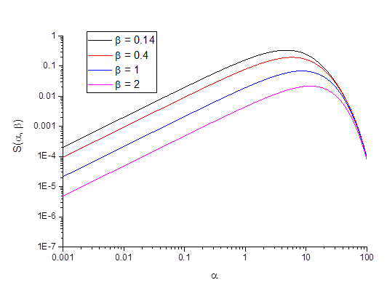

Thermal Scattering Law
The scattering law plotted against $β$ exhibits a maximum in the low energy range
Notes:
Here we show the thermal scattering law calculated from the density of states, plotted against alpha.
The same plot against beta reveals a maximum for low energy transfers, which is further shown in the next slide of the differential scattering cross section.

Slide 15
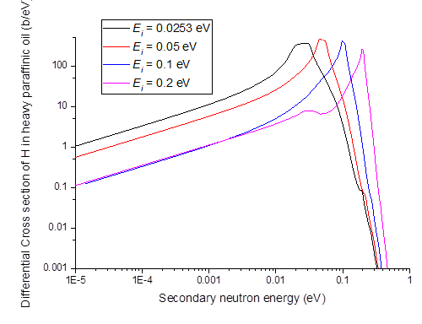
Differential
Scattering Cross Section
Increased scattering mode availability with higher initial neutron energies
~ 0.18 eV
Notes:
If you look at the initial neutron energies and compare them to their secondary energies under each peak, you will notice that they are very close to one another, which is indicative of the small energy transfers mentioned previously.
Also, if you look closely at the black and pink curves, you will notice that the vertical lines shown here cross through two peaks in each.
The lower peak in the pink curve arises due to the presence of a scattering mode from the high peak to the low peak.
Similarly, the small bump around .2 eV on the black curve appears due to the presence of an up-scatter mode, although it is quite suppressed.
The energy difference between the peaks is roughly .18 eV, which interestingly enough, corresponds to the second highest peak in the density of states.
So what you are seeing is the appearance of available scattering modes with increasing initial neutron energies.

Slide 16
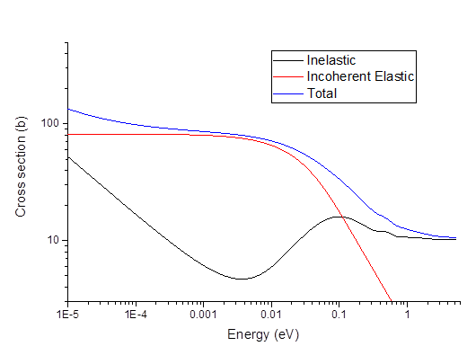
Integrated
Scattering Cross Section
Free atom cross section overshoot due to availability of scatter modes between 0.04 to 0.4 eV
Free atom asymptote
Notes:
If we integrate the differential cross section, we can obtain the total cross section. Where the inelastic component exhibits a couple of interesting features.
If you look closely between .04 and .4 eV, you will notice the cross section rises above the free atom asymptote shown here. This “bump” is due to the presence of scattering modes within this energy range, and the smaller “bump” ,which lies around .37 eV, is a direct result of the high energy, c-h bond mode in the density of states.
So as you can see, the unique energy structure of heavy paraffinic oil noticeably impacts the total cross section. This will result in equally unique behavior in any sort of neutronic environment.
Why not consider carbon?
Less effective at thermalizing fast neutrons
Ratio of H:C is roughly 2:1 in alkanes
Predominantly occupies lower energy modes

Slide 17
Summary
Heavy paraffinic oil is modeled utilizing the LAMMPS molecular dynamics code
The calculated density and viscosity are in reasonable agreement with experimental data
The resulting hydrogen density of states is used to calculate the thermal scattering law
The thermal neutron scattering cross sections are generated for hydrogen in heavy paraffinic oil
Notes:
So to summarize, we have developed an MD model for heavy paraffinic oil.
We have calculated the density and viscosity and found them to agree well with experimental data.
And lastly, we have calculated the thermal scattering law and have used this to generate the thermal neutron scattering cross sections for hydrogen in heavy paraffinic oil.
Thank you for your time.

