Slide 1

Background:
The 2014 U.S. Nuclear Data Program Panel Review recommended:
Office of Nuclear Physics
U.S. Nuclear Data Program Panel Review
5. …
6. USNDP should devise effective and transparent mechanisms to solicit input and feedback from all stakeholders on nuclear data needs and priorities.
7. …
July 16-18, 2014

Slide 2
Workshop on “Nuclear Data Needs and Capabilities for Applications” (NDNCA), Berkeley, May 27-29, 2015
10/20/2015: Whitepaper of workshop submitted to arXiv
4/14/2016: Community-organized Nuclear Data Working Group (NDWG) presented an extensive draft proposal to federal officials from various agencies involved in ND regarding how one might address the needs identified in the NDNCA White Paper. A Federal Interagency Nuclear Data Working Group (INDWG) formed.
6/13/2016: First meeting of the Federal INDWG.

Slide 3
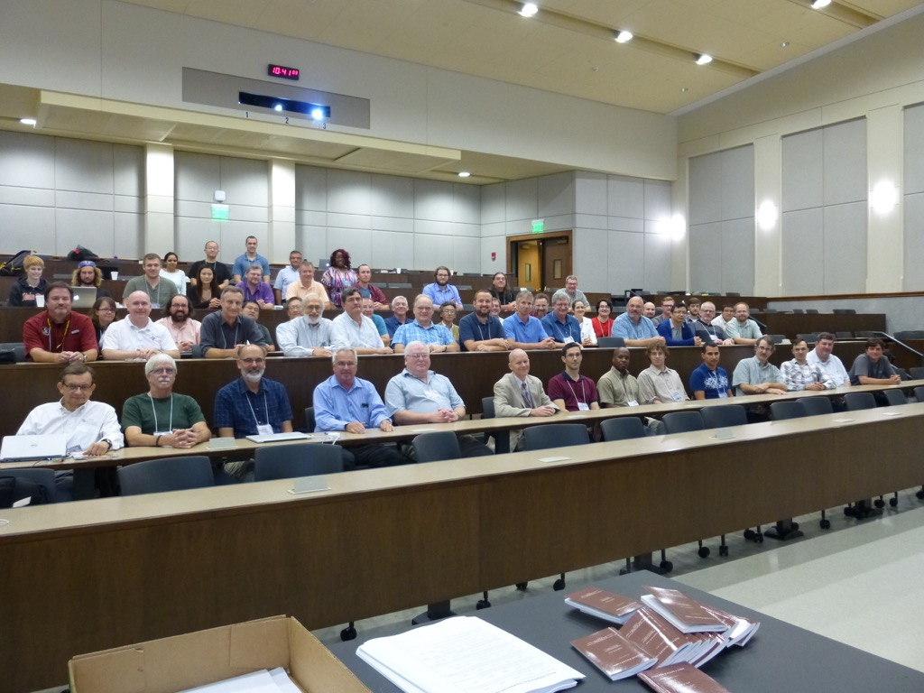
Workshop on “Nuclear Data Needs and Capabilities for Basic Science” (NDNCBS) Notre Dame, August 10-11, 2016
1.5 day workshop in conjunction with the annual Low-Energy Community Meeting
87 participants from 33 different institutions
Organizing committee:
J. Batchelder (Berkeley), T. Kawano (LANL), J. Kelley (NCSU), F.G. Kondev (ANL),
E. McCutchan (BNL), M. Smith (ORNL), M. Thoennessen (MSU), I. Thompson (LLNL)
Thanks to the local organizers Maxime Brodeur, Ani Aprahamian, and the University of Notre Dame staff

Slide 4
Workshop on “Nuclear Data Needs and Capabilities for Basic Science” (NDNCBS) Notre Dame, August 10-11, 2016
The purpose of the was to assemble and prioritize the needs of the nuclear physics research community for data sets and capabilities in areas including:
  Nuclear Structure
  Nuclear Reactions
  Nuclear Astrophysics
  Fundamental Interactions
  Neutrino Physics
A white paper summarizing the workshop discussions should guide future nuclear data activities in those areas that directly benefit the broader nuclear physics research community.
DRAFT
Slides prepared by M. Thoennessen and F. Kondev in preparation of the white paper

Slide 5
Program
9 Overview Speakers:
B. Balantekin (Wisconsin)
A. Brown (MSU)
R. Casten (Yale)
A. Champagne (North Carolina)
H. Crawford (LBNL)
L. McCutchan (BNL)
G. Savard (ANL)
B. Sherrill (MSU)
L. Sobotka (WUSL)
20 Contributed Talks:
M. Almond (ORNL), L. Bernstein (LBNL), M.P. Carpenter (ANL), J. Clark (ANL), J. Greene (ANL), D.J. Hartley (USNA), B. Kay (ANL), T. Koi (SLAC), F.G. Kondev (ANL), H-Y. Lee (LANL), S. Liddick (MSU), E. Olsen (MSU), G. Perdikakis (CMU), M. Redshaw (MSU), A. Rogers (UMass Lowell), K. Rykaczewski (ORNL), H. Schatz (MSU), M. Smith (ORNL), O. Tarasov (MSU), C-Y. Wu (LLNL)

Slide 6
Different interpretation of needs and capabilities
Workshop on Nuclear Data Needs and Capabilities for Applications
Needs: Accurate nuclear data which may have a significant impact on application related calculations and simulations
Capabilities: Experimental facilities available to perform the necessary experiments
Workshop on Nuclear Data Needs and Capabilities for Basic Science
Needs: Existence of complete up-to-date evaluated nuclear data bases as the basis for data interpretation and planning future experiments
Capabilities: Available tools to interpret and analyze the existing evaluated data

Slide 7
USNDP and applications
Innovations
New techniques
New devices
Applications
Experiments
Dissemination
Compilations
Nuclear physics applications (for example isotope production, nuclear security and nuclear energy) continue to strongly depend on the measurement, publication, compilation, and evaluation of experimental nuclear data
Evaluation
Archival
USNDP

Slide 8
USNDP and basic science
Nuclear Physics Community
Theory
Simulations
Computations
DISCOVERIES
Experiments
Dissemination
Compilations
Evaluation
Archival
USNDP

Slide 9
Survey

Slide 10
General comments
D. Hartley: “I am an NNDC evangelist”
R. Casten: “I could not imagine doing my research without the USNDP data bases. It is the first tab in my bookmark bar… They are an incredibly valuable resource.”
H. Crawford: “The role of the USNDP in exotic beam physics is clear and essential to support our science and FRIB science.”
B. Sherrill: “It is obvious that the US Nuclear Data Program is central to basic science.”
Implicit to all presentations:
Assumption that the USNDP data bases are always up-to-date!

Slide 11
Selected examples: Horizontal evaluations

Slide 12
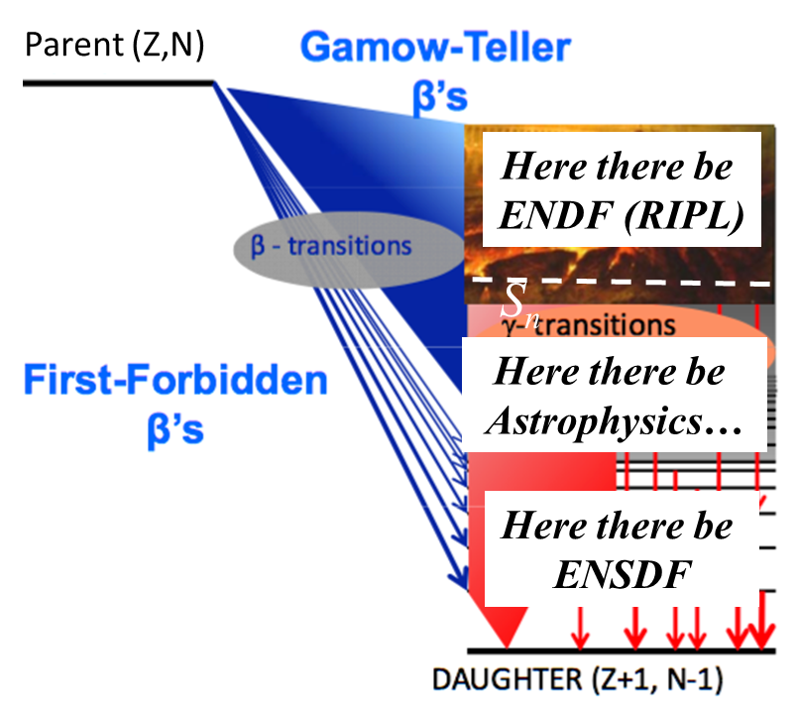
Missing experimental data in ENSDF
Some nuclear observables are best described by continuous quantities:
    Properties of highly-excited,
    quasi-continuum states in
    heavy nuclei (e.g., level density, radiative/particle emission strength)
    β-decay electron/neutrino spectra
    Fission fragment and neutron energy spectra (PFNS)
L. Bernstein modified by B.M. Sherrill

Slide 13
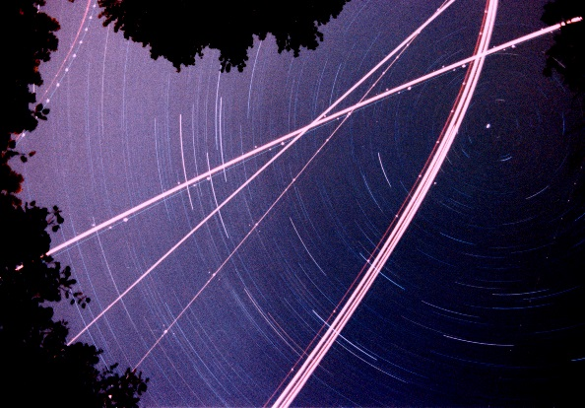
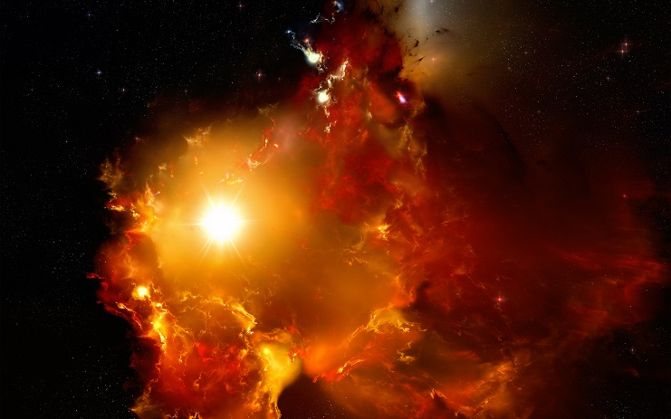
Nuclear astrophysics
Art Champagne: “All nuclear data is relevant to astrophysics at some level”
Hendrik Schatz: “(Data is) at the heart of nuclear astrophysics”
Key data for modeling:
  Masses, weak interaction rates, partition functions
  Neutrino interactions
  Fission, EOS
  Reaction rates
Challenges:
Evaluations lag behind new data
picture credit: Art Champagne
picture credit: https://aswathigalaxy.files.wordpress.com/2012/09/nebula_.jpg

Slide 14
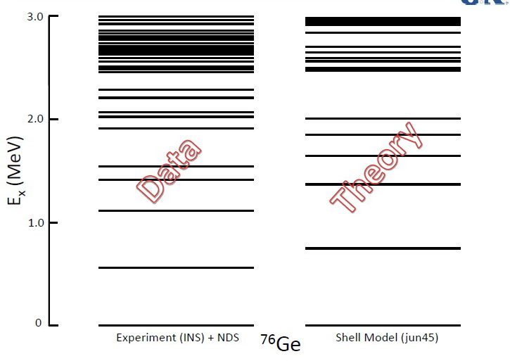
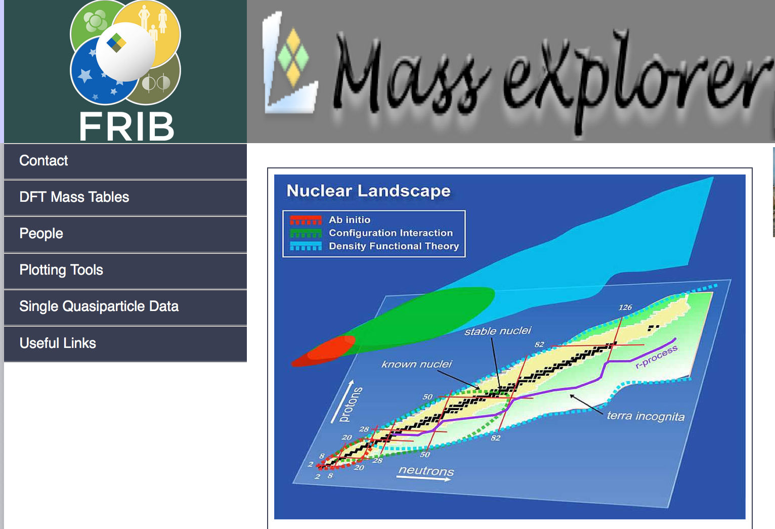
Nuclear theory
Interface theoretical data bases with NNDC data bases
  Modern nuclear theory calculations produce large-scale surveys of nuclear observables.
A close discussion with “users” is necessary to make the resources accessible and most useable.
B.A. Brown
E. Olsen

Slide 15
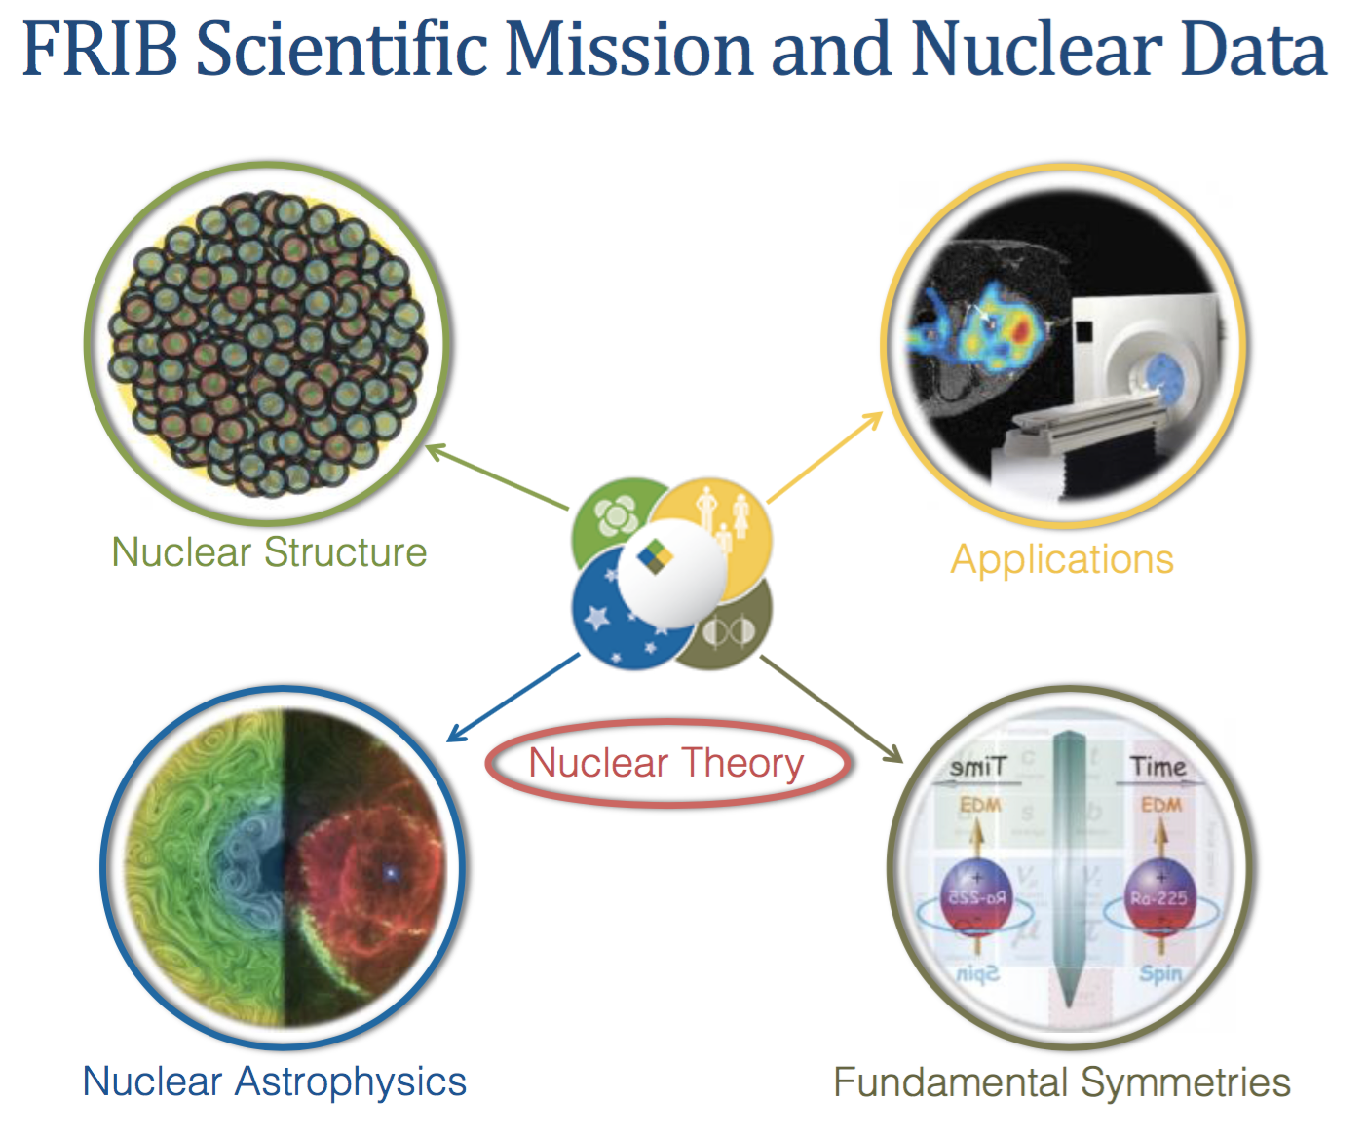
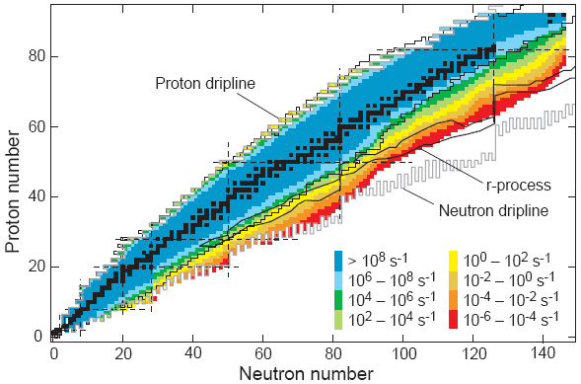
FRIB
FRIB will generate lots of data, but this will only be useful if the data is constantly evaluated and updated.
FRIB mission is intertwined with the data program
Nuclear data is essential for planning and successful execution of experiments
Topical compilations help to highlight specific areas and questions of interest for FRIB physics
Compilations of theoretical calculations would provide an important reference
Experiments will yield multiple results and data archiving becomes important
H. Crawford

Slide 16
Recovery of old data
All historical data are still highly relevant
It would be valuable to digitize angular distributions and cross section data from transfer reactions
Ensure that in the future all primary data are published
B. Kay

Slide 17
Expand USNDP to include theory databases
Nuclear Physics Community
Experiments
Dissemination
DISCOVERIES
Compilations
Evaluations
Theory
Simulations
Computations
Archival
USNDP

Slide 18
Workshop comments
The USNDP is central to experiment and theory in basic nuclear science and nuclear astrophysics
The evaluation, archival, dissemination aspects of the program is critical
There is a need for expanding the data program for astrophysics
There is a need for an expansion of the effort to include theory
In the FRIB era significant new data is coming – How do we archive and make it available? How do we identify what is important?
Must deal with the complexity of new experiments, correlated data (understanding and evaluating errors), continuous quantities, etc.

Slide 19
Proposed actions I
The USNDP must be maintained and improved. Evaluated nuclear structure and reactions data represent the fundamental building blocks of basic nuclear physics research. There is a strong need from the nuclear physics research community for reliable, up-to-date and comprehensive databases of nuclear properties and bibliographical information (see the talks).
Maintain a high level of expertise and activity in the critical area of nuclear structure data evaluation
Continue the active role of the USNDP in research
Expand the scope to include more theory and nuclear astrophysics activities

Slide 20
Proposed actions II
Have data management plans from investigators include submission of measured quantities, e.g. cross sections, which are presented in publications, in an easily readable format
Continue development of new tools and products (software, data evaluation for researchers, …) – maybe hold targeted workshops to address issues like continuous data
Investigate the possibility to offer data-related pre-review of manuscripts (helping to avoid mistakes and errata)
Version controlled publication of ENSDF to allow reproducible citations
Continue the effort to digitize and catalogue old graphical data and obscure publications

Slide 21
White paper status and schedule
Sections of the white paper were drafted by members of the organizing committee in September
First preliminary draft of the white paper was compiled in October by F. Kondev and M. Thoennessen
First draft to be distributed to the organizing committee at the beginning of December
Draft to be distributed to workshop participants and the broader community for comments at the end of December
Final white paper completed by the 2017 budget meeting.

