Slide 1
TUNL Contributions in the US Nuclear Data Program
Nuclear Structure Data Evaluation Program
J.H. Kelley - USNDP Structure Group Leader: (6 months FTE),
J. Purcell (emeritus 0.1 FTE), and G. Sheu (Adm. Assist. 0.75 FTE)
Kent Leung (post doc 0.5 FTE)
We are responsible for nuclear structure evaluation in the A=2-20 mass region
Energy Levels of Light Nuclei reviews published in Nuclear Physics A
ENSDF files for A=2-20
XUNDL from A=2-20
Web interface for A=3-20 Information
This material is based upon work supported by the U.S. Department of Energy, Office of Science, Office of Nuclear Physics.

Slide 2
Recent Evaluation Activities
ENSDF datasets for ⁶n, ⁷H, ¹¹O, ¹⁵F, ^{16,18}B, ¹⁹C
Work in progress:
A=12 Evaluation for “Energy Levels” is essentially complete. To be published in Nuclear Physics A.
Preparing A=12 ENSDF file
Preparing NDS article on A=2
Moving away from NPA articles to ENSDF/NDS
Focusing on ENSDF evaluations of A=13 (&14)
As in past years, we will update a handful of dripline nuclides, including ⁴n, ¹⁸C, ²⁰C. Recent publications increase priority.

Slide 3
Compilation Activities
Committed to XUNDL (A=2-20) since 2009
5-6/month
Compilation of ground state decay & β-decay references and data
Compilation of (p,X) and (α,X) excitation functions
Compilation of thermal neutron capture references and data

Slide 4
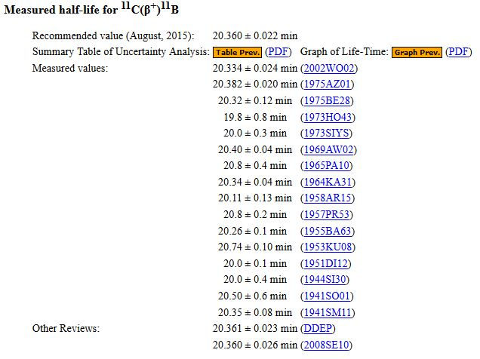
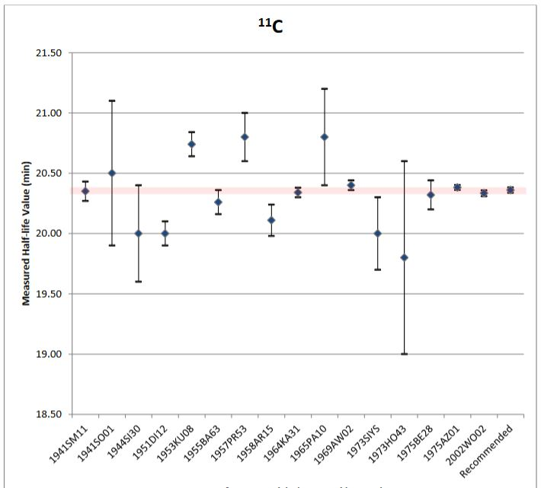
Decay Lifetimes
2015 REU student compiled and evaluated all lifetimes in this nuclear region. This is complete and up-to-date on our page

Slide 5
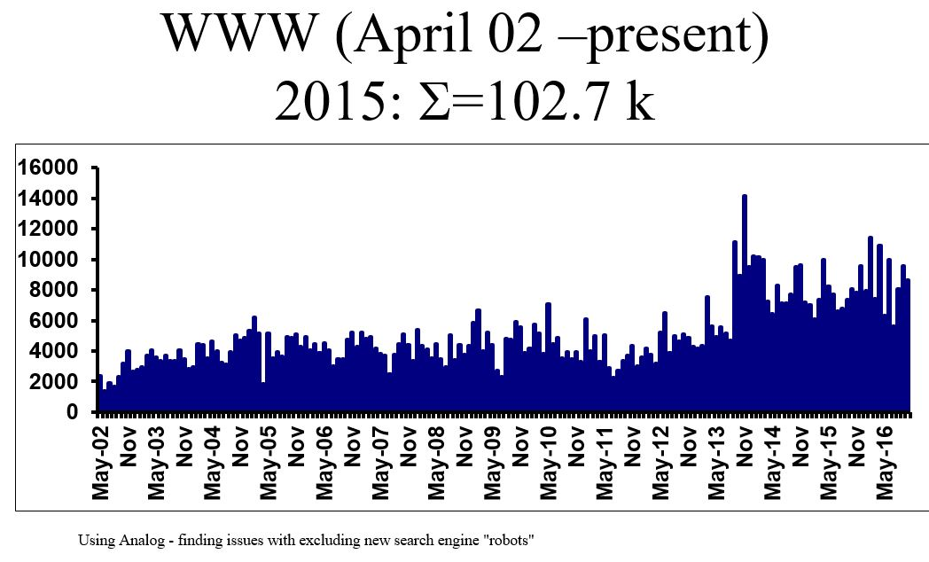

Slide 6
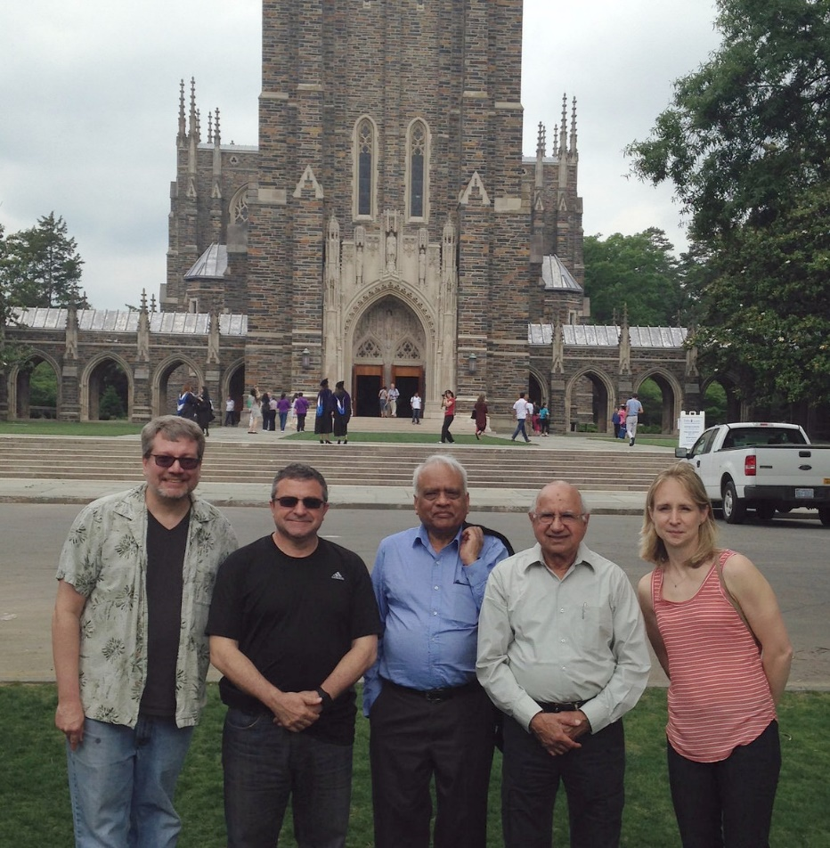
Hosted NDS-Java Workshop
Over the past several years TUNL has become the USNDP “Camp David”, offering a pleasant location for working meetings on:
XUNDL organization
Implementation of NDS-Java
Intensely focused 1-2 day meetings
Problem Solving
Also: Jun Chen and Shamsu Basunia

