Slide 1
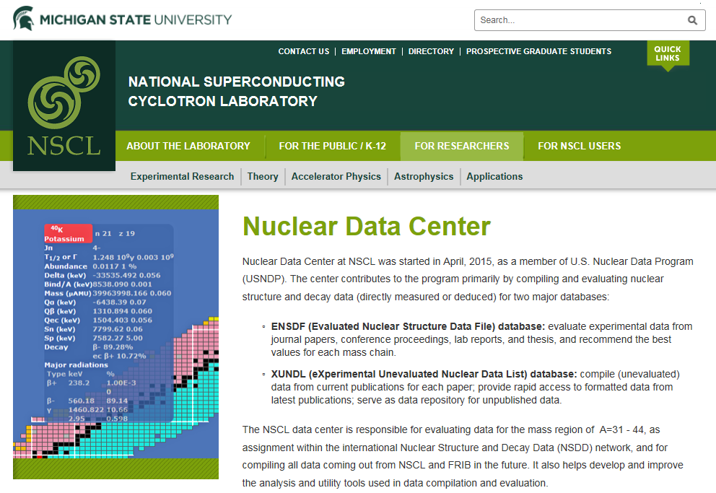
USNDP MSU Report
The MSU Nuclear Data program was launched in December 2014 when Jun Chen was hired as a data evaluator to facilitate the compilation and evaluation of the nuclear structure data from experiments performed at the NSCL.
The program was funded from
2015 – Sep. 2016 via a subcontract
with ANL
At the 2015 IAEA Technical Meeting
of the International Network of
Nuclear Structure and Decay Data
Evaluators in Vienna, MSU was
accepted as an independent Nuclear
Data Center by the IAEA and was
assigned the responsibilities for the
evaluations of the mass chains
A = 31 – 44.

Slide 2
ENSDF & XUNDL work at MSU
ENSDF evaluations:
  responsible for mass region A = 31–44
  additional mass chains from other centers
  with approval (A = 138 from NNDC)
  collaboration with evaluators in their mass
  regions (A = 85, 109, 164, 209)
  completed mass chains at MSU:
  A = 40: 11 nuclides, post-review
  A = 138: 16 nuclides, in review
XUNDL compilations: (FY15: 172 data sets, FY16: 57 data sets)
  responsible for compiling data coming out from NSCL and FRIB in the future
  compiling data from other facilities as well when available
  commitment: 4-5 papers a month

Slide 3
Code development: JAVA-NDS
Modern JAVA program for NDS production (with potential plotting capabilities), started at McMaster in 2007 and now being developed at MSU
JAVA-NDS
Current
JAVA-NDS font: 10pt TimesNewRoman
Current font: 6pt NewCenturySchlbk

Slide 4
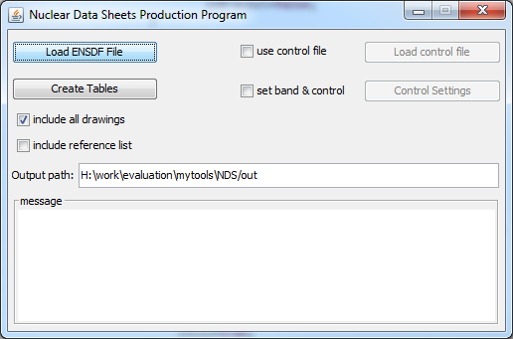
Current status of JAVA-NDS
Fully-functioning version 1.5 released on Nov 8, 2016
Available for downloading in Google Drive; will be available on NNDS website
Applications (other than NDS production):
for ENSDF evaluators: produce pre-review PDF outputs for mass-chain evaluations
for XUNDL compilers: produce PDF outputs for XUNDL compilations
for researchers:
-- future online web-display of ENSDF and XUNDL databases
-- produce level/decay scheme & band drawings (more plotting capabilities to be added)

Slide 5
Plans for next year
ENSDF evaluations:
  2 mass chains (A = 39 and A = 38)
XUNDL compilations:
  50+ papers or 80+ data sets
Code development:
  visualization of ENSDF-format data using JAVA-NDS: implement independent plotting capabilities
  improvements of existing utility and analysis programs, e.g., xls2ens
Other activities:
  collaboration with other nuclear data centers or coordinators for data evaluation and for training of nuclear data personnel
  participation in collaborative research activities on improving nuclear structure data at NSCL and other facilities

Slide 6
Improve data compilations
An experiment is only completed once all the results have been compiled.
As experiments get more expensive, it is important to extract the maximum amount of data possible from each experiment and to publish all results.
Experiments, from which the data and results do not get published and compiled are a huge waste of effort, resources and money.
All published results should be made available in a readable format including all relevant underlying physics results.
Example:
Intensities were measured but not given on the paper

Slide 7
Tools exist I
Submit supplementary data to journals!

Slide 8
Tools exist II
Submit supplementary data directly to NNDC to be included in XUNDL database!

Slide 9
Tools exist III
Submit extra data to designated data journals!

Slide 10
Benefits and plan
Benefits:
Utilizing these tools ensure that all data are properly archived.
It makes the compilation efforts of the USNDP evaluators more efficient.
Plan at NSCL:
Encourage and train current NSCL users to submit all data to journals and NNDC.
Interact directly with users at the time of submission of results.
Establish a process to ensure publication of all data.

