Slide 1
New database for Beta-delayed Neutron emitters
Balraj Singh
(McMaster University, Hamilton, Canada)
US-NDP meeting at BNL
November 17, 2016

Slide 2
Beta-delayed neutrons
In neutron-rich nuclides, beta-delayed neutron decay mode occurs when Q(β-) >S(n) (daughter nucleus), a process known soon after the discovery of fission: R.B. Roberts et al., Phys. Rev. 55, 510 & 664 (1939)
Two or more neutron emission mode occurs when Q(β-) >S(2n), S(3n), etc. Quantified in terms of P(1n), P(2n), etc., as probabilities of neutron emission per 100 decays of the precursor.
Half-lives and P(1n), P(2n),.. values for the decay of neutron-rich nuclides throughout the nuclear chart are of interest.
Amongst all the experimentally known nuclides, ~600 are energetically possible beta-delayed neutron emitters (600 for 1n-; 290 for 2n-; 100 for 3n-; and 60 for 4n-decay modes).
So far, while half-life measurements are available for most of these nuclides, P(1n) values have been measured for 227 cases, P(2n) for 24 nuclei, P(3n) for 6, and tentative P(4n) for only B-17.
Until a PRL 117, 012501 (July 2016) article, for A>150, a tentative P(n) value was available for only one isotope: Tl-210 decay (1961St20: G. Stetter: TID-14880 (1961) report of a DOE-contracted research project at the University of Vienna, Austria)

Slide 3
Relevance of B-dn database
Nuclear structure of neutron-rich nuclides, models
Applications in nuclear astrophysics: r-process in nucleosynthesis; see e.g. articles from Univ. of Notre dame astrophysics group:
The Sensitivity of r-Process nucleosynthesis to Individual β-Delayed neutron
Emission Probabilities: JPS Conf. Proc. 6, 010010 (2015); and related articles:
PRC 94, 055802 (Nov 2016); Prog. Part. and Nucl. Phys. 86, 86 (2016)
Reactor physics applications for nuclides produced in the fission process, e.g. fission of U-235, U-238 and Pu-239. Back in 1954, extensive delayed-neutron program at LANL produced 6-group and 8-group parameterizations based on precursor half-lives or Keepin parameters: G.R. Keepin et al., Phys. Rev. 107, 1044 (1957).

Slide 4
How we got involved with the project
In 2010, Christoph Scheidenberger and Iris Dillmann at GSI suggested a collaborative project to compile and evaluate B-n data. Iris is nuclear astrophysicist, and now at TRIUMF. She has experience in developing the KADoNiS (Karlsruhe Astrophysical Database of Nucleosynthesis in Stars) database for applications in s- and p-processes.
Keeping in view reactor applications of beta-delayed neutron precursors, in 2011, I suggested to IAEA-NDS whether such a project could be undertaken under the auspices of the IAEA. Subsequently, a consultants’ meeting was held Oct 10-12, 2011 at the IAEA, attended by 8 participants from GSI, McMaster, NNDC, Valencia, Madrid and IAEA. (INDC(NDS)-0599 report, Dec 2011).
The project was approved as an IAEA-CRP in Aug 2012 for 2013-17.
First research coordination meeting (RCM) was held at the IAEA Aug 26-30, 2013, attended by 20 participants from 10 countries, representing 16 laboratories (INDC(NDS)-0643 report, March 2014).
Second RCM held at the IAEA, March 23-27, 2015: progress reviewed. (INDC(NDS)-0683 report, July 2015).
Third and final RCM planned in June 2017.

Slide 5
Objectives of the IAEA-CRP (2013-2017) for a Reference Database of Beta-delayed neutron emission data
New experimental measurements at several major nuclear labs.
Theoretical calculations of P(xn) and half-lives, in addition to those by Moller et al. Phys. Rev. C 67, 055802 (2003); At. Data & Nucl. Data Tables 66, 131 (1997)
Empirical systematics of P(n), half-lives and Q values, in addition to those of Kratz and Hermann: Z. Phys. 263, 435 (1973).
Compilation and evaluation of half-life and P(xn) data. (Previous compilations outdated or incomplete: see 2011 Consultants’ meeting report)
Creation of a reference database at IAEA-NDS for microscopic i.e. properties of individual precursors, as well as microscopic quantities i.e. aggregate properties of fissile materials of interest. Details are listed in the summary report of the first RCM in 2013.
I will describe mainly the on-going compilation and evaluation work.

Slide 6
B-n data for Z=2-28
McMaster Univ: Balraj Singh, Michael Birch
TRIUMF: Iris Dillmann
NNDC, BNL: Alejandro Sonzogni, Libby McCutchan, Tim Johnson
CNEA, Argentina: Daniel Abriola
This work was completed in 2015 and published.
The paper went through a detailed review by 3 experimentalists, deeply involved with the B-delayed neutron measurements at various laboratories. Available neutron spectra were also digitized for EXFOR.

Slide 7
Empirical systematics for Z=2-28 region
Using formulation in:
E.A. McCutchan, A.A. Sonzogni, T.D. Johnson, D. Abriola, M. Birch and B. Singh: PRC 86, 041305(R) (2012)
Using formulation in:
K.L. Kratz and G. Hermann: Z. Physik 263, 435 (1973)
Another systematic formulation of P(n) vs. Q(B-n) is based on level-density systematics, where no T1/2 is used: K. Miernik: PRC 88, 041301 (2013)

Slide 8
Tables and Data Files
a. Table of recommended half-life and Pn data file with complete
bibliography (list of references hyperlinked to NSR database)
b. Table of nuclides and Q-values for possible P_{1n}, P_{2n}, P_{3n} precursors (based on AME-12)
c. Table of compiled data for P_{1n}, P_{2n}, P_{3n} and half-lives with
all available references, including some secondary
publications.
d. Supplementary Table of comments for Pn and half-life
measurements; made available, but not published
e. Above data exist in three .excel files (Q values for relevant nuclides, recommended Pn and half-lives, compiled data for Pn and half-lives) These files were sent to IAEA-NDS in 2015 for setup of B-DN database by Marco Verpelli and Vivian Dimitriou at IAEA-NDS.

Slide 9
B-n data for Z>28
McMaster Univ: Balraj Singh, Liang Johnson, Michael Birch:
Z=30-40, 49, 50; checking/editing of data from other
groups, overall coordination; preparation of publication;
digitizing available neutron spectra for EXFOR database
TRIUMF: Iris Dillmann: detailed checking, plots, publication.
NNDC, BNL: Alejandro Sonzogni, Libby McCutchan, Tim Johnson:
Systematics, detailed checking, publication.
CIAE, Beijing: Xiaolong Huang, MengXiao Kang, Jimin Wang: Z=51-57
VECC, Kolkata: Gopal Mukherjee, Kaushik Banerjee: Z=41-48. Digitizing
available neutron spectra
Univ. of Valencia: Alejendro Algora: Z>57
CNEA, Argentina: Daniel Abriola: Z=29
IAEA-NDS: Marco Verpelli, Vivian Dimitriou: Database setup,
update and maintenance

Slide 10
Z>28 region: current status
First draft of Excel tables for all the Z>28 nuclides is almost ready and will be sent to collaborators at NNDC and TRIUMF by mid December for generating systematics, charts of nuclides, and detailed checking of compiled and evaluated data.
This draft will also be sent to the Marco Verpelli and Vivian Dimitriou for inclusion in the trial database, and distribution to CRP participants interested in calculating macroscopic or aggregate quantities for the fission nuclides of interest.
Later we will update all the data files to be consistent with AME-2016 values, as well as for newly published data.
Expected submission of paper by summer 2017.

Slide 11
Progress on other fronts of CRP
Experiments: 17 papers published 2013-2016, mostly from ORNL in PRC.
Commissioning of BRIKEN for beta-delayed neutron measurements: November 2016 (happening now!)
Commissioning of DESCANT (coupled to GRIFFIN) at TRIUMF for beta-delayed neutron measurements: May 2015
Macroscopic quantities: 5 publications from CRP participants in Russia
Theoretical calculation of half-lives and P(xn),x=0-5 for 5409 n-rich nuclei (pn-RQRPA and covariant density-functional theory):
T. Marketin, L. Huther, G. Martinez-Pinedo, PRC 93, 025805 (2016)
5 other theory papers: from CRP participants in Russia and Japan.
Empirical systematics: 2 papers in PRC in 2012, 2013

Slide 12
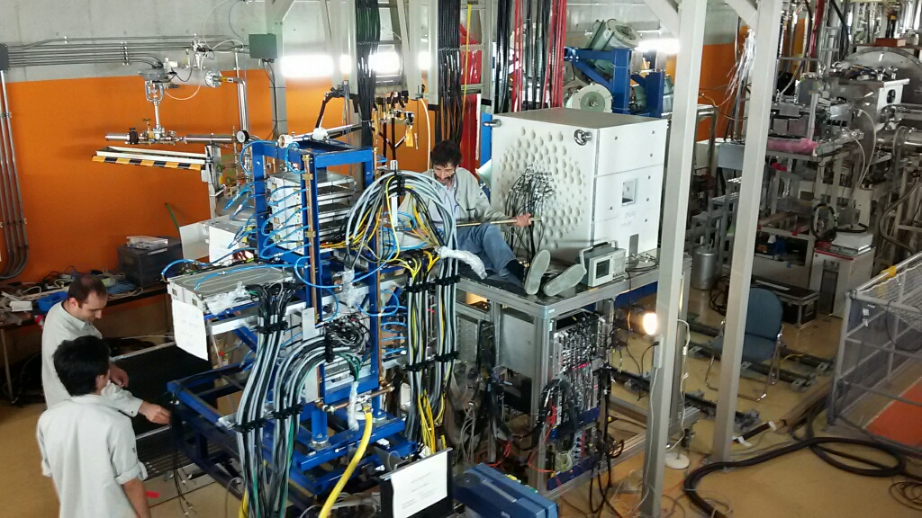
BRIKEN Setup at RIKEN (July 2016)
BRIKEN Collaboration: RIKEN, Valencia, ORNL, TRIUMF, UPC-Barcelona, Edinburgh
Setup: July 2016
Commissioning: Nov. 2016

Slide 13
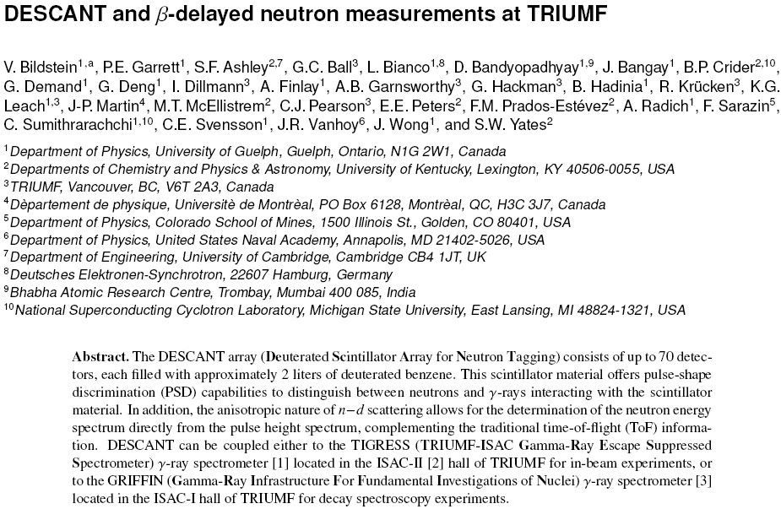
EPJ-Web of Conferences 93, 07005 (2015)

Slide 14
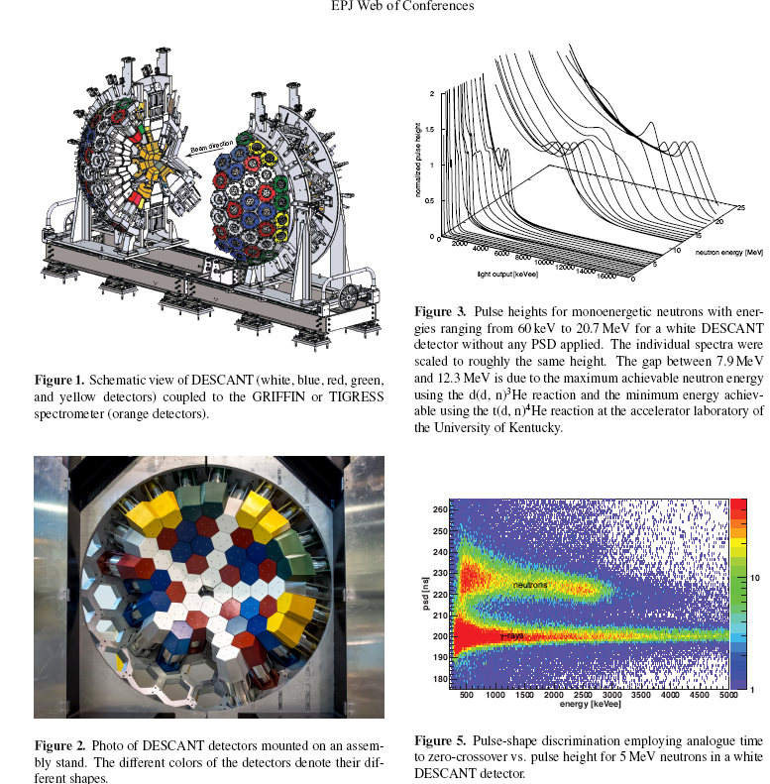
DESCANT-GRIFFIN/TIGRESSS at TRIUMF
EPJ-Web of Conferences 93, 07005 (2015)

Slide 15
Example: compiled data

Slide 16
Example: recommended data

