Slide 1



Update on the Nuclear Data Working Group (NDWG)
Lee Bernstein
Nuclear Science Division - Lawrence Berkeley National Laboratory
Department of Nuclear Engineering – UC Berkeley
Dave Brown
National Nuclear Data Center – Brookhaven National Laboratory

Slide 2
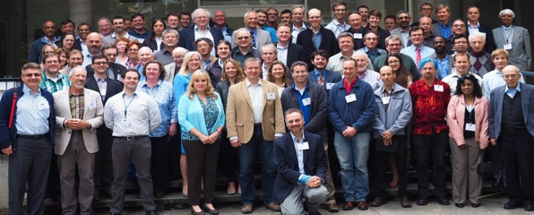
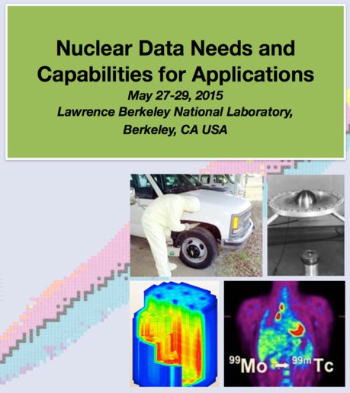
NDWG Timeline
NDNCA Workshop (5/2015)
Nuclear Data Exchange Meeting Presentations to Program Managers (4/2016)
NDNCBS Notre Dame
(8/2016)
NDNCA Whitepaper release (10/2015)
Interagency Nuclear Data Working Group (PMs) (6/2016)
Now
USNDP Review (7/2014)
Nuclear Data Working Group
(C. Romano – ORNL)
DOE-NP, DOE-NE, NNSA, DTRA, DNDO
(11/2015, 12/2015,
2/2016, 3/2016)
NSSC Renewal
w/new Nuclear Data Crosscutting Area (10/2016)
New USNDP Mission Statement: …. The USNDP also addresses gaps in the data, through targeted experimental studies and the use of theoretical models.

Slide 3
NDNCA led to the Nuclear Data Working Group (NDWG) to look for ways to jointly fund high-priority nuclear data needs
Presentations were made in Washington on April 14, 2016

Slide 4

The Nuclear Data Working Group under the leadership of Cathy Romano (ORNL) developed a multi-agency 5-year proposal to address cross-cutting nuclear data needs
Proposals presented to Program Managers from DOE (7 offices), DTRA and DHS - Washington DC (4/14/16)
Revitalizing the Nuclear Data Pipeline
Expanding Covariance Data and its use
Improved Scattering Data for Neutron Transport
Upgrading Capture Gamma-ray Data in ENDF
Improvised Theory, Modeling and Evaluation of Fission Fragment Yields
Nuclear Fission Experiments
Reestablishment of Actinide Target Production Capabilities
DOE-NP is leading a new Interagency Group of Program Managers charged with determining how to address these needs

Slide 5
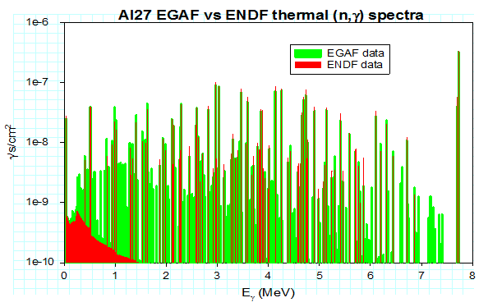
The non-USNDP NDWG Proposals
The NDWG met three times to develop a joint plan and “down select” to a list of the “most important” topics
All experimental proposals included an evaluation component
7 topics made the cut and the USNDP is involved in 4 or them
Capture Gamma Data (Brad Sleaford)
Fission Experiment
(Todd Bredeweg)
Actinide Targetry
(C. Romano)
ENDF Chain Yields

Slide 6
Improved Neutron Transport : Conversion Electron and Neutron Spectroscopy for Understanding Scattering (CENSUS)
Summary of Tasks
(n,n’) on the “Big 3” actinides are very poorly known*
Task 1: Measure outgoing neutron energies using the Chi-nu spectrometer with new detectors developed at RPI
Task 2: Develop a conversion electron spectrometer (CENS) to definitively identify scattered neutrons over fission neutrons
Task 3: Mount an experimental using Chi-nu + CENS to campaign at neutron facilities with complementary capabilities throughout the world
Task 4: An evaluation campaign where embedded evaluators train students as they produce improved (n,n) cross sections
Evaluation
CENS/BESCA (ORNL)
+ Chi-nu (LANL)
*NDS 108 (2007) 2589–2654
Nucl. Sci. Eng.: 81, 491-511 (1982)

Slide 7
And now for Dave…

Slide 8
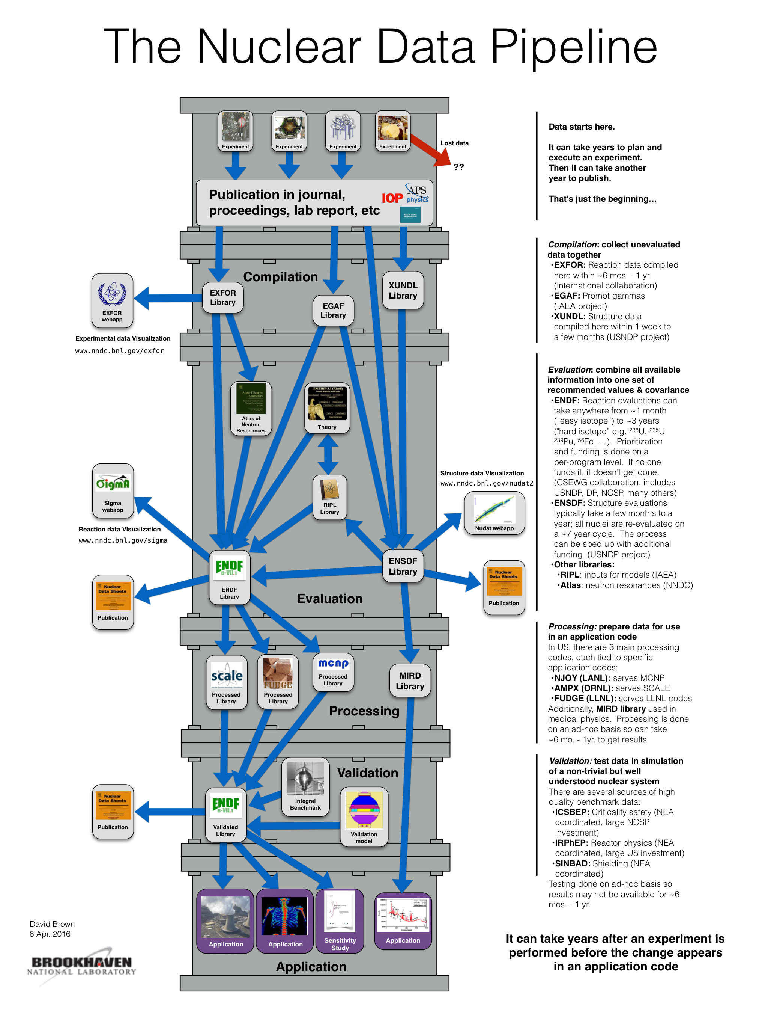
Revitalizing the Nuclear Data Pipeline
Summary of Tasks
Task 1: Nuclear structure data infrastructure modernization Innovation is hobbled by a legacy punchcard format
Task 2: Nuclear data table quality assurance Eliminate a major bottleneck to getting data to users through benchmark automation
Task 3: Processing code quality assurance Processing codes feed applications, QA essential
Task 4: Data visualization and web modernization Visualize reaction and structure data on both open and closed computer systems

Slide 9
Expanding Covariance Data and its use
Summary of Tasks
Task 1: Expand the ENDF Format: Allow more complete covariance information to be included in evaluated nuclear data files.
Task 2: Expand ENDF Checking Codes: Allow for verification of these covariance data.
Task 3: Expand ENDF Processing Codes: Permit translation of these covariance data from general purpose evaluated data file(s) to end-user defined application specific files.
Task 4: Expand Application Code Capabilities: Allow for more sophisticated and comprehensive end-user simulations of problems of programmatic interest.
Task 5: Expand End-User Training: Provide end-users with the knowledge how to properly interpret the application code results
Δσ/σ vs. E_{n} for ²³⁵U(n,el)
Δσ/σ vs. E_{n} for ²³⁵U(n,f)

Slide 10
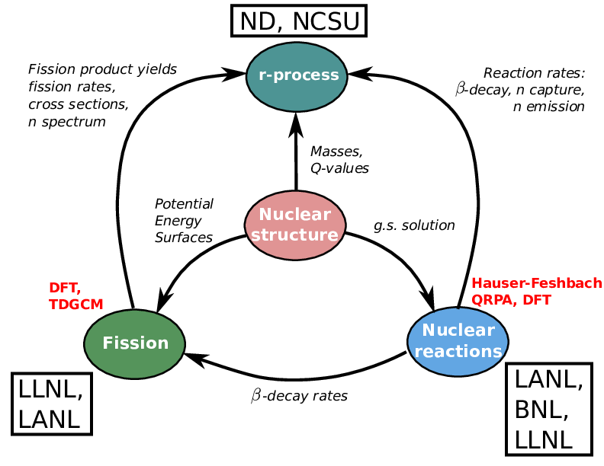
Newly Funded Activity: FIRE—Fission In R-process Elements
Incorporate state-of-the-art fission models developed at NNSA laboratories into simulations of the r-process
  Participants: LLNL (lead), LANL, BNL + Notre Dame, North Carolina State University
  Jointly support by DOE/NP and NNSA/NA221
Calculated r-process abundances depend crucially on masses, separation energies, decay rates (β-decay, γ-emission, fission), capture rates, etc.
Fission has a major impact on the r-process
  Fission properties are by far the most uncertain data for r-process simulations
  NNSA laboratories have developed advanced capabilities to describe fission
  Fission may be the key to pinpointing the location of the r-process

Slide 11
Summary and Path Forward
Following the 4/14 meeting the program managers formed an Interagency NDWG (Comments Ted?)
The is already an increased focus on nuclear data
  NA-22 support for Nuclear Data Activities (Talou venture renewed, FIRE, Nuclear Data Area in the NSSC…)
  FOAs featuring nuclear data - FY17 DTRA-BAA, FY17 DNDO-ARI included the NDNCA whitepaper Appendix A, FY18 DNDO lab call included NDWG targetry support…
  FY18 NA-22 lab call: Nuclear Data for Nonproliferation Applications: As a cross-cutting, enabling capability that underpins nearly all aspects of nonproliferation science, there is desire for significant improvements in nuclear data, theory, and library tools relevant to the nonproliferation mission. The emphasis of nuclear data measurements or theory must be explicitly applied to solving current or future needs for the nonproliferation mission.

Slide 12
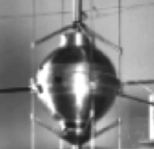
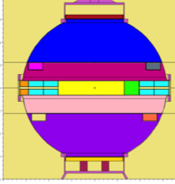
Improved Neutron Transport : Conversion Electron and Neutron Spectroscopy for Understanding Scattering (CENSUS)
P.G. Young et al., , Nuclear Data Sheets 108 (2007) 2589–2654
G. Haouat et al., Nucl. Sci. Eng.: 81, 491-511 (1982)
Evaluation
BRC09 (CEA)
k_{eff}=1.00082(11)
ENDF-VII.1
k_{eff}=1.00060(12)
How does k_{eff} change when a BRC09 value is replaced by one from ENDF-VII.1?
Quantity | Δk_{eff} (1000th’s of %)
Fission | -138
Capture | +269
Elastic Scattering | -638
Inelastic Scattering | +522
BESCA (HRIBF) + Chi-nu (LANL)
The end result is a lack of confidence in modeling systems that significantly differ from the integral benchmark

Slide 13
The NDWG is having impacts on new RFPs
Following the April 14 meeting the program managers formed an Interagency Nuclear Data Working Group (I-NDWG) to pursue paths forward
The is already some sign of an increased focus on nuclear data
  Last DTRA-BAA, DNDO-ARI included the NDNCA whitepaper App. A and the NDWG targetry language
  NA-22 support for Nuclear Data Activities (Talou venture renewed, Nuclear Data Area in the NSSC…)
Some proposals are getting funded now…
Any comments Ted?

Slide 14
NDNCA led to the Nuclear Data Working Group (NDWG) to look for ways to jointly fund high-priority nuclear data needs
Partners | Program Manager | Program Area | Working Group Member | Lab
NA-22 | Jim Peltz/David Beach | Enabling Capabilities / Nuclear Weapons and Material Security Teams | Catherine Romano | ORNL
DOE/OS/NP | Ted Barnes/ Tim Hallman | Nuclear Data | Lee Bernstein | LLNL
NA-22 | Tom Kiess | Forensics / Post Det. | Todd Bredeweg/Jason Burke | LANL/LLNL
DNDO / TAR | Namdoo Moon | Nuclear Detection | Doug Mayo | LANL
NA-511/ NCSP | Jerry McKamy | Criticality Safety | Skip Kahler | LANL
DTRA | Dave Peterson | Basic Research/Forensics/ detection | TBD
NA-113 | Ralph Schneider Staci Brown | Defense Programs/ Research and Development | Dennis McNabb | LLNL
NA-114 | Douglas Wade Adam Boyd | Defense Programs/Physics and Engineering Models | Bob Little | LANL
NE | Rob Versluis | Nuclear Energy | Phillip Finck | INL
DNDO / NTNFC | William Ulicny Jeff Morrison | Forensics | Richard Essex | NIST
NA-45/83 | Tom Black/Steve Goldberg | Nuclear Technical Forensics | Bob Rundberg | LANL
NA-82 | Rick Christensen | Nuclear Threat Science | John Maenchen
Presentations were made in Washington on April 14, 2016

