Slide 1
Streaming Workshop: ePIC/Protocols/Interface/Timing/Clock Distribution
Fernando Barbosa (JLab), L3 CAM Electronics
December 9, 2022

Slide 2
Outline
Requirements and Design Philosophy
Streaming Readout Architecture
Readout Chain
Channels
eRD109 ASIC/Electronics
Timeline
Summary

Slide 3
Requirements and Design Philosophy
Front-End Boards custom designed for each detector, populated with ASICs/COTS, operate in large magnetic fields.
ASICs/COTS process analog signals and digitization tailored to each type of detector technology, data reduction (e.g., zero suppression) desirable.
Maximize synergies in electronics and minimize cabling.
Electronics, including digitizers, close to the detector as much as possible and where applicable.
Prefer to limit FPGA use inside detector volume.
Serviceability as a design criteria.
Triggerless operation of the electronics as default; triggered operation for calibration, test, de-bugging.
Meet current US standards per NEC, UL, FCC, NEMA:
Equipment assessment reviews for conformance to EHS&Q.
Radiation levels at EIC are much lower than at LHC by O(100). EIC detector radiation map has been updated and will guide formulation of electronics requirements for radiation hardness/ tolerance.

Slide 4
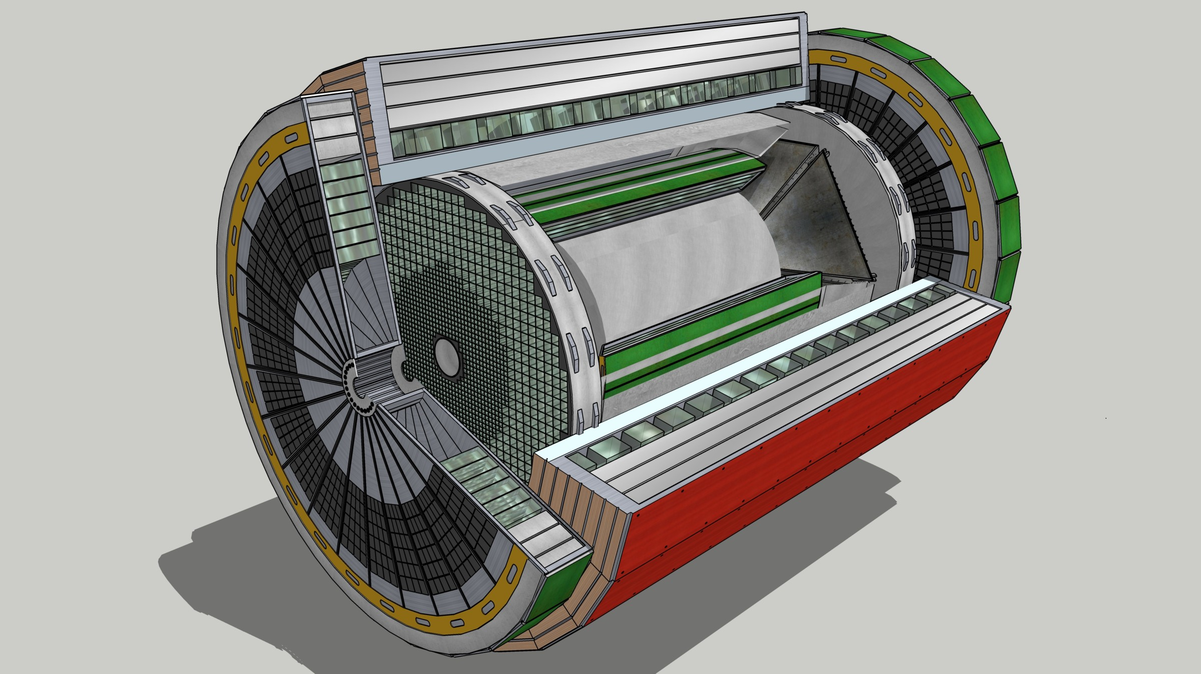
EIC Streaming Readout Architecture
Front-End Electronics
DAQ
Detector
FEB
(Front End Board)
RDO
(Readout Board)
DAM + Computing (Data Aggregation Module)
Total
BW: O(100 Tbps)
BW: O(10 Tbps)
GTU
(Global Timing Unit)
Bunch Crossing ~ 10.2 ns/98.5 MHz
Event Rate ~ 2 us/500 kHz
Low occupancy.
L ~ 100 m
fiber
Jitter ~ 5 ps
ASIC
Goal: O(100 Gbps)
Fiber
Switch / Server / Link-Exchange: Readout
Switch / Server: Processing
Switch / Server: Buffer
FEB
Storage
FPGA
Fiber
Monitoring
RDO
FEB
LVDS ~ 20-30 m*
Analog ~ 20m
Power Supply System
(HV, LV, Bias)
Cooling Systems
Data
Configuration & Control
Power
*LVDS – ANSI/TIA/EIA-644A standard. Maximum cable length dependent on data rate.
w/ Jin and Kai

Slide 5
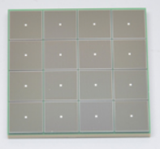
EIC Readout Chain
Global Timing Unit (GTU)
-Interfaces to Collider, Run Control & DAM
-Config & Control
-Clock & Timing
On Detector
SMT BGA
Name
Design
Function
Attributes
Sensor
Detector Specific
-Multi-Channel Sensor
-MAPS
-AC-LGAD
-MPGD
-MCP-PMT
-SiPM
-LAPPD
Adapter
Detector Specific
-HV/Bias Distribution
-HV divider
-Interconnect Routing
-Sensor Specific
-Passive
Front End Board
(FEB)
Detector Specific
-Amplification
-Shaping
-Digitization
-Zero Suppression
-Bias Control & Monitoring
-ASIC/ADC
-Discrete
-Serial Link
Readout Board
(RDO)
Few Variants
-Communication
-Aggregation
-Formatting
-Data Readout
-Config & Control
-Clock & Timing
-FPGA
-Fiber Link
Data Aggregation Module (DAM)
Common
-Computing Interface
-Aggregation
-Software Trigger
-Config & Control
-Clock & Timing
-Large FPGA
-PCIe
-Ethernet
Computing
Common
-Data Buffering and Sinking
-Calibration Support
-QA/Scalers
-Collider Feedback
-Event ID/Building
-Software Trigger
-Monitoring
-COTS
-Ethernet

Slide 6
ePIC Detector Channels
Note: Some of these entries have not been updated to the current number of sensors.
Detector System | Channels | Nominal Readout Technology
Si Tracking: 3 vertex layers, 3 sagitta layers, 4 backward disks, 5 forward disks | 7 m^2 32 B pixels 5,200 MAPS sensors | MAPS
MPGD tracking: 3 layers | 100k | Strips
Calorimeters: Forward: LFHCAL pECAL HCAL inset Barrel: HCAL ECAL Imaging, if used Backward: ECAL | 60k 25k 8k 3k (25k?) 8k 50M pixels 25k | SiPM
Far Forward: B0: 3 MAPS layers 1 or 2 AC-LGAD layer 2 Roman Pots 2 Off Momentum ZDC: Crystal Calorimeter 32 Silicon pad layer 4 silicon pixel layers 2 boxes scintillator | 3x20cmx20cm (300M pixel) 300k or 600k 1M (4 x 135k layers each) 650k (4 x 80k layers each) 400 11520 160k 72 | MAPS AC-LGAG AC-LGAD AC-LGAD APD HGCROC
Far Backward: Low Q Tagger 1 Low Q Tagger 2 2 Calorimeters | 1.3M 480k 700 | AC-LGAD AC-LGAD
PID-TOF | 3M-50M | AC-LGAD
PID-Cherenkov: dRICH pfRICH (if selected) mRICH (if selected) DIRC | 300k 225k 74k | SiPM SiPM SiPM
The five (5) eRD109 proposals to be considered, cover most of the EIC readout requirements.
And may extend to others.

Slide 7
Readout Channels & eRD109 proposals
Note: Some of these entries have not been updated to the current number of sensors.
Detector Group | Channels | AC-LGAD | SiPM/PMT | MPGD
 | MAPS | AC/DC-LGAD | SiPM/PMT | MPGD
Tracking | 32 B |  |  | 100k
Calorimeters | 50M |  | 150k
Far Forward | 300M | 2.3M | 500
Far Backward |  | 1.8M | 700
PID |  | 3M-50M | 600k
TOTAL | 32 B | 7.1M-54M | 750k | 100k
ASIC | ITS-3 | EICROC | Discrete/COTS HGCROC3 ALCOR-EIC | SALSA
These ASICs are leading candidates for the EIC. The large number of channels, density, granularity and geometry favor high circuit density solutions.
We continue to assess ASIC developments from other sources such as NALU, Pacific Microchip, Alphacore, SenseICs, Weeroc.
Some sub-detectors, with less restrictive requirements, may benefit from discrete implementations and developments such as from STAR and sPHENIX.

Slide 8
Readout Channels Updates
An example of recently updated information – Calorimeters (in P6):
ePIC
Detector System | Nominal Readout Technology | # Sensors | Grouping | # Readout Channels
Calorimeters: | SiPM
Forward: LFHCAL | 3x3 mm | 63280 | 2::1 | 31640
pECAL | 6x6 mm | 76000 | 4::1 | 19000
Barrel: HCAL | 3x3 mm | 7680 | 5::1 | 1536
ECAL | 3x3 mm | 130560 | 16::1 | 8160
Backward: ECAL | 3x3 mm | 52000 | 16::1 | 3256
nHCAL | 3x3 mm | 16200 | 5::1 | 3240
 |  |  | TOTAL | 66832
# Calorimeter Digitizer Channels
Allows for a proper estimate of input characteristics (capacitance, dark noise, etc.) and PCB layout and size.
Allows for proper cost estimates in P6 (i.e., Project) and scaling.

Slide 9
eRD109 ASIC/Electronics
R&D initiatives to develop front end readout solutions for EIC.
Five (5) proposals were received and originated from various EIC sub-detector groups. These cover the R&D efforts for ASICs and Electronics in support of the EIC detector readout:
Proposal | File | Authors | Sub-Detector | Sensor Type | Readout Solution
A | eRD109_pECAL_readout_prototype_FINAL | G. Visser (IU), et al. | Calorimeter | SiPM | Discrete, COTS, ASIC
B | eRD109CalorimeterReadout | N. Novitzky (ORNL), et al. | Calorimeter | SiPM | ASIC (HGCROCv3)
C | eRD109-alcor | M. Ruspa (INFN), et al. | dRICH | SiPM | ASIC (ALCOR)
D | ACLGAD_ASIC_Electronics_FY23 | Z. Ye (UIC), et al. | Central, Far-Forward | AC-LGAD | ASIC (EICROC1, FCFD1) (2)
E | eRD109_SALSA_proposal_vfinal1 | D. Neyret (CEA), et al. | Micromegas, GEM, MicroRWell | MPGD | ASIC (SALSA)

Slide 10
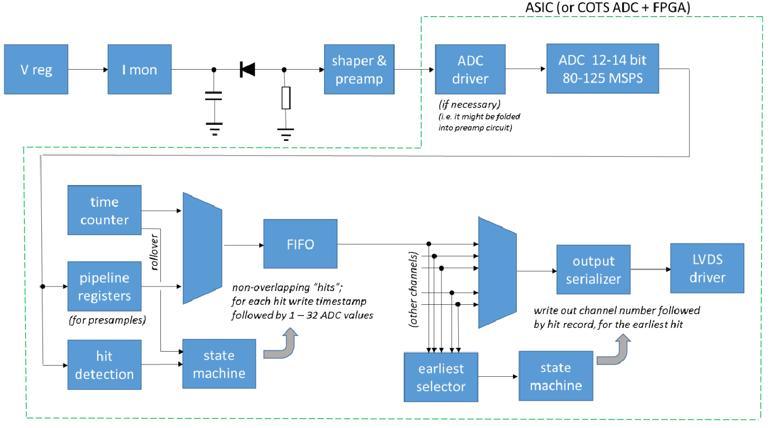
Proposal A – Calorimeters, SiPMs – Discrete/COTS/ASIC
eRD109 ASIC/Electronics
R&D initiatives to develop front end readout solutions for EIC.
Develop a simple, high resolution waveform readout solution for the calorimeters with SiPMs by:
Employing discrete, COTS devices.
Developing PCBs for full readout chain.
Developing cabling, power, cooling infrastructure.
Making it adaptable to implementations that may benefit from the availability of ASICs.
FEB PCBs
Adapter PCBs
Based on STAR FCS.

Slide 11
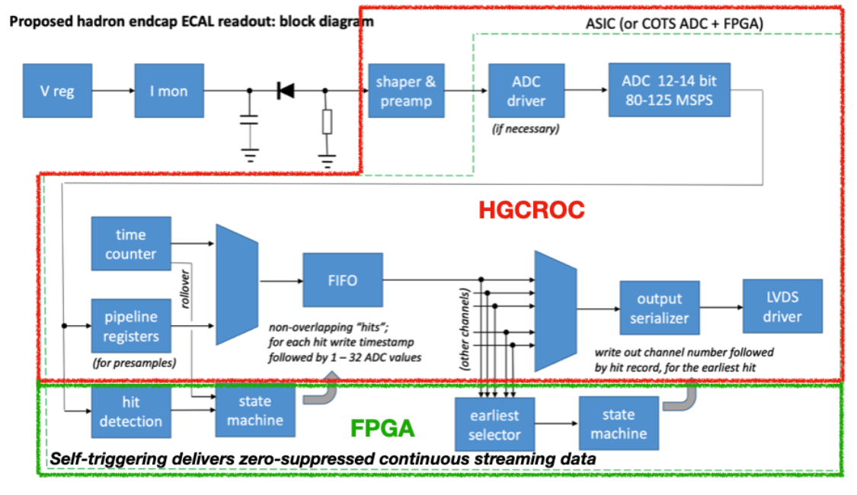
Proposal B – Calorimeters, SiPMs – HGCROCv3
Develop a readout solution for the calorimeters with SiPMs by:
Employing existing HGCROCv3 ASIC
Developing PCBs for full readout chain
Developing cabling infrastructure
FEB PCBs
Adapter PCBs
RDO PCBs

Slide 12
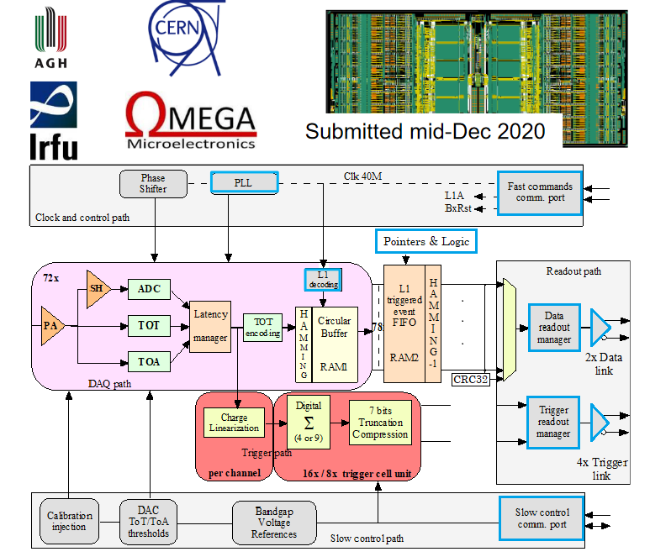
SiPM version.
Large dynamic range.
Low noise.
Charge: ADC+TOT.
Time: TOA (25 ps).
512 DRAM buffer.
2x 1.28 Gbps links.
I2C controls.
40 MHz operation.
20 mW/Ch.
Radiation tolerant.
Developed for CMS.

Slide 13
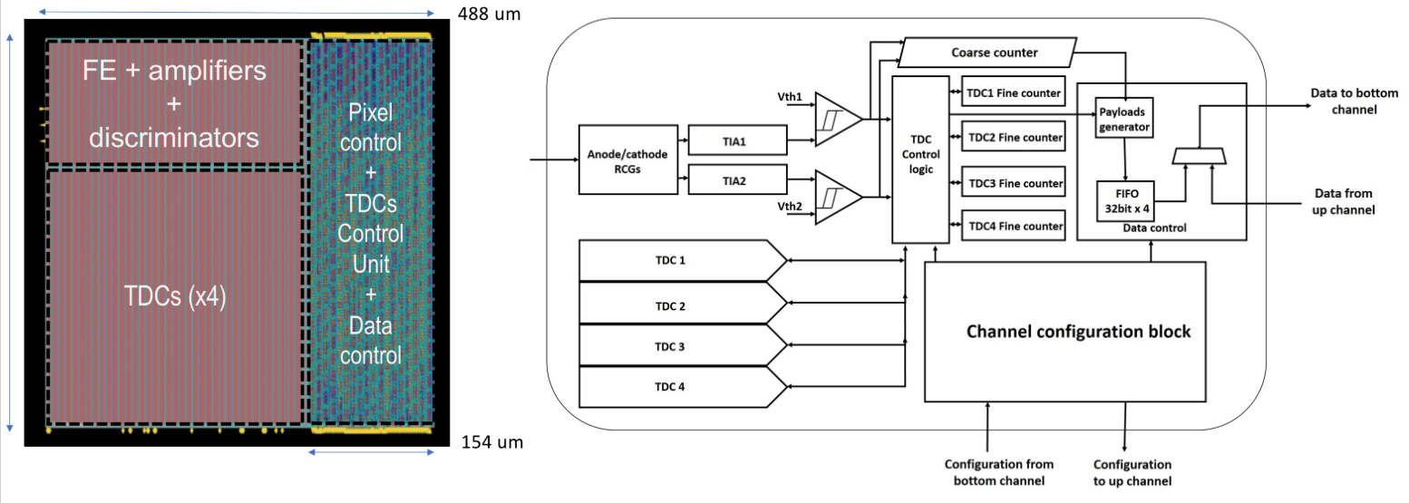
Proposal C – dRICH, SiPMs – ALCOR
Develop a readout solution specific to the dRICH with SiPMs by:
Qualifying existing ALCOR v2 ASIC.
Further development and refinements towards final ALCOR v3.
64-Ch, 110/65 nm CMOS, SiPM readout.
Dual polarity, RCG Amplification, conditioning, digitization.
Modes of operation: single-photon tagging or time and charge.
Triggerless and triggered operation.
25 ps TDCs, 5 MHz input.
4 or 8x 640 Mbps LVDS links.
SPI configuration.
Originally developed by INFN for DARKSIDE.

Slide 14
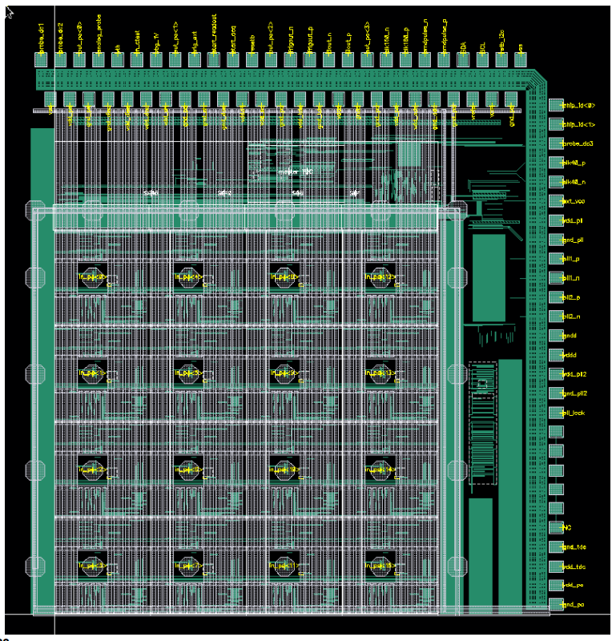
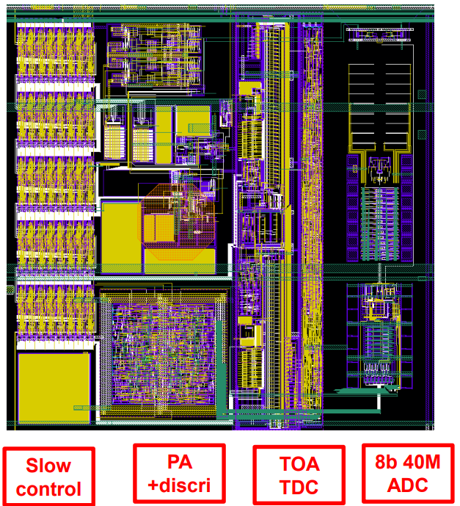
Proposal D – AC-LGAD (Low Gain Avalanche Diode) – EICROC
Develop a readout solution for AC-LGADs by considering three (3) options:
Develop the EICROC2 based on existing EICROC0 (4x4 pads):
EICROC1 (8x4 or 16x4 pads): 2023
EICROC2 (32x16 or 32x32 pads): 2024 - 2025
One pixel – EICROC0
4x4 500 um pixels
Preamp, discriminator – ATLAS ALTIROC.
I2C slow controls – CMS HGCROC.
TOA TDC – CEA-Irfu.
ADC (8b) – AGH Krakow and IJCLab (EICROC1, EICROC2).
Readout FIFO depth 8 (200 ns).
Jitter: 15-20 ps.
Power: 1-2 mW/Ch.
Collaboration by OMEGA/IJCLab/CEA-Irfu/AGH
One pixel

Slide 15
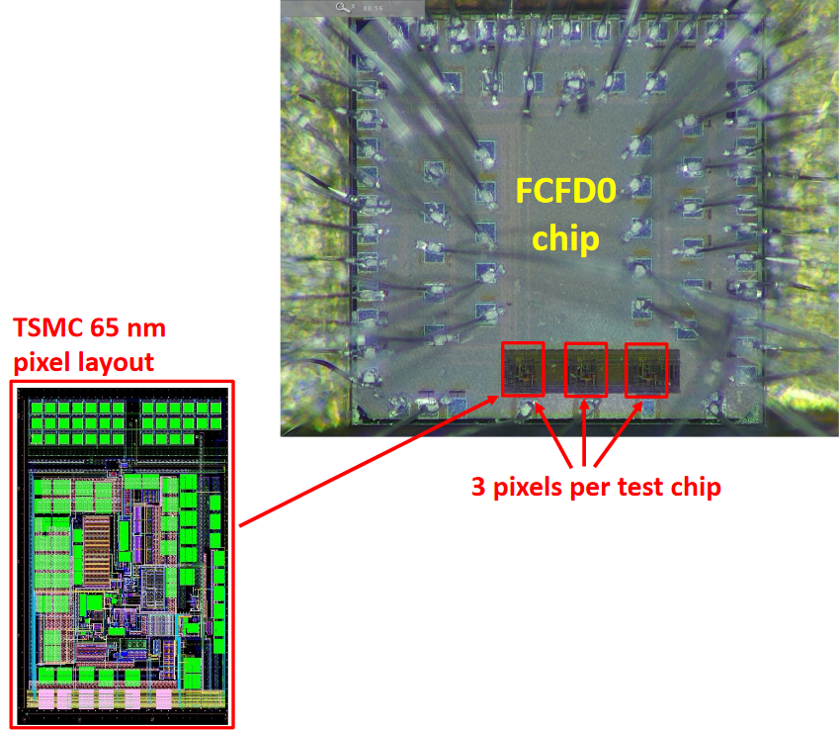
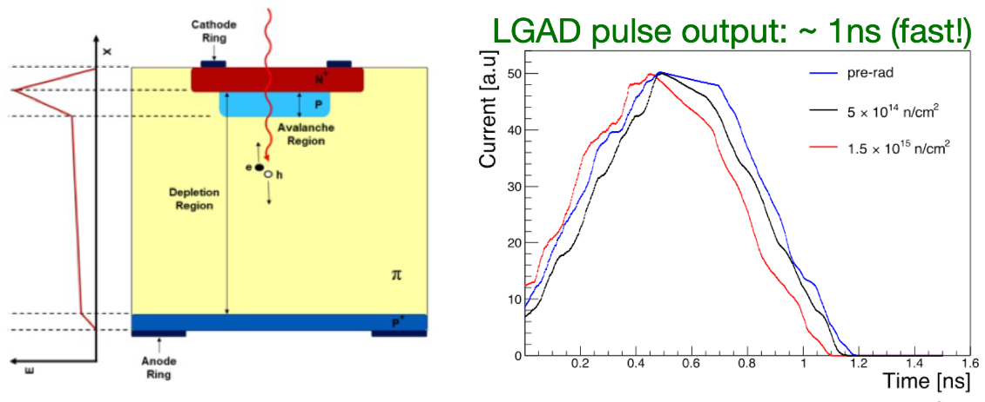
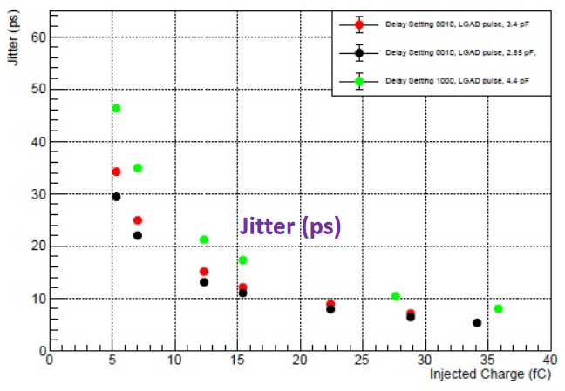
Proposal D – AC-LGAD (Low Gain Avalanche Diode) – FCFD (Fermilab CFD), …
2. Develop the FCFDv2 based on existing FCFDv0:
FCFDv1: 2023
FCFCv2: 2024 - 2025
TSMC 65 nm.
Timing precision: ~30 ps @ 5 fC; <10 ps @ 30 fC.
3. Investigate third-party ASIC solutions, e.g.:
HPSoC – NALU.
ASROC – Anadyne.
FAST – INFN.
…

Slide 16
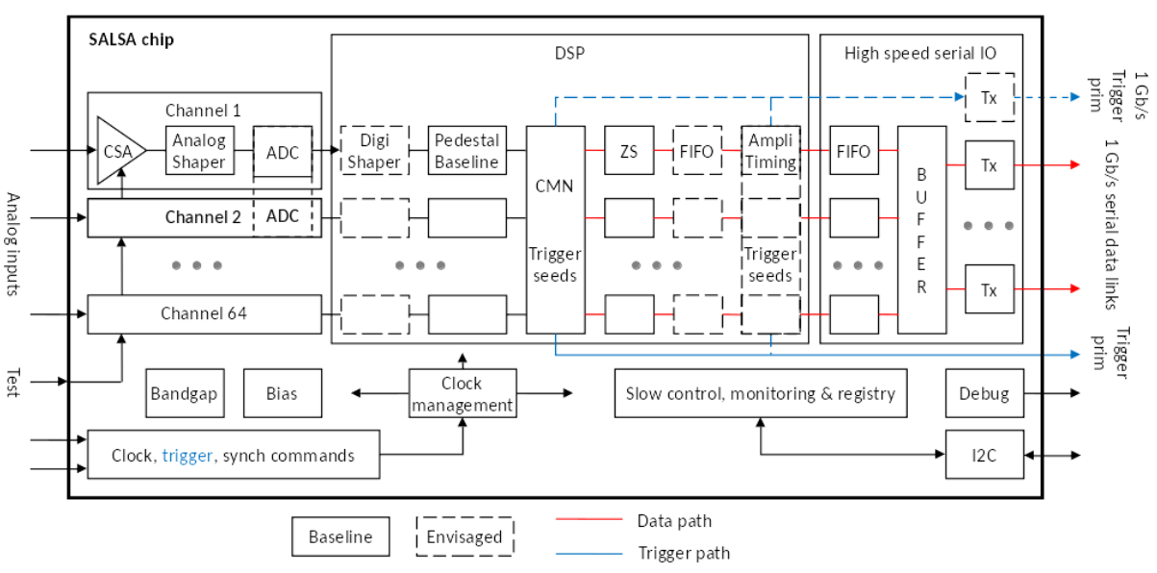
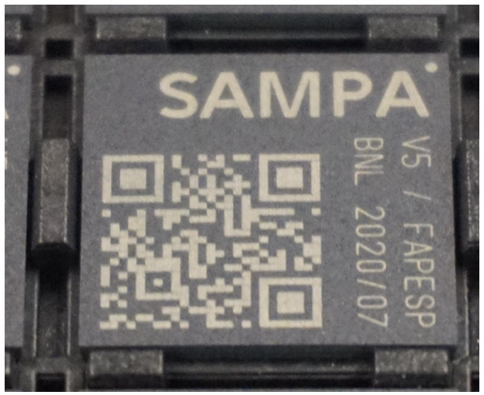
Proposal E – MPGD (Micro-Patterned Gaseous Detectors) – SALSA
Develop a readout solution for MPGDs, based on previous ASICs:
SALSA1: 2023
SALSA2: 2024
SALSA (pre-production): 2025
64-Ch, updated design from SAMPA V5, migrating to 65 nm CMOS.
Peaking time: 50 – 500 ns
Inputs: Cin optimized for 200 pF; Rates: >25 kHz/Ch (~100’s kHz); Dual polarity.
ADC: 12 bits, 5 – 50 MSPS.
Extensive data processing capabilities.
Triggerless and triggered operation.
Power: 15 mW/Ch
Several 1 Gbps links.
I2C configuration.
SALSA prototype submission – late 2022 ( a few channels).
Collaboration of Irfu CEA Saclay and U. of São Paulo.

Slide 17
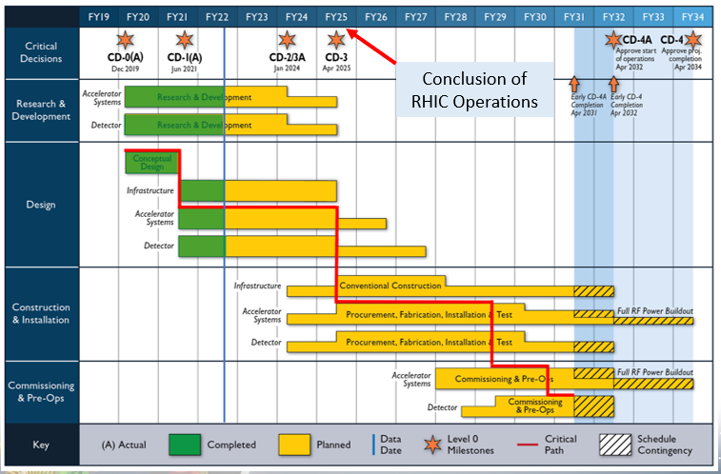
Timeline
Construction and Installation includes procurements and deliveries and are initiated at different times of this phase.
R&D until 4/2025.
(Most~1.5 Years)
Design until 9/2027.
(Most~2 Years)
4/2025 to 4/2031.
(~6 Years)
Bulk of Construction & Installation phase for Electronics: April 2025 – January 2030.
Installation of some items may be extended to April 2031.

Slide 18
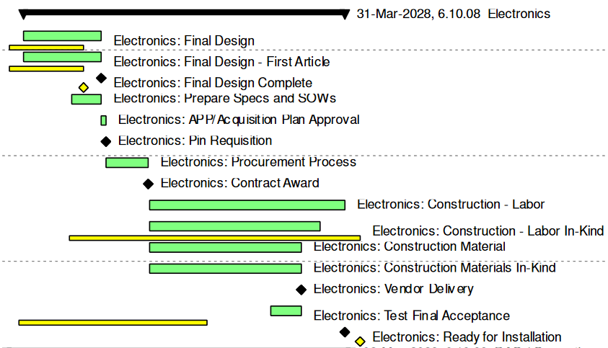
Timeline (cont.)
Resource loaded schedules were earlier developed for the Reference Detector (CD-1) and then for the ECCE selected proposal.
ePIC presently follows the ECCE proposed schedule.
Summary Gantt chart for Electronics WBS 10.06.08 (internal tasks not shown for simplicity)
Resource loaded schedules have just been submitted for updates to the Primavera P6.
These will be transitioned over the next 6 months to the final ePIC schedule towards CD-2.
DOE OPA Status Review: January 31-February 2, 2023 (Primavera P6 towards final version).
CD-2 – Baseline: Review October 2024/ Approval January 2025
CD-3 – Construction Phase: Review TBD/ April 2025 – April 2031

Slide 19
Summary
A very active technical review schedule:
Electronics&DAQ – August 2022
eRD109 DAC – October 2022
Calorimeters – December 2022
More to come.
Start funding eRD109 activities ASAP.
Need to finalize detector sensor and readout channel count, normalize nomenclature, finalize specifications.
Transition resource-loaded schedules to final ePIC P6 by June 2023.

