Slide 1
Overview of the Large Area Picosecond Photodetector − LAPPD™
Shawn S. Shin
Associate Research Scientist
Incom, Inc.
Melvin J. Aviles, Stephen M. Clarke, Stefan Cwik, Michael R. Foley, Cole J. Hamel, Alexey V. Lyashenko, Derrick O. Mensah, Michael J. Minot, Mark A. Popecki, Michael E. Stochaj
Incom, Inc., Charlton, MA, USA

Slide 2
Outline
Introduction
Capacitively Coupled LAPPD Performance
High Rate Picosecond Photodetector (HRPPD) Preliminary Results
Ongoing Efforts

Slide 3
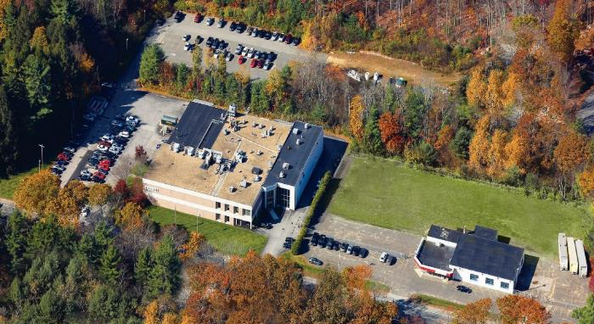
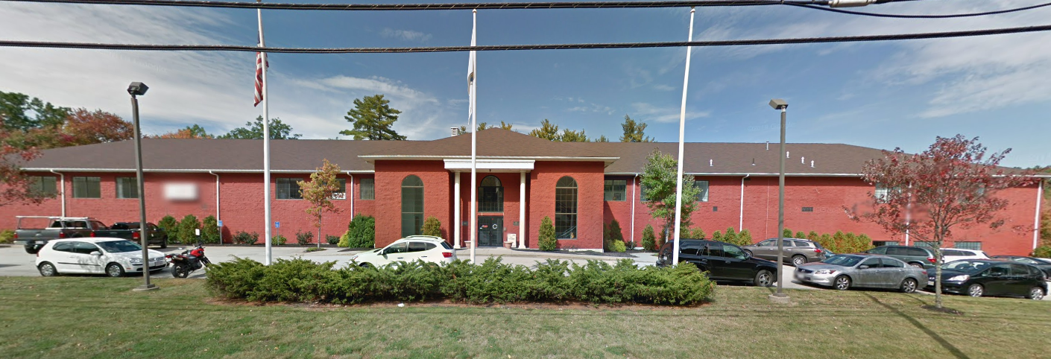
Incom, Inc.
Founded 1971
~175 employees
Three facilities:
  Incom West – Vancouver, WA
  Incom East (2) – Charlton, MA
    LAPPD Pilot Production by Detector Business Unit (DBU)
HQ Main Plant
Detector Pilot Production Facility

Slide 4
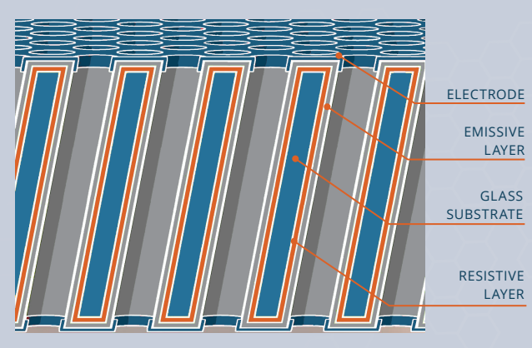
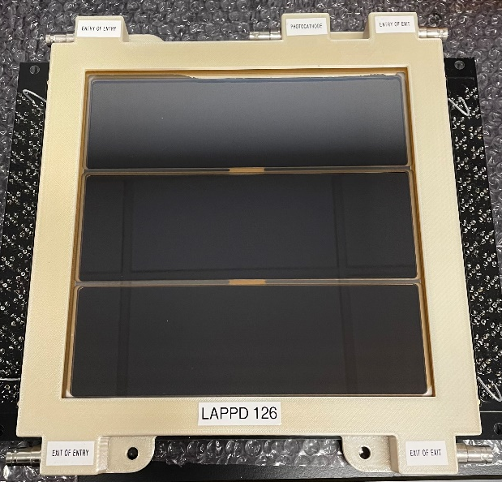
Large Area Picosecond Photodetector (LAPPDTM)
Technical Overview
20 cm x 20 cm MCP-PMT
  Chevron pair of ALD-functionalized MCPs(10 µm or 20 µm)
  Glass/Ceramic package
  373 cm² effective area (~74% active area ratio)
High Gain (~10⁷)
Bialkali Antimonide Photocathode
  Sodium-Potassium-Antimony Na₂KSb
  >30% QE at 365 nm
  >95% spatial uniformity
Timing Resolution
  SPE: ~50 ps (Vagnoni, INFN)
  150 GeV induced EM shower: ~8 ps (Vagnoni, INFN)
Position Resolution
  O(mm) (dependent on readout board)
*Magnetic Field Tolerance up to ~1.4 T

Slide 5
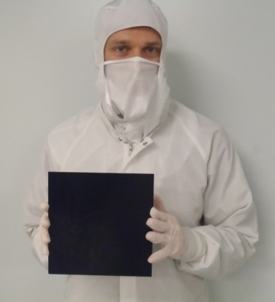
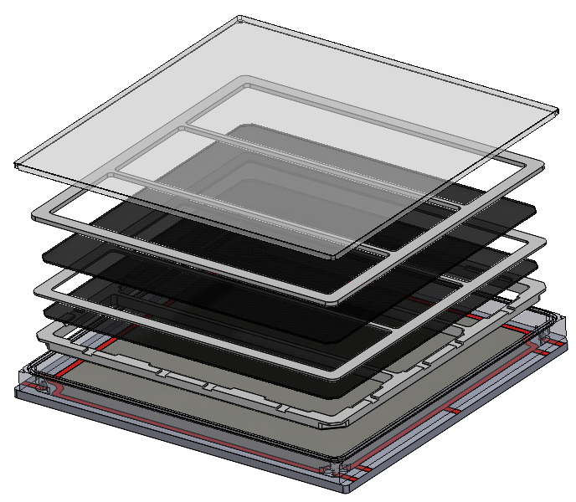

LAPPD Design
Fused Silica window (Photocathode inside)
Internal Resistive Anode
MCPs + Spacers
Sidewall frit bonded to Anode plate
HV tabs at each corner
(Independently power MCPs)
73.72% Active Area

Slide 6
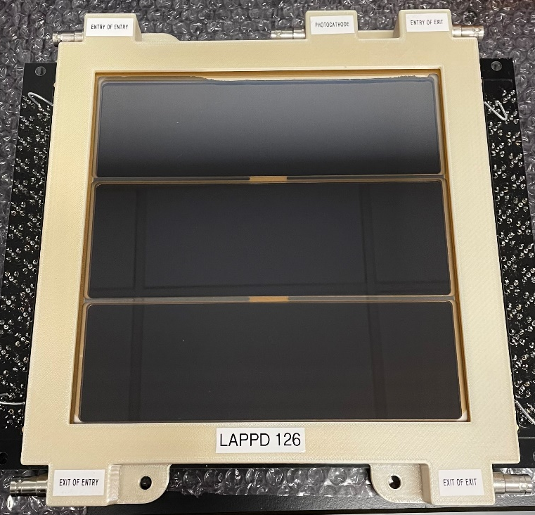
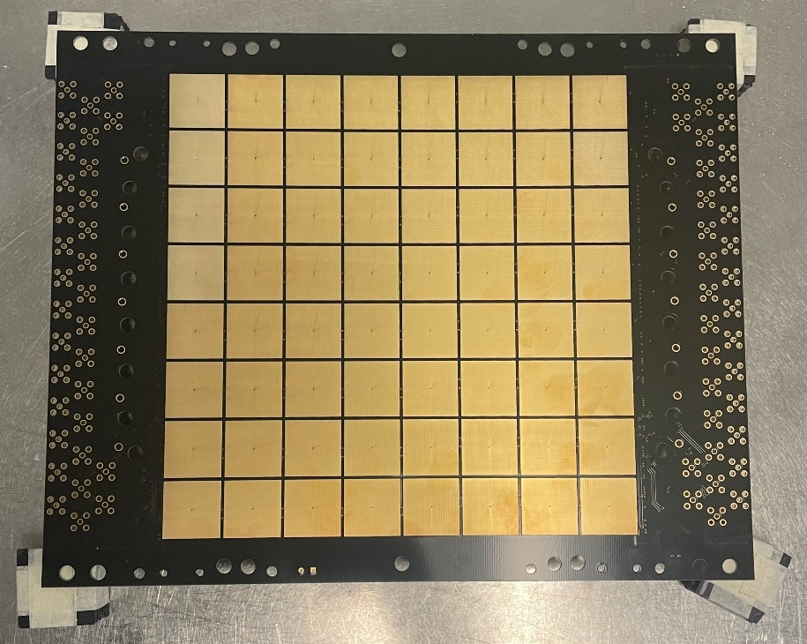
Gen-II LAPPD
Photocathode HV
8 x 8 Pad Array
25 mm pixels
MCP HV
Ultem Housing

Slide 7
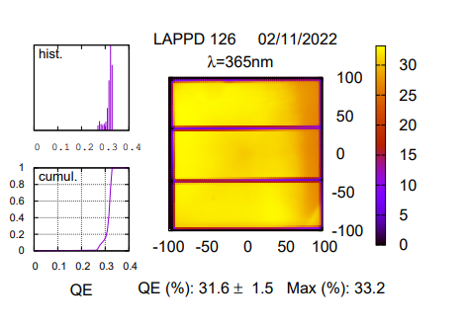
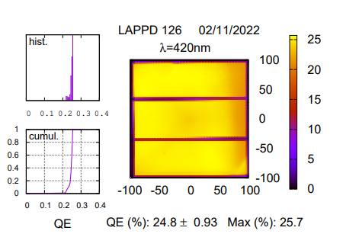
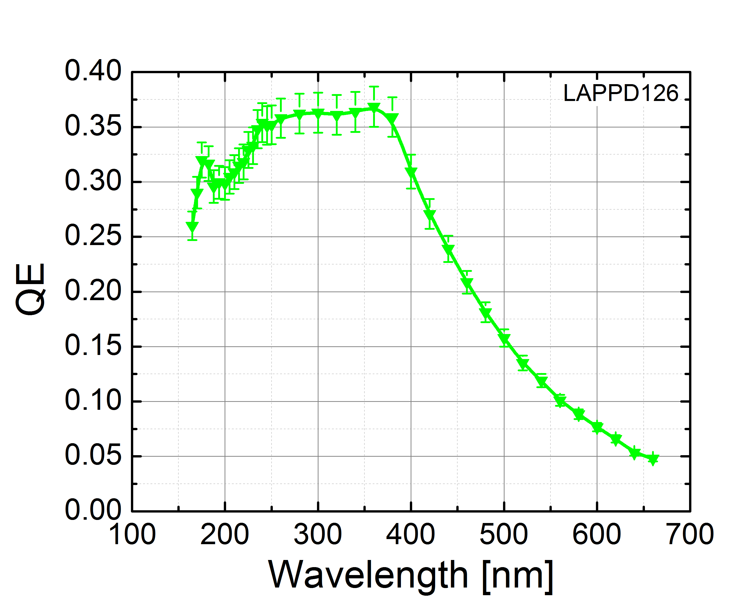
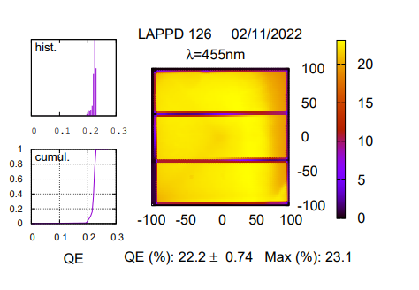
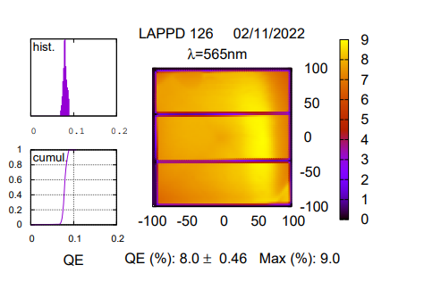
Photocathode QE
Cutoff wavelength: ~160 nm
Notes:
FS allows for extended UV sensitivity whereas borosilicate’s cutoff wavelength is roughly 300 nm.
Current PC is blue sensitive

Slide 8
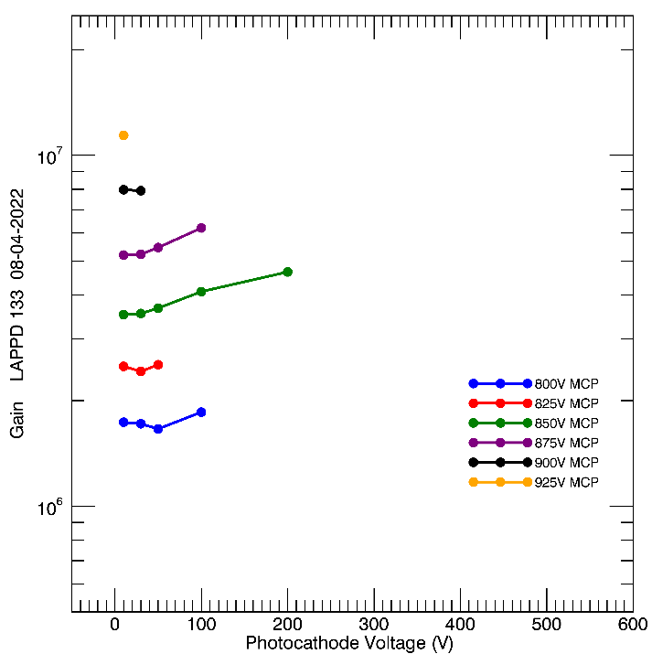
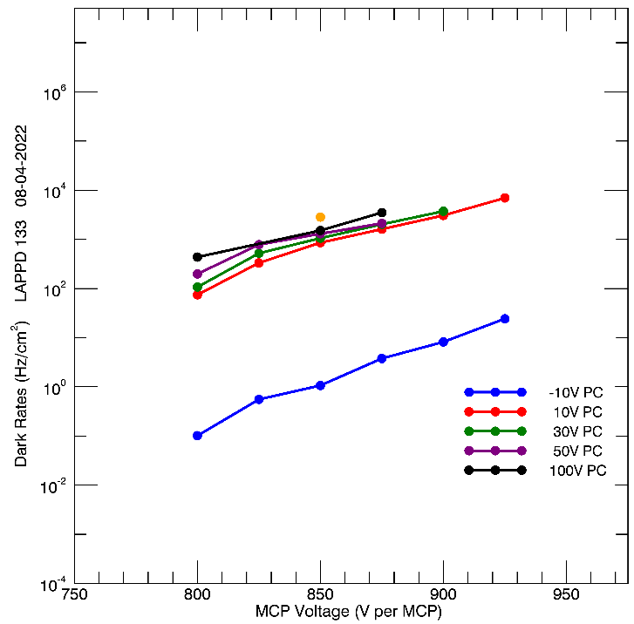
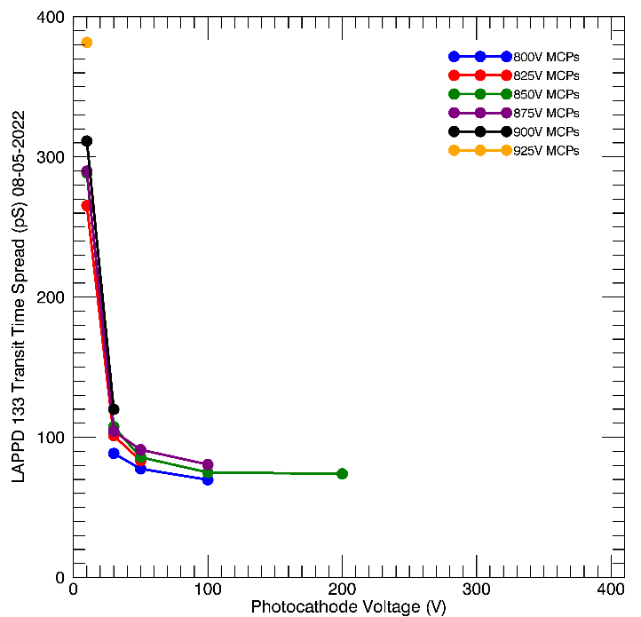
LAPPD Performance
Gain
Dark Rates
Core Transit Time Spread
Gain ~6∙10⁶ , Dark rates ~1 kHz/cm², σ_{core} ~70 ps
@ 875V/MCP, 100V PC

Slide 9
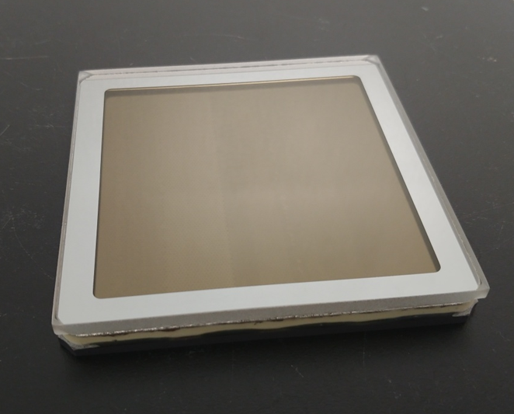
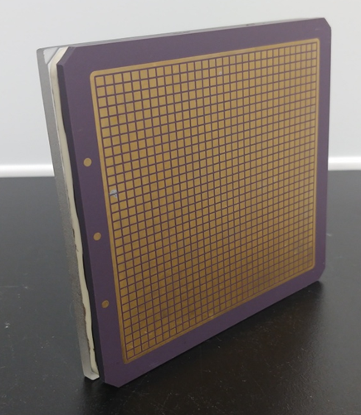
HRPPD – High Rate Picosecond Photodetector
10 cm x 10 cm MCP-PMT
  Chevron pair of ALD-functionalized MCPs (10 µm)
  Glass/Ceramic package
  Capacitive (CC) or Direct (DC) Coupling
  100 cm² active area (only spacers on edges)
High Gain (~10⁷)
Bialkali Antimonide Photocathode
  Sodium-Potassium-Antimony Na₂KSb
  >30% QE at 365 nm
  >95% spatial uniformity
Timing Resolution
  SPE: ~23 ps (Vagnoni, INFN for 10 um pores)
Position Resolution
  < 0.6 (mm) (dependent on readout board)
  DC version has 1024 2.5 x 2.5 mm pixels
Available today!

Slide 10
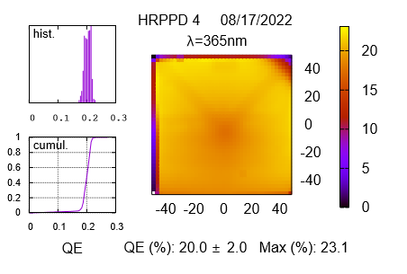
HRPPD Photocathode QE

Slide 11
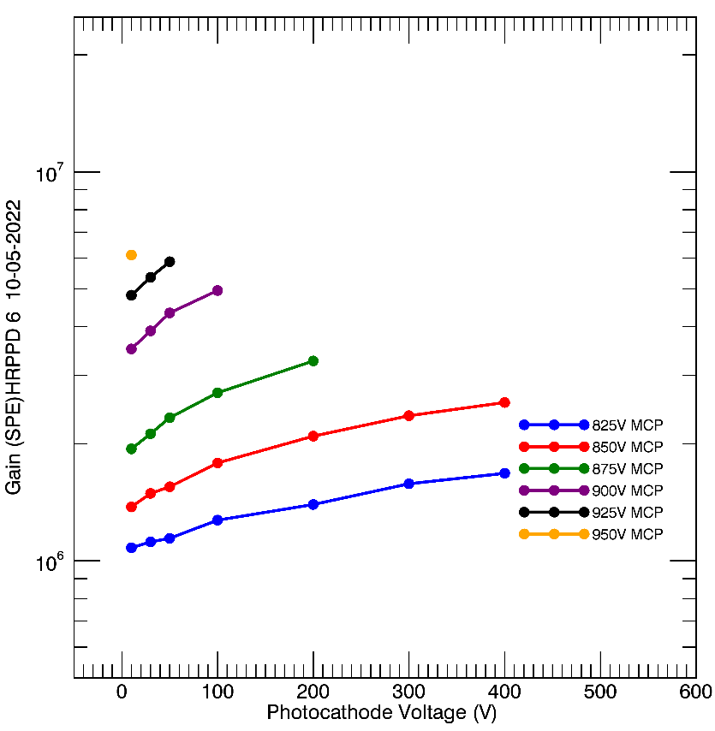
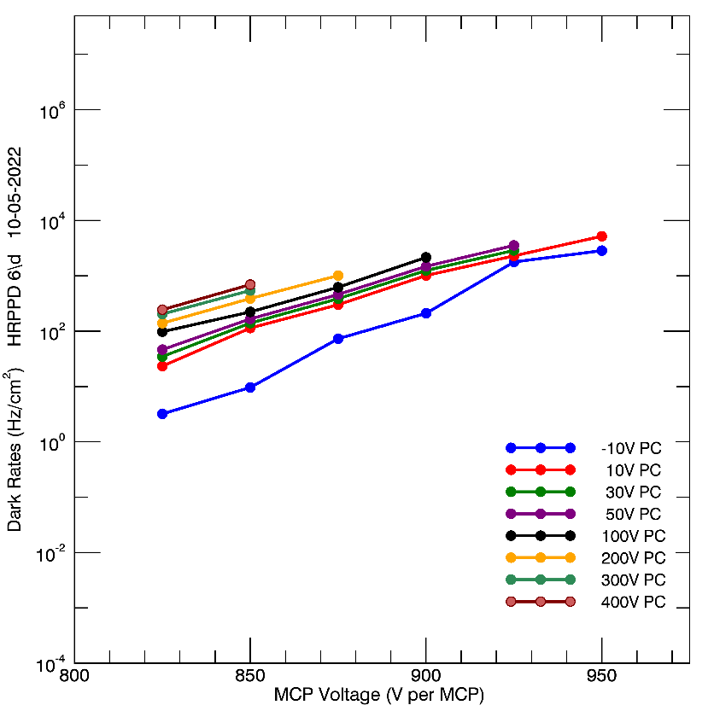
HRPPD Gain & Dark Rates
Gain ~5∙10⁶ , Dark rates ~1 kHz/cm²
@ 900V/MCP, 100V PC

Slide 12
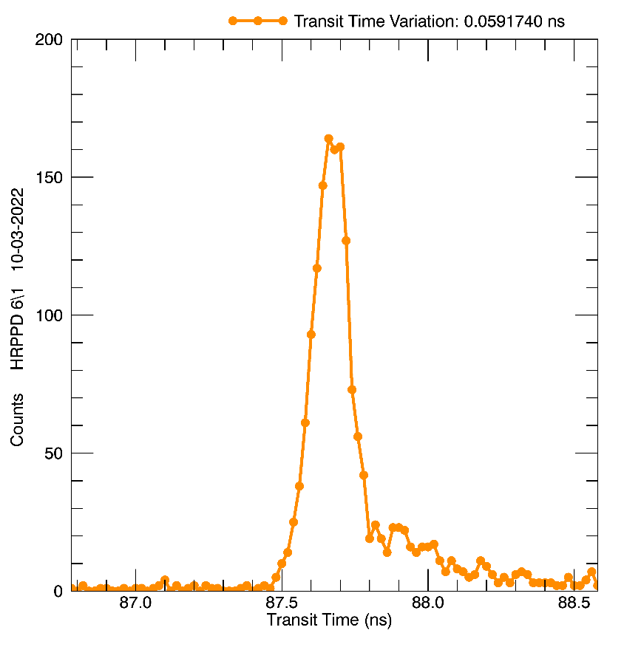
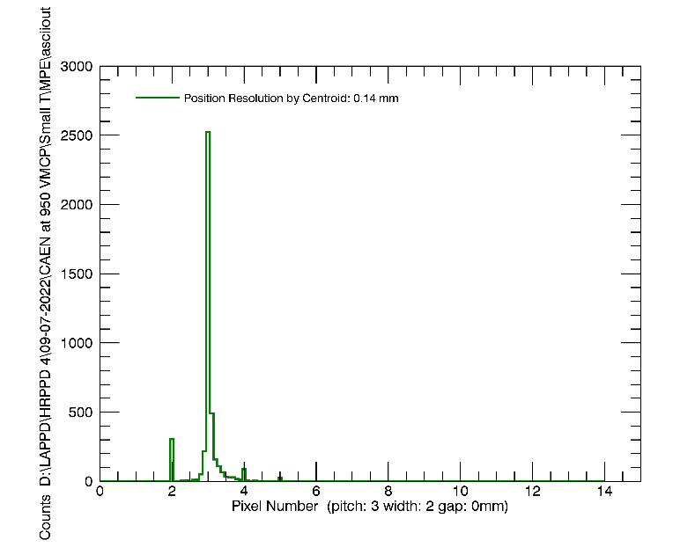
HRPPD Timing + Position Resolution
Transit Time Distribution
Directly Coupled HRPPD Position Distribution
σ_{core} = 50 ps
σ = 0.14 mm

Slide 13
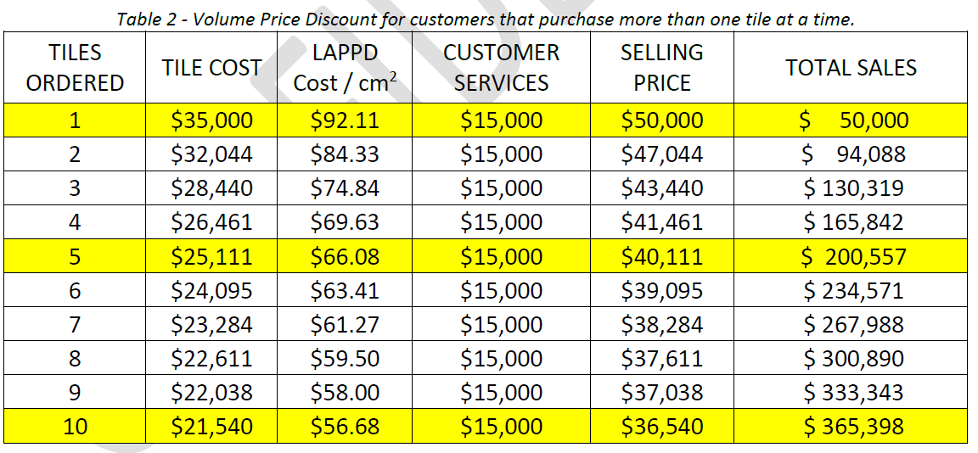
LAPPD/HRPPD Pricing Model

Slide 14
Ongoing Efforts
High B-field tolerance LAPPD/HRPPD
  Junqi Xie, LAPPD magnetic field tolerance measurements at ANL.
MCP: Low Thermal Coefficient of Resistance (TCR) + High Gain Secondary Electron Emission (SEE) Film
  Anil Mane, R&D on MCP ALD coating at Argonne.
Extending photocathode response to ~450 nm
  Cole Hamel, LAPPD and HRPPD: Upcoming Upgrades to Incom’s Fast Photosensors.
Device lifetime
  Varghese Chirayath, LAPPD life time measurements at UTA.
Enhancing photosensor active area and tile-ability
  Alexey Lyashenko, Optimizing LAPPD/HRPPD Active Area to Meet or Exceed EIC Requirements.
Z-stack LAPPD
  Vincenzo Vagnoni, LAPPD R&D in Bologna.

Slide 15
Thank You For Listening!
Shawn Shin
sshin@incomusa.com
shawn.shin@berkeley.edu

Slide 16
Back Up Slides

Slide 17
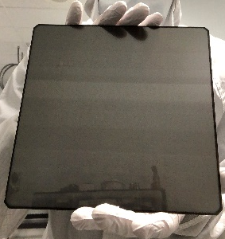
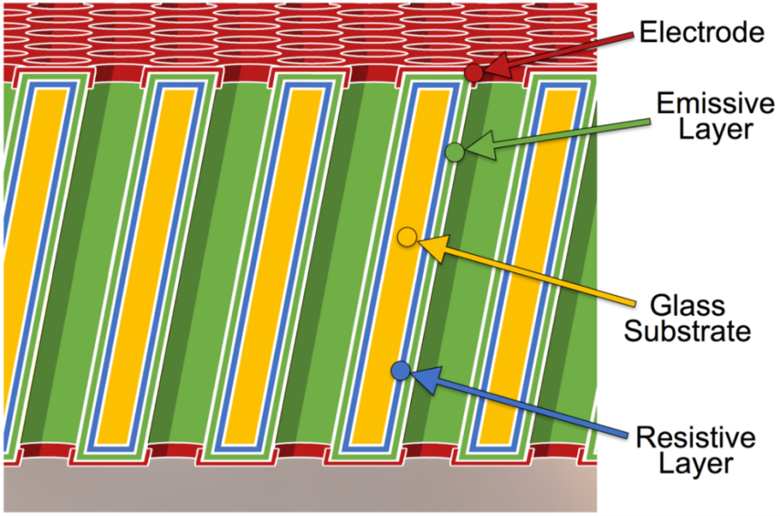
ALD-GCA-MCP
Hollow core Glass Capillary Array (GCA) substrate
  Borosilicate glass (AKA Pyrex)
    Little radioactive ⁴⁰K
  No etching necessary! Already hollow
Atomic Layer Deposition (ALD) is a thin-film deposition technique used to functionalize GCAs
  GCA + ALD = MCP
Flexible adjustment of film composition and resistivity
GCA
Open Area Ratio (OAR) up to 74%
MCP
Popecki, M. A., et al. (2016), Microchannel plate fabrication using glass capillary arrays with
Atomic Layer Deposition films for resistance and gain, J. Geophys. Res. Space Physics, 121,
7449–7460, doi:10.1002/2016JA022580.

Slide 18
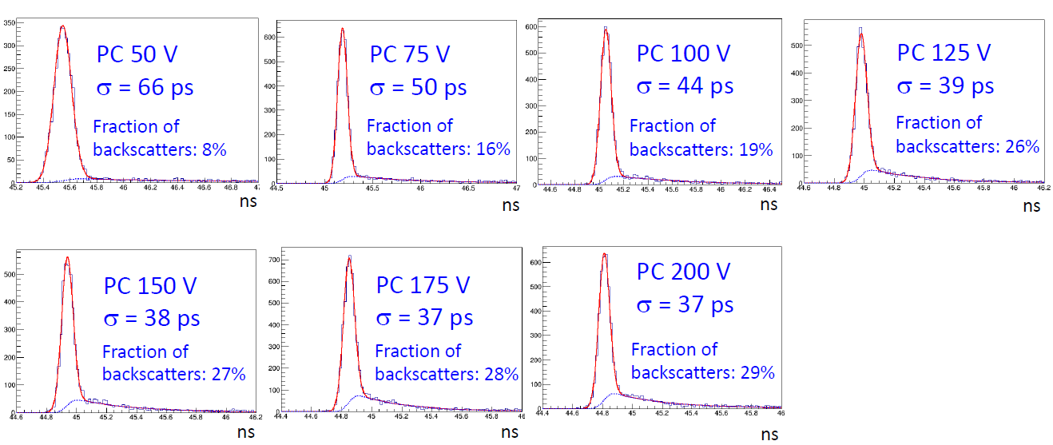
TTS vs PC Voltage

