Slide 1
Towards higher active area LAPPD/HRPPD
Alexey Lyashenko (Incom Inc.)
2nd LAPDD Workshop, October 26, 2022

Slide 2
General considerations
Enclosure
Contact Overlap
Active area fraction is defined as a ratio of unobscured detector area to detector foot print
Power/readout electrodes should move to the back side of LAPPD/HRPPD
Photocathode
Sidewall

Slide 3
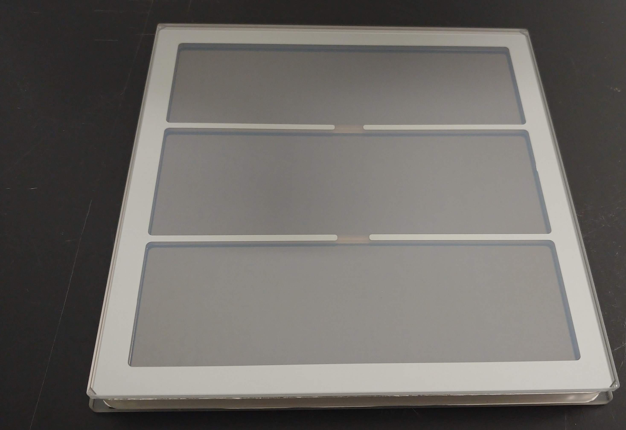
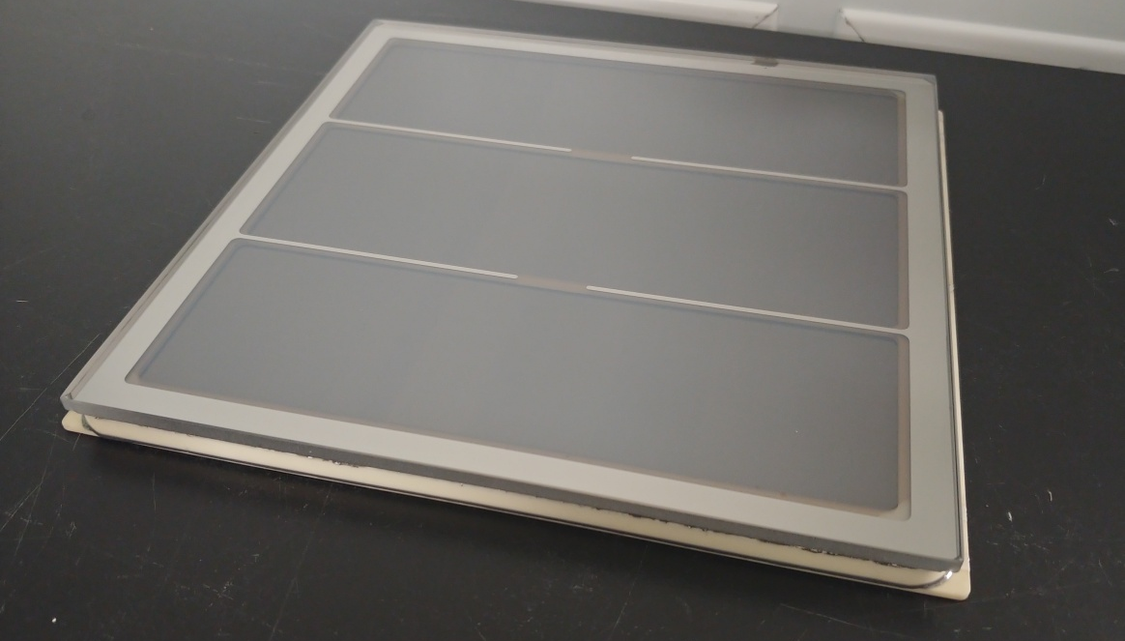
LAPPD active area
MCPs powered independently
Capacitive coupling
Glass or ceramic
2 mm thick ceramic anode
Active area fraction: 72%
Excluding enclosure
Ceramic LAPPD

Slide 4
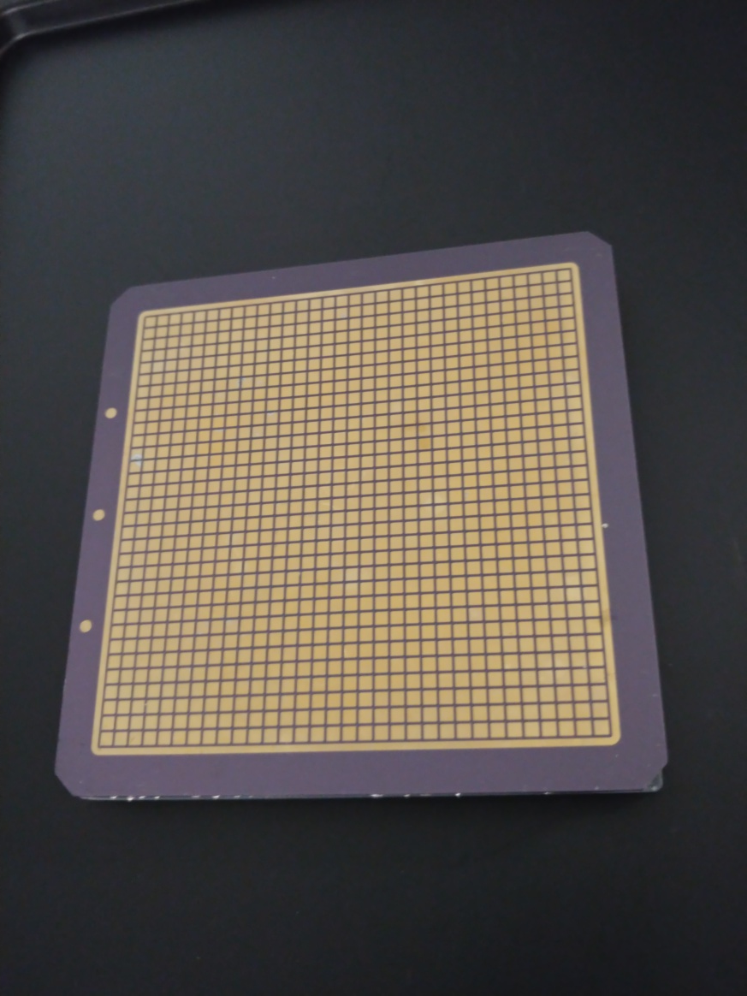
HRPPD active area (presently)
Present design
Gapless MCP configuration
2.54 mm pixel size/3.175 mm pitch
32 x 32 array
Directly coupled pixelated anode
100 mm
69% active area fraction

Slide 5
HRPPD active area
New design
Present design
104 mm
100 mm
80% active area fraction
69% active area fraction

Slide 6
HRPPD active area
Increasing active area
Sidewall thickness reduced from 4 mm to 3 mm
MCP contact overlap reduced from 4 mm to 2 mm
Anode footprint reduced by 1 mm
Concerns
High voltage stability
Manufacturability of ceramic sidewall
Sealing challenges
Higher dark rates

Slide 7
HRPPD Anode: High Open Area (1077 pixels) vs Original 2.5 mm pads (1024 pixels)
Spacer coverage

Slide 8
HRPPD Anode: High Open Area (1077 pixels) vs Original 2.5 mm pads (1024 pixels)

Slide 9
HRPPD High Open Area 3 mm pads (772 pixels)

Slide 10
Conclusions
There is a potential for achieving larger active area in LAPPD
80% active area fraction will be achieved in HRPPD
If there is a demand HRPPD anode can be modified for larger pixel size/ less readout channel count

