Slide 1
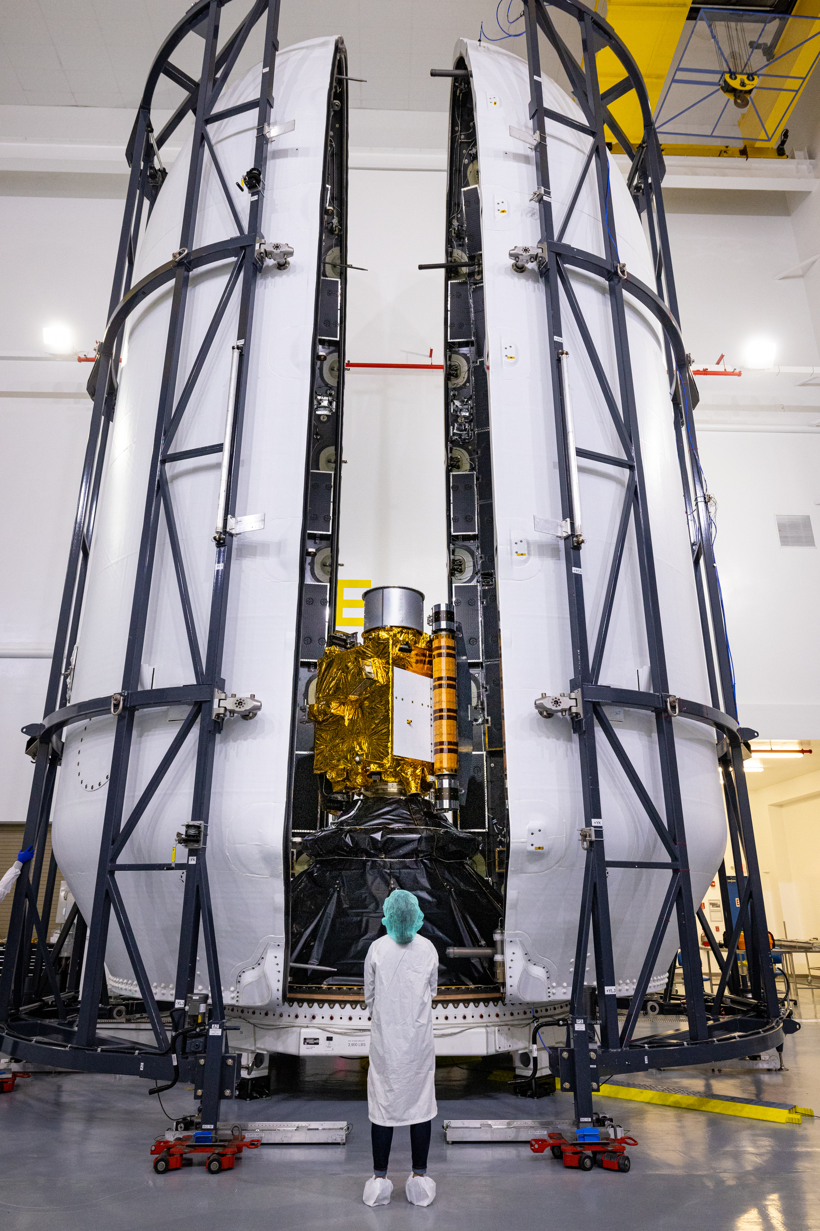
The Planetary Science Journal, 2:173 (24pp), 2021 October
Selecting the Target
Needs to be close enough in velocity change space to minimize cost.
Needs to be low enough mass that the impact with a 570 kg spacecraft will make a detectible difference In dynamics

Slide 2
DART Impactor
DART is a low-cost spacecraft. The main structure of the spacecraft is a box with dimensions of roughly 1.2 × 1.3 × 1.3 meters (3.9 × 4.3 × 4.3 feet), from which other structures extend to result in measurements of roughly 1.8 meters (5.9 feet) in width, 1.9 meters (6.2 feet) in length, and 2.6 meters (8.5 feet) in height. The spacecraft has two very large solar arrays that when fully deployed are each 8.5 meters (27.9 feet) long. DART navigated to crash itself into Dimorphos at a speed of approximately 6.1 kilometers (3.8 miles) per second. The total mass of the DART spacecraft was approximately 1,345 pounds (610 kilograms) at launch and roughly 1260 pounds (570 kilograms) at impact. DART carries both hydrazine propellant (about 110 pounds, or 50 kilograms) for spacecraft maneuvers and attitude control, and xenon (about 130 pounds, or 60 kilograms) to operate the ion propulsion technology demonstration engine.

Slide 3
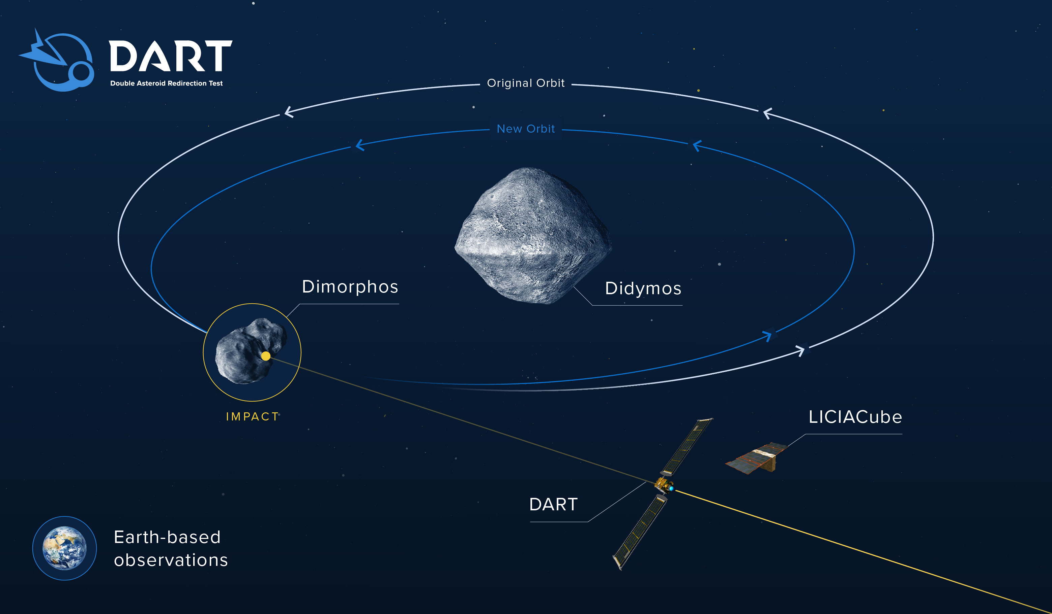

Slide 4
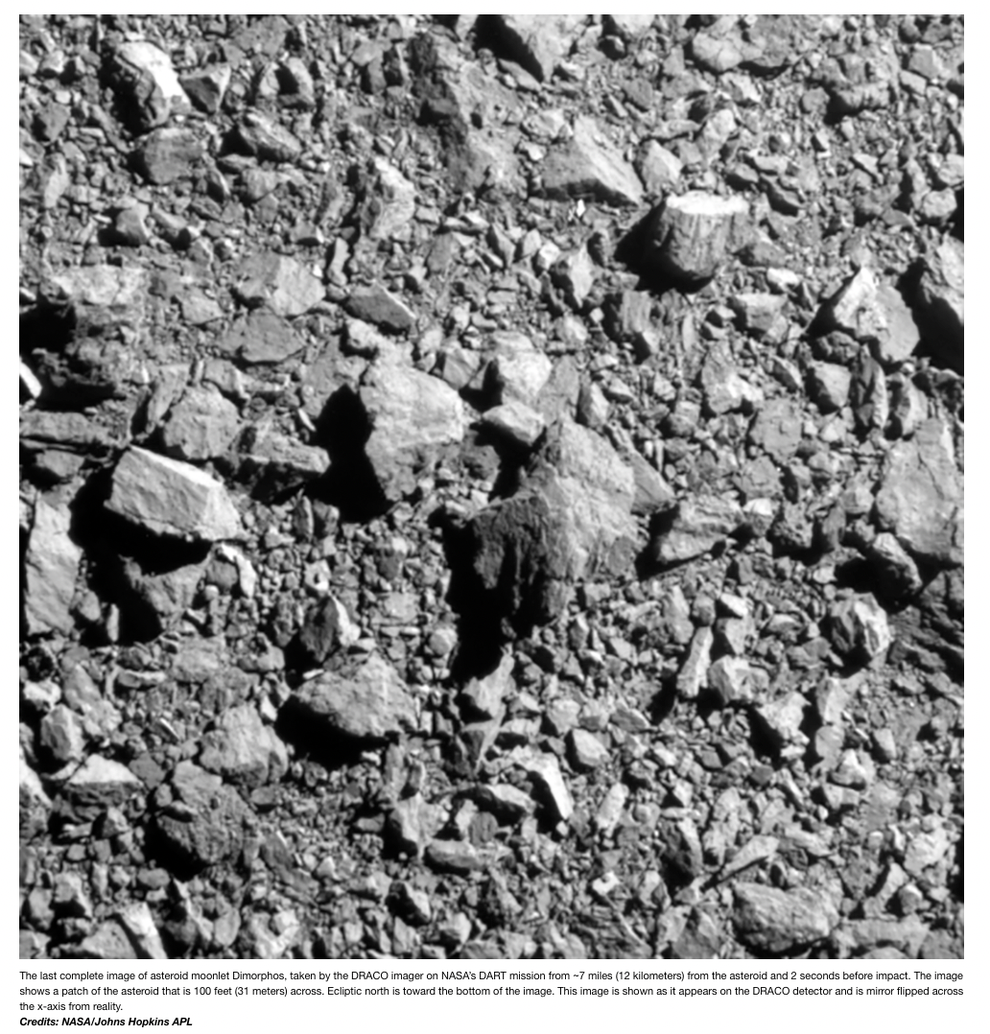
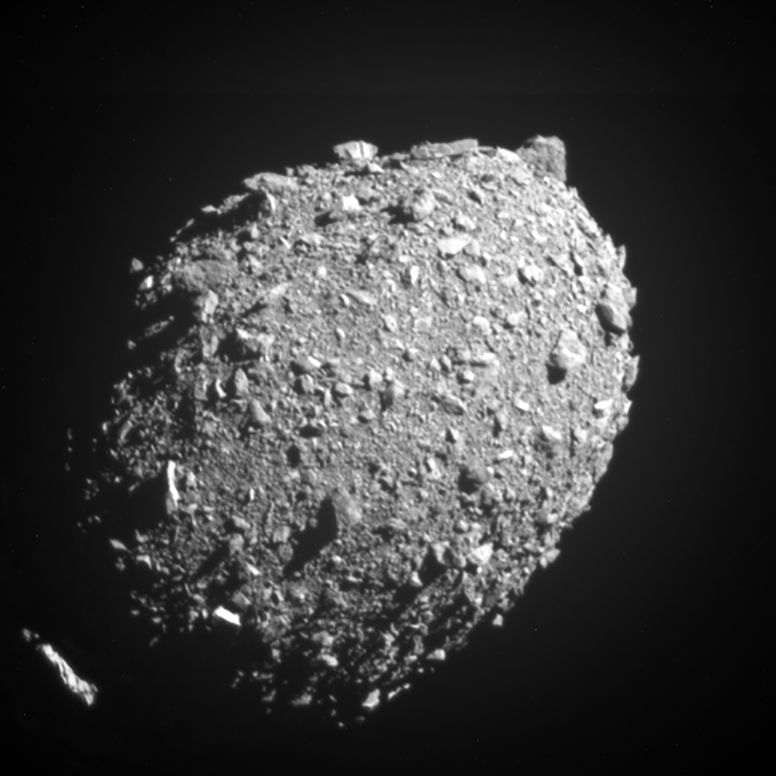
Didymos composition like an L/LL Chondrite
L chondrites have low total iron contents (including 7–11% Fe-Ni metal by mass). ~46% of ordinary chondrite falls belong to this group, which makes them the most common type of meteorite to fall on Earth. LL chondrites have low total iron and low metal contents (3–5% Fe-Ni metal by mass of which 2% is metallic Fe and they also contain bronzite, oligoclase and olivine).^{[17]} Only 1 in 10 ordinary chondrite falls belong to this group.

Slide 5
Requirements
1. DART-1. DART shall intercept the secondary member of
the binary asteroid (65803) Didymos as a kinetic
impactor spacecraft during its 2022 September–October
close approach to Earth.
2. DART-2. The DART impact on the secondary member of
the Didymos system shall cause at least a 73 s change in
the binary orbital period.
3. DART-3. The DART project shall characterize the binary
orbit with sufficient accuracy by obtaining ground-based
observations of the Didymos system before and after
spacecraft impact to measure the change in the binary
orbital period to within 7.3 s (1σ confidence).

Slide 6
4. DART-4A. The DART project shall use the velocity
change imparted to the target to obtain a measure of the
momentum transfer enhancement parameter referred to as
“Beta” (β) using the best available estimate of the mass of
Didymos B.
5. DART-4B. The DART project shall obtain data, in
collaboration with ground-based observations and data
from another spacecraft (if available), to constrain the
location and surface characteristics of the spacecraft
impact site and to allow the estimation of the dynamical
changes in the Didymos system resulting from the DART
impact and the coupling between the body rotation and
the orbit.

Slide 7
Post Collision Observation Network

Slide 8
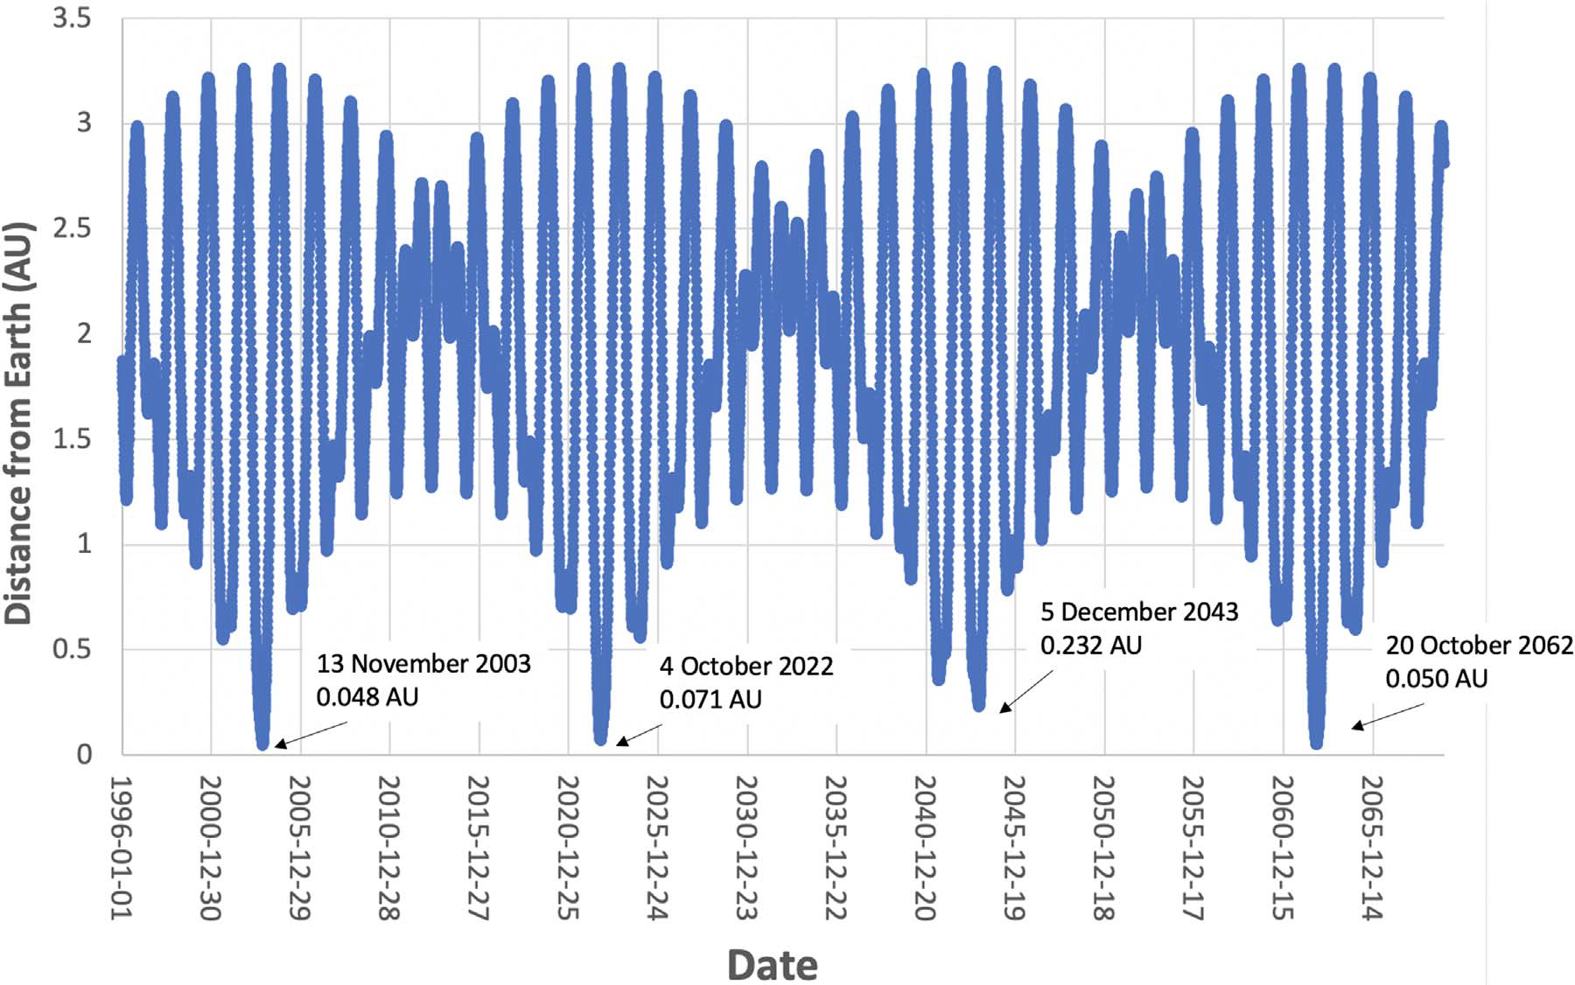
Didymos Orbit around Sun
The orbit of Didymos ranges from just outside the orbit of Earth (about 1 AU) to a bit beyond the orbit of Mars (about 2.27 AU) and is slightly inclined with respect to the plane of the planets (called the ecliptic), by about 3 degrees. It takes 2.11 years to make each trip around the Sun.
Figure 1. Distance between Didymos and Earth over time. Over the 75 yr span from the beginning of 1996 to the end of 2069, the Didymos system has three close
approaches (<0.1 au) to Earth. The first of those was in 2003 and was a period of intense Earth-based characterization, including the radar measurements reported in
Naidu et al. (2020a). The second close approach will be the DART impact epoch. After 2022, Didymos does not come within 0.1 au of Earth until 2062.

Slide 9
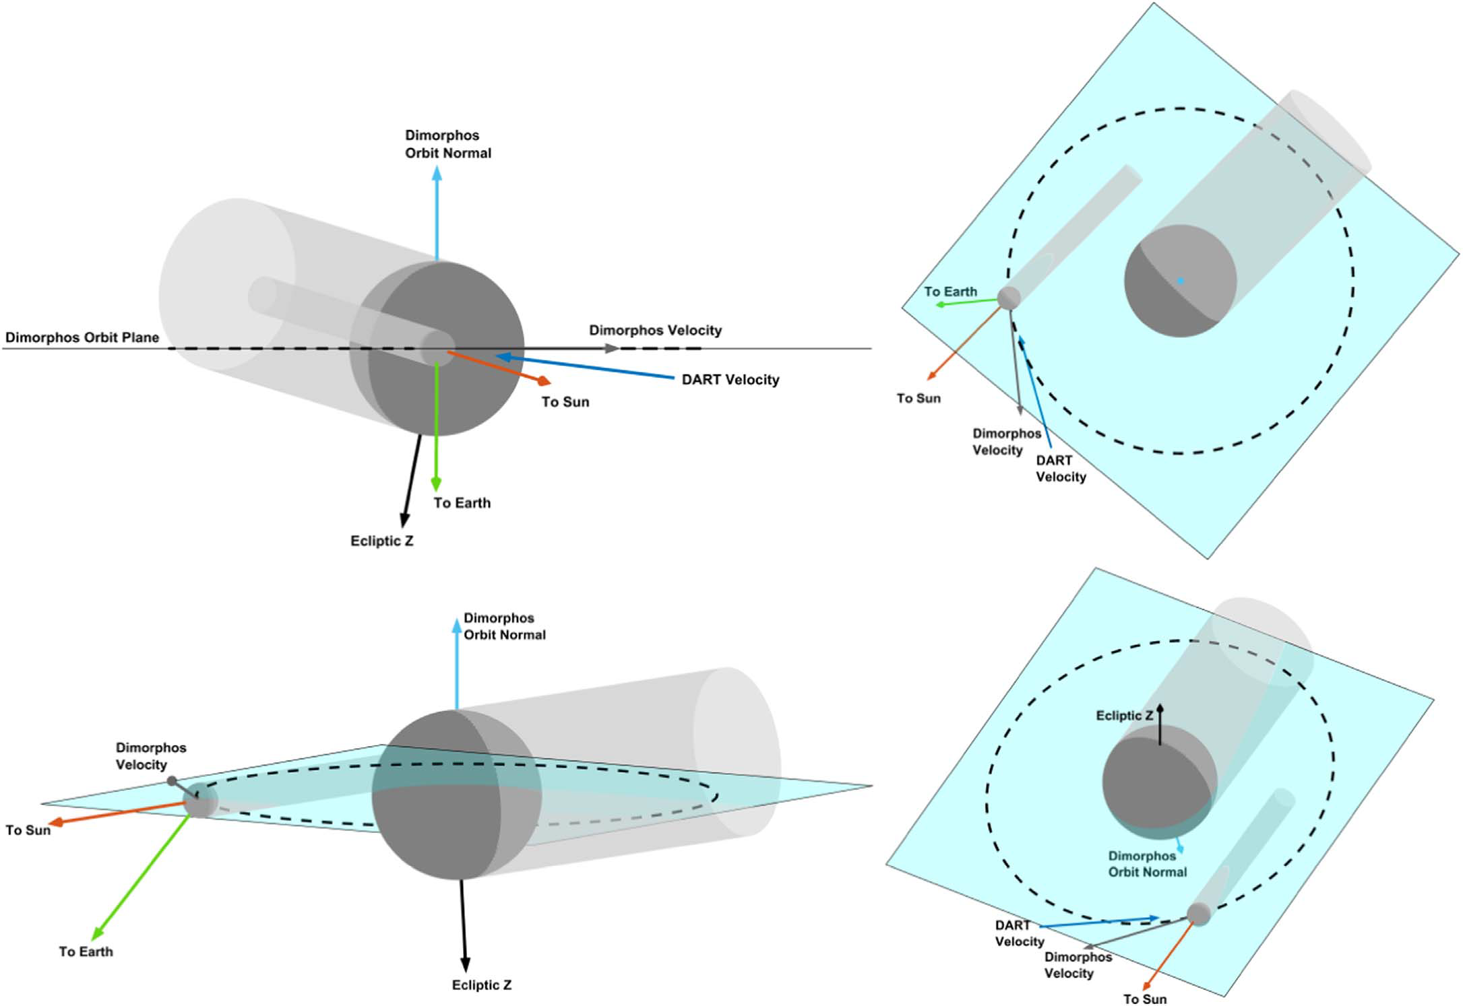
Collision designed to slow Dimorphos. So it DOESN’T escape orbit around Didymos. Period decreases.
Decreasing the orbital period from 11hr 55 min, moving it away from 12 hr observational issues

Slide 10
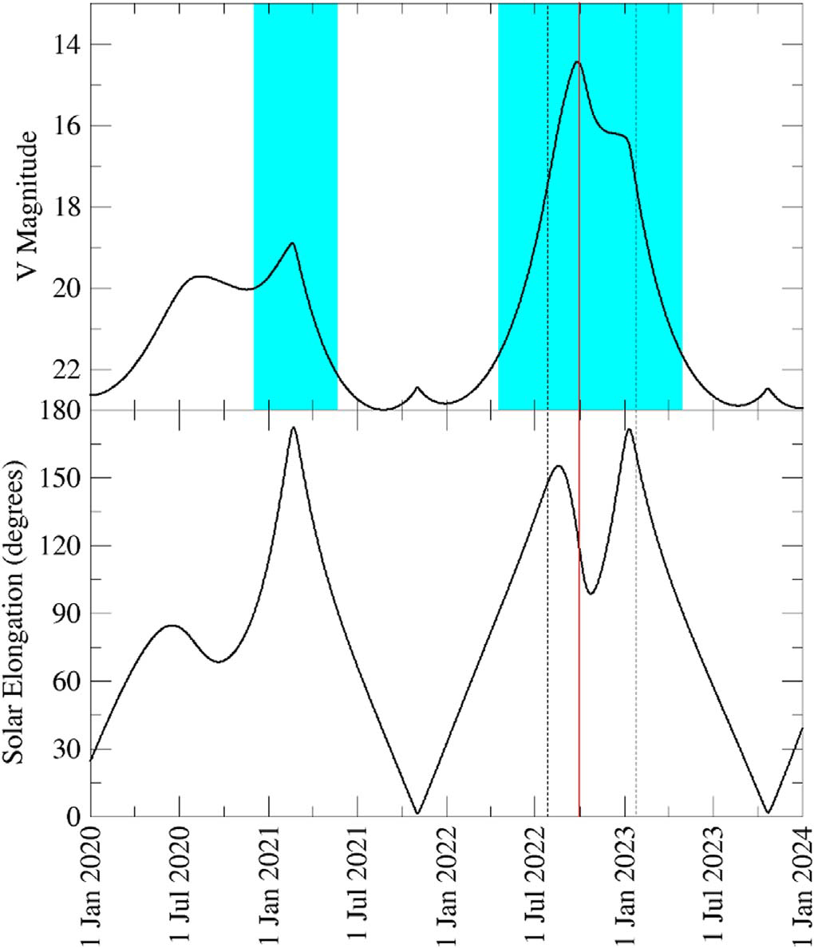
Figure 3. V magnitude (top) and solar elongation (bottom) for the Didymos
system over 2020–2023. Note that the y-axis for the top panel is inverted to
represent larger magnitudes being fainter. Didymos spends an extended period
as a bright object at large solar elongations during the DART impact epoch in
2022–2023, with two separate oppositions. Shaded regions on the top panel
represent periods when Didymos is >90° from the Sun. The solid red vertical
line represents an impact date of 2022 September 30. The period between the
two vertical dashed lines is the period when Didymos is brighter than V = 17.5
and meter-class telescopes can obtain data that can meet required photometric
precision in typical conditions (Section 3.2.1).

Slide 11
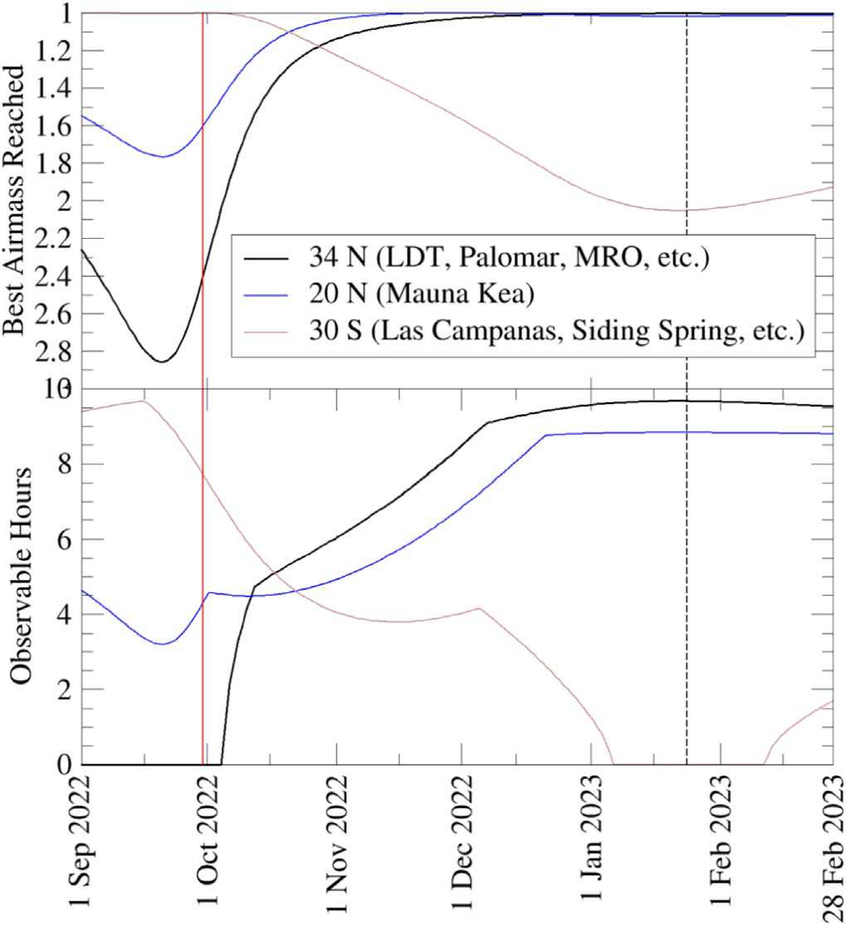
Figure 4. Best air mass (astronomically defined as the secant of the zenith
angle, so air mass overhead = 1.0) reached by Didymos (top) and the number
of hours above 30° elevation (i.e., air mass <2) for three latitudes during the
DART impact apparition. These latitudes are representative ones for southern
hemisphere observatories (30°S), Hawaiian observatories (20°N), and the
observatories of the U.S. Southwest (34°N). As in Figure 3, the dashed line
marks the time after which Didymos is fainter than V = 17.5, Early in the
apparition, observations from Las Campanas (and other observatories at similar
southern latitudes) are best, with Didymos spending long periods high in the
sky. By late October, northern hemisphere observatories have observing
circumstances as good as southern hemisphere locations and are better sites for
Didymos observations through late 2022 into early 2023.

Slide 12
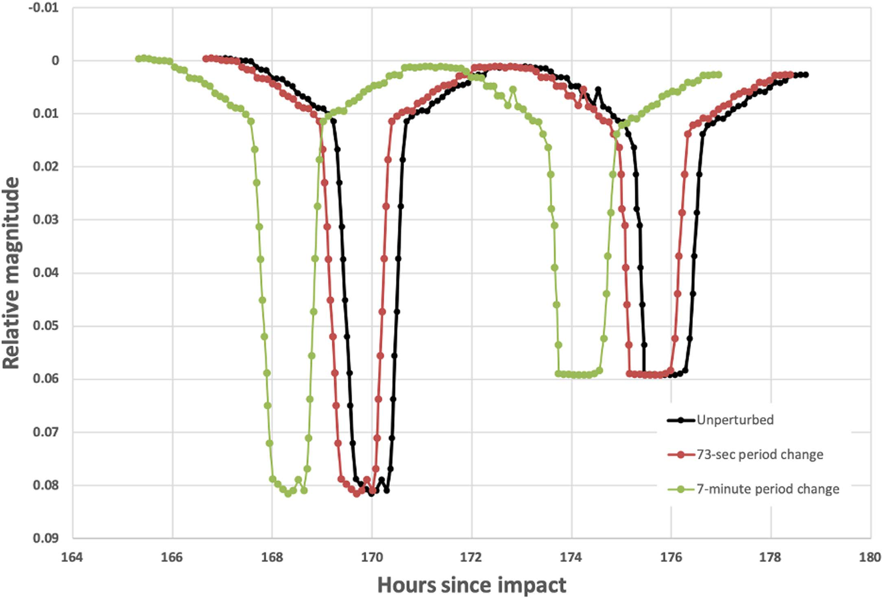
Figure 5. Schematic offset between the mutual events in the unperturbed Didymos system light curve and light curves from 73 s and 7-minute period changes, as seen
15 orbits following a leading-side (“head-on”) DART impact. There is a roughly 18-minute difference between the timing of the mutual events of the unperturbed
system and the minimum required 73 s period change case, easily detectable given expected data. The 7-minute period change leads to an even larger offset.

Slide 13
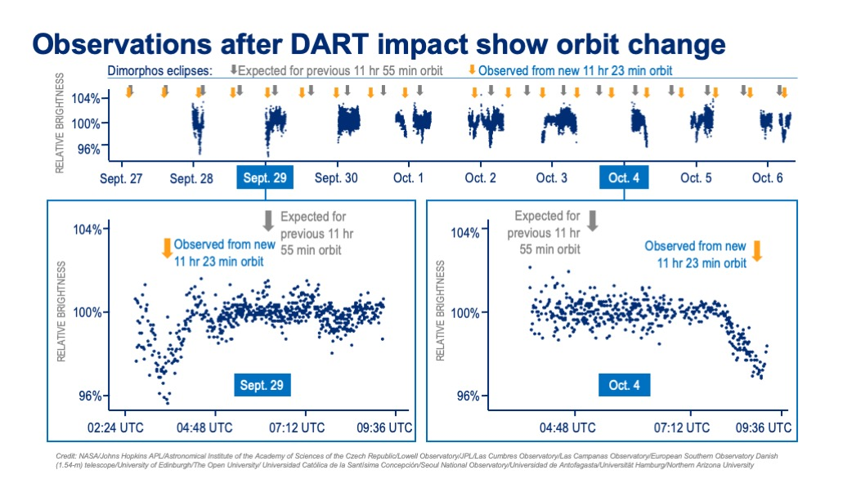

Slide 14
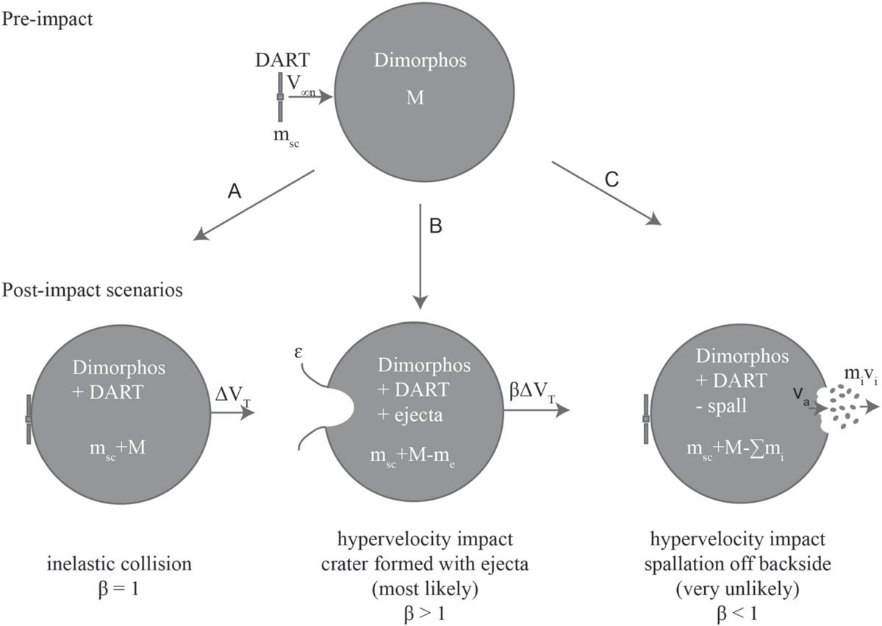
Figure 6. Possible scenarios post DART impact. (A) Slow-speed than counteract the momentum enhancement from the spacecraft, resulting in β < 1. or inelastic collision adds DART’s momentum to the asteroid, β = 1. (B) Hypervelocity impact
creates a crater and results in ejecta being thrown off asteroid, which acts to increase momentum of the asteroid system, β > 1. (C) In a very unlikely case, spallation
on the backside of the asteroid after the collision could act to more

Slide 15
The mutual orbit period of Dimorphos and
the sizes of the system components give a density for the
system of 2170 ± 350 kg m−3 and an implied porosity of
38% ± 6% (Naidu et al. 2020a),
The densities are assumed to be the same for the two objects.

