Slide 1
PMG Presentation
sPHENIX Status
Recommendations from End Game Review
Remaining MIE items for PD-4
KPP self-evaluation document
Status of IRR/ARR planning

Slide 2
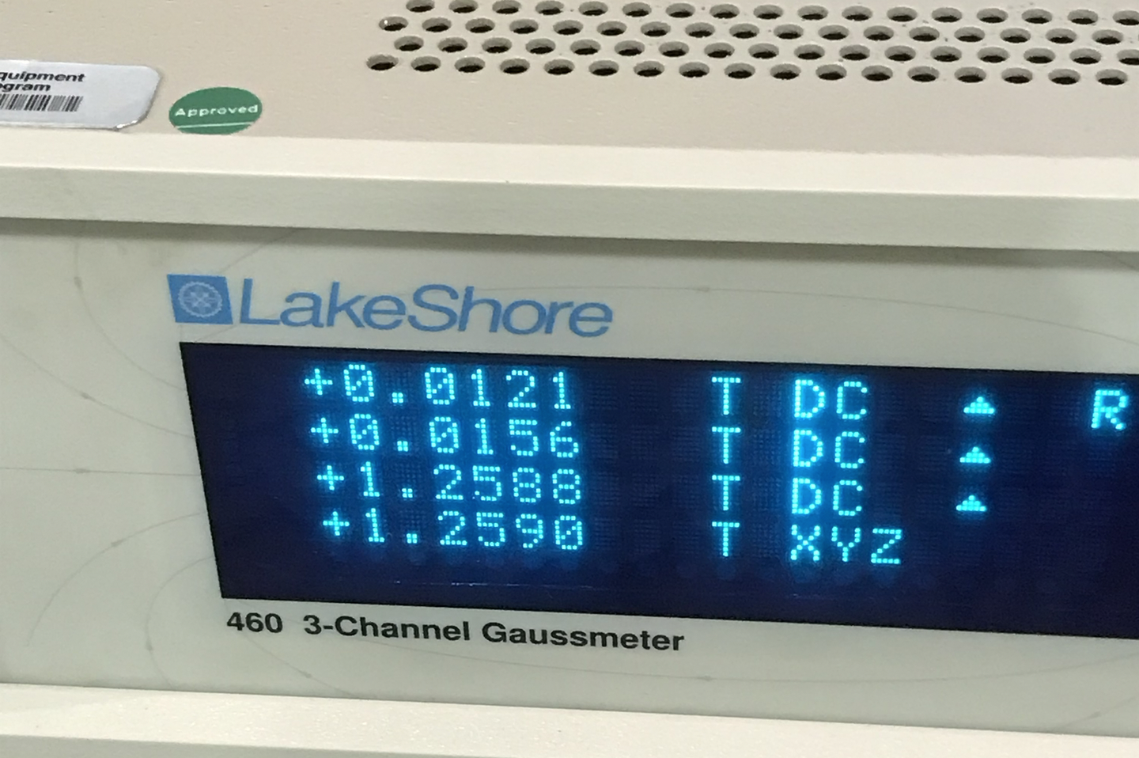
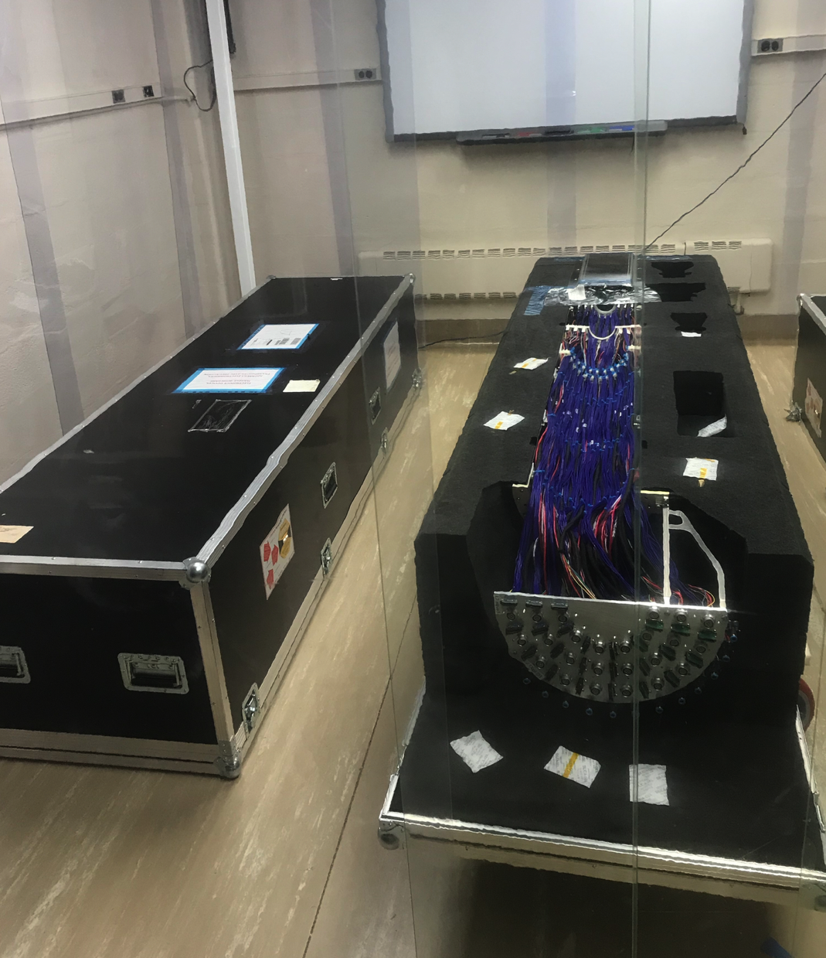
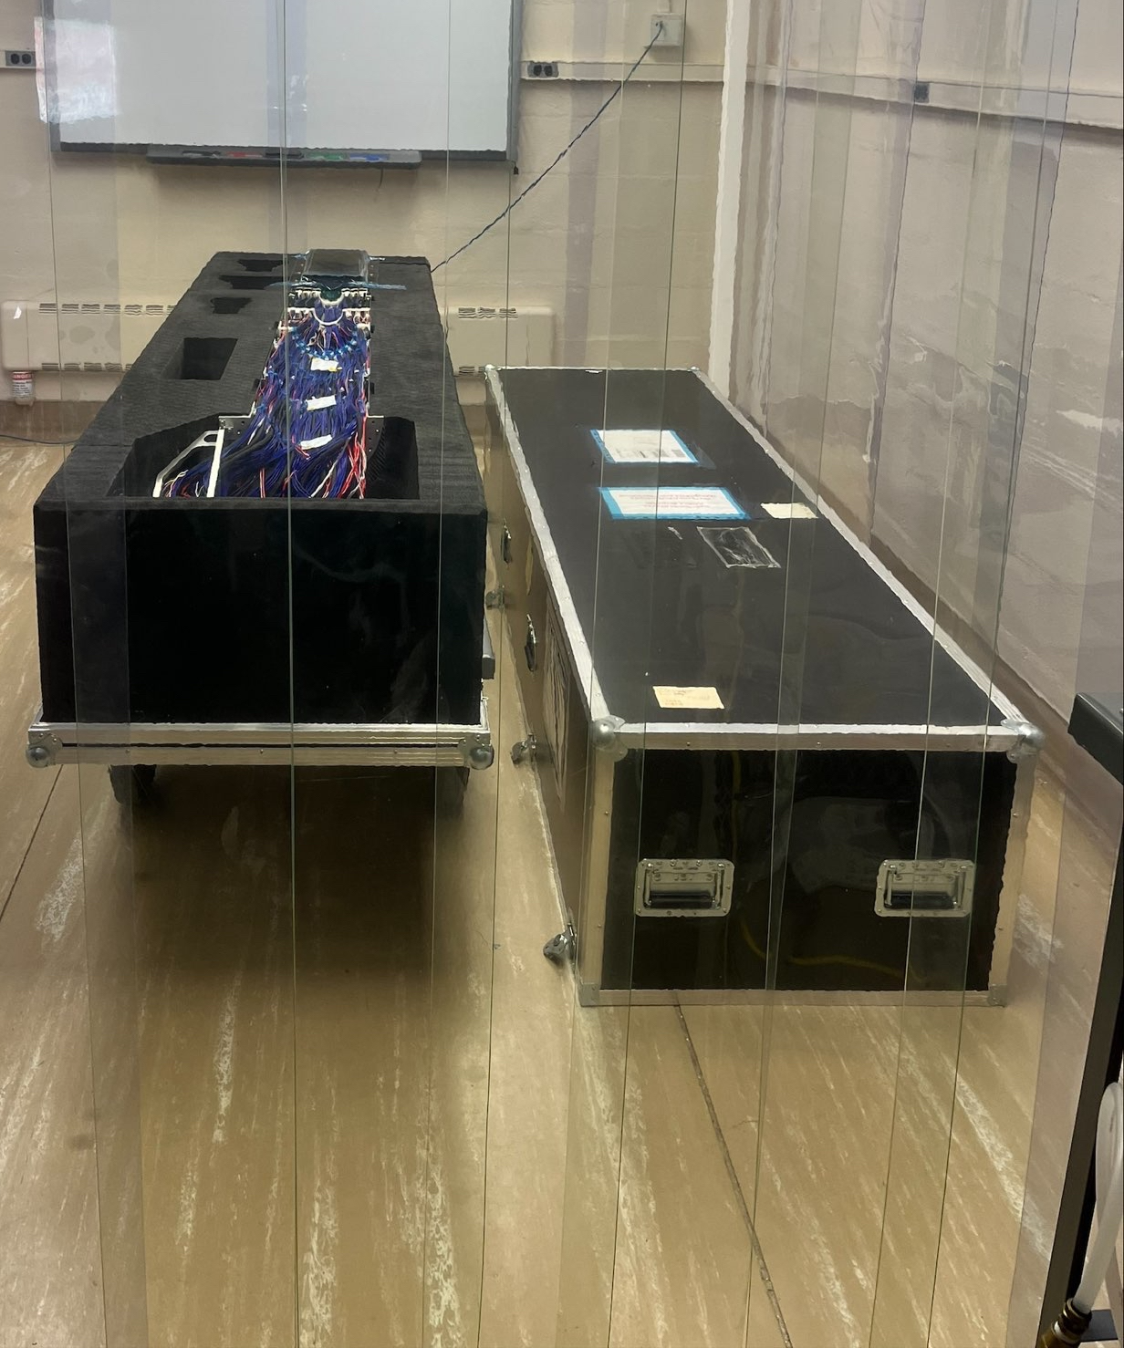
sPHENIX Status
End Game review report available. Overall it is quite positive. Thank you to everyone whose effort contributed to the positive outcome.
CERN Magnet Mapping team (Nicola, Raphael, Francois, Pritindra) arrives at BNL Monday morning 10/31. Mapping to commence next week
Both halves of MVTX now at BNL
SC Magnet ramped to full current Tuesday. Testing will continue throughout the week.
MVTX-1
MVTX-2
B-field on Hall probe during ramp tests

Slide 3
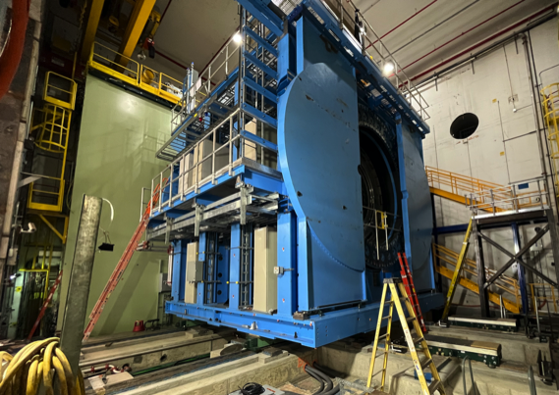
sPHENIX MIE Project Overview
TPC | Project Director | Last CD Achieved | % Complete | CPI | SPI
$27.0M | Edward O’Brien | PD-2/3 | 99.3% BCWP/BAC@ 9/30/2022 | 0.99 | 0.99
Scope
  Detector systems produced, tested and ready for installation: Time Projection Chamber w/ electronics, Electromagnetic Calorimeter w/ electronics, Hadronic Calorimeter w/ electronics, DAQ/Trigger, Minimum Bias Detector, Project Management
Not in scope
  SC-Magnet, Bldg/Det Infrastructure, Installation and System Commissioning
Schedule
  CD-0 received Sept 2016
  CD-1/3A received Aug 2018
  PD-2/3 received Sept 2019
  Early completion last wk of Oct 2022. 2.0 months of float to PD-4
  PD-4 Dec 2022
Cost
  $27.0M AY TPC 126.0% contingency on an ETC of $0.72M

Slide 4
BNL 1008 Infrastructure & Facility Upgrade
TPC | Project Director | % Complete | CPI | SPI
$33.4 M AY | Edward O’Brien | 94.1% BCWP/BAC @ 9/30/2022 | 0.87 | 0.96
Scope
  SC-Magnet support including the Flux Return, Cryogenics into Bldg 1008, Detector Carriage/Cradle, other Bldg 1008 Infrastructure improvements
  sPHENIX Installation, Integration and Commissioning of each Subsystem is part of the scope
Schedule
  sPHENIX Ready for Operations (Early Completion) 3/20/23 based on P6
  However separate assessment of schedule by sPHENIX engineers predict 4/24/23 end date
  No float in schedule between sPHENIX “Ready to Operate” & nominal start of RHIC-23 run. Looking to recoup schedule contingency with extended workdays and weekend shifts
Cost
  $33.4 M AY Total Project Cost with 0% contingency (after Oct PCR) on ETC of $2.07M
  Huge influx of CAD and BNL Trades labor(Jun-Sept) has used up available budget contingency
Commitments = $0.48M

Slide 5
sPHENIX End Game Review Recommendations
Recommendations
Prepare a detailed up-to-date fully integrated and resource-loaded plan for the remaining work, and submit by the end of October. Glenn w/ Ishani, Irina
Consider adopting a compressed schedule to complete the installation and assembly as promptly as feasible without interleaved beam operations, assuming all necessary resources (including extending the work day and work week) are available. Glenn w/ Ishani, Irina
Identify the time profile of necessary additional technician and trade resources and communicate this to BNL. BNL should give the highest priority to providing the required resources. Glenn w/ Jim, Russ, Joel
BNL should work closely with the BHSO to explore rapid processing of the SAD, ASE, and other related safety approvals. EO’B
Ensure that the responsible individual is clearly identified for coordinating the day-to-day remaining installation of subsystems and cables, and coordinating with all detector subsystem experts. Installation: Russ to Jim transition in December. Chris is the 1008 Floor Manager of activities

Slide 6
Remaining PD-4 Deliverables
Complete the deliverables for the PMP
  TPC detector instrumentation and testing at SBU. Done when final two are complete. See below
  JACK production. 5 of 30 production boards available 11/4. Done when all boards are produced and 1st 20% test good.
Complete KPP tests for deliverables and write up
  Most of the KPP’s can be written up as complete except:
    TPC > 90% single hit efficiency/mip track (due 11/11)
    TPC ≥ 90% live channels based on laser, pulser, cosmics (due 11/18)

Slide 7
High Priority Issues
Complete MIE deliverables & write our KPP report. Glenn will coordinate the KPP report.
Final preparation for magnet mapping.
Respond to End Game Review recommendations
Generate a punch list of all remaining tasks between now and closing of shield wall.
  Include anything that may still need to be ordered
Continue installing racks on platform. Cabling/Plumbing/Gas/Fibers
Continue working on the SAD/ASE with CAD. Draft released to CAD/sPHENIX in last few days.

Slide 8
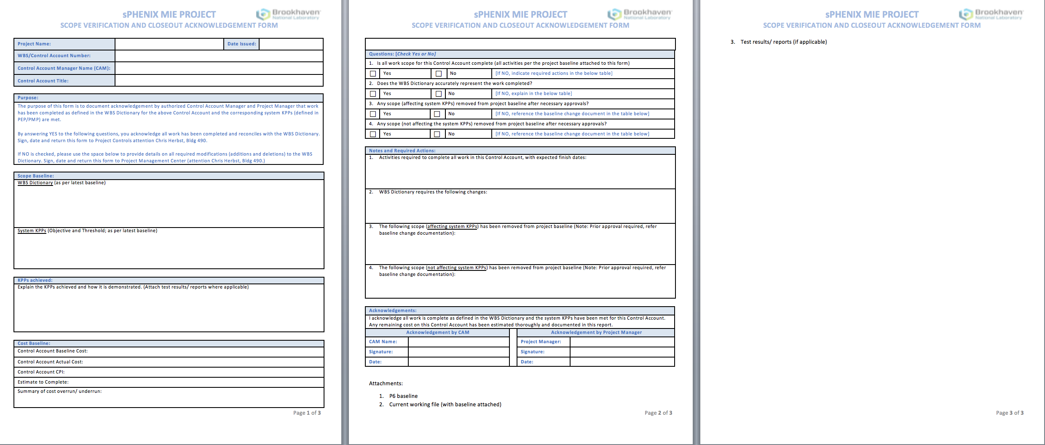
PD-4 Scope Verification Document
I do not see a problem having the L2 Managers fill out this document prior to the PD-4 Verification Review

Slide 9
IRR/ARR Planning
SAD draft is complete and has been distributed to CAD and sPHENIX for comment.
Ray Fliller recommends holding the ARR soon after last detector gets installed (MBD). And holding IRR 6 weeks prior.
However we may be able to negotiate one combined ATT/IRR review.

Slide 10
EV Slides

Slide 11
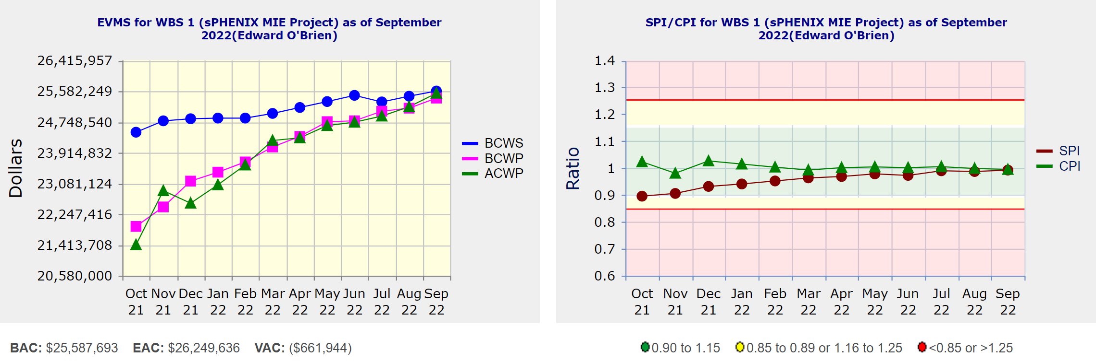
Performance Indices – sPHENIX MIE
Cumulative SPI | Cumulative CPI
0.99 | 0.99
Cumulative BCWS (Scheduled) | $25,587,693
Cumulative BCWP (Performed) | $25,395,893
Cumulative ACWP (Actual) | $25,526,499
DOE SPI or CPI Value Thresholds
0.90 to 1.15
0.85 to 0.89 or 1.16 to 1.25
<0.85 or >1.25

Slide 12
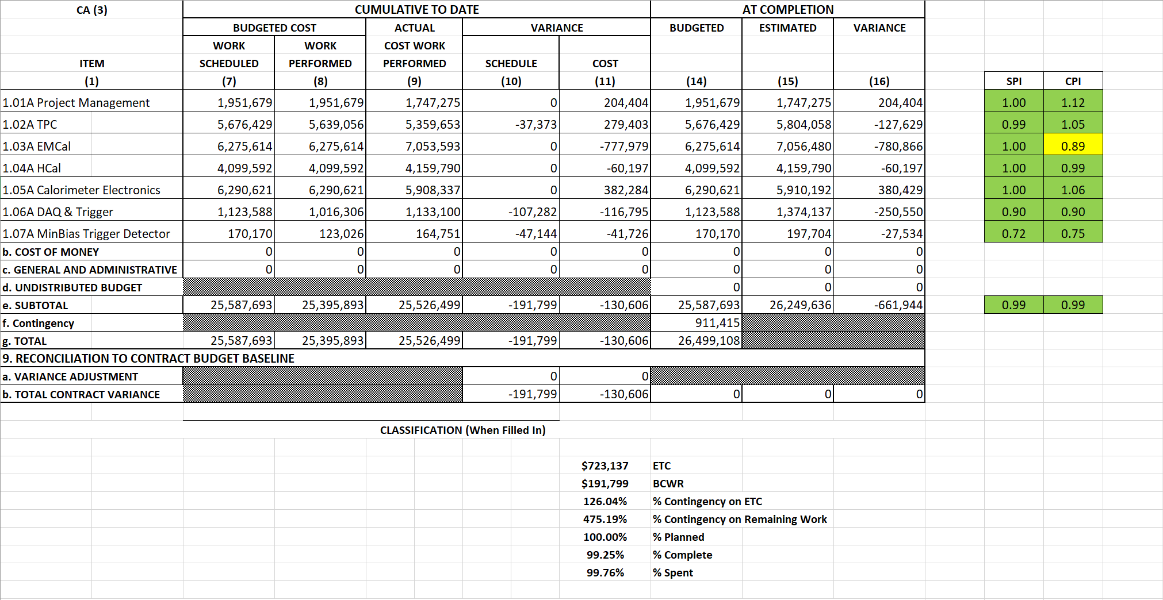
Cost Performance Report (CPR) – sPHENIX MIE
DOE SPI or CPI Value Thresholds
0.90 to 1.15
0.85 to 0.89 or 1.16 to 1.25
<0.85 or >1.25
*Highlights in table above takes variance $ into consideration, not just Indices

Slide 13
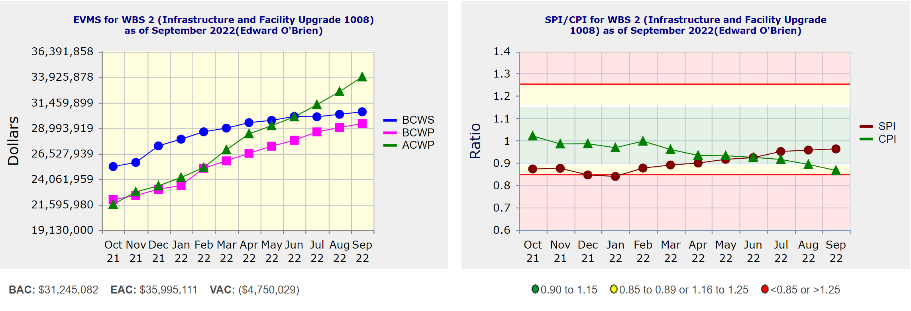
Performance Indices – 1008 Infra and Facility Upgrade
Cumulative SPI | Cumulative CPI
0.96 | 0.87
Cumulative BCWS (Scheduled) | $30,544,411
Cumulative BCWP (Performed) | $29,408,051
Cumulative ACWP (Actual) | $33,926,075
DOE SPI or CPI Value Thresholds
0.90 to 1.15
0.85 to 0.89 or 1.16 to 1.25
<0.85 or >1.25

Slide 14
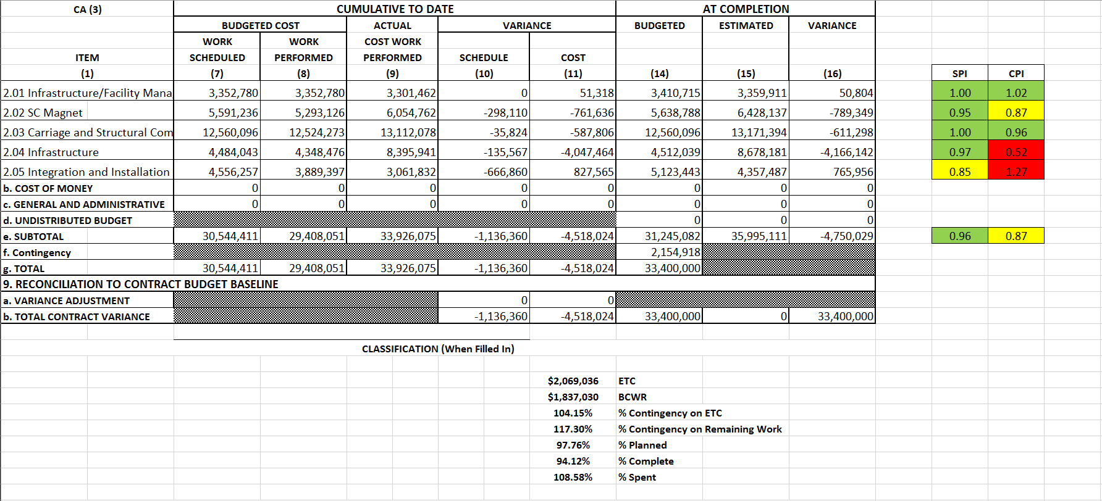
Cost Performance Report (CPR) – 1008 Infra and Facility Upgrade
DOE SPI or CPI Value Thresholds
0.90 to 1.15
0.85 to 0.89 or 1.16 to 1.25
<0.85 or >1.25
*Highlights in table above takes variance $ into consideration, not just Indices

Slide 15
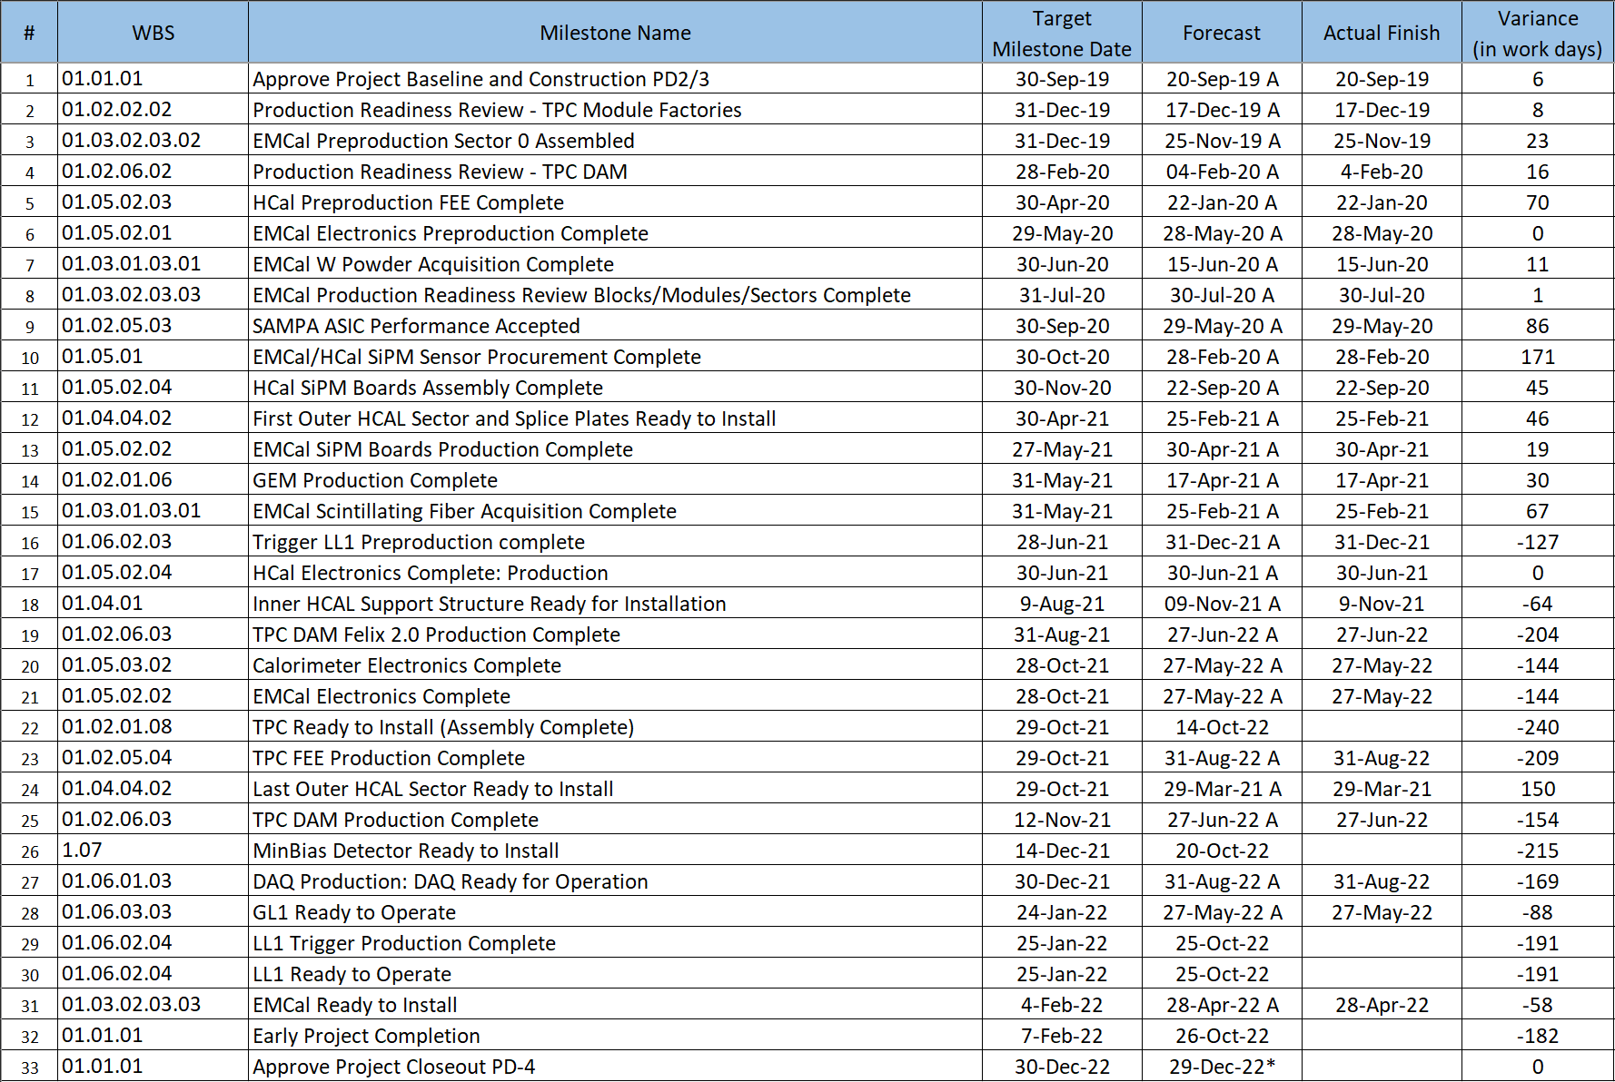
Milestones Status – sPHENIX MIE

Slide 16
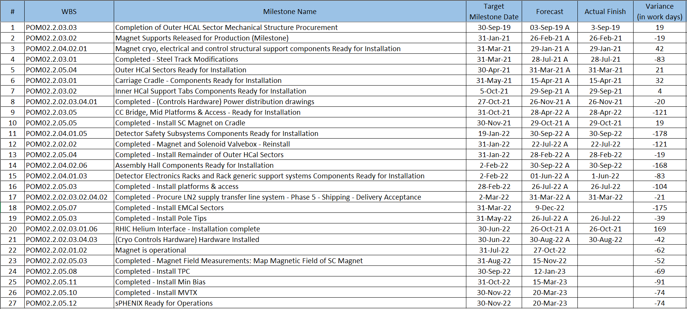
Milestones Status – 1008 Infra and Facility Upgrade

Slide 17
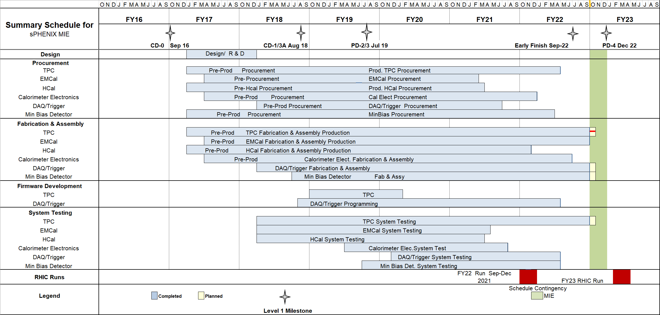
Summary Schedule – sPHENIX MIE

Slide 18
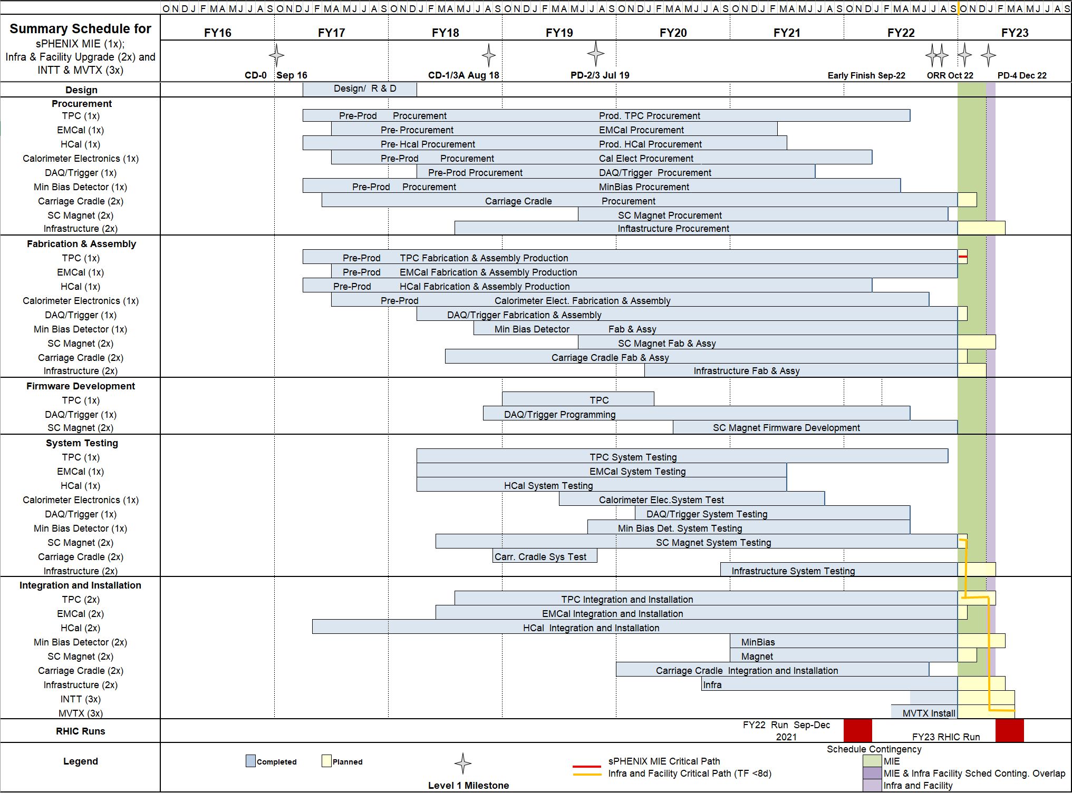
Summary Schedule – sPHENIX MIE and 1008 Infra and Facility Upgrade

Slide 19
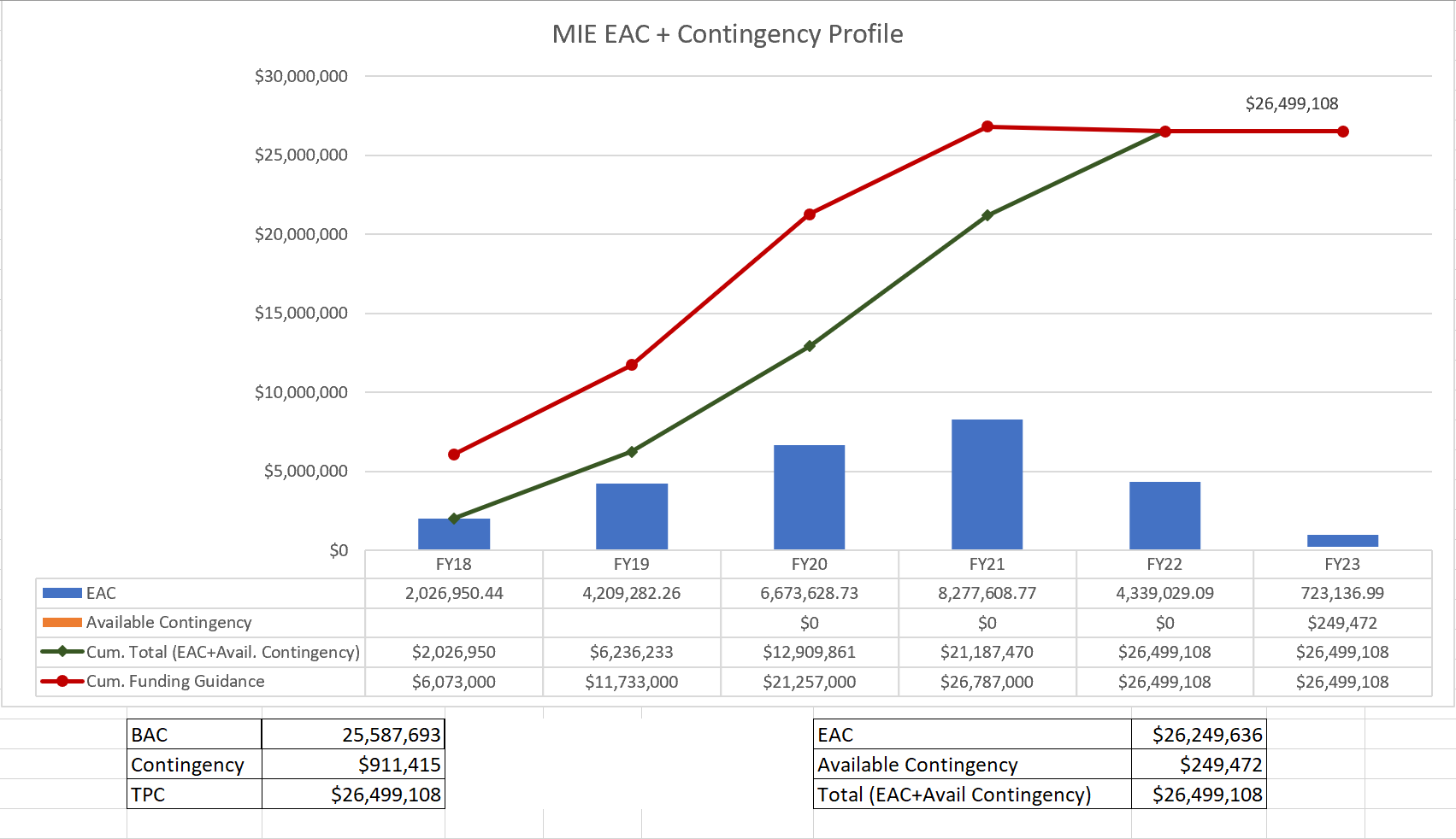
EAC and Contingency Profile – sPHENIX MIE

Slide 20
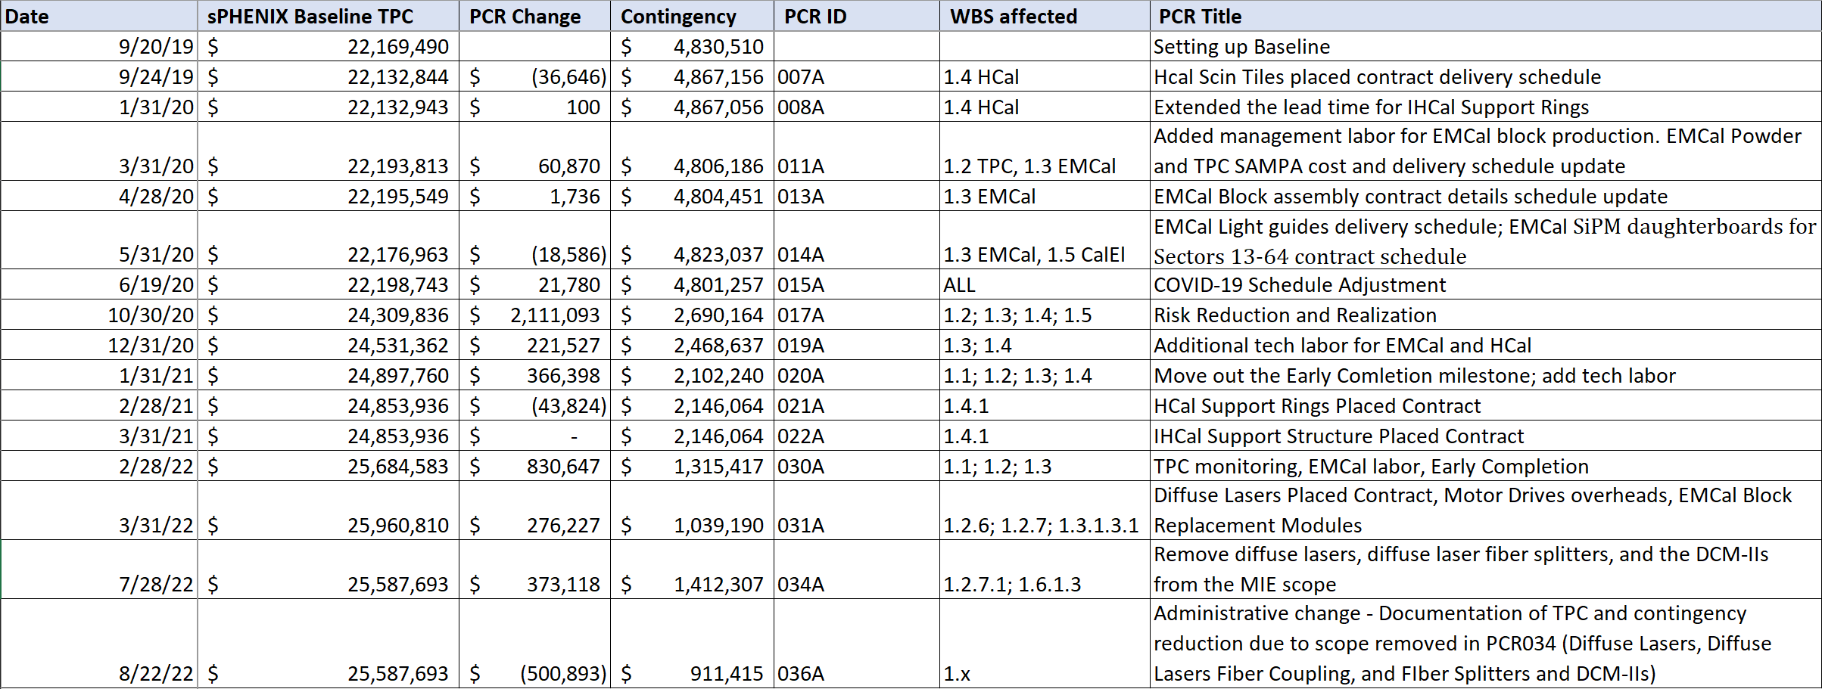
Baseline/Contingency Log and ETC adjustment Log - MIE
ETC Adjustments
Control Account | Aug’21 | Sep’21 | Oct’21 | Nov’21 | Dec’21 | Jan’22 | Feb’22 | Mar’22 | Apr’22 | May 22 | Jun’22 | July 22 | Aug’ 22 | Sep’ 22
1.02 | 326,377 | 556,377 | 716,238 | 725,089 | 722,064 | 703,567 | 244,065 | 228,272 | 250,324 | 344,847 | 332,160 | 606,391 | 311,838 | 407,032
1.03 |  |  |  | 34,439 | 18,420 | 17,328 | 67,559 | 9,776 | 9,766 | 5,999 | 5,999 | 5,999 | 5,999 | 2,887
1.05 | $22,833 | $22,833 | 219,343 | 414,468 | 250,807 | -6,101 | 87,313 | 11,509 | 10,098 | 3,112 | 3,112 | 3,112 | 1,855 | 1,855
1.06 | $79,352 | $79,352 | $26,259 | -62,490 | -63,278 | -63,278 | -45,001 | -45,001 | -43,839 | -81,200 | -81,870 | 111,590 | 140,218 | 129,421
1.07 | $25,705 | $25,705 | $16,041 | 16,575 | 8,731 | 8,731 | -7,013 | -1,748 | -1,747 | -11,118 | -11,333 | -18,835 | -9,693 | -16,096
Total | 454,267 | 684,267 | 977,880 | 1,128,081 | 936,744 | 660,247 | 346,923 | 202,798 | 224,602 | 261,640 | 248,068 | 708,257 | 450,217 | 525,099

Slide 21
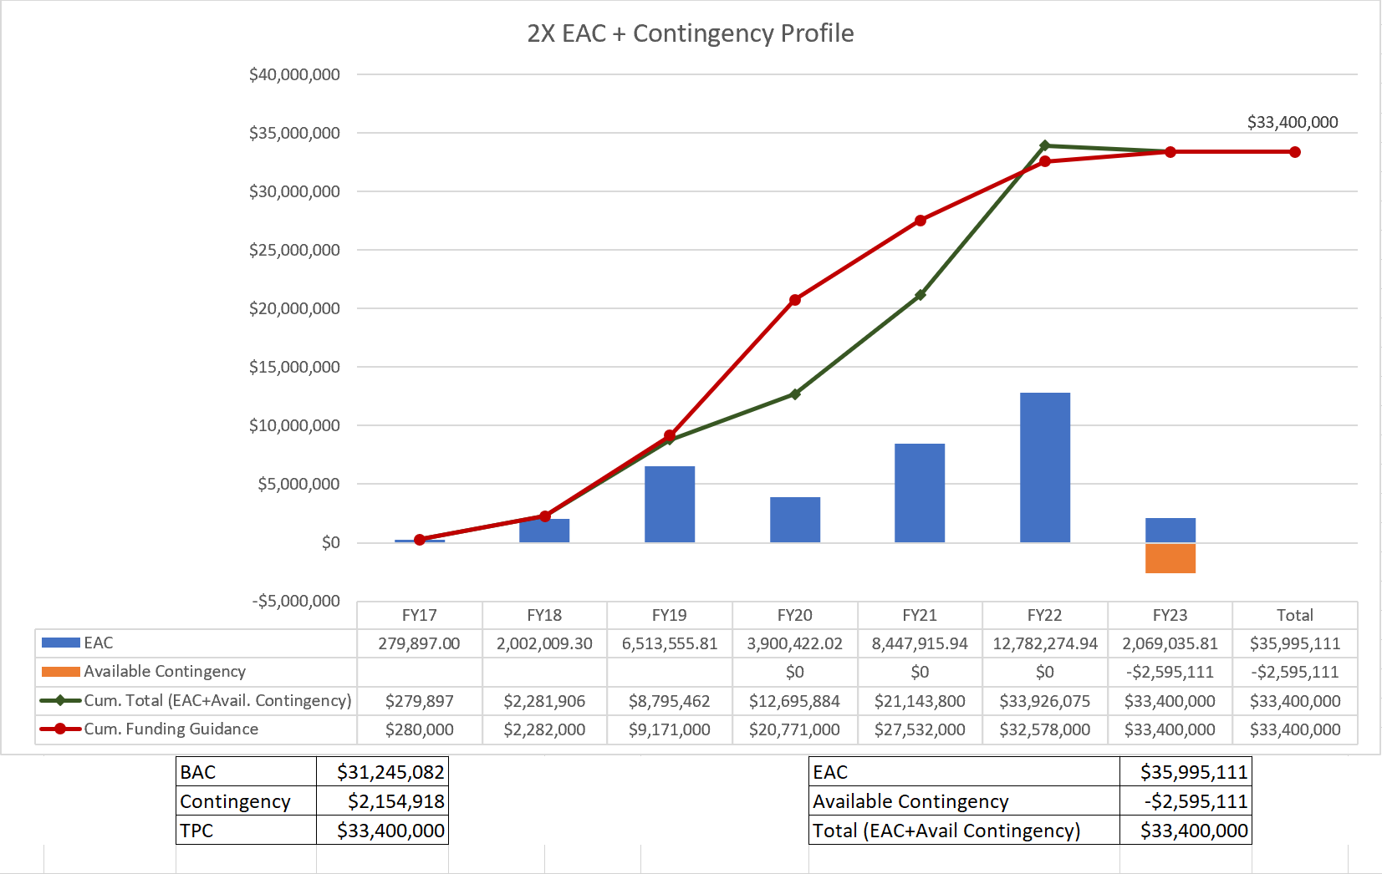
EAC and Contingency Profile – 1008 Infra and Facility Upgrade

Slide 22
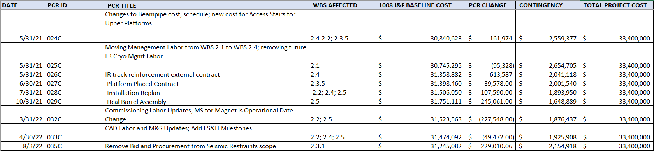
Baseline/Contingency Log and ETC adjustment Log – 2.X
ETC Adjustments
Control Account | Sep’21 | Oct’21 | Nov’21 | Dec’21 | Jan’22 | Feb’22 | Mar’22 | Apr’22 | May 22 | Jun’22 | July 22 | Aug’ 22 | Sep’ 22
2.1 |  |  |  |  |  |  |  |  |  |  |  |  | 514
2.2 | - | - | - | - | 20,551 | 14,635 | 8,407 | 15,713 | 32,069 | 44,483 | 41,629 | 17,840 | 18,437
2.3 | 90,775 | 70,349 | 125,472 | 102,957 | 117,533 | 102,161 | 138,461 | 57,622 | 57,458 | 43,393 | 16,113 | 17,487 | 21,608
2.4 | 70,160 | 350,388 | 152,069 | 69,283 | 23,810 | 296 | 52,663 | 92,478 | 121,081 | 127,664 | 158,728 | 88,852 | 113,343
2.5 | - | 73,413 | 63,117 | 161,496 | 208,816 | 136,000 | - | - | - | - | - | 39,872 | 39,872
Total | 160,935 | 494,150 | 340,658 | 333,737 | 370,709 | 253,092 | 199,530 | 165,812 | 210,609 | 215,541 | 216,470 | 164,050 | 193,774

Slide 23
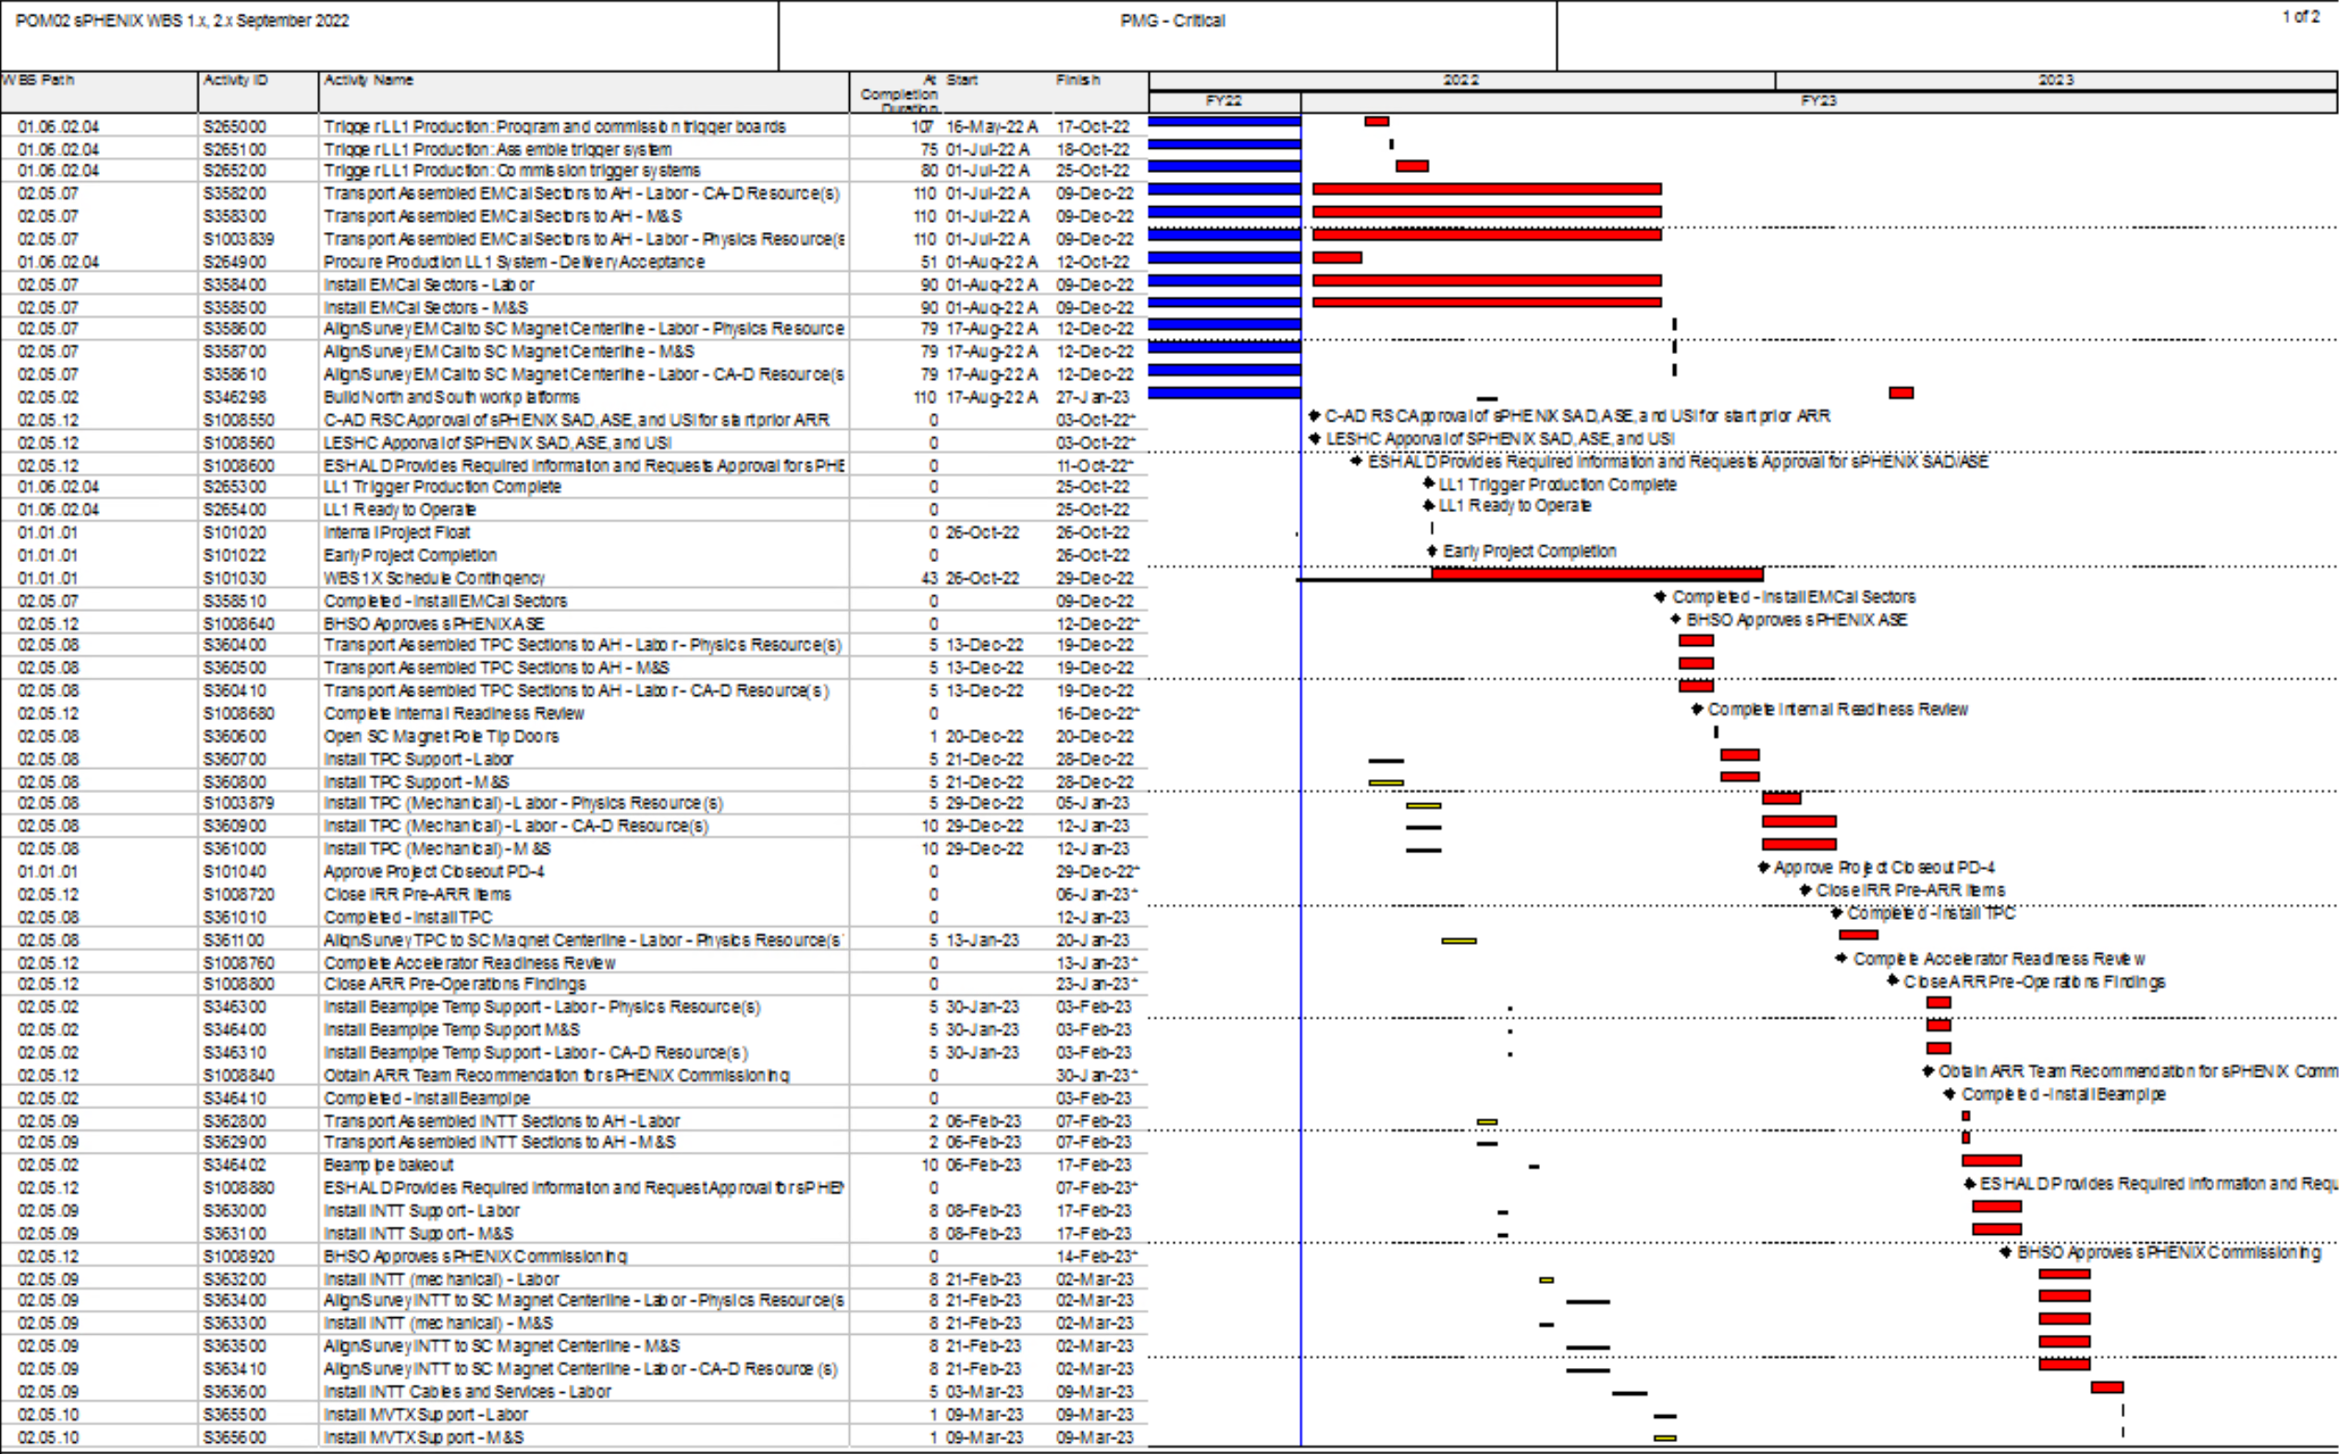
Critical Path (1x, 2x and 3x Combined)

Slide 24
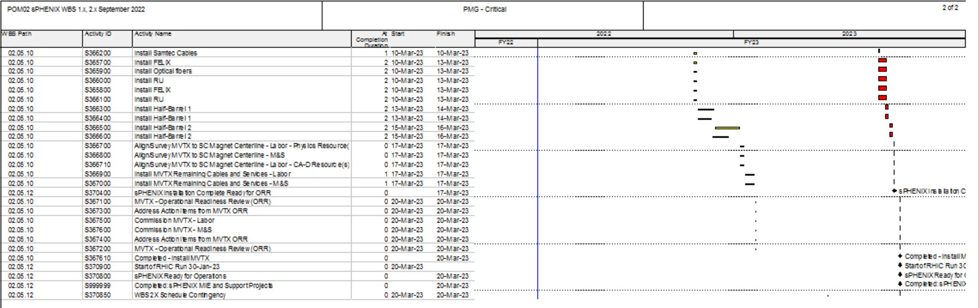
Critical Path (1x, 2x and 3x Combined)

