Slide 1
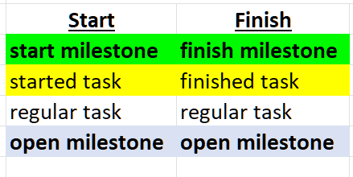
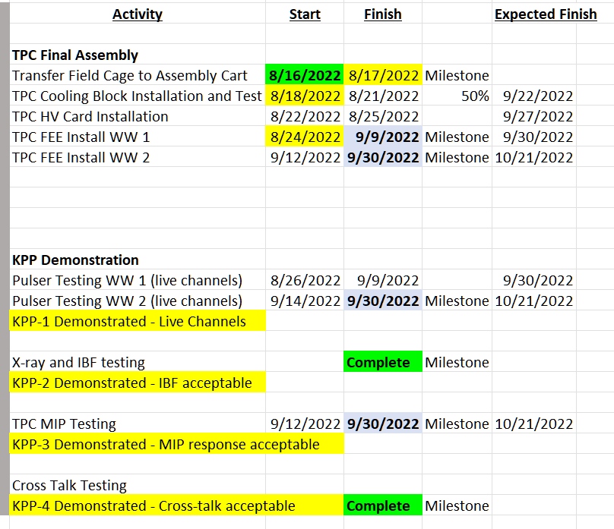
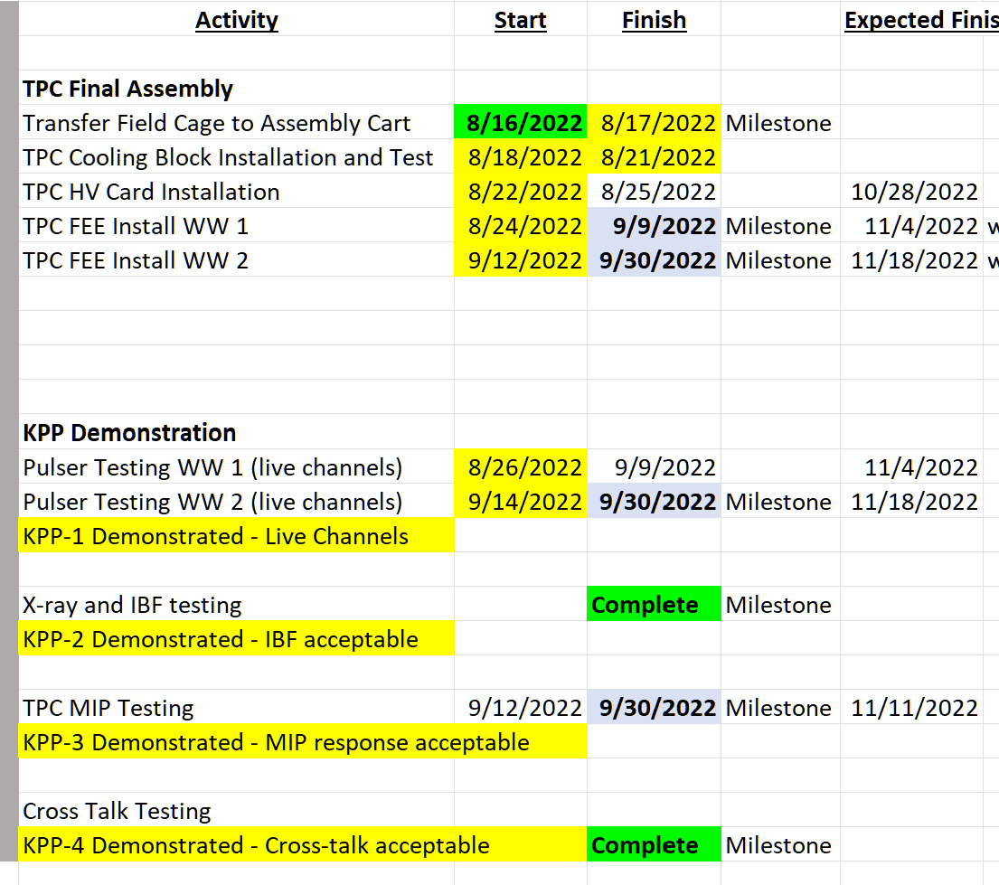
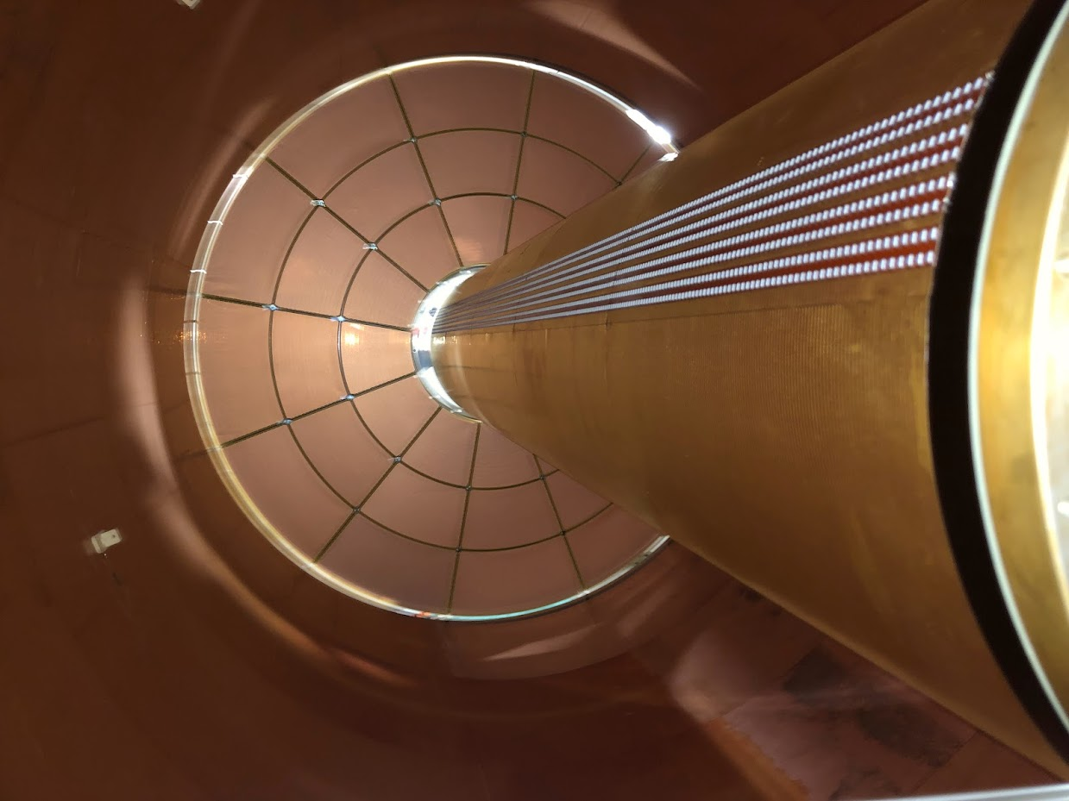
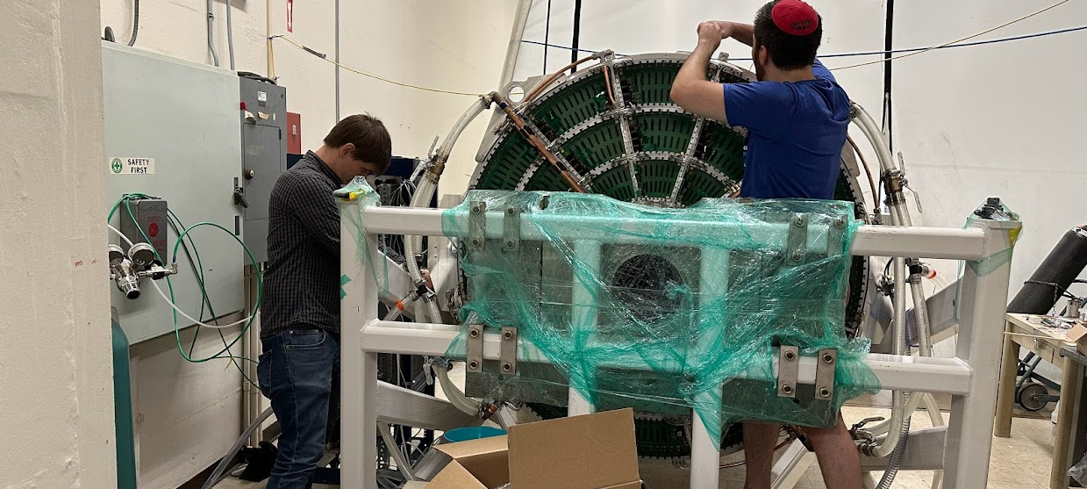
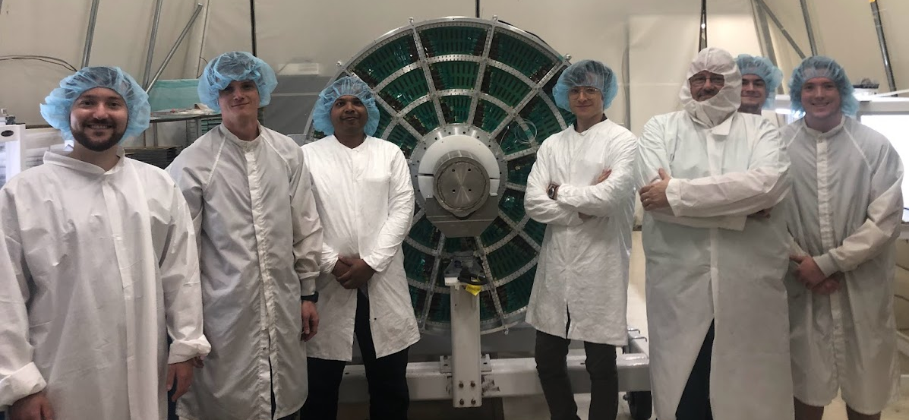
TPC Completion Schedule
TK Hemmick

Slide 2
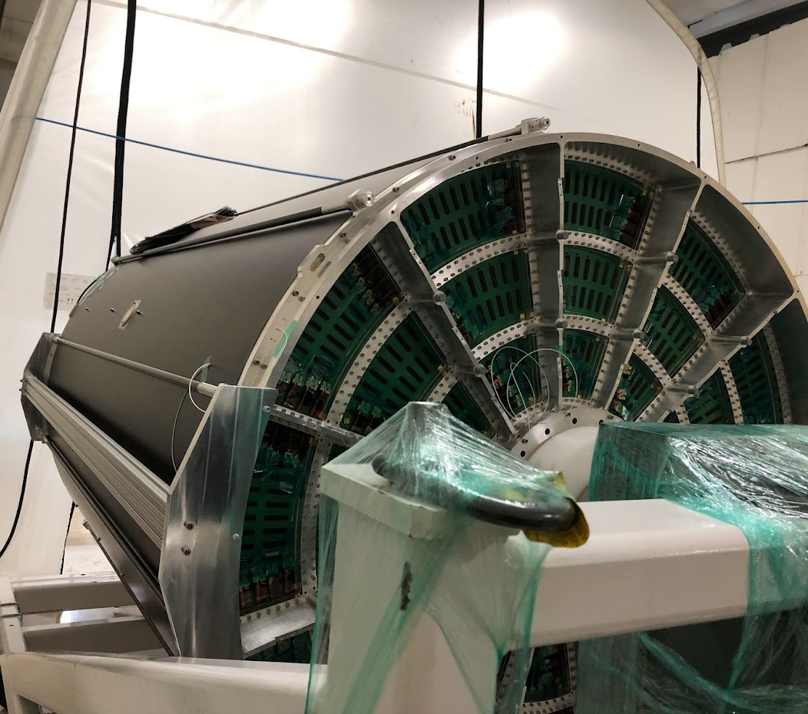
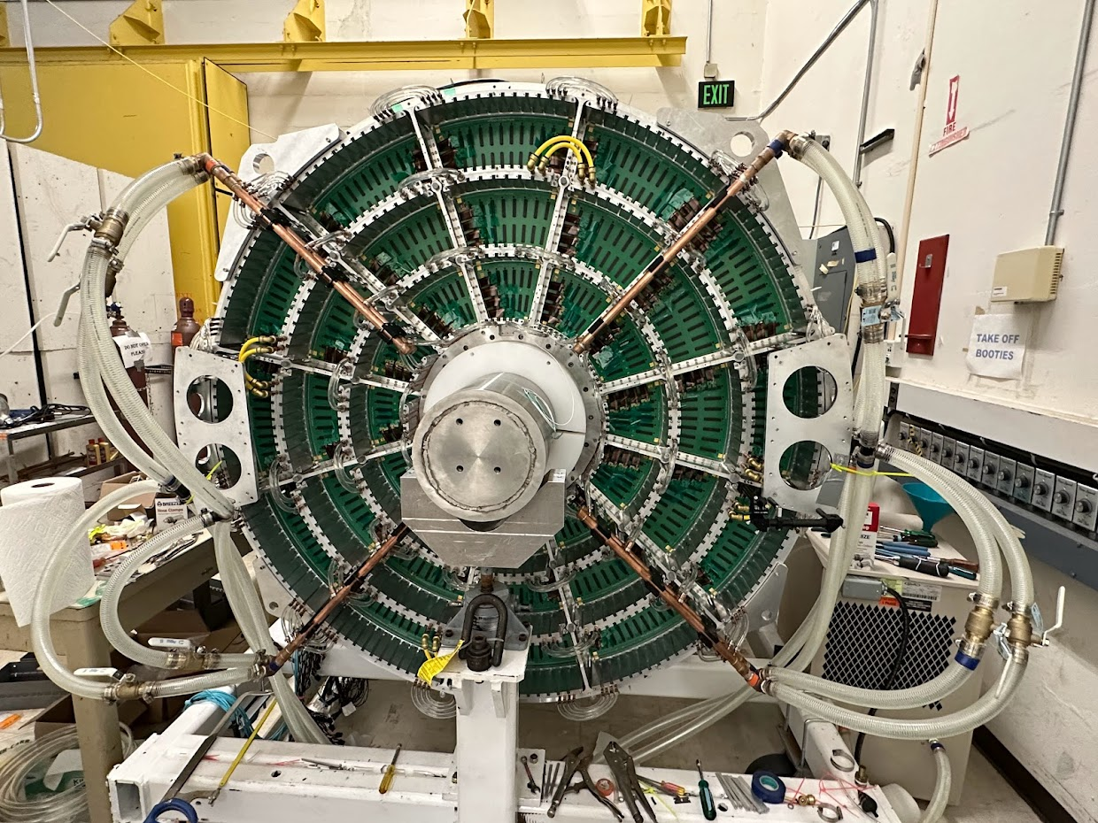
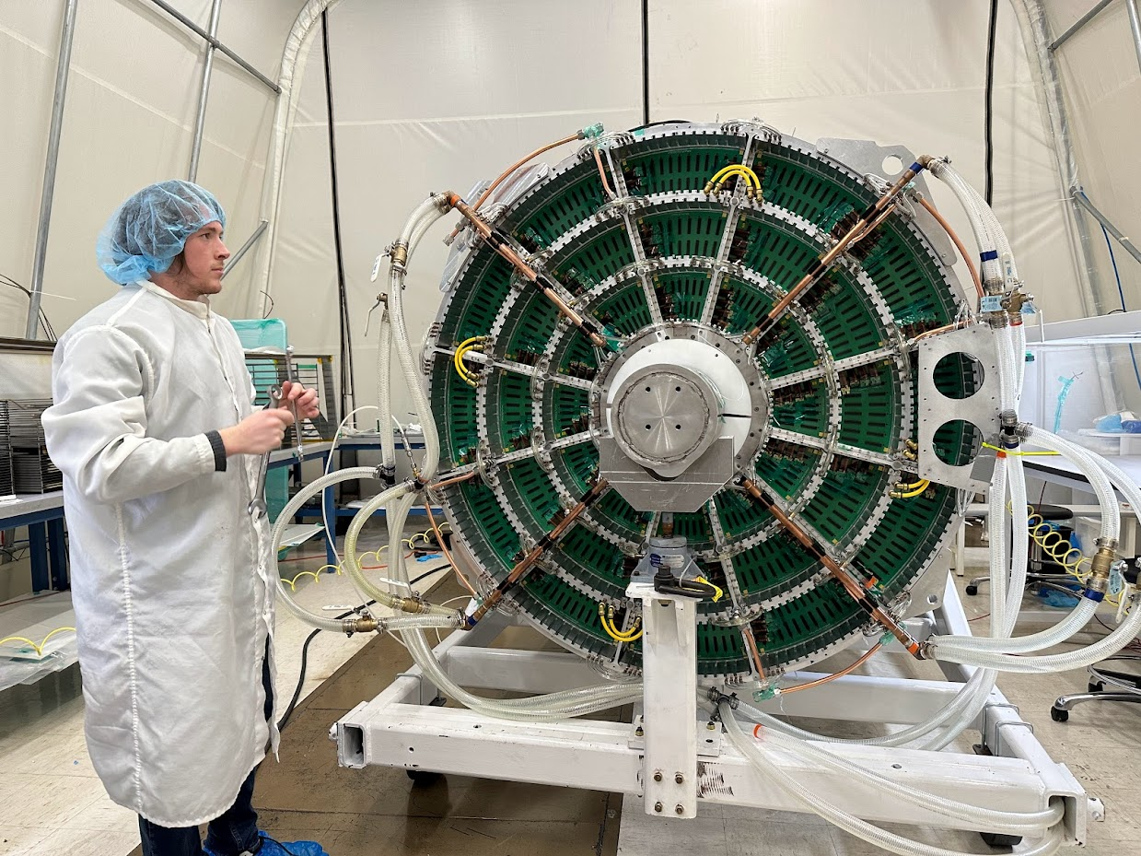
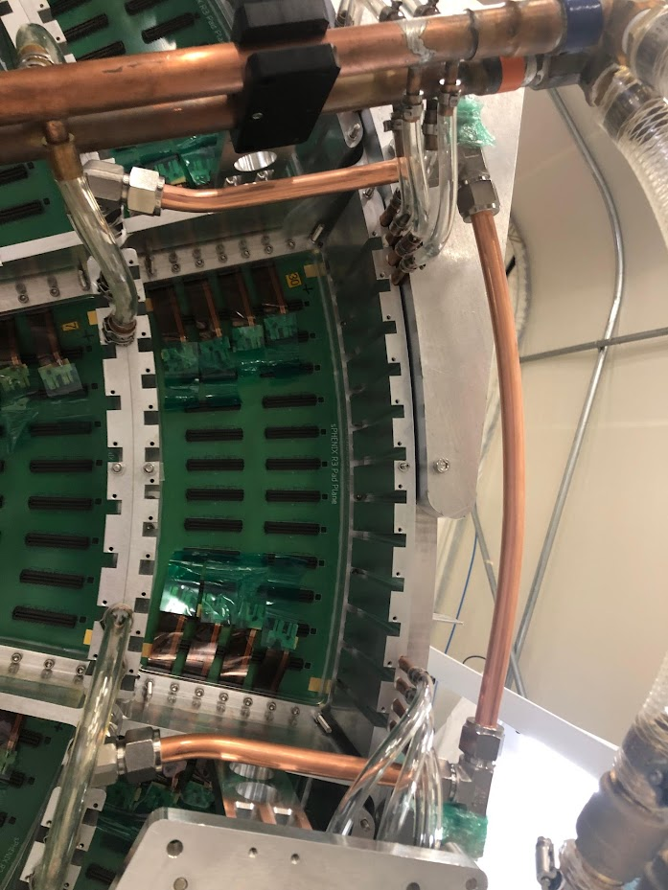
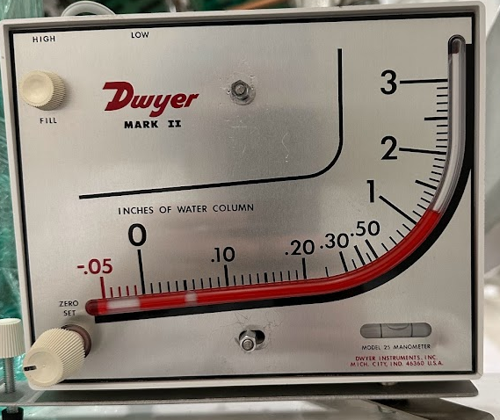
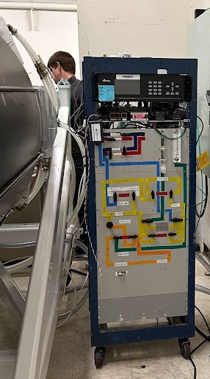
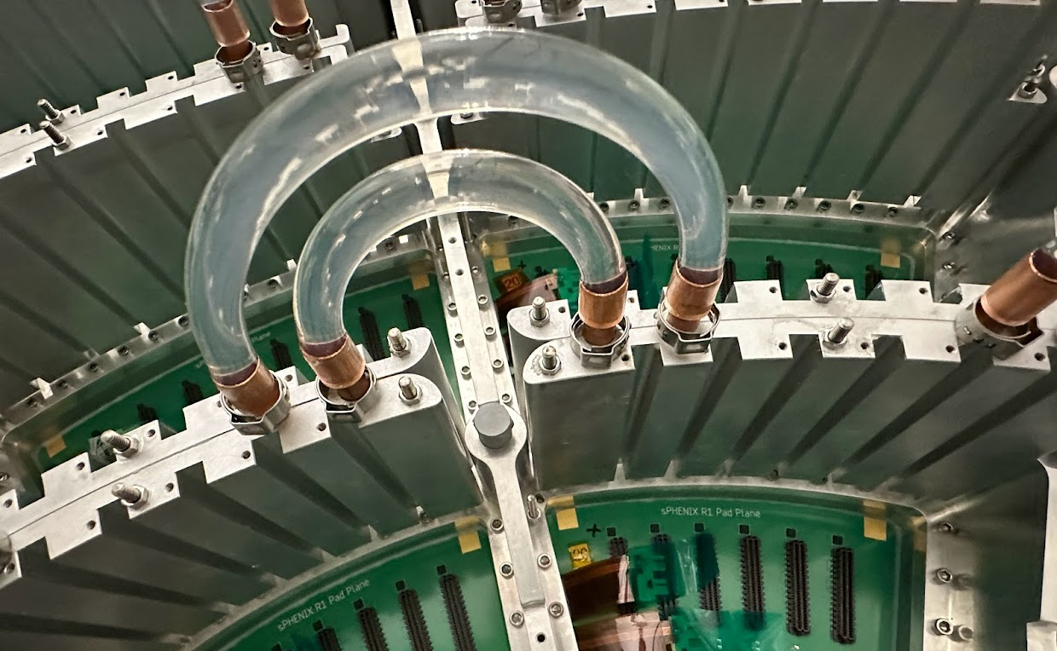

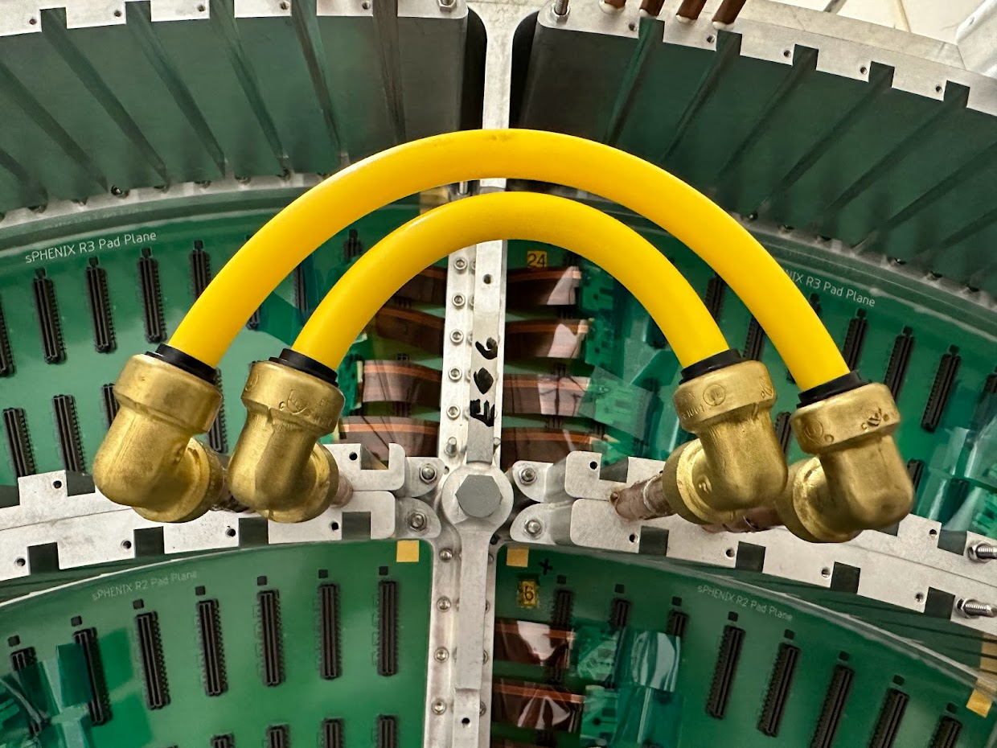
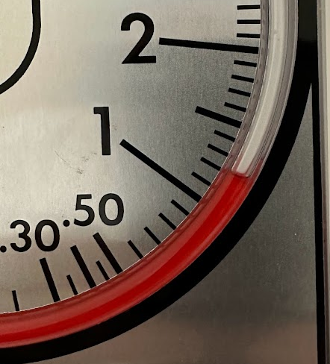
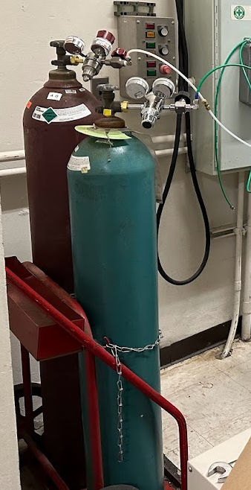
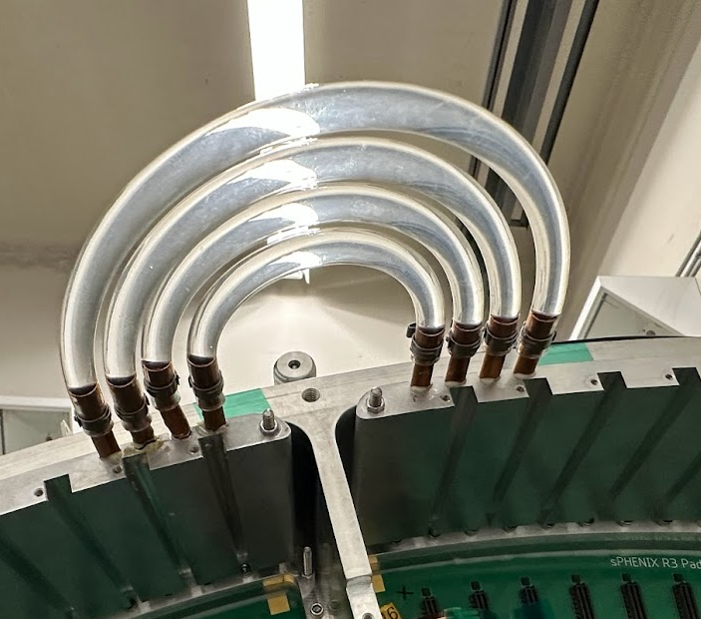
TPC Non-Electrical Services (Done)
Where we left off
Cooling fully installed and leak free (wide hoses temporary)
Wide Tubes
Leak Down
Laser Port
Gas Fittings in Clean Room
Close Up
Ar/CF₄
Gas Flows 24/7
Narrow Tubes

Slide 3
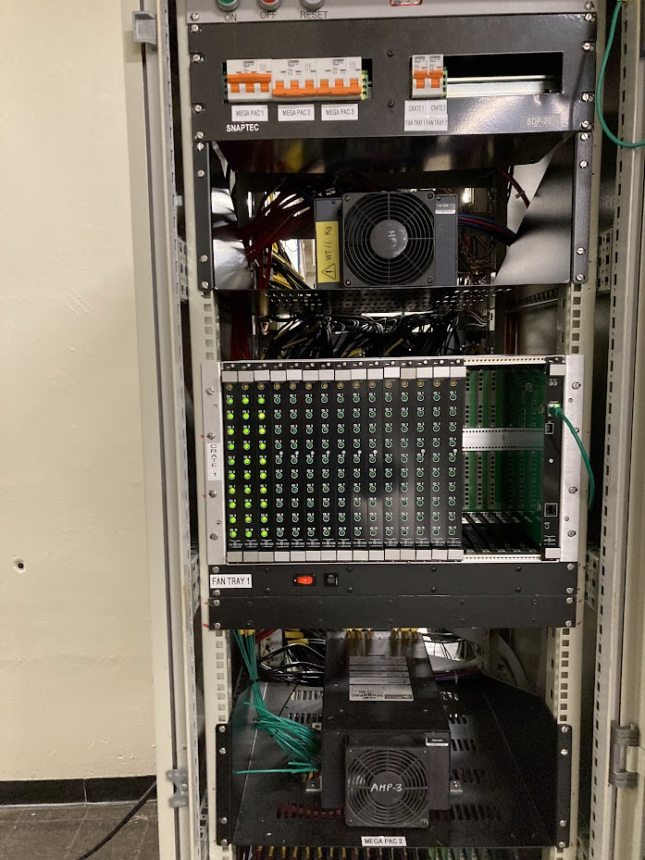
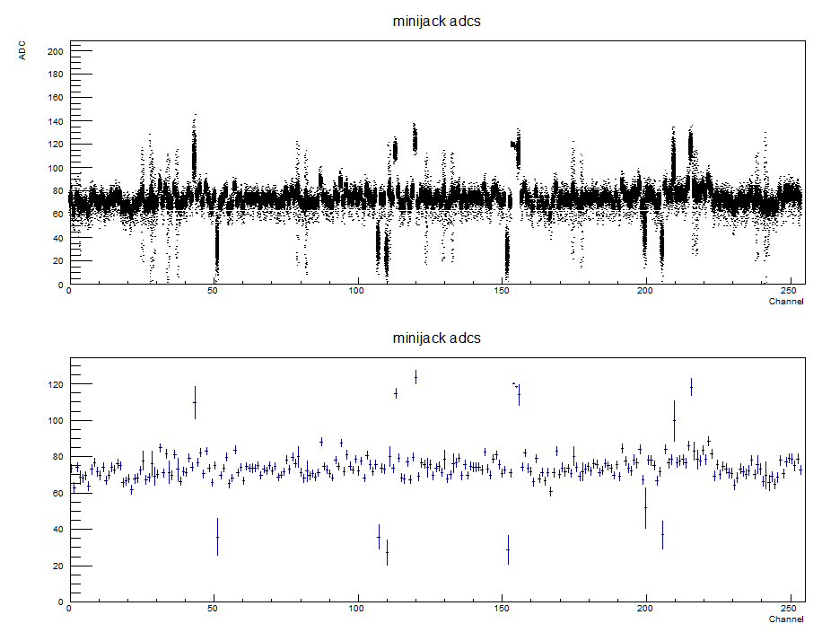
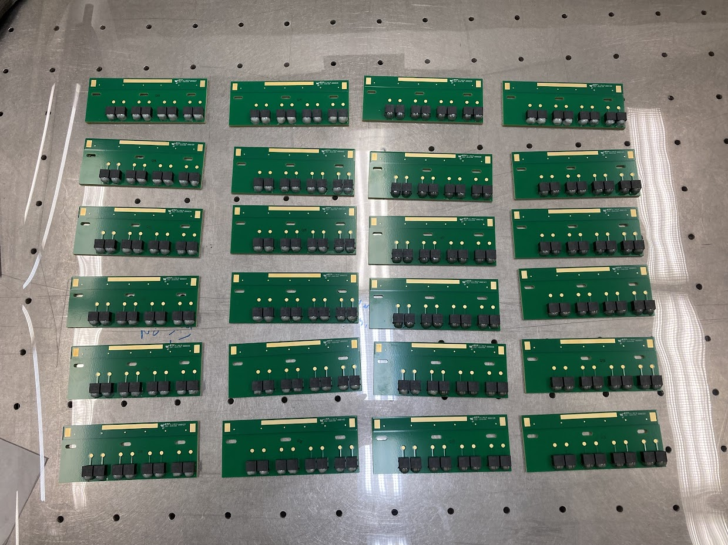
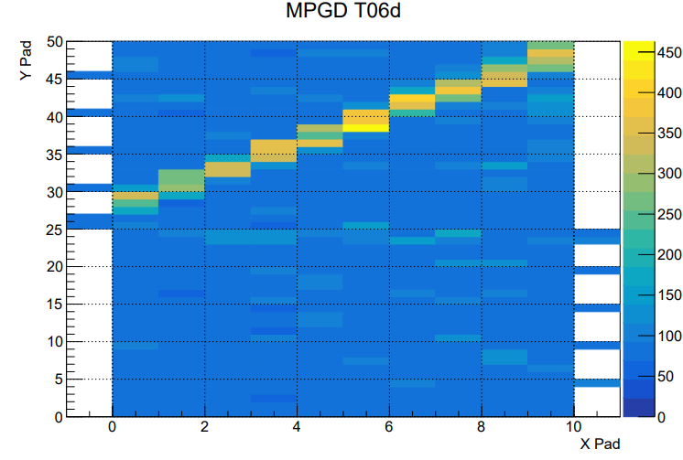
TPC Electrical Services
Pedestals Read (SBU…not BNL)
DC Low Voltage
HV cards:
75% = “chain”, 25% = “mirror”
Mirror on hand, chain promised 10/21.
Company claims COVID delay.
Maybe Friday, but not promised.
FEE cards:
All cards exist
require burn-in, test, FPGA
50% done.
MirrorCards
Mini TPC Tracks
Mitigation (enhanced readiness):
MIP & Laser tracks in MiniTPC at BNL
Pedestals at SBU
Tension between goals:
Can do “live channels” test before HV cards.
Would require disassembly of FEE when HV arrives.

