Slide 1
TPOT Status
Hugo Pereira Da Costa (LANL),
for the TPOT team
PMG meeting, October 27, 2022

Slide 2
Updates since PMG 2022/09/22
Micromegas detectors
all modules tested at SBU. 8 Fully functional modules identified for assembly on TPOT structure
for the remaining two modules: one has 1 problematic HV channel (trips). The second is missing metrology. Are kept as “spare” in case something happen before TPOT installation
Mechanics
TPOT support structure has been fully assembled at BNL, on transportation cart.
Detector installation on support structure and cabling completed
Pre-installation system tests nearly completed. Until end November
TPOT installation mechanics: all parts ordered. Some received, need machining at BNL shop.

Slide 3
High level milestones and risk
Milestone | date | Status | risk
Number of TPOT modules produced | Today | 10 | done
FEA analysis finished and reviewed | 18/05/22 | FDR happened. more FEA analyses requested. Agreed with TC to move forward | done
First batch of 5 TPOT Modules assembled & tested (Saclay) | 07/06/22 | 6 modules assembled, test ongoing | done
FEE to detector fabricated and tested | 07/23/22 | cables/boards received on 6/21 | done
HV system tested | 06/16/22 | happened on Week 21 (May 23) | done
Second batch of 5 TPOT modules assembled & tested (Saclay) | 07/22/22 |  | done
Characterization of all TPOT modules at SBU | 09/09/22 | 80% done. Two more modules to test, and 5 channels to recover | done
Gas system designed, ES&H reviewed and tested | 07/07/22  ? | designed and ESRC reviewed on 6/21 | low
TPOT mechanical support assembled | 09/16/22 | delayed due to last minute modifications | done
installation of modules on support structures | 09/23/22 | First 5 modules will be assembled this week. Remaining modules the next, pending validation | done
End of TPOT assembly | 10/21/22 |  | done
Installation of TPOT in sPHENIX | December 5 2022 | also depends on sPHENIX schedule | moderate

Slide 4
Schedule
Schedule as shown during end-game review on October 14
October 2022 | November 2022 | December 2022 | January, February 2023
cable mapping gas, cooling tightness LV/HV connectivity Finalize/fabricate installation mechanics | HV test and cosmics Noise measurements Survey Finalize/fabricate installation mechanics | Installation inside EMCAL, cabling | post installation system test: noise, calibration, alignment

Slide 5
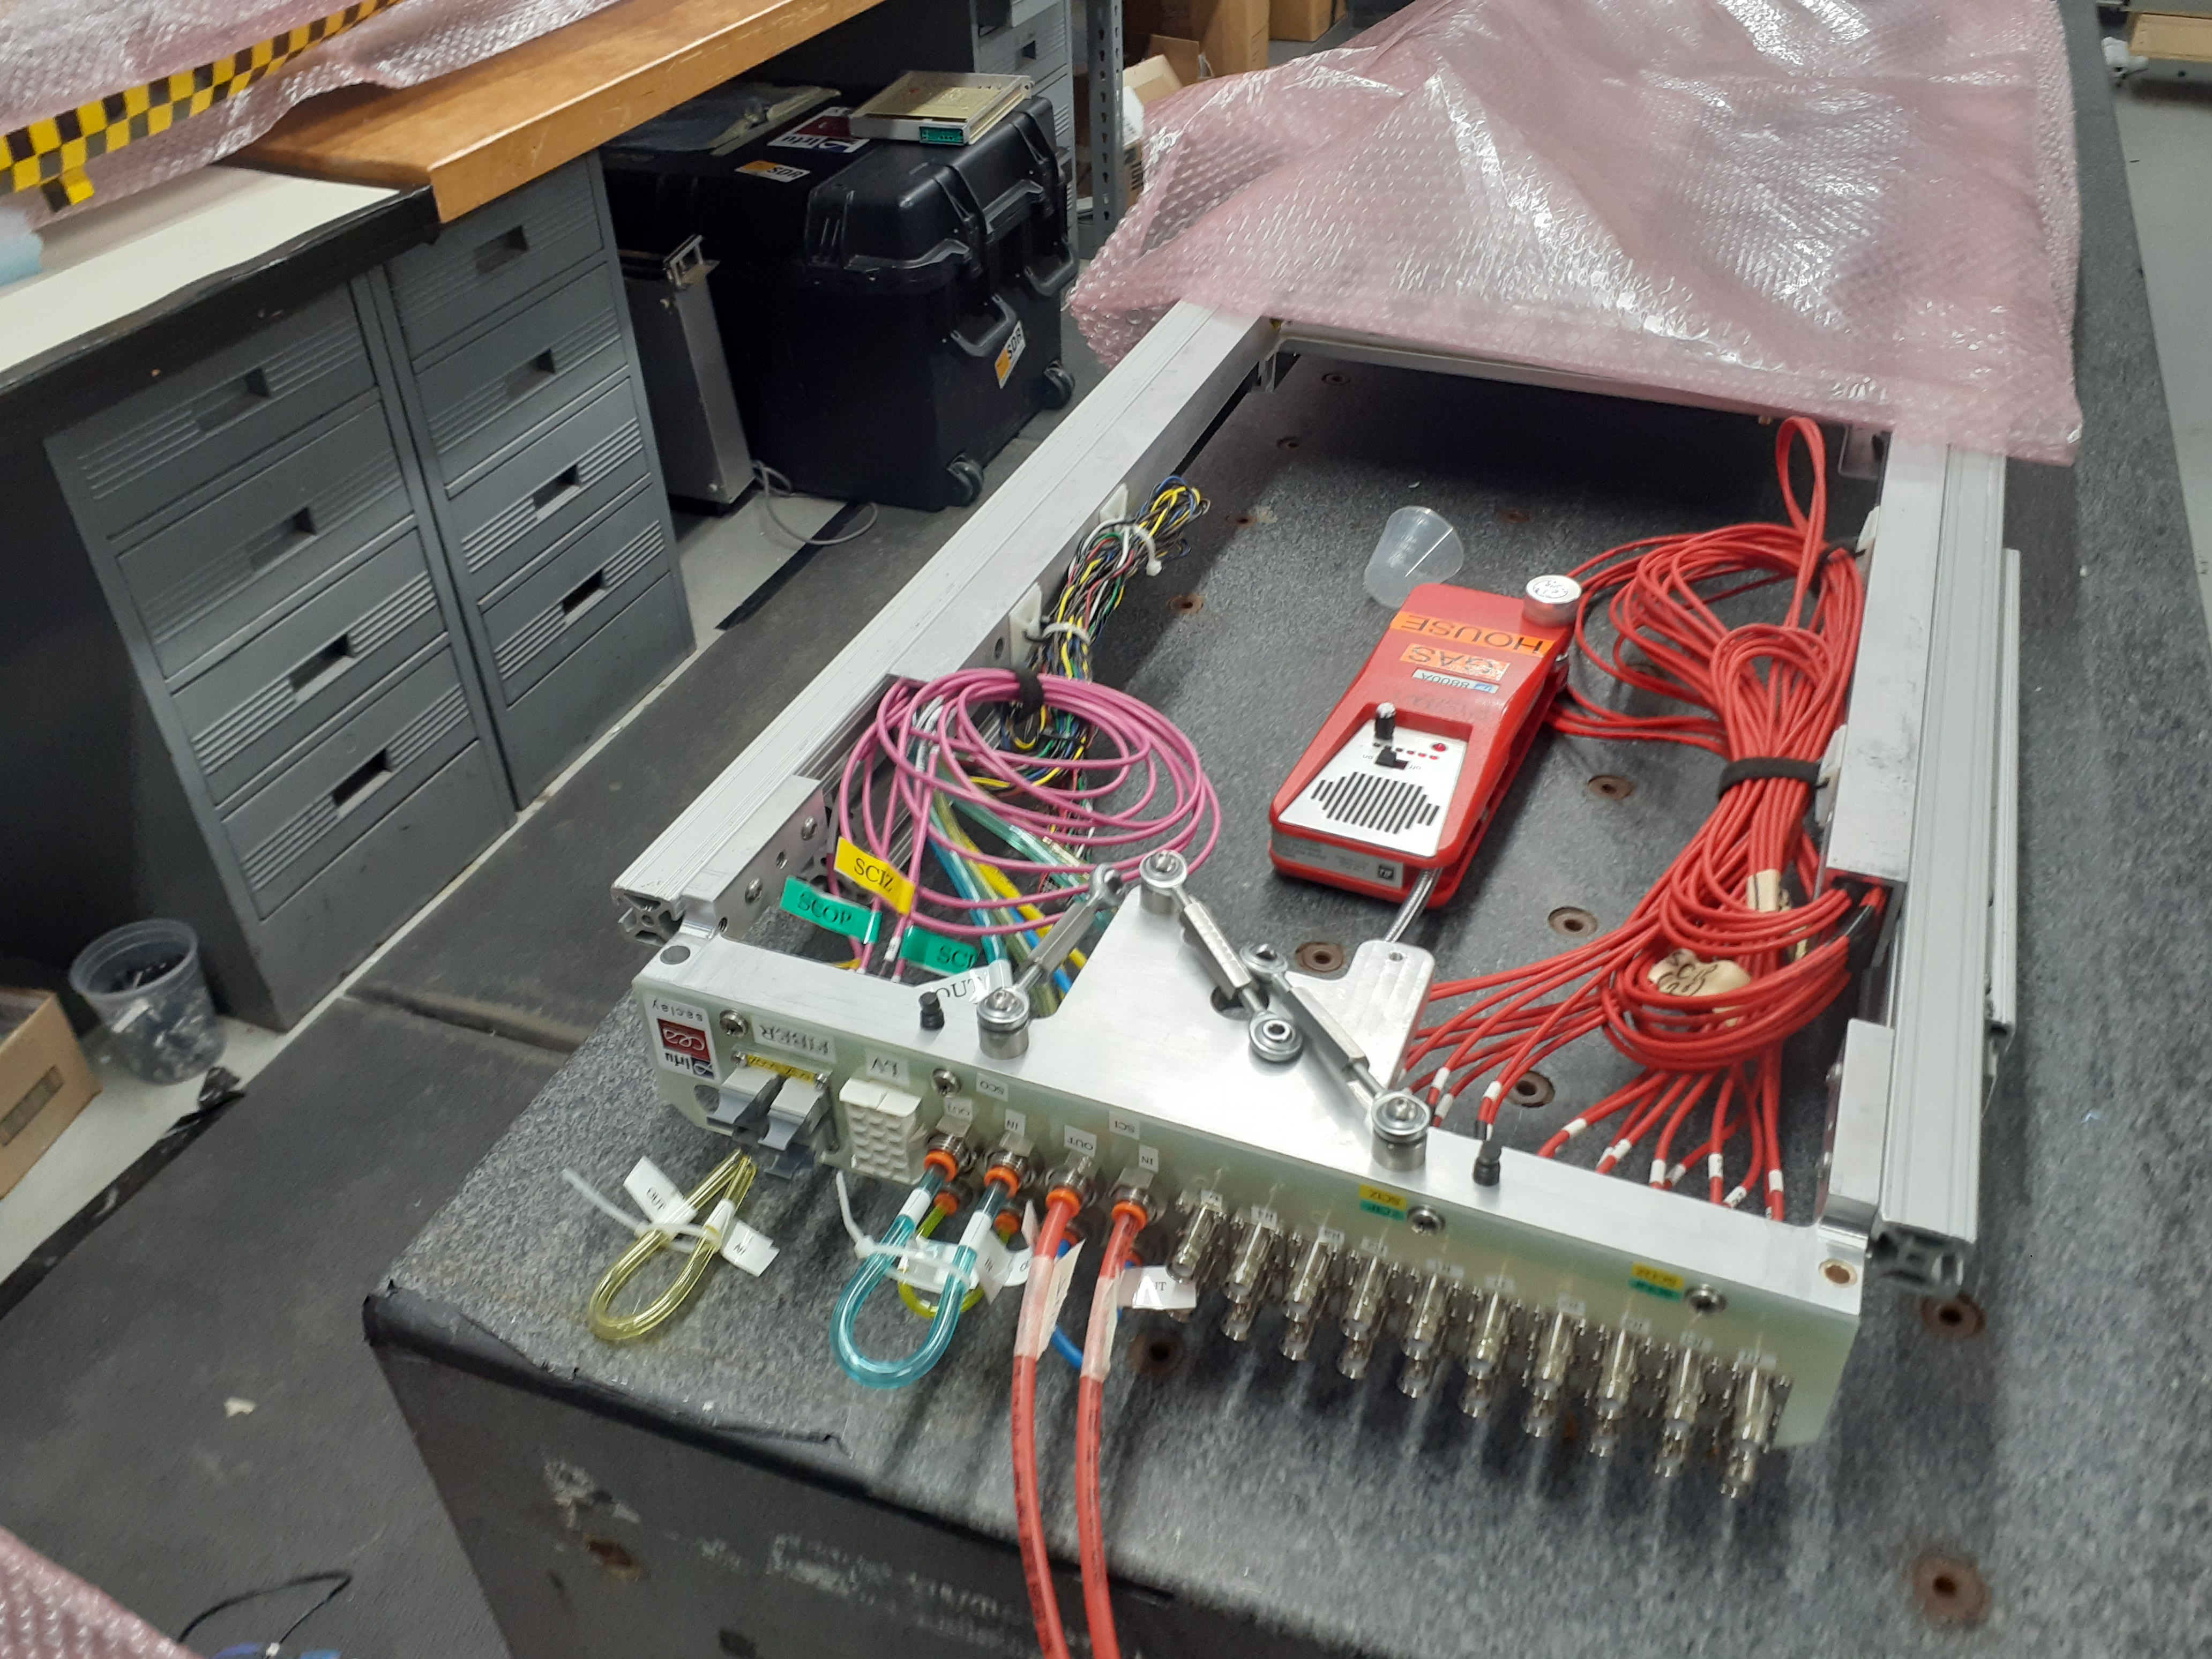
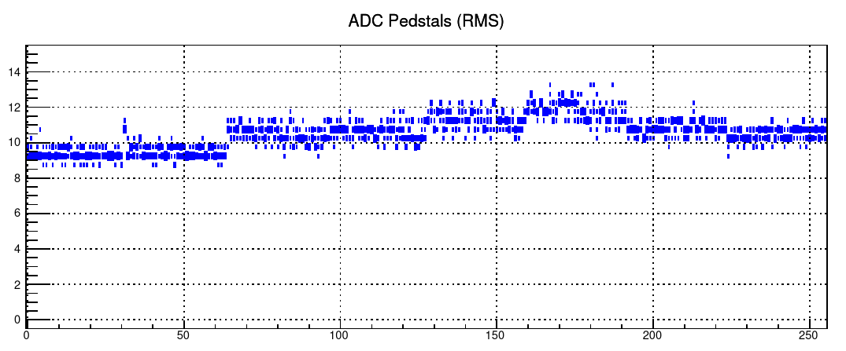
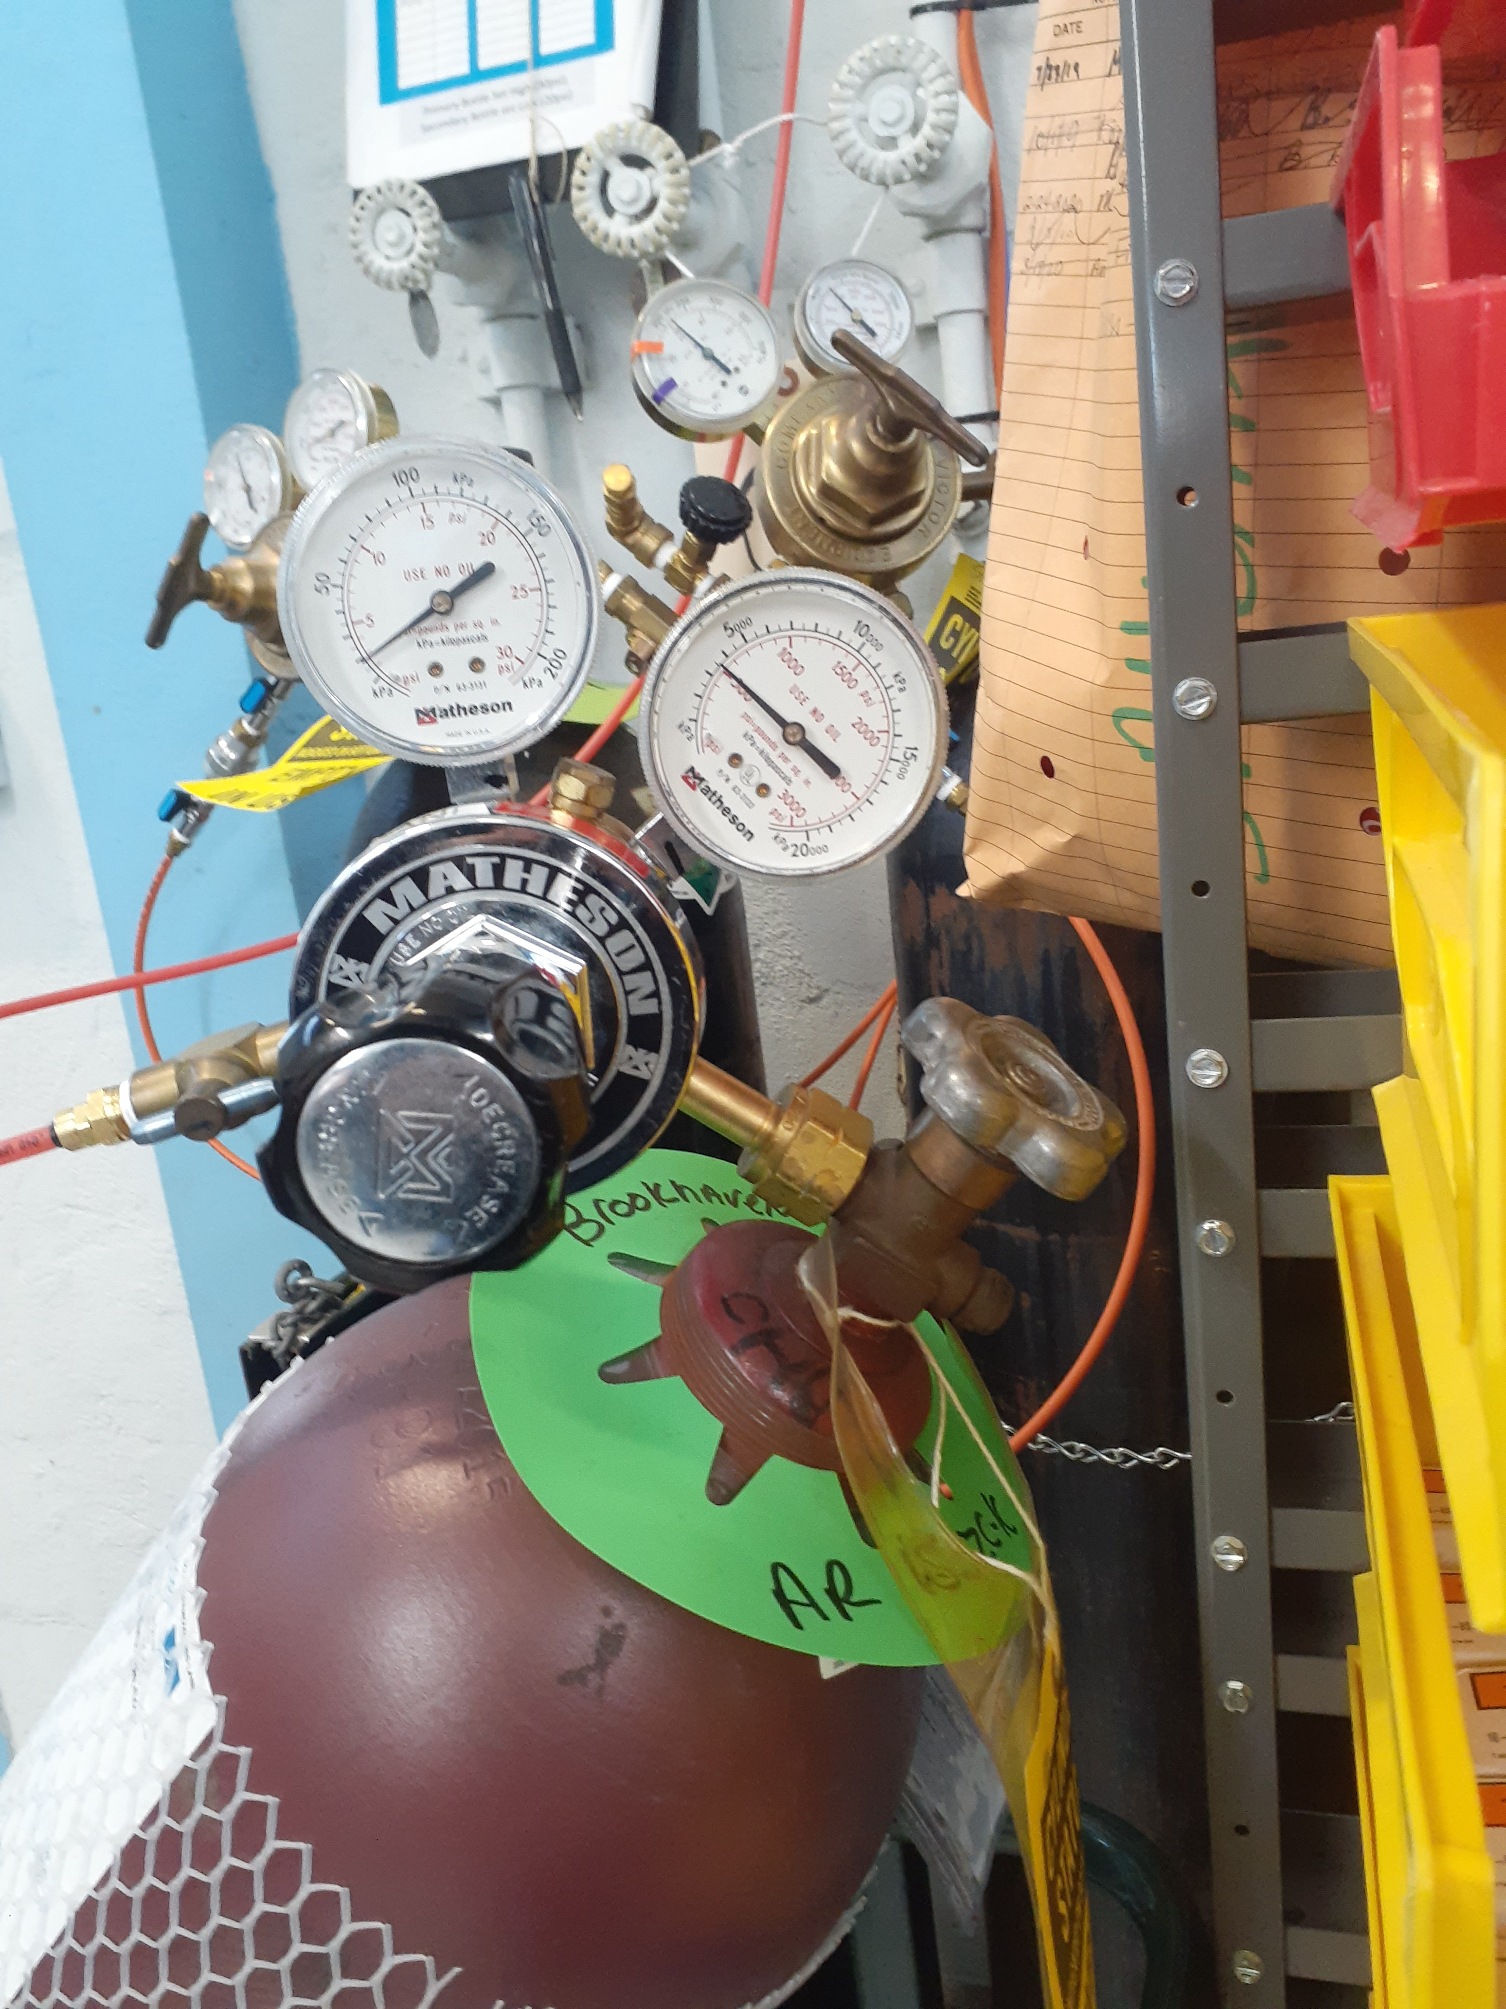
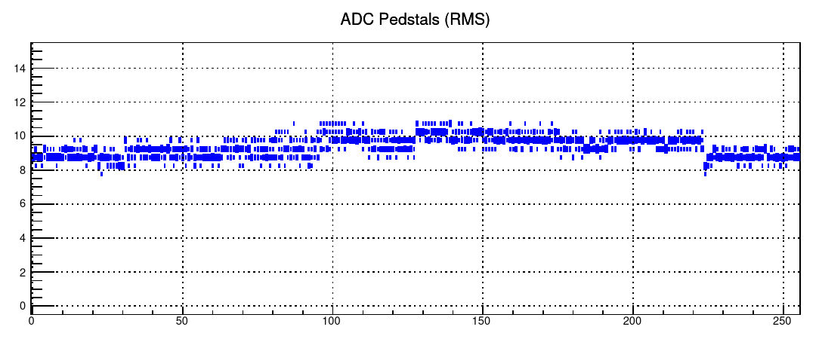
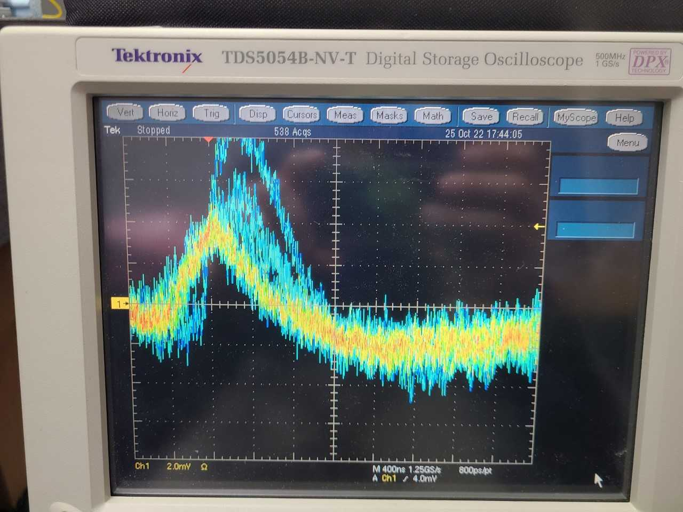
Pictures
NWZ
leak test using Ar/iC4H10
No leak detected in either gas or cooling circuits
SWZ
Noise measurements
All channels respond and are connected to detector
Cosmic signal observed on all modules, all HV channels

