Slide 1
sPHENIX KPP Demonstration and
WBS Dictionary
November 18, 2022
BNL

Slide 2
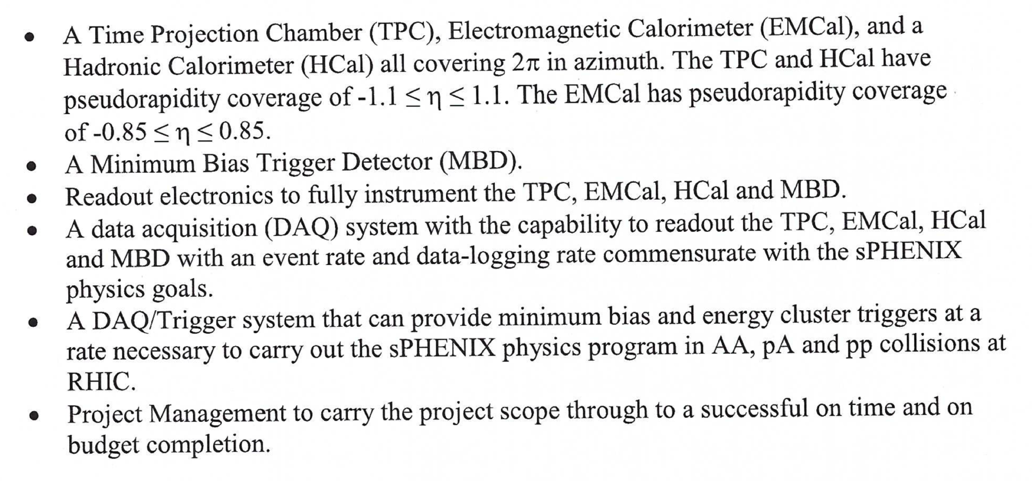
sPHENIX MIE Deliverables

Slide 3
sPHENIX MIE KPP’s
System | Demonstration or Measurement | Threshold KKP’s | Objective KPP’s
Time Projection Chamber | Preinstall, Bench tests | ≥ 90% live channels based on laser, pulser, cosmics | ≥ 95% live channels based on laser, pulser, cosmics
Time Projection Chamber | Preinstall, Bench tests | Ion back flow ≤ 2% per GEM module avgd over active area of ea GEM module | Same
Time Projection Chamber | Preinstall, Bench tests w/ cosmics | ≥ 90% single hit efficiency/mip track, averaged over active TPC volume | ≥ 95% single hit efficiency/mip track, averaged over active TPC volume
Time Projection Chamber Front End Electronics | Preinstall, Fee stand alone bench tests | Cross talk ≤ 2% per channel averaged over all channels | Same
EM Calorimeter | Preinstall, Bench tests | ≥ 90% live channels based on LED, cosmics | ≥ 95% live channels based on LED, cosmics
Hadronic Calorimeter | Preinstall, Bench tests | ≥ 90% live channels based on LED, cosmics | ≥ 95% live channels based on LED, cosmics

Slide 4
sPHENIX MIE KPP’s
System | Demonstration or Measurement | Threshold KKP’s | Objective KPP’s
EM Calorimeter | Preinstall, Bench tests | Each sector w/ an absolute energy precalibration of ≤ 35% RMS | Same
Hadronic Calorimeter | Preinstall, Bench tests | Each sector w/ an absolute energy precalibration of ≤ 20% RMS | Same
Min Bias Trigger Detector | Preinstall, Bench tests | ≥ 90% live channels based on laser. 120 ps/channel timing resolution w/ bench test | ≥ 95% live channels based on laser. 100 ps/channel timing resolution w/ bench test
DAQ/Trigger | Event rate | 10 kHz w/ random pulser | 15 kHz w/ random pulser
DAQ/Trigger | Data Logging rate | 10 Gbit/s with pulser | Same

Slide 5
WBS 1.1 Project Management

Slide 6
Management was Level-Of-Effort task
27K hours personnel effort
FY2017-FY2022 duration
Level-of-effort EVMS tracking
$32K for project travel to vendors
Completed

Slide 7
WBS 1.2 TPC – 1.2.1 TPC Mechanics (& Assembly)

Slide 8
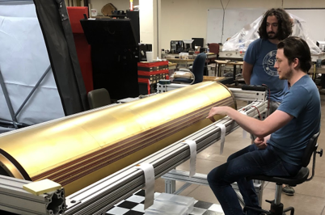
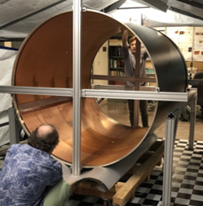
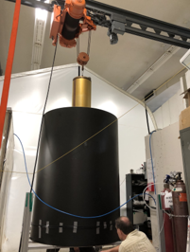
WBS 1.2.1: Field Cages
Inner Field Cage
Cage
Insertion
Outer Field Cage
The inner and outer field cages were formed on mandrels
Tested to 10% above operating voltage for one hour.
They were made concentric before assembly.

Slide 9
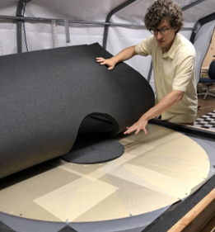
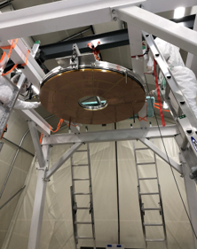
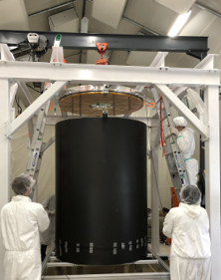
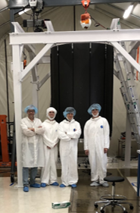
WBS 1.2.1: Central Membrane and Full TPC
Central Membrane with evaporated Aluminum stripes
TPC Assembly in vertical orientation.

Slide 10
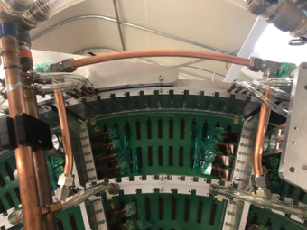
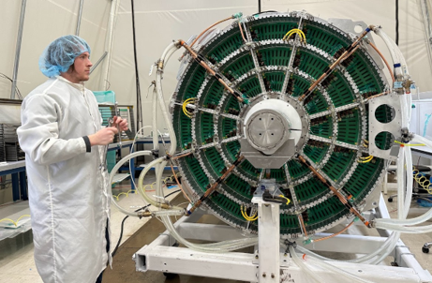



WBS 1.2.1: Wagon Wheel with Cooling and Gas
Gas Lines
Complete Gas and Cooling Services
Wide Tubes
Laser Port
No water leaks.
99.4% gas return at full flow.
Narrow Tubes

Slide 11
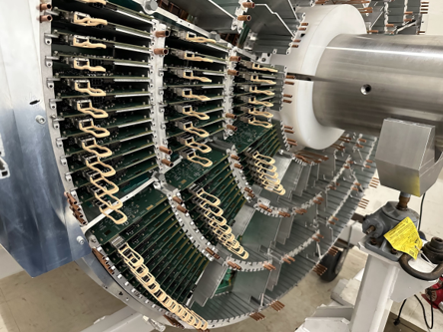
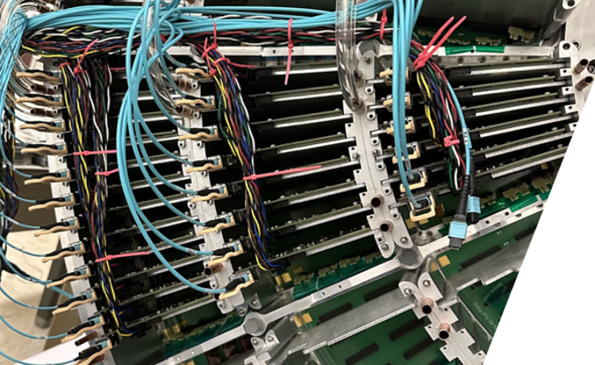
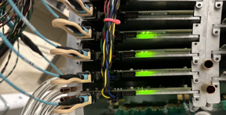
WBS 1.2.1: TPC Instrumented with FEE Cards
Cables w/ Optical/Electrical
Powered
Stuffed with FEE Cards
FEE cards are cooled by cooling blocks.
FEE cards require one optical and one LV connector.

Slide 12
WBS 1.2 TPC – 1.2.2, 1.2.3, 1.2.4 GEM Modules

Slide 13
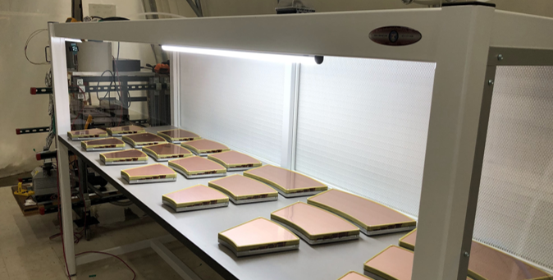
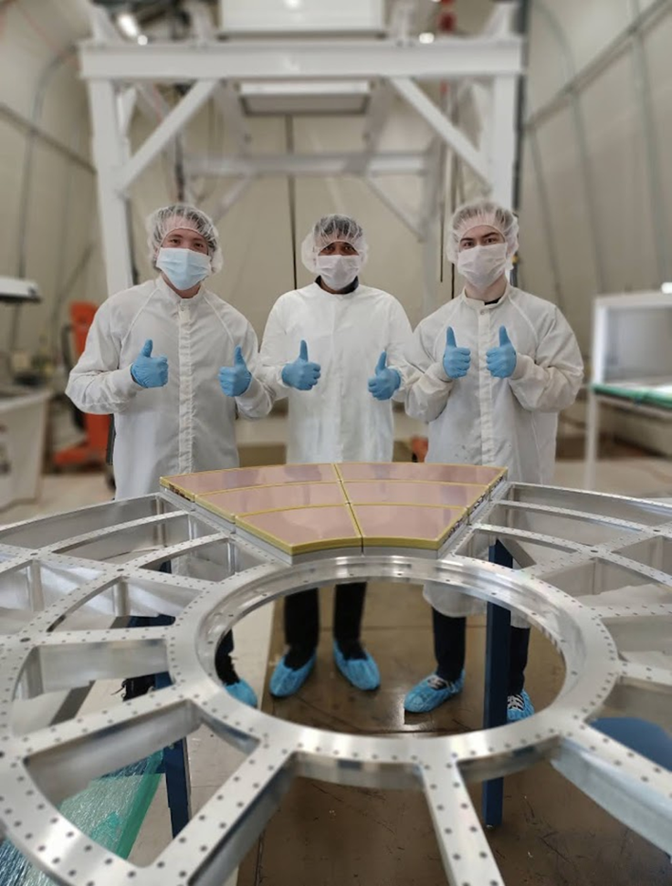
WBS 1.2.2, 1.2.3, 1.2.4: R1, R2, R3 GEM Modules
R2
R3
R1
Earliest Completed TPC Modules.
72 Modules total
Three sizes: R1, R2, R3
Gain * IBF Mapped using Xray SOurce.
Module Test Fit to Wagon Wheel

Slide 14
WBS 1.2 TPC – 1.2.5 TPC FEE, 1.2.6 TPC DAM

Slide 15
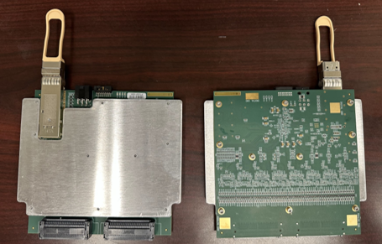
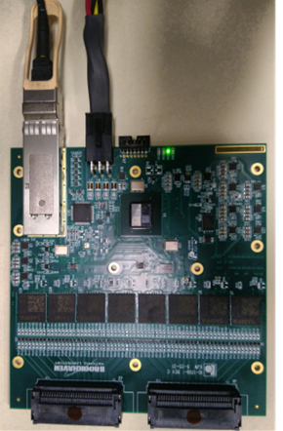
WBS 1.2.5: TPC FEE status
312 FEE boards (one-end of TPC) have been delivered 11/03/2022.
Boards burnt-in: 416 (16-sector worth qty) 11/07/2022
FEE w/o Cooling Plate
FEE with Cooling Plate

Slide 16
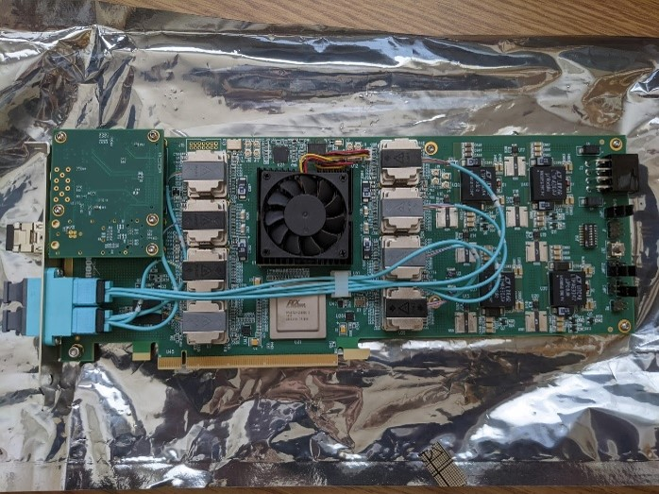
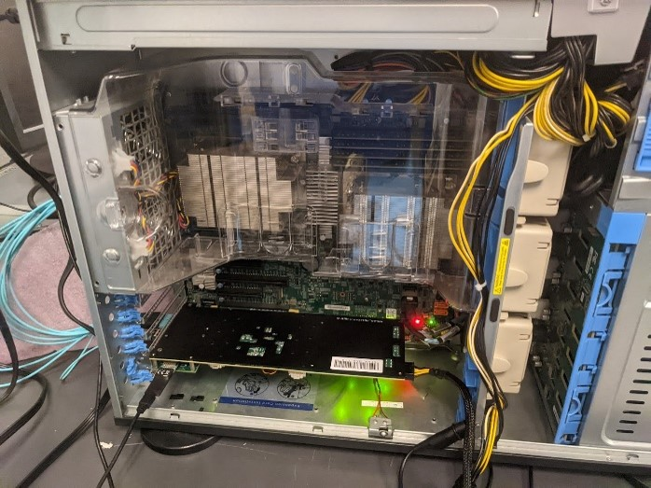
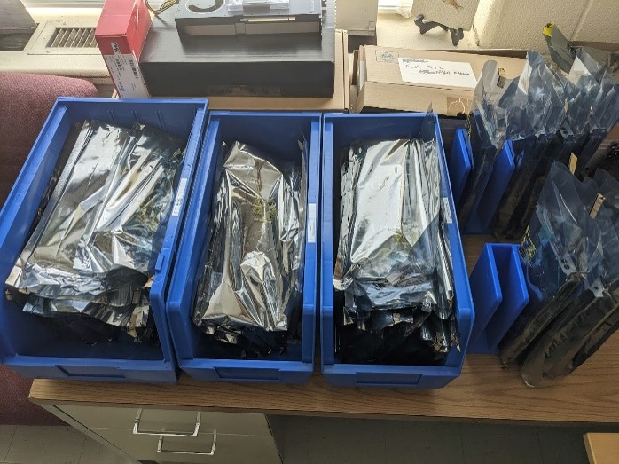
WBS 1.2.6: 24 TPC DAM boards + spares
Completed sPHENIX TPC DAM Testing server setup Completed DAMs

Slide 17
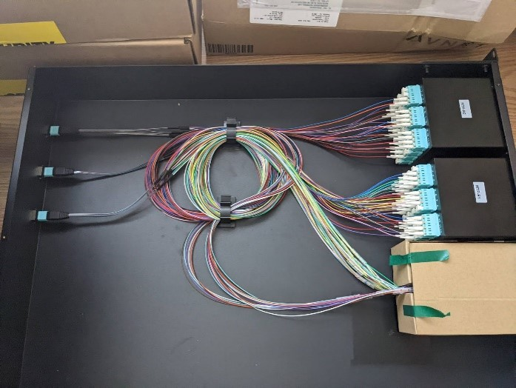
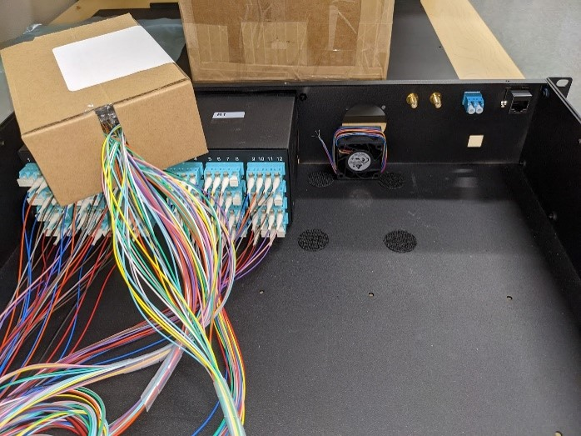
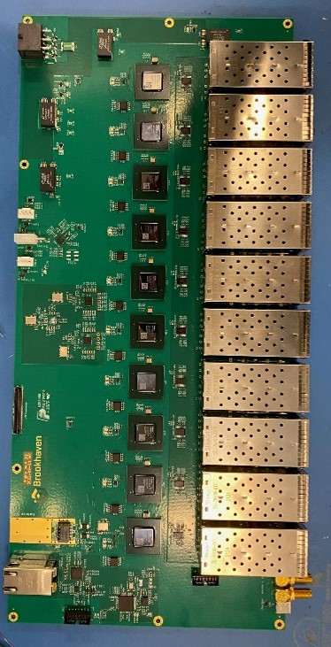
WBS 1.2.6: 24 Fiber Sort-Out Box (SOB)
SOB internal fiber routing SOB front panel past fitting test JACK Board

Slide 18
WBS 1.2 TPC – 1.2.7 TPC Support Systems

Slide 19

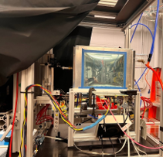
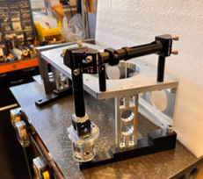

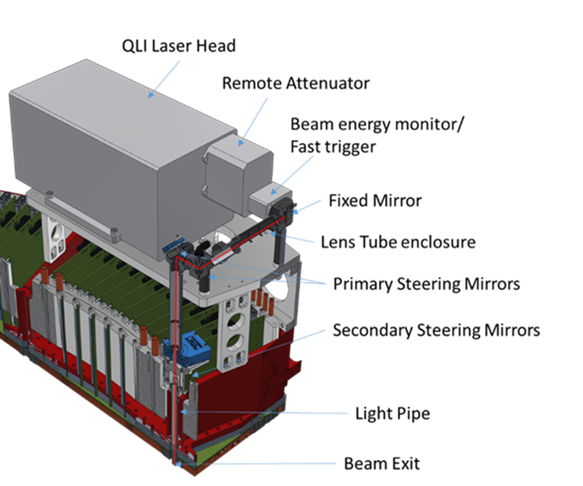
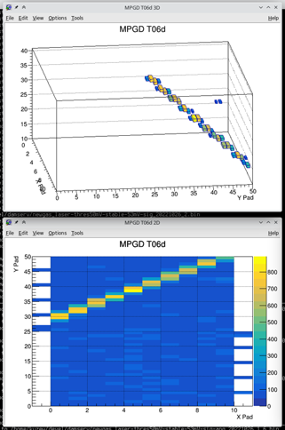
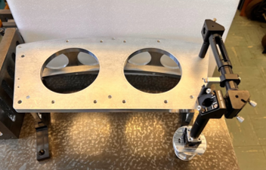
WBS 1.2.7.1: TPC Line Laser Status - Nov. 2022
TPC Line Laser Tested with “miniTPC” proto.
LP Entrance
→Same laser, optics, gas, FEE, avalanche, fields
All design work complete
All lasers stress tested
Proof of concept successful
Procurement of parts ~95%
Assembly to be completed by Dec. 2022
Laser Bench
Light Pipe + Secondary Steering Device
MiniTPC Proto Event Display of Laser Track
Laser Bench optics

Slide 20
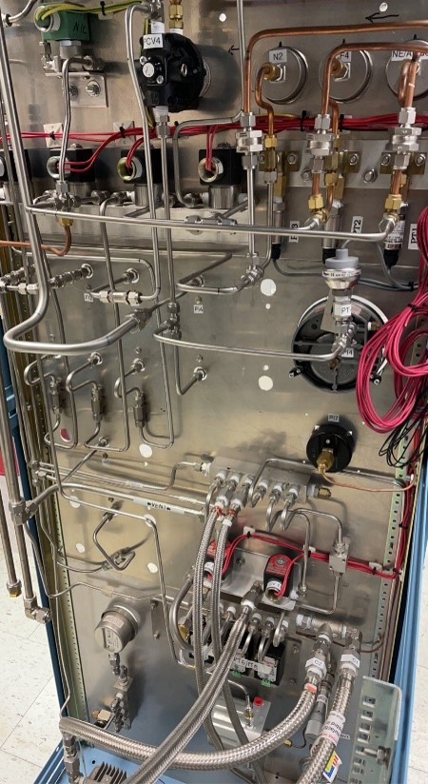
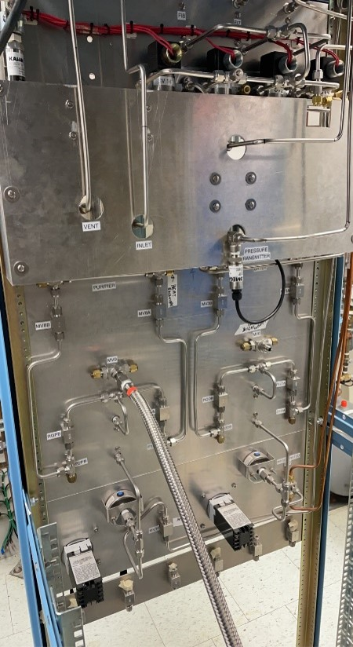
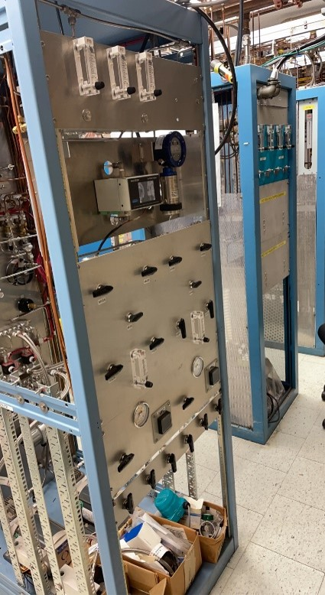
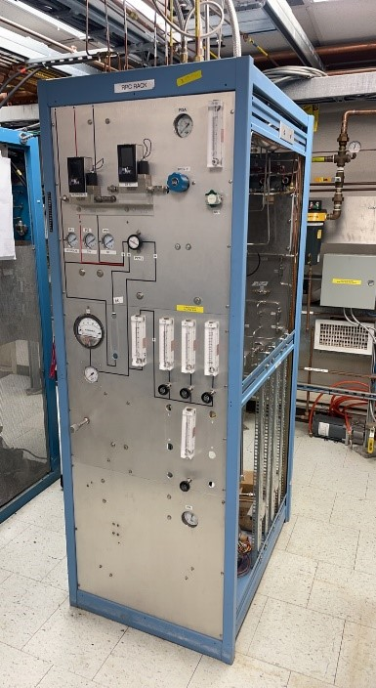

WBS 1.2.7.2: TPC Gas Rack Status
All design work complete
All Major components mounted and plumbed
Flow controllers, Gas Analyzer, H20 Monitor, O2 Meter, Pumps, etc
Purifiers and Driers built.

Slide 21
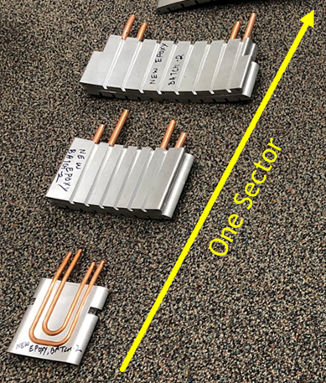
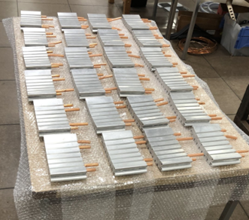
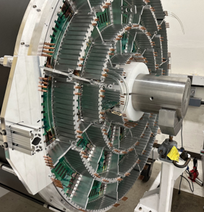
WBS 1.2.7.3: TPC FEE Cooling Blocks
Cooling plate on FEE engages “cooling blocks”.
Cooling blocks act as both card guide and heat sink.

Slide 22
Time Projection Chamber KPP – Live Channels
Demonstration or Measurement: Preinstall, bench tests
Threshold KPP’s: ≥ 90% live channels based on Laser, pulser, cosmics
Objective KPP’s: ≥ 95% live channels based on Laser, pulser, cosmics
Live channels checking needs all FEE cards mounted, we have started this and continue to mount FEE cards, thus we are continuing to progress on that one.

Slide 23
Time Projection Chamber KPP – Ion Back Flow
Demonstration or Measurement: Preinstall, bench tests
Threshold KPP’s: Ion back flow ≤ 2% per GEM module avgd over active area of each GEM module
Objective KPP’s: Same

Slide 24
Time Projection Chamber KPP – Single Hit Efficiency
Demonstration or Measurement: Preinstall, bench tests w/cosmics
Threshold KPP’s: ≥ 90% single hit efficiency/mip track, averaged over active TPC volume
Objective KPP’s: ≥ 95% single hit efficiency/mip track, averaged over active TPC volume
MIPs can be seen with one sector FEE and the HV, gas and cooling, all of which are now in hand and in place

Slide 25
Time Projection Chamber KPP – Cross Talk
Demonstration or Measurement: Preinstall, FEE stand alone bench tests
Threshold KPP’s: Cross talk ≤ 2% per channel averaged over all channels
Objective KPP’s: Same

Slide 26
WBS 1.3 EMCAL – 1.3.1 EMCAL Blocks

Slide 27
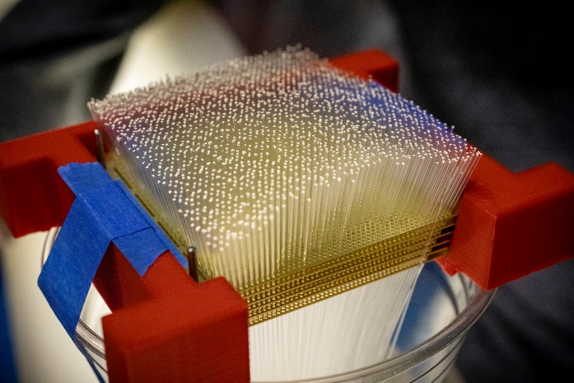
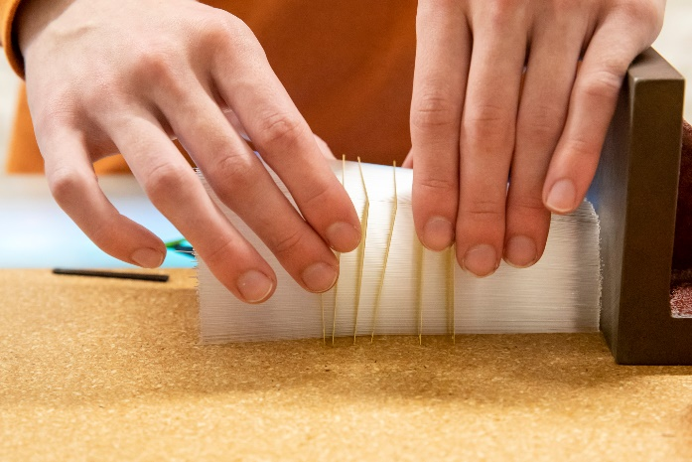
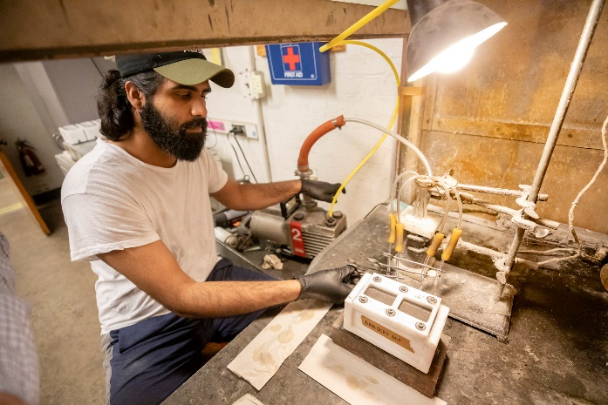
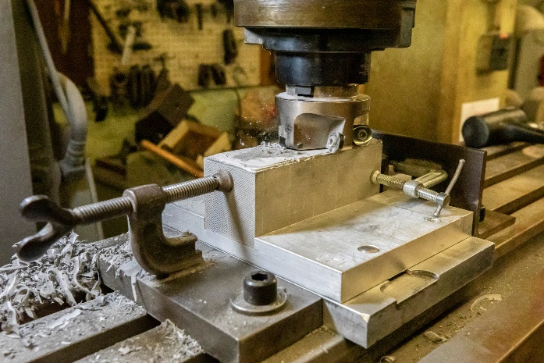
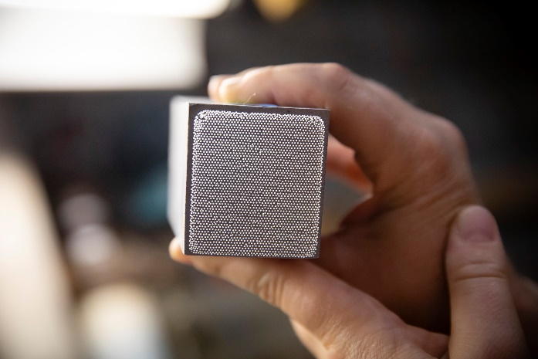
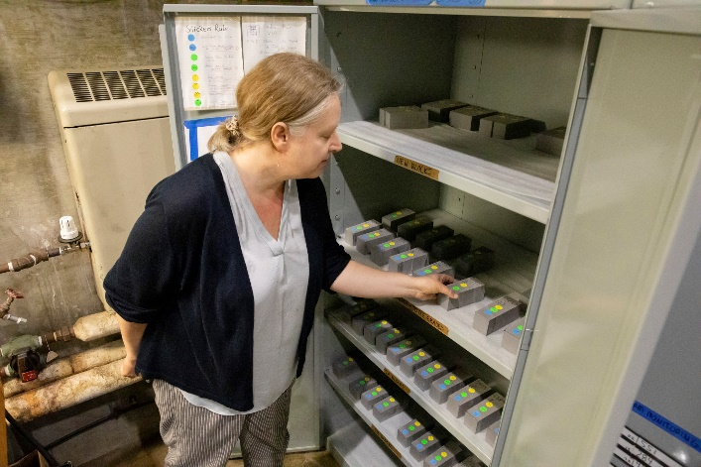
WBS 1.3.1 EMCal Block Construction (U. Illinois)
Scintillating Fibers Loaded into Brass Screens
Separating Brass Screens Prior to Placing in Mold
In Mold with Tungsten Powder, Readying for Epoxy Impregnation
Molded Block Being Machined to Dimensions
Block Storage and Inventorying prior to Shipment to BNL
Initial Inspection of Completed Block

Slide 28
WBS 1.3 EMCAL – 1.3.2 EMCAL Modules & Sectors

Slide 29
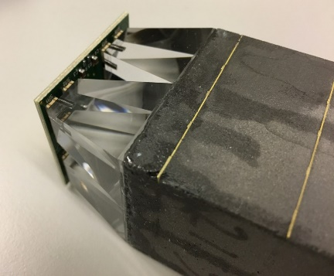
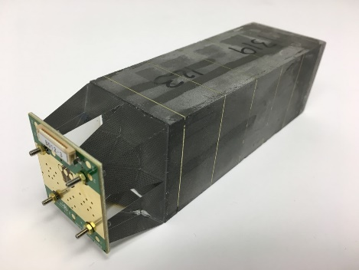
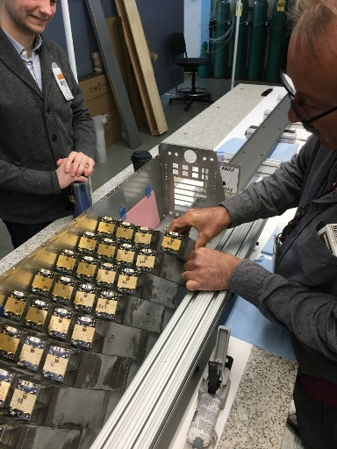
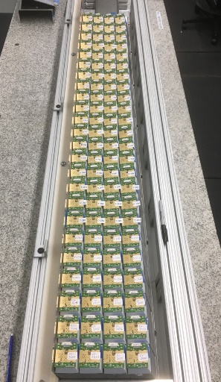
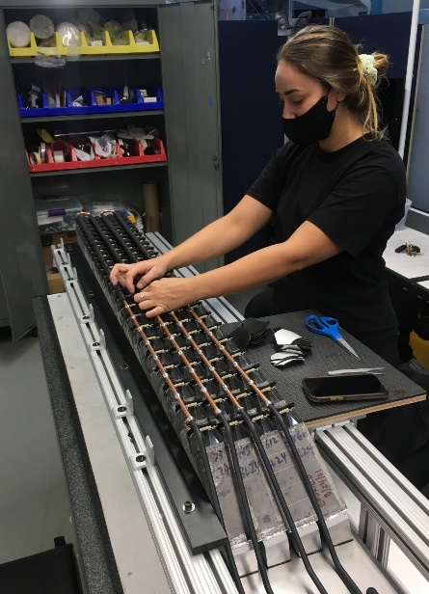
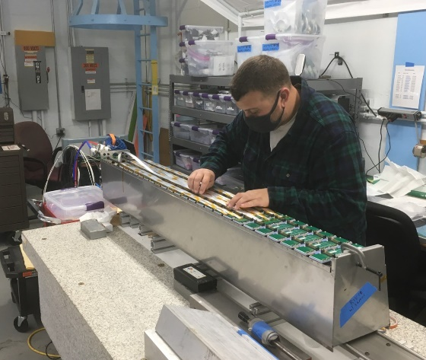
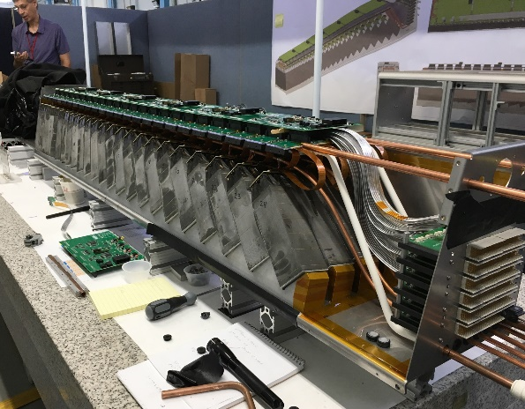
WBS 1.3.2 EMCal Module & Sector Construction (1)
Block with 4 Lightguides and 4 SiPM Daughtercards (16 SiPMs total)
Blocks Epoxied onto Strongbacks
SiPM Daughtercard Cooling Loop Added
Preamp Cards and Cooling Loop Added
Cables and Interface Cards Added; Ready for Outer Skins

Slide 30
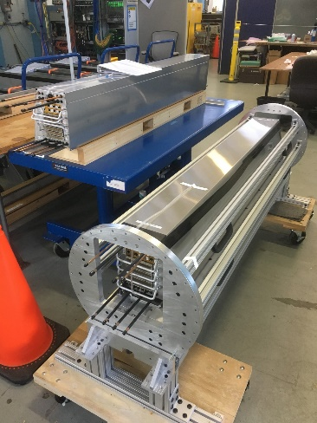
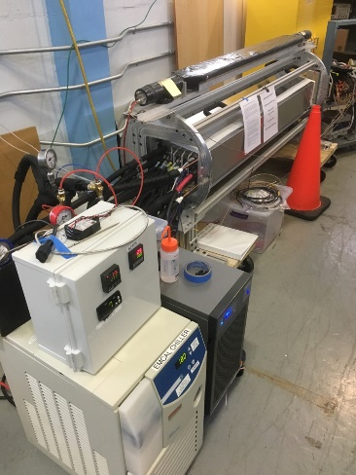



WBS 1.3.2 EMCal Module & Sector Construction (2)
Finished Sectors in the Rotating Test Fixture for Cosmic Tests
Completed Sectors under Extended Burn-In Test
Finished Sectors in Bldg 510 Awaiting Installation

Slide 31
Electromagnetic Calorimeter KPP – Live Channels
Demonstration or Measurement: Preinstall, bench tests
Threshold KPP’s: ≥ 90% live channels based on LED, cosmics
Objective KPP’s: ≥ 95% live channels based on LED, cosmics

Slide 32
Electromagnetic Calorimeter KPP – Absolute Energy Precalibration
Demonstration or Measurement: Preinstall, bench tests
Threshold KPP’s: ≥ 90% live channels based on LED, cosmics
Objective KPP’s: ≥ 95% live channels based on LED, cosmics

Slide 33
WBS 1.4 HCAL

Slide 34


Hadronic Calorimeter Deliverables
32 assembled, tested and calibrated OuterHCAL sectors
InnerHCAL support structure (32 sectors)
All deliverables completed and installed in sPHENIX
Inner HCAL assembled support structure being installed in sPHENIX
(32 sectors)
Inner HCAL detector instrumentation supplied by separate capital project
Completed 4/2022
Outer HCAL instrumented sectors assembled into barrel on sPHENIX platform.
(32 sectors)
Completed 3/2022

Slide 35



Additional Photos - Hadronic Calorimeter Deliverables
Outer HCAL sectors in Bldg. 912 factory, undergoing burn-in testing
Partially completed assembly of Inner HCAL barrel
support structure.
Two Inner HCAL sectors under assembly by ISU student Noah Applegate

Slide 36
Hadronic Calorimeter KPP – Live Channels
Demonstration or Measurement: Preinstall, bench tests
Threshold KPP’s: ≥ 90% live channels based on LED, cosmics
Objective KPP’s: ≥ 95% live channels based on LED, cosmics
All towers in all sectors were verified with electronics test pulse, LED test pulse, and cosmic rays at assembly.
In addition, all towers in all sectors were verified using an LED test pulse after barrel assembly in 1008.

Slide 37

System | Demonstration or Measurement | Threshold KKP’s | Objective KPP’s
Hadronic Calorimeter | Preinstall, Bench tests | ≥ 90% live channels based on LED, cosmics | ≥ 95% live channels based on LED, cosmics
All towers in all sectors were verified with electronics test pulse, LED test pulse, and cosmic rays at assembly.
In addition, all towers in all sectors were verified using an LED test pulse after barrel assembly in 1008.
As of 5/17/2022 all oHCAL towers are fully functional – the oHCAL has 100% live towers.
All sector test data is archived at: https://sphenix-intra.sdcc.bnl.gov/WWW/subsystem/hcal/test/sector/
As an example, below is the LED test data for Sector 12:
ADC (Ped. Subtracted)
Time Sample

Slide 38
Hadronic Calorimeter KPP – Absolute Energy Precalibration
Demonstration or Measurement: Preinstall, bench tests
Threshold KPP’s: ≥ 90% live channels based on LED, cosmics
Objective KPP’s: ≥ 95% live channels based on LED, cosmics
All towers are precalibrated initially using the Landau peak in cosmic ray data. The location of this peak is used to normalize the gains between the towers and fix the initial absolute energy scale. The accuracy of this precalibration is determined by how well we know the location of the Landau peak.

Slide 39

System | Demonstration or Measurement | Threshold KKP’s | Objective KPP’s
Hadronic Calorimeter | Preinstall, Bench tests | Each sector w/ an absolute energy precalibration of ≤ 20% RMS | Same
All towers are precalibrated initially using the Landau peak in cosmic ray data. The location of this peak is used to normalize the gains between the towers and fix the initial absolute energy scale. The accuracy of this precalibration is determined by how well we know the location of the Landau peak.
We estimate this by plotting the ratio of the error on the mean to the mean for every HCAL tower. This ratio is less than a percent for all towers, indicating we have achieved the threshold and objective KPP of <20%.

Slide 40
WBS 1.5 CALORIMETER ELECTRONICS

Slide 41
WBS1.5 Executive Summary
No KPP’s specific to WBS 1.5
All deliverables for WBS 1.5 have been delivered
WBS 1.5 is complete

Slide 42
WBS 1.5 Details – EMCAL FEE
MIE EMCal Deliverables (includes 10% for failures):
Item | Quantity | Status
SiPMs | 72500 | Delivered
EMCal SiPM DaughterBoards | 4120 | Delivered
EMCal preamps | 1030 | Delivered
EMCal interfaces | 285 | Delivered
EMCal cables | 53 Sets | Delivered
EMCal controllers | 45 | Delivered
EMCal power system | 1 | Delivered
EMCal signal cables | 955 | Delivered

Slide 43



WBS 1.5 Details – EMCAL FEE example items in use

Slide 44
WBS 1.5 Details – HCAL FEE
MIE oHCal Deliverables (includes 10% for failures):
Item | Quantity | Status
SiPMs | 6800 | Delivered
oHCal SiPM DaughterBoards | 6800 | Delivered
oHCal preamps | 1400 | Delivered
oHCal interfaces | 60 | Delivered
LED Boards and Backplanes | 60 | Delivered
oHCal cables | 27 Sets | Delivered
oHCal controllers | 10 | Delivered
oHCal power system | 1 | Delivered
oHCal signal cables | 85 | Delivered

Slide 45
WBS 1.5 Details – Digitizer System
MIE Digitzer Deliverables:
Item | Quantity | Status
Digitzer Boards | 275 | Delivered
XMIT Boards | 112 | Delivered
Controllers | 32 | Delivered
JSEBC-II | 60 | Delivered
Crate | 28 | Delivered
Optical Fibers | 2045 | Delivered
Clock Master | 6 | Delivered

Slide 46
WBS 1.5 Summary
COVID-19 provided a significant challenge but had minimal impact on delivery schedule.
Lots of testing support from UMichigan, LehighU, UColorado and ColumbiaU to complete this portion of the project on time.
Failure rate of electronics was less then 3% on average.
Components were delivered to EMCal and HCal groups in a timely manner to keep assembly pipelines running.
All components in WBS 1.5 were completed and delivered by July 1, 2022

Slide 47
WBS 1.6 DAQ/TRIGGER – 1.6.1 DAQ & 1.6.2 Local Level-1

Slide 48
WBS 1.6 DAQ/TRIGGER – 1.6.3 Global Level-1 and 1.6.4 Timing

Slide 49







DAQ/Trigger Deliverables
WBS 1.6.1 DAQ
Network switch
WBS 1.6.3 Global Level-1
WBS 1.6.4 Timing
WBS 1.6.2 Local-Level-1
EBDCs
Disk Enclosure (102 14TB disks)
Disk Enclosure (102 14TB disks)
EBDCs
Disk Enclosure (102 14TB disks)
SEBs
Gl1/GTM unit
SEBs
Local Level-1 Trigger Module
Local Level-1 Trigger Module
BufferBoxes
BufferBoxes

Slide 50
DAQ/Trigger KPP – Event Rate
Demonstration or Measurement: Event Rate
Threshold KPP’s: 10 kHz w/ random pulser
Objective KPP’s: 15 kHz w/ random pulser
The event-rate limit results from re-use of the existing DCM-2 modules to read out the calorimeter digitizers. This is a legacy backplane-based system, which in turn is read out via the legacy “jSEB2” readout card which is a 4-lane PCIExpress “Generation 1” device.
We used both a BNC pulser that can generate random pulses for a random trigger, as well as a large scintillator paddle connected to a Constant Fraction Discriminator (CFD). The CFD threshold was adjusted to generate random triggers at a rate of about 30KHz. We used the number of samples that we read out as a proxy for the achieved level of zero-suppression. We will nominally read out 16 waveform samples. A reduction to 8 samples in the readout would represent a zero-suppression level of 50%. The achievable zero-suppression with an occupancy of about 25% in the electromagnetic calorimeter would then correspond to a reduction to 4 readout samples. We note here that 25% is a high occupancy. We did not adjust the number of samples in the demonstration test to below 6, corresponding to an occupancy of about 35%, which is a very conservative assumption for the operation of the sPHENIX detectors.

Slide 51
DAQ/Trigger KPP – Event Rate
For each number of waveform samples, we took exactly 3 million events and measured how long this takes. For example, with no zero-suppression and the full 16 samples for each event, this took 619 seconds, resulting in an event rate of 4.8 KHz. The table shows the rates as a function of the number of waveform samples, with the start and ending times measured in terms of the readout PC’s Unix time. We cross the 10KHz event rate threshold between 8 and 7 samples, corresponding to zero-suppression levels of 50% and 44%, respectively.
Table 1: the achieved readout rates with different number of samples, corresponding to various levels of achieved zero-suppression in the calorimeters. We cross the 10KHz threshold between 8 and 7 samples, corresponding to zero-suppression levels of 50% and 44%, respectively.
 |  | 3 million events
samples | start | end | Duration (s) | Rate [Hz] | zero suppression level (%)
 | Unix Time
16 | 1661294686 | 1661295305 | 619 | 4847 | 100
12 | 1661294050 | 1661294511 | 461 | 6508 | 75
8 | 1661293650 | 1661293958 | 308 | 9740 | 50
7 | 1661292800 | 1661293071 | 271 | 11070 | 43.75
6 | 1661289915 | 1661290168 | 253 | 11858 | 37.5

Slide 52


DAQ/Trigger KPP – Data Logging Rate
Demonstration or Measurement: Data Logging Rate
Threshold KPP’s: 10 Gbit/s with pulser
Objective KPP’s: Same
To demonstrate this, we configured the data acquisition system for a special running mode where the actual detector (that is not yet available in its entirety) is replaced with a setup that delivers data as the real detector would, just without any practical limits on the rate of delivered events. This setup, informally called “unlimited data detector”, therefore tests the capabilities and limits of the network and data logging system.
The data logging system consists of 6 so-called “Buffer Boxes”, high-end file servers that collectively provide 6PB of RAID disk space. The detectors are read out with Front-End Modules (FEM/FEE) that in turn are read out with DCM2 modules or FELIX cards, that in turn transfer data to buffer boxes that temporarily store the data before sending them to the SDCC computing center for permanent storage and analysis. The buffer boxes level the variable data rate from the detector that changes during a RHIC store with the available RHIC luminosity. The buffer boxes also allow us to ride out a storage system downtime at the SDCC side for about 4-5 days. The right side figure shows how the actual detector readout is replaced with the “unlimited data detector”. This system still uses all parts of the DAQ system, except the actual detector front-ends.
For logging test

Slide 53



DAQ/Trigger KPP – Data Logging Rate
Top Figure: The achieved aggregate logging rate to the buffer boxes when running that “unlimited data detector” configuration. Test runs for over an hour.
Bottom Figures: The achieved logging rate with concurrent access of previously acquired data to transfer to the SDCC. (Left: 90 minutes; Right: 24 hours)
15 GB/s
10 GB/s

Slide 54
Min Bias Trigger Detector KPP – Live Channels, Timing
Demonstration or Measurement: Preinstall, bench tests
Threshold KPP’s: ≥ 90% live channels based on laser. 120 ps/channel timing resolution w/ bench test
Objective KPP’s: ≥ 95% live channels based on laser. 100 ps/channel timing resolution w/ bench test

Slide 55
WBS 1.7 MIN BIAS TRIGGER DETECTOR

Slide 56



WBS 1.7 Min Bias Trigger Detector and Discriminator/Shaper
Four MBD Sections –
Two Each for North and South
Discriminator/Shaper Boards (2 of 16)
Three MBD Sections in Storage
One MBD Section under test

Slide 57
Back Up

Slide 58

sPHENIX MIE Project Overview
TPC | Project Director | Last CD Achieved | % Complete | CPI | SPI
$27.0M | Edward O’Brien | PD-2/3 | 99.3% BCWP/BAC@ 9/30/2022 | 0.99 | 0.99
Scope
  Detector systems produced, tested and ready for installation: Time Projection Chamber w/ electronics, Electromagnetic Calorimeter w/ electronics, Hadronic Calorimeter w/ electronics, DAQ/Trigger, Minimum Bias Detector, Project Management
Not in scope
  SC-Magnet, Bldg/Det Infrastructure, Installation and System Commissioning
Schedule
  CD-0 received Sept 2016
  CD-1/3A received Aug 2018
  PD-2/3 received Sept 2019
  Early completion last wk of Oct 2022. 2.0 months of float to PD-4
  PD-4 Dec 2022
Cost
  $26.5M AY TPC 126.0% contingency on an ETC of $0.72M

Slide 59


sPHENIX Status
18 EMCal sector-pairs installed
As of 10/6/22
EMCal Installation in progress
Magnet mapping equipment installed 11/1/22

Slide 60

Performance Indices – sPHENIX MIE
Cumulative SPI | Cumulative CPI
0.99 | 0.99
Cumulative BCWS (Scheduled) | $25,587,693
Cumulative BCWP (Performed) | $25,395,893
Cumulative ACWP (Actual) | $25,526,499
DOE SPI or CPI Value Thresholds
0.90 to 1.15
0.85 to 0.89 or 1.16 to 1.25
<0.85 or >1.25

Slide 61

Cost Performance Report (CPR) – sPHENIX MIE
DOE SPI or CPI Value Thresholds
0.90 to 1.15
0.85 to 0.89 or 1.16 to 1.25
<0.85 or >1.25
*Highlights in table above takes variance $ into consideration, not just Indices

Slide 62

Budget Profile
All MIE funds now received

Slide 63

Milestones Status – sPHENIX MIE

Slide 64

EAC and Contingency Profile – sPHENIX MIE

Slide 65
Project Status
1 month of float from early completion to PD-4 based on P6 (third week of Nov to end Dec 2022)
  Outstanding project deliverables are the TPC completion (testing) and JACK boards.
  Have removed DCMII, diffuse lasers, diffuse laser fiber bundles from project scope.
SPI=0.99, CPI=0.99 both excellent
TPC completion on the Critical Path.
EVMS processing complete.
Have completed an EAC in October. Will repeat EAC exercise each month until project is done.
No PCR in October
Continue monthly EVMS process and Change Control.

Slide 66
High Priority Issues
Complete the MIE deliverables(TPC and JACK board) and write our KPP report.

Slide 67
sPHENIX Has Two PEMP Notables in 2023
NP: Initiate commissioning of the super Pioneering High Energy Nuclear Interaction Experiment (sPHENIX) and demonstrate successful integration of all detector subsystems.(Objective 1.2)
BHSO/SC: Continue to effectively execute and successfully deliver the 2023 scope for the SC projects equal to or less than $50 million designated to the Laboratory Director by SC [Super Pioneering High Energy Nuclear Interaction (sPHENIX)]. (Objective 7.2)
  Complete PD-4 Review 31-Dec-2022 (proposed)
11/09/22
DOE S&T Review

Slide 68

Baseline/Contingency Log and ETC adjustment Log - MIE
ETC Adjustments
Control Account | Aug’21 | Sep’21 | Oct’21 | Nov’21 | Dec’21 | Jan’22 | Feb’22 | Mar’22 | Apr’22 | May 22 | Jun’22 | July 22 | Aug’ 22 | Sep’ 22
1.02 | 326,377 | 556,377 | 716,238 | 725,089 | 722,064 | 703,567 | 244,065 | 228,272 | 250,324 | 344,847 | 332,160 | 606,391 | 311,838 | 407,032
1.03 |  |  |  | 34,439 | 18,420 | 17,328 | 67,559 | 9,776 | 9,766 | 5,999 | 5,999 | 5,999 | 5,999 | 2,887
1.05 | $22,833 | $22,833 | 219,343 | 414,468 | 250,807 | -6,101 | 87,313 | 11,509 | 10,098 | 3,112 | 3,112 | 3,112 | 1,855 | 1,855
1.06 | $79,352 | $79,352 | $26,259 | -62,490 | -63,278 | -63,278 | -45,001 | -45,001 | -43,839 | -81,200 | -81,870 | 111,590 | 140,218 | 129,421
1.07 | $25,705 | $25,705 | $16,041 | 16,575 | 8,731 | 8,731 | -7,013 | -1,748 | -1,747 | -11,118 | -11,333 | -18,835 | -9,693 | -16,096
Total | 454,267 | 684,267 | 977,880 | 1,128,081 | 936,744 | 660,247 | 346,923 | 202,798 | 224,602 | 261,640 | 248,068 | 708,257 | 450,217 | 525,099

Slide 69

TPC Status
Figures counter clockwise from upper left:
Gas fitting installation
TPC cabling
HV distribution cards
TPC Fee pedestals
Powered TPC Fees
LV power supplies
TPC gas system
Recent two week delay due to late delivery of the HV cards from the assembly house.

