Slide 1
High-precision timing R&D at CERN
EPIC DAQ working group meeting 2022
Eduardo Mendes – CERN EP-ESE – 10/11/2022
eduardo.brandao.de.souza.mendes@cern.ch

Slide 2
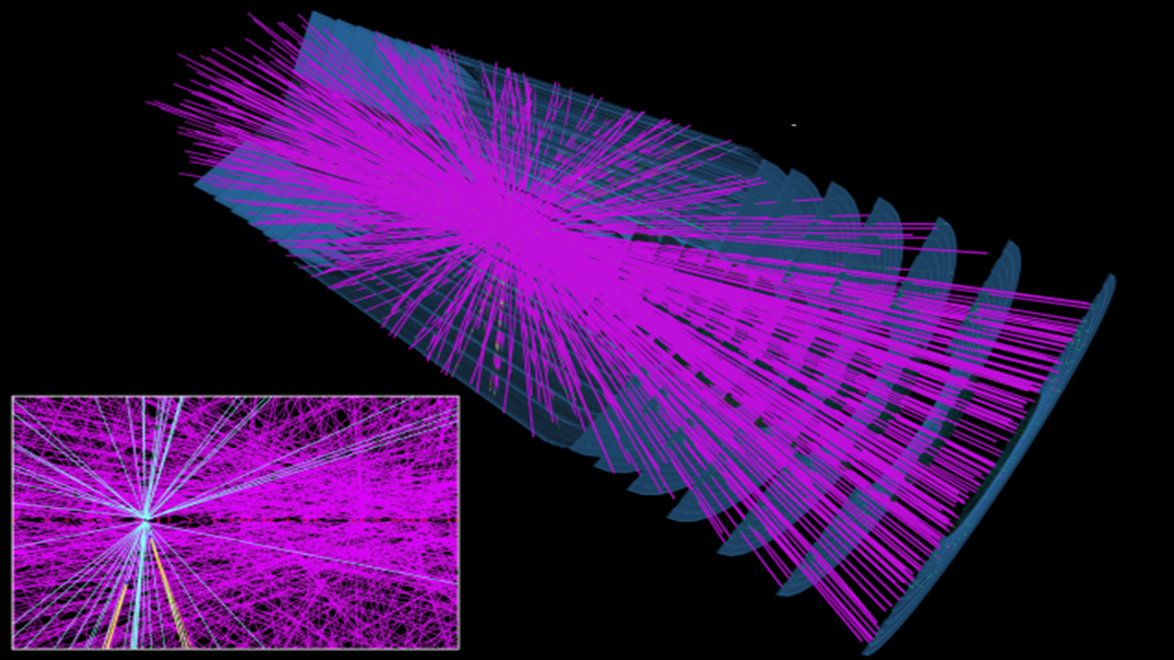
…
Simulated HL-LHC collision event in the ATLAS detector
…

Slide 3
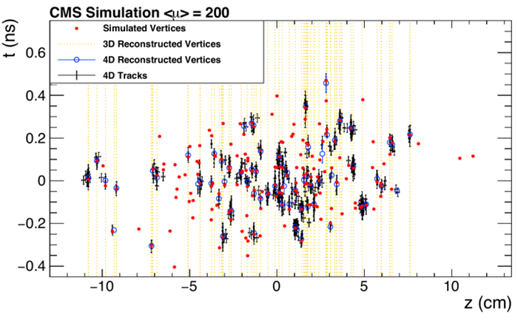
Timing helps removing pile-up
CMS and ATLAS
Building timing detectors for phase-2 upgrades
Stringent constraints regarding clock quality
Josh Bendavid (CERN/LPC), Oct 2017
CMS detector performance for HL-LHC
Experiment Axis

Slide 4
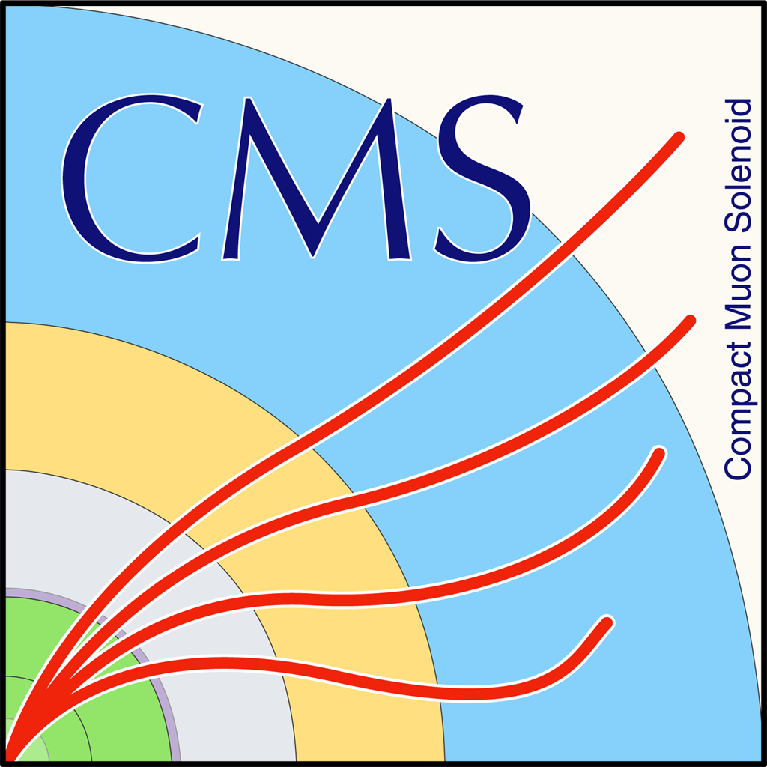
Overview of an experiment
ASIC
Point-to-point links
FPGA
FPGA
ASIC
FPGA
…
FPGA
ASIC
FPGA
Being evaluated for Phase-2 upgrades
FPGA
ASIC

Slide 5
Basic principle of clock characterization
Measure the phase difference between a REF clock and the CUT
Reference
Clock
Under Test

Slide 6
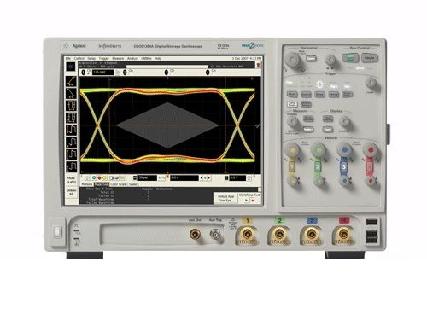
Time Interval Error Jitter
Time-based measurement
Based on oscilloscope
Nowadays we obtain O(5ps)
Taken into account for physics simulation
Events
Mean - μ
Standard Deviation - σ
histogram
~10ms
Time (ps)

Slide 7
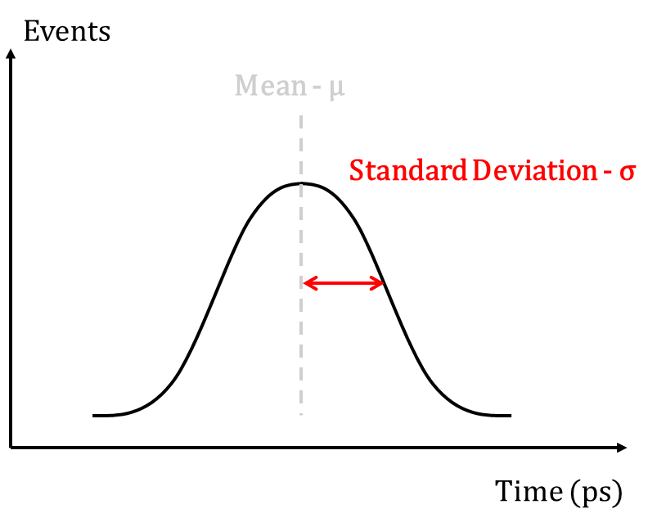
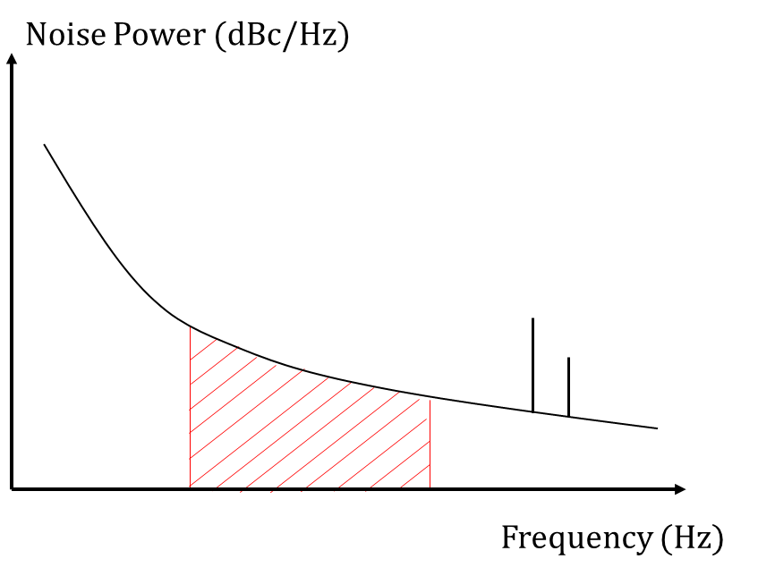
Measuring clock quality
Clock
Quality
Fast
Variations
(<1s)
time
freq.
TIE Jitter
Phase
Noise

Slide 8
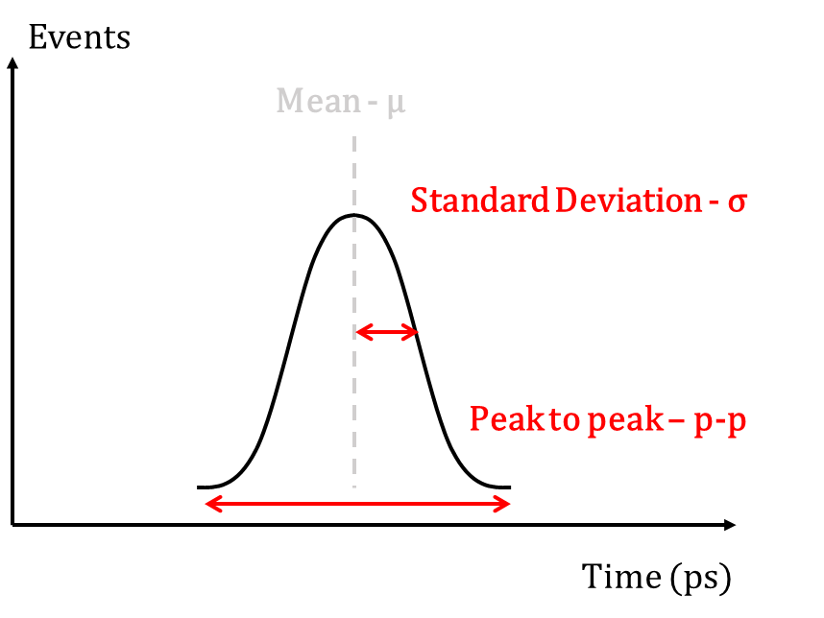
Measuring clock quality
Clock
Quality
Fast
Variations
(<1s)
Slow Variations
(>1s)
time
freq.
restart
TIE Jitter
Phase
Noise
Phase
Determinism

Slide 9
Phase-determinism (reproducibility)
How much phase average change after restarts (e.g. power cycles)?
Reference
Clock
Under Test
Average

Slide 10
Phase-Determinism (reproducibility)
Time-based measurement
Events
TIE plot
Events
Phase determinism
Mean - μ
Mean - μ
histogram
of means
Repeat measurement several times
restarting system
Standard Deviation - σ
Standard Deviation - σ
Peak to peak – p-p
Time (ps)
Time (ps)

Slide 11
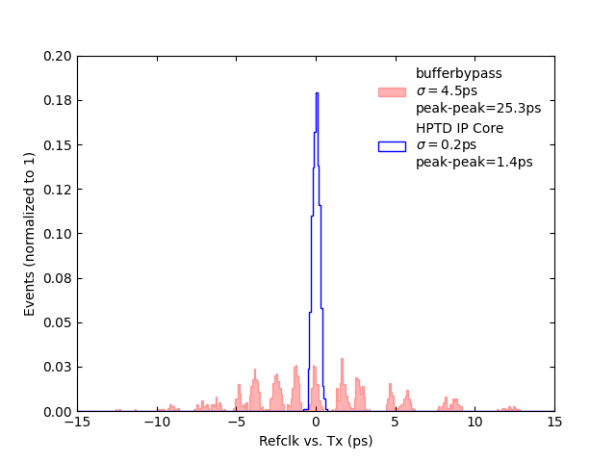
Calibration-related phase-variations
Example for Ultrascale Transmitter
sub-Unit Interval Level
Clock
gen
Probability density function
Scope
FPGA
Tx

Slide 12
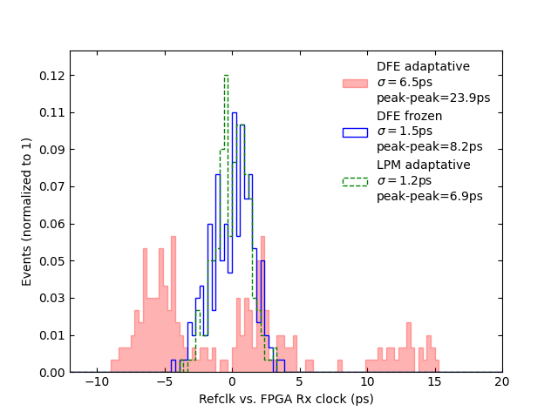
Calibration-related phase-variations
Example for Ultrascale Receiver
sub-Unit Interval Level
DFE: Discrete Feedback Equalizer
LPM: Low-Power Mode equalizer
Probability density function

Slide 13
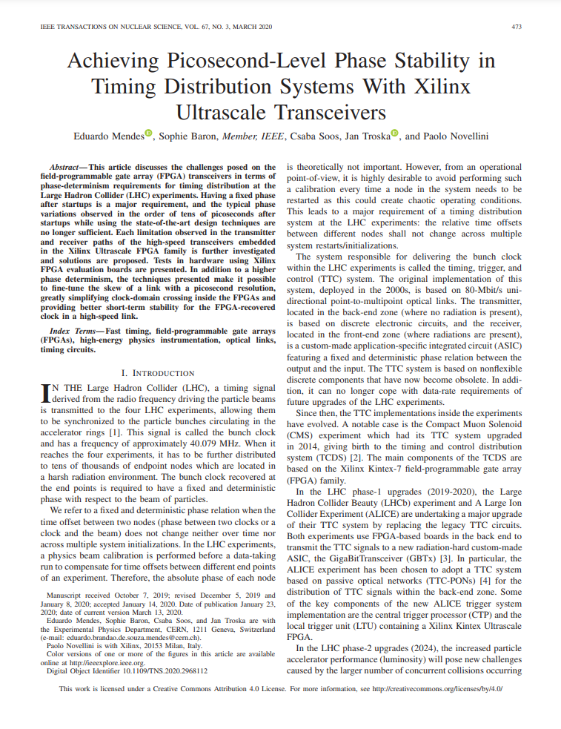
Calibration-related phase-variations
First published by our team in 2020 IEEE TNS (link here)
Close collaboration with Xilinx
Results have been applied in several institutes and companies worldwide
Thanks to CERN Open Hardware License
IEEE TNS most popular paper of 04/20
sub-Unit Interval Level

Slide 14
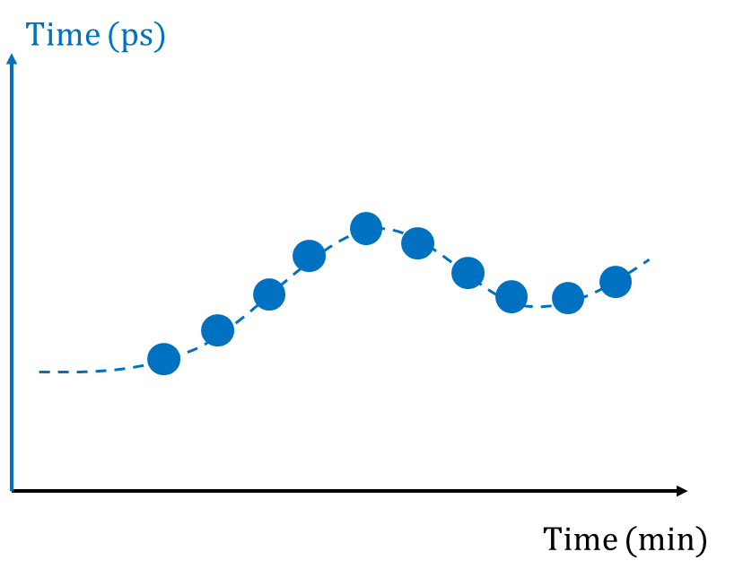
Measuring clock quality
Clock
Quality
Fast
Variations
(<1s)
Slow Variations
(>1s)
time
freq.
trend
restart
TIE Jitter
Phase
Noise
Phase
Time Trend
Phase
Determinism

Slide 15
Phase Time-Trend
Time-based measurement
Events
TIE plot
Time (ps)
Mean - μ
time trend
of means
Repeat measurement several times
Standard Deviation - σ
Time (ps)
Time (min)

Slide 16
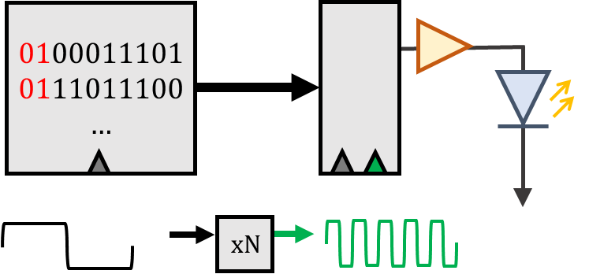
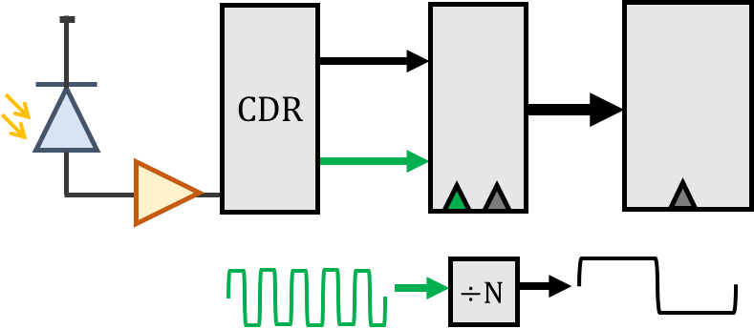
Bidirectional self-synchronous link
reference
clock
Downlink
recovered clock
PLL

Slide 17
Bidirectional self-synchronous link
Temperature variations in fiber change phase of recovered clock
reference
clock
Downlink
recovered clock
Tx
Rx
Temperature
PLL
Temperature
Rx
Tx

Slide 18
Bidirectional self-synchronous link
Temperature variations in fiber change phase of recovered clock
reference
clock
Downlink
recovered clock
Tx
Rx
Temperature
PLL
Temperature
Rx
Tx
Uplink
recovered
clock
Temperature

Slide 19
Timing Compensated Link
TCLink implementation: inspired on the PLL concept
reference
clock
Downlink
recovered clock
phase
detector
Loop
Filter
Phase
Shifter
Tx
Rx
PLL
Rx
Tx
Uplink
recovered
clock

Slide 20
Timing Compensated Link
TCLink implementation: fully integrated in FPGA
reference
clock
Downlink
recovered clock
phase
detector
Loop
Filter
Phase
Shifter
Tx
Rx
PLL
UltrascaleFPGA
Rx
Tx
Uplink
recovered
clock

Slide 21
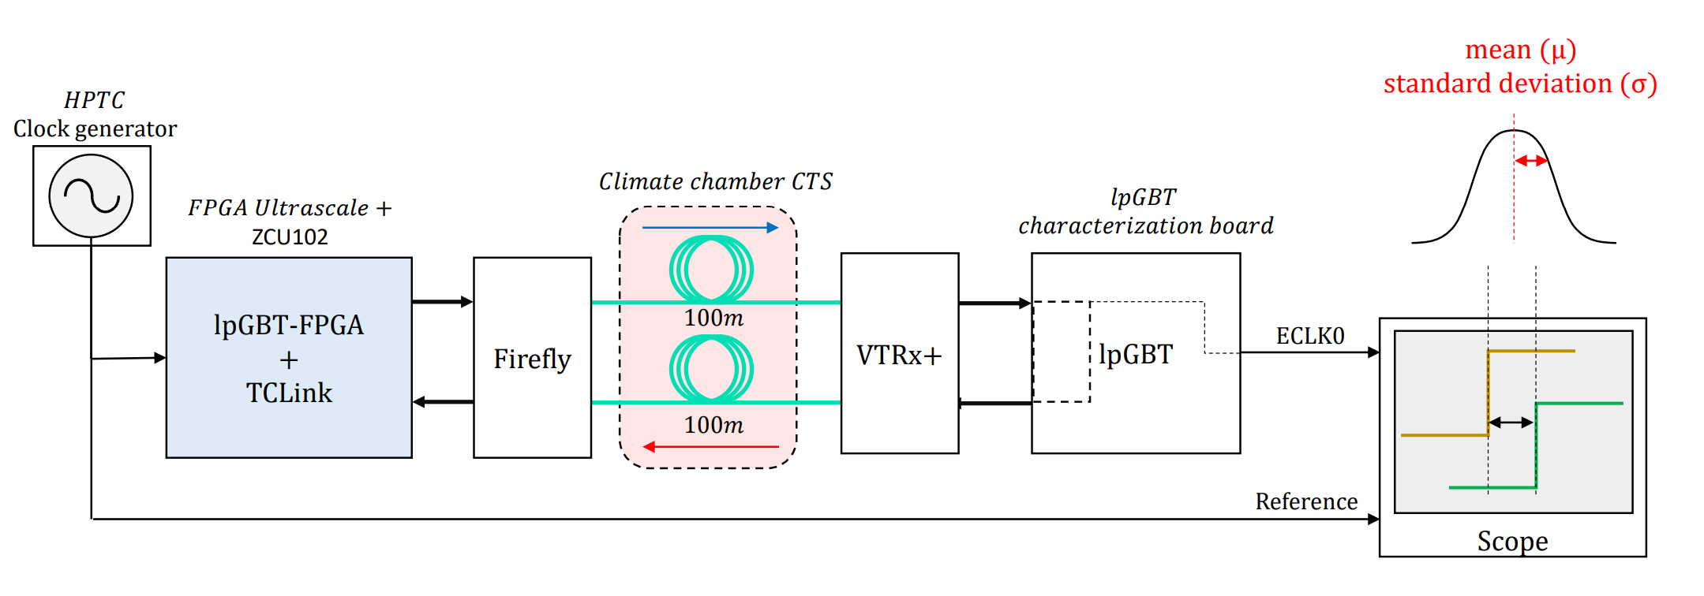
Timing Compensated Link
Let’s see its performance…

Slide 22
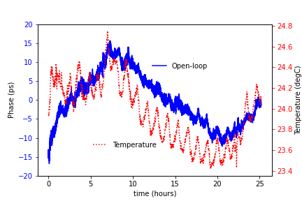
Timing Compensated Link
A more realistic example

Slide 23
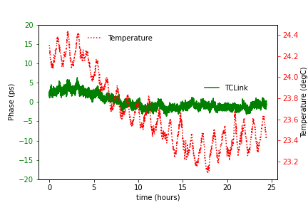
Timing Compensated Link
A more realistic example

Slide 24
Looking forward in the future

Slide 25
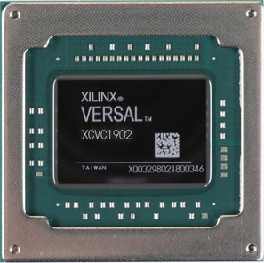
Applicability to Versal family
Research developed is very dependent on specific feature of GTY/GTH transceivers of the Ultrascale(+) family: the Tx phase interpolator (PI)
Versal GTY/GTYP also have the Tx PI
However, tests have to be performed to check performances are the same
GTM transceiver does not have the Tx PI accessible

Slide 26
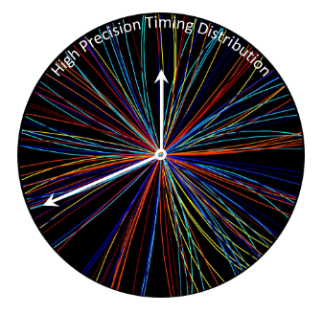
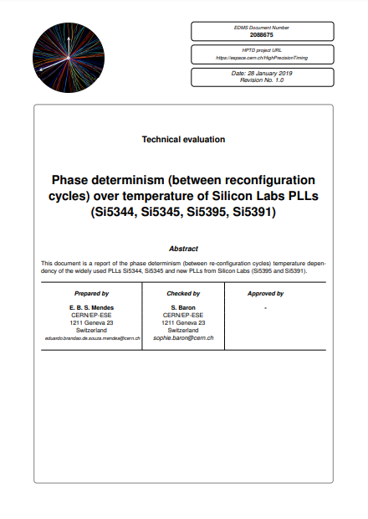
CERN R&D in precision timing distribution
CERN HPTD interest group founded in 2018
+100 members – 12 meetings
Interdisciplinary collaboration: ASIC, FPGA, board design, physics, etc…

Slide 27
Looking further in the future…
ECFA 2021 detector R&D Roadmap (link here)
High-precision timing will remain a hot topic in the next decades for HEP

Slide 28
Looking further in the future…
Current performances depend on specific hardware
Not guaranteed in the future…
Precision of timing distribution will not improve as a mere consequence of moving to higher technology nodes…
Very important for CERN to keep active in high-precision timing and maintain this knowledge in the long-term

Slide 29
Thanks
Subscribe to the High Precision Timing Distribution group for more information (search and subscribe)

Slide 30
References & Useful links
TCLink
Paper: https://pos.sissa.it/370/057/pdf
Gitlab: https://gitlab.cern.ch/HPTD/tclink
Papers on phase-determinism
UI-level phase fixed: https://ieeexplore.ieee.org/document/5703158
Sub-UI level phase fixed: https://ieeexplore.ieee.org/stamp/stamp.jsp?tp=&arnumber=896
HPTD Interest Group
Workspace: https://espace.cern.ch/HighPrecisionTiming
ECFA 2021 detector R&D roadmap
Document: https://cds.cern.ch/record/2784893

