Slide 1
Status Update from EPIC Charter Committee
Pietro Antonioli , Olga Evdokimov (co-chair), Douglas Higinbotham (co-chair),
Barbara Jacak, Zein-Eddine Meziani, Rosi Reed, Ralf Seidl and Peter Steinberg
with guidance from
Vicki Greene and Frank Sabatie

Slide 2
Original Timeline
Charter committee finishes editing the draft document by the end of September
Two week comment period in Oct.
Final revisions after taking into consideration all comments.
That does not mean will be just implement all comments
But it does mean all comments will be discussed and taken into account
Again, it is not possible have a perfect charter, but we will make the best we can that reflects the diverse points of the view of the EPIC collaboration!

Slide 3
And where are we….
We are exactly two weeks behind where we wanted to be by our original timeline.
BUT the document did circulate and we have your comments.
We have results of the poll on the spokesperson(s) to share (next slide).
Our goal now is to implement the comments in a timely fashion and get the document back to the interim IB for a vote.
NOTE: I didn’t see anything in the comments that looked to contentious so hopefully we will not need another comment period and the document will go directly to the interim IB for consideration.
( and if the Charter is passed the interim IB will become the CC )

Slide 4
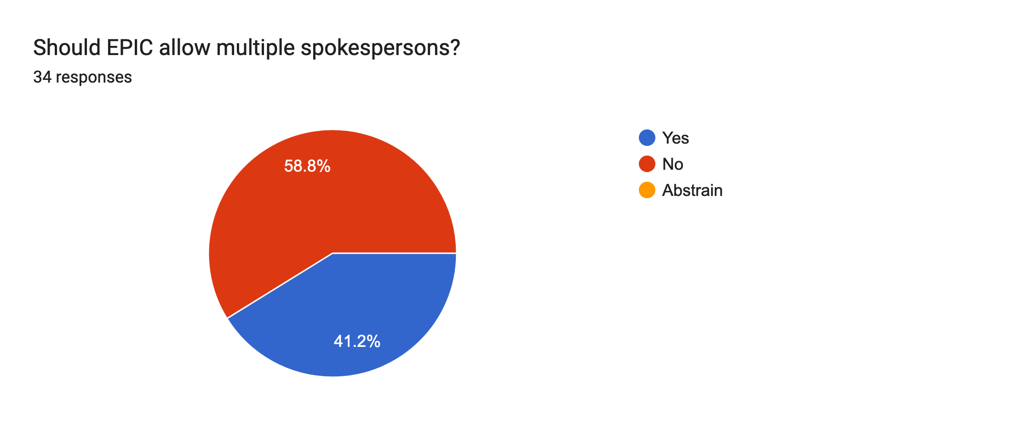
Result of our polling on the # of spokespersons.

Slide 5
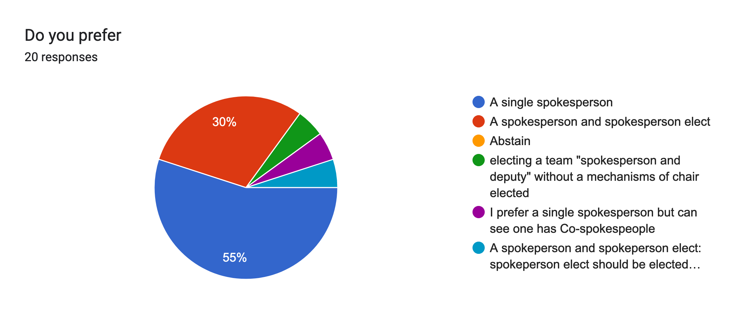
And as a follow-up for those who prefer one spokesperson:

Slide 6
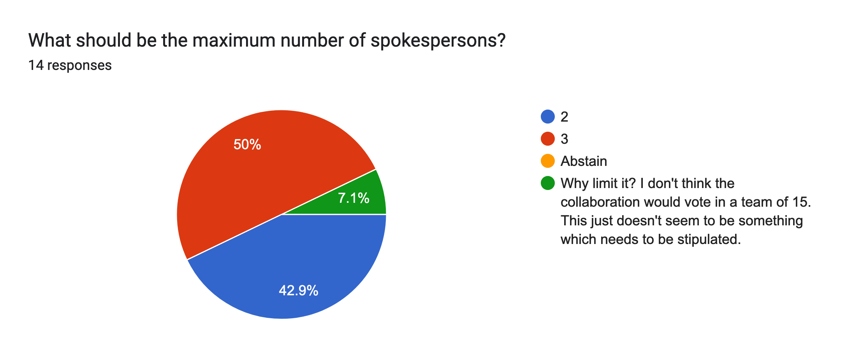
For those who voted for >1 we asked a 2nd question:

Slide 7
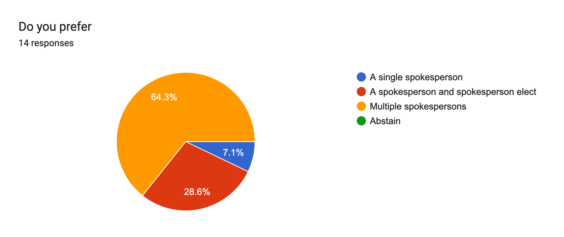
And for those who voted >1 we did also ask about a spokesperson elect:

Slide 8
My personal take on the polling result is EPIC should likely go with the simplest solution that the majority likes (i.e. one spokesperson and deputies); but the charter committee still needs discuss and we also welcome your feedback.

