Slide 1
EIC Project Update
Elke Aschenauer and Rolf Ent
Co-Associate Directors for the Experimental Program
ePIC General Meeting
October 28th 2022

Slide 2
Recent Events
September 26 – EIC Advisory Board meeting (~ Director’s Council for US projects)
October 12-13 – “Resource Review Board”-like kickoff meeting
https://indico.bnl.gov/event/17354/
Now planning for first RRB meeting April 2023
October 18-19 – 60% Magnet Review @ JLab
We implemented the design change to go to six layers of conductor – with thanks to our CEA Saclay colleagues to help us out. This should allow a robust 1.7 Tesla magnet with stretch goal of 2 T.
Five engineers from CEA Saclay attended in person. The meeting will be hybrid as the reviewers and further engineers/designers will be remote.
The reviewers will be the same as for the earlier 30% design review and are confirmed – Ruben Fair (PPPL) –chair, Vladimir Kashikhin (FNAL), GianLuca Sabbi (LBNL).
October 19-21 – Detector Advisory Committee meeting
EIC project update
Update on the EPIC detector, the steps following the DPAP process
and as main part of the meeting reports on the status of the various project detector R&D projects and FY23 plans/requests
https://indico.bnl.gov/event/17159/

Slide 3
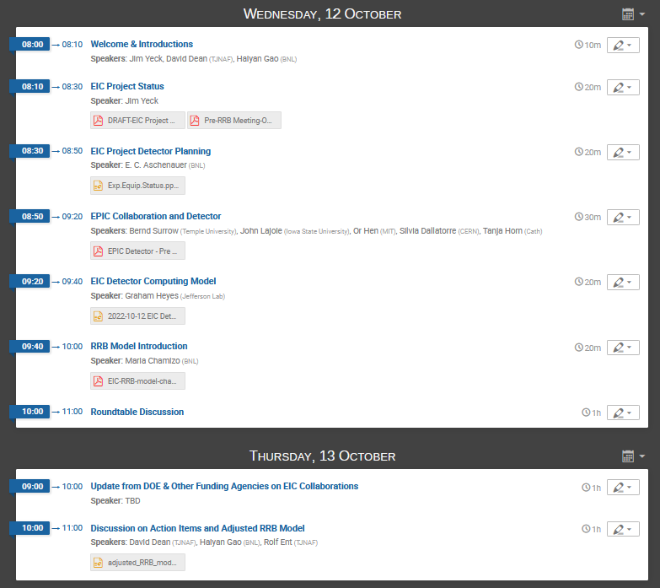
“Pre-RRB” Meeting Agenda
Participation from Canada, Czech, France, Italy, Japan, Korea, Poland, UK

Slide 4
Discussion on Action Items and Adjusted RRB Model
David Dean, Haiyan Gao, Rolf Ent (with input from Elke Aschenauer, Maria Chamizo-LLatas, Luisella Lari, Jim Yeck)
EIC Pre-RRB Meeting
October 13th 2022
Electron Ion Collider

Slide 5
Role of RRB for experiment and computing
10/13/2022 adjusted after discussion
Provide coordination among the different funding partners during the two phases
Construction of the experiment
Operation and scientific exploitation
Oversight of the experiments and computing
Reaching agreement on contributions to the experiments and computing
Monitoring progress, finances and workforce support
Reaching agreement on common projects and the use of common funds (when proposed and supported)
Reaching agreement on maintenance and operations scope and financing and monitoring its functioning
Endorsing the annual construction and maintenance and operations budgets of the detector
The RRB is not a scientific committee. The RRB is about making sure the plans for the experiments are consistent with the resources reasonably expected to be available.

Slide 6
Homework and First RRB meeting
.
EIC Project and host labs: define expectations up front on how new members can come in, and how to make decisions
Non-DOE funding agencies to decide on election/rotation scheme for RRB co-chair
Initial RRB to draft charter as first organizational step?
Aim for the first RRB meeting in Spring 2023
Discuss level* of documents and agreements towards CD-2/3A
* ECA/RE: means projected state of completion

Slide 7
Recent Events
September 26 – EIC Advisory Board meeting
October 12-13 – “Resource Review Board”-like kickoff meeting
Now planning for first RRB meeting April 2023
October 18-19 – 60% Magnet Review @ JLab
We implemented the design change to go to six layers of conductor – with thanks to our CEA Saclay colleagues to help us out. This should allow a robust 1.7 Tesla magnet with stretch goal of 2 T.
Five engineers from CEA Saclay attended in person. The meeting will be hybrid as the reviewers and further engineers/designers will be remote.
The reviewers will be the same as for the earlier 30% design review and are confirmed – Ruben Fair (PPPL) –chair, Vladimir Kashikhin (FNAL), GianLuca Sabbi (LBNL).
October 19-21 – Detector Advisory Committee meeting
EIC project update
Update on the EPIC detector, the steps following the DPAP process
and as main part of the meeting reports on the status of the various project detector R&D projects and FY23 plans/requests
https://indico.bnl.gov/event/17159/

Slide 8
Context – EIC MARCO Magnet Design Change ~ August
can we make a conservative magnet design that can reach a robust >1.5 Tesla but with the BaBar magnet geometry?
possible concerns: increase of technical risk, increase of material need (nuclear interaction lengths) and increase in costs.
High-level summary of first view:
Increase number of conductor layers from 4 to 6 – this is possible within the geometry and given the present conductor choice ☺
Actually, this has a plus in that the current requirement goes down to 4000 Amps which increase critical current margin – a magnet high-level design parameter. ☺ The temperature margin remains very safe. ☺
The nuclear interaction lengths for the BaBar magnet is 0.36, for the initial 1.5 Tesla new magnet design it was 0.42, it became 0.36 once CEA-Saclay had finalized the conductor choice, and now for a potential 2 Tesla new magnet it is back to 0.42 again → this is acceptable ☺
The stored power goes like field squared, so from 1.5 Tesla to 2 Tesla it goes up by a factor of 1.78. Cost goes roughly as stored power to the power 0.7, so cost would go up a factor of 1.5. That roughly equates to +5M$. ☹ This was accepted by the EIC Management Team as needed for the EIC science and is now included as part of the P6 baseline cost/schedule.

Slide 9
Additional Info on Use of BaBAR Magnet
Use of BaBAR magnet is in the risk registry as an opportunity, currently at 10%
The probability to use the BaBAR magnet is shrinking
This is because the design of the ePIC detector is very different from the symmetric-collider cases of sPHENIX / BaBAR. This affects the material distribution and as a result the internal forces
the forces on the magnet increase → BaBAR magnet can only reach 1.15 T for the sPHENIX operating current
one would have to increase the current to reach 1.5 T → this requires invasive repairs of diagnostics and safety systems → increased risk
the science requirement for tracking is larger than 1.5 T → 1.7 T
60% design review recommendation to drop the BaBAR magnet option

Slide 10
Closeout Report
Ruben Fair; Gianluca Sabbi; and Vladimir Kashikhin
60% Solenoid Magnet Subsystem Technical Design Review
October 18-19, 2022

Slide 11
Conclusion
Significant progress has been made since the 30% design review point in Feb 2022. However, a change to the magnet field requirements and the conductor design approach (i.e. utilizing Cu-clad instead of Al-clad) has meant that some work has had to be repeated, and as a result other work required for the 60% design point has perhaps lagged somewhat.
The formalization of the requirements and interface documents is still a work in progress and further changes at this stage in the design process could pose a risk to schedule and cost.
The collaboration between Jlab, CEA-Saclay and BNL is working very well.
The current JLab/CEA-Saclay team will be on track to be ready for the 90% design review in 2023 as long as the recommendations are addressed adequately.

Slide 12
New Recommendations
By end Dec 2022, reassess the use of the BABAR magnet as an opportunity, now that the team has a better understanding of the requirements and any shortcomings of the BABAR magnet in achieving those requirements. Given the field requirement of 1.7 T to 2.0 T, we recommend dropping the BABAR magnet option.
By end Feb 2023, approve the magnet requirements document formally, and utilize a change control process for any further changes to requirements.
By Mar 2023, fast-track the design aspects of the magnet that presently appear to be at a lower maturity level than the 60% design point.
By Sep 2023, complete and approve the interface document. Utilize a change control process for any further changes to interfaces.
By Sep 2023, include ESH&Q considerations in the magnet and system design.
By the CD2/3A review date, demonstrate significant progress in prototyping and characterization of sample conductor and plans for full conductor production.

Slide 13
Recent Events
September 26 – EIC Advisory Board meeting
October 12-13 – “Resource Review Board”-like kickoff meeting
Now planning for first RRB meeting April 2023
October 18-19 – 60% Magnet Review @ JLab
We implemented the design change to go to six layers of conductor – with thanks to our CEA Saclay colleagues to help us out. This should allow a robust 1.7 Tesla magnet with stretch goal of 2 T.
Five engineers from CEA Saclay attended in person. The meeting will be hybrid as the reviewers and further engineers/designers will be remote.
The reviewers will be the same as for the earlier 30% design review and are confirmed – Ruben Fair (PPPL) –chair, Vladimir Kashikhin (FNAL), GianLuca Sabbi (LBNL).
October 19-21 – Detector Advisory Committee meeting
EIC project update
Update on the EPIC detector, the steps following the DPAP process
and as main part of the meeting reports on the status of the various project detector R&D projects and FY23 plans/requests
https://indico.bnl.gov/event/17159/

Slide 14
Context – Project Detector R&D Proposals
Most proposals were submitted by October 1st, all proposals were submitted by October 3rd (compilation of ASICs/electronics proposals took extra time).
See https://wiki.bnl.gov/conferences/index.php/ProjectRandDFY23
Main surprise: large increase in Si-related detector R&D requests, we worked with the Si consortium to understand this. The Si consortium subsequently submitted revised proposals (thanks!).
DAC Meeting October 19-21: https://indico.bnl.gov/event/17159/
Good presence of the DAC: 9 were present all days or most of it.
We also discussed the charter with the DAC and after their initial tenure we start the process to rotate each year 4 members (out of 12) off, starting late this year. New members get a 3-year tenure.

Slide 17
Upcoming: meetings of Patrizia, Thomas, Elke, Rolf to go over the various DAC R&D-specific recommendations. Largest issue is how to fit in a box (mainly due to that Si MAPS-ITS3 sensors moved to project R&D)

Slide 18
Upcoming Events
October-December – EIC Subsystem Status Reviews on Tracking, Particle Identification Systems, Electromagnetic Calorimetry, Hadronic Calorimetry, Infrastructure/Installation, Polarimetry
already completed
Magnet Incremental Design and Safety Review (6.10.07) – Preliminary 30% Design
IR Integration and Ancillary detectors (6.10.11)
Electronics/Computing Subsystem Status Review (6.10.08 & 6.10.09)
Magnet Incremental Design and Safety Review (6.10.07) – 60% Design
in planning stage
Calorimetry Review (6.10.05 & 6.10.06) – First two weeks December
Polarimetry Review (6.10.14) – Aim before end of CY
Incremental Integration/Installation Review – waiting for sPHENIX installation schedule
To do beyond
Tracking Review (6.10.03)
Particle Identification Review (6.10.04)
Infrastructure Review (6.10.10)
Magnet Incremental Design and Safety Review (6.10.07) – 90% Design ~September 2023
DOE OPA Status Review - Confirm CD-2/3A Plans Jan. 31 – Feb. 2, 2023
Preliminary Design and Director’s Reviews June 2023
DOE CD 2/3A OPA Review and ICR, requires pre-TDR October 2023
DOE CD 2/3A ESAAB Approval January 2024

Slide 19
Incremental Design and Safety Review of the EIC Detector Calorimeters
Timing: 2 days, period of November 28 to December 14 (preferentially November 28 - December 9). Assume each day from 8 am to 2 pm EST, or 2 pm to 8 pm CET.
Agenda Day-one (note that each talk time assumes more than 1/3 of time for questions and discussion)
30 min Executive Session (Closed Session) – needs some time as context important
30 min Welcome and Introduction (introduce the general project status) – Elke/Rolf
30 min Electromagnetic Calorimetry Overview and Requirements – Sasha Bazilevsky (BNL)
30 min Hadronic Calorimetry Overview and Requirements – Alexander Kiselev (BNL)
30 min Overall Detector Integration Status and CAD Design – Roland Wimmer or Rahul Sharma (BNL)
30 min Break
40 min Backward Electromagnetic Calorimetry detector and integration –
Carlos Munoz Camacho (IJCLab) and engineer
20 min Backward Hadron Calorimetry detector upgrade (material distribution and impact on magnet design, backward HCal requirements, simulations and feasibility –
Leszek Kosarzewski (CTU Prague)
40 min SciGlass-Based Barrel Electromagnetic Calorimetry detector and integration –
Tanja Horn (CUA) and Josh/Avishay
20 min Imaging-Calorimeter Barrel Electromagnetic Calorimetry alternate option – TBD (ANL)
60 min Executive Session – Discussion
Agenda Day-Two
30 min Barrel Hadronic Calorimetry detector and upgrades – John Lajoie (ISU)
40 min Forward Electromagnetic Calorimetry detector and integration – Oleg Tsai (UCLA) and engineer
40 min Forward Hadronic Calorimetry detector and integration – Friederike Bock (ORNL) and engineer
20 min Calorimetry Electronics Overview – Fernando Barbosa (JLab)
20 min Forward Hadronic Calorimetry electronics – Gerard Visser (Indiana)
30 min Break
3 hr Executive Session and closeout
DRAFT!!!!

Slide 20
International Engagement
Many international engagement meetings are planned – both from the labs/project side and from the DOE/NP side, with individual agencies.
08/23/2022: meeting of DOE and UK/STFC representatives, EIC large topic
Feedback from DOE/NP: very positive meeting
08/31/2022: meeting of DOE and France/IN2P3 representatives, topic mainly FRIB but also EIC
Feedback from DOE/NP on EIC: strong support by IN2P3 for groups there and detector, end of October official presentation of EIC/IN2P3 group to IN2P3 council.
09/12/2022: meeting of DOE and Israel/BSF representatives at BNL
Feedback from DOE/NP: positive, “want to sign contract” (similar as NSF-Israel)
10/12-13/2022: pre-RRB kickoff meeting, agencies and country PIs https://indico.bnl.gov/event/17354/
International Attendance: UK, Korea, Czech, Canada, Japan, Poland, Italy
Tim Hallman: “DOE would be just another seat at the RRB table”
Discussion of DOE meeting with ICT Korea/Ministry of Science – late October?
DOE/NP setting up meeting with various international agencies (6-10?) in Washington DC tentatively scheduled for November 17.

Slide 21


