Slide 1
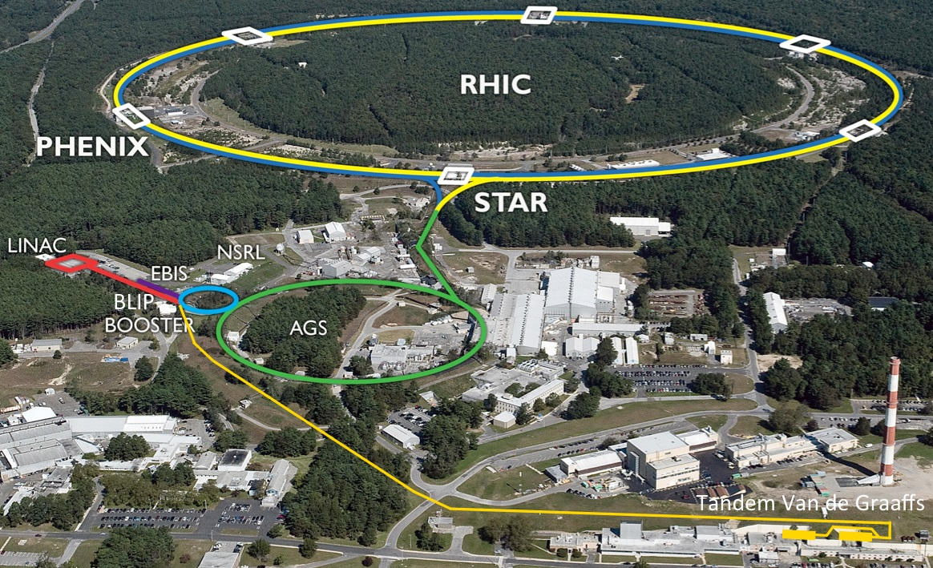
Short summary of RHIC Run-16 and outlook for for Run-17/18 and BES-II Wolfram Fischer
16 June 2016
BNL NPP PAC
Notes:
09:00, 30 min total => 25 slides

Slide 2
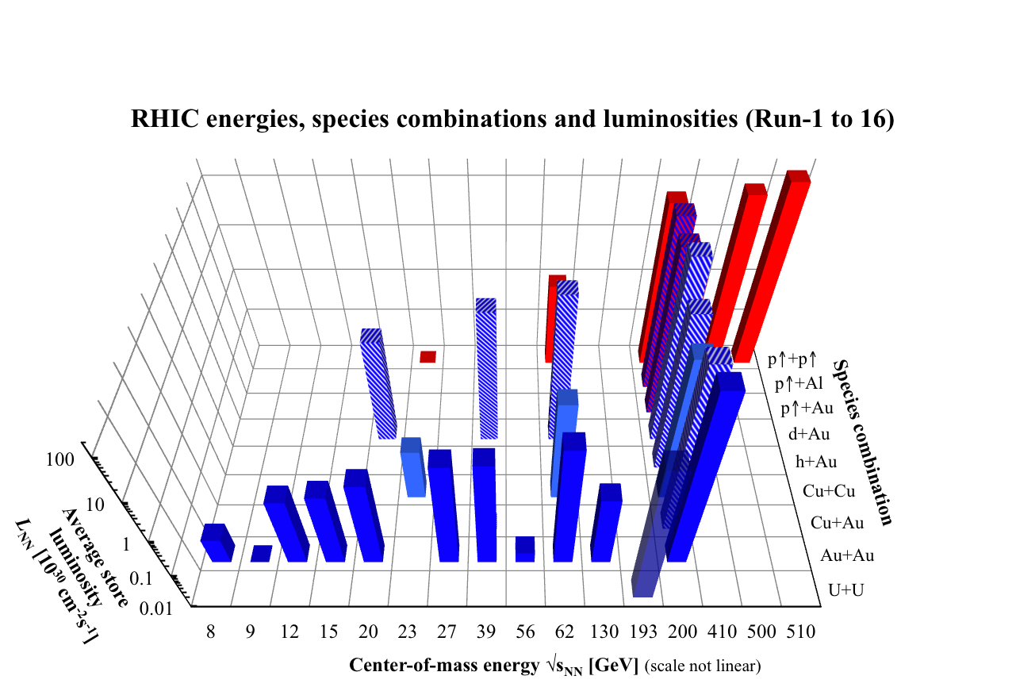
Run-16 – most demanding in terms of flexibility to date
6 setups for physics, d+Au with Au cooling except at lowest energy (new aperture limit at Coherent electron Cooling test, sensitive to losses)

Slide 3
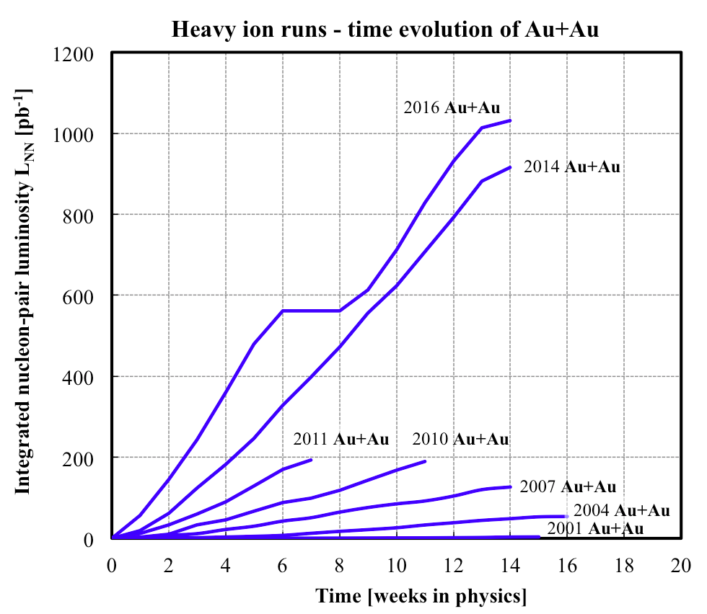
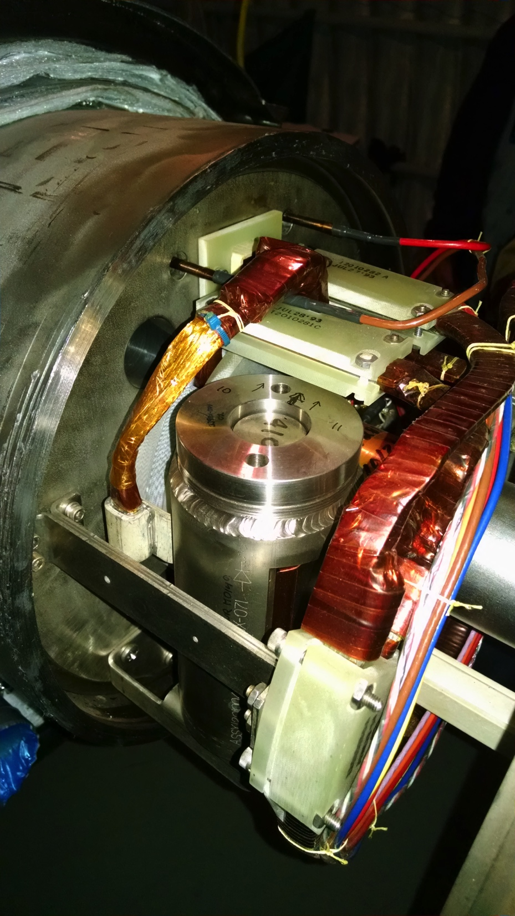
Au+Au at √s_{NN} = 200 GeV – record luminosities
replacement of shorted quench protection diode (19.5 days)
L_{avg} = 44x design (plans for 2x more)
losses of secondary
BFPP/EMD beams (~ L) contributed

Slide 4
Coherent electron Cooling test V. Litvinenko, I. Pinayev et al.
Novel cooling scheme for eRHIC
2016 first year with beam transported from SRF gun to dump, acceleration in newly installed 704 MHz SRF cavity
had demonstrated 3 nC/bunch in 2015, record for CW guns
Still to be demonstrated (next 2 years):
full electron beam parameters (energy, bunch charge, rep rate, emittances)
interaction with Au beam, amplification of density modulations
cooling
Undulator is aperture limit for BES-II (needs to be removed)

Slide 5
Run-17: ph+ph √s = 510 GeV – luminosity leveled at 1.6x10³³ cm⁻²s⁻¹
Calculation with multiple β* squeezes (expect only one in Run-17) – Y. Luo
Goal: L within ±10% of target
Luminosity [10³² cm⁻²s⁻¹]

Slide 6
Run-18 Possible isobar combinations
 | ⁹⁶Zr⁴⁰⁺ | ⁹⁶Ru⁴⁴⁺
Natural abundance | 2.81% | 5.54%
... from EBIS | enriched ⁹⁶Zr metal available | no source of enriched ⁹⁶Ru
... from Tandem | good intensity with ZrH₂ | good intensity with Ru metal
 | ¹²⁴Sn⁵⁰⁺ | ¹²⁴Xe⁵⁴⁺
Natural abundance | 5.79% | 0.095%
... from EBIS | possible | possible
... from Tandem | possible | not possible
 | ¹³⁰Te⁵²⁺ | ¹³⁰Ba⁵⁶⁺
Natural abundance | 34.08% | 0.11%
... from EBIS |  | difficult
... from Tandem | good intensity with CdTe | perhaps with enriched Ba in BaH₂
 | ¹³⁶Xe⁵⁴⁺ | ¹³⁶Ce⁵⁸⁺
Natural abundance | 8.86% | 0.185%
... from EBIS
... from Tandem | no possible | not possible, poisons ionizer
Notes:
Checked abundance (mole fraction) for all isotopes (Wikipedia).

Slide 7
Run-18: ⁹⁶Zr + ⁹⁶Zr, ⁹⁶Ru + ⁹⁶Ru – luminosity estimates
based on 2016 test, natural Ru, from Tandem
estimate from last year (likely too conservative)

Slide 8
Other requests
RHICf
RHICf (Run-17)
discussed with RHICf, request reasonable (both colliding and fixed target part)
largest uncertainty is measurement and adjustment of radial polarization in time (can tolerate large error)
Au+Au √s_{NN} = 62.4 GeV (Run-17)
Au+Au √s_{NN} = 27 GeV (Run-18)
no issues

Slide 9
LEReC Physics integration BES-II required events
RHIC Beam Energy Scan II (BES-II) for search of critical point in QCD phase diagram
center-of-mass energy √s_{NN} | GeV | 7.7 | 9.1 | 11.5 | 14.6 | 19.6
events BES-I, actual | M | 4.3 |  | 11.7 | 24 | 36
events BES-II, min goal | M | 80 | 100 | 150 | 200 | 300
events BES-II, full goal | M | 100 | 160 | 230 | 300 | 400
General strategy to maximize integrated luminosity:
Cooling at the 3 lowest energies (4x gain in L_{avg}), no cooling at the 2 highest energies (3x gain in L_{avg}) => demonstrated at √s_{NN} = 19.6 GeV in Run-16
Increase cryo-time from 22 to 24 weeks/year
Start BES-II at highest energies (machine ready w/o cooling)
Interleave cooling commissioning with physics operation
Finish BES-II at lowest energies (largest gain in L_{avg} and time)
Notes:
STAR vertex acceptance: +- 1m
STAR contacts: Zhangbu Xu (spokesperson), Bill Christie, Paul Soerensen, Daniel Cebra

Slide 10
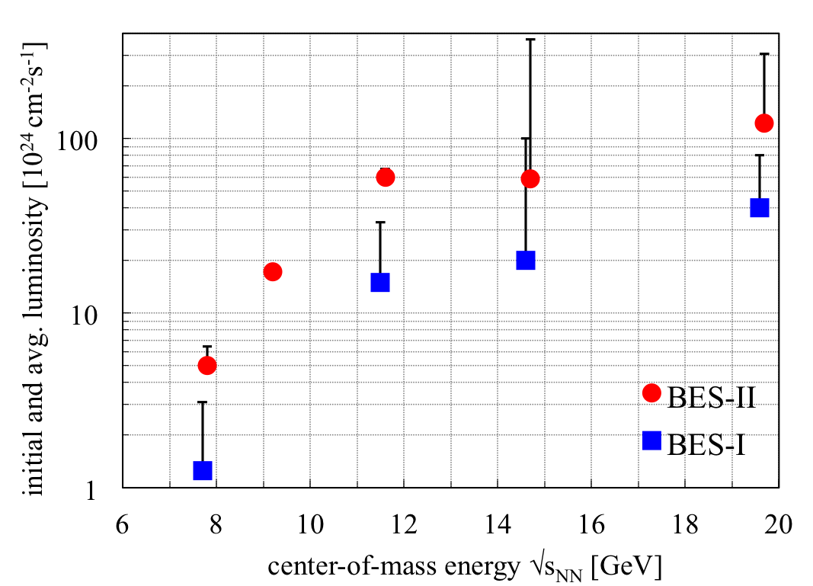
Physics integration BES-I and BES-II luminosities
nominal injection energy
4x increase in L_{avg} with e-cooling
3x increase in L_{avg} without e-cooling

Slide 11
Low Energy RHIC electron Cooling (LEReC)
A. Fedotov
64 m to IP2
(not to scale)
Commissioning
Diagnostic Line 1
704 SRF
Booster Cavity
Commissioning
Diagnostic Line 2
704 MHz Cu Cavity
9 MHz Cu Cavity
2.1 GHz Cu Cavity
DC e⁻ Gun
e⁻
COOLING
in Yellow RHIC ring
e⁻
RHIC TRIPLET
RHIC DX
e⁻
COOLING
in Blue RHIC ring
LEReC Solenoids
Compensating (LF)
Matching (HF)
Merger/Transport
180° Bending Magnet
20° Bending Magnets
Beam Dump
Energies E : 1.6, 2.0 (2.65) MeV Avg. current I_{avg} : 27 mA Momentum δp/p : 5×10⁻⁴
Luminosity gain : 4×
1st bunched beam electron cooler planned operation in 2019/2020

Slide 13
56 MHz SRF +11% total luminosity gain
Notes:
Fillno 19941

Slide 14
56 MHz SRF +15% luminosity gain in +- 10 cm
Notes:
Fillno 19941

Slide 15
Run-17 ph+ph at √s = 510 GeV (STAR)
STAR requested level luminosity at 1.3×10³² cm⁻²s⁻¹
(0.9 events per bunch-bunch crossing, ≈ 50% of Run-13 max, ≈ 30% of Run-17 expected max)
Possible methods for leveling: Dynamic β* change during store (tested in Run-14) Changing transverse offset with electron lens (needs study)
New operating mode, plan for L_{avg} ≈ 90% L_{peak}
Need Run-17 also for high-luminosity test for sPHENIX era
Run-13 luminosity (17491)
Run-17 leveled luminosity request

Slide 16
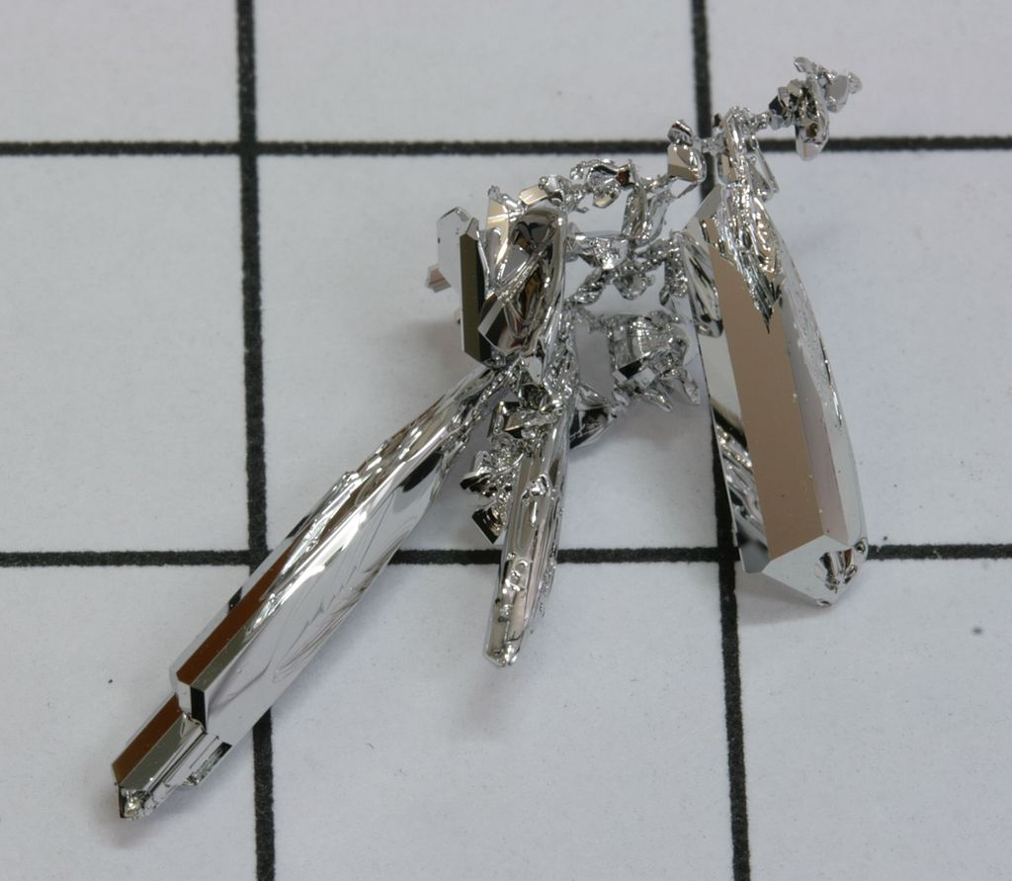
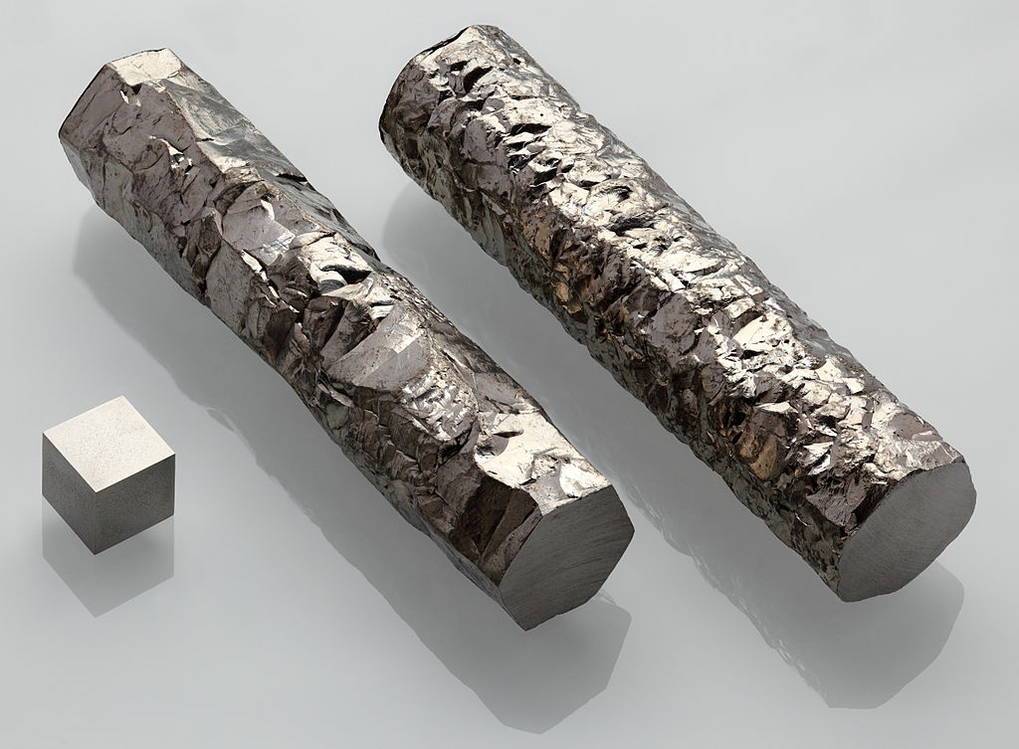
Ru+Ru and Zr+Zr Run-17 at √s_{NN} = 200 GeV (STAR)
Full intensity = Ru, Zr charge per bunch ≥ Au charge per bunch
Need enriched source material for laser ion source or hollow cathode source Ru-96 abundance 5.6%, Zr-96 abundance 2.8%
Enriched Zr-96 available in metallic form => can run at full intensity
Enriched Ru-96 not available from any source (still searching ...) Need ≈ 1 g for operation Have 40 mg in hand (97.92% enriched) 400 mg target material at GSI => can likely run at 5% of full intensity tested in Run-16
ruthenium grown out of gas phase (Wikipedia)
zirconium (Wikipedia)
Notes:
Calutron picture, Ru picture, Zr picture

