Slide 1


STAR
Experimental Overview
Runs 14 & 15
Frank Geurts (Rice Univ.)

Slide 2

Outline
STAR Physics & Detector
Publications 2015/2016
Offline Physics Production
  run 14 & 15 production status
Run 14 & 15 Analysis Highlights

Slide 3
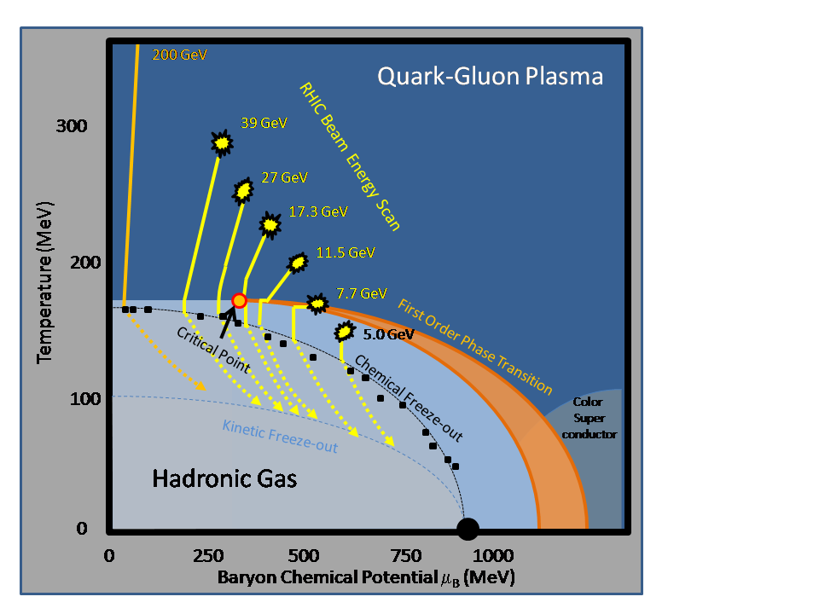
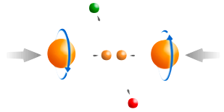
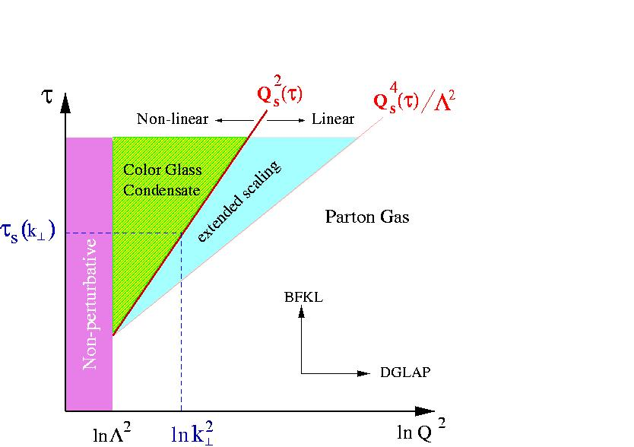
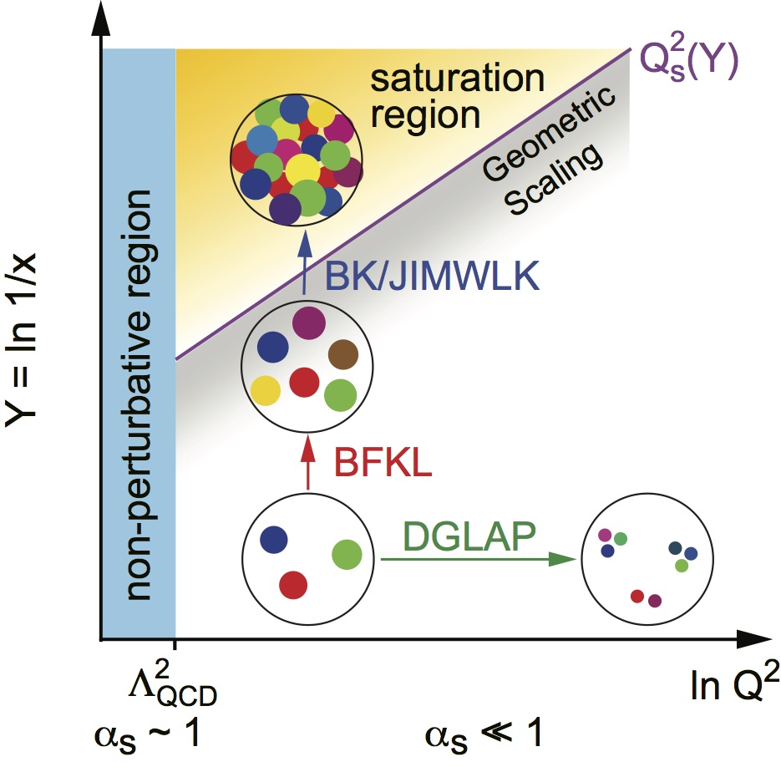
eight key unanswered questions
Hot QCD Matter
Partonic structure
6: Spin structure of the nucleon
7: How to go beyond leading twist
and collinear factorization?
6: Spin structure of the nucleon
7: Image proton in momentum and coordinate space
1: Properties of the sQGP
2: Mechanism of energy loss:
weak or strong coupling?
3: Is there a critical point, and if so, where?
4: Novel symmetry properties
5: Exotic particles
8: What are the properties of
cold nuclear matter?
STAR Decadal Plan
http://www.bnl.gov/npp/docs/STAR_Decadal_Plan_Final%5b1%5d.pdf

Slide 4


STAR Detector System
EEMC
Magnet
MTD
BEMC
TPC
TOF
BBC
Run-14/15 key upgrades:
Heavy Flavor Tracker
Muon Telescope Detector
Roman Pot upgrade
Forward Meson Spectrometer
  restacked
FMS Preshower
  first use of SiPMs
FMS/FPS
RP
HFT

Slide 5
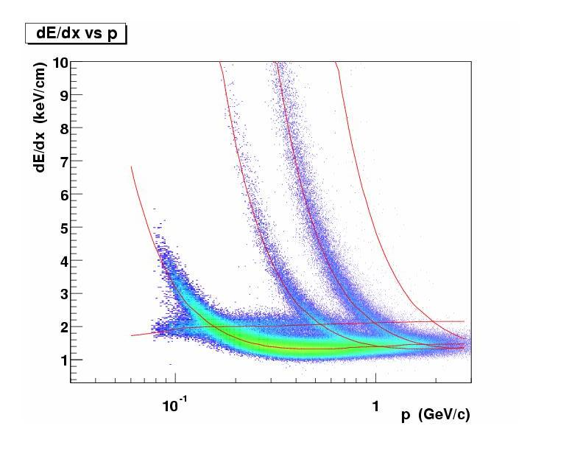
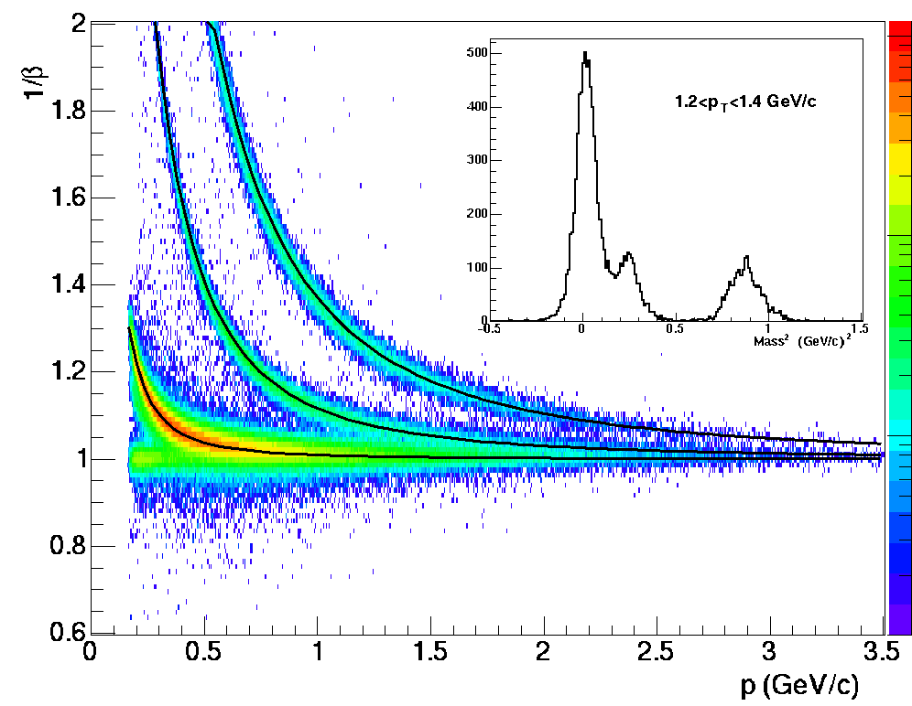
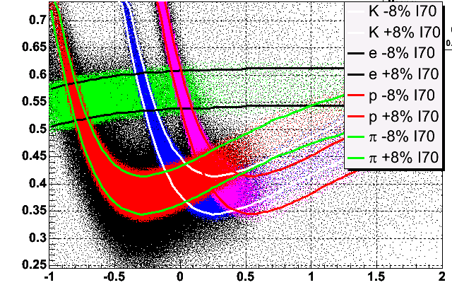
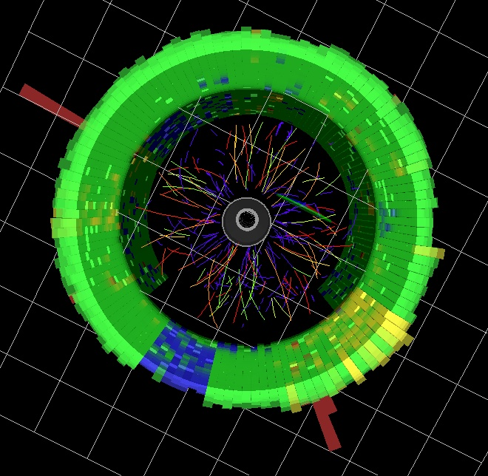
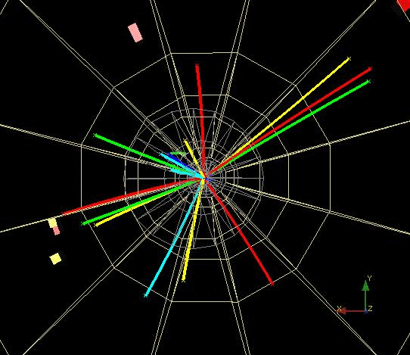
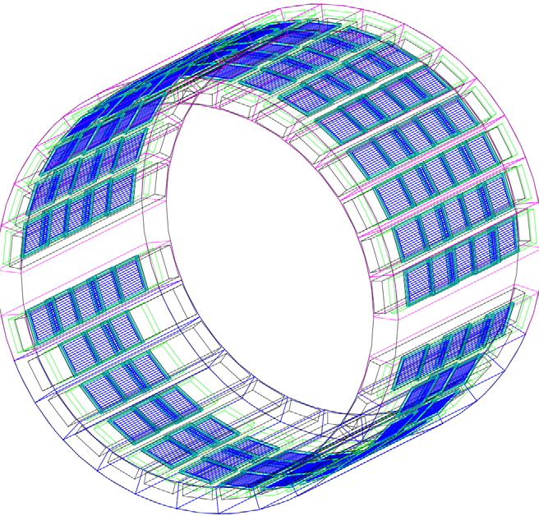
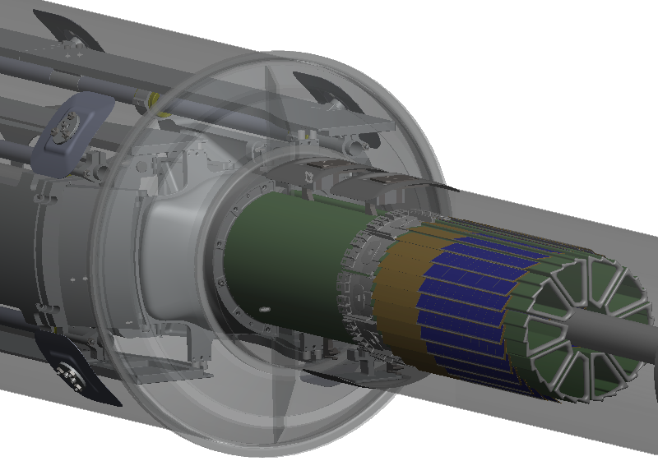
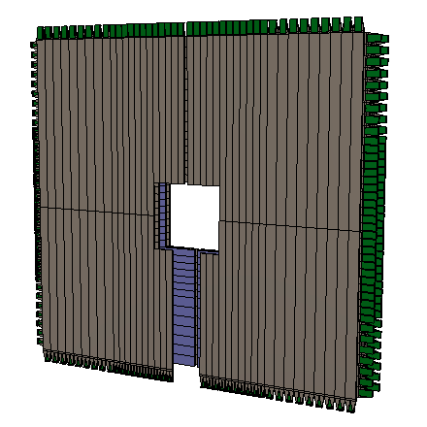
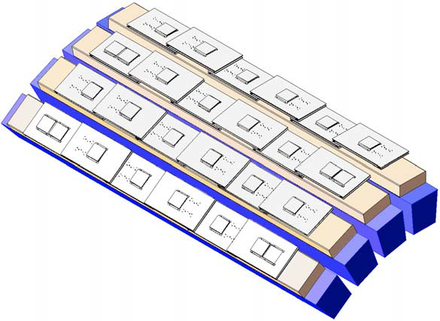
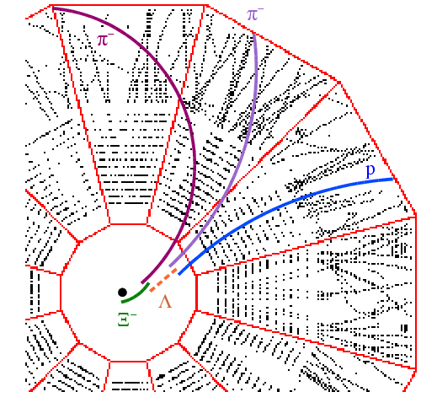
Particle Identification at STAR
TPC TOF TPC
TPC
K p d
π
e, μ
TOF
Log₁₀(p)
Charged hadrons
Hyperons & Hyper-nuclei
EM particles
MTD
HFT
RP
EMC
Jets
FMS/FPS
Jets & Correlations
High p_{T} muons
Heavy-flavor hadrons
Forward protons
Forward photons
Multiple-fold correlations for identified particles!

Slide 6
STAR Detector Systems
 | Period | Detectors | Physics
 | 2001-2010 | TPC | u, d, s
 | 2009 | DAQ1000
 | 2010 | TPC + TOF | u, d, s + dilepton
 | 2013 | TPC + TOF + MTD | u, d, s, c, b + dilepton
 | 2014 | TPC + TOF + MTD + HFT
 | 2015 | TPC + TOF + MTD+HFT+FPS/FMS+RP
STAR: large coverage, excellent PID, fast DAQ
- detects nearly all particles produced at RHIC
- multiple fold correlation measurements
- probes: bulk, penetrating, and bulk-penetrating
STAR: perfect mid-rapidity collider experiment
STAR: expanding into forward rapidity regions

Slide 7
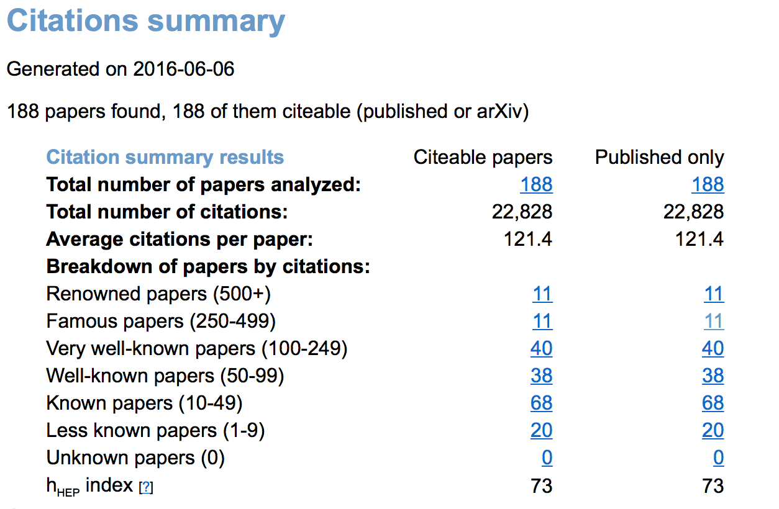
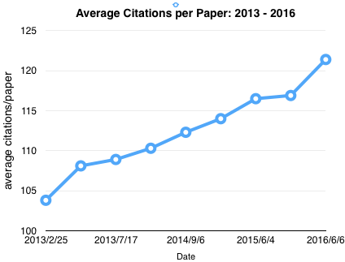
STAR Publications: Citation Summary
Citations (as per June 6)
22,828 citations
188 peer-reviewed scientific papers
2005 white paper: 2334
average citations/paper: 121.4
Renowned and Famous Papers: 11 + 11
2015: 9+10; 2014: 6+9
Source: inspire.net

Slide 8
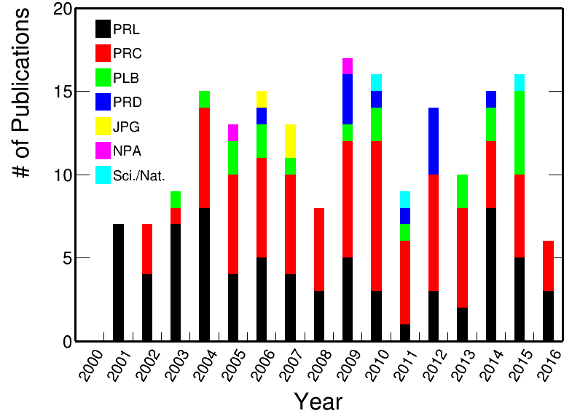
STAR Publication History
June 2015 – 2016
17 published papers (incl. 1 accepted)
  7 PRLs, 6 PRCs, 3 PLB, 1 Nature
    3 PRL Editor’s Suggestion
5 in journal review
13 in collaboration (GPC) review process
9 paper proposals readied for GPC
14 PhD graduations

Slide 9
Published Papers :: June 2015 – now (1)
Long-range Correlations in d+Au at 200GeV
Di-Hadron correlations with identified leading hadrons in 200 GeV Au+Au and d+Au collisions at STAR
  Phys. Lett. B 751 (2015) 233
Long-range pseudorapidity dihadron correlations in d+Au collisions at √s_{NN} =200 GeV
  Phys. Lett. B 747 (2015) 265
Au+Au at 200GeV
Measurement of interaction between antiprotons
  Nature 527 (2015) 345
Azimuthal anisotropy in U+U and Au+Au collisions at RHIC
  Phys. Rev. Lett. 115 (2015) 222301
Centrality and transverse momentum dependence of elliptic flow of multi-strange hadrons and φ meson in Au+Au collisions at √s_{NN} = 200 GeV
  Phys. Rev. Lett. 116 (2016) 62301
Polarized p+p at 200/500GeV
Precision measurement of the longitudinal double-spin asymmetry for inclusive jet production in polarized proton collisions at √s = 200GeV
  Phys. Rev. Lett. 115 (2015) 92002 {PRL Editor’s Suggestion}
Observation of transverse spin-dependent azimuthal correlations of charged pion pairs in p+p at √s =200 GeV
  Phys. Rev. Lett. 115 (2015) 242501
Measurement of the transverse single-spin asymmetry in p+p➝W±/Z at RHIC
  Phys. Rev. Lett. 116 (2016) 132301 {PRL Editor’s Suggestion}
Notes:
204, 202, 198, 197, 196, 195

Slide 10
Published Papers :: June 2015 – now (2)
Dielectron Measurements
Measurements of dielectron production in Au+Au collisions at √s_{NN}=200 GeV from the STAR Experiment
  Phys. Rev. C 92 (2015) 024912
Energy dependence of acceptance-corrected dielectron excess mass spectrum at mid-rapidity in Au+Au collisions at √s_{NN} = 19.6 and 200GeV
  Phys. Lett. B 750 (2015) 64
CNM (p+p and d+Au at 200GeV)
J/ψ Production at low transverse momentum in p+p and d+Au collisions at √s_{NN}=200 GeV
  Accepted by PRC
Beam Energy Scan (➢ incl. Run-14 14.6GeV)
Beam energy dependent two-pion interferometry and the freeze-out eccentricity of pions in heavy ion collisions at STAR
  Phys. Rev. C 92 (2015) 014904
Kπ, pπ, and Kp fluctuations in Au+Au collisions from √s_{NN} = 7.7 to 200GeV
  Phys. Rev. C 92 (2015) 021901(R)
Observation of charge asymmetry dependence of pion elliptic flow and the possible chiral magnetic wave in heavy-ion collisions
  Phys. Rev. Lett. 114 (2015) 252302 {PRL Editor’s Suggestion}
Probing parton dynamics of QCD matter with Ω and φ production
  Phys. Rev. C 93 (2016) 21903
Centrality dependence of identified particle elliptic flow in relativistic heavy ion collisions at √s_{NN} = 7.7-62.4 GeV
  Phys. Rev. C 93 (2016) 014907
Beam energy dependence of the 3rd harmonic of azimuthal correlations in Au+Au collisions at RHIC
  Phys. Rev. Lett. 116 (2016) 112302
16 papers published
1 accepted
Notes:
204, 202, 198, 197, 196, 195

Slide 11
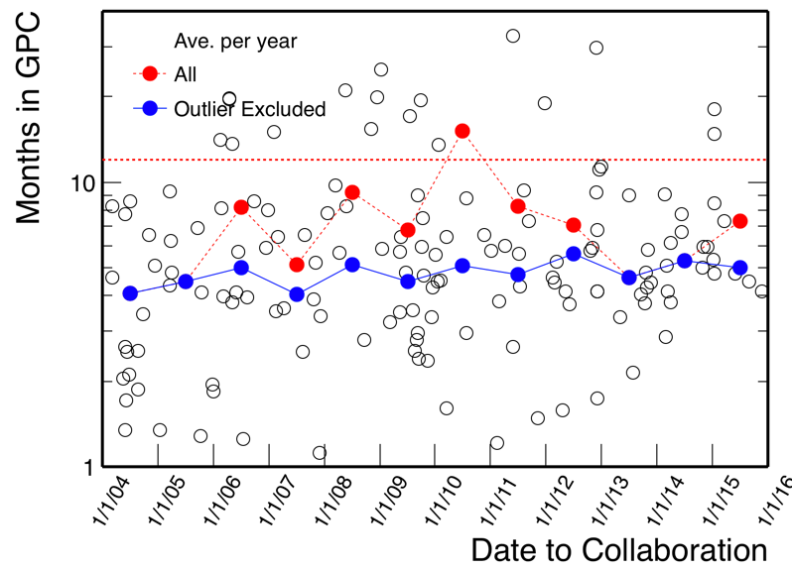
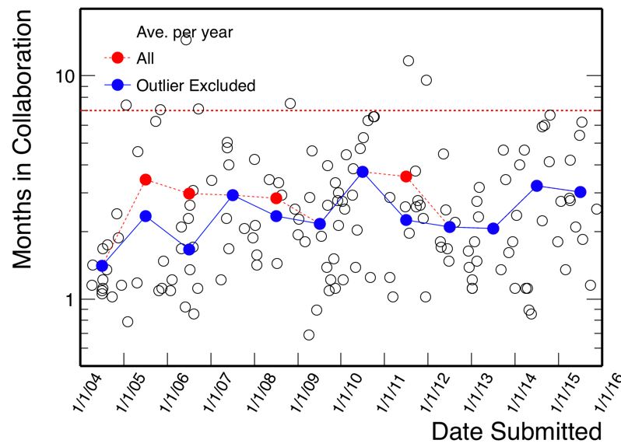
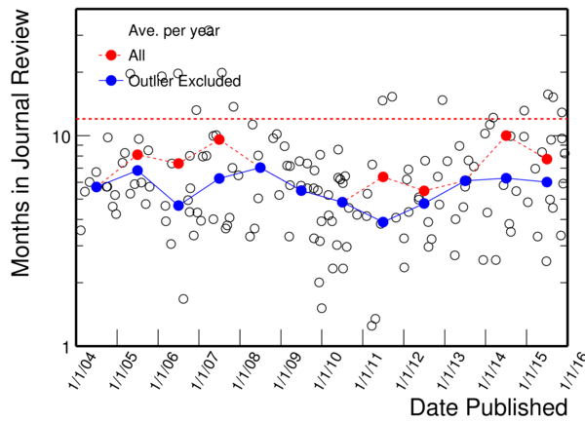
STAR Formal Paper Process
tracked by PWGs
tracked by Editorial Board
PWGC “early” preview
GPC
Collaboration Review
Journal Submission /Referee Report
PWG review
introduction
outline of data
and physics
draft plots
review physics analysis
review draft
technical note
(incl. analysis code)
review paper
ensure persuasive
physics message
technical accuracy
correctness of analysis
open for comments
from all of STAR +
5 institutional readers
distribute report to
the collaboration
work with GPC on response
Monitor Progress and Minimize Outliers …
~5 months
~1½ - 3 months
~6 months

Slide 12
Paper Plans in PWGs :: PWGC previews
date | pwg | title/url
June 23, 2015 | Spin | inclusive jet cross-section in p+p@200GeV
July 7, 2015 | BulkCorr | BES v3 published
July 7, 2015 | BulkCorr | BES PID v2 published
Oct. 6, 2015 | UPC | Coherent Diffraction of rho mesons in GPC
Oct.27, 2015 | Heavy | D⁰ and D* Production in p+p@500GeV ready for GPC
Nov. 3, 2015 | Spin | 2011 IFF in pp@500GeV
Nov. 3, 2015 | JetCorr | Di-jet imbalance measurements in Au+Au@200GeV in GPC
Dec. 8, 2015 | Heavy | D⁰ v2 in Au+Au@200GeV (HFT) in GPC
Dec. 15, 2015 | JetCorr | Away-side jet correlations in Au+Au@200GeV submitted
Jan.5, 2016 | BulkCorr | Three-particle harmonic decomposition in GPC
Jan.12, 2016 | LFS | BES Dielectron ready for GPC
Feb. 2, 2016 | BulkCorr | Charge-dependent directed flow in Cu+Au ready for GPC
Feb. 23, 2016 | BulkCorr | Global polarization of Lambdas in BES ready for GPC
March 22, 2016 | JetCorr | Hadron-Triggered Charged Jets in Au+Au@200GeV
14 pwgc previews
Paper proposals prepared across all 6 PWGs
Includes Run-14/15 data

Slide 13
Offline Physics Production
Physics production priorities regularly reviewed and set by the joint PWGs
  with input from Software & Computing leadership
Priorities from PWGs (Fall 2015)
Top priority
Run­14 Au+Au@200GeV
  main physics stream (HFT)
Immediate priorities (in parallel)
Run­14 Au+Au@200GeV :: MTD stream
Run15 p+p and p+A :: FMS stream
Next priorities (no order)
Run­15 RP stream
Run15 p+Al
Run15 p+p and p+A heavy-ion/spin physics
FXT for Au+Au @4.5GeV and Au+Al @4.9GeV
Modification (early 2016)
Reproduction Run-14 Au+Au HFT stream
  following a fix in the HFT decoding software
Prioritization 2015/16 – considerations:
Run 14 Au+Au
Fast-track Run-14 Au+Au at 200GeV to enable HFT publications
Understand MTD performance ahead of Run-16 Au+Au
J/ψ and Υ from MTD
  Estimate backgrounds
Run 15 p+p
Input from Run-15 FMS data in p+p and p+A (FMS stream)
Roman Pot data sets from Run-15 p+p and p+Au (RP stream)
Run-15 p+p and p+Au heavy-ion/spin physics

Slide 14
Run 14 and 15 Production Status
Run 14:
Au+Au @ 14.6GeV
  production finished Jan. ’15
Au+Au @ 200GeV
  started: March ‘15
  completed: April ’16
  includes HFT and MTD
³He+Au @ 200GeV
  preview production
Au+Au @ 200GeV
  reproduction of HFT stream
    (ongoing, currently at 30%)
Run 15:
Fixed Target production
  Au+Au @ 4.5GeV
  Au+Al @ 4.9GeV
p+p_{trans} and p+p_{long}
  FMS, RP streams
  physics stream (ongoing, currently at 39%)
  MTD stream (ongoing, currently at 71%)
p+Au @ 200GeV
  FMS stream
    (calibrations done)
p+Al @ 200GeV
  not started
    (calibrations done)
Run 16: calibrations being prepared

Slide 15
Production Projections
status | Dataset | Projection | Farm Occupancy
ongoing | 2014 Au+Au reproduction | 80 days (September 2016) | 50%
 | 2015 pp production | 50 days (August 2016) | 50%
queued | 2015 p+Au/p+Al | 5.5 months | 50%
preparing calibrations | 2016 Au+Au | 8 months | 100% (all streams)
Enable parallel productions
maximimize involvement of all PWGs
optimal usage of RHIC farm
  (100% = 13k nodes)
Continued concern about lack of scaling of available computing resources
Effort to involve other facilities (Dubna/NERSC) up to 20% impact on current projections
Notes:
2014: HFT efficiency, loss of parts of HFT sensors
2015: different beam efficiency and luminosity profile

Slide 16
Postproduction Resources :: Storage
Context:
Large and very active analysis community
Wide variety of data sets
  species, energies, data streams
Significant increase in size of individual data sets
  per run: RAW ~10PB; DST ~6PB
No proportional growth in active storage availability at BNL
  total distributed storage 8PB
Mitigation:
Data Carousel: rotate datasets (staging)
Data format: evolve from DST to MuDST
  still reaching 6 PB/year
PWGs move to picoDST further expand use case
  expect reduction by ~5-10
Impact
  timelines of physics analyses and paper prospects
  local storage at “Tier2” institutes and availability of data sets to the collaboration
 | Current Usage
Data written & read per run | RAW 10PB
 | DST 6 PB
I/O Bandwidth (max) | RAW 1.6 GB/sec
 | DST 15 TB/day
 | User 15 GB/sec
Permanent online storage (projected ~2020) | DST 8 PB (DST 20 PB)
Source: STAR Note PSN0658 – Exascale Requirements Review for Nuclear Physics – STAR, from data taking to analysis
Notes:
2014: HFT efficiency, loss of parts of HFT sensors
2015: different beam efficiency and luminosity profile

Slide 17
Run14/15 at Major Conferences in 2015/16
ISMD XLV (2015)
Central exclusion production in p+p
DIS 2016
  accepted: 5
J/ψ production in UPC
A_{N} in p+p and p+A
SQM 2016 (coming up)
  accepted: 14
Global Lambda polarization
BES v₂, v₃
FXT strangeness
Quarkonium in p+p and Au+Au (MTD)
BES net-Kaon moments
Ds production
D⁰ v₂, v₃
Quark Matter 2015
  21 oral presentations (incl. teaser, plenary, flash)
  21 posters
BES v₁ of identified hadrons
BES di-hadron correlations
Higher moments in net-p and net-Q at 14.5GeV
Jet-quenching and charged-particle R_{CP} in 14.5GeV
Identified particle spectra in 14.5GeV
BES rapidity density distributions
Fixed target results
Nuclear modification factors of D mesons
D-meson v₂
D_{S} measurements
Quarkonium measurements
STAR HFT and upgrade plans

Slide 18
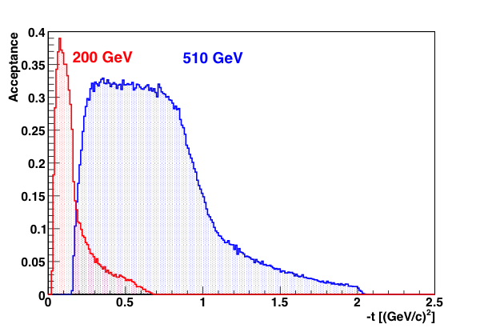
Ultra-Peripheral Collisions Highlight: J/ψ
DIS 2016
VM production from UPC photoproduction on other nucleus
J/ψ production sensitive to Au gluon content
  clear signal in Run 10/11
  run14: large sample with new EM trigger
GPDs in polarized p
  run15: RPs tag/measure scattered p
  phase-II*: RPs closer than Run9
  larger |t| range, increased acc.

Slide 19
UPC Highlight: Central Exclusive Production
ISMD XLV (2015)
Colliding protons interact via color-singlet exchange
Expect system of mass M_{X} to be produced
  decay products present in the central detector region
Tag on forward protons with RPs
First results (based on 2.5% of the full 2015 data sample of 600M CEP triggers, ~18 pb⁻¹)
M_{X}(ππ) similar resonance-like features as seen by CDF and AFS (at ISR)
M_{X}(KK) similar peak structure 1.5-1.6 GeV/c², similar as seen by WA102
  absence of f⁰(980) due to limited STAR acceptance

Slide 20
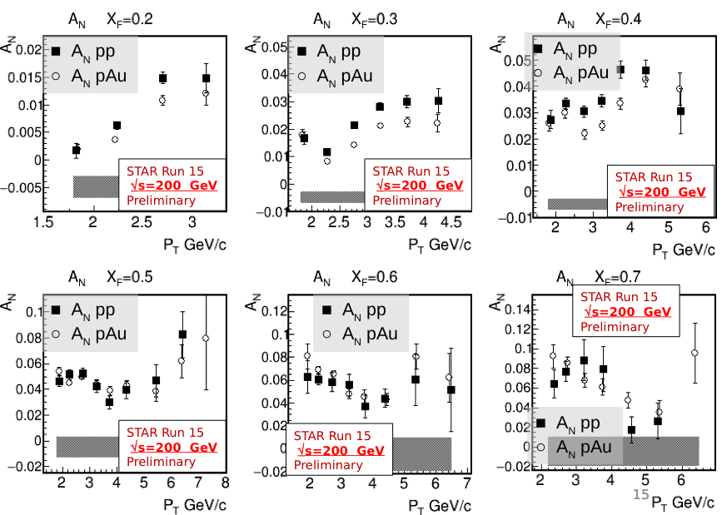
Spin Highlight: Transverse Single-Spin A_{N}
MPI2015/DIS 2016
Spin asymmetries are a unique way to probe the gluon nuclear wave function and confront CGC and pQCD models.
Forward Meson Spectrometer
  EM calorimeter for detecting forward π⁰s
Run 15 pp
  large A_{N}, rising with x_{F}, p_{T}
Run 15: first data for polarized p+A
  compare AN in p+A to p+p
  similar dependence on π⁰ topology
  study centrality and nuclear modification factors
Use RPs to investigate whether A_{N} depends on diffraction
  tag outgoing proton(s)

Slide 21
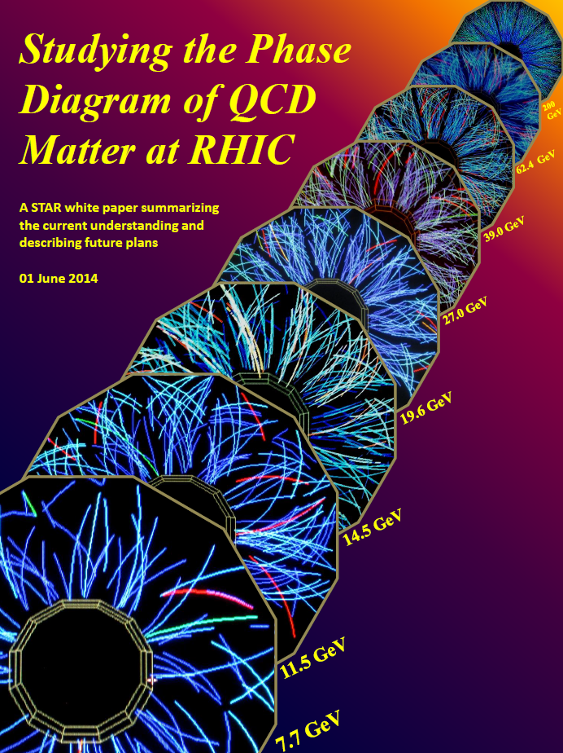
Heavy-Ion Highlights: 14.5 GeV Au+Au
All 14.5 GeV analyses are in their final stages - 24M events (BES-2 : ~300M)
Concludes Beam Energy Scan – Phase 1
  many BES papers have been submitted/accepted in the past years
QM 2015:
  11 presentations that involve new measurements with 14.5 GeV data
  preliminary results available for all key BES analyses
  cf. STAR plenary presentation for a concise overview
    https://drupal.star.bnl.gov/STAR/files/2015-10-01-QM15-STAR-Overview-v5.pdf
https://drupal.star.bnl.gov/STAR/starnotes/public/sn0598
Notes:
8 (LFS) + 11 (BC)

Slide 22
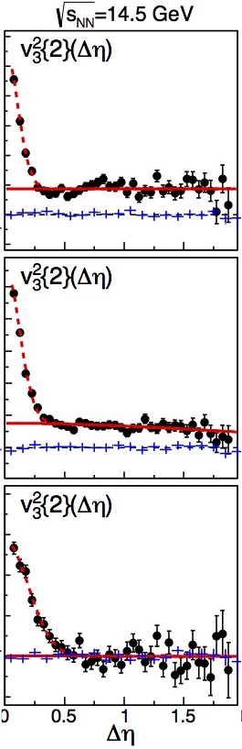
Au+Au 14.5 GeV results
PRC 93 (2016) 14907
PRL 116 (2016) 112303
Publication Strategy:
Results are or will be integrated with several (BES) paper proposals that are already in an advanced state:
  BES identified particle v₂ (published)
  BES v₃ (published)
  Kaon v₁ measurements (preparing for GPC)
  R_{CP} of charged and identified hadrons (preparing for GPC)
  Rapidity density (pending PWGC preview)
In addition, key results shown at QM2015
  strangeness: Ω, φ, Ks, Λ, and Ξ results (preparing for GPC)
  Light nuclei B₂ (pending PWGC preview)
  3.9 GeV fixed target analysis using 14.5 GeV data
QM2015
R_{CP}
STAR Preliminary
R_{CP}

Slide 23
Heavy-Ion Highlights:
CME and CMW in Au+Au 14.5 GeV
See Paul Sorensen’s talk on behalf of CME Taskforce
Charge Separation in BES
different γ_{os} and γ_{ss} consistent with CME expectations
charge separation diminishes at lower energies
  14.5 GeV follows the trend
v₂ of (anti-)particles as a function of charge asymmetry A_{ch}
slope parameter in v₂±=v₂^{base} ± (q_{e}/ρ_{e}) A_{ch}
chiral separation effect + CME→ Chiral Magnetic Wave
  collective excitation
  signature of chiral symmetry restoration
STAR measurements at 200GeV consistent with CMW theoretical calculations
  similar trend pattern down to 19.6 GeV
Study global hyperon polarization to probe vorticity and B field
  first observation of global Λ polarization
  decompose into magnetic (B) and vortical (V)

Slide 24
Heavy-Ion Highlights: Fixed Target
Gold target inserted in 14.5 GeV run
  √s_{NN} = 3.9 GeV
  2015: test run with beam lowered for direct collisions with target (√s_{NN}=4.5 GeV)
Fixed target preliminary results consistent with published data
QM2015
AUM2016
QM 2015 – Flash Talk

Slide 25
Heavy-Ion Highlights: Quarkonia
J/ψ→μ⁺μ⁻(BR~6%) and ϒ→μ⁺μ⁻(BR~2.5%)
  no γ conversion
  less Bremsstrahlung → better resolution
  less contribution from Dalitz decays
  trigger capability for J/ψ in central A+A
Run 14 data with full MTD
  analyses ongoing – results based on 30% of 2014 data set
  J/ψ R_{AA}, v₂, and dN/dp_{T}
    All confirm published dielectron results
  ϒ(2S+3S)/ϒ(1S) ratio consistent with dielectron channel
    Large error bars
Expect 7x statistics for Run14+16
Use mixed-event background to further reduce √2
QM2015
Notes:
Vertesi, ECT*2015

Slide 26
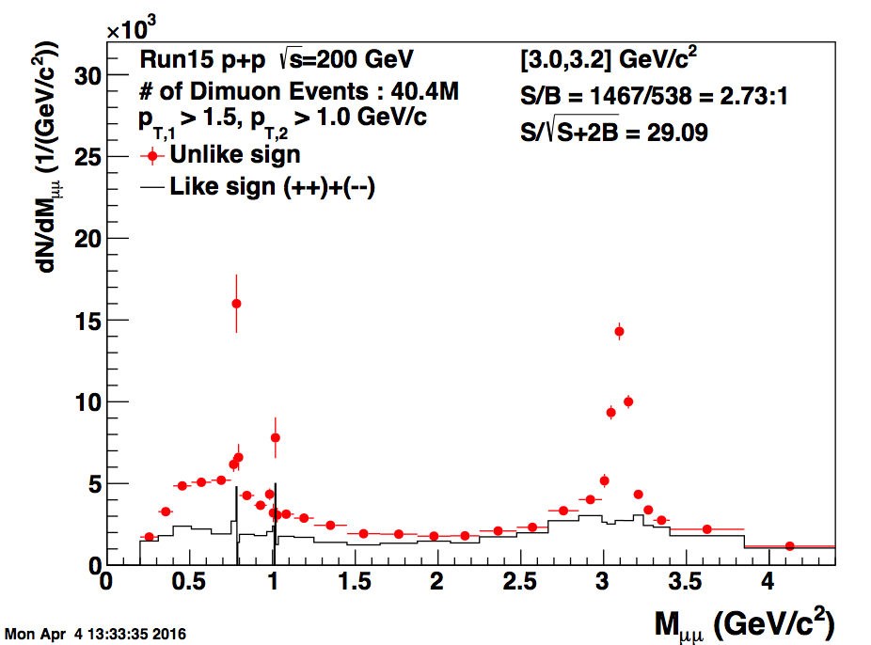
Heavy-Ion Highlights: Run-15 dimuons
Run 15 p+p data with full MTD
  dimuon M_{μμ} invariant mass distribution
  clear ω, φ, and J/ψ signals
  analyses ongoing – results based on 13% of 2015 MTD-triggered data set
Notes:
Vertesi, ECT*2015

Slide 27
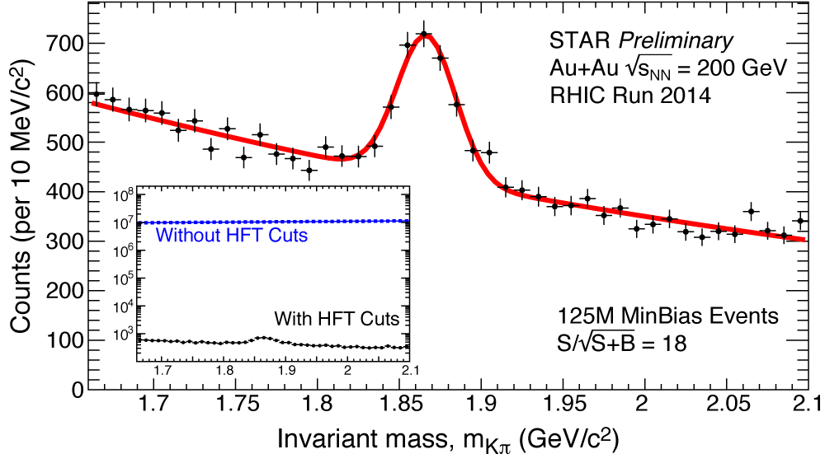
Heavy-Ion Highlights: Open Charm
HFT will enable high-precision open-charm measurements
  thermalization and modification of charm?
  charm v₂ and R_{AA}
clear D⁰ signal with HFT
  when compared without
QM2015: 780M out of 1.2B minbias events
  D⁰ R_{AA} and D^{0/±} v₂
    Charm is produced early … will experience the full evolution
    At LHC v₂ is compatible with light flavors ... thermalized?
    Seek simultaneous constrains to models
      At low p_{T} : sensitive to partonic medium
      At high p_{T}: test energy loss mechanisms
  D_{S} measurements
    Strangeness enhancement reflected in RAA (compared to other D)?
    Effects of expected early freeze-out in a reduced elliptic flow?
QM2015
Notes:
Note regarding v2 plot error bars don't include effects from dead sensors, geometry acceptance, and detector hit efficiency
a) dead sensors (Run14, is close to 25-30% with three layer added together)
b) geometry acceptance (added together ~9-10%)
c) detector responding efficiency + tracking loss (for this we don't have solid numbers. likely to be around 90-95% for each layer, so it could have a finite impact on the total efficiency).

Slide 28
Heavy Ion Highlights: Open Charm (2)
Current Status
STAR initiated reproduction of Run-14 Au+Au
  solved HFT decoding issue in the production software
  significant improvement in single-track efficiencies
  reproduction of HFT physics stream only
Improvement factor in D⁰ significance is
about 4 at low p_{T},
and 2-2.5 at high p_{T}
M [GeV/c²]

Slide 29
Summary
STAR is fully engaged in the Runs 14 and 15 physics analyses
  14.5GeV data set concludes BES Phase-1
  new HFT & MTD with improved DAQ and high luminosities
  STAR has fully entered its high-precision Heavy-Flavor era
Run 14 Au+Au production has finished; reproduction ongoing
  significant improvement in HFT reconstruction
  expect to see Λ_{C} in Run-14 data set!
Run 15 productions are underway
  FMS and RP streams have been done
  p+p physics stream ongoing
BES results and papers made available to heavy-ion community
  include 14.5GeV results where possible
Concerns remain on limited production and post-production resources
  production: production times are (very) long
  post-production: unable to sustain multiple large active data sets (run 14+15+16 …)

Slide 30
Backup

Slide 31
Physics Organization: PWGs & Editorial Board
New entity in STAR’s editorial process
GPC chairs and PWG conveners
Track progress in GPC
Quickly recognize issues that can benefit from direct PAC/convener involvement
not a new layer
Physics Analysis
Coordination
Spokesperson
Bulk-Corr PWG
Jet-Corr PWG
Spin PWG
Paper Godparent
Committee chairs
Physics production priorities regularly reviewed and set by the joint PWGs
Light-Flavor Spectra PWG
Heavy-Flavor PWG
UPC PWG

Slide 32
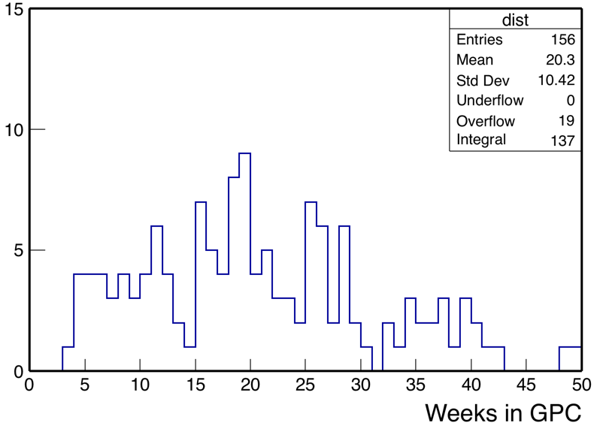
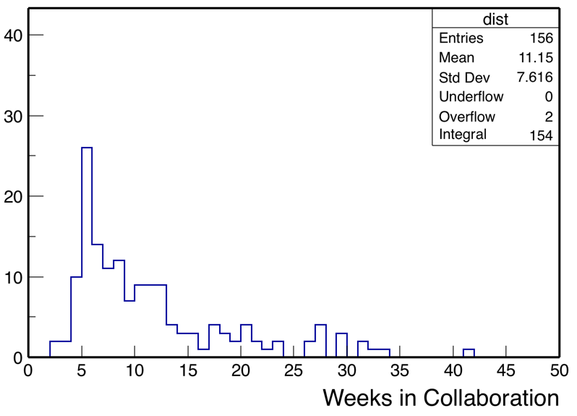
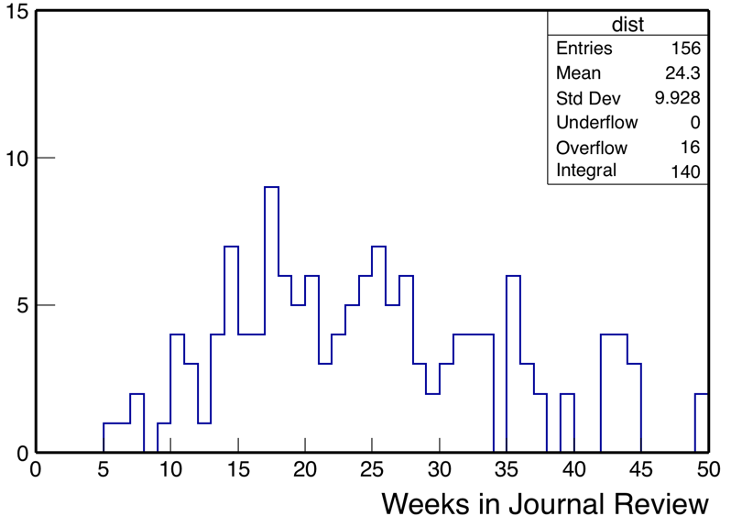
STAR Paper Proposal Tracking
Notes:
input to each plot involves published papers only
mean/std.dev based on truncation at 50 wks

Slide 33
Citation History :: Details
Two papers crossed from “famous” to “renowned” earlier this year
Transverse momentum and centrality dependence of high-pT non-photonic electron suppression in Au+Au @200GeV
  PRL 98 (2007) 192301, PRL 106 (2011) 159902
Systematic Measurements of Identified Particle Spectra in pp,d+Au and Au+Au
  Phys.Rev. C79 (2009) 034909
PRL98(2007)192301
515 records
PRC79(2009)034909
508 records

