Slide 1

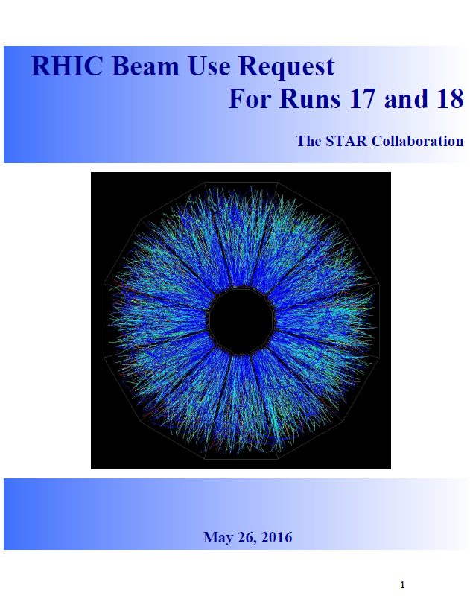

Zhangbu Xu
(Brookhaven National Lab)
Highlights
Performance in run16
BUR on Spin
(sign change)
BUR on Isobars
(chiral effect)
BUR on Au+Au @ 62GeV
(Jet, NPE)
BUR on Au+Au @ 27 GeV
(global Lambda polarization)
Summary
https://drupal.star.bnl.gov/STAR/starnotes/public/sn0657

Slide 2
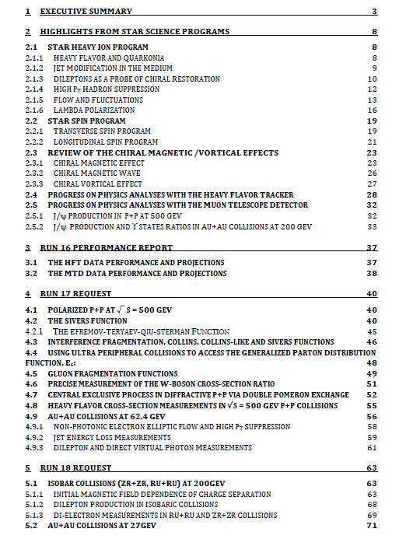
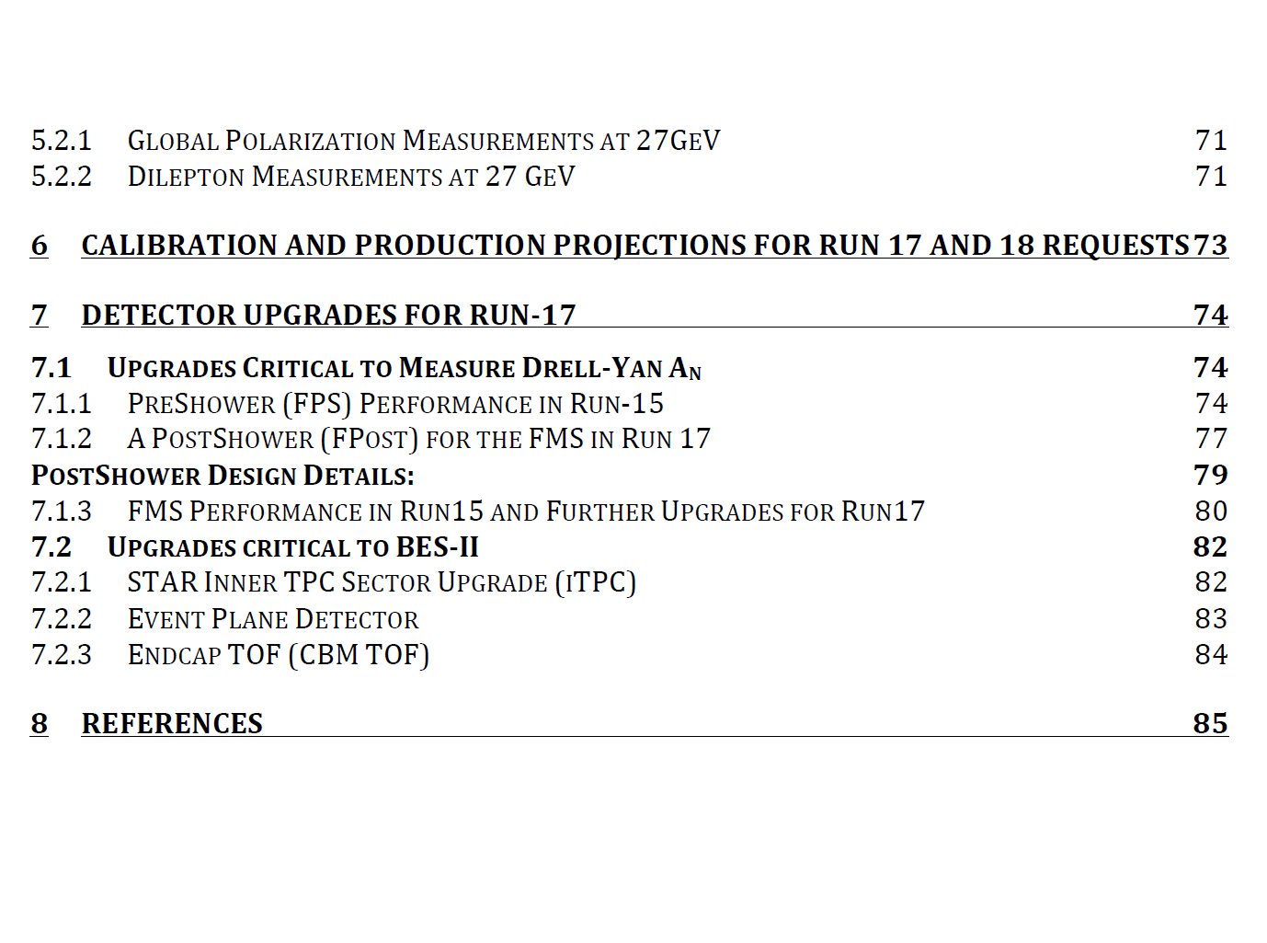
Zhangbu Xu
(Brookhaven National Lab)

Slide 3
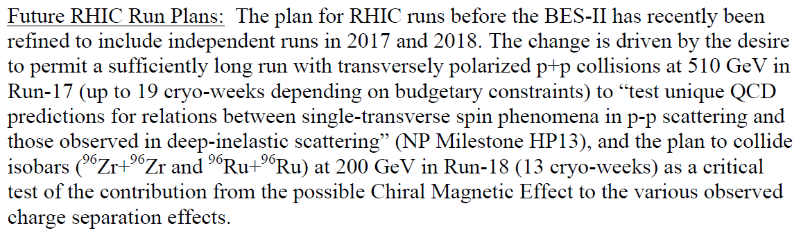
BUR charges
From: Mueller, Berndt
Sent: Tuesday, February 23, 2016 9:12 PM
To: Xu, Zhangbu; Morrison, David; Gunther M Roland; Yasuyuki Akiba; Takashi SAKO
Cc: Dunlop, James C
Subject: 2016 Beam Use Request
Dear Zhangbu, Takashi, Yasuyuki, Dave & Gunther:
I am writing to solicit the STAR beam use request for RHIC Run-17 and to request presentations from the RHIC collaborations at this year’s PAC meeting, which is scheduled to be held on June 16+17, 2016.
Following the recommendations of the 2015 PAC, we anticipate the combination of a 510 GeV polarized p+p run and a 200 GeV run of a suitable isobar pair. Following current guidance from DOE, we are planning for a 24 cryo-week run, but the beam use request should also consider options for shorter runs of 20 weeks and 15 weeks to allow flexibility in case of other budget scenarios. The beam use request should be submitted no later than May 27 in order to allow the PAC members to study it in detail before the meeting.
In addition to the STAR/RHICf beam use request, I would like to request updates from STAR and PHENIX on the status of results from Runs 14 and 15, in particular, the results of the heavy quark measurements using the upgraded vertexing capabilities of both detectors. This is one of the key performance indicators for RHIC in this year as defined by DOE. I would also like to request an update from the PHENIX collaboration of their plans to complete the analysis of accumulated data, and a brief update from the sPHENIX collaboration concerning their planned physics program. In addition, I will ask the CME Task Force to present their findings to the PAC.
Best regards
Berndt

Slide 4
Executive Summary Table
Run | Energy | Duration | System | Goals | priority | Sequence
17 | √s_{NN}=500 GeV √s_{NN}=62.4 GeV | 13-wk 1-wk 2-wk 4-wk | Transverse p+p p+p CeC Au+Au | A_{N} of W±, γ, Drell-Yan, L=400 pb⁻¹, 55% pol RHICf Jets, dileptons, NPE 1.5B MB | 1 3 | 1 2 3
18 | √s_{NN} =200 GeV √s_{NN}=200 GeV √s_{NN}=27 GeV | 3.5-wk 3.5-wk 2-wk | Ru+Ru Zr+Zr Au+Au | 1.2B MB 1.2B MB >500M MB | 2 2 3 | 4 5 6
Options from guidance:
24 cryo-weeks in run 17, 13 weeks in run 18
19 cryo-weeks in run 17, 13 weeks in run 18
If only 15 weeks in run 17, all for pp500

Slide 5


STAR Detector System
15 fully functioning detector systems
EEMCESMD
Magnet
MTD
BEMC
BSMD
TPC
TOF
BBC
FMS
FPS
RP
ZDC
NSAC RECOMMENDATION #I:
The upgraded RHIC facility provides unique capabilities that must be utilized to explore the properties and phases of quark and gluon matter in the high temperatures of the early universe and to explore the spin structure of the proton.
HFT
X10³ increases in DAQ rate since 2000, most precise Silicon Detector (HFT 2014-16)

Slide 6
Highlights of Recent Results
Jets
Heavy-Flavor
Dileptons
v_{n}
Spin
Experimental overview on run14/15: Frank Geurts (Rice)
BES-II (I): Helen Caines (Yale)
CME Task Force: Paul Sorensen (BNL)
Cold QCD Plan: Carl Gagliardi (TAMU)

Slide 7
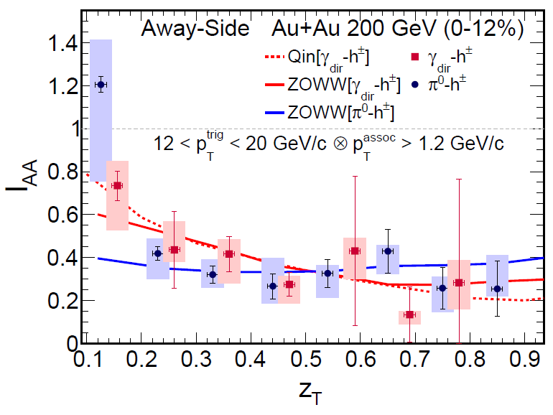
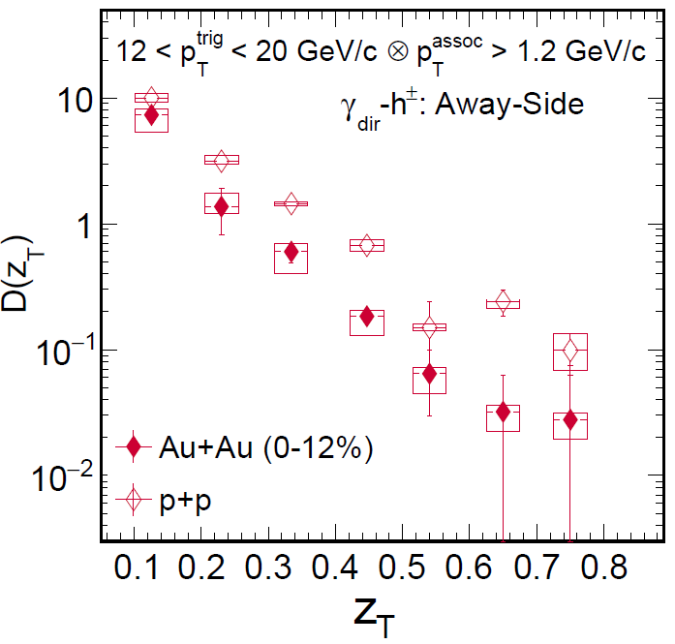
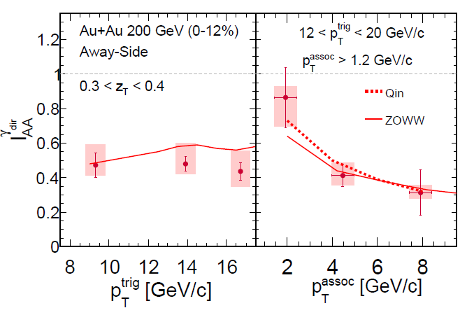
γ-jet correlation
Paper submitted: arXiv:1604.01117
Golden probe of Jet Energy Loss
calibrated energy from γ for FF (Z_{T})
Cover large range of Z
γ and π⁰ triggered hadron I_{AA} similar
Suppression independent of jet energy
Lost energy reappear at low p_{T}

Slide 8
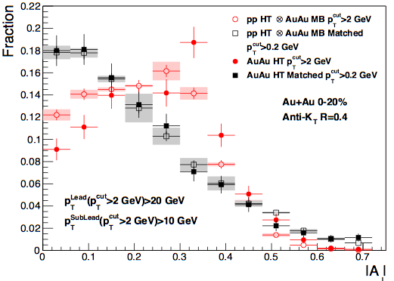
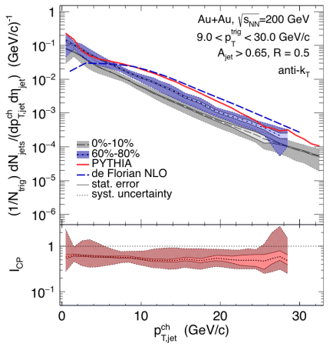
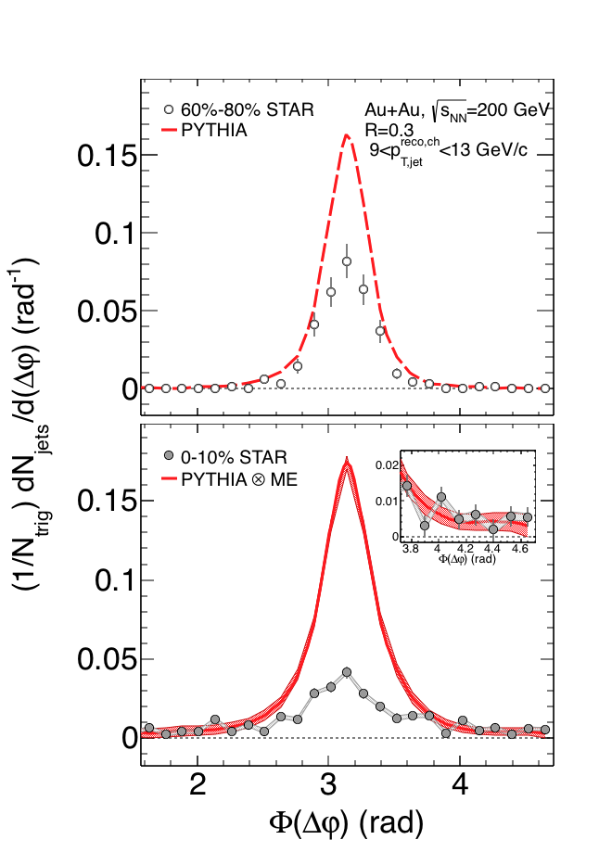
Semi-inclusive hadron jets
STAR Preliminary
STAR Preliminary
STAR Preliminary
Reconstruction of semi-inclusive jet is successful to very low-pt using mix-event method
Energy loss is estimated to be ~3-5GeV for these jets; smaller than at LHC
Medium-induced radiation beyond 0.5 rad
Di-jet imbalance of Au+Au Aj similar to p+p only when low-p_{T} constituents are included
Significant broadening of h-jet correlation angle
No evidence for large-angle scattering of jets (maybe due to statistics)

Slide 9
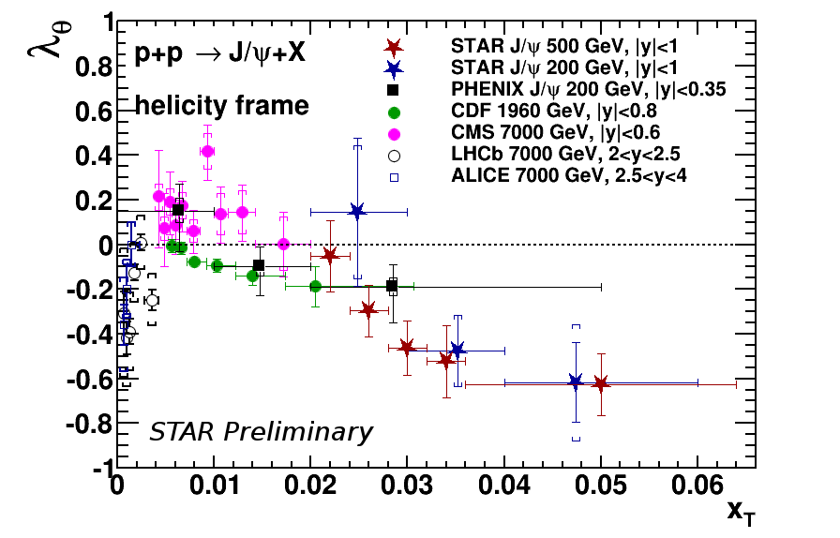
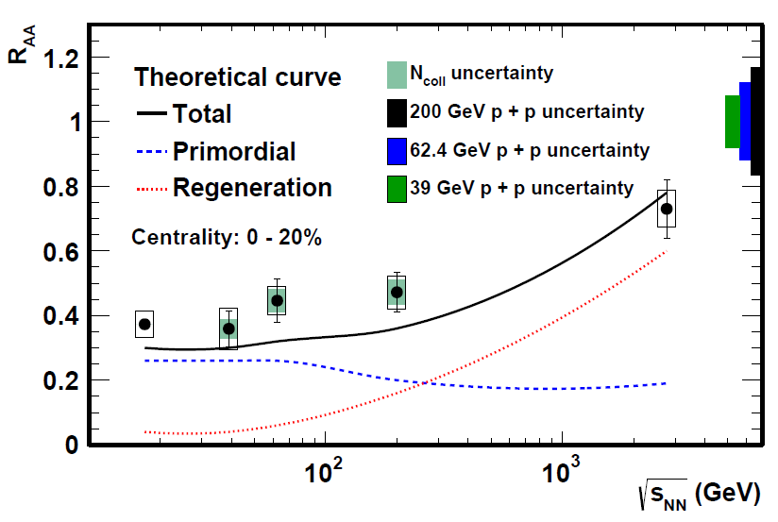
Quarkonia production and probes
STAR Preliminary
New MTD dataset covers whole p_{T} range
with high statistics (x3 more data)
Polarization measurements in p+p extend
to large X_{T}
Beam Energy dependence of J/ψ R_{AA}

Slide 10
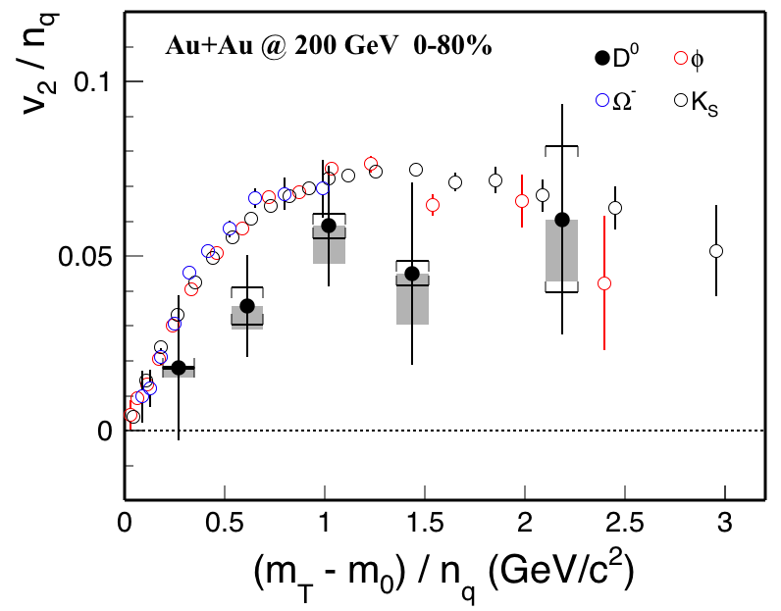
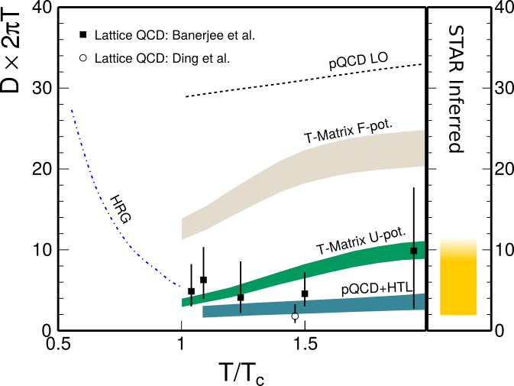
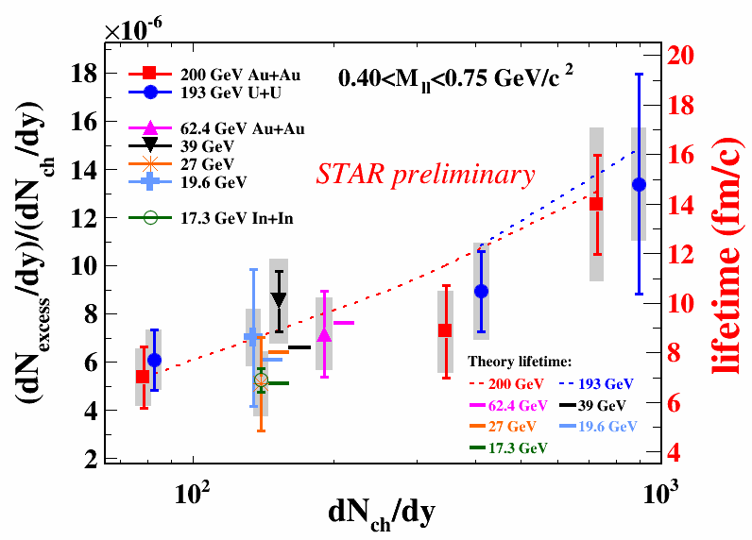
(STAR QM15) Penetrating Probes
STAR Preliminary
PLB750(2015)
Brownian motion (diffusion) of heavy quarks
Heavy Flavor Tracker (HFT) delivers
its first results
First result of quarkonia suppression
from the Muon Telescope Detector (MTD)
Charm flows at RHIC top energy
Extracted diffusion coefficient compared
to theory
Low-mass di-electron production
Measured in many systems (Au+Au, U+U, p+p)
and different energies (19.6, 27, 39, 62, 200 GeV)
Quantifying how vector mesons evolve in the medium
The yields probe timescale of collisions

Slide 11
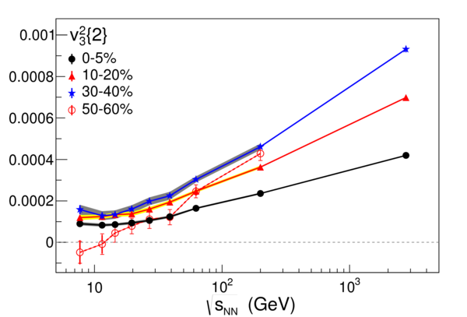
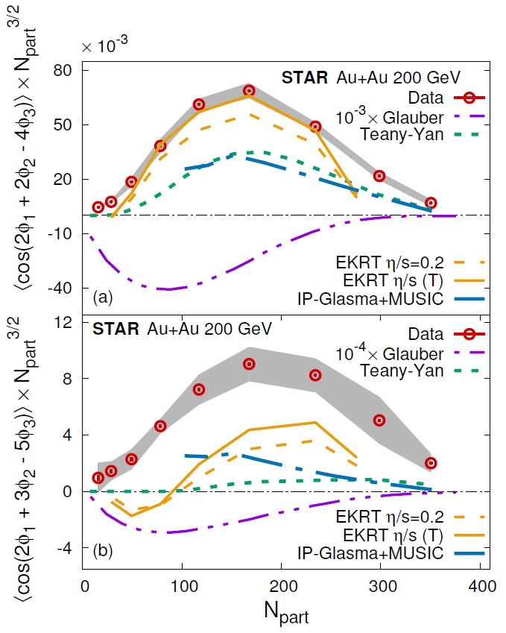
Flows in n^{th} order
PRL 116(2016)
STAR Preliminary
Higher harmonics sensitive to earlier stage
Study BES and small system size:
Turn OFF QGP?
Multiple-Harmonics sensitive to η/s
STAR
Preliminary

Slide 12
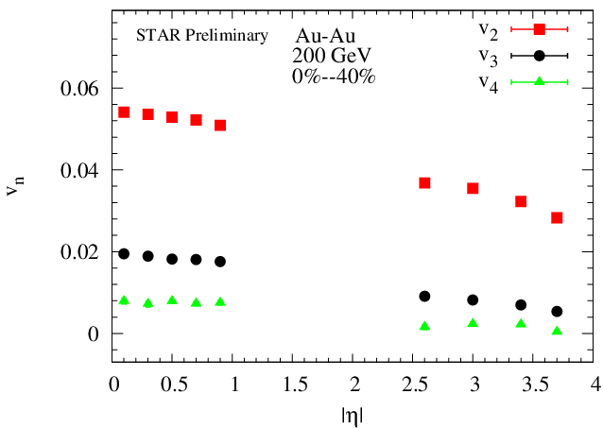
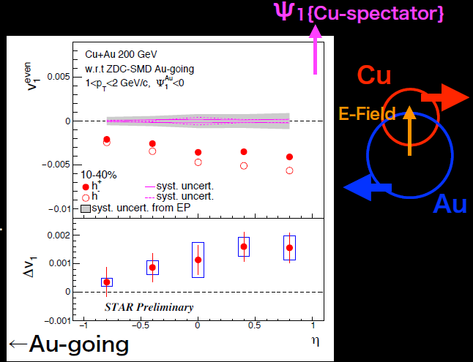
Flows in Rapidity
Flow (vn) vs rapidity:
η/s and initial stage;
baryon stopping at BES-II
(require upgrades)
Flow in asymmetric collisions sensitive
to the existence of E-field and quark content
STAR
Preliminary

Slide 13
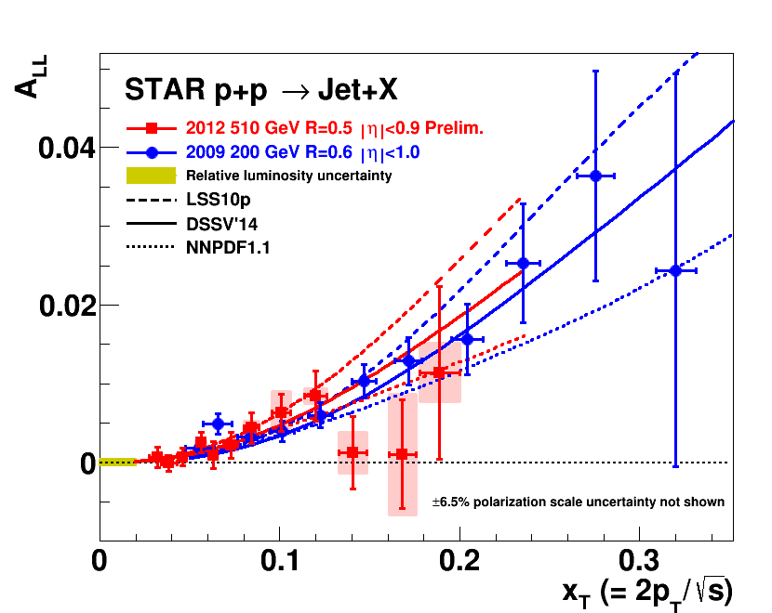
NSAC Milestone (HP12)
PRL 115 (2015)
Notes:
Here you want to show the 2009 200 GeV data which has placed the strongest constraints to date and its excellent agreement with the 2012 data which opens the door to lower x data.

Slide 14
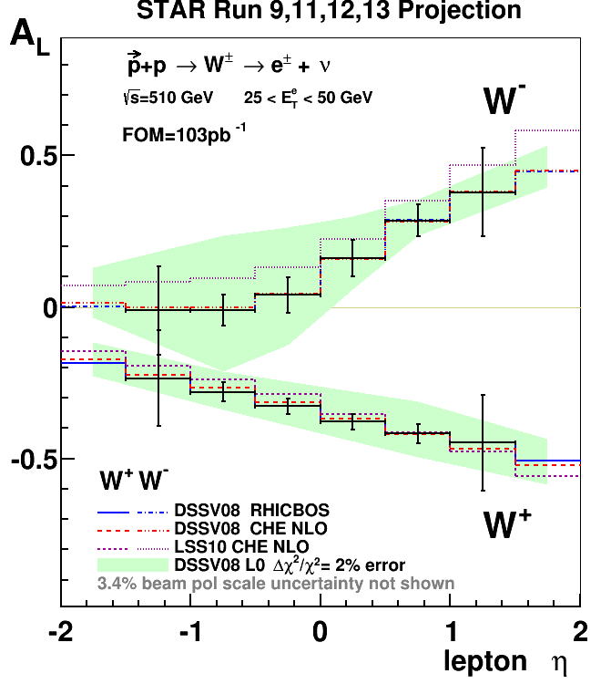
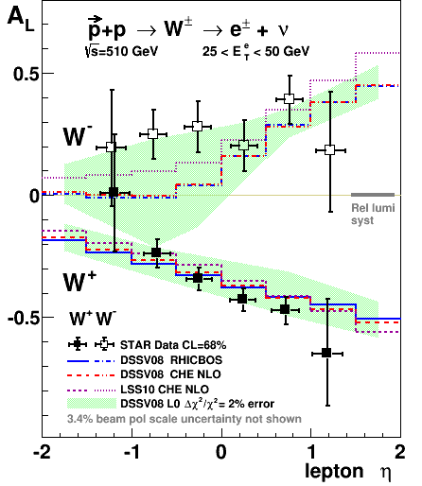
NSAC Milestone (HP8)
First significant evidence that u and d anti-quark spin distributions are significantly different.
PRL 113 (2014) + run13
Notes:
By introducing the milestones first you can show that we have met them and the exceptional physics that comes out of meeting the milestones. When we get to the Sivers sign change milestone this will only add to the importance of making this measurement by putting it on the same foot as the DeltaG and W.

Slide 15
2015 BUR ➔ RUN 16
Run | Energy | Duration | System | Goals | priority | Sequence
16 | √s_{NN}=200 GeV √s_{NN}=62 GeV √s_{NN}=19.6 GeV | 13-wk 4-wk 1-wk | Au+Au Au+Au d+Au | Λ_{c}, D v₂, R_{AA}, ϒ R_{AA} 10nb⁻¹, 2billion MB 1.5B MB (1B w/ HFT) 100M MB | 1 4 4 | 1 2 3
17 | √s = 510 GeV √s_{NN}=19.6 GeV √s_{NN} =200 GeV √s_{NN}=200 GeV | 11 wk 1-wk 3-wk 3-wk | Transverse p+p p+p Ru+Ru Zr+Zr | A_{N} of W±, γ, Drell-Yan, L=360 pb⁻¹, 55% pol 400M MB 1.2billion MB 1.2billion MB | 2 4 3 3 | 1 2 3 4
In each scenario, the data requirements for STAR’s two top priority scientific goals will be met. In no scenario can all the data needs for all programs be met in runs 16 and 17

Slide 16
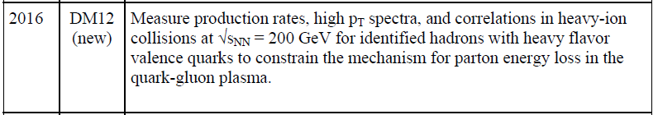
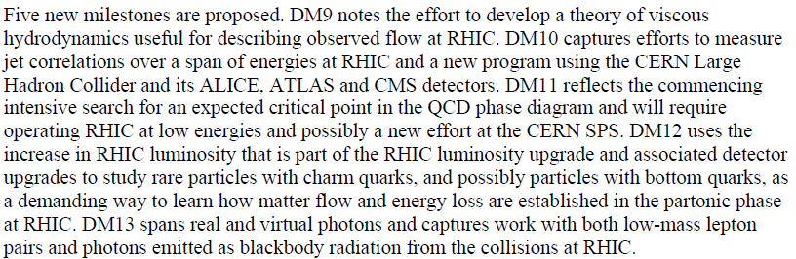
Run 16 Heavy-Flavor Program
- Completion of DM12
Au-Au 200 GeV Highest Priority of STAR and PAC for Run-16
DOE Milestones for High Temperature/High Density Hadronic Matter
http://science.energy.gov/~/media/np/nsac/pdf/docs/perfmeasevalfinal.pdf

Slide 17
Run 16 proposed by STAR
Run | Energy | Duration | System | Goals | Priority | Sequence
16 | √s_{NN}=200 GeV √s_{NN}=19.6 GeV √s_{NN}=39 GeV | 13-wk 1-wk 1-wk | Au+Au d+Au d+Au | Λ_{c}, D v₂, R_{AA}, ϒ R_{AA} 10nb⁻¹,2billion MB 100M MB 400M MB | 1 2 2 | 1 2 3
PAC recommendation of 10 weeks of Au+Au; additional 2 floating weeks
Could have reached goals: 95 hours*10wk*3600seconds*600Hz=2B
Or we could have just scaled down our goals by 30%
RHIC Machine Efficiency not Luminosity key
STAR Operation and Optimization
- key to achieving this goal.
Presented at 01/19/2016 schedule meeting
Notes:
Changed line about PAC rec

Slide 18
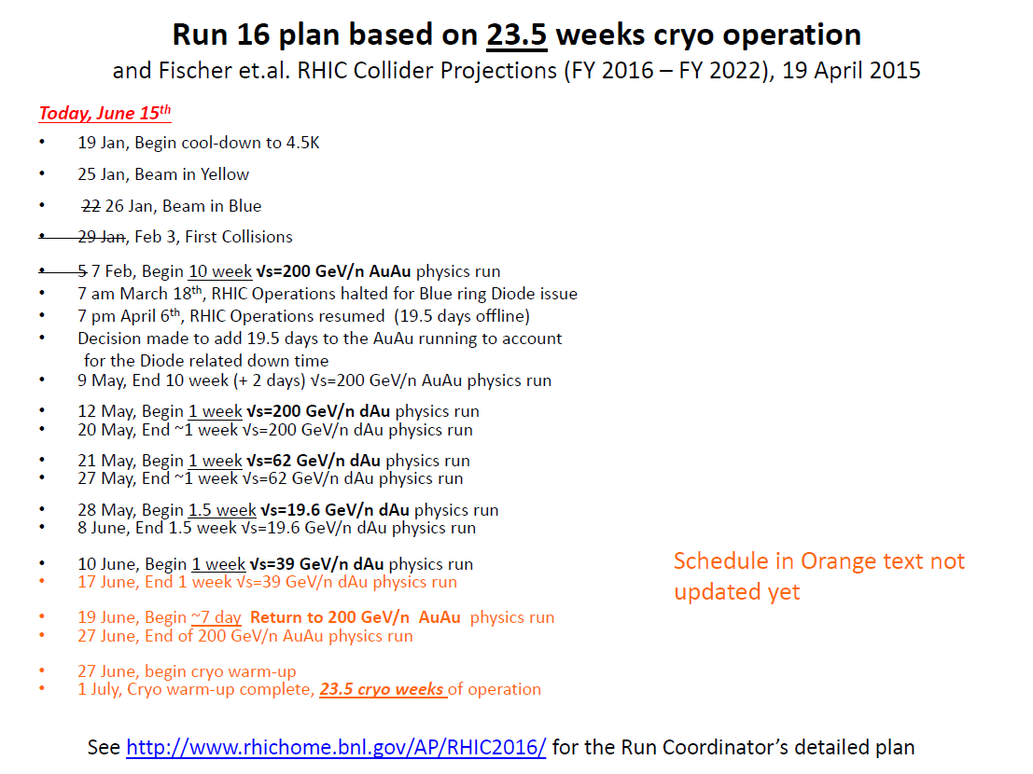
Run16 schedule and main events
February 7, start Au+Au physics run
March 4, switching to run14 HFT firmware
March 17, new online vertex implemented
May 9, end of 1st 200GeV Au+Au run
75% goal reached for HFT (open charm)
90% goal reached for MTD (Quarkonia)
May 12, begin d+Au Run
June 19, begin 2nd Au+Au datataking

Slide 19
Substantial Investments to reach our BUR goals
-- Many improvements since Run14
Open Charm (HFT) related: (MB events)
Cables: Cu => Al Cable for HFT readout: up to x2 better S/B low-p_{T} D⁰
Refurbished PXL and SSD firmware: ~18% PXL dead in Run-14
SSD improves tracking 10% (20% for Ds)
Overall factor of 3.6 improvement for D⁰
Vertex Cut quality improvement (~15%)
Pile-up protection study w/o 30% more data volume and 10% worse efficiency
optimize protection (10%)
Re-populate TPC ASIC and RDO, DAQ software optimization, online disk and network, +50% faster readout speed, reduced deadtime
Bring up detector at RHIC Flattop and detector ramp down for beam dump
Run 16: 7 (5) minutes vs Run 14: 9 (11) minutes
Quarkonia (MTD ) related: (triggered/luminosity)
High-Level Trigger dedicated to online dimuon selection
Express stream of Upsilon candidates x10 reduction
Reduce monitoring triggers to minimum required

Slide 20
Setbacks in First few weeks of run16
Online Vertex Selection Efficiency (-5-10%)
A version of hardware has been commissioned during the first 5 weeks, final implementation in March 16.
improve efficiency 17%
Uptime (-15%)
Run 14 over 95 DAQ hours per week (110 CAD hours)
Run 16 about 85 DAQ hours per week (94 CAD hours)
April 6 after CAD Diode Fix, 95 DAQ hours (107 CAD hours)
HFT readout Firmware (-20%)
Low efficiency due to incorrect time latch
Affects data from first 3 weeks
A report assembled by a Detector Operation Task Force
RHIC Machine Diode Failure (March 18-April 6)
Repaired and came back more efficient (Thanks!)

Slide 21
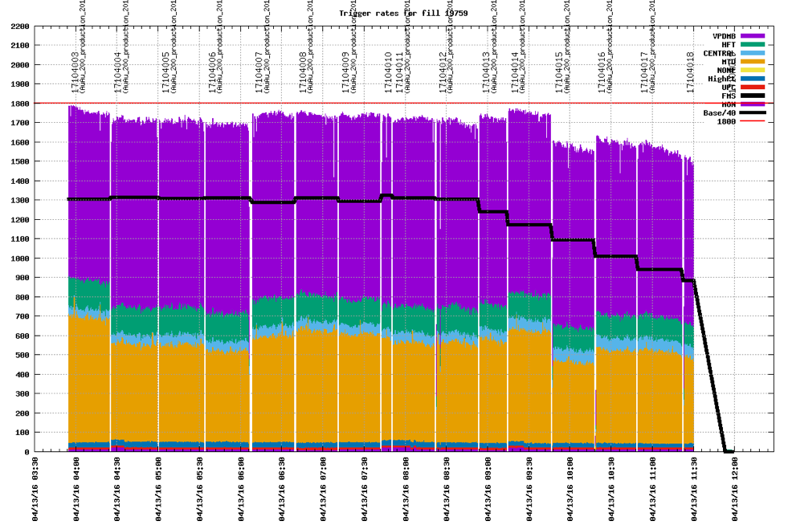
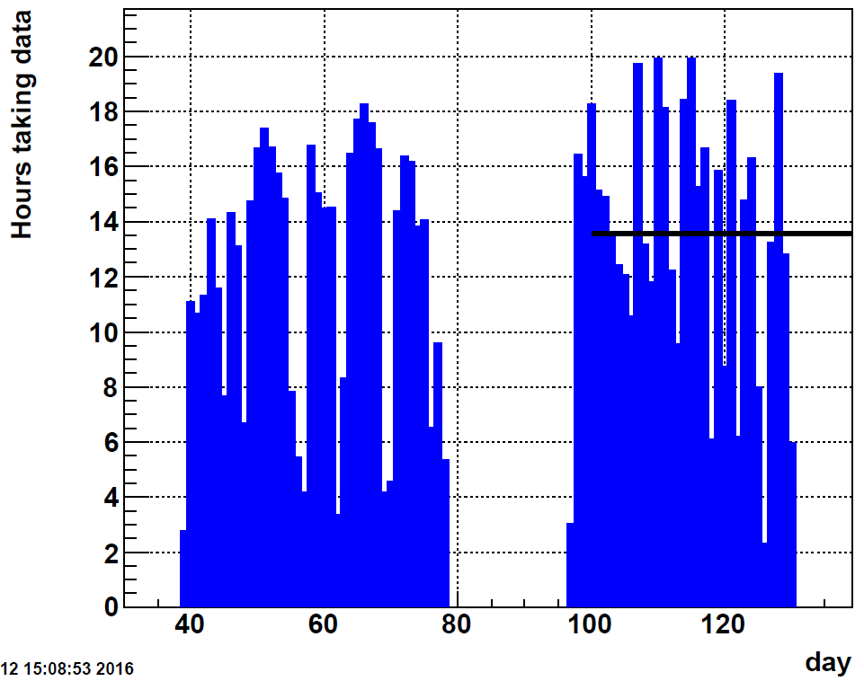
Typical Data-taking Mode
HFT Minbias
Roman Pots
HFT
MTD
Jets&HT
MTD dimuon
Average 13.5 DAQ hours/day
Designed and implemented by Jeff Landgraf.
Linked from Trigger versioning page
http://online.star.bnl.gov/RTS/plots/storedPlots.php
Last 4 weeks’ performance:
95 hours*8.3wk*3600seconds*700Hz=2B
Excellent Machine Performance after Diode Repair

Slide 22
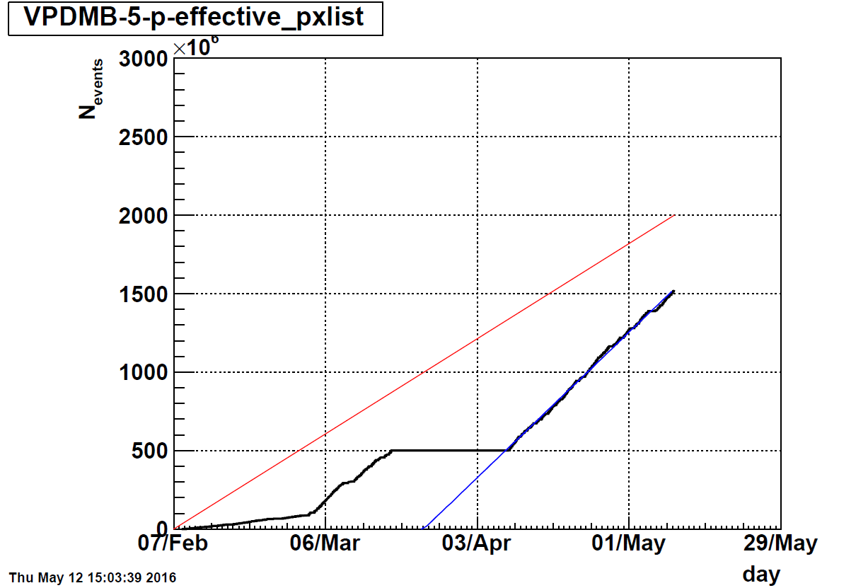
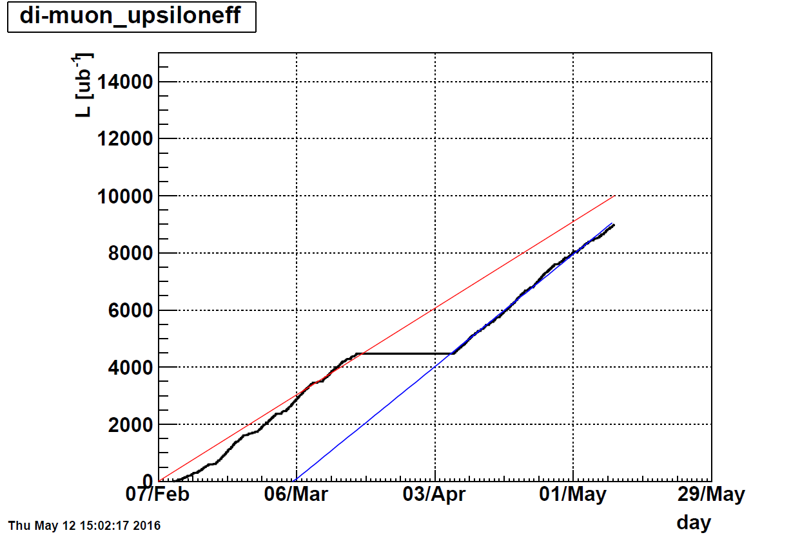
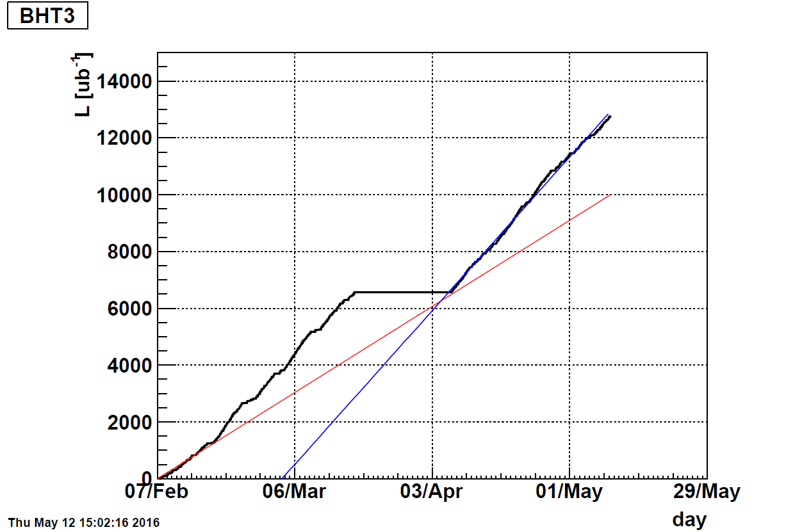
Au+Au Dataset Goals
HFT
Open charm
MTD
Quarkonia
✓
75%
EMC
γ-jet
Minbias goal is about 75%,
one more week of Au+Au to reach >90%
Quarkonium (ϒ) and γ-jet integrated luminosities
(mostly) reach our goals.
✓

Slide 23
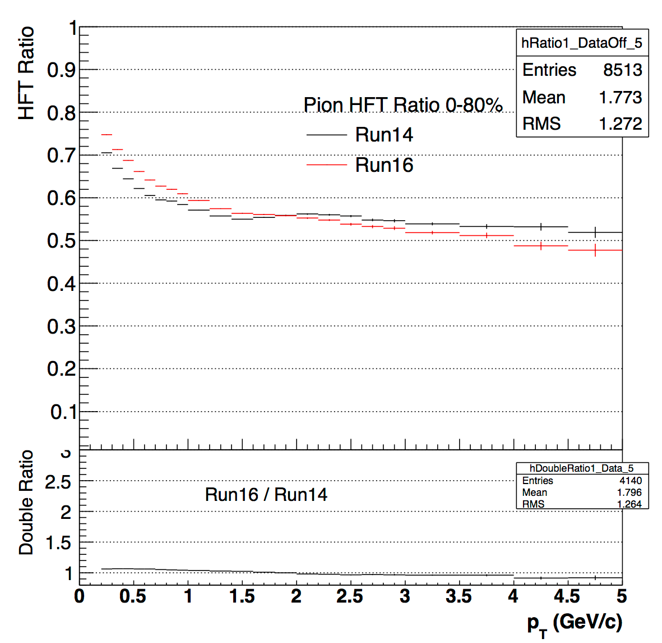
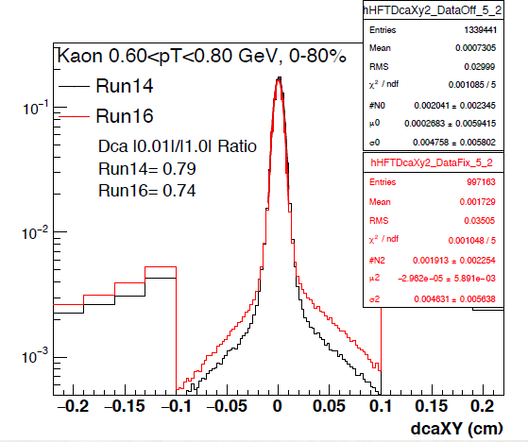
HFT Preliminary Performance (Run 16)
With preliminary calibrations, Run16 HFT matching efficiency and DCA
resolution show a comparable or slightly better performance w.r.t Run14
➡ different luminosity level
➡ different trigger setup for pileup protection

Slide 24
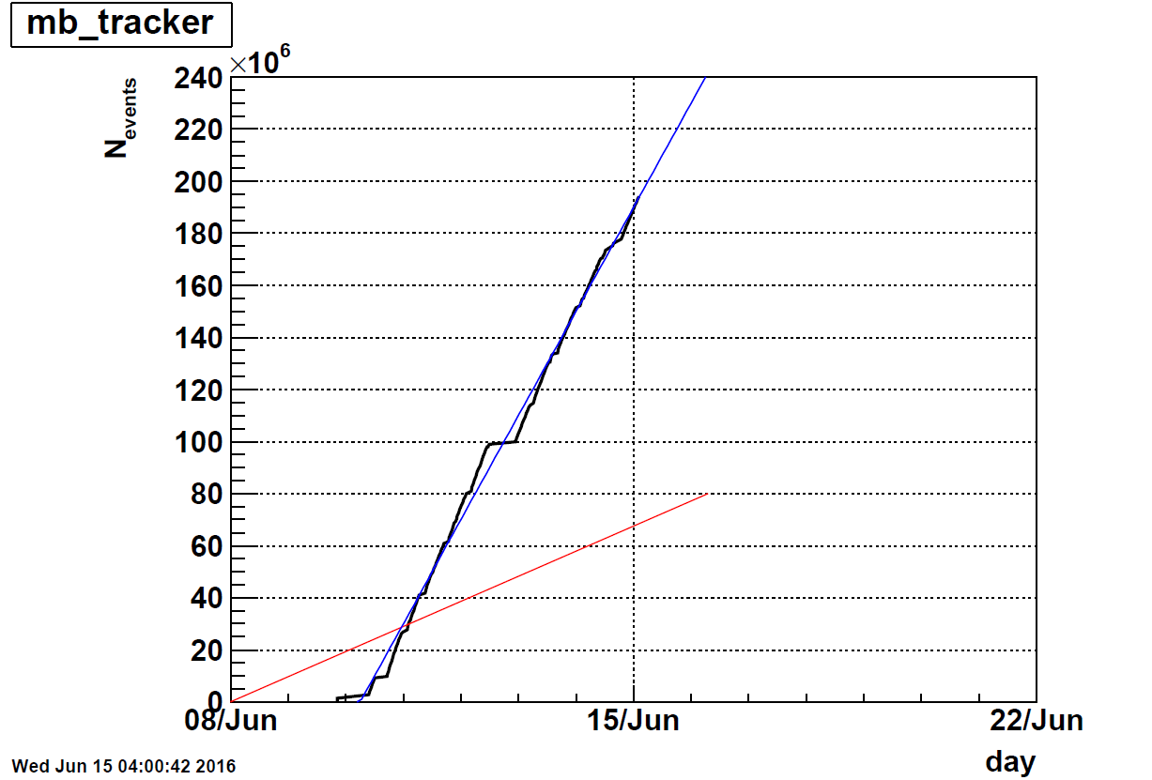
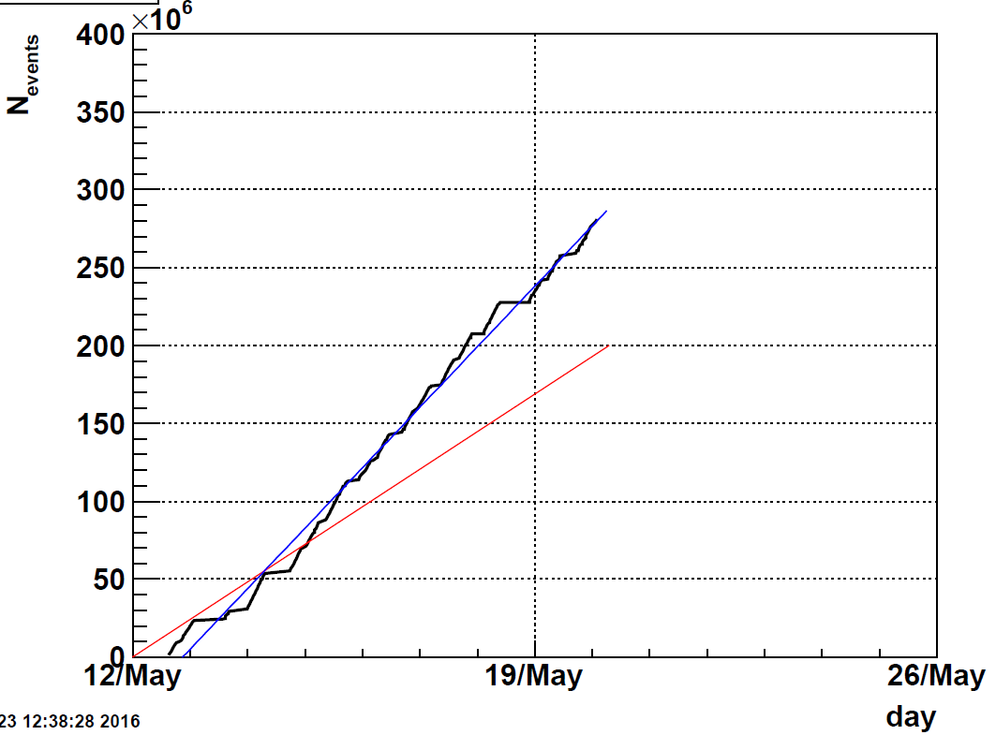
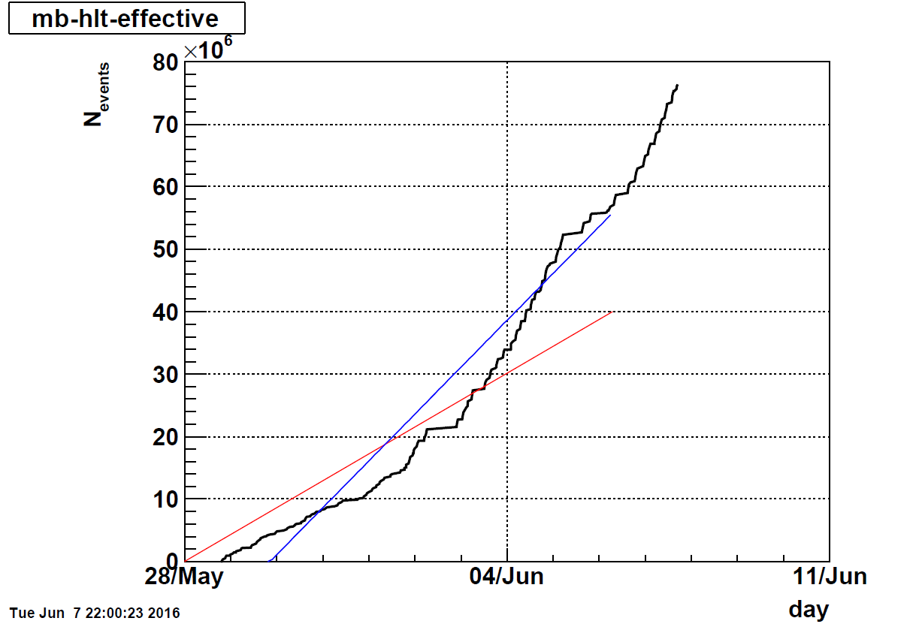
d+Au goals and projections
39GeV
200GeV
19.6GeV
Goals mostly achieved (200,62.4,39,19.6 GeV);
Because of the Nbin = 7.5 in d+Au Minbias
in comparison with p+p.
Better primary vertex resolution,
Expect comparable D⁰ signals in d+Au to that
from the p+p dataset in run15 with best HFT
performance

Slide 25
BUR Executive Summary Table
Run | Energy | Duration | System | Goals | priority | Sequence
17 | √s_{NN}=500 GeV √s_{NN}=62.4 GeV | 13-wk 1-wk 2-wk 4-wk | Transverse p+p p+p CeC Au+Au | A_{N} of W±, γ, Drell-Yan, L=400 pb⁻¹, 55% pol RHICf Jets, dileptons, NPE 1.5B MB | 1 3 | 1 2 3
18 | √s_{NN} =200 GeV √s_{NN}=200 GeV √s_{NN}=27 GeV | 3.5-wk 3.5-wk 2-wk | Ru+Ru Zr+Zr Au+Au | 1.2B MB 1.2B MB >500M MB | 2 2 3 | 4 5 6
Options from guidance:
24 cryo-weeks in run 17, 13 weeks in run 18
19 cryo-weeks in run 17, 13 weeks in run 18
If only 15 weeks in run 17, all for pp500

Slide 26
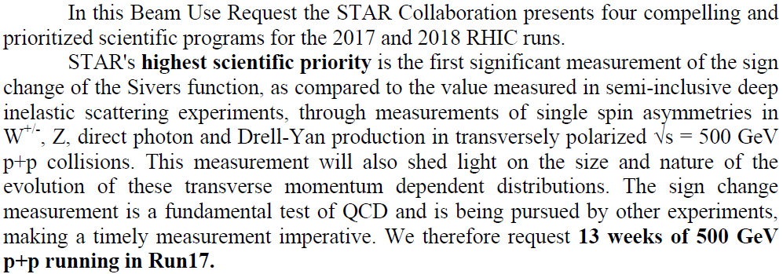
Run 17 Spin Program BUR and Projections

Slide 27
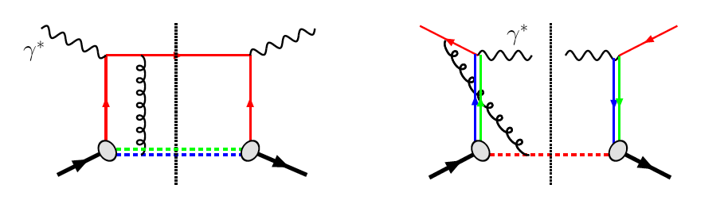
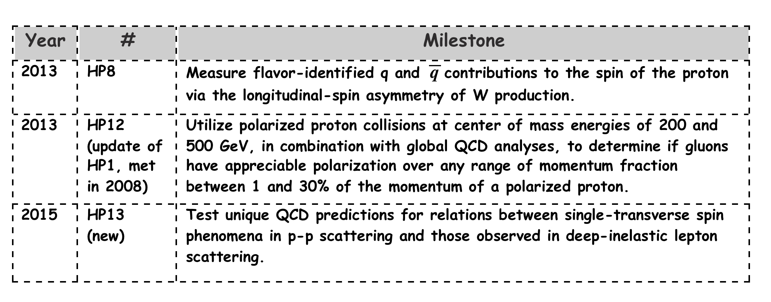
NSAC Milestone (HP13)
✓
✓
A_{N} of W±,γ, DY in pp 500 are all sensitive to the Sivers sign-change.
STAR can access all three world-class measurements in the proposed 2017 Run – Significant discovery potential before 2020!
Notes:
Not written here but you need to say verbally that one of the more interesting and important tests for these relations between single transverse spin in pp and SIDIS is sign of the Sivers function and we have access to that in A_N of W, gamma and DY.

Slide 28
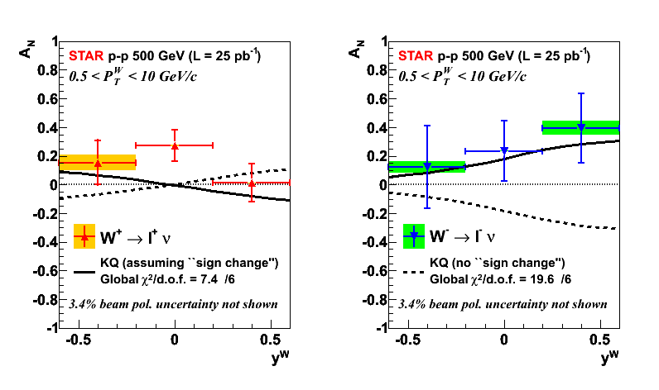
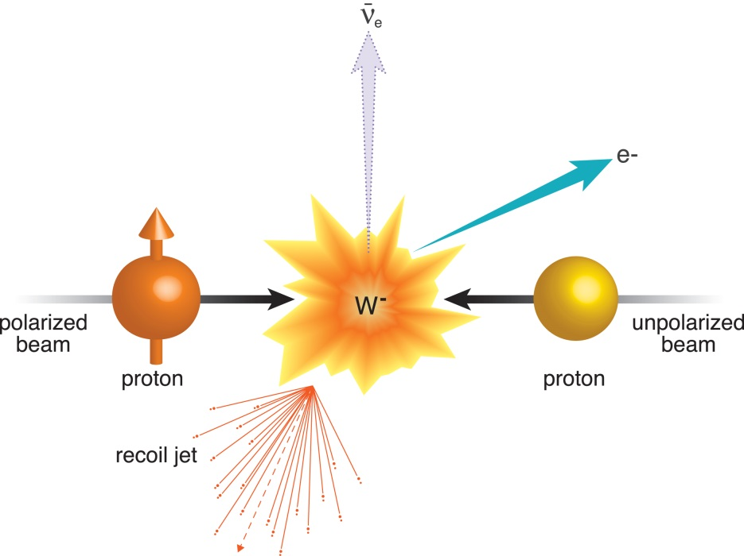
Measure QCD interaction sign and TMD evolution
More in-depth discussions this afternoon:
See C. Gagliardi’s talk
How to measure certain color interactions are repulsive and others attractive:
A View of the Colorful Microcosm Within a Proton (foundation for run 2017)
https://www.bnl.gov/rhic/news2/news.asp?a=1824&t=pr
STAR paper Phys. Rev. Lett. 116, 132301 (2016), Editors’ Suggestion

Slide 29
Run 17 Projection W± A_{N}
First measurement of
sign change (a big deal)
Quantifying TMD evolution
Constraint sea quark Sivers

Slide 30
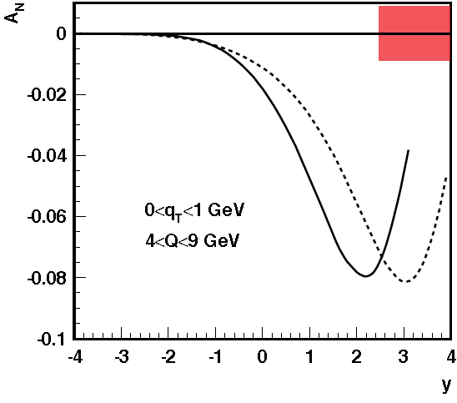
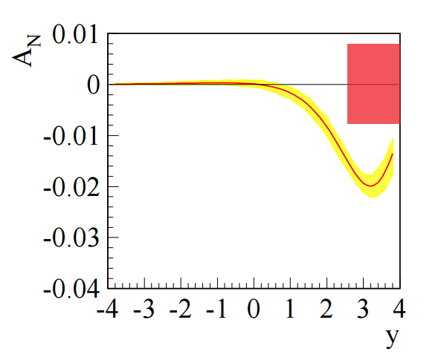
Another TMD Observable: Drell-Yan e⁺e⁻
The orange square: achievable statistical precision for A_{N} DY asymmetry with 400 pb⁻¹
the theoretical prediction for the Sivers asymmetry A_{N} as a function of DY lepton-pair rapidity at √s=500 GeV, before any TMD evolution is applied.
Same evolution scheme as in W-Boson
Theoretical predictions for DY for 0 <p_{T} < 1 GeV and 4 < Q < 9 GeV after TMD evolution is applied. The yellow bands represent the uncertainties for the asymmetry.

Slide 31
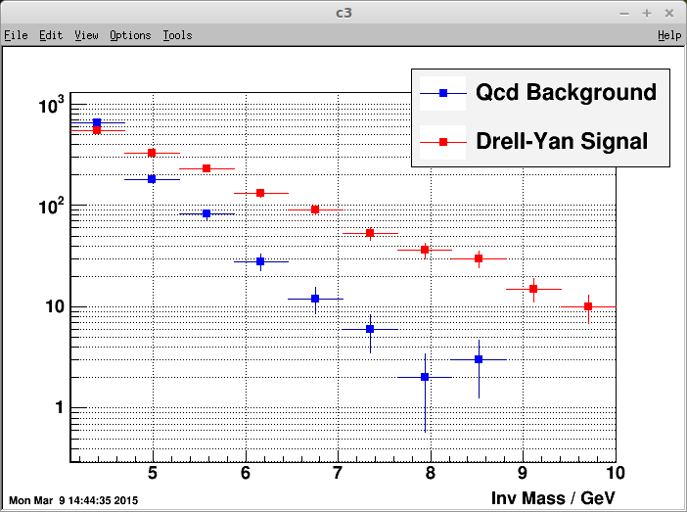
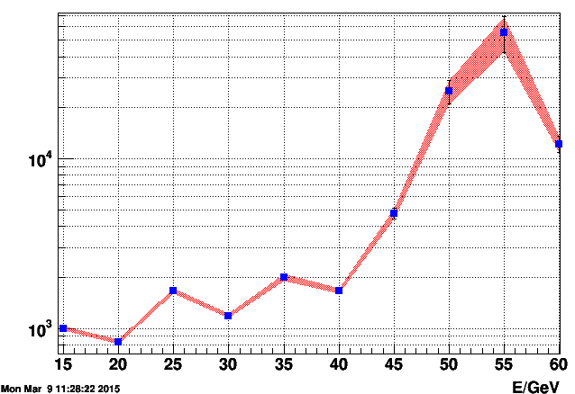
QCD background rejection: Drell-Yan e⁺e⁻
Add post-shower (run 17) to refurbished Pb-Glass FMS and scintillator pre-shower detector (run 15).
Simulate response of detector package to pions and electrons, collecting energy deposited in 3 pre-shower layers, FMS tower and post-shower layer.
Use multivariate analysis techniques to achieve hadron rejection powers of 800-14,000 for hadrons of 15 to 60 GeV while maintaining 90% electron detection efficiency.
yields
pp510
Hadron rejection power
Run 17 performance
simulation

Slide 32
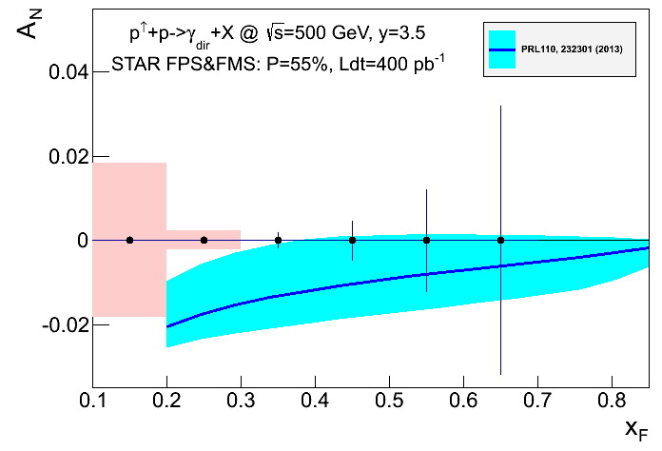
Twist-3 Observable: Direct photon A_{N}
Measurements of twist-3 observables explore the consistency between TMD and Collinear Twist-3 formalism.
Statistical and systematic uncertainties for the direct photon A_{N} after background subtraction compared to theoretical predictions for √s = 500 GeV.
Notes:
Both PHENIX and STAR have installed preshowers in front of their forward electromagnetic calorimeters the MPC and the FMS. Left is for 200 GeV at PHENIX. Similar error bars will be collected at STAR.

Slide 33
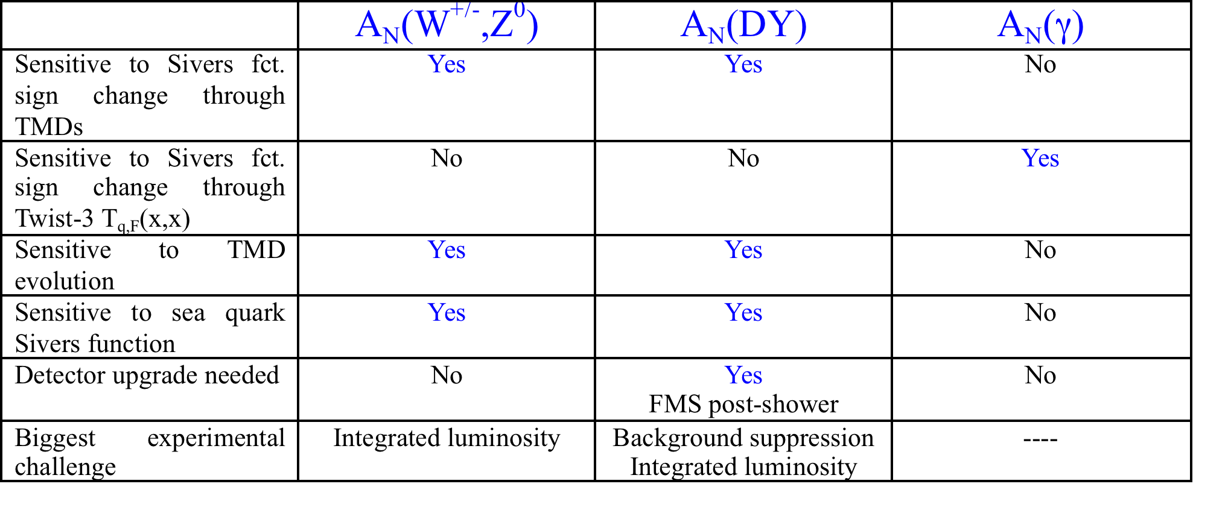
Summary of Sivers Function Tests Planned for STAR
for x ~ 10⁻⁴

Slide 34
pp500 Operation mode for W-boson
STAR TPC event pile-up affects tracking efficiency
The W-boson reconstruction efficiency
was obtained from the data measured in 2011 to 2013 and with improved Tracking Algorithm.
The highest FoM is reached at a ZDC rate of 330 kHz corresponding to a luminosity of 1.5 x 10³² cm⁻²s⁻¹.
Optimization of delivered luminosity with dynamic beta* squeeze.
Requires 13 weeks to reach 400pb⁻¹
Run17
run13

Slide 35
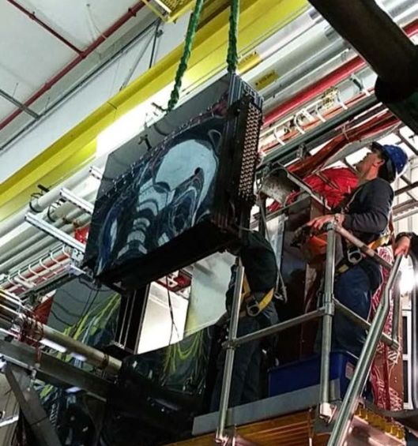
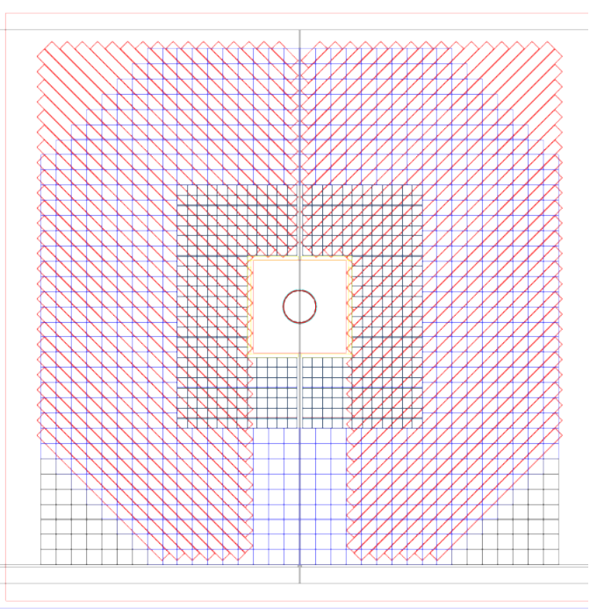
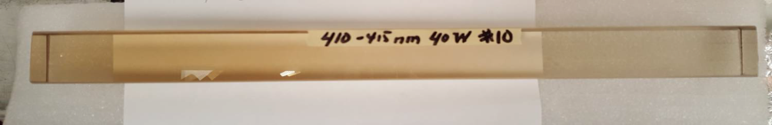
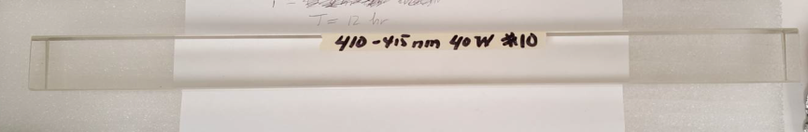
Forward Detector preparation for run 17
Forward Meson Spectrometer (FMS) + FMS Pre-shower + FMS Poster-Shower
Installation of pre-shower for run 15
All three detector subsystems:
existing FMS, Pre-shower
Add new post-shower
Add UV lights to cure FMS radiation
https://drupal.star.bnl.gov/STAR/system/files/STAR.FMS_.Postshower.v2.pdf
FMS radiation cure by UV lights

Slide 36

Isobar
Run | Energy | Duration | System | Goals | priority | Sequence
17 | √s_{NN}=500 GeV √s_{NN}=62.4 GeV | 13-wk 1-wk 2-wk 4-wk | Transverse p+p p+p CeC Au+Au | A_{N} of W±, γ, Drell-Yan, L=400 pb⁻¹, 55% pol RHICf Jets, dileptons, NPE 1.5B MB | 1 3 | 1 2 3
18 | √s_{NN} =200 GeV √s_{NN}=200 GeV √s_{NN}=27 GeV | 3.5-wk 3.5-wk 2-wk | Ru+Ru Zr+Zr Au+Au | 1.2B MB 1.2B MB >500M MB | 2 2 3 | 4 5 6

Slide 37


Results from Chiral Effects
More in-depth discussions this afternoon:
Talk by Paul Sorensen from CME Task Force
We have published a few papers on possible Chiral Magnetic Effect and potential background
U+U collisions
Better understanding
BES-I results on CME
14.5GeV
BES II with more statistics
Chiral Magnetic Wave
14.5GeV
Chiral Vortical Effect
PRL on possible Chiral Magnetic Wave

Slide 38

A decisive test with Isobars
CAD was not able to locate enriched Ruthenium-96 source
Possible with the refurbished Oakridge Isotope Facility,
Run with natural abundance reduces luminosity by x5
Can reach 1.2 Billion events within 3.5 weeks of operation

Slide 39

Projections for Isobar
With 1.2B minbias events each species
5σ significance
if 80% observed correlation is background
(0,0)

Slide 40

Au+Au at 62.4GeV
Run | Energy | Duration | System | Goals | priority | Sequence
17 | √s_{NN}=500 GeV √s_{NN}=62.4 GeV | 13-wk 1-wk 2-wk 4-wk | Transverse p+p p+p CeC Au+Au | A_{N} of W±, γ, Drell-Yan, L=400 pb⁻¹, 55% pol RHICf Semi-inclusive Jets, dileptons, NPE, 1.5B MB | 1 3 | 1 2 3
18 | √s_{NN} =200 GeV √s_{NN}=200 GeV √s_{NN}=27 GeV | 3.5-wk 3.5-wk 2-wk | Ru+Ru Zr+Zr Au+Au | 1.2B MB 1.2B MB >500M MB | 2 2 3 | 4 5 6

Slide 41

Au+Au at 62GeV
Inclusive jet measurements
STAR Preliminary
Au+Au at 62GeV helps establish
the trend in temperature dependence

Slide 42


Resolving possible charm puzzle
Large charm (NPE) suppression in Au+Au at 200GeV with large elliptic flow
Indication of enhancement in Au+Au at 62.4GeV with (~)zero elliptic flow
Preliminary data
Projection 1.5B
Projection 1.5B

Slide 43

Au+Au at 27GeV
Run | Energy | Duration | System | Goals | priority | Sequence
17 | √s_{NN}=500 GeV √s_{NN}=62.4 GeV | 13-wk 1-wk 2-wk 4-wk | Transverse p+p p+p CeC Au+Au | A_{N} of W±, γ, Drell-Yan, L=400 pb⁻¹, 55% pol RHICf Jets, dileptons, NPE 1.5B MB | 1 3 | 1 2 3
18 | √s_{NN} =200 GeV √s_{NN}=200 GeV √s_{NN}=27 GeV | 3.5-wk 3.5-wk 2-wk | Ru+Ru Zr+Zr Au+Au | 1.2B MB 1.2B MB >500M MB | 2 2 3 | 4 5 6

Slide 44


QCD phase transition is a chiral phase transition
Charge separation (14.5GeV)
Bulk charge dependence of π± v₂
Low-mass dilepton excess
Global polarization of hyperons
PRL113(2014)
STAR Preliminary

Slide 45
QCD fluid responds to external field
Current data not able to distinguish
Lambda/AntiLambda polarization difference,
(potentially) Direct measure of
Magnetic Field effect
Need >x10 more data
sum
STAR Preliminary
difference
RHIC/AGS Users Meeting:
June 7 Xin-Nian Wang Polarization of Fermions in Vorticular Field
June 8 Issal Upsal Lambda Global Polarization

Slide 46


Request Au+Au 27GeV in run18 with EPD
Clearly, very exciting development
Signal and BES dependence need more data
Request Au+Au 27GeV in run 18 with EPD
or run17 without EPD, but earlier results
To establish whether there is a difference
Result will guide further studies in BES-II
https://drupal.star.bnl.gov/STAR/system/files/EPD_Construction_Proposal.pdf
X10 more data

Slide 47

Plan presented in 2011
BES-I BES-II
C. Gagliardi for the STAR Collaboration

Slide 48
RHIC has been adaptable to science needs
2010-2013 | 2014 | 2015 | 2016 | 2017 | 2018 | 2019 | 2020 |  | 2022+
Au+Au p+p | Au+Au | p+p p+A | Au+Au d+Au | p+p Au+Au | Isobar Au+Au | Au+Au | Au+Au |  | Au+Au pp,pA
ΔG, QGP property | Charm flow | Ref. A_{N} | D_{c}, Λ_{c} ϒ, Jets | Fc sign | CME, Λ↑ | Critical Point, Phase Transition |  |  | Jets, ϒ forwardA_{N}
BES-I | 200, 14.5 | 200 | 200-19.6 | 500, 62.4 | 200, 27 | BES-II 11-20 | BES-II 7-11 |  | 200
BES-I
BES-II
2010-13 2014-16
BES-I BES-II
Expand to include several programs:
p+A in run 15,
pp500 in run17,
Isobar (Zr, Ru-96) in run 18
BES-II more compelling, detector and machine upgrades in 2018
Future high-luminosity jets and Upsilon in 2020+
3+1D hydrodynamics and Unique Cold QCD (DY) portal to EIC

Slide 49
Summary
Successful run16 (thanks CAD)
Compelling Heavy-Ion Programs for run 16 and run 18
  Completion of Heavy-Flavor program for HFT+MTD
  Decisive test of Chiral Magnetic Effect
  Partonic coupling to QGP close to T_{c}
  Quantifying the role of external field in Global Hyperon Polarization
Compelling Spin Program in run17
Three measurements related to TMD evolution and sign change
(A_{N} W^{+/-}, γ, DY)
Maintain track record in Results and Publications
Preparation for BES II and beyond
(3+1D hydro and Cold QCD)
Run | Energy | Duration | System | Goals | priority
17 | √s_{NN}=500 GeV √s_{NN}=62.4 GeV | 13-wk 4-wk | Transverse p+p Au+Au | A_{N} of W±, γ, Drell-Yan, L=400 pb⁻¹, 55% pol Jets, dileptons, NPE 1.5B MB | 1 3
18 | √s_{NN} =200 GeV √s_{NN}=200 GeV √s_{NN}=27 GeV | 3.5-wk 3.5-wk 2-wk | Ru+Ru Zr+Zr Au+Au | 1.2B MB 1.2B MB >500M MB | 2 2 3

Slide 50



Slide 51
Rapidity Coverage (BES-II)
TPC+iTPC+eTOF+EPD+FMS (2019--)
TPC-FMS
FMS-FMS
TPC-FMS

