Slide 1
Defects, higher symmetries and fault-tolerant logical gates in (3+1)D lattice gauge theories
Guanyu Zhu
IBM Quantum, T. J. Watson Research Center
arXiv:2208.07367 (2022)
Maissam Barkeshli, Yu-An Chen, Sheng-Jie Huang, Ryohei Kobayashi, Nathanan Tantavasidakarn, GZ

Slide 2
Motivation
A common direction in our community: using quantum computer to simulate lattice gauge theories and
quantum field theories.
An alternative direction:
ideas from quantum information and error correction ---> better understanding of gauge theories and
quantum field theories.
3. Some connections:
Z₂ lattice gauge theory
Toric code (quantum error correcting code QEC)
(lattice) G-gauge theories with discrete gauge group G
Topological quantum field theories (TQFTs)
backbone
quantum field theories (QFTs)
Symmetries in gauge theories and TQFTs (or more generally QFTs)
Fault-tolerant logical gates in QECs
Some exotic logical gates in 3d topological codes provides inspiration to new discoveries of higher-form symmetries and codimension-2 defects in gauge theories and TQFTs

Slide 3
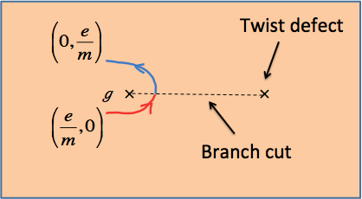

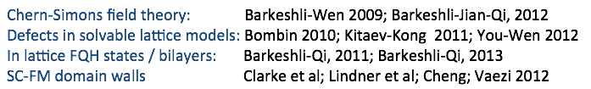
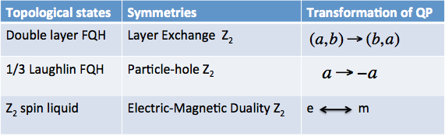
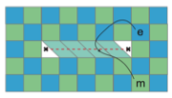
Twist defects and topological symmetries in (2+1)D topological order
topological (anyon) symmetry = mapping among different quasi-particles that preserves spin, statistics, etc
e-m twist defects in toric code
More general concepts (also applicable to higher dimensions): emergent symmetries

Slide 4
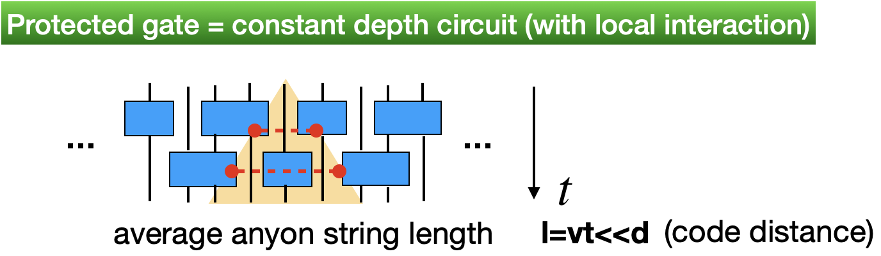
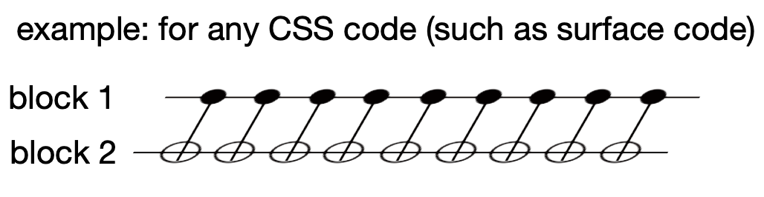
Fault-tolerant logical gates
More generally, locality-preserving unitary
(for continuum case and TQFT):
maps local operator to local operator
Error propagation bounded by the Lieb-Robinson light cone

Slide 5
Connection between transversal logical gates and emergent symmetries
Consider a transversal gate
(or more generally a constant-depth circuit),
it is a logical gate iff
: code space
U can be considered as an emergent symmetry of the ground state subspace (code space) of the gauge theory
or the corresponding topological order.
Furthermore, U is a global symmetry if it acts on the entire system of d-spatial dimension.
U is a higher-form (k-form) symmetry if it acts on a codimension-k submanifold
GZ, M. Hafezi, and M. Barkeshli, Phys. Rev. Research 2, 013285 (2020)
GZ, Tomas Jochym-O’Connor, Arpit Dua, PRX Quantum 3 (3), 030338 (2022)
Maissam Barkeshli, Yu-An Chen, Sheng-Jie Huang, Ryohei Kobayashi, Nathanan Tantavasidakarn, GZ, arXiv:2208.07367 (2022)

Slide 6
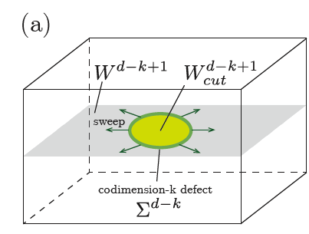
Connection to defect sweeping
The action of the emergent symmetry U is equivalent to sweeping the corresponding defect (domain wall) ω :
B. Yoshida, Phys. Rev. B 91, 245131 (2015), Phys. Rev. B 93, 155131 (2016)
P. Webster and S. D. Bartlett, Phys. Rev. A 97, 012330 (2018)
GZ, M. Hafezi, and M. Barkeshli, Phys. Rev. Research 2, 013285 (2020)
GZ, Tomas Jochym-O’Connor, Arpit Dua, PRX Quantum 3 (3), 030338 (2022)
Maissam Barkeshli, Yu-An Chen, Sheng-Jie Huang, Ryohei Kobayashi, Nathanan Tantavasidakarn, GZ, arXiv:2208.07367 (2022)
global symmetry
Generalization to codimension-k defect and (k-1)-form symmetry:

Slide 7
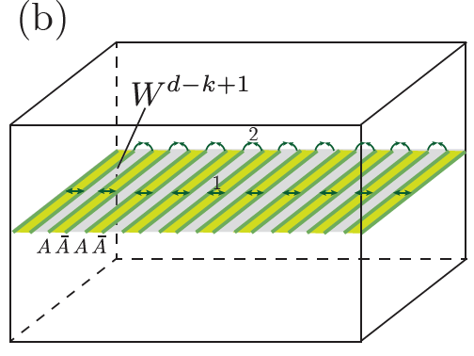
Invertible defects
A codimension-k defect in the topological equivalence class is invertible if there exists another codimension-k defect in an equivalence class , such that if the two codimension-k defects are near each other, they are topologically equivalent to the trivial codimension-k defect.
=
The sweeping of the codimension-k invertible defect can always be implemented as a constant depth local circuit.

Slide 8
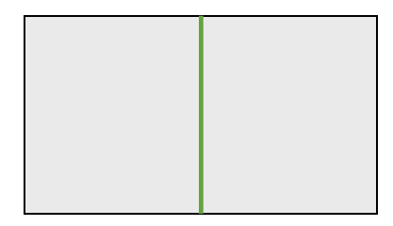

Invertible codimension-1 defects in (2+1)D G gauge theory: Twist strings
Twist strings in Z₂ x Z₂ gauge theory (two copies of toric codes)
Decorate with (1+1)D Z₂ x Z₂ bosonic symmetry protected topological (SPT) state (cluster state) and then gauge the Z₂ x Z₂ global symmetry.
Gauging: turning the global symmetry into a local gauge symmetry.
Alternative view: coupling the system to a dynamical gauge field.

Slide 9
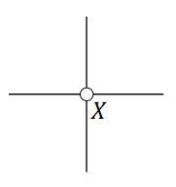
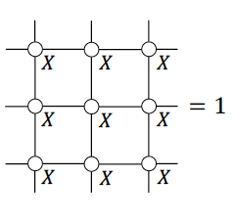
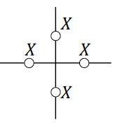
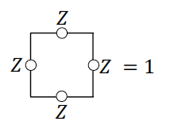




Gauging the Ising model (Kramers-Wannier duality)
Ising Hamiltonian:
Global Z₂ symmetry:
Gauge constraint:
Gauging
Fixed-point paramagnetic Hamiltonian:
Toric-code Hamiltonian:

Slide 10
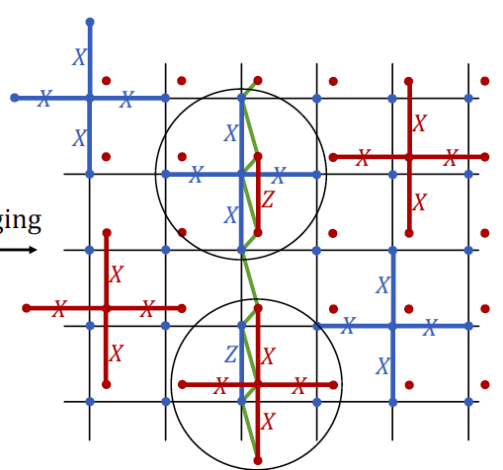
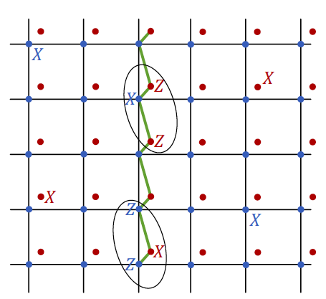
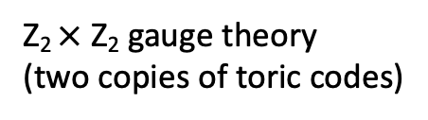

Twist string via gauging
1d Z₂ $×$ Z₂ SPT (cluster state)
CZ twist string
Gauging
Z₂ x Z₂
global symmetry
Two copies of paramagnetic states
Z₂ $×$ Z₂ gauge theory
(two copies of toric codes)

Slide 11
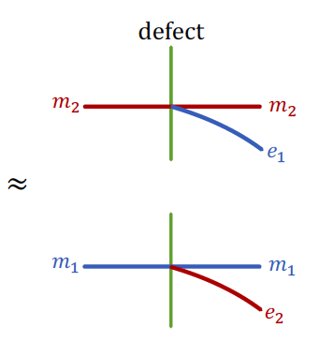
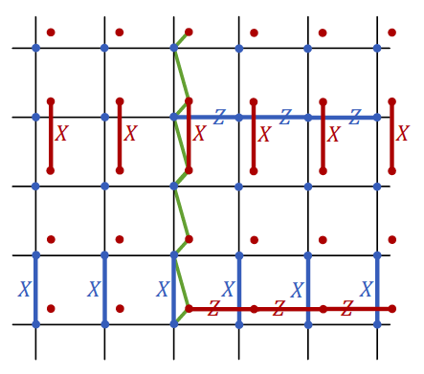
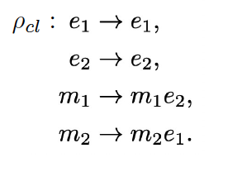
Defect fusion rule and logical gates
sweep
sweep
Automoprhism (anyon permutation):
sweep this twist string = transversal logical CZ gate

Slide 12



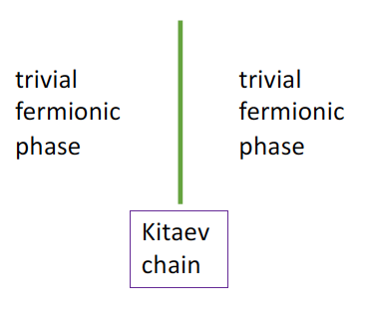
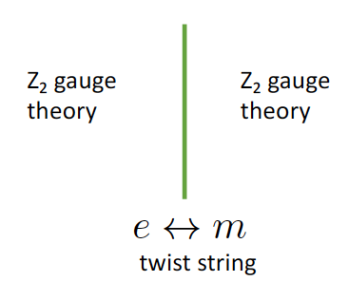

Twist strings in Z₂ gauge theory (toric code)
Can start with a trivial (2+1)D fermionic phase and gauge Z₂^{f} fermion parity symmetry
(2+1)D Z₂ gauge theory
Decorate a codimension-1 line with Kitaev chain

Slide 13


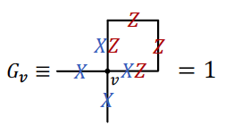


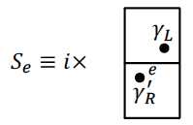
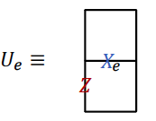
Gauging the Kitaev chain
Gauging
(bosonization)
Gauge constraint:

Slide 14
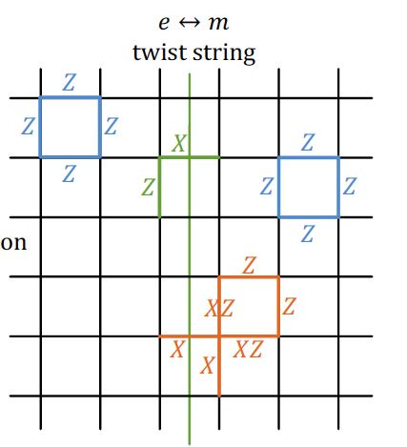
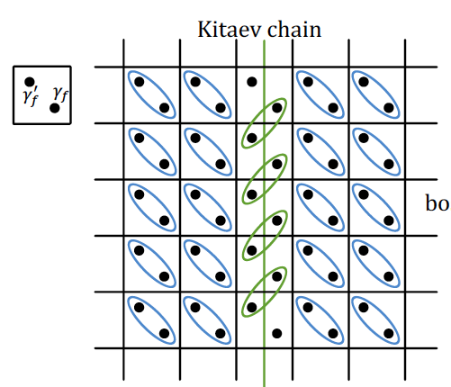
e-m twist string via gauging
Gauging
(bosonization)
s
s
trivial fermionic phase
Z₂ gauge theory

Slide 15
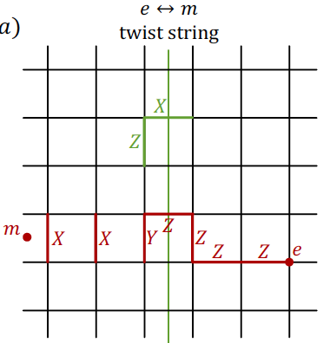
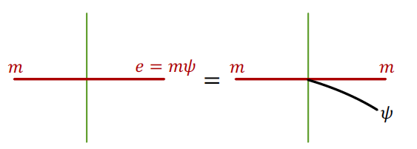
Defect fusion rule and logical gates
sweeping the e-m twist string = logical Hadamard gate (up to a π/2 rotation)
realized via a constant-depth local circuit
(rather than transversal gate)

Slide 16
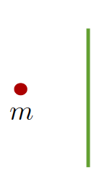

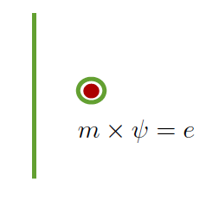
Dimensional reduction picture
m = fermion parity flux
Kitaev chain dimensionally reduced with fermion parity flux has odd fermion parity

Slide 17
Invertible codimension-2 defects in (3+1)D G gauge theory: Twist strings
Two constructions:
Layer construction
Decorating with (1+1)D SPT states and gauging

Slide 18
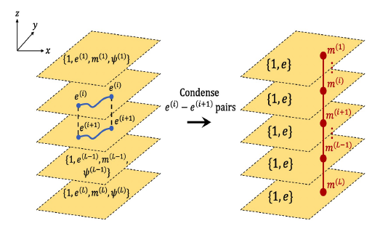
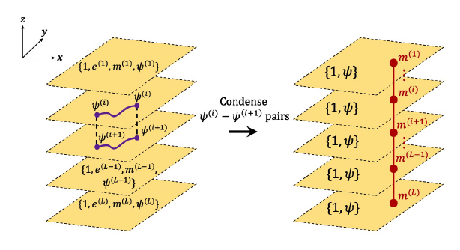
General construction I: layer construction
(3+1)D Z₂ gauge theory with bosonic charge
(3d toric code)
(3+1)D Z₂ gauge theory with fermionic charge
(3d fermionic toric code)
In general, condense composites of charges and conjugate charges from neighboring layers
Charge becomes mobile in 3d.
Fluxes become confined to strings.

Slide 19
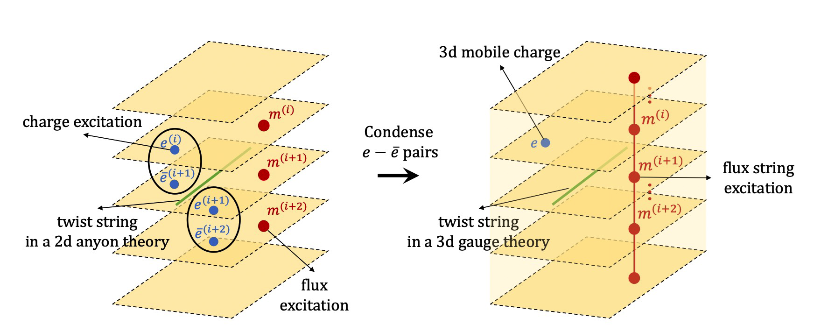
Layer construction for twist strings: Abelian G
Certain twist strings (invertible codim-1 defects) in (2+1)D become twist strings (invertible codim-2 defects) in (3+1)D
Compatibility condition: automorphism induced by twist string in (2+1)D must be compatible with interlayer condensation

Slide 20



Layer construction: Abelian G

Slide 21
Compactibility condition for the layer construction
Can we promote the e-m twist from (2+1)D Z₂ gauge theory (2d toric code) to (3+1)D gauge theory?
Impossible for (3+1)D gauge with bosonic charge (3d toric code)
e-m twist string
m
e
Broken flux string!
Flux line cannot end on vacuum, violate flux conservation.
m (flux)
m
The twist string in the (2+1)D gauge theory should correspond to a flux-preserving automorphism.

Slide 22


Compactibility condition for the layer construction
Flux preserving automorphism:
Fluxes are labeled by
Flux-preserving condition is equivalent to
Invertible codimension-1 defect in (2+1)D implementing flux-preserving automorphism becomes invertible codimension-2 defect in (3+1)D

Slide 23
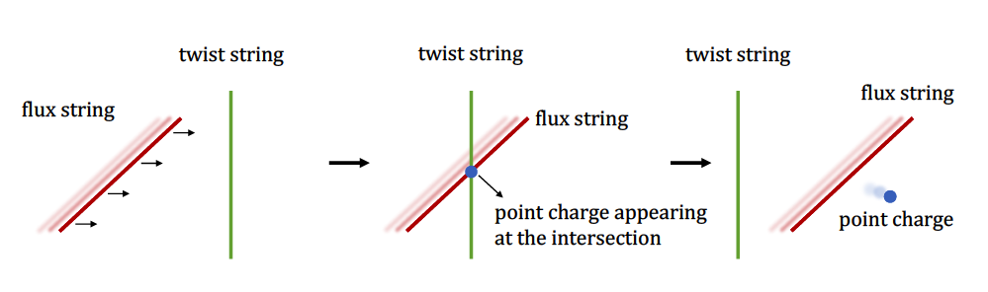
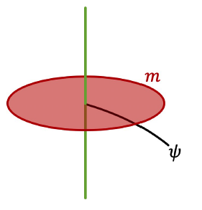
Interaction between twist strings and flux strings
Examples for Abelian G gauge theory:
In (3+1)D Z₂ gauge theory with fermionic charge (3d fermionic toric code)
the e – m twist string from (2+1)D becomes a twist string in (3+1)D.
Intersection of surface operator that creates m flux string sources the fermionic charge:
2. In (3+1)D Z₂ $×$ Z₂ gauge theory with bosonic charge (2 copies of 3D toric codes), the CZ twist string from (2+1)D becomes a twist string in (3+1)D.

Slide 24
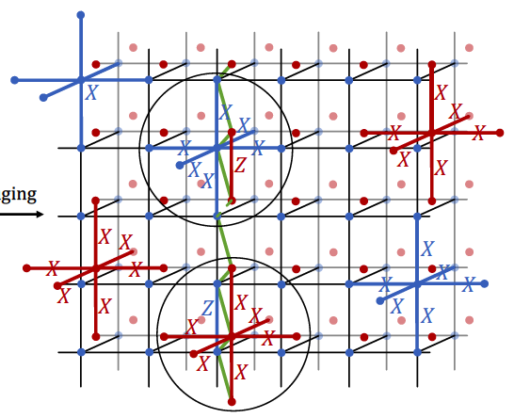
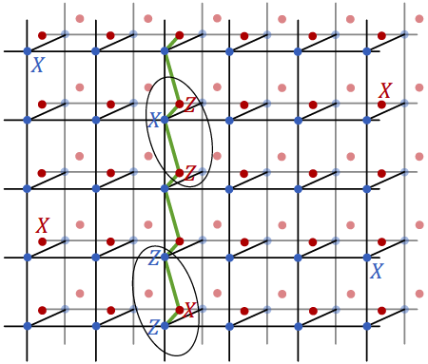


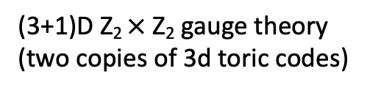
Twist string in (3+1)D Z₂ $×$ Z₂ gauge theory
Construction II: Decorating with (1+1)D SPT states and gauging
1d Z₂ $×$ Z₂ SPT (cluster state)
CZ twist string
Gauging
Two copies of 3d paramagnetic states
(3+1)D Z₂ $×$ Z₂ gauge theory
(two copies of 3d toric codes)

Slide 25
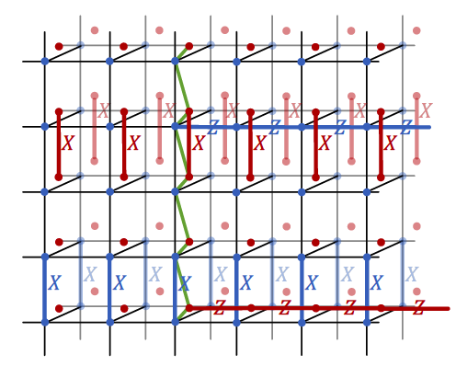
Defect fusion rule (lattice model)

Slide 26
Defect fusion rule
See also B. Yoshida, Phys. Rev. B 91, 245131 (2015), Phys. Rev. B 93, 155131 (2016)
CZ twist string:
(codimension-2 domain wall)
codimension-2 defect
1-form symmetry:
sweep

Slide 27
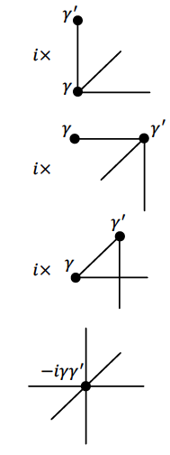
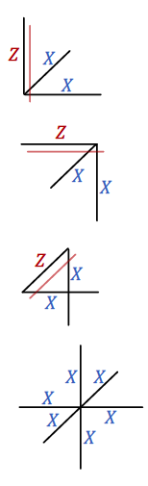
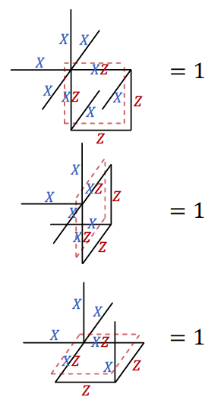
Twist string in (3+1)D Z₂ gauge theory with fermionic charge (gauging construction)
Gauging
(bosonization)
Gauge constraint:

Slide 28
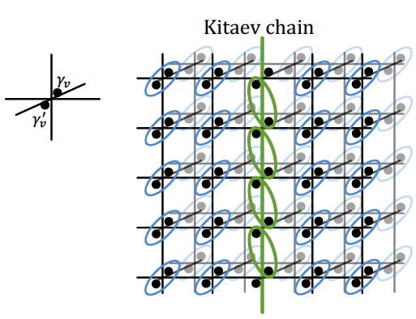
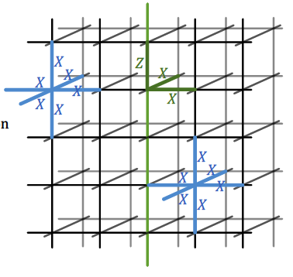
Gauging the Kitaev chain in (3+1)D
twist string
Gauging
(bosonization)
(3+1)D Z₂ gauge theory with fermionic charge
(3d fermionic toric code)
trivial fermionic phase

Slide 29
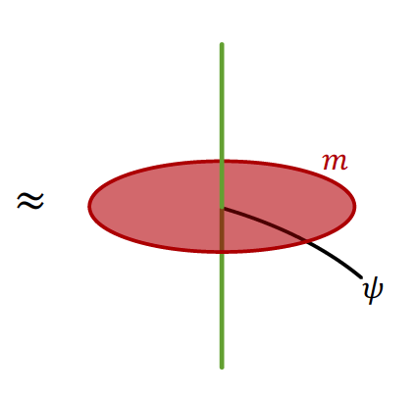
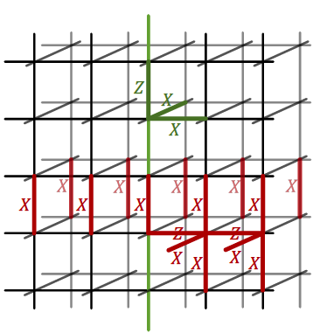
Defect fusion rule
A different construction with the Levin-Wen fermion model:
P. Webster and S. D. Bartlett, Phys. Rev. A 97, 012330 (2018)

Slide 30

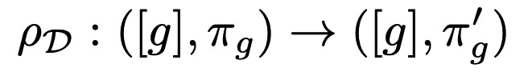
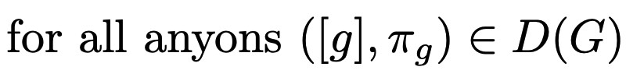
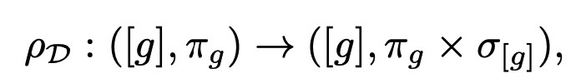
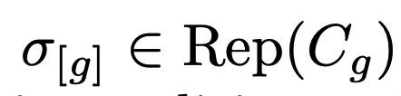

Layer construction for (3+1)D non-Abelian G gauge theory
Pure point charges Rep(G)
Flux loops labeled by conjugacy classes [g]
Flux loops can carry charge, labeled by
: irrep of centralizer of g
Need to condense pure charges and pure anti-charges from neighboring layers.
Need flux-preserving automorphism to get twist strings in (3+1)D:
(1).
This is not enough to guarantee that the twist string is topological. Also need:
(2).
(2) Is strictly stronger than (1). (1) implies that charges are invariant under
There are examples of twist strings satisfying (1) but not (2). These are geometric, not topological, invertible codim-2 defects.
c.f. fractons

Slide 31

D₄ gauge theory
Flux-preserving automorphism in the D₄ gauge theory:
One can verify that these automorphisms are modular invariants, which keep
the modular S and T matrices and invariant.

Slide 32








A₆ gauge theory
The corresponding group G = A₆ is the alternating group of order six, i.e., the group of even permutations of six objects: {1, 2, ..., 6}.
Consider a particular group element composed of two elementary permutations, i.e., α = (1, 2)(3, 4).
The corresponding conjugacy class is the set of permutations with form of a product of two elementary permutations, i.e., (i₁, i₂)(i₃, i₄).
The centralizer group of α is then:
with
The conjugacy classes of the centralizer subgroup C_{α} are
trivial rep.
The character table of C_{α}.
Flux-preserving automorphism:

Slide 33



Geometric twist string in A₆ gauge theory
Consider the example:
Both twist strings ρ₁ and ρ₂ are non-topological since the fusion outcome depends on the detailed geometric path,
we hence call them geometric twist strings.
The composite of these two geometric twist strings is a topological twist string, since the fusion rule is independent of
the charge.

Slide 34



General recipe for the 2nd Construction:
Twist strings in (3+1)D from (1+1)D invertible phase decoration and gauging (including non-Abelian)

Slide 35





Dimensional reduction picture

Slide 36


Slide 37
Summary and outlook
Invertible topological defects in G gauge theory can be (fully?) described by decorating submanifolds of a trivial phase with lower dimensional invertible topological phases and then gauging
Invertible codimension-2 defect (twist string) in (3+1)D G-Gauge theory can be constructed from the layer construction with a codimension-1 defect (twist string) in (2+1)D G-gauge theory which implement. a flux-preserving automorphism.
Caution: Gapped codimension-k defect is not the same as a topological defect
topological vs geometric defects
The sweeping of such codimension-2 defect gives rise to emergent 1-form symmetries, which are equivalent to fault-tolerant logical gates on the corresponding quantum error correcting code: transversal logical gates, or more generally logical gates corresponding to constant-depth local circuits.
Outlook: a more complete classification of defects and logical gates
Generalization to continuous gauge group G

