Slide 1
pfRICH Tiling
Alex Eslinger/Alexander Kiselev

Slide 2
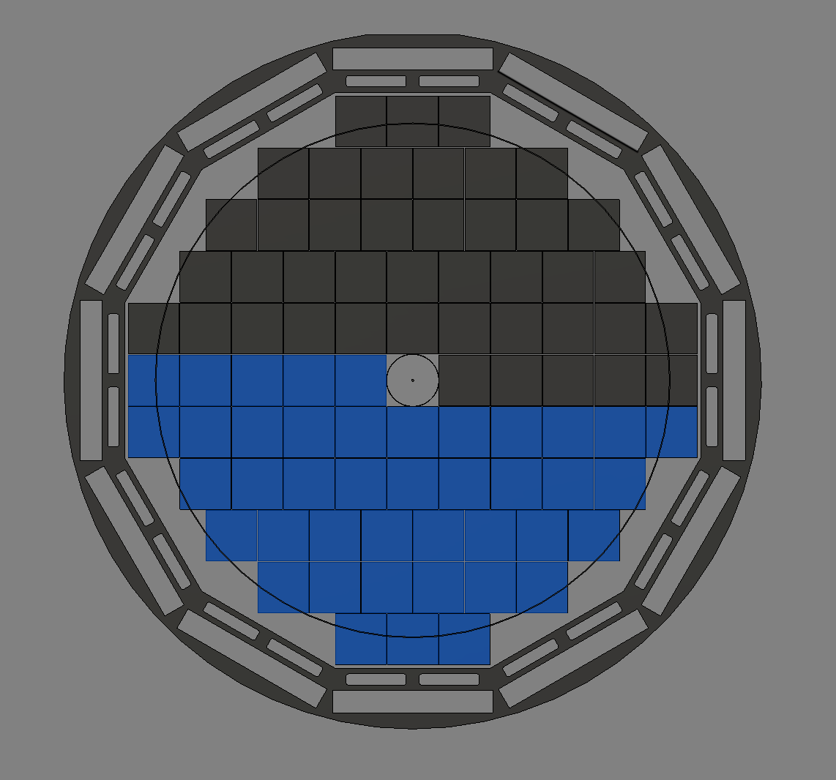
Sensor Tiling Scheme
Blue and Grey sections represent proposed “halving solution” for this layout.
The outer member is the DIRC support
On the inside we must consider the beam pipe size at this location

Slide 3
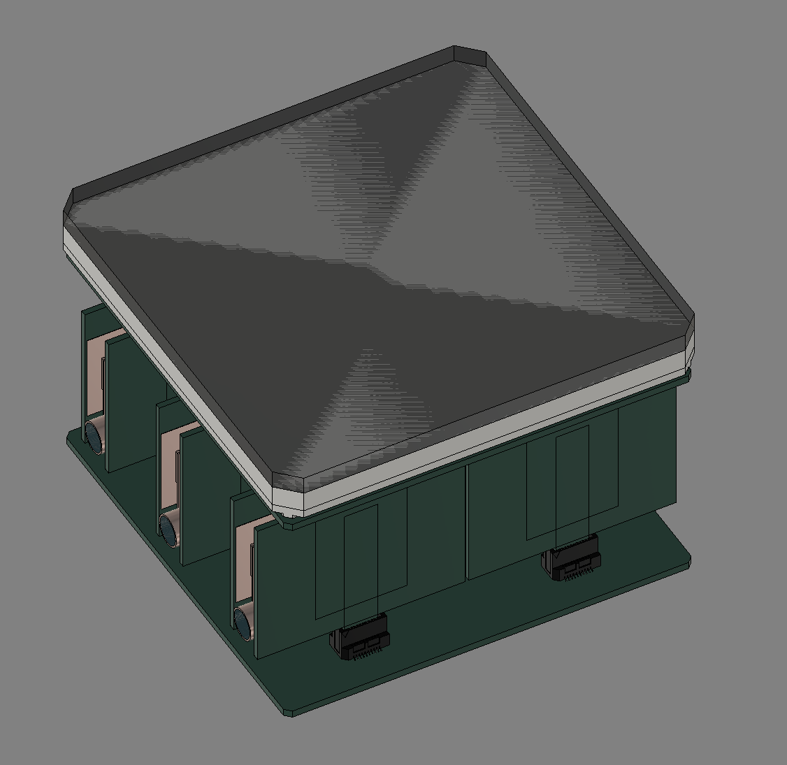
Proposed sensor Modifications
Cut the corners from each sensor to allow a fastening mechanism to pass through
(Not shown): create a small notch on the backside in the ceramic to interface with a support plate

Slide 4
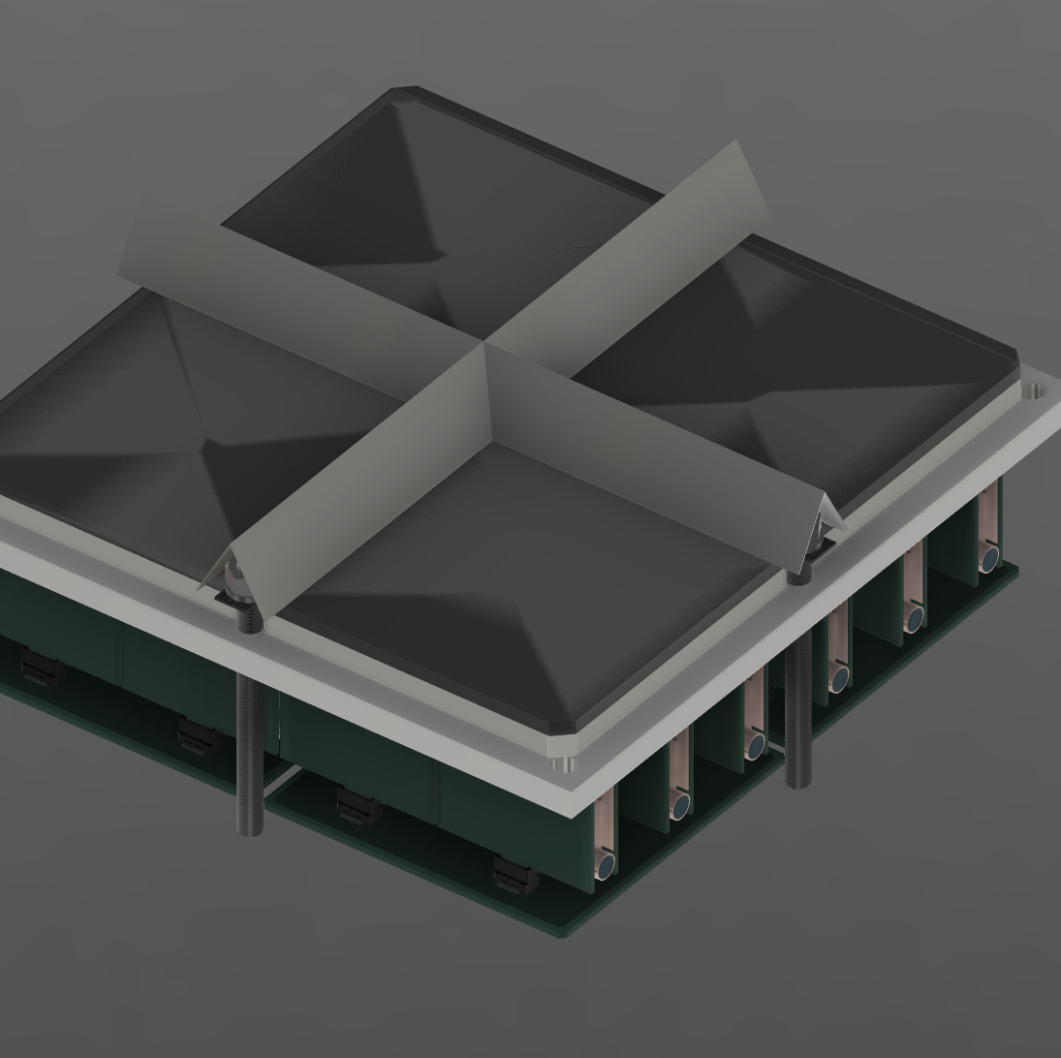
Sensor Tiling Support Concept
Create a backing plate to hold multiple sensors and pass-through hardware in the cut-out corners
Make a small, thin, and rigid grid on the sensor front side to provide a larger surface area for the hardware

Slide 5
