Slide 1
EIC Project Update
Elke Aschenauer and Rolf Ent
Co-Associate Directors for the Experimental Program
ePIC Collaboration Meeting
January 9th 2023

Slide 2
Jim Yeck Mail to EIC Project 11/26/22
Dear EIC Project Team,
Good news! I am happy to report that the slower than planned ramp up of the EIC start-up phase is resolved by the Inflation Reduction Act (IRA) funding. We are restoring our momentum and remain committed to expeditiously achieving the upcoming DOE Critical Decision (CD) milestones. We continue to plan according to our Reference Funding Profile Version 3’ (V3 plus IRA), which assumes $90M in the FY2023 annual appropriation and subsequently ramping up to $300M per year by FY2026.
We are preparing for a major DOE status review scheduled for January 31 – February 2, 2023. The primary focus of this review is to provide an update on status since CD-1 and our plans to achieve CD-3a, CD-2, and CD-3. In consideration of our current status and the funding plans, we are making an adjustment to our CD plans as described below:
CD-3a, Long Lead Procurement Approval = No Change. DOE review in October 2023 and DOE approval of CD-3a in January 2024.
CD-2, Performance Baseline Approval = Revised. DOE review in October 2024 and CD-2 approval in January 2025.
CD-3, Start of Construction Approval = No Change. DOE review TBD and CD-3 approval in April 2025 prior to RHIC Shutdown in June 2025.
After consultation with DOE, we are accepting a later date for CD-2 given the limited people resources available and our priority on completing preliminary and final design of CD-3a Long Lead Procurement items. This schedule acknowledges slower than planned progress in the last two years including: ramp-up of staff, execution of contracts, securing international partners, and a delay in securing the $100M of New York State funding for an EIC Infrastructure Project.
We will continue to manage to our preliminary baseline, using formal change control and EVMS starting in July 2023. This is essential in order to maintain the CD-3a approval date as it drives the overall schedule and requires a clear understanding of the baseline technical scope.
There are important details to work out concerning the sequence of activities, particularly reviews after CD-2 approval and prior to CD-3 approval. Plans for the CD approvals in 2025 will continue to develop as we discuss the details with DOE. Please continue to hire, partner, collaborate, and define in-kind deliverables /institutions. The pace of the project will be determined by our ability to grow the effort dedicated to project activities and schedule performance.
Best wishes for this Thanksgiving holiday break!
Sincerely, Jim

Slide 3
Jim Yeck Mail 12/02/22
Dear Rolf,
Dear Elke,
This short note provides further clarification on project plans and the EIC Critical Decision schedule. There is very little change in the project plans. We will develop the project performance baseline (scope, technical performance, cost, and schedule) on the original schedule. DOE approval of the performance baseline, Critical Decision 2, will be one year later. The additional time results in a higher level of project design maturity and a higher quality baseline at the time of approval. We will request CD-2 and CD-3 approval prior to the RHIC shutdown in summer of 2025. A change in the RHIC shutdown plans is extremely unlikely as the cost-effective construction of the EIC depends on the redirection of RHIC operations funding to EIC construction.
The progress defining the EIC Project Detector scope has well aligned with the project schedule. The Project Detector performance baseline preparation should not be altered or slowed as a consequence of the change in the CD-2 approval timeline.
Sincerely,
Jim

Slide 4
Schedule till a week ago
Schedule Now
Conclusion of
RHIC Operations
06/2025
CD-2
01/2025
early
CD-4A
04/2031
early CD-4
CD-4A
04/2032
CD-0
12/2019
CD-2/3A
01/2024
CD-1
06/2021
CD-3A
01/2024
CD-3
04/2025
CD-4
04/2034
Preliminary
Design
Conceptual
Design
Preliminary
Design
Final
Design
Construction
Transition into
Operations
Start of
Operations
&
Science
Final Design LLPs
Approve final design
for all subdetectors
Design Maturity: ~90%
Need TDR
January 2023:
start change control
process for detector
April 2023:
train EVMS process
Approve preliminary design
for all subdetectors
Design Maturity: >60%
Need “pre-”TDR
Define Baseline:
Subdetector technologies,
Scope, Cost & Schedule
Design Maturity: 50% – 60%
Long Lead Procurement items
Design Maturity: ~90%
Plan is tracked through EVMS
& Change control process
Need Pre-TDR
Define Baseline:
Subdetector technologies,
Scope, Cost & Schedule
Long Lead Procurement items
Design Maturity: ~90%
Plan is tracked through EVMS
& Change control process
Need TDR for LLPs
No Impact on experimental program
time to full design remains short

Slide 5
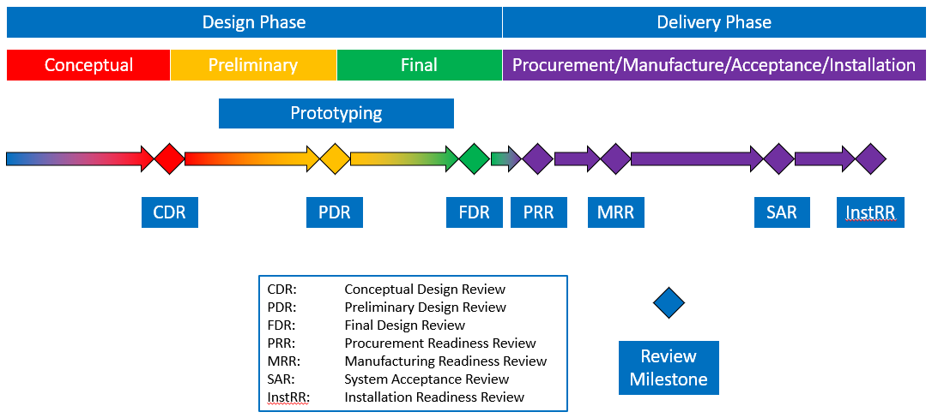
Technical Review Milestones as fct. of Time
Example of a technical review milestone path from conceptual design through handoff to installation.
Reviews are defined in the ”EIC Technical Review Plan”.
Technical Status Reviews

Slide 6
Reviews: Completed, Upcoming and Planned
October-December – EIC Subsystem Status Reviews on Tracking, Particle Identification Systems, Electromagnetic Calorimetry, Hadronic Calorimetry, Infrastructure/Installation, Polarimetry
  already completed
    Magnet Incremental Design and Safety Review (6.10.07) – Preliminary 30% Design
    IR Integration and Ancillary detectors (6.10.11)
    Electronics/Computing Subsystem Status Review (6.10.08 & 6.10.09)
    Magnet Incremental Design and Safety Review (6.10.07) – 60% Design
    Calorimetry Review (6.10.05 & 6.10.06) – 6th and 7th of December
  in planning stage
    Polarimetry Review (6.10.14) – 17th of January
    Incremental Integration/Installation Review – waiting for sPHENIX installation schedule
  To do beyond
    Tracking Review (6.10.03)
    Particle Identification Review (6.10.04) → after ePIC internal Review
    Infrastructure Review (6.10.10)
    Magnet Incremental Design and Safety Review (6.10.07) – 90% Design ~September 2023
  Note that we use incremental design reviews, at some stage before CD-3A some will serve as (and be called) Preliminary Design Review, and similar before CD-3 some will serve as Final Design Reviews, to fulfill the project requirements. For you nothing will change.
DOE OPA Status Review - Confirm CD-3A Plans Jan. 31 – Feb. 2, 2023
DOE CD3A OPA Review and ICR October 2023
DOE CD 3A ESAAB Approval January 2024

Slide 7
Plan for (Draft) TDR
.
With CD-2 and CD-3 combined, the formal Pre-TDR and TDR need now closely coincide. We will simply start writing a draft TDR this year, and then this will become a TDR in 2024. Nothing changes in our planning.
Working model will be similar as we used to create the CDR, Elke/Rolf with engagement of EPIC leadership, and a mix of the project CAMs and EPIC WG representatives. At the late phases the editing rights will become more restricted. We plan to use where we can input from the CDR, YR, proposals, technical notes, etc.
Chapter 2: Physics Goals and Requirements (should be short, < 50 pages)
2.1 EIC Context and History (like CDR 2.2 or YR section 1)
2.2 The Science Goals of the EIC and the Machine Parameters (like CDR 2.3)
2.3 The EIC Science (follow YR structure)
2.4 Scientific Requirements
Chapter 3: Interaction Region 6 Overview (Elke/Rolf contributing)
Chapter 8: Experimental Systems
8.1 Experimental Equipment Requirements Summary (like CDR 8.2)
8.2 General Detector Considerations and Operations Challenges (YR 10, CDR 8.3)
8.3 EIC Detector
8.4 Detector R&D Summary
8.5 Detector Integration
8.6 Detector Commissioning and Pre-Operations
Chapter 11: Commissioning (Elke/Rolf contributing)
Appendix-B: Integration of a Second Experiment (mainly emphasizing feasibility, luminosity sharing, polarization with two experiments, and first-order checks of magnets/acceptance)

Slide 8
Planning for CD-3A
Need to define Long Lead Procurements (LLP)
  Detector LLPs
    1.7 T Solenoid
    subdetector parts limited by vendor capabilities
    SiPMs for calorimeters and dRICH
    PbWO4 – crystals
    fHCal: Steel – plates, WSF, and scintillator plates
  the parts need to have a 90% design by October 2023
  requirements for procurement need to be fully defined
Define technical baseline for all subdetectors (scope, cost, schedule)
This has implications for any change in scope, cost and schedule → will now go through a formal change control process with thresholds for approval defined in the Project Execution Plan – a formal document signed off by DOE
It is good practice to start using the change control process well in advance
  For accelerator scope this has been in use for the last years
  For detector scope this will start January 2023

Slide 9
Technical Change Control Process - Detector
Copy process as has been used for the accelerator as it works well.
will have more people with detector expertise in the TCCB for such change requests. We need to involve the detector collaboration to initiate documentation for change requests and use their technical board or equivalent to ensure the change request is consistent with the NAS science requirements, and then use the "detector TCCB" to ensure the project part.
As final step it goes to the EMT for the formal approval.
Proposed detector TCCB:
  Qiong Wu (chair)
  Person with detector experience to take notes and help Qiong
  Elke Aschenauer
  Rolf Ent
  detector lead mechanical engineer (Rahul Sharma, 6.10.10 CAM)
  detector lead electronics engineer (Fernando Barbosa, 6.10.08 CAM)
  two members of the ePIC collaboration (for example the lead of the detector/technical board, perhaps a technical coordinator if there is one)
  three accelerator L2 leads or alternate: HSR, ESR and IR to ensure overlap
  relevant L3 CAM of the WBS the change is requested for
  add subject matter experts as needed (for example Charlie Folz for infrastructure).
Always included in TCCB process: Ferdinand Willeke and Todd Satogata
Note: After the TCCB advise, the formal baseline change control is done through the EMT but in obeyance of the various thresholds in the Project Execution Plan.

Slide 10
Technical Change Control Process - Detector
This is a five-step process:
The detector collaboration initiates a possible change in baseline scope
The collaboration technical board or equivalent ensures the change is consistent with the NAS science requirements and initiates the change request
The detector TCCB collects wide input, discusses, and gives advise
The Project Technical Director gives approval
The EIC Management Team needs to approve the formal baseline change control

Slide 11
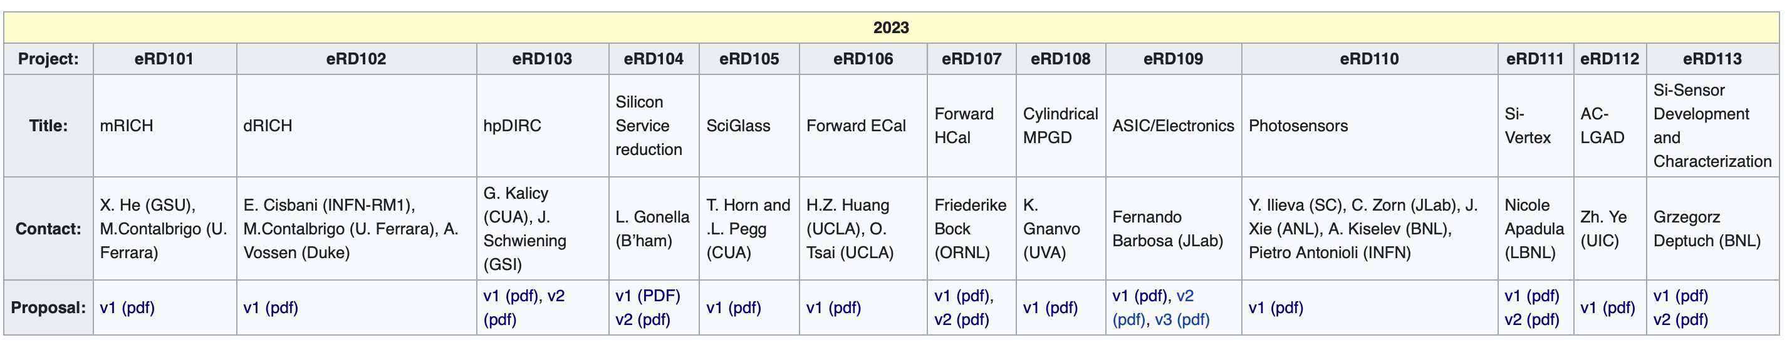
EIC Project R&D
All Info can be found here: https://wiki.bnl.gov/conferences/index.php?title=General_Info
Note:
Project R&D support innovative and critical conceptual designs by prototyping of components. The initial design process with calculations, simulations and layouts is only one element and means to achieve the maturity required to carry out preliminary and final design and eventually construction of the project scope elements. The focus of the R&D projects is to demonstrate a solution to the fundamental challenges.
Thus, project R&D is very focused on the needs of the project to advance to manufacturing the novel and challenging system components.
If you want to help to answer the critical EIC Project R&D questions, contact PIs listed in table
Started in
2023
New in
2023
New in
2023

Slide 12
EIC Project R&D
EIC Project R&D - DAC Meeting 19th – 21st October
Final Report: https://indico.bnl.gov/event/17159/attachments/43857/76048/DAC-Report-Oct22-vf.pdf
ID | R&D Subject | Contacts | Institutions that receive funding (need contracts) | Comments
eRD101 | mRICH | Prof. Xiaochun He (Georgia State University), Dr. Marco Contalbrigo (INFN Ferrara) | Georgia State University, Glasgow | Reduced funding as compared to proposal. Focus on to critical project detector R&D.
eRD102 | dRICH | Dr. Evaristo Cisbani (INFN Roma), Dr. Marco Contalbrigo (INFN Ferrara), Prof. Anselm Vossen (Duke University) | Duke University, INFN Ferrara | Funded.
eRD103 | hpDIRC | Dr. Gregor Kalicy (Catholic University of America), Dr. Jochen Schwiening (GSI) | Catholic University of America, Old Dominion University, Stony Brook University | Funded. Note that work to move ex-BABAR DIRC bars from SLAC to JLab is done separate
eRD104 | Service reduction | Laura Gonella (Birmingham) | Oak Ridge National Laboratory | Funded.
eRD105 | SciGlass | Prof. Tanja Horn (Catholic University of America) | Catholic University of America, IJCLab-Orsay, INFN-Genova, Kansas University, AANL/Armenia | Funded.
eRD106 | Forward EMCAL | Prof. Huan Z. Huang, Dr. Oleg Tsai (UCLA) | UCLA, BNL, UCR | Funded.
eRD107 | Forward HCAL | Friederike Bock (ORNL) | ORNL, FNAL, UTK, GSU, Yale, ISU, Valp, UCR | Reduced funding as compared to proposal. Focus on injection molding. Working on PED part.
eRD108 | MPGDs | Dr. Kondo Gnanvo (Thomas Jefferson National Accelerator Facility) | BNL, Florida Institute of Technology, Saclay, Temple University | No funding for Planar, considered (and supported through) EIC generic detector R&D. Funded to complete GEM/muRWELL test at FNAL and for MM-based work.
eRD109 | ASICs/Electronics | Fernando Barbosa (Thomas Jefferson National Accelerator Facility) | 1) Indiana; 2) ORNL; 3) INFN-Torino; 4) UIC et al; 5) CEA-Saclay & USP/Brazil | Fully funded but reduced funding as compared to detector R&D plan. Five subprojects: 1) ECAL discrete/COTS; 2) HGCROCv3; 3) ALCOR; 4) EICROC1/FCFD1; 5) SALSA.
eRD110 | Photosensors | Dr. Pietro Antonioli (INFN), Prof. Yordanka Ilieva (USC) Dr. Alexander Kiselev (BNL), Dr. Junqi Xie (ANL), Dr. Carl Zorn (TJNAF), | ANL, INFN (GE/TS), INFN (BO/FE/CS), MSU, BNL, JLab, UC-EIC, USC | Reduced funding as compared to proposal. Focus on LAPPD.
eRD111 | Si-Tracker/no sensors | Nikki Apadula (LBL) | INFN, LANL, LBL, ORNL | Funded R&D part of proposal. Moved as much as possible to PED apart from stitching and air cooling as latter was started as R&D - follows discussions with Nikki/Ernst. Waiting for completion of PED contract with LBL.
eRD112 | AC-LGAD | Prof. Zhenyu Ye (University of Illinois Chicago) | BNL, University of Illinois Chicago, Rice University, UC Santa Cruz (SCIPP), LANL, Purdue | On hold until questions on requirements following FY22 R&D are clarified.
eRD113 | MAPS sensors (ITS3) | Dr. Grzegorz Deptuch (BNL) | INFN, BNL, LBL, ORNL, LANL | Reduced funding compared to proposal.
Follows EIC detector R&D plan with Si/MAPS and LAPPD moved to project R&D
Cuts to fit in the box of $3M and to obey the Project R&D definition

Slide 13
International Engagement DOE, EIC Project, Host Labs
EIC International Boards
EIC Advisory Board
  Includes leaders of international and domestic partner institutions
  BNL Director welcoming new members interested in contributing to the EIC accelerator facility
Resource Review Board (RRB) for the EIC experiments
  Similar to the LHC RRBs, includes funding agency reps
  EIC RRB pre-planning meeting October 12-13, 2022
  1st EIC RRB meeting in person April 3-4, 2023 on Long Island
    Charter being drafted by host labs (BNL & JLab) and one international partner
    → will be ratified at the next meeting
    Attendance: one representative by funding agency as member → can be several per country
    one Principal Investigator per agency as observer
    (for this first meeting we may invite a handful “extra” countries/agencies as observer)
DOE International Funding agency meetings
had by now several meetings with international funding agency representatives
  Most recent one: 11/17/2022 in person in Washington DC
  next one planned late spring 2023
Many meetings with individual country representatives, i.e., scientific attaches, funding agency representatives, ……

Slide 14
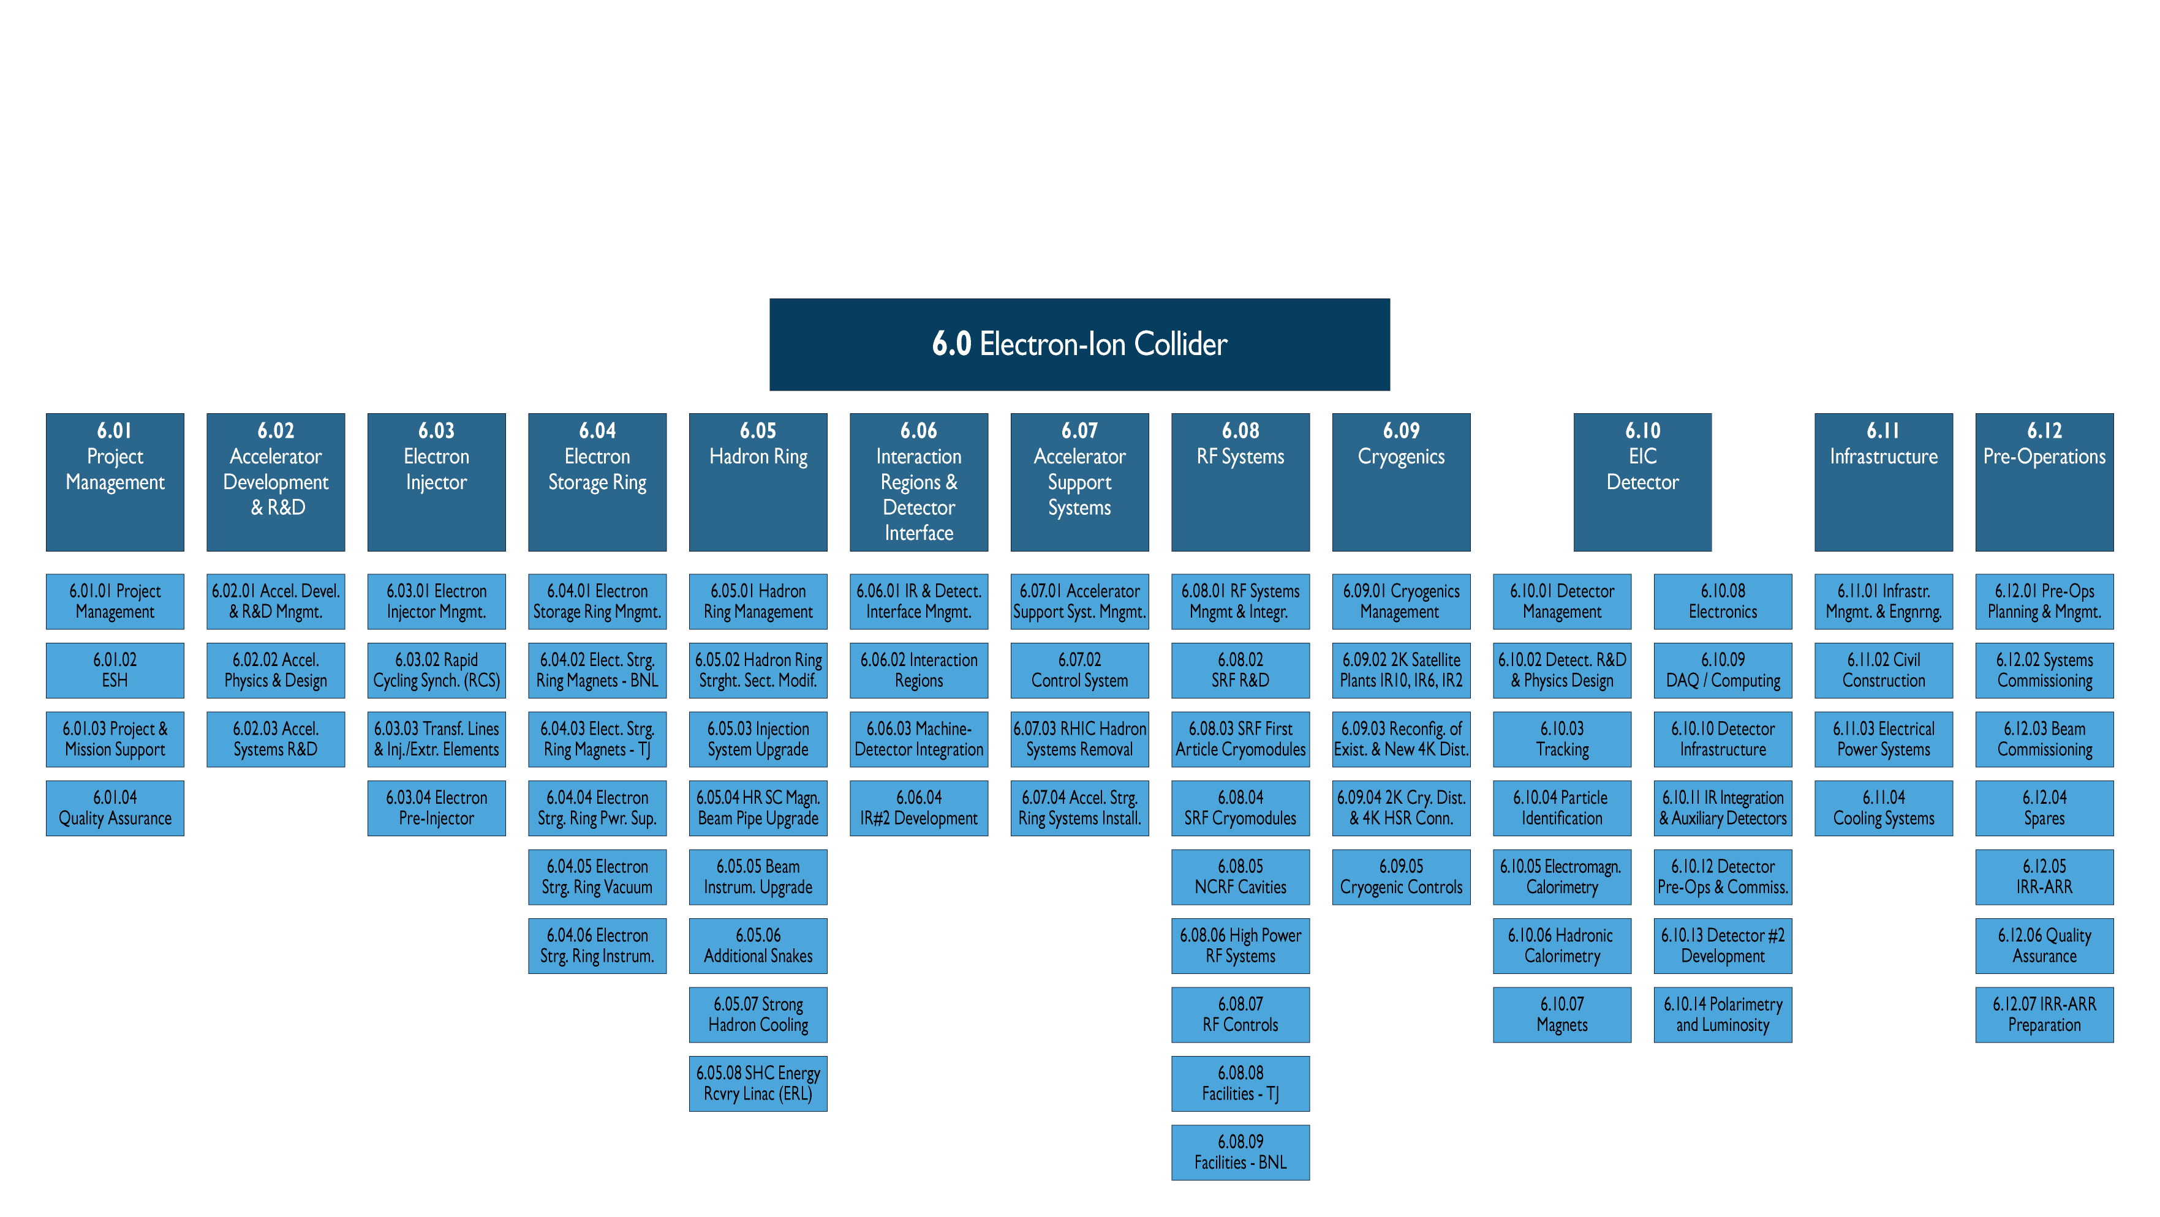
Technical Progress
Defined and documented system requirements down to L4
Work defining electronics needs & standards, i.e. ASICs
Work fo complete readout specifications
test stand to calibrate ANSYS simulations with measurements to verify technical solution to bake-out beam pipe with μ-vertex in-situ
develop beam pipe support
Define Streaming readout needs and standards
Support timing and streaming DAQ test stands
Working on many fronts on the infrastructure layout, reuse and modification of platforms and so on
synchronize aerogel requirements and contacts with producers
working on preliminary mechanical design of mRICH, dRICH and pfRICH
Focusing on design of all far-forward & backward detectors and impedance calculations and screening of in-vacuum detectors
progress on mechanical design and integration for all ECals
progress on mechanical design and integration for all HCals
Provided input for far-forward & backward simulations
60% design finalized barring punchlist
Eased design, use Cu-stabilized conductor – working on conductor test contract
Contract with Saclay to continue final design for a 1.7 - 2 T Solenoid established
BaBAR Solenoid cannot be used B_{max}~1.1 T
ePol: Compton polarimeter is integrated in IR; layout & technical definition are further refined
HPol: worked with accelerator to find new location at IP-4, integration finalized for p and He-3 polarimeter

Slide 15
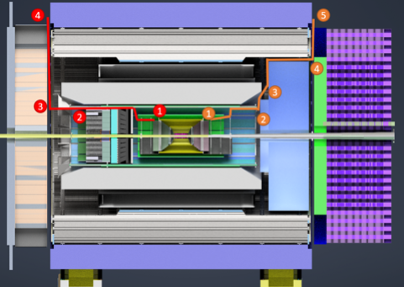
Technical Progress
Remember:
Fill excel-sheet at https://wiki.bnl.gov/EPIC/index.php?title=Project_Information
Define choke points
layout conduits
separate services, signal cables, HV&LV, cooling
calculate cooling current through HV and LV cables
Currently a factor 2-3 over space budget
→ will need to iterate
→ might need to integrate DC-DC
converters and other means to
split the HV & LV out inside the
detector
→ material budget
→ will meet with individual sub-
detector groups
For details see presentation at GDI 12th of December 2022

Slide 16
ePIC Readout Chain
Collaboration between ePIC DAQ/Electronics WG and Project Electronics & DAQ CAMs
Goal:
define readout chain for each subdetector
determine synergies between different subdetectors
determine what support is needed from the project in design of front-end-electronics
Global Timing Unit (GTU)
-Interface between collider, Run Control, & DAM
-Config & Control
-Clock & Timing
Computing
COTS / Ethernet
-Data buffering and sinking
-Run Control
-Calibration Support
-QA / Scalers
-Collider Feedback
-Event ID/Building?
-Software Trigger
-Monitoring
Name
Sharing
Function
Attributes
Sensor
Detector Specific
-Multi-Channel
Sensor
-MAPS
-AC-LGAD
-MCP-PMT
-SiPM
-LAPPD
Adapter
Detector Specific
-HV/Bias distribution
-HV divider
-Interconnect routing
-Sensor Specific
-Passive
Front End Board
(FEB)
Detector Specific
-Amplification
-Shaping
-Digitization
-Zero Suppression
-ASIC/ADC
-Discrete
-Serial Link
Readout Board
(RDO)
Shared / (potential variations)
-Communication
-Aggregation
-Formatting
-Data Readout
-Config & Control
-Clock &Timing
-FPGA
-Fiber Link
Data Aggregation Module (DAM)
Shared / (FELIX)
-Computing Interface
-Aggregation
-Software Trigger
-Clock & Timing
-Config & Control
-Large FPGA
-PCIe
-Potentially Ethernet

Slide 17
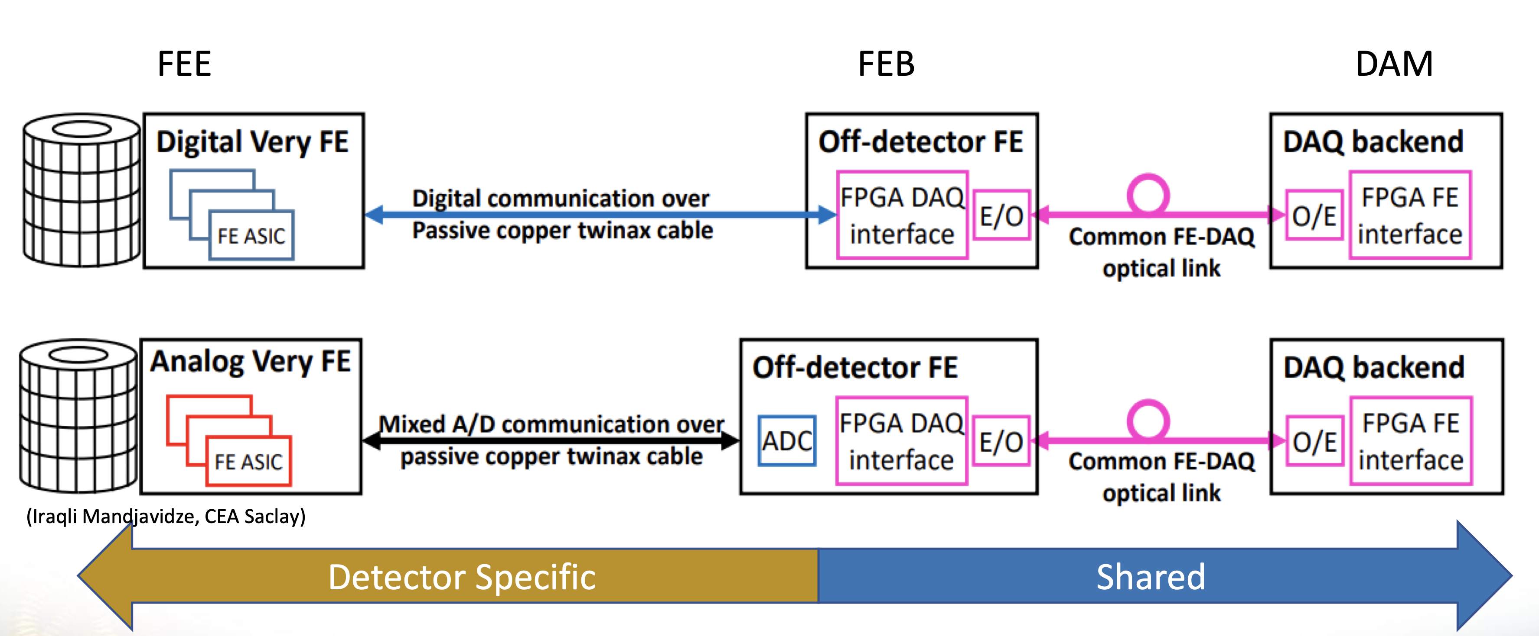
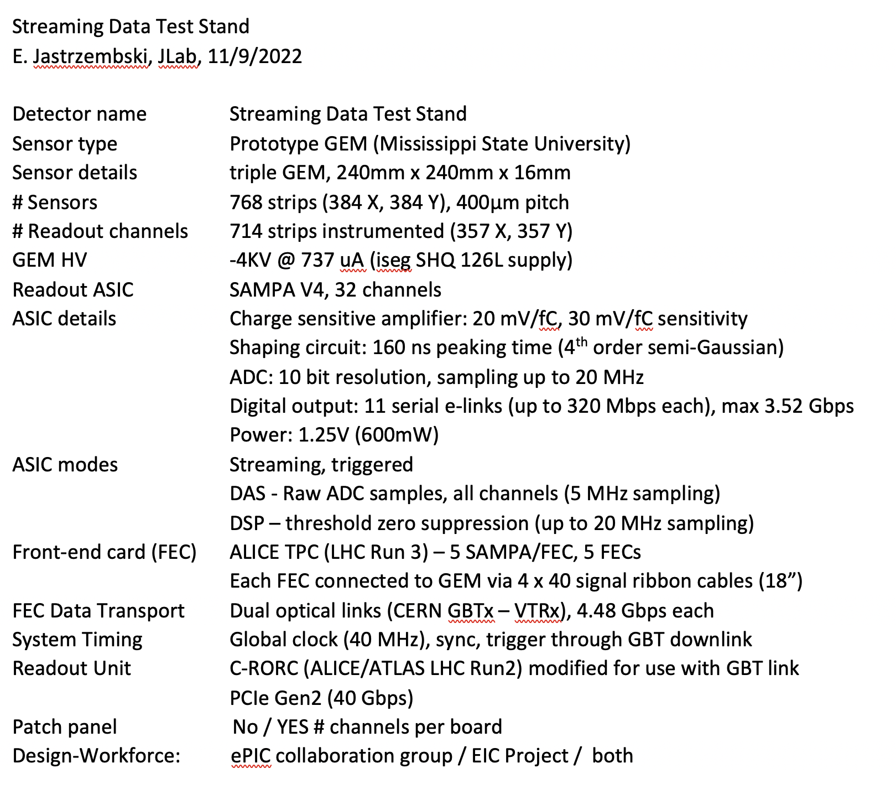
Next “ePIC – Project” Project: Subdetector Readout Chains
Have integrate read-out chain questionnaire for all subdetectors following this example to be filled by experts in the service excel-sheet
FEB
RDO
All linked to:
https://wiki.bnl.gov/EPIC/index.php?title=Project_Information#Documents%3A
Deadline: 9th of January 2023
Sensor
detector specific
FEB:
detector specific
RDO:
hopefully one board
common to many
subdetectors

Slide 18
Background Taskforce
Need info on is the current machine design for vacuum and SR good enough to operate ePIC → questions during technical reviews
  need SR rate in detectors
  beam gas background rates
  total hadronic and electromagnetic radiation load
  neutron fluence → SIPMs, Silicon, ….
  impact on track seeding and finding
  overall rates as fct. of η and Φ
  …………
formed a taskforce of people working on these tasks at the project and ePIC
Jarda, Zhengqiao, Alex, Kolja, Joe, Jae, Wouter, David L., Rey, Benjamin, Jakub, Elke
welcome everybody who wants to do concrete work
have met three times till now Friday 12/2 & 12/16 9:30 am, and Friday 01/6th
will report results to ePIC GDI and respective detector WGs and Project Accelerator WG
Wiki: https://wiki.bnl.gov/EPIC/index.php?title=Background
Indigo: https://indico.bnl.gov/category/461/
Mattermost: https://eic.cloud.mattermost.com/main/channels/background-embedding
email-list coming
For more details see Rey’s talk

Slide 19
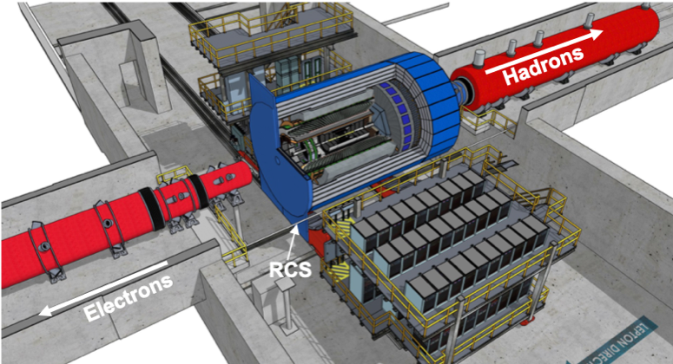
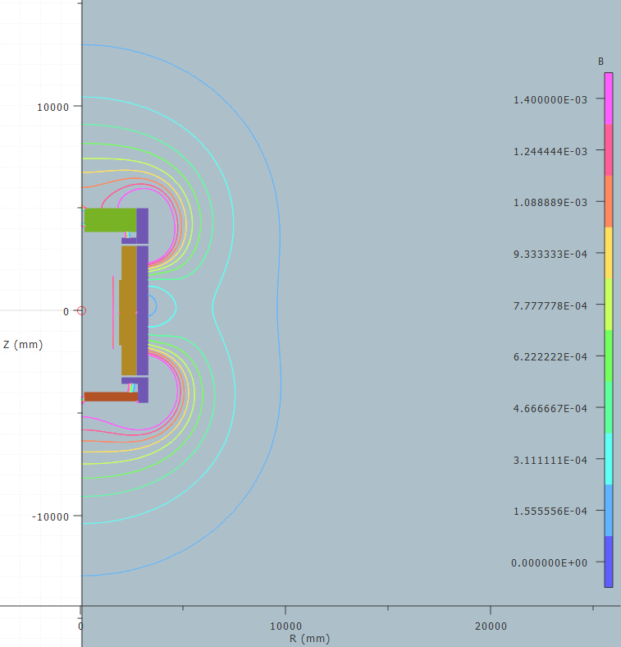
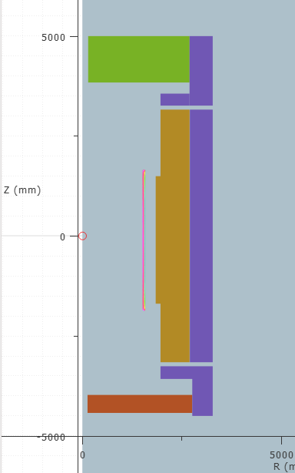
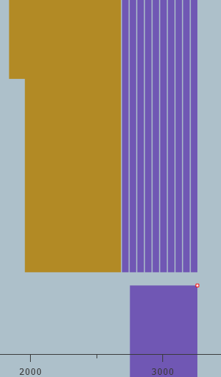
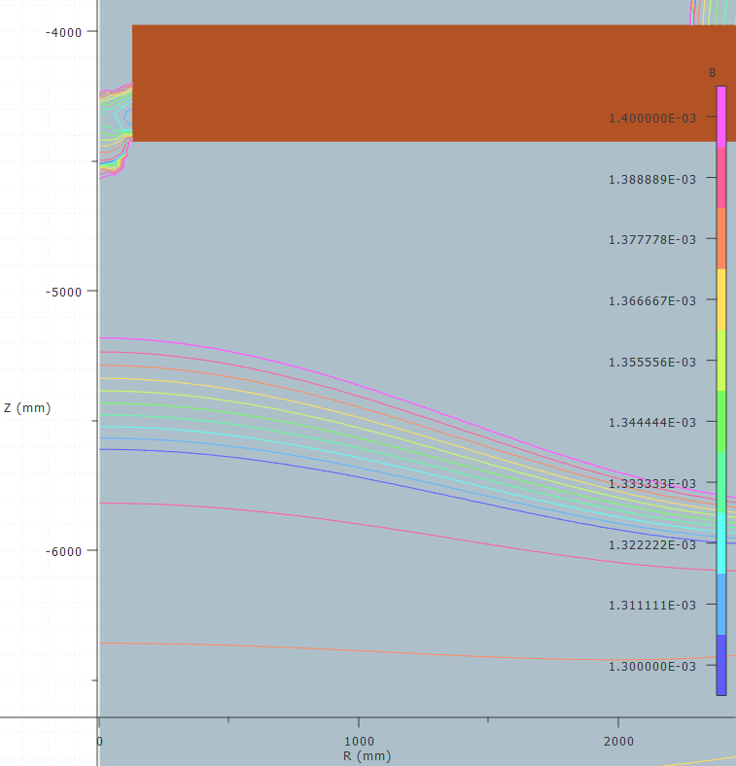
Flux Return layout
Requirement for fringe field: <10 Gauss at forward and backward side
and at RCS location
Challenges detector design not symmetric
→ critical that forces get balanced
Consequences on design:
backward HCal moved as far back as possible
add both sPHENIX flux return doors behind bHCal
forward HCal need to have first tungsten
plates and then steel ones
add additional steel around barrel HCal
layered barrel extra flux return
6 layers 50 mm steel 40 mm air
Reach 14 gauss and lower

Slide 20
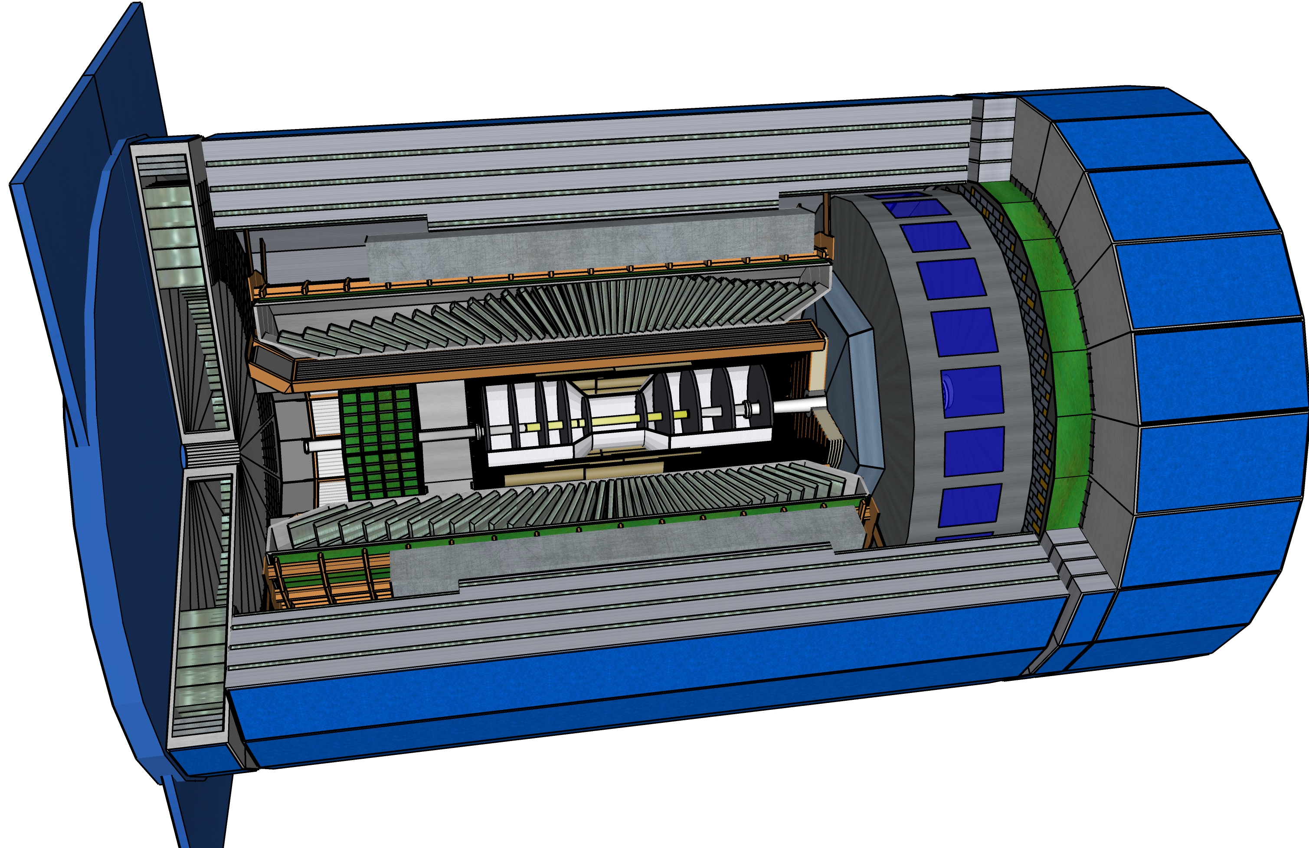
New Release Geometry Database & SketchUp
The geometry database has been updated as follows:
  Consistency with CAD (Tanja, with input from Roland W, Elke)
  Included dynamic model for Si tracker (Walt A., with input from Ernst S)
  Included initial model for MPGD MicroMegas (Walt A.)
  Updated backward EMCal and beam pipe with custom made flange (Carlos Munoz C et al)
Release information will be on the menagerie: https://eic.jlab.org/Geometry/Detector/
  Perhaps some further minor fixes this week taking advantage of experts on site

Slide 21


Slide 22


Slide 23
(Draft) TDR – more details on section on Experimental Systems
.
8.1 Experimental Equipment Requirements Summary (like CDR 8.2)
8.2 General Detector Considerations and Operations Challenges (YR 10 and CDR 8.3)
8.2.1 Beam Energies, Polarization, Versatility, Luminosities (like YR 10.1)
8.2.2 Rates and Multiplicities (like CDR 8.3.1)
8.2.3 Interaction Region Integration, Vacuum and Backgrounds (like CDR 8.3.2)
8.2.4 Systematic Uncertainties (like YR 10.5)
8.3 EPIC Detector CAM(s) and collaboration contact(s)
8.3.1 Magnet For each subsection end with R&D and design maturity
8.3.2 Tracking
8.3.3 Electromagnetic Calorimetry
8.3.4 Hadronic Calorimetry
8.3.5 Particle Identification
8.3.6 Far-Forward Detectors
8.3.7 Far-Backward Detectors
8.3.8 Polarimetry and Luminosity Detector
8.3.9 Readout Electronics and Data Acquisition
8.3.10 Software, Data Analysis and Data Preservation (EICUG SWG?)
8.4 Detector R&D Summary
8.5 Detector Integration (Walt, Rahul, Tim/Christian, Fernando, Roland, Elke, Rolf)
8.5.1 Experimental and Assembly Hall Infrastructure (like CDR 8.7.1, YR 13.1)
8.5.2 Interaction Region and Protection (include also YR 13.2)
8.5.3 Support Frames and Installation Fixtures (new, ask Roland and Walt to draft?)
8.5.4 Detector Alignment (like YR 13.4)
8.5.5 Schedule and Installation (like CDR 8.7.2, YR 13.3)
8.5.6 Access and Maintenance (like CDR 8.7.3, YR 13.5)
8.5.7 System Engineering and Interface Controls (links to later global Section 12 on System Engineering)
8.6 Detector Commissioning and Pre-Operations

Slide 24
Accelerator Technical Change Control Process
Example based on EIC accelerator
This procedure shall be invoked if any of the following conditions are met:
The change will result in changing of a global design parameter from the list below:
  beam energy
  range of beam energy
  design luminosity
  design polarization
  bunch frequency
  bunch charge
  beam-beam parameters including crossing angle
  major technology changes for magnets, RF, vacuum, instrumentation and controls
The change will require a cost change which is greater than 5M $ or 20% of the contingency fund in its WBS level 3 category.
The change will affect the design progress of systems in other WBS level 2 categories.
The change may cause a schedule delay of more than 30 days.
The change will constitute an increase of performance risk of 10% measured in integrated luminosity, or cost risk which is greater than 20 M$ or 60% of the contingency fund in its WBS level 3 category or a schedule risk of greater the 60 days.
This is used for EIC accelerator scope presently. The latter bullets will need to be modified after CD-2 as cost and schedule contingencies are not defined system by system anymore, and the various numbers used are moot.

Slide 25
Technical Change Control
Initiating Stage
  A proposed change initiated by a requester
  The change is discussed among home WBS level 3 and level 2 category
Preparation Stage
  The requester generates the form and collects all supporting material
  Pre-TCCB review if needed
Review Stage
  All material regarding the change is submitted to the TCCB
  TCCB review meeting
  TCCB provides recommendations
Complete Stage
  TCCB submits recommendations to the EIC Technical Director
  New baseline announced if change accepted
  Case documented
Requester
TCCB Board
TCCB Chair + TD
This is used for EIC accelerator scope.
An equivalent for EIC detector may make direct use of technical work done within ePIC collaboration.

Slide 26
DOE Order Change Control Process
Not for the faint of heart…

Slide 27
Baseline Change Control – from Project Execution Plan
Tim Hallman/DOE-NP
Robert Caradonna
Jim Yeck/EIC Project
Changes in technology require DOE Federal Project Director approval.
After baselining contingency is owned by DOE – they need to approve use.
You build management reserve (MR) by having items come in below estimate.

Slide 28
Baseline Change Control – from Project Execution Plan
After baselining schedule contingency is also owned by DOE

Slide 29
Baseline Change Control – from Project Execution Plan

