Slide 1
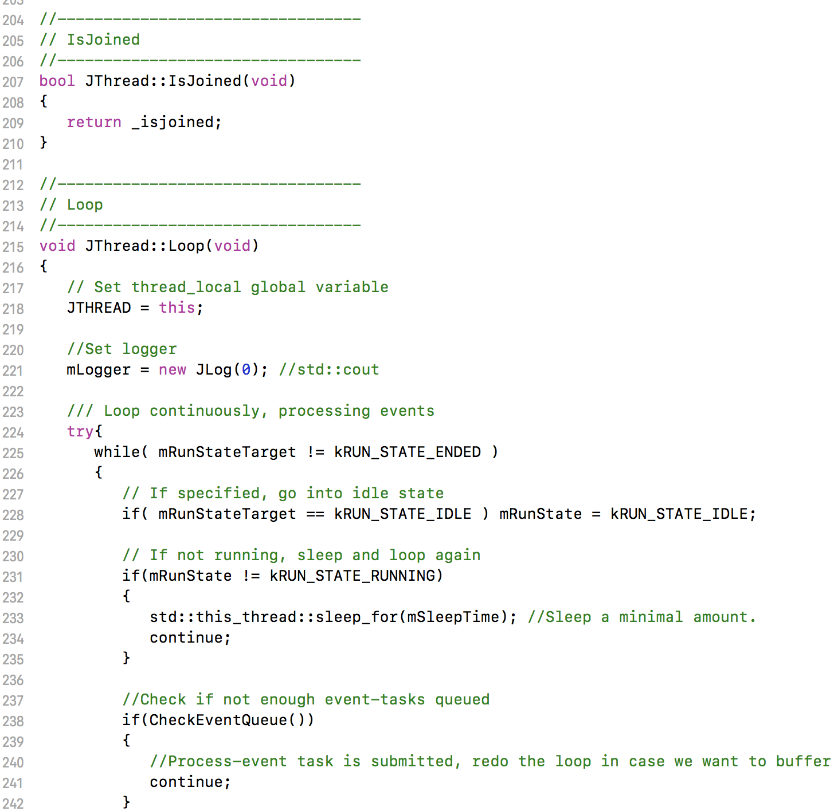
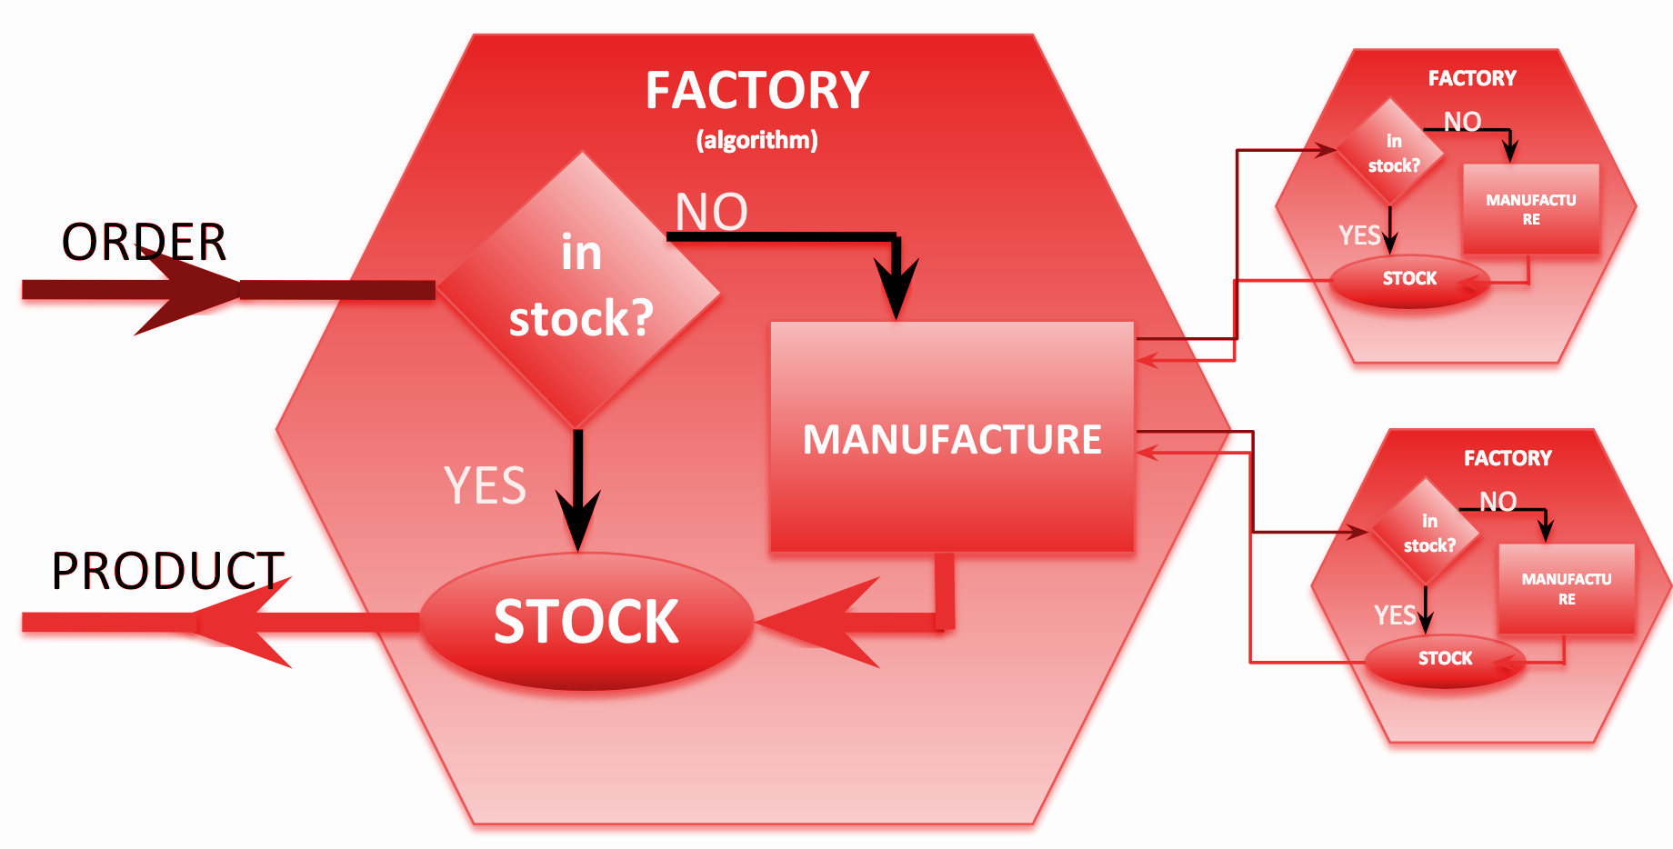
Heterogeneous Computing and SRO in JANA2
Nathan Brei
Jefferson Lab
January 9, 2023
ePIC Collaboration Meeting
JANA2: Multi-threaded Event Reconstruction - David Lawrence - JLab - HSF Framework WG Apr. 1, 2020

Slide 2
What is JANA2?
JANA is a multithreaded reconstruction framework project with nearly 2 decades of experience behind it, written in optimized low-level C++.
JANA2 is a rewrite that incorporates modern CS practices. Aims to be clean, lightweight, and user-friendly. “Paying off technical debt”
JANA2 introduces an innovative dataflow parallelism paradigm under the hood, which has implications for streaming readout and heterogeneous hardware utilization
Projects using JANA
GlueX
INDRA-ASTRA (near-realtime calibrations using AI/ML)
BDX
TriDAS (+ERSAP) + JANA2 Streaming DAQ

Slide 3
JANA’s Role in Data Processing
C++ objects
(low level)
C++ objects
(refined)
DAQ
stream
obj
reconstruction algorithms
obj
stream
obj
track
or
hit
track
track
or
raw data files
JANA
reconstructed data files

Slide 4
cloud services
Services:
geometry
configuration
calibration
I/O
logging
Plugins:
Stream Monitoring
Benchmarking
DST writer
…
Conditions DB
Calibrations DB
Resources:
Field Maps
Material Maps
AI/ML Models
…
Common Algorithms:
digitization
clusterizer
tracking
PID
…
Configuration:
User supplied (custom)
Simulation
Real data
Bench tests
…
external packages
Geometry
DD4hep
ACTS
Detector Specific:
EcalEndcapN
HcalEndcapN
HPDIRC
…
Utilities:
Background event merger
cull_events
geometry query
…
Data Model
PODIO
JANA2

Slide 5
cloud services
Services:
geometry
configuration
calibration
I/O
logging
Plugins:
Stream Monitoring
Benchmarking
DST writer
…
Conditions DB
Calibrations DB
Resources:
Field Maps
Material Maps
AI/ML Models
…
Common Algorithms:
digitization
clusterizer
tracking
PID
…
Configuration:
User supplied (custom)
Simulation
Real data
Bench tests
…
external packages
Geometry
DD4hep
ACTS
Detector Specific:
EcalEndcapN
HcalEndcapN
HPDIRC
etc
Utilities:
Background event merger
cull_events
geometry query
…
Data Model
PODIO
JANA2

Slide 6
Multi-threading in JANA2
A complete set of factories is assigned to an event giving it exclusive use while that event is processed
thread
Event Source
thread
Factories only work with other factories in the same thread eliminating the need for expensive mutex locking within the factories
Event Processor
All events are seen by all Event Processors (multiple processors can exist in a program)
thread
thread

Slide 7
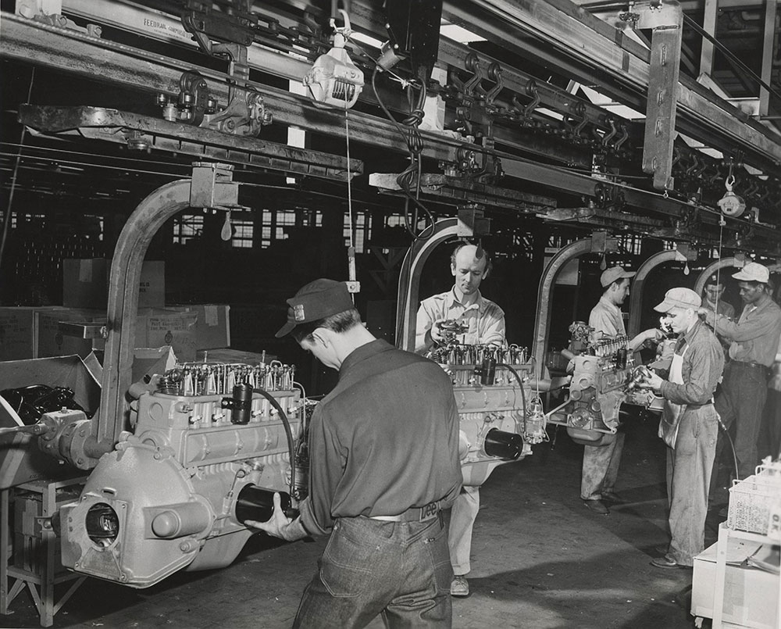
Looking under the hood: Dataflow Parallelism
JANA2 avoids locks in favor of a network of ‘queues and arrows’.
This is analogous to an assembly line in a real-world factory
Each worker (thread) is assigned an arrow, conceptually like a conveyor belt
Arrows can be either sequential (only one worker at a time) or parallel (many workers can perform these tasks at once)
Between each arrow lies a queue. Workers don’t need to coordinate with each other, just pick up new tasks off their input queue and put finish tasks onto their output queue.
If a queue backs up, some of the workers move to a different arrow (backpressure!)

Slide 8
A graphical notation for queues and arrows
Arrows are allowed produce a different number of output objects than they consume, and to choose from different output queues
This allows us to do things like
Split/merge
Gather/scatter
Filtering
Streaming joins
This lets us have different units of parallelism at different points in our computation
Event blocks
Events
Subevents
Sequentially, read events from input file (e.g. sim or DAQ)
In parallel, run all algorithms for one event (in parallel)
Sequentially, write events to output file

Slide 9
Event blocks
Problem: GlueX stores entangled events. Disentangling is expensive and ought to be done in parallel. In the current GlueX codebase, this is accomplished by a separate thread team that JANA knows nothing about.
Solution: Flatmap pattern:
block_source.get :: () -> block
block_source.disentangle :: block -> [event]
Read event block
Disentangle (split) block into individual events
Write processed event
Process event

Slide 10
SRO: Event selection and filtering
Det A
Det B
Recon. Tracks
“event t1eN”
“event t2e1”
“event t2e2”
“time slice 1”
“time slice 2”
Timeslices
Timeslices
(+ tracks, clusters)
Event
candidates
Events
(+jets, kin fits)
Read stream of time slices
Reconstruct
Select events
PID, filter
Write DST/histos
of events
https://arxiv.org/abs/2202.03085 Streaming readout for next generation electron scattering experiments
https://doi.org/10.1051/epjconf/202125104011 Streaming Readout of the CLAS12 Forward Tagger Using TriDAS and JANA2
https://doi.org/10.1051/epjconf/202024501022 JANA2 Framework for Event Based and Triggerless Data Processing
https://doi.org/10.2172/1735849 Evaluation & Development of Algorithms & Techniques for Streaming Detector Readout

Slide 11
Het Hardware: Subevents/Event collating
Problem: Offloading the data to a GPU/TPU/etc is a sequential bottleneck! We want to batch our data so that we can utilize the full parallelism of the heterogeneous hardware.
Solution: Split/merge pattern:
Split each event into subtasks
Batch subtasks together, possibly across event boundaries
Send the batched subtasks to the hardware and wait for the results
Attach the subtask results to their corresponding event
event
event
recon
recon
split
merge
offload
subevent output
CPU
subevent input
GPU
subevent

Slide 12
Next steps for JANA+SRO+HetHW
EIC ML+FPGA R&D project with Sergey Furletov & Dmitry Romanov
PHASM LDRD project
A toolkit for creating AI surrogate models of legacy code
Tight integration with JANA
Performance analysis of offloading onto heterogeneous hardware
Continuing support for EICRecon, GlueX
First-class PODIO, key4hep support

