Slide 1
Tracker Performance Simulations
L. Gonella, P. G. Jones, S. Maple, P. R. Newman

Slide 2
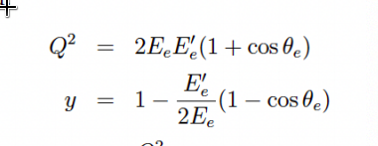
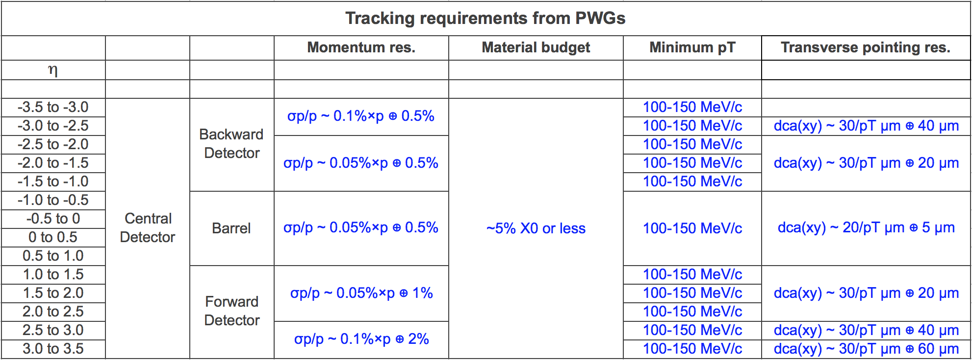
Tracking requirements
High precision tracking measurements required for EIC physics program
Precise measurement of scattered electron (or hadrons) to reconstruct DIS kinematics
Momentum measurements for e.g. invariant mass resolution, E/p etc
Jet measurements (need tracks for particle-flow)
Determination of primary vertex, secondary vertex separation
EPIC tracker design informed by desire to meet momentum and DCA_{T} requirements set by physics working groups
1

Slide 3
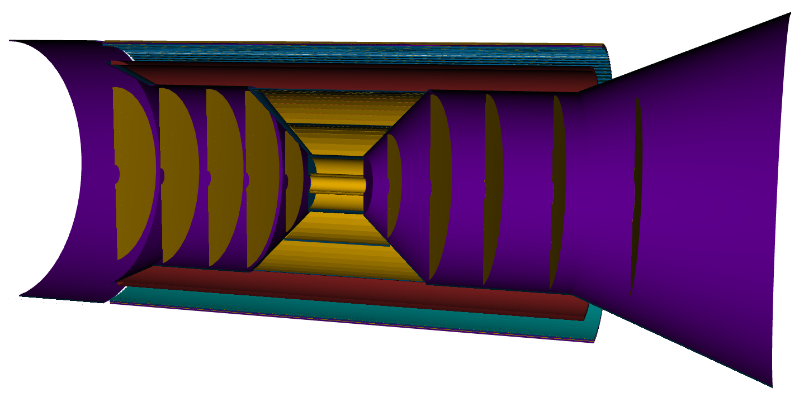
Tracker Simulation Configuration
Results shown in following slides use the single pion simulation files available on S3 (EPIC Brycecanyon 22.11.2)
Simulation geometry defined with layers positioned as detailed in summary talk
Pions of energies between 100MeV and 20GeV fired from particle gun at origin
Hits recorded and tracks reconstructed with EICrecon/Juggler* (ACTS)
5 “backward” Si disks
Service cones + cylinders
Note: Hits in the ToF are not used during track reconstruction in these simulations
Barrel AC-LGAD ToF
MPGD Barrel
5 Si Barrel layers
5 “forward” Si disks
1

Slide 4
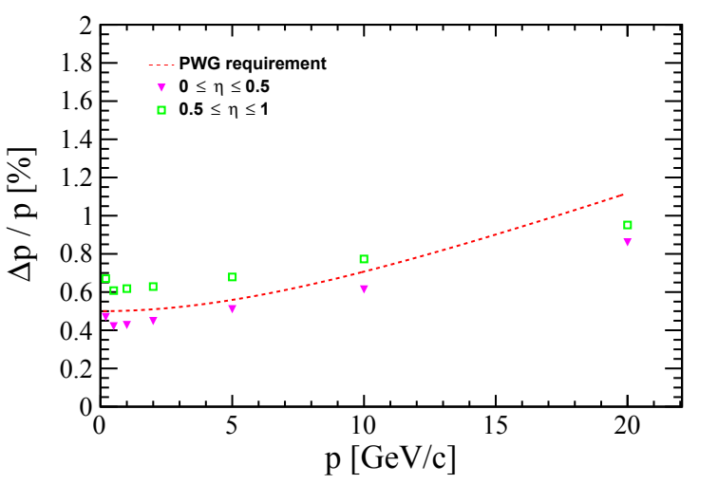
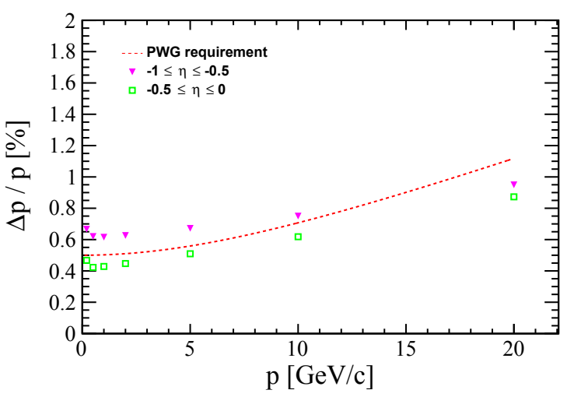
Relative Momentum Resolution (Central)
PWG requirement met for |η| < 0.5 for all momenta
Requirement not met for 0.5 < |η| < 1
Note: Service cone begins at η = 0.88 therefore extra material seen in range 0.5 < |η| < 1
Requirement met for -0.88 < |η| < 0.88 (see backup)
Hadron going
Electron going
1

Slide 5
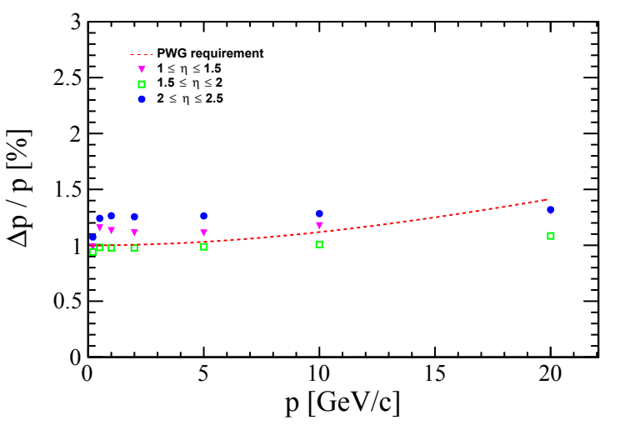
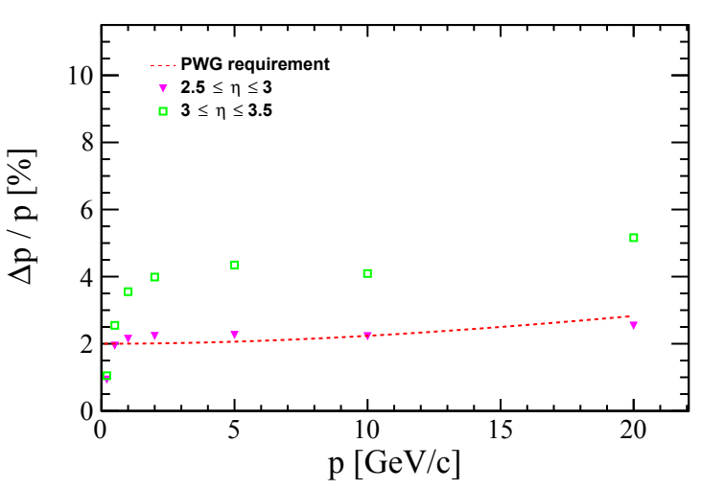
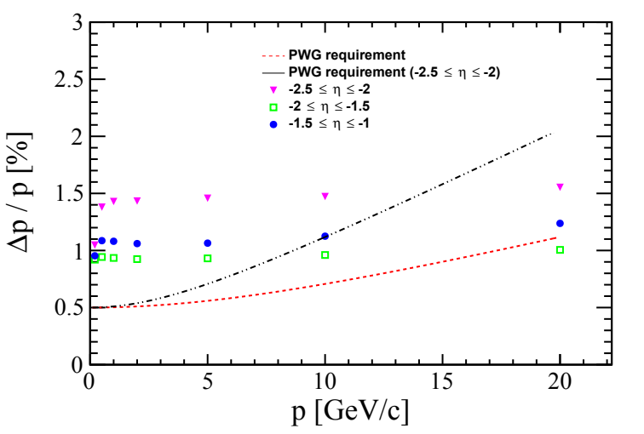
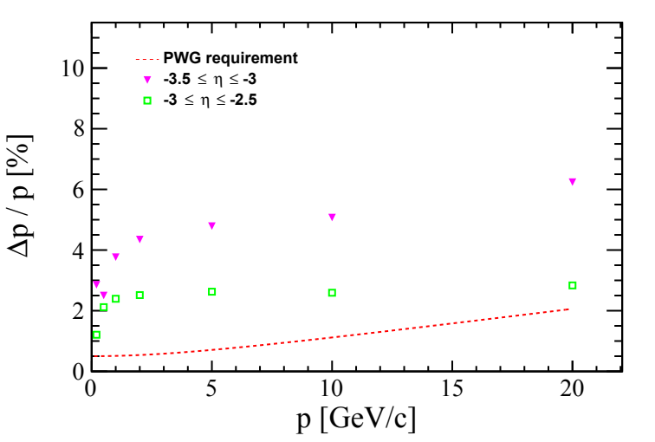
Relative Momentum Resolution (Forward/Backward)
Smaller lever arm for disks in the electron going direction → worse resolution compared to hadron going direction
Different amount of support and service material crossed in different η ranges (See diagram in backup)
Fwd/Bwd requirements only met over full momentum range for 1.5 < η < 3
Different reqs for Fwd/Bwd
Hadron going
Electron going
1

Slide 6
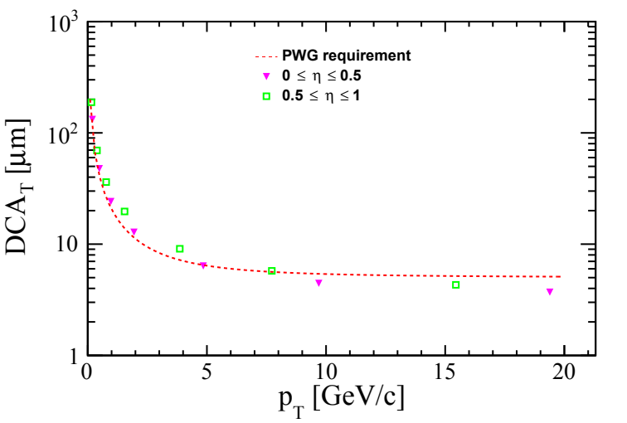
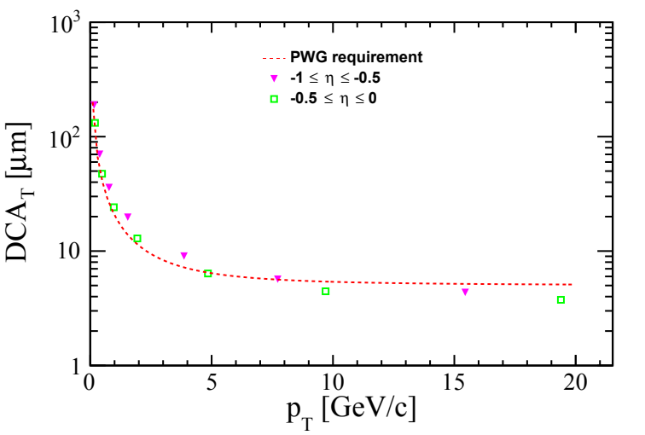
Transverse Pointing Resolution (Central)
Performance consistent with requirement for |η| < 0.5 at all momenta
Requirement not met for |η| > 0.5 in barrel region below ~8 GeV
Hadron going
Note: x-axes are p_{T} for DCA_{T} resolutions
Electron going
1

Slide 7
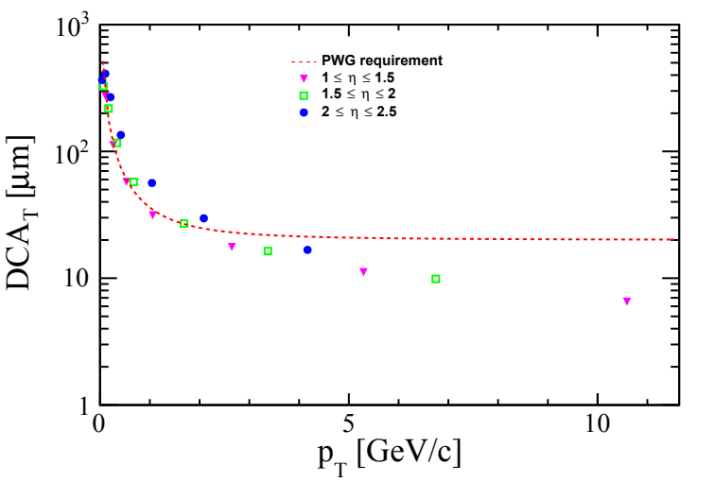
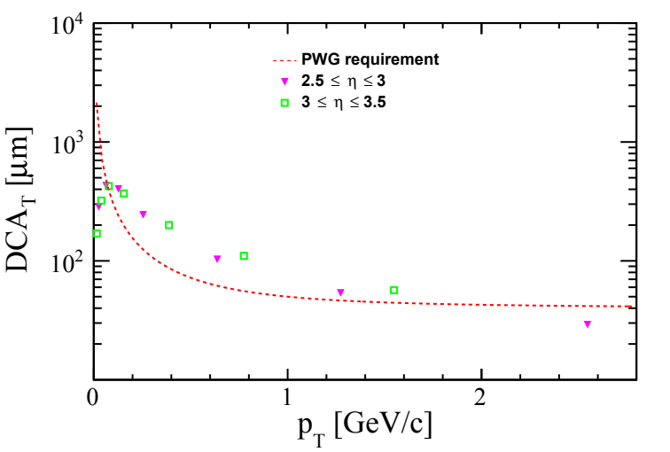
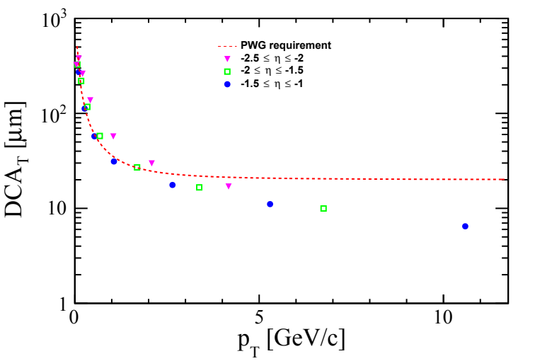
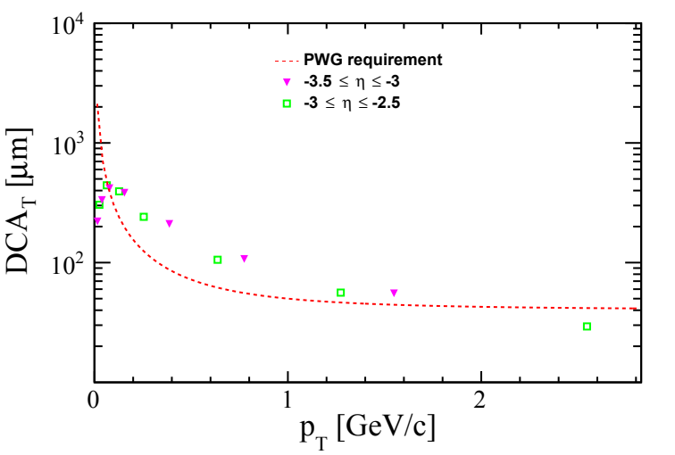
Transverse Pointing Resolution (Forward/Backward)
Fwd/Bwd pointing resolution consistent with requirements at all momenta for 1 < |η| < 2
Requirements met at |η| > 2 for p_{T} > ~2 GeV
Hadron going
Electron going
1

Slide 8
Summary
The measurements necessary for the EIC physics program impose stringent requirements on the momentum and pointing resolution of the EPIC detector
For both momentum and DCA_{T} resolution there are challenges meeting requirements in the forward and backwards directions, this has been the case for previous configurations studied in the yellow report and detector proposals
Effect from passive material on tracking and vertex performance is notable. Geometry description to be kept up to date with R&D progress on low material solutions
1

Slide 9
Backup

Slide 10
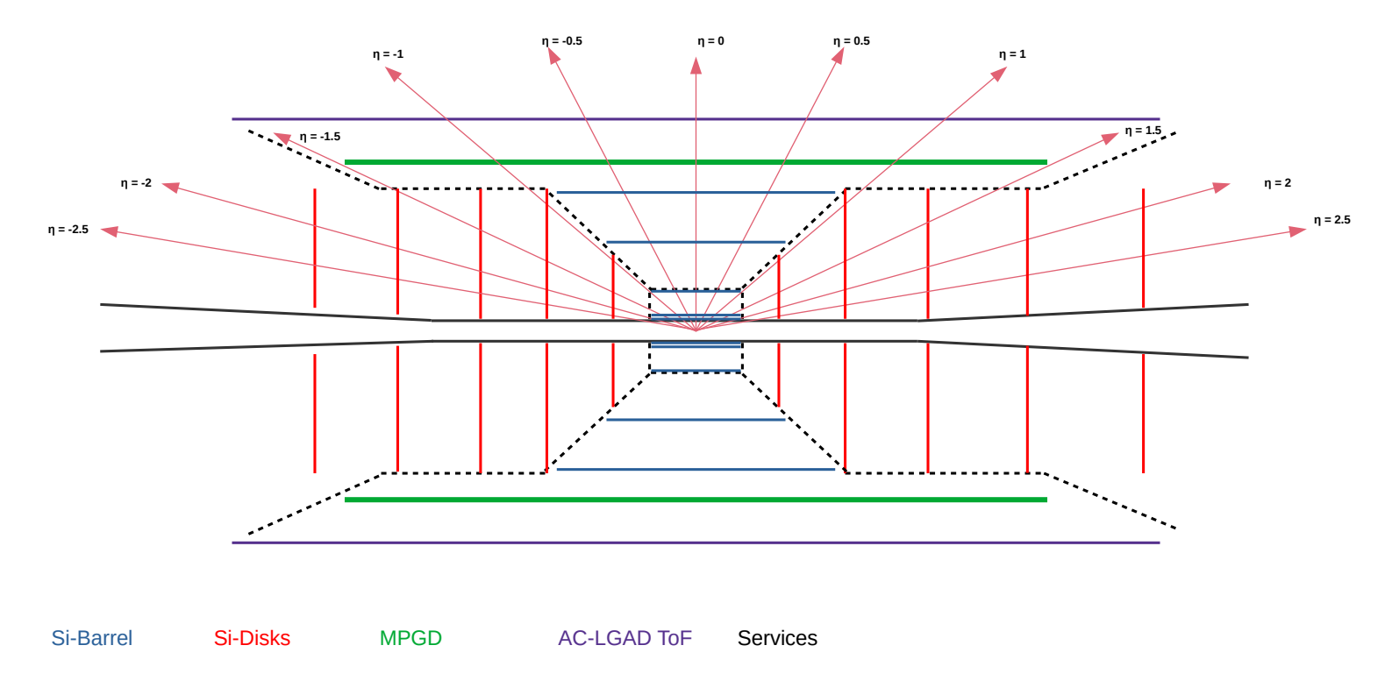
Detector layout
1

Slide 11
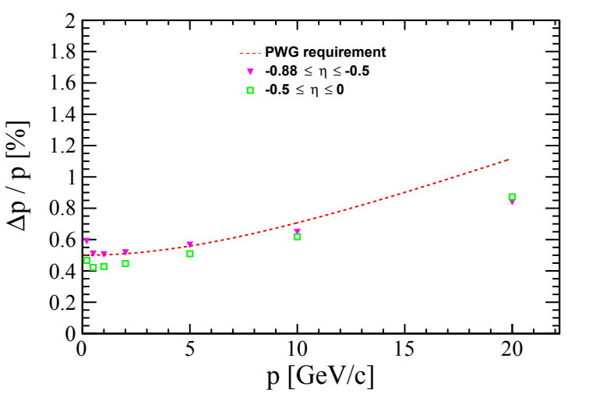
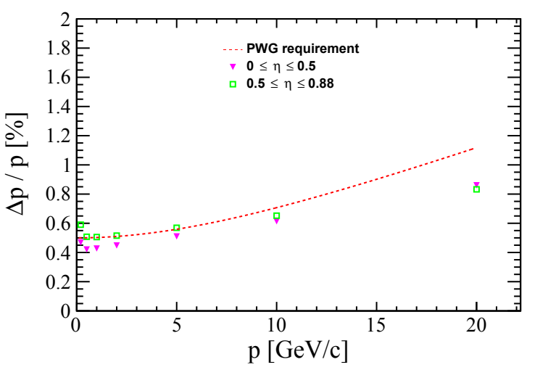
Before Support Cone Momentum Resolution
Momentum resolution consistent with requirements up to η=0.88 (support cone)
1

Slide 12
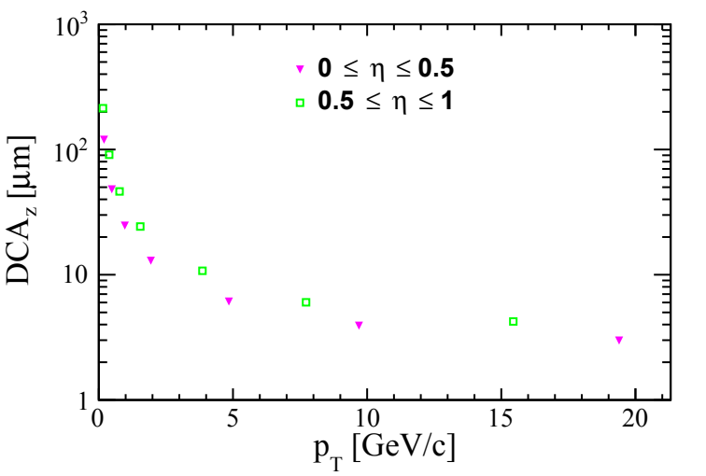
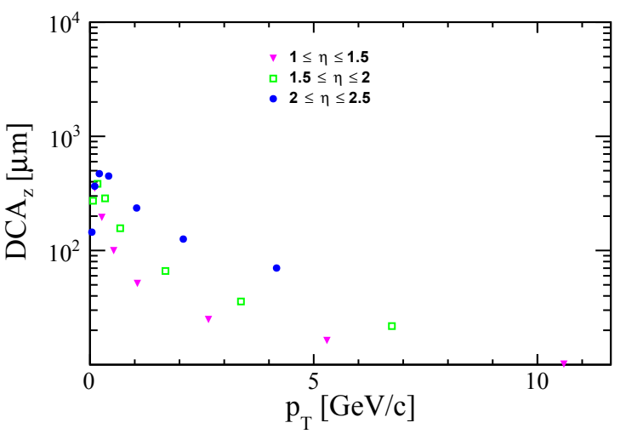
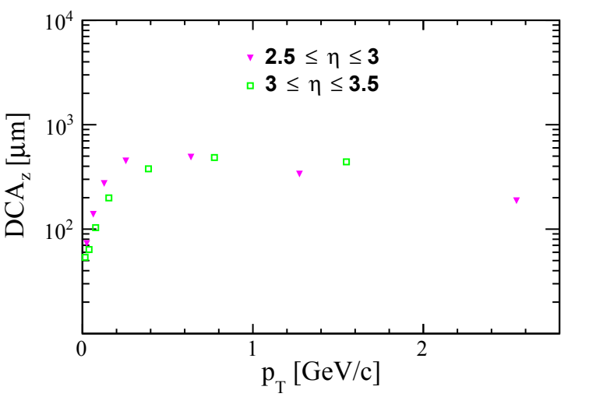
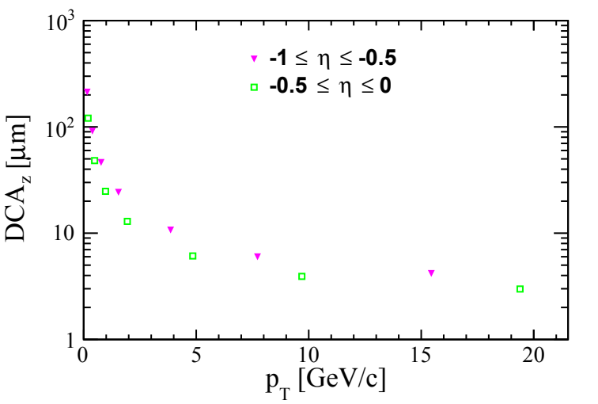
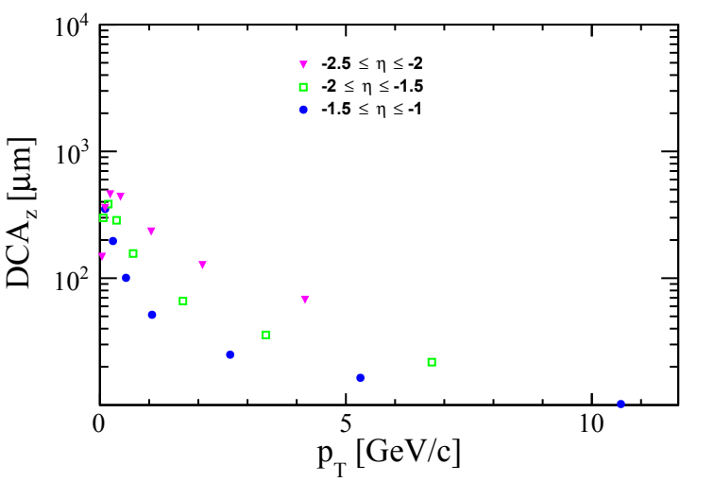
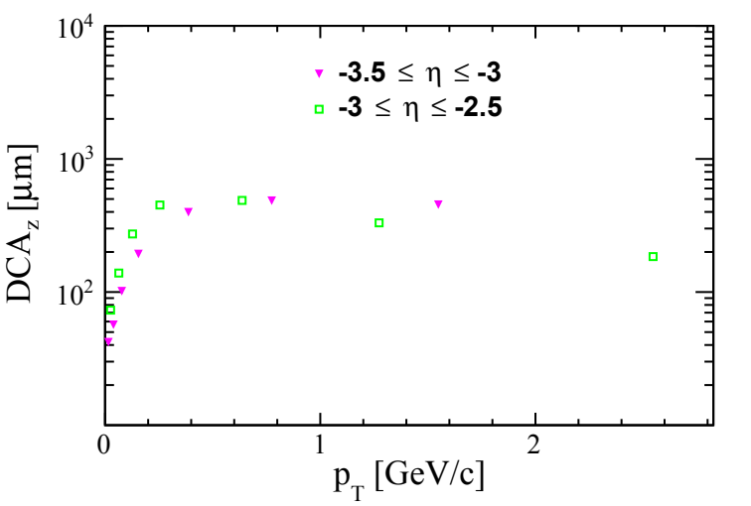
Longitudinal Pointing Resolution
1

Slide 13
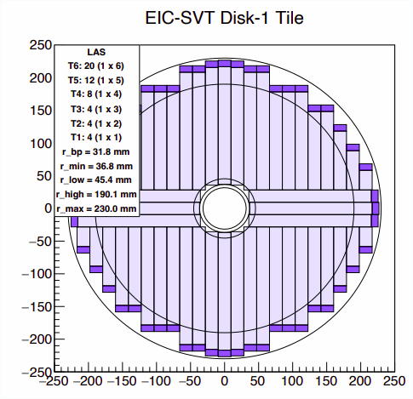
Acceptance around beampipe
Disks consist of tiles of ITS3-like sensors, with length and width determined by the ITS3 reticle
The result is that the inner opening of the disks is not perfectly circular → instead they are squared off
This means that there isn’t full azimuthal acceptance at the inner radii we’ve been using (beampipe radius +5mm)
Realistic disks
Disks in simulations
* P. G. Jones https://indico.bnl.gov/event/15486/contributions/62590/attachments/40656/67919/EIC-Sensors-Jones.pdf
1
1

Slide 14
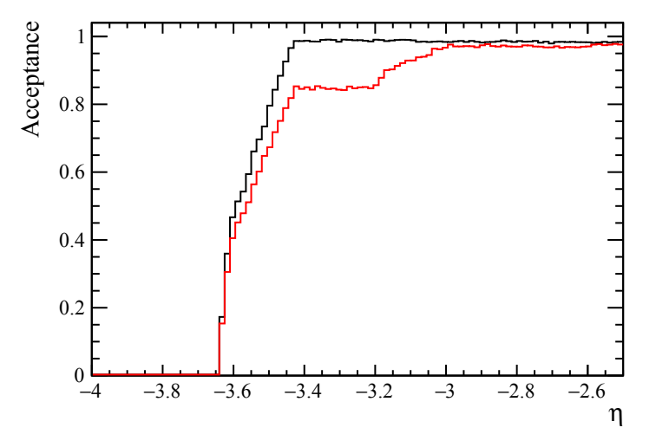
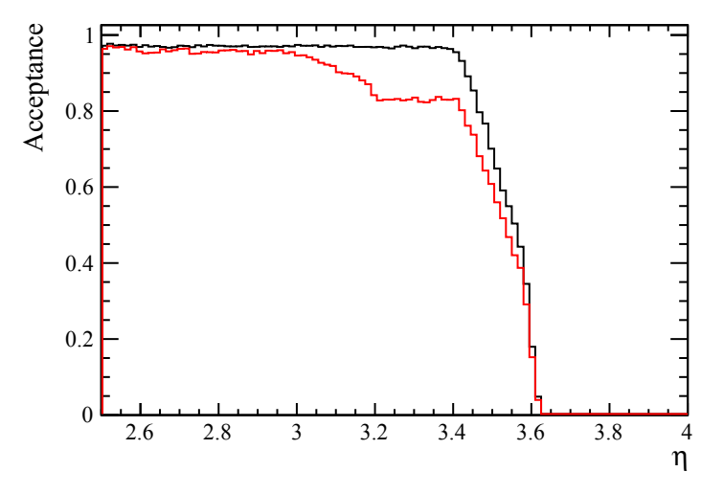
Disk acceptance vs η
Implemented disk modules in Fun4All with inner cutouts in the same shape as the “realistic” disks as produced by the tiling algorithm
Particles propagated by Geant4, tracks reconstructed by Genfit (instead of ACTS)
Generated events in far forward/backward region and studied acceptance in η bins:
$Acceptance=\frac{Numberofeventswithatleast3hits}{Totalnumberofevents}$
95% efficient disks
100% efficient disks
1
1

Slide 15
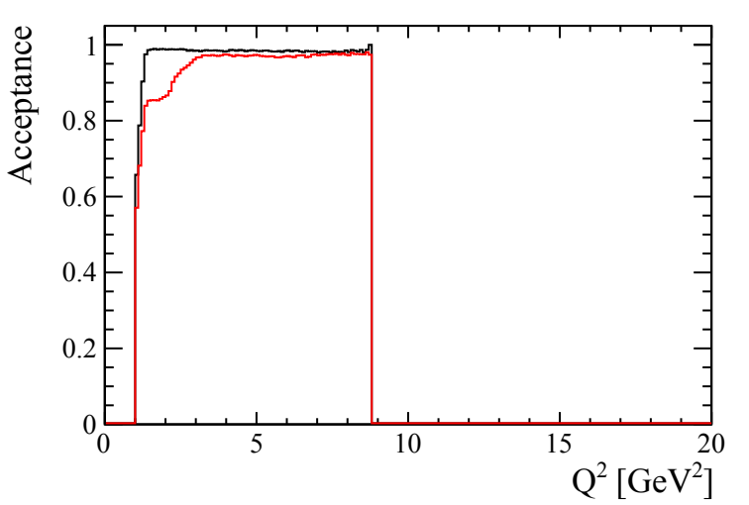
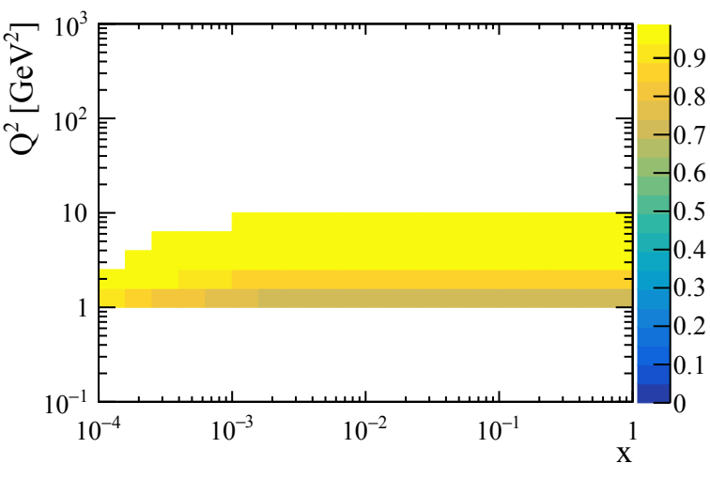
Disk acceptance vs (x-)Q²
Considered only 18x275 GeV² NC-DIS events (Pythia8, Q² > 1 GeV²)
Scattered electron mapped to relevant η bin and weighted number of reconstructed events by acceptance in this η bin and recorded x-Q² for the event → Acceptance here is fraction of events reconstructed in a given x-Q² range
Higher x lower Q² bins lose acceptance
95% efficient disks
100% efficient disks
95% efficient disks
100% efficient disks
Acceptance > ~80% for all bins Q²>1GeV² for 100% efficient disks
1

Slide 16
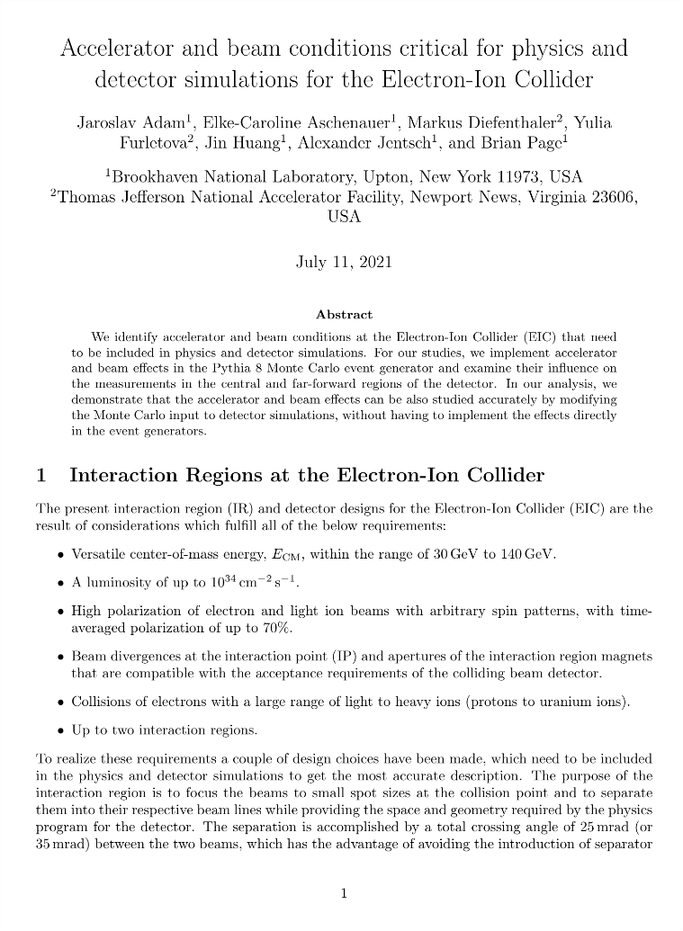
https://github.com/eic/documents/blob/master/reports/general/Note-Simulations-BeamEffects.pdf
Effect of beamspot on tracking performance
A very helpful report on beam conditions at EIC was produced last year
This included a transport model which allows one to obtain the primary vertex distribution in terms of x, y, z
→ Generated single particle events in Fun4All with the origin vertex distributed according to these distributions
1

Slide 17
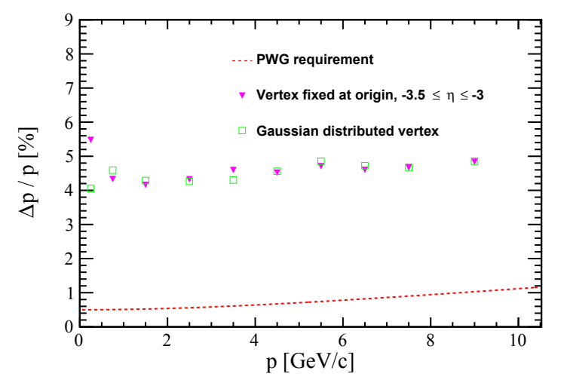
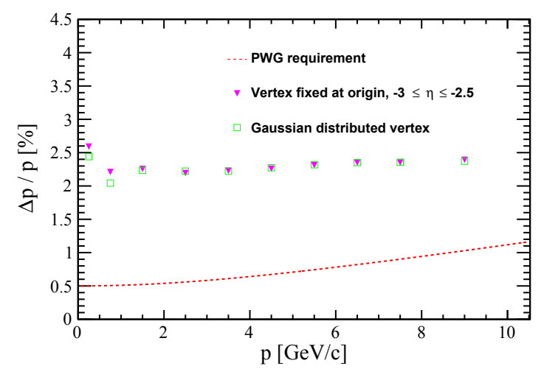
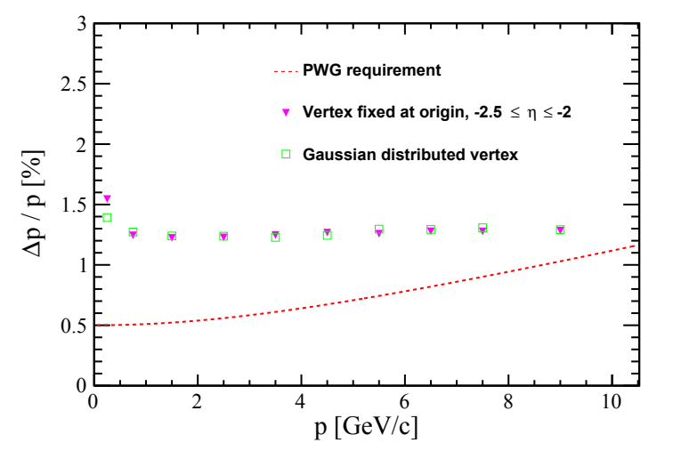
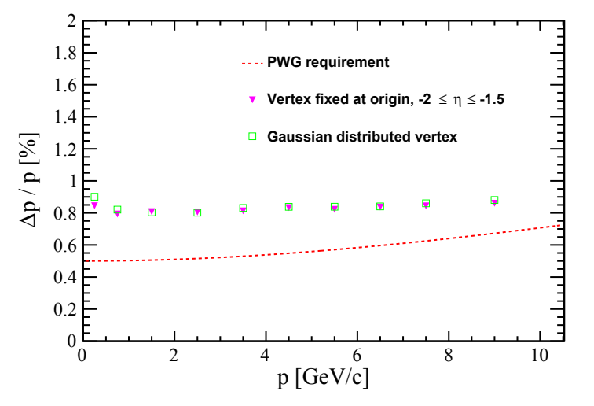
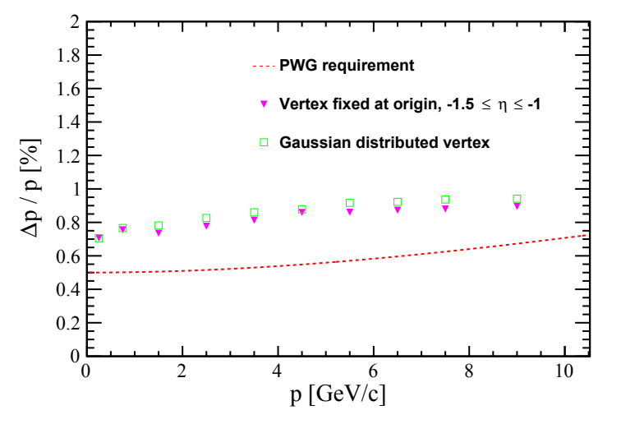
Momentum resolution - Backward
A very small loss of performance for -1.5<η<-1, with other regions being mostly the same
1

Slide 18
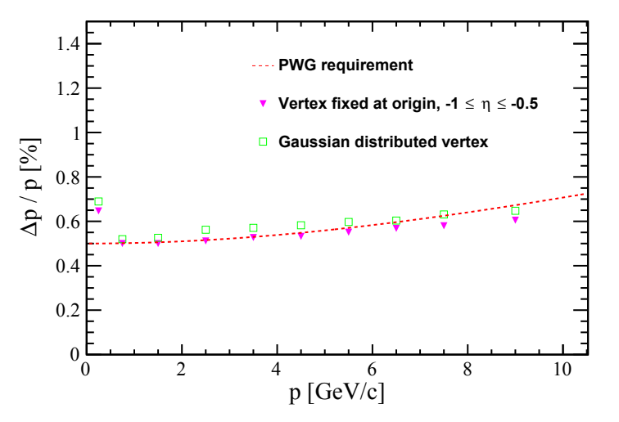
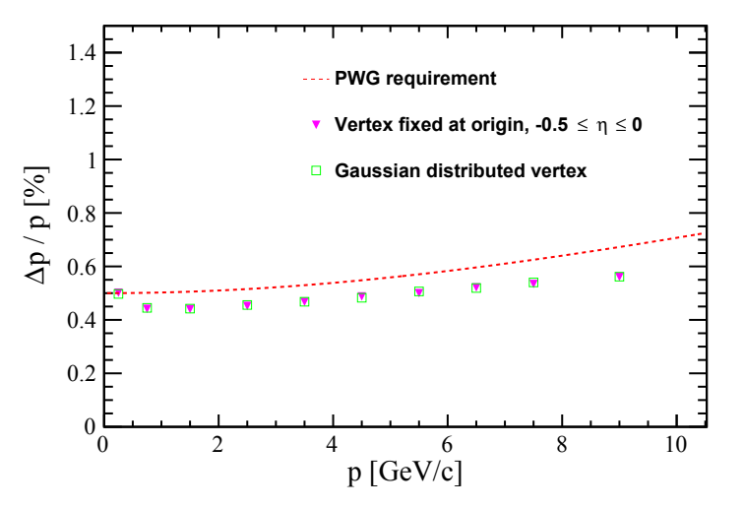
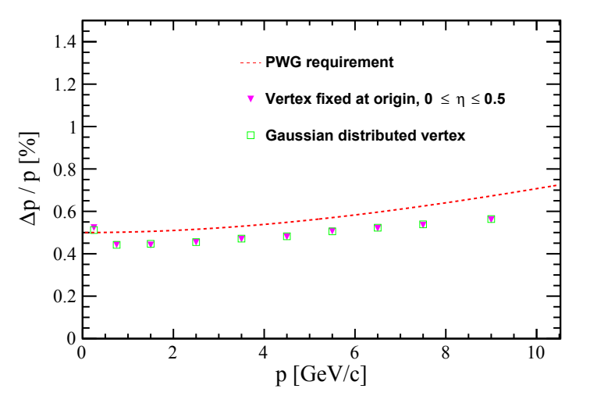
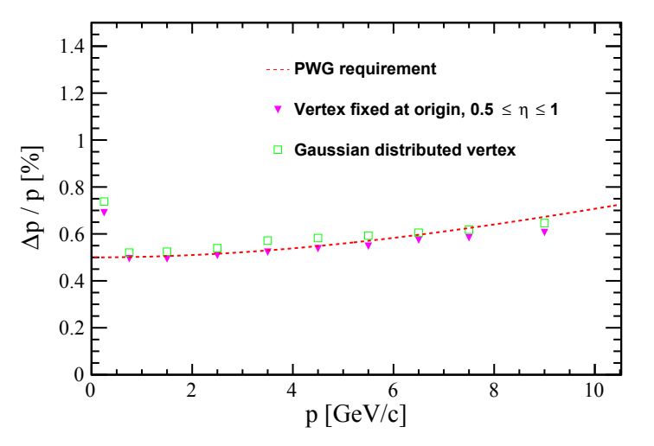
Momentum resolution - Central
Small difference in performance for 0.5<|η|<1
1

Slide 19
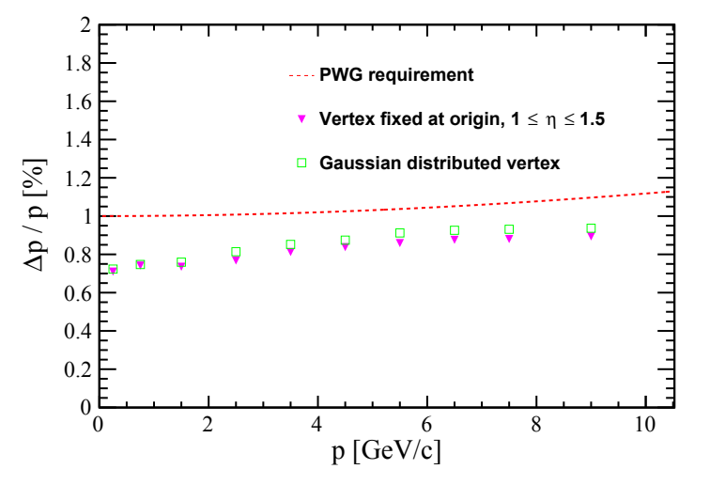
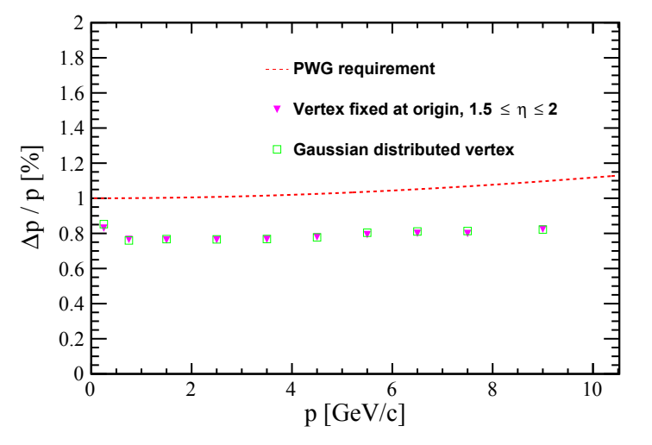
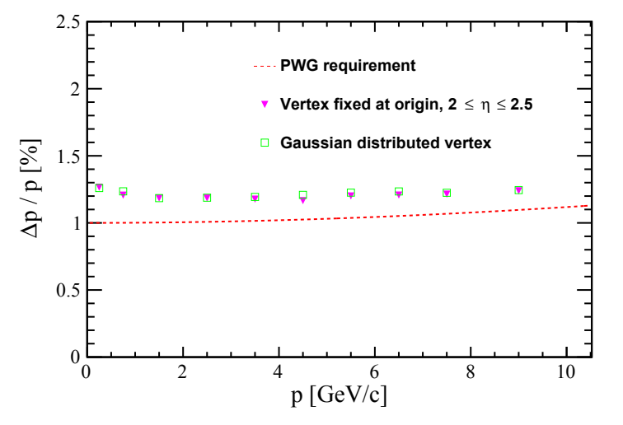
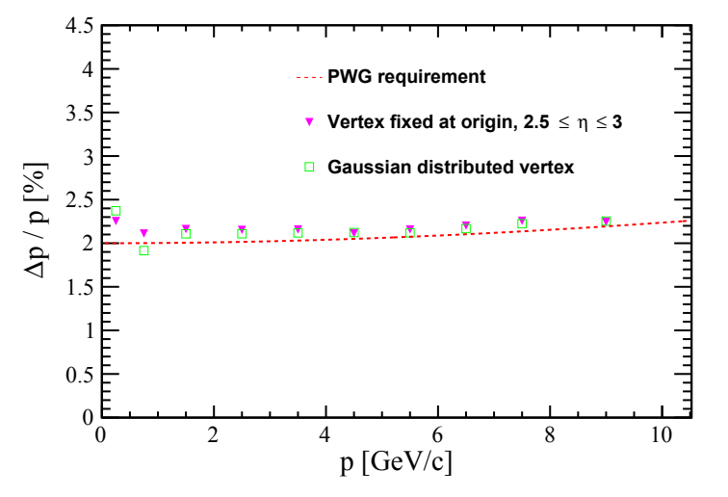
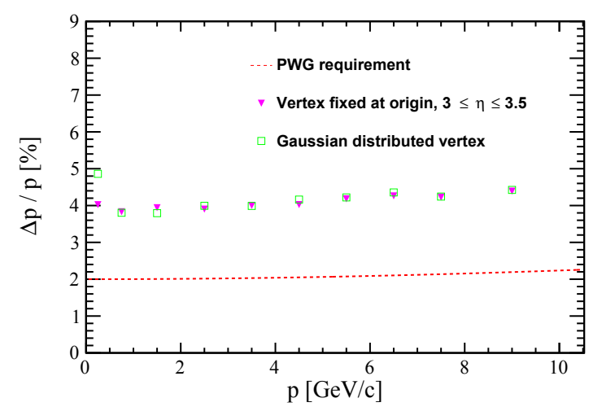
Momentum resolution - Forward
Same trend as for Backward: only 1<η<1.5 shows a small loss of performance
Can attribute this to extra material seen when crossing over service cone
1

Slide 20
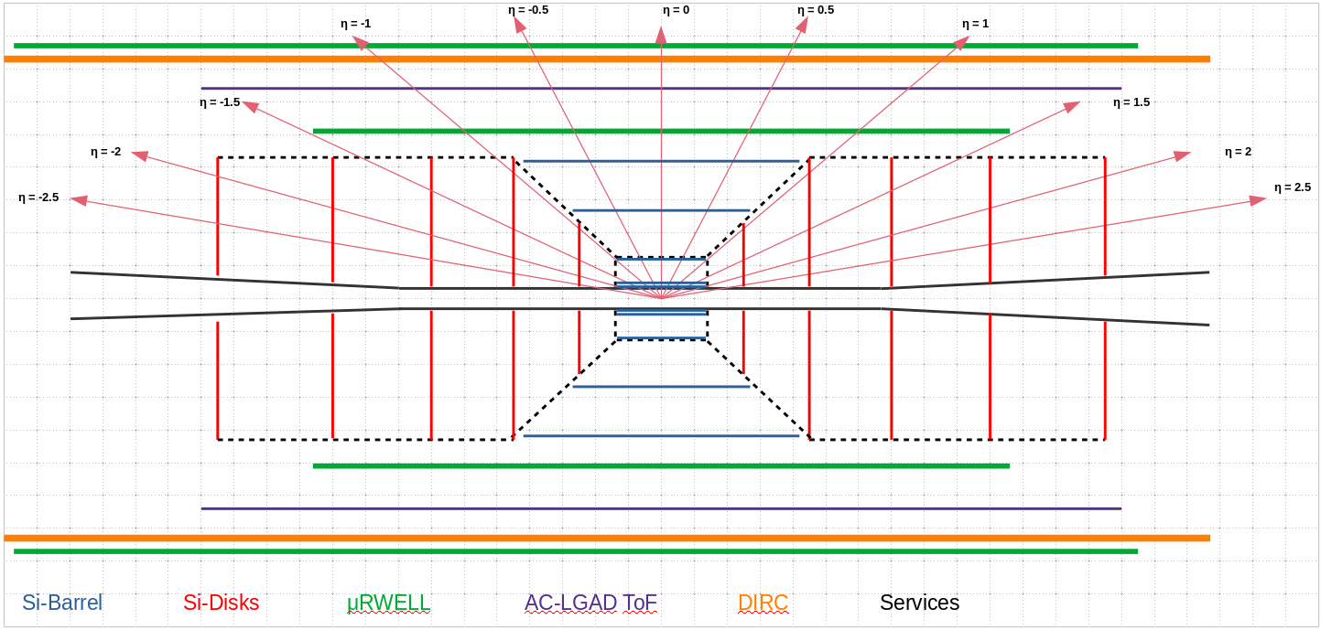
Extra material seen by particles from offset vertex if they traverse service cone
1

Slide 21
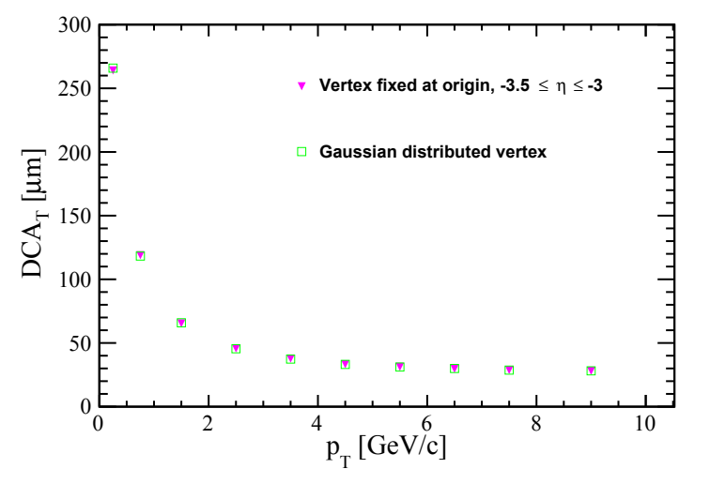
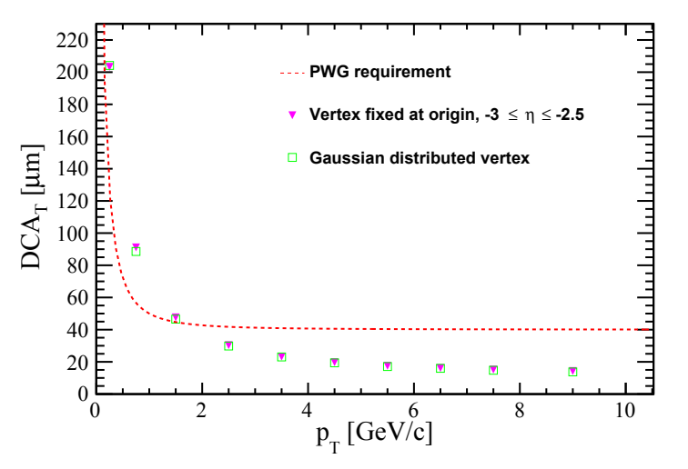
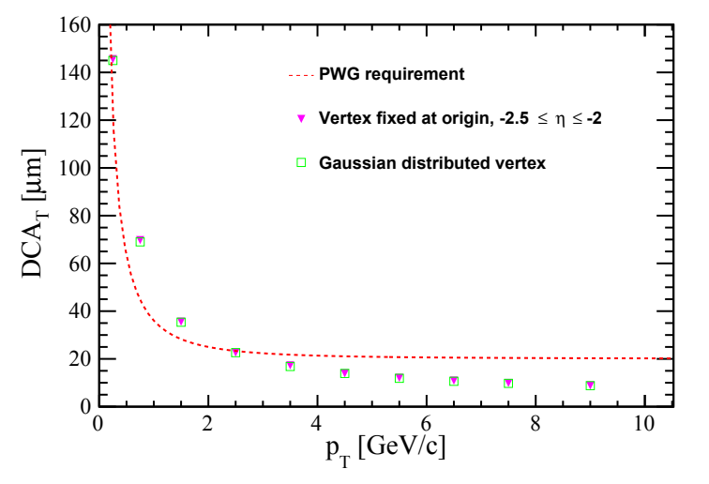
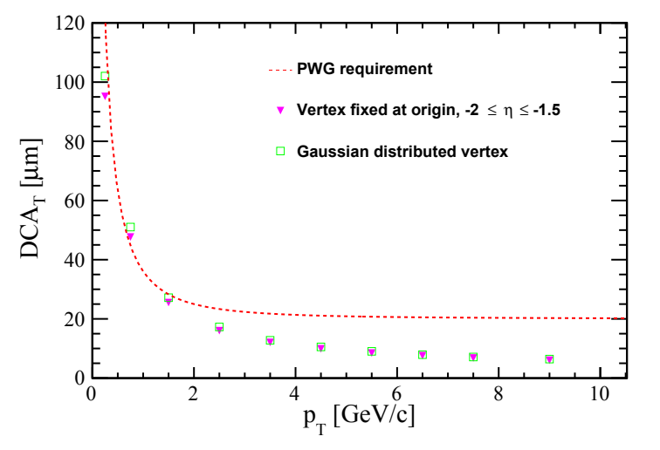
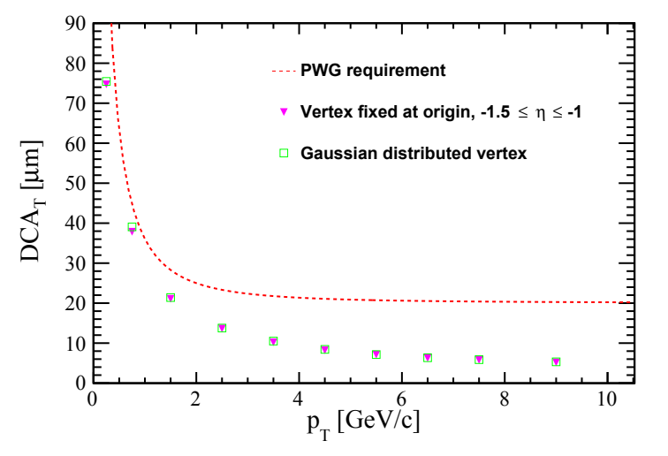
Transverse pointing resolution - Backward
No significant differences in transverse pointing resolution
1

Slide 22
Transverse pointing resolution - Central
No significant differences in transverse pointing resolution
1

Slide 23
Transverse pointing resolution - Forward
No significant differences in transverse pointing resolution
1

