Slide 1
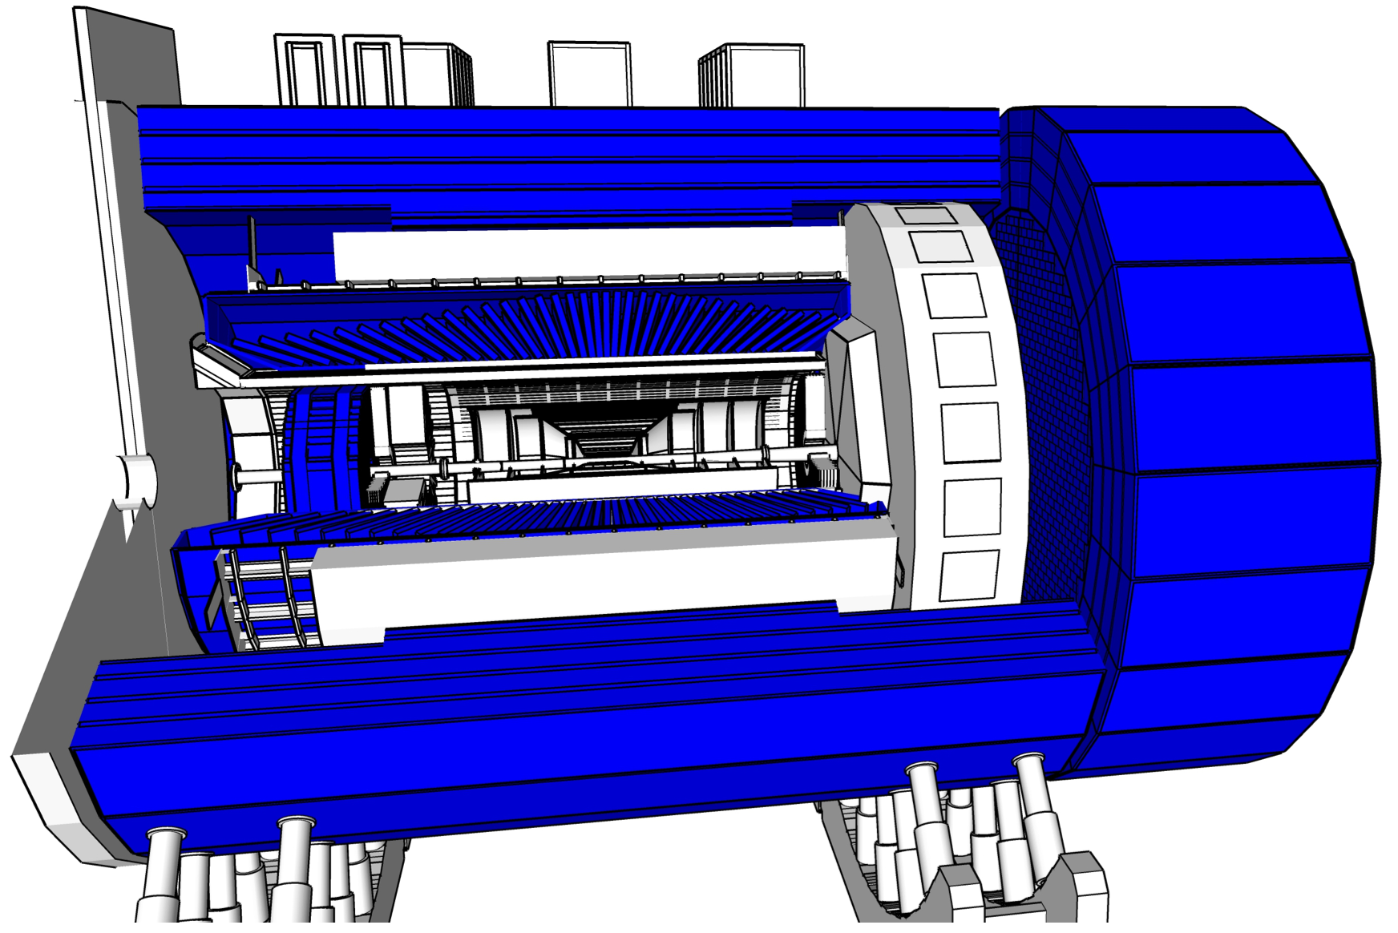
ePIC Calorimetry WG
Paul E Reimer
erhtjhtyhy
Newport News, VA
10 January 2023
Thanks to Calo WG, Conveners and esp. Alexander Kiselev, Alexander Baxilevsky and Elke C Aschenauer whose slides I’ve borrowed
This work was partially supported under grant DE-AC02-06CH11357 from the US Department of Energy, Office of Nuclear Physics

Slide 2
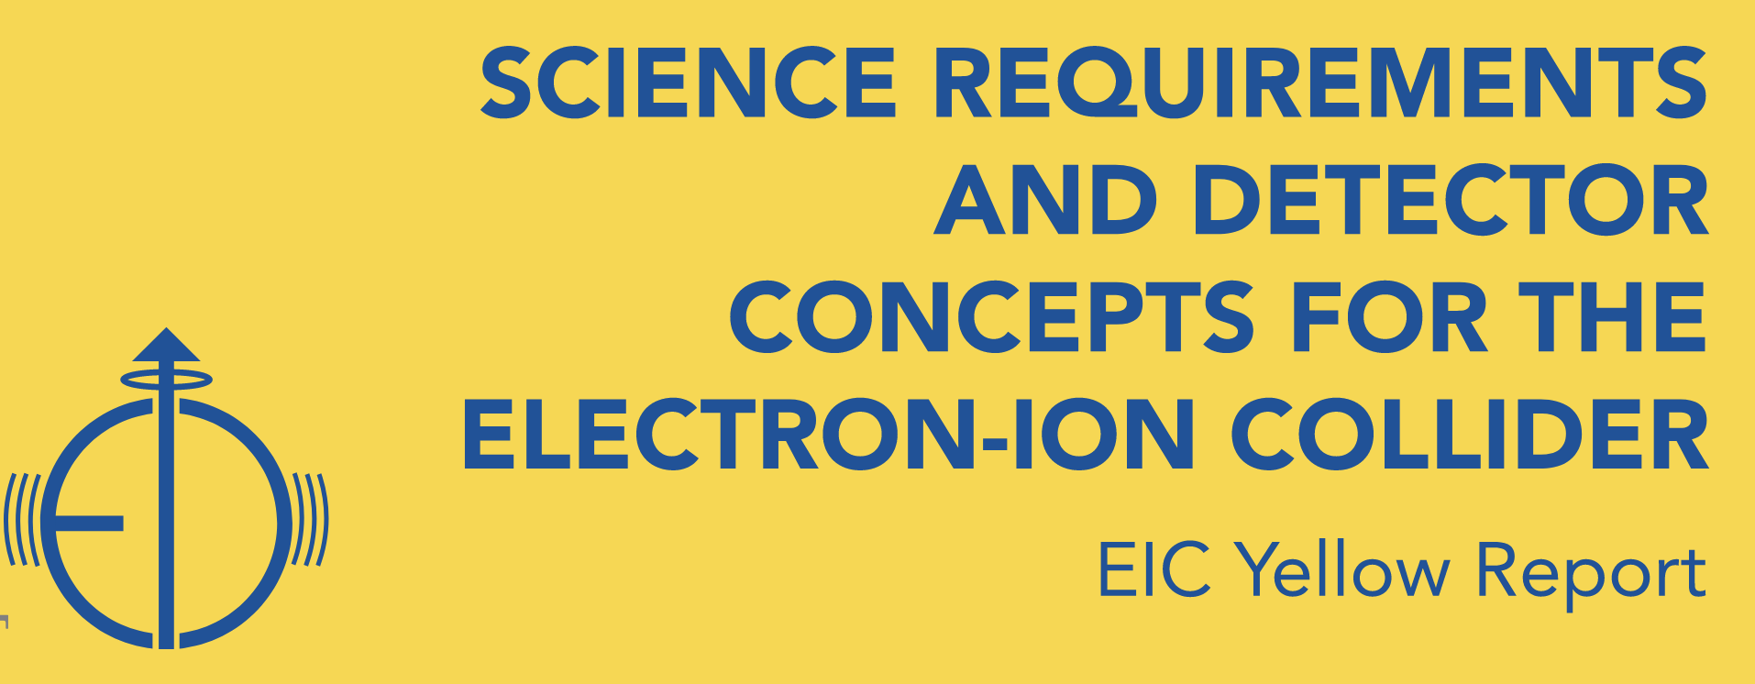
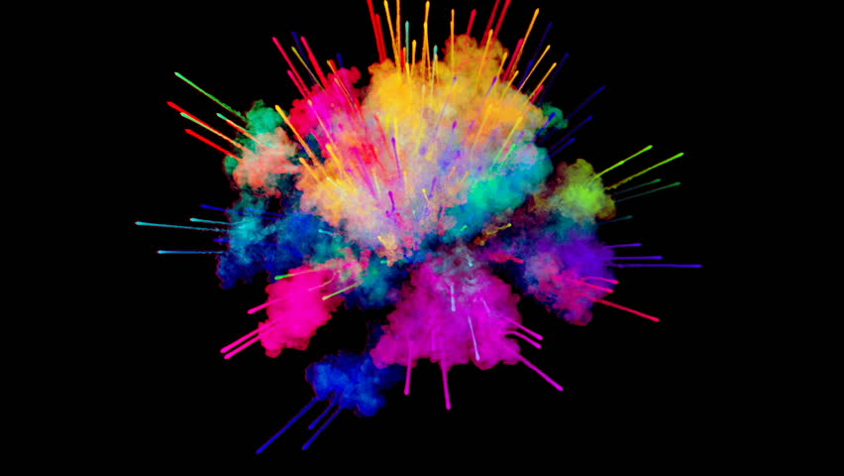
Calorimetry
Why do we need what we need where it is?
p/A beam
electron beam
high Q²
Electromagnetic calorimeter → Measure photons (E, angle), identify electrons
  PbWO₄ Crystals (backward), W/SciFi Spacal (forward)
  Barrel: Pb/SciFi+imaging part or new Scintillating glass
Hadron calorimeter → Measure charged hadrons, neutrons and K_{L}⁰
  challenge achieve ~50%/√E + 10% for low E hadrons (<E> ~ 20 GeV)
  Fe/Sc sandwich with longitudinal segmentation
lepton
medium x
scattered
hadrons
Θ = 90º
hadrons
Θ = 135º
Θ = 45º
low Q²
low x
high x
Θ = 178º
Lepton
Endcap
Central
Detector
Hadron
Endcap
Θ = 2º
z
and all the detectors integrated in the IR along the beam line

Slide 3
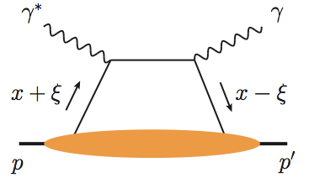
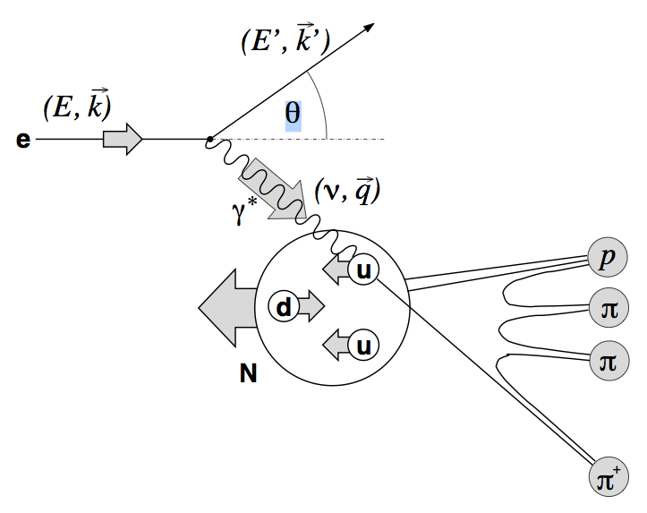
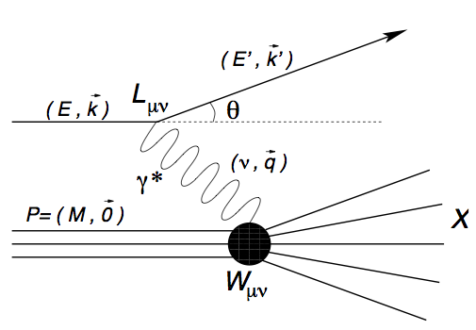
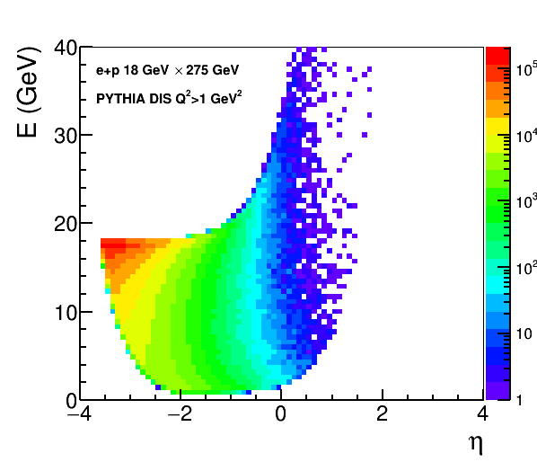
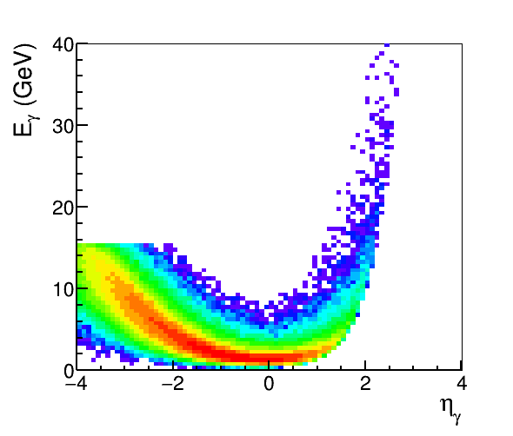
E&M Calorimetry
Electron/photon PID, energy, angle/position:
Coverage (in rapidity and energy), resolution, e/𝜋, granularity, projectivity
DIS e
DVCS photons
SIDIS π0
MILOU DVCS
e+p 18×275 GeV
PYTHIA
18 x 275 GeV
PYTHIA
18 x 275 GeV
e-endcap
Barrel
h-endcap

Slide 4
E&M Calorimetry
Electron/photon PID, energy, angle/position:
Coverage (in rapidity and energy), resolution, e/𝜋, granularity, projectivity
DIS e
DVCS photons
SIDIS π0
MILOU DVCS
e+p 18×275 GeV
PYTHIA
18 x 275 GeV
PYTHIA
18 x 275 GeV
e-endcap
Barrel
h-endcap

Slide 5
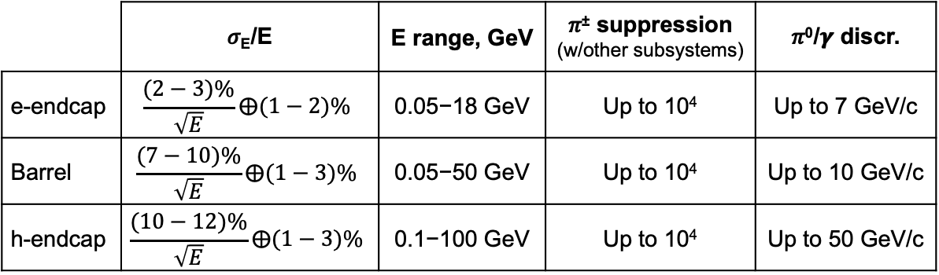
E&M Calorimetry
As documented in YR and
“General, Functional, and Performance Requirements for the EIC Detector Systems”
 | 𝜎_{E}/E | E range, GeV | 𝜋± suppression (w/other subsystems) | 𝜋⁰/𝜸 discr.
e-endcap | $$\frac{(2−3)\%}{\sqrt{E}}⨁(1−2)\%$$ | 0.05−18 GeV | Up to 10⁴ | Up to 7 GeV/c
Barrel | $$\frac{(7−10)\%}{\sqrt{E}}⨁(1−3)\%$$ | 0.05−50 GeV | Up to 10⁴ | Up to 10 GeV/c
h-endcap | $$\frac{(10−12)\%}{\sqrt{E}}⨁(1−3)\%$$ | 0.1−100 GeV | Up to 10⁴ | Up to 50 GeV/c
Continuous acceptance (particularly from e-endcap to barrel)
Minimal material budget on the way from the vertex (particularly for e-endcap to barrel)
Photosensors and FEE tolerate magnetic field
Operate at full luminosity and expected background conditions (rad. dose, neutron flux)

Slide 6
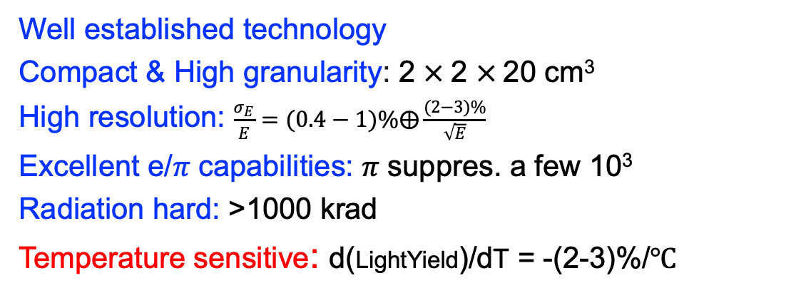

e-endcap: PbWO₄
Well established technology
Compact & High granularity: 2 $×$2 $×$20 cm³
High resolution: $\frac{σ_{E}}{E}=(0.4−1)\%⨁\frac{(2−3)\%}{\sqrt{E}}$
Excellent e/𝜋 capabilities: 𝜋 suppres. a few 10³
Radiation hard: >1000 krad
Temperature sensitive: d(LightYield)/dT = -(2-3)%/℃
$$\frac{σ_{E}}{E}=0.5\%⨁\frac{2.6\%}{\sqrt{E}}⨁\frac{1.1}{E}$$
Jlab-PrimEx eta/NPS PWO EMCal prototype
Consortium with >10 institutions
Extensive experience from recent PANDA (GSI) and CMS (CERN)
NIM A 1013 (2021), 165683

Slide 7
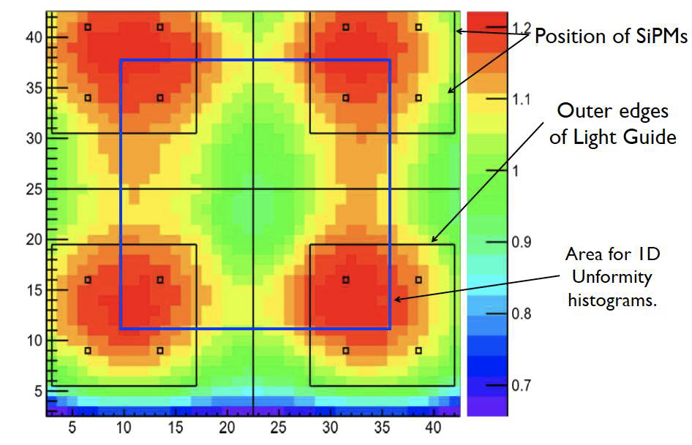
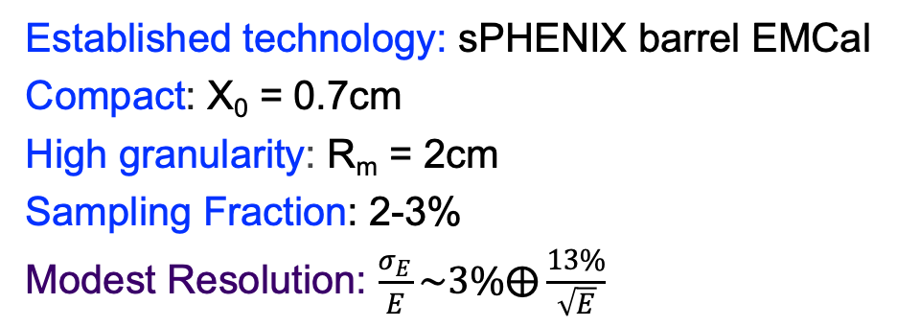

h-endcap: W/SciFi
Established technology: sPHENIX barrel EMCal
Compact: X₀ = 0.7cm
High granularity: R_{m} = 2cm
Sampling Fraction: 2-3%
Modest Resolution: $\frac{σ_{E}}{E}\sim 3\%⨁\frac{13\%}{\sqrt{E}}$
BNL-sPHENIX: W/SciFi
$$\frac{σ_{E}}{E}\sim 3\%⨁\frac{13\%}{\sqrt{E}}$$
R&D:
  Improve light collection eff. and uniformity

Slide 8
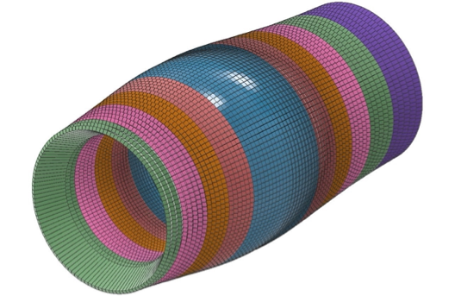
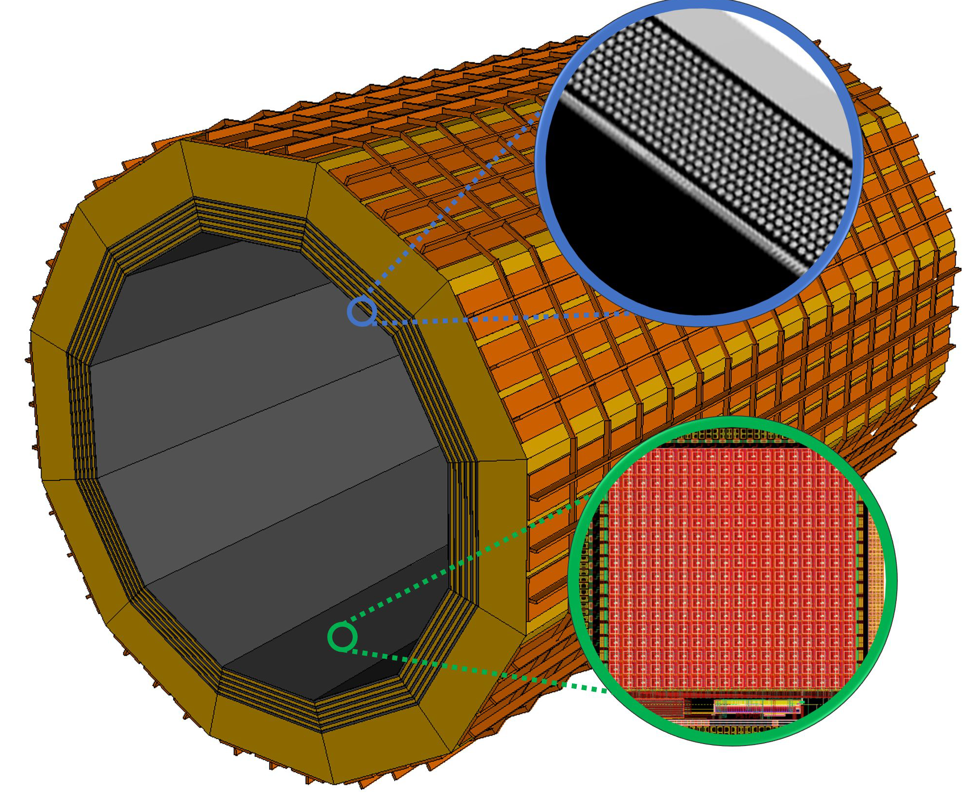
Barrel: Two Options
Discussion in the following two talks by Joshua Crafts (CUA) and by Maria Zurek (ANL)
Complementary options for BECAL:
SciGlass or
Imaging Calorimeter

Slide 9
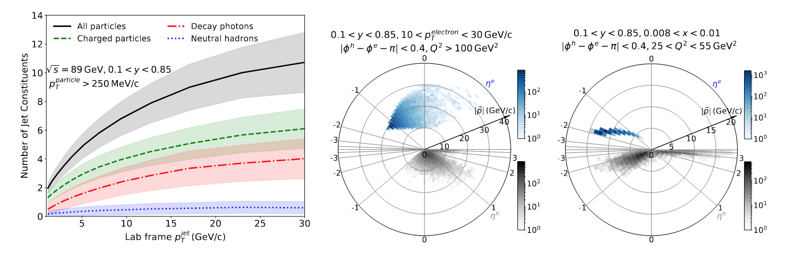
Hadronic Calorimetry
Energy resolution driven by particle flow reconstruction
Granularity driven by neutral cluster isolation and jet substructure measurements
soft, low multiplicity jets
low energy hadrons
(except for the very forward region)

Slide 10
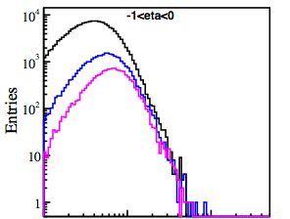
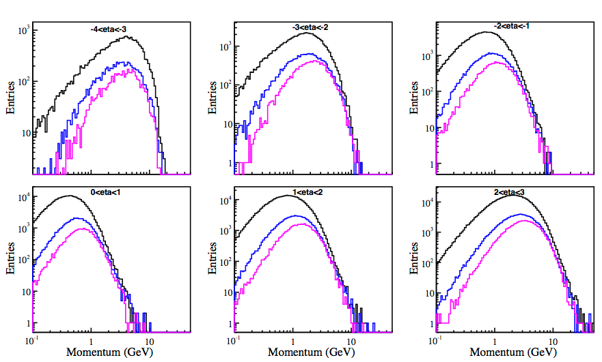
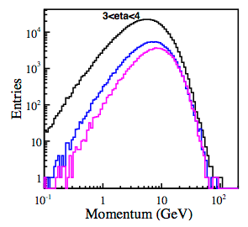

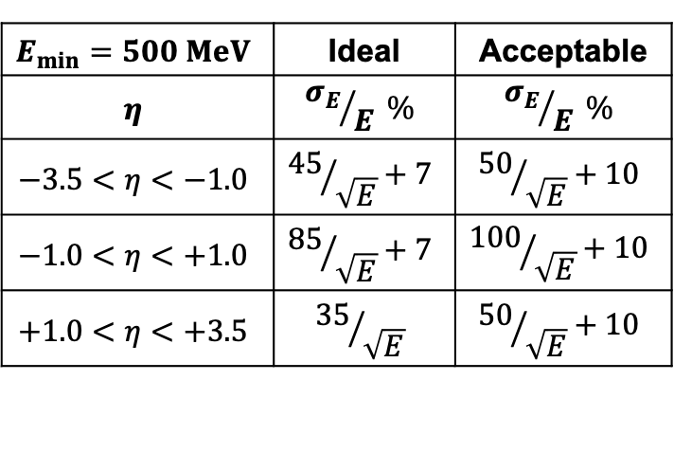
Hadronic Calorimetry
Yields vs momentum for a 20 x 250 GeV configuration, -4 < η < 4
$$E_{min}=500 MeV$$ | Ideal | Acceptable
$$η$$ | $${σ_{E}}/E \%$$ | $${σ_{E}}/E \%$$
$$−3.5<η<−1.0$$ | $${45}/{\sqrt{E}}+7$$ | $${50}/{\sqrt{E}}+10$$
$$−1.0<η<+1.0$$ | $${85}/{\sqrt{E}}+7$$ | $${100}/{\sqrt{E}}+10$$
$$+1.0<η<+3.5$$ | $${35}/{\sqrt{E}}$$ | $${50}/{\sqrt{E}}+10$$

Slide 11
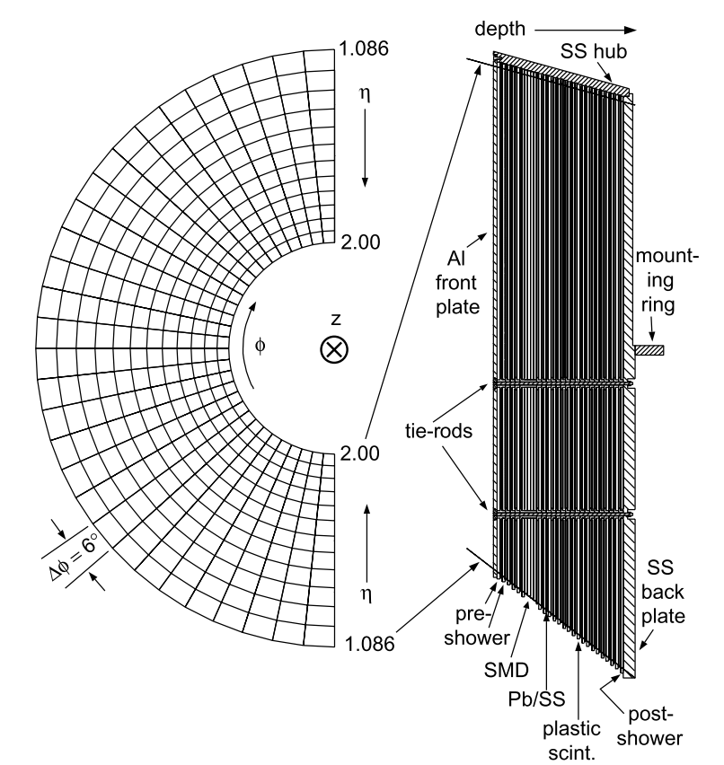
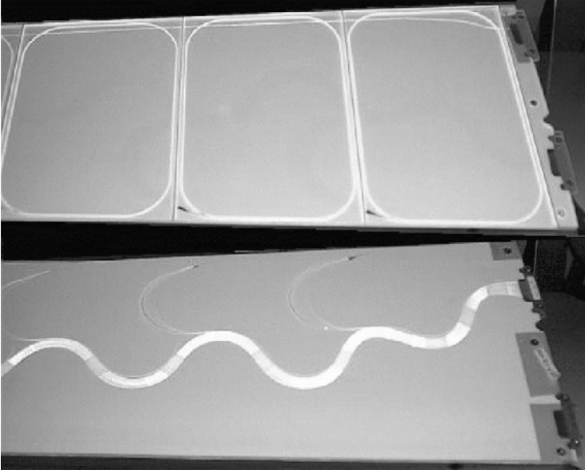
Backward Hadronic Calorimeter
Recycle scintillating plates from STAR
Embedded WLS fibers
SiPM readout
Replace lead absorber by steel
Full depth ~440mm only
It is indeed a tail catcher
High energy resolution is not needed
Acceptance -4 < η < -1
STAR EEMC
Fe/Sc sandwich , ~2.0 λ_{I}
Talk by Leszek

Slide 12
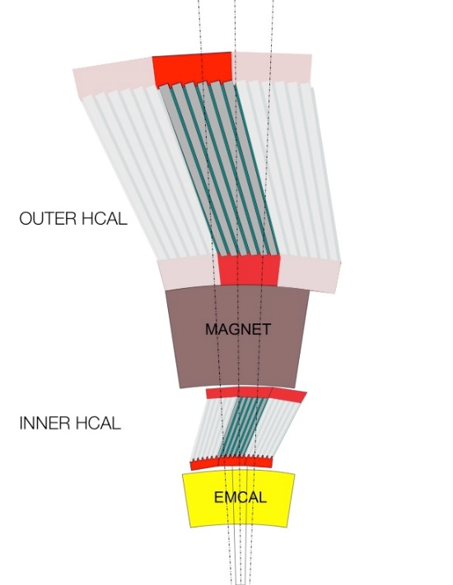
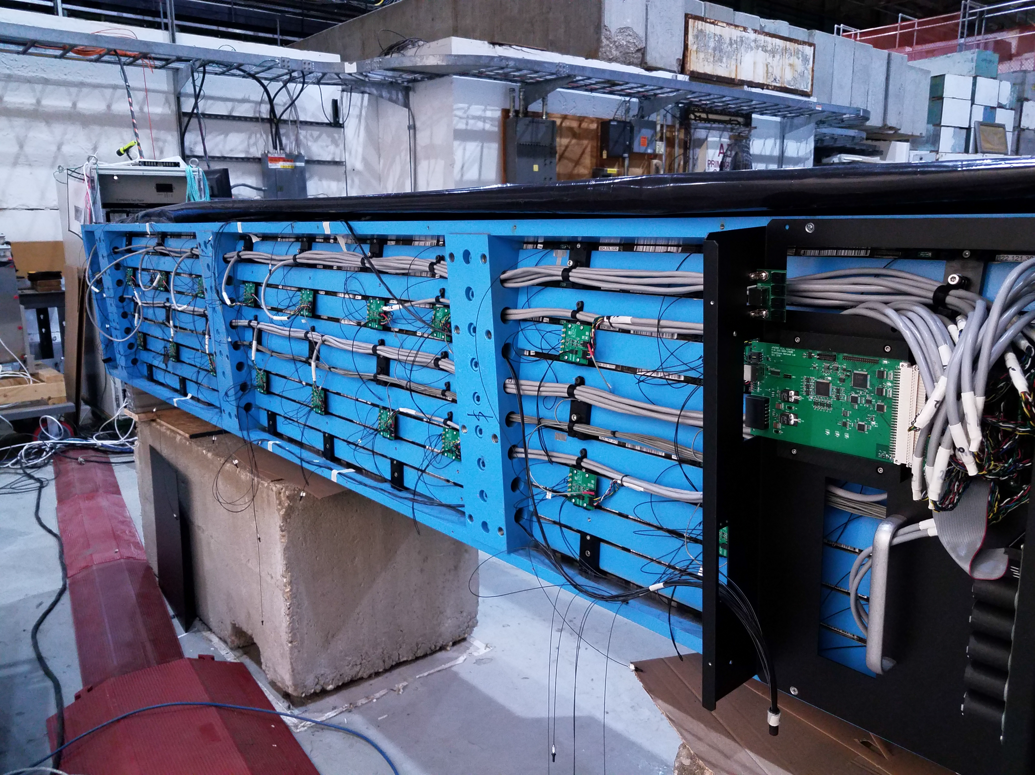
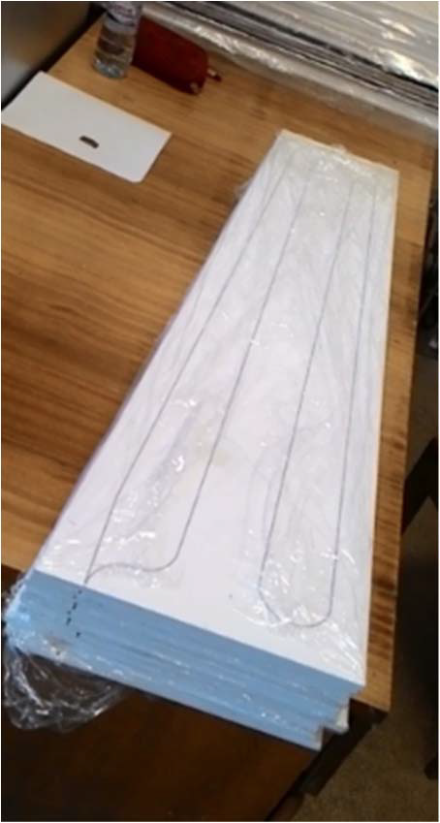
Barrel Hadronic Calorimeter
Partly reuse sPHENIX barrel calorimeter
Replace SiPMs
Upgrade electronics
Moderate energy resolution suffices
Acceptance -1 < η < 1
Fe/Sc sandwich, ~3.5 λ_{I}

Slide 13
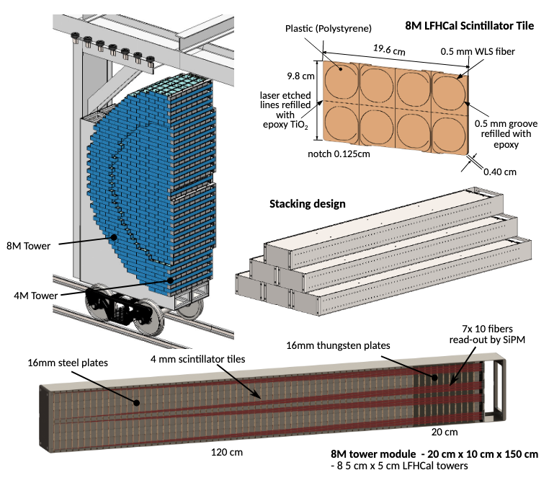
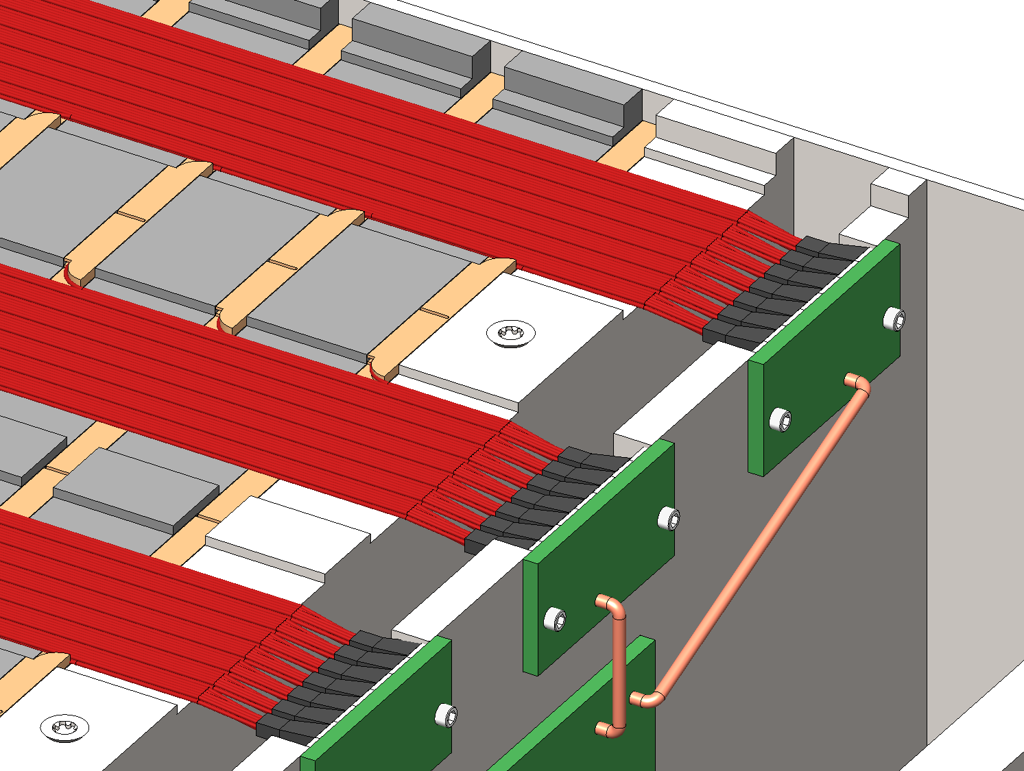
Forward Hadronic Calorimeter
New innovative design
High 3D granularity
High energy resolution
Acceptance 1 < η < 4
Fe/Sc + W/Sc sandwich , ~6.9 λ_{I}

Slide 14


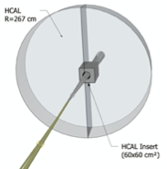
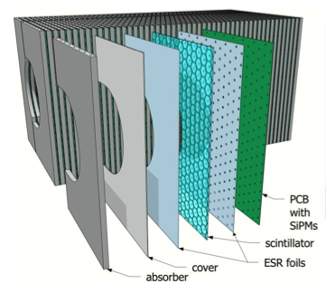
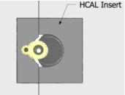
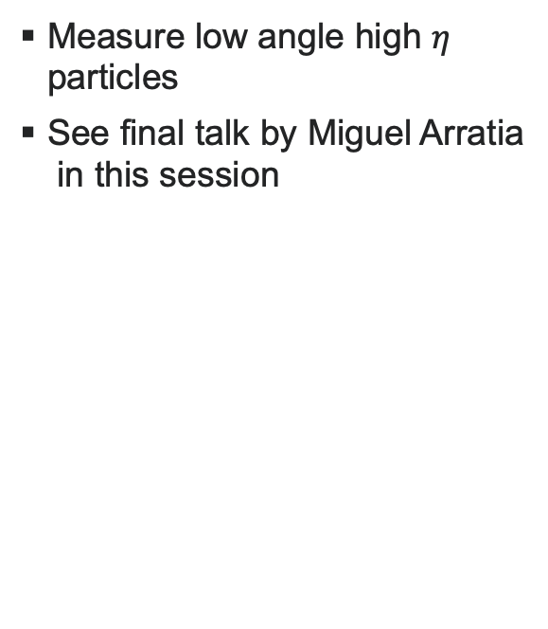
Forward Hcal Insert
Measure low angle high $η$ particles
See final talk by Miguel Arratia
in this session

Slide 15
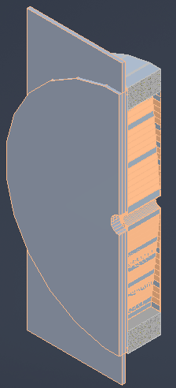
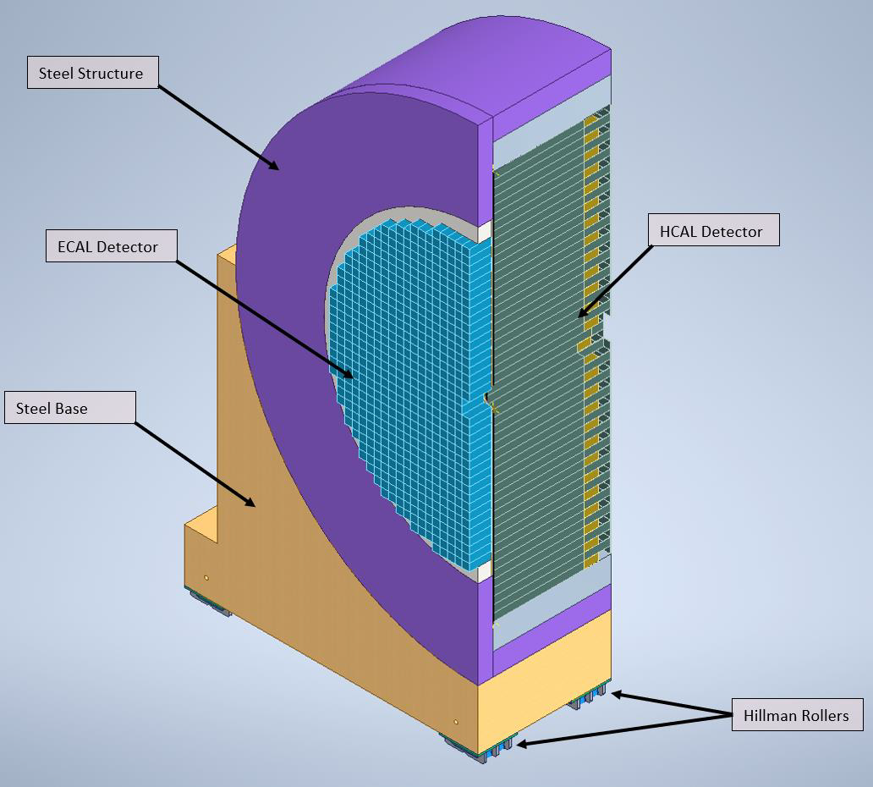
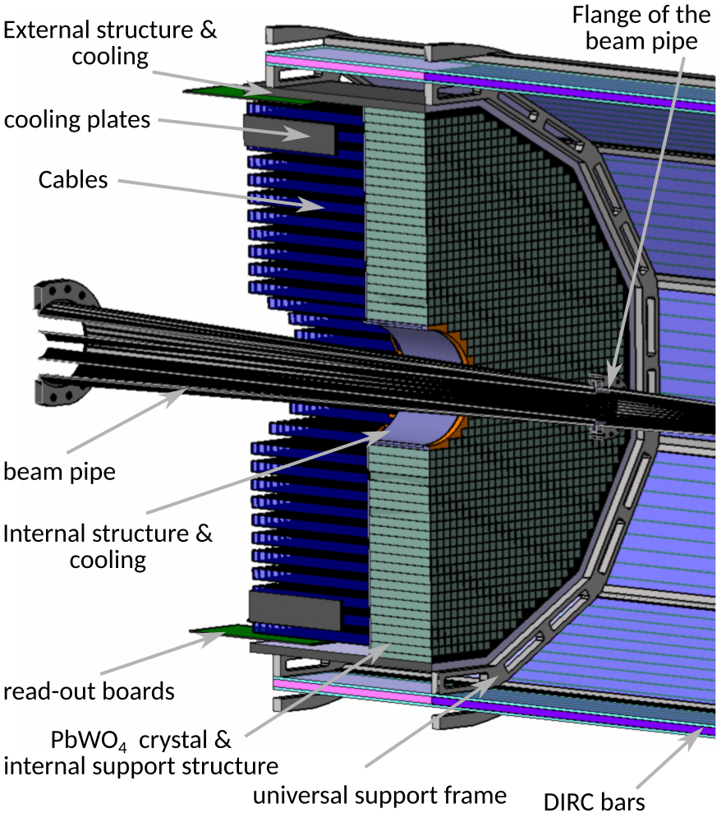
EPIC Calorimetry
Barrel HCAL
(sPHENIX re-use)
Backwards HCal
Steel/Sc Sandwich
tail catcher
Backwards EMCal
PbW04 crystals
High granularity
W/SciFi EMCal
Longitudinally separated HCAL with high-η insert
PbSc Layer
slide from E.C. Aschenauer
Complementary options for BECAL:
SciGlass or
Imaging Calorimeter
Imaging Layer

Slide 16
p/A beam
electron beam
high Q²
lepton
medium x
scattered
hadrons
Θ = 90º
hadrons
Θ = 135º
Θ = 45º
low Q²
low x
high x
Lepton
Endcap
Central
Detector
Hadron
Endcap
Θ = 178º
Θ = 2º
z
and all the detectors integrated in the IR along the beam line

