Slide 1
EIC Far-Backward Direct Photon Detector
A. Kowalewska¹, J. Nam², K. Piotrzkowski¹, B. Surrow²
1. AGH University of Science and Technology, Krakow
2. Temple University, Philadelphia

Slide 2
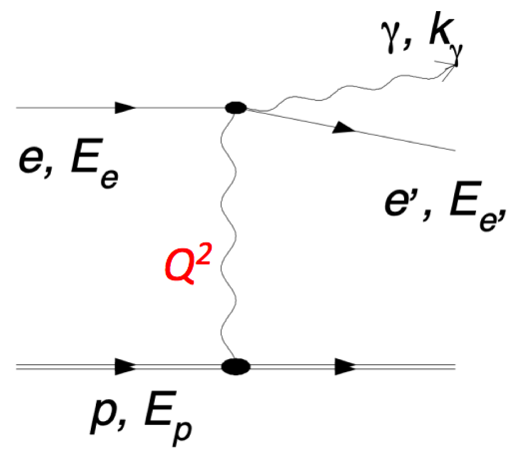
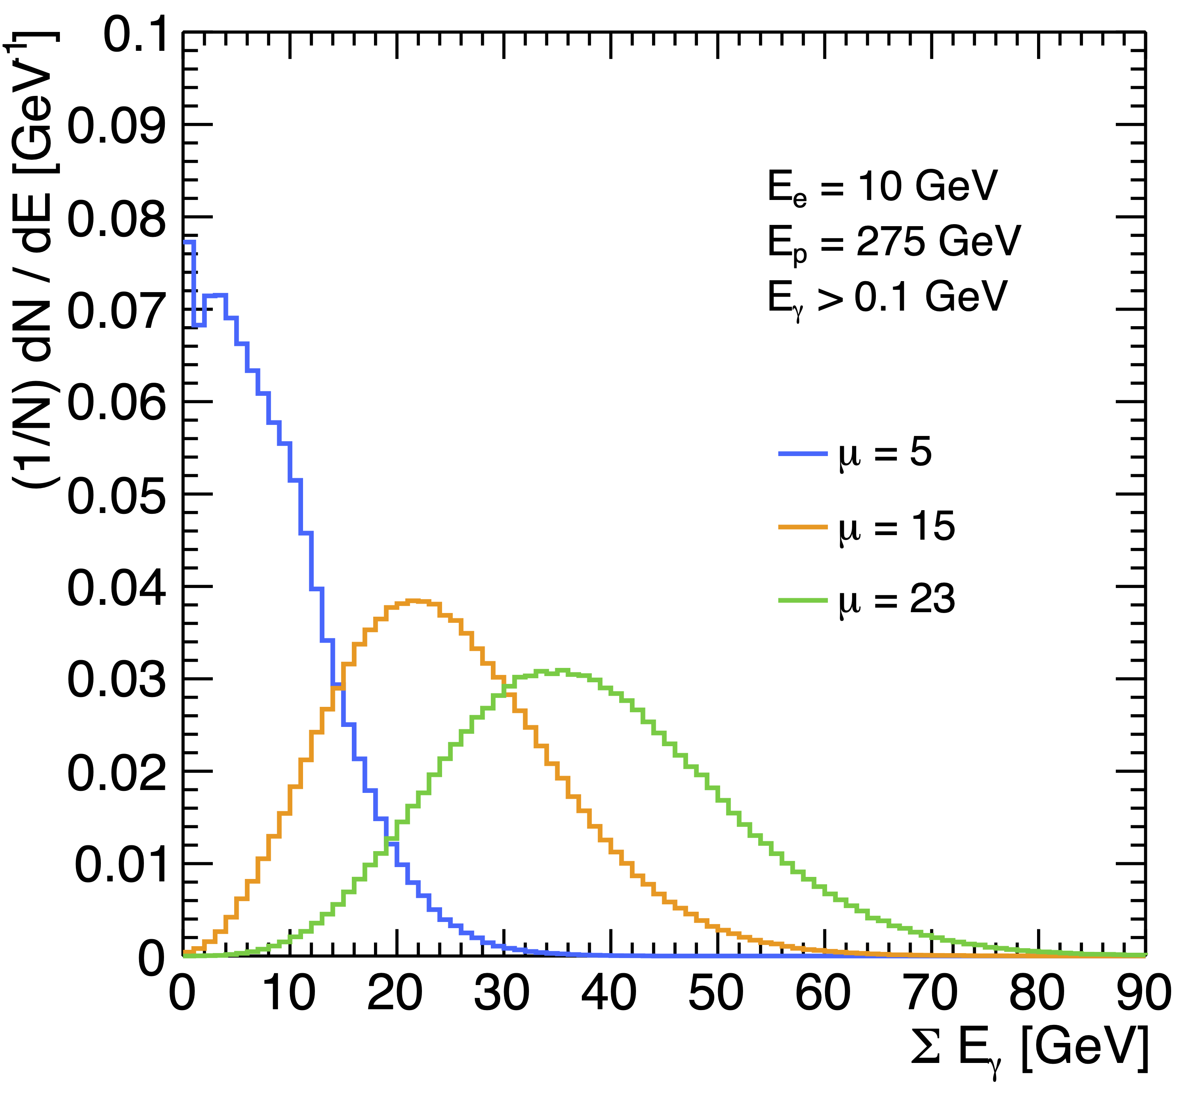
Direct Photon Detection in ePIC
The proposed physics programs at EIC require
$δL≤1\%$
$δ(dL/L)≤{10}^{−4}$
In principle, measurements of direct bremsstrahlung photons should provide a very simple and precise luminosity determination at the EIC, as the photon (geometrical) acceptance is almost 100% then one has to simply account for a photon energy cutoff, which can be well calibrated.
However, using a simple method of photon counting is only possible at low luminosities. For the nominal L = 10³⁴ cm⁻²s⁻¹ about 23 hard photons on average will be emitted for each bunch crossing, forcing measurements of energy flow instead, which are more difficult.

Slide 3
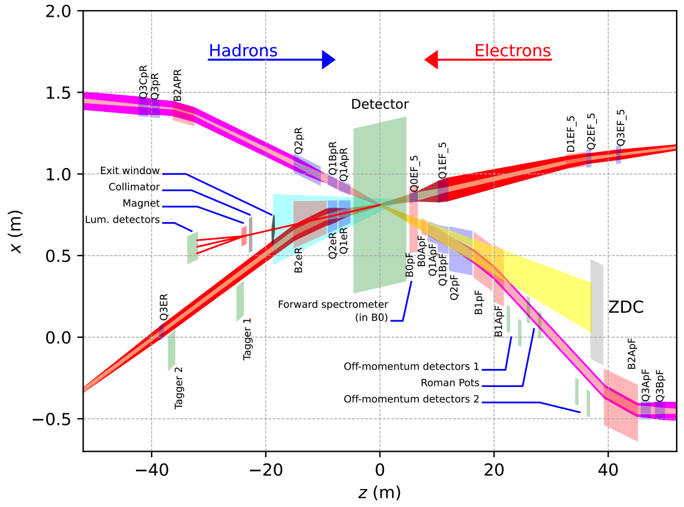
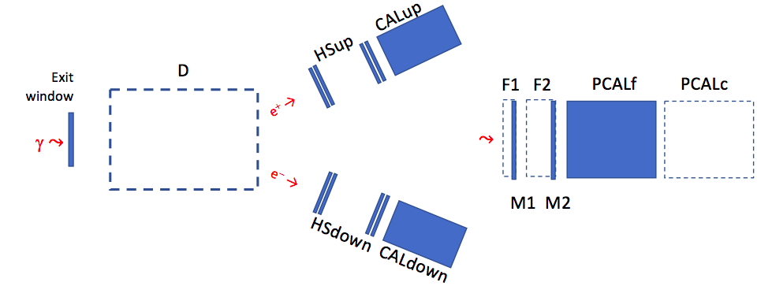
Direct Photon Detection in ePIC
Therefore, two separate direct photon calorimeters are proposed:
one with an excellent energy resolution to be used only for the special luminosity calibration runs at low L.
one which is capable of withstanding > 1 GHz event rates and be used for a robust luminosity monitoring during the nominal ePIC running.
Direct bremsstrahlung photon calorimeters are inevitably exposed to the direct synchrotron radiation, mostly originating in the electron beam ”separating” dipole B2eR.
For a 18 GeV electron beam that requires using thick absorbers/filters to attenuate SR, at a cost of deteriorating the energy measurements. We therefore need to carefully study the optimal way of configuring such filters.

Slide 4
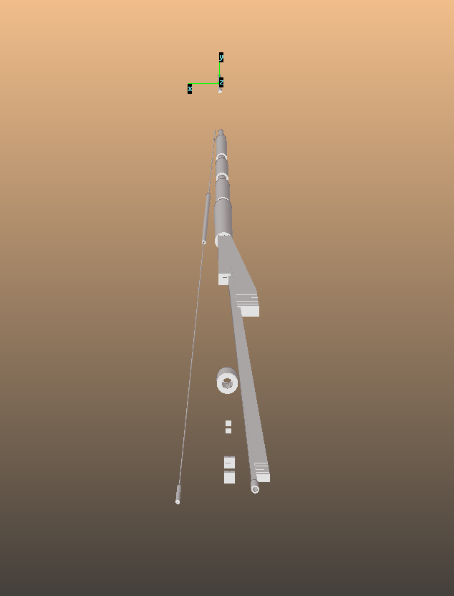
Introduction
Far backward Geometry
Objectives
We aim to study the SR dosage on the photon calorimeters & other sensitive components in the far backward region.
We will also study distributions of energy deposited by bremsstrahlung, for various detector types and configurations
Relevant Geometries
$2 ×$ focusing/defocusing Quad Poles (Q1eR, Q2eR).
$2 ×$ dipoles (B2AeR, B2BeR) further separate the outgoing electrons from the incoming hadrons.
Low- $Q^{2}$ taggers (Simon)
$e^{+}e^{−}$ calorimeters with a separating dipole and 2 electron trackers. (Dhevan)
Direct photon detectors.
Q1eR
B2AeR
Q2eR
B2BeR
Exit
window
Taggers
SPEC
Direct
Photon
Geom generated in the standard EIC framework and imported to SynRad+

Slide 5
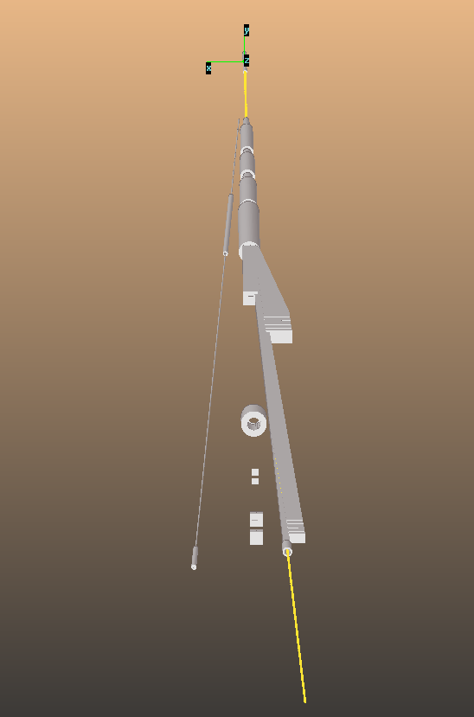
Beam Information
Far Backward Geometry
w/ Beam and Field
Electron beam
18 GeV electron beam at 250 mA current.
Magnetic Field
B2AeR/B2BeR
0.192/0.238T dipoles.
Located at 10.5/13.275m downstream.
Q1eR/Q2eR
-13.3/12.1(T/m) focusing/defocusing quad poles.
Located at 6.2/8.3m.
Relevant studies
H. Witte et al, DOI: 10.18429/JACoW-IPAC2021-WEPAB002
M. Stutzman, DOI: 10.18429/JACoW-IPAC2021-WEPAB340
Charles Hetzel, https://indico.bnl.gov/event/12026/
Beamline studies aimed to optimize beam line spacing, material, conditioning time, pumping configuration.
Geom generated in the standard EIC framework and imported to SynRad+

Slide 6
SR Simulation
Physics event
based on
power dist.
Geometry exported
Geometry from
EIC repository
(GITHUB)
SR simulation
w/ SynRad+
G4 simulation
SynRad+
http://cds.cern.ch/record/2694236?ln=en
MC simulator developed by CERN to simulate synchrotron radiation (SR).
Traces photons originating from particles traversing through magnetic regions.
Calculates flux and power distribution/spectrum of SR incident on geometric surfaces.
Geometry can be generated with built-in GUI tools or imported from CAD software (STL format).
DD4hep/DDG4 interfaced with Ddsim
Integrated into standard EIC SW framework.
Generate geometry as input to SynRad+
Handles G4 simulation.
Ongoing effort from EIC Background working group.
To produce realistic beam environment, the correct accelerator model is needed.
ePIC background group has started investigating the SR with the help of Charles Hetzel, Marcy Stutzman.
The SR in the FB effort will also contribute to this investigation.

Slide 7
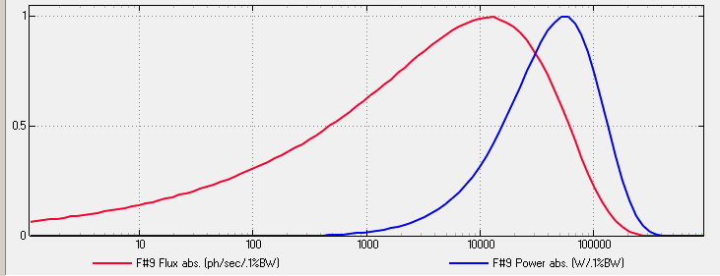
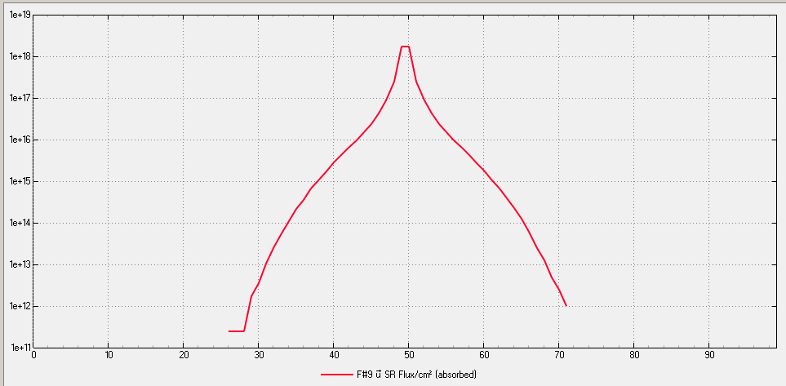
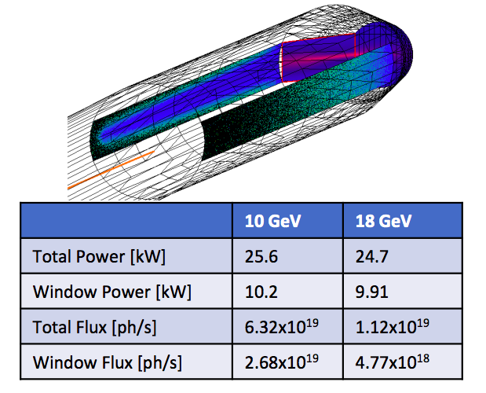
Test Study
Power/Flux spectrum
First Check:
Photon distribution on exit window
from SynRad+
Flux profile along vertical direction
A “sanity check“ assuming ideal beam conditions
SR incident on the exit window simulated.
$E_{e}=18 GeV$ at $I_{e}=250 mA$.
Subjected to B2AeR and B2BeR.
The resulting SR power/flux consistent with the previous studies within a factor of 2.
Charles Hetzel,
https://indico.bnl.gov/event/12026/

Slide 8
Summary & Outlook
Summary
Direct photon calorimeters in ePIC far backward region will help to provide high precision measurement of luminosity, as required by EIC physics programs.
Studies have been initiated to quantify the dosage of SR in the photon detectors & other sensitive components in FB $→$ provide context for SR filter design.
ePIC Background group has begun the effort to generate realistic SR simulation samples with non-ideal beam properties and complete accelerator modeling.
Framework for studies of bremsstrahlung energy depositions is being prepared
Outlook
Conversion of SR simulation from SynRad as DDSim events need to be streamlined (ideally along with bremsstrahlung).
Choice of SR filter specifications based on energy measurement vs SR dosage.
Final technology choice for the direct photon detectors will be based on these on-going studies

Slide 11
Synchrotron Radiation (SR)
Pic for tagger
Highlight the dipole/quadrupole in the backward electron region.
Expected power with 10/18 GeV modes.

Slide 12
Relevant Geometry
Far backward Geometry
Geometry from November
$2 ×$ focusing/defocusing Quad Poles (Q1eR, Q2eR).
$2 ×$ dipoles (B2AeR, B2BeR) further separate the outgoing electrons from the incoming hadrons.
Low- $Q^{2}$ taggers
$e^{+}e^{−}$ calorimeters with a separating dipole and 2 electron trackers.
Additional luminosity monitor with direct photons.
Not implemented in EIC platform, although relevant parameters exist.
Q1eR
B2AeR
Q2eR
B2BeR
Exit
window
Taggers
SPEC
Direct
Photon
Geom generated in the standard EIC framework and imported to SynRad+

