Slide 1
Summary of eRD109 Activities
Fernando Barbosa (JLab), L3 CAM Electronics
ePIC Collaboration Meeting
11 January 2023

Slide 2
Outline
Readout Channels & eRD109 proposals
Proposals – Five (5):
A – Calorimeters, SiPM - Discrete/COTS/ASIC
B – Calorimeters, SiPM – HGCROCv3
C – dRICH, SiPM – ALCOR
D - AC-LGAD – EICROC/FCFD/3rd party ASICs Evaluation
E – MPGD - SALSA
Project Timeline
eRD109 Costs & Timeline
Summary

Slide 3
ePIC Detector Channels
Detector System | Channels | Nominal Readout Technology
Si Tracking: 3 vertex layers, 3 sagitta layers, 4 backward disks, 5 forward disks | 7 m^2 32 B pixels 5,200 MAPS sensors | MAPS
MPGD tracking: 3 layers | 100k | Strips
Calorimeters: (in P6) Forward: LFHCAL pECAL Barrel: HCAL ECAL Backward: ECAL nHCAL | 31640 19000 1536 8160 3256 3240 | SiPM
Far Forward: B0: 3 MAPS layers 1 or 2 AC-LGAD layer 2 Roman Pots 2 Off Momentum ZDC: Crystal Calorimeter 32 Silicon pad layer 4 silicon pixel layers 2 boxes scintillator | 3x20cmx20cm (300M pixel) 300k or 600k 1M (4 x 135k layers each) 650k (4 x 80k layers each) 400 11520 160k 72 | MAPS AC-LGAG AC-LGAD AC-LGAD APD Si/HGCROC PMT/SiPM
Far Backward: Low Q Tagger 1 Low Q Tagger 2 2 Calorimeters | 1.3M 480k 700 | AC-LGAD AC-LGAD PMT/SiPM
PID-TOF | 3M-50M | AC-LGAD
PID-Cherenkov: dRICH pfRICH (if selected) mRICH (if selected) DIRC | 300k 225k 225k? 74k | SiPM SiPM LAPPD SiPM
The five (5) eRD109 proposals cover most of the EIC readout requirements.
And may extend to others.

Slide 4
Readout Channels & eRD109 proposals
Detector Group | Channels | AC-LGAD | SiPM/PMT | MPGD
 | MAPS | AC/DC-LGAD | SiPM/PMT | MPGD
Tracking | 32 B |  |  | 100k
Calorimeters | 50M |  | 67k
Far Forward | 300M | 2.3M | 500
Far Backward |  | 1.8M | 700
PID |  | 3M-50M | 600k
TOTAL | 32 B | 7.1M-54M | 670k | 100k
ASIC | ITS-3 | EICROC FCFD HPsOC ASROC FAST | Discrete/COTS HGCROC3 ALCOR-EIC | SALSA
Readout implementations with discrete/COTS and ASICs (HGCROCv3) are leading candidates for the EIC. The large number of channels, density, granularity and geometry favor high circuit density solutions.
We continue to assess ASIC developments from other sources such as NALU, Pacific Microchip, Alphacore, EPIR, SenseICs, Weeroc.
Some sub-detectors, with less restrictive requirements, may benefit from discrete implementations and developments such as from STAR and sPHENIX.

Slide 5
Proposals
Five (5) proposals were received and originated from various EIC sub-detector groups. These cover the R&D efforts for ASICs and Electronics in support of the EIC detector readout:
Proposal | File | Authors | Sub-Detector | Sensor Type | Readout Solution
A | eRD109_pECAL_readout_prototype_FINAL | G. Visser (IU), et al. | Calorimeter | SiPM | Discrete, COTS, ASIC
B | eRD109CalorimeterReadout | N. Novitzky (ORNL), et al. | Calorimeter | SiPM | ASIC (HGCROCv3)
C | eRD109-alcor | M. Ruspa (INFN), et al. | dRICH | SiPM | ASIC (ALCOR)
D | ACLGAD_ASIC_Electronics_FY23 | Z. Ye (UIC), et al. | Central, Far-Forward | AC-LGAD | ASIC (EICROC1, FCFD1, 3rd Party)
E | eRD109_SALSA_proposal_vfinal1 | D. Neyret (CEA), et al. | Micromegas, GEM, MicroRWell | MPGD | ASIC (SALSA)
For further details, refer to the documentation submitted for each of the proposals.

Slide 6
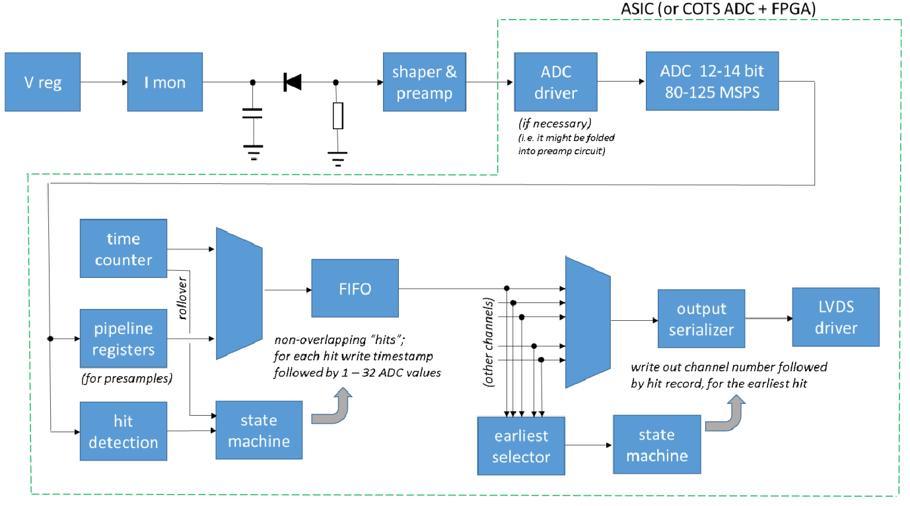
Proposal A – Calorimeters, SiPMs – Discrete/COTS/ASIC
Develop a simple, high resolution waveform readout solution for the calorimeters with SiPMs by:
Employing discrete, COTS devices.
Developing PCBs for full readout chain.
Developing cabling, power, cooling infrastructure.
Making it adaptable to implementations that may benefit from the availability of ASICs.
FEB PCBs
Adapter PCBs
Based on STAR FCS.

Slide 7
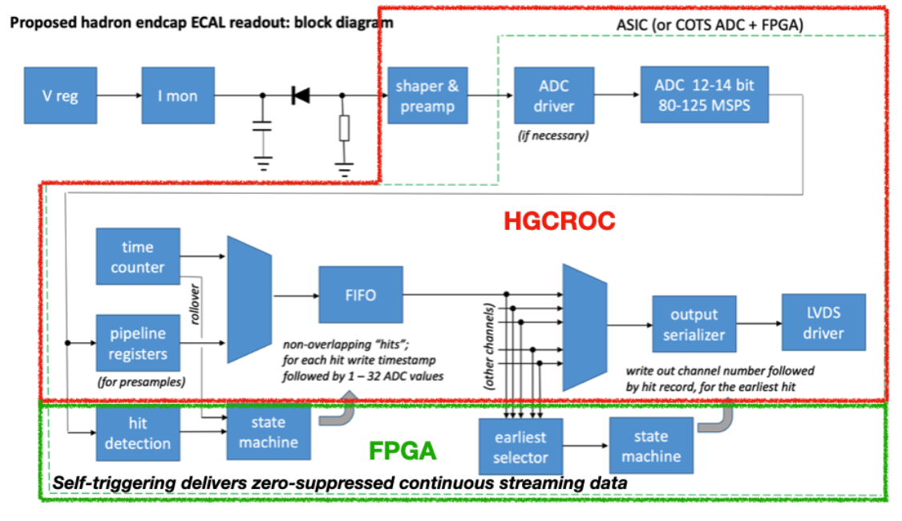
Proposal B – Calorimeters, SiPMs – HGCROCv3
Develop a readout solution for the calorimeters with SiPMs by:
Employing existing HGCROCv3 ASIC
Developing PCBs for full readout chain
Developing cabling infrastructure
FEB PCBs
SiPM PCBs
RDO PCBs

Slide 8
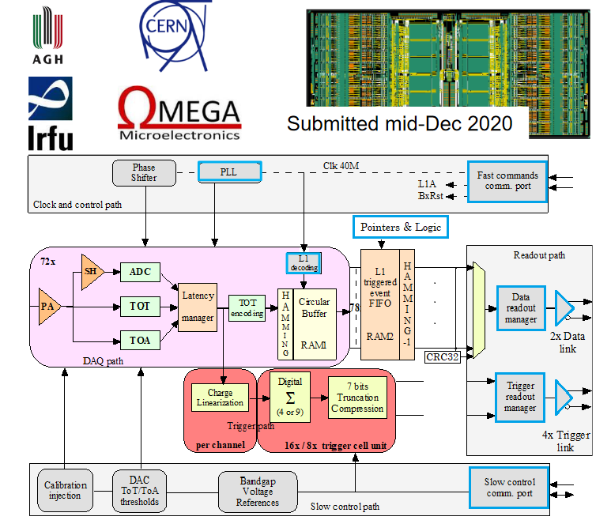
SiPM version.
Large dynamic range.
Low noise.
Charge: ADC+TOT.
Time: TOA (25 ps).
512 DRAM buffer.
2x 1.28 Gbps links.
I2C controls.
40 MHz operation.
20 mW/Ch.
Radiation tolerant.
Developed for CMS.

Slide 9
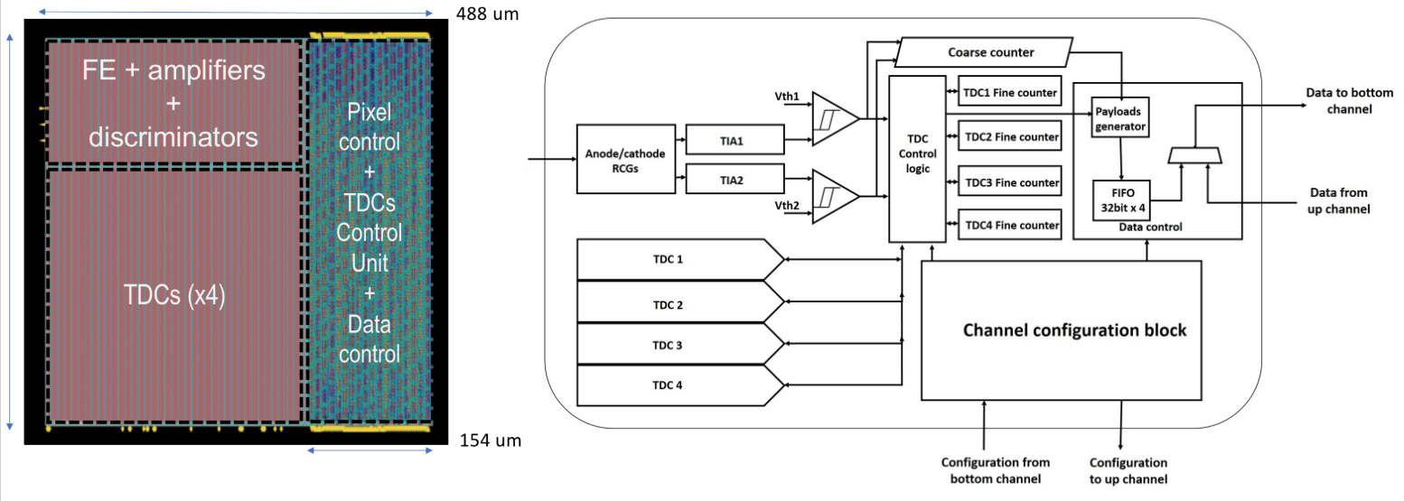
Proposal C – dRICH, SiPMs – ALCOR
Develop a readout solution specific to the dRICH with SiPMs by:
Qualifying existing ALCOR v2 ASIC.
Further development and refinements towards final ALCOR v3.
64-Ch, 110/65 nm CMOS, SiPM readout.
Dual polarity, RCG Amplification, conditioning, digitization.
Modes of operation: single-photon tagging or time and charge.
Triggerless and triggered operation.
25 ps TDCs, 5 MHz input.
4 or 8x 640 Mbps LVDS links.
SPI configuration.
Originally developed by INFN for DARKSIDE.

Slide 10
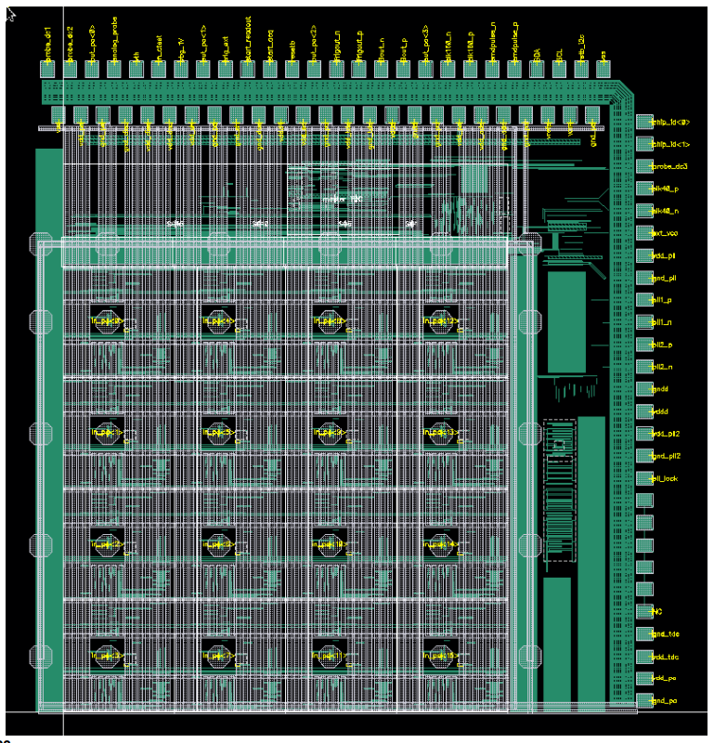
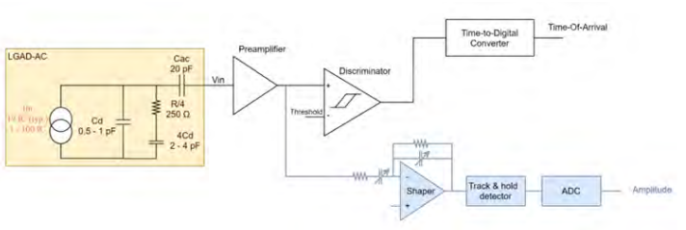
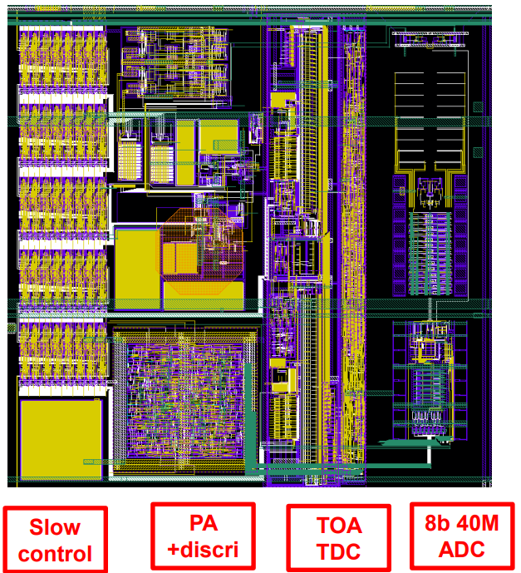
Proposal D – AC-LGAD (Low Gain Avalanche Diode) – EICROC
Develop a readout solution for AC-LGADs by considering three (4) options:
Develop the EICROC2 based on existing EICROC0 (4x4 pads):
EICROC1 (8x4 or 16x4 pads): 2023
EICROC2 (32x16 or 32x32 pads): 2024 - 2025
One pixel – EICROC0
4x4 500 um pixels
Preamp, discriminator – ATLAS ALTIROC.
I2C slow controls – CMS HGCROC.
TOA TDC – CEA-Irfu.
ADC (8b) – AGH Krakow and IJCLab (EICROC1, EICROC2).
Readout FIFO depth 8 (200 ns).
Jitter: 15-20 ps.
Power: 1-2 mW/Ch.
Collaboration by OMEGA/IJCLab/CEA-Irfu/AGH
One pixel

Slide 11
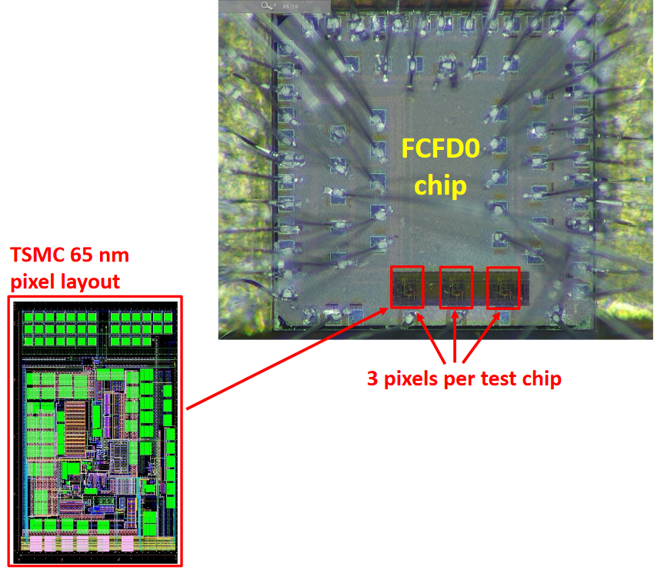
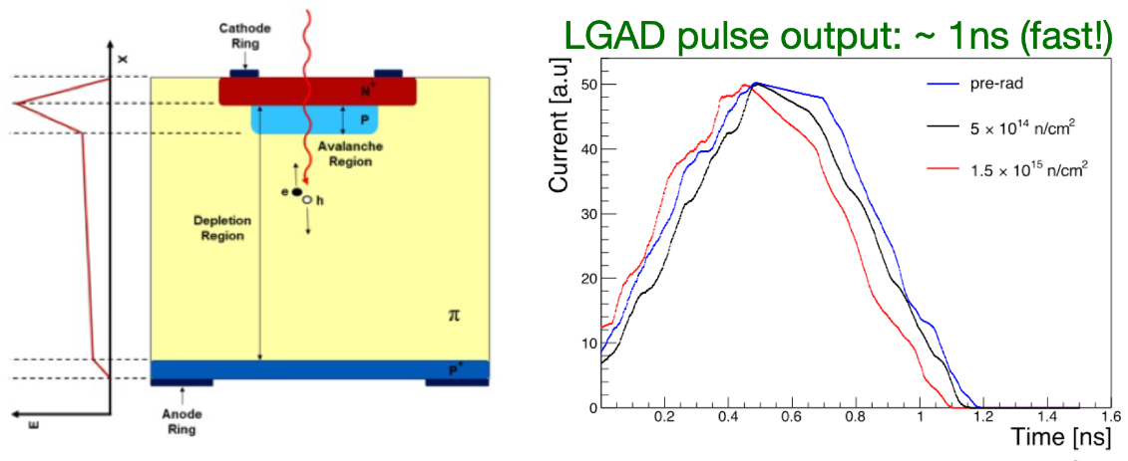
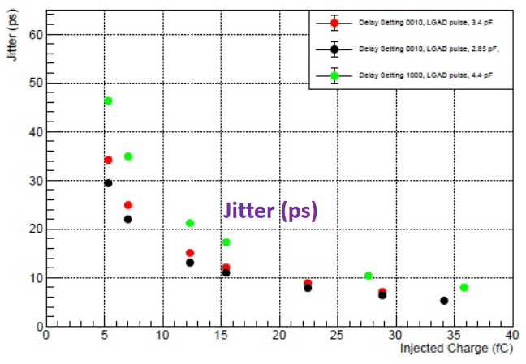
Proposal D – AC-LGAD (Low Gain Avalanche Diode) – FCFD & BTOF Service
2. Develop the FCFDv2 based on existing FCFDv0:
FCFDv1: 2023
FCFCv2: 2024 - 2025
TSMC 65 nm.
Timing precision: ~30 ps @ 5 fC; <10 ps @ 30 fC.
3. Barrel TOF Low Mass Service Hybrid
Development, design and construction of the power delivery and readout service system for the barrel TOF:
Connect to a row of AC-LGAD readout chips on a given TOF stave module.
Aggregate their data into a single data stream.
Deliver power distribution, sensor biasing, voltage regulation and slow control services to and from all readout chips and sensor modules.

Slide 12
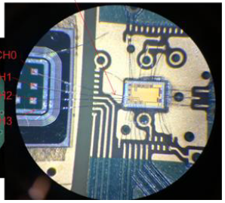
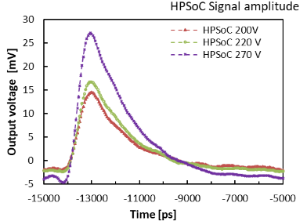
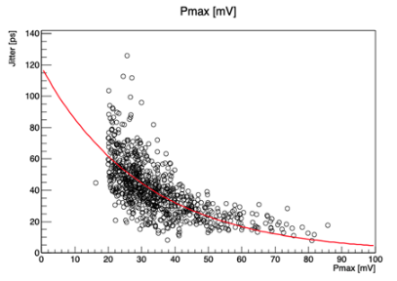
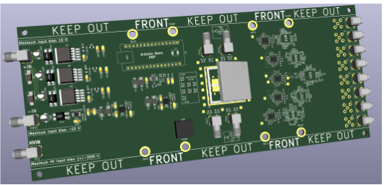
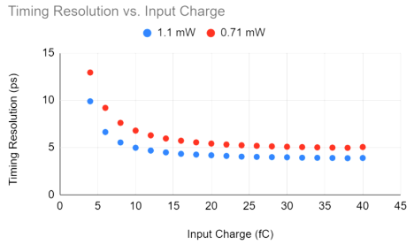
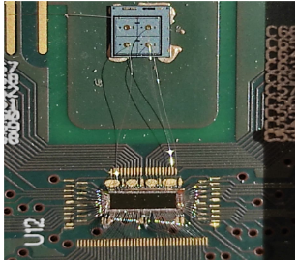
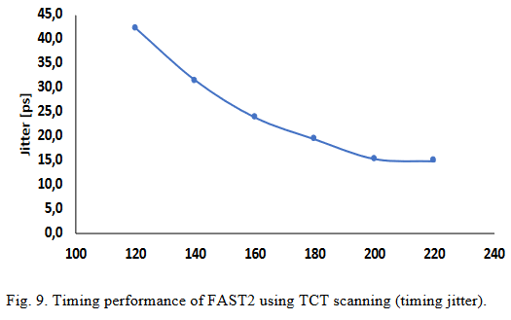
Proposal D – AC-LGAD (Low Gain Avalanche Diode) – 3rd Party
2. Investigate third-party ASIC solutions (SCIPP):
HPSoC (NALU) – December 2023
Waveform, TSMC 65 nm, 4 ch, ~3.6 mW/ch, Timing precision: 10 ps – 20 ps (goal).
b) ASROC (Anadyne) – August 2023
Discriminator, SiGe BiCMOS, 16 ch, ~ 1 mW/ch, Timing precision: 5 ps – 15 ps.
b) FAST (INFN) – May 2023
TDC, 110 nm CMOS, 16/20 ch, ~2 mW/ch, Timing precision: 15 ps – 45 ps.

Slide 13
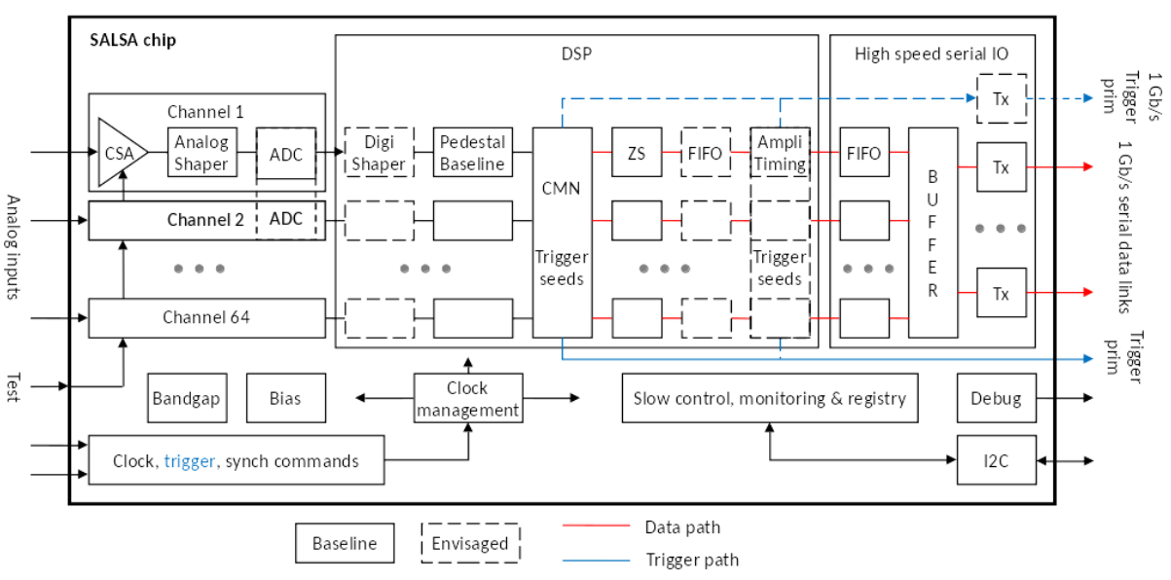
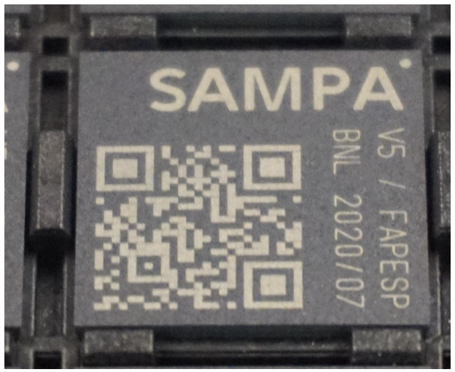
Proposal E – MPGD (Micro-Patterned Gaseous Detectors) – SALSA
Develop a readout solution for MPGDs, based on previous ASICs:
SALSA1: 2023
SALSA2: 2024
SALSA (pre-production): 2025
64-Ch, updated design from SAMPA V5, migrating to 65 nm CMOS.
Peaking time: 50 – 500 ns
Inputs: Cin optimized for 200 pF; Rates: >25 kHz/Ch (~100’s kHz); Dual polarity.
ADC: 12 bits, 5 – 50 MSPS.
Extensive data processing capabilities.
Triggerless and triggered operation.
Power: 15 mW/Ch
Several 1 Gbps links.
I2C configuration.
SALSA prototype submission – late 2022 ( a few channels).
Collaboration of Irfu CEA Saclay and U. of São Paulo.

Slide 14
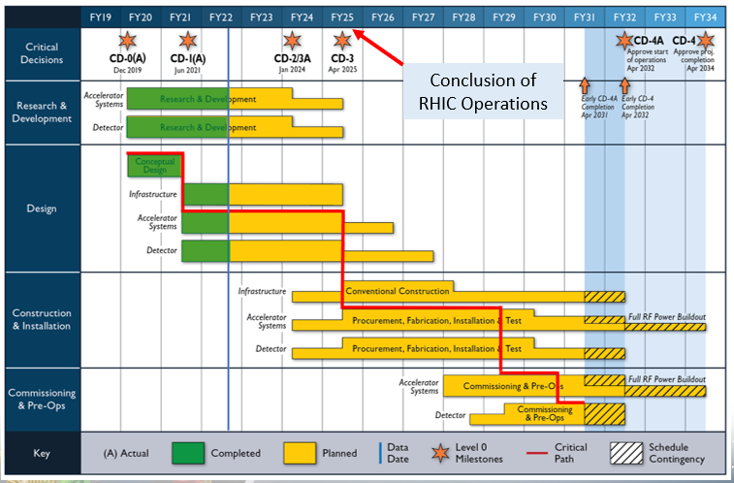
Project Timeline
Construction and Installation includes procurements and deliveries and are initiated at different times of this phase.
R&D until 4/2025.
(Most~1.5 Years)
Design until 9/2027.
(Most~2 Years)
4/2025 to 4/2031.
(~6 Years)
Bulk of Construction & Installation phase for Electronics: April 2025 – January 2030.
Installation of some items may be extended to April 2031.

Slide 15
eRD109 – Proposals: Cost & Timeline
Budget requests for each of the five (5) proposals:
 | File | Authors | FY23 ($k) | FY24 ($k) | FY25 ($k) | FY26 ($k)
A | eRD109_pECAL_readout_prototype_FINAL | G. Visser (IU), et al. | 79.7 | 31 - 41 | 31 - 41 | Not provided
B | eRD109CalorimeterReadout | N. Novitzky (ORNL), et al. | 39 | 34 | 26 | Not provided
C | eRD109-alcor | M. Ruspa (INFN), et al. | 60 | 60 | 60 | Not provided
D | ACLGAD_ASIC_Electronics_FY23 | Z. Ye (UIC), et al. | 192 (Note 1) | 220 | 700 | 100
E | eRD109_SALSA_proposal_vfinal1 | D. Neyret (CEA), et al. | 197 | Not provided | Not provided | Not provided
Note 1: Details of AC-LGAD development costs:
 | ACLGAD_ASIC_Electronics_FY23 | FY23 ($k)
1 | EICROC ASIC | 75
2 | FCFD ASIC | 40
3 | Barrel Low-Mass Service Hybrid | 44
4 | Third party ASIC Evaluation | 33

Slide 16
eRD109 – Summary
Addresses ASIC and Electronics R&D needs of the EIC.
Proposals received by October 2022 - DAC review October 2022.
Full funding approved - finalizing SOWs/contracts.
These 5 proposals are distinct, with some complementarity, cover and inform packing form-factors and integration into the various sub-detectors.
Developing the readout electronics by building upon previous developments, with design re-use as a guiding principle.
Engaging the community and benefiting from in-kind contributions.
Very active program, likely to grow with new proposals for FY24.
There is a suggestion to start the eRD proposal process earlier (April/May) to make funding coincident with FY cycles.

