Slide 1
Spokesperson Candidate Presentation
J. Lajoie
Iowa State University

Slide 2
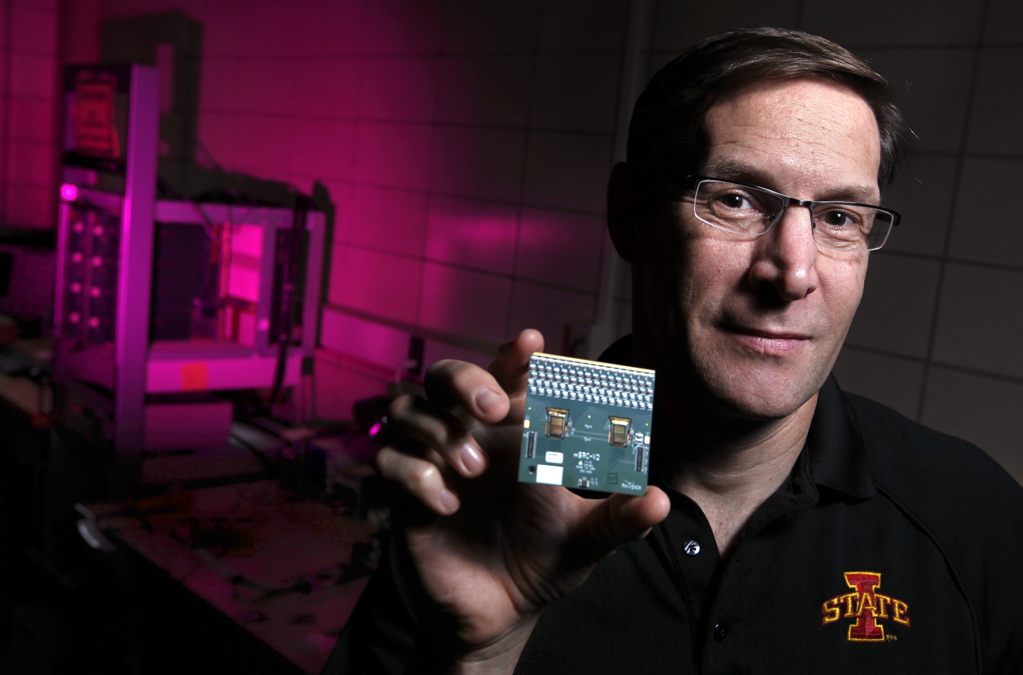
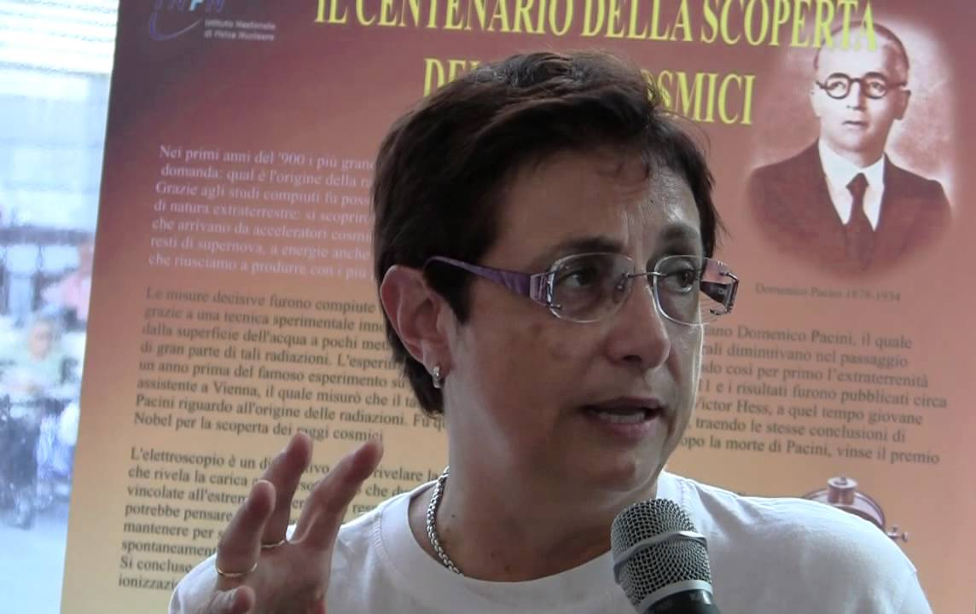
The Spokesperson’s Office
SP Candidate: John Lajoie
Deputy SP: Silvia Dalla Torre
Both SP and Deputy SP will dedicate to ePIC > 80% of their professional time
Well defined distribution of responsibilities

Slide 3
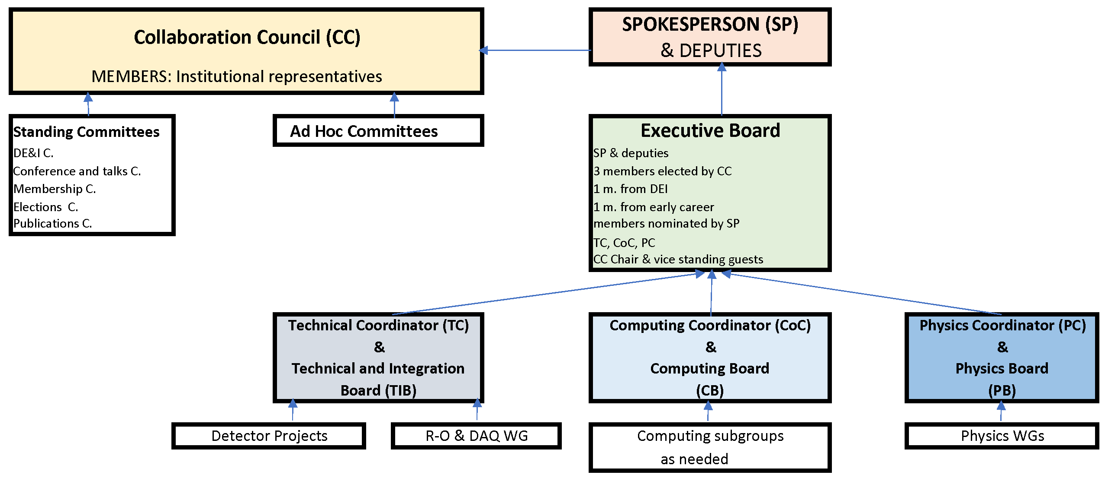
Collaboration Structure Including the Scientific Structure for the Next Two-year Term
Our proposal for
the management plan
Added scientific management structure

Slide 4
Key Features of the Management Plan
Tailored to the current phase in ePIC’s development
Emphasizes distributed leadership:
SP and Deputy SP with clear division in responsibilities
An active Executive Board to support the SP Office
Decision making process flows from management structure
Plan to engage international community and enable participation
Attention to continuing to develop the culture of ePIC:
Silvia and I are dedicated to making ePIC a collegial, friendly, safe, and welcoming environment for everyone
Support the development of junior scientists
Facilitate participation in ePIC

Slide 5
Thank You!
Silvia and I will be happy to answer your questions

