Slide 1
pfRICH Design
Alex Eslinger (Jlab) / Alexander Kiselev (BNL)
EPIC PID Working Group Meeting
4Nov22

Slide 2
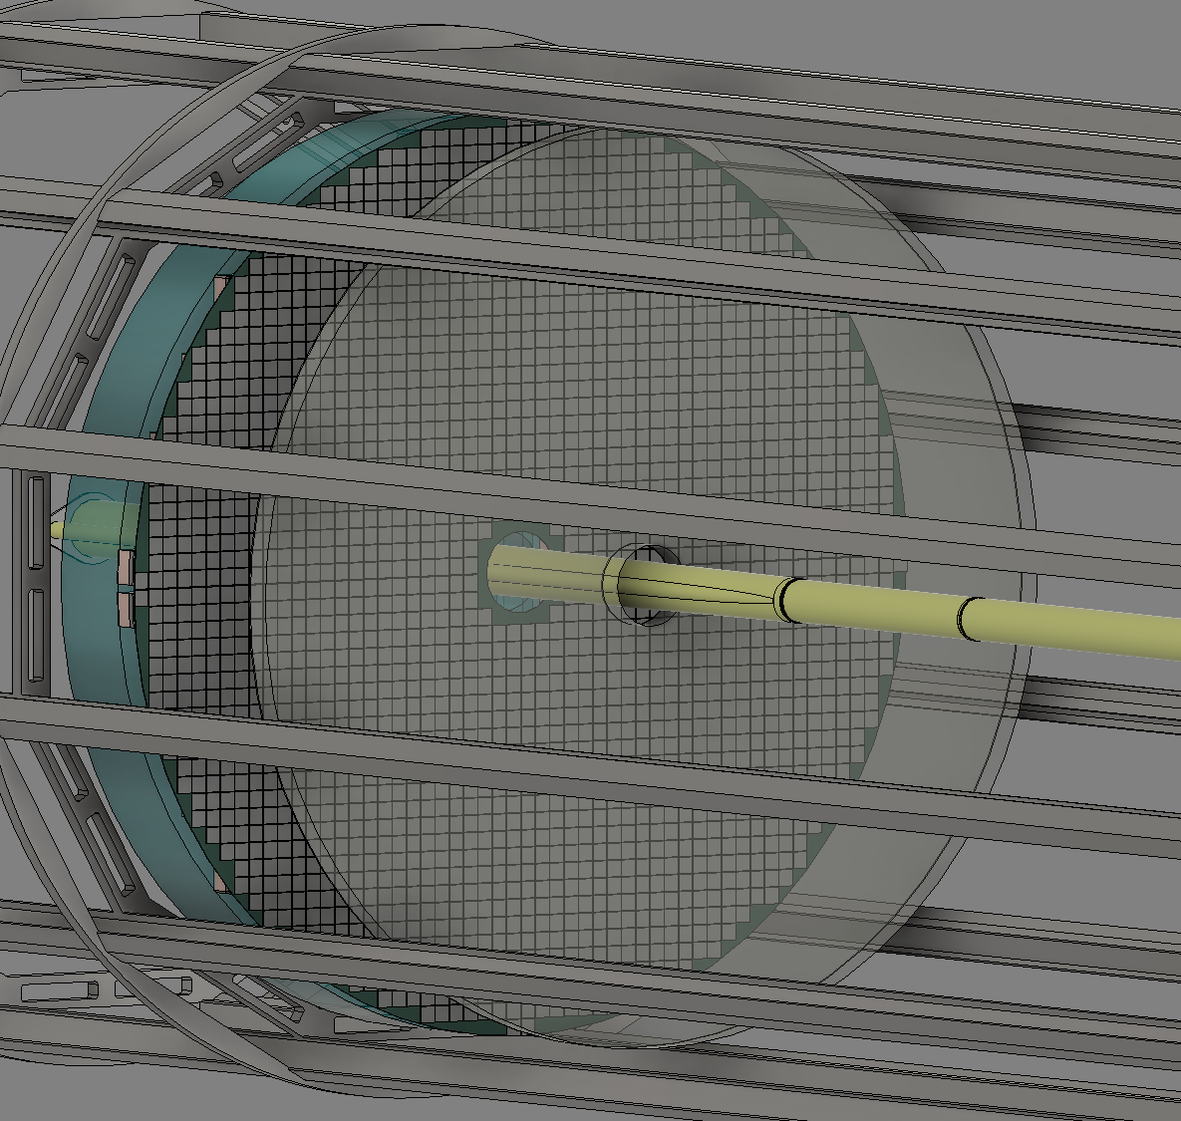
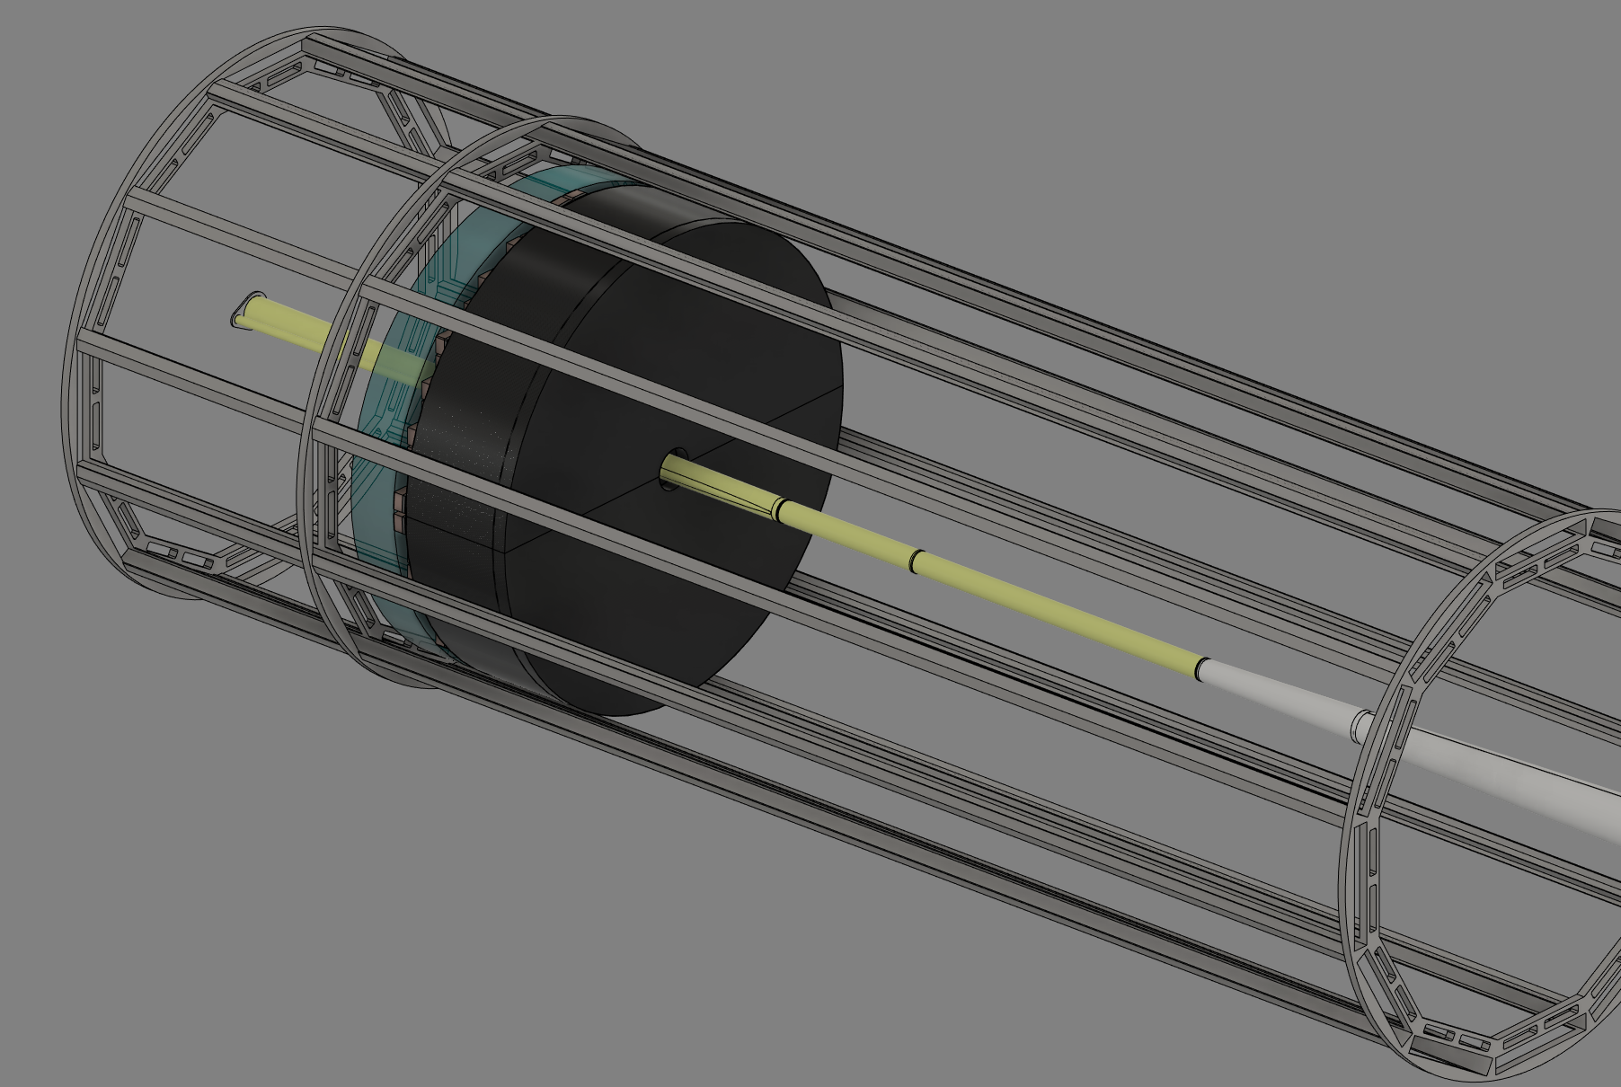
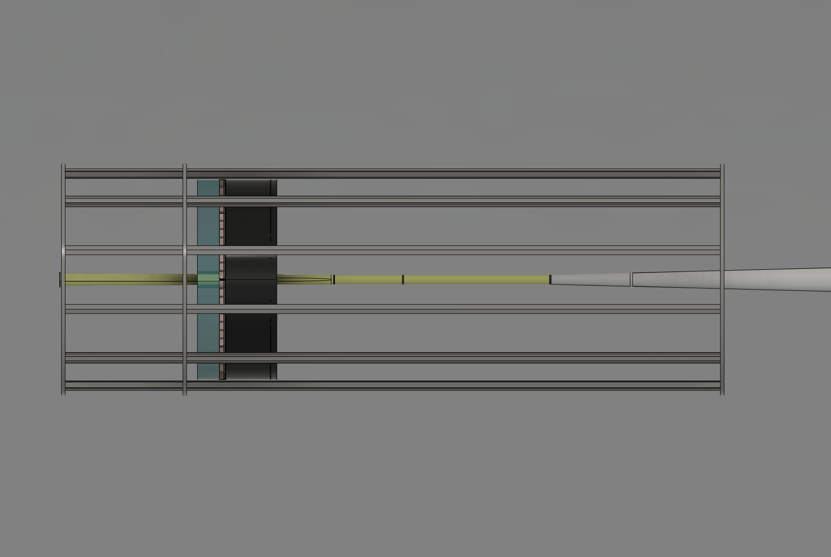
First Design Update
Aerogel
SiPM Sensors utilized (with associated cooling budget)
Intention: check to see if pfRICH could fit, provide a conceptual comparison to mRICH
DIRC Support
Frame
Sensor Plane
Beam Pipe
Allotted Space
For Readout
(Light Blue)
Est Cooling
Reqmt

Slide 3
Identified First Design Issues
Sensor choice (SiPM vs LAPPD)
Support structures unknown
Sensor tiling generic
Aerogel segmentation not considered
Cooling/Cabling/Services utilized placeholders
Material choices not considered
However, initial design served its purpose of showing what integration might look like and whether it might fit.

Slide 4
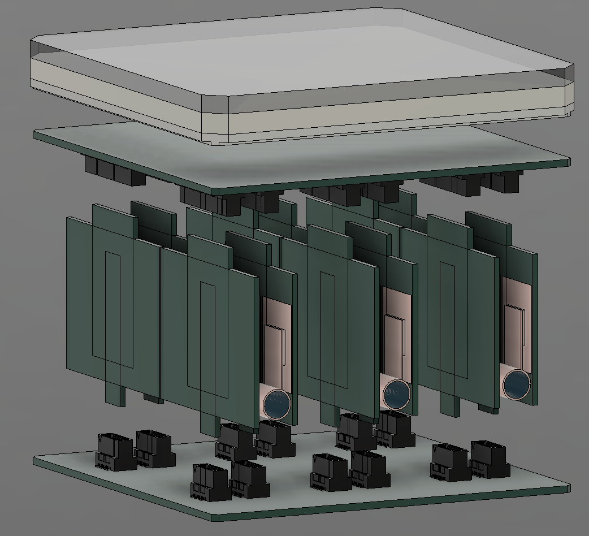
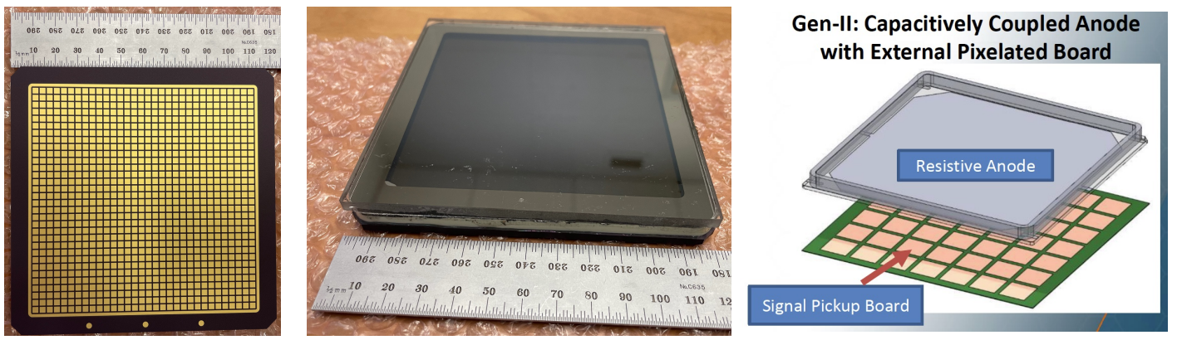
Sensor Choice
HRPPD Sensor chosen moving forward
  Reduced cooling load
General concept shown on left

Slide 5
Generic Tiling
Selected tiling arrangements for the sensors shown below – considerations include:
Symmetry to allow the sensor plane to be split in quadrants or halves (installation/removal/maintenance)
Packing efficiency

Slide 6
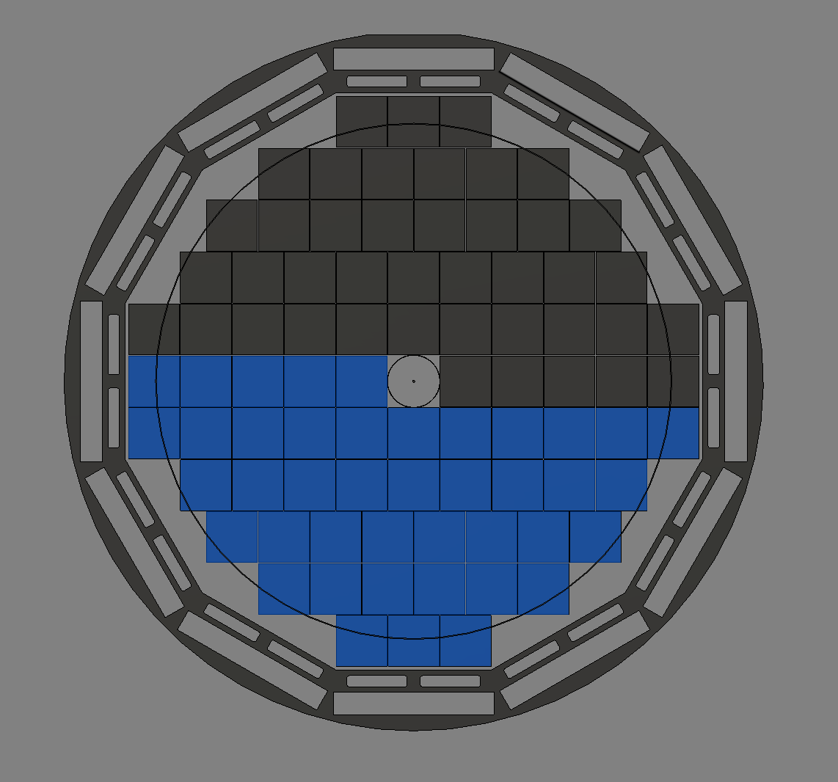
Sensor Tiling Scheme
Blue and Grey sections represent proposed “halving solution” for this layout.
The outer member is the DIRC support
On the inside we must consider the beam pipe size at this location

Slide 7
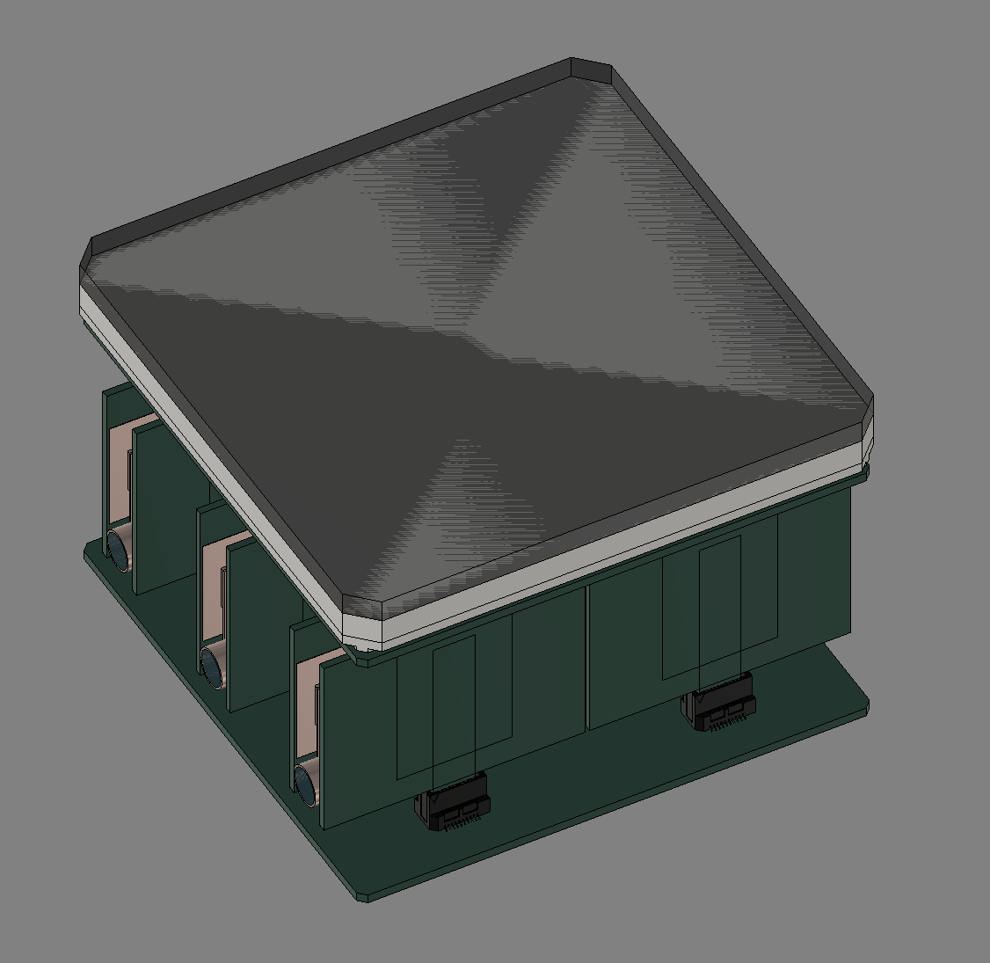
Proposed sensor Modifications
Cut the corners from each sensor to allow a fastening mechanism to pass through
(Not shown): create a small notch on the backside in the ceramic to interface with a support plate

Slide 8
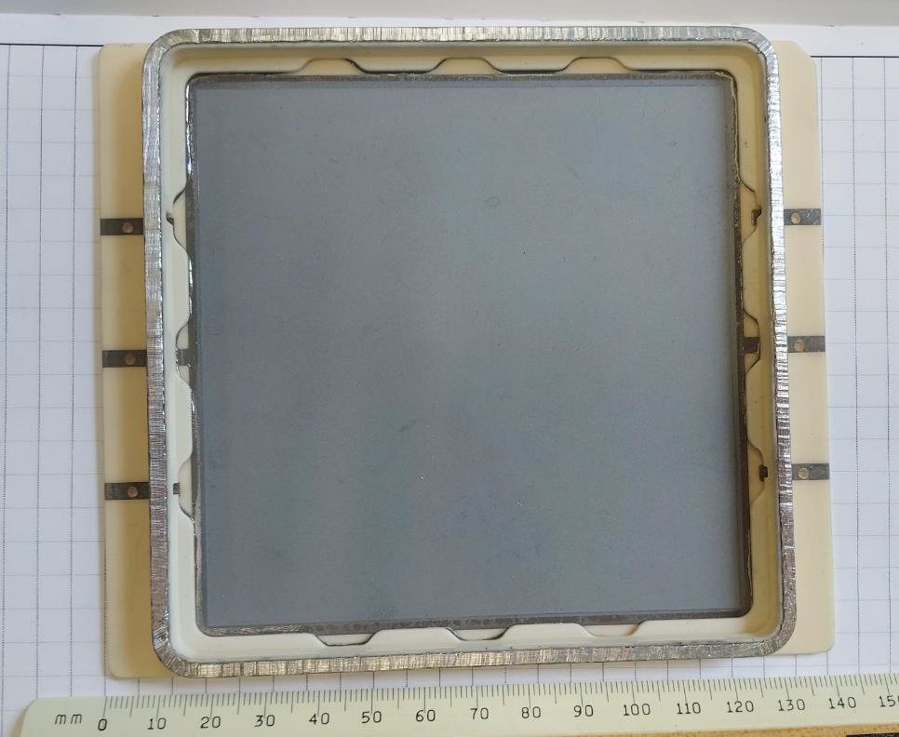
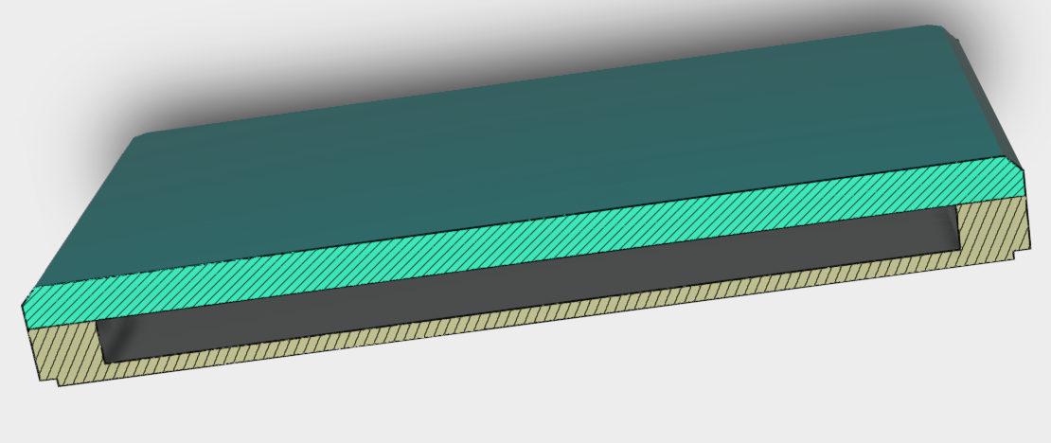
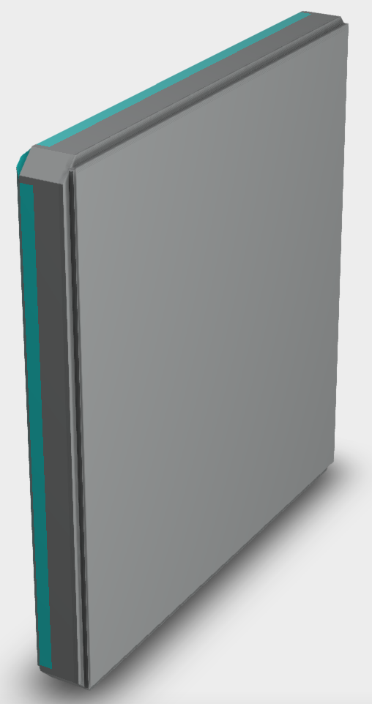

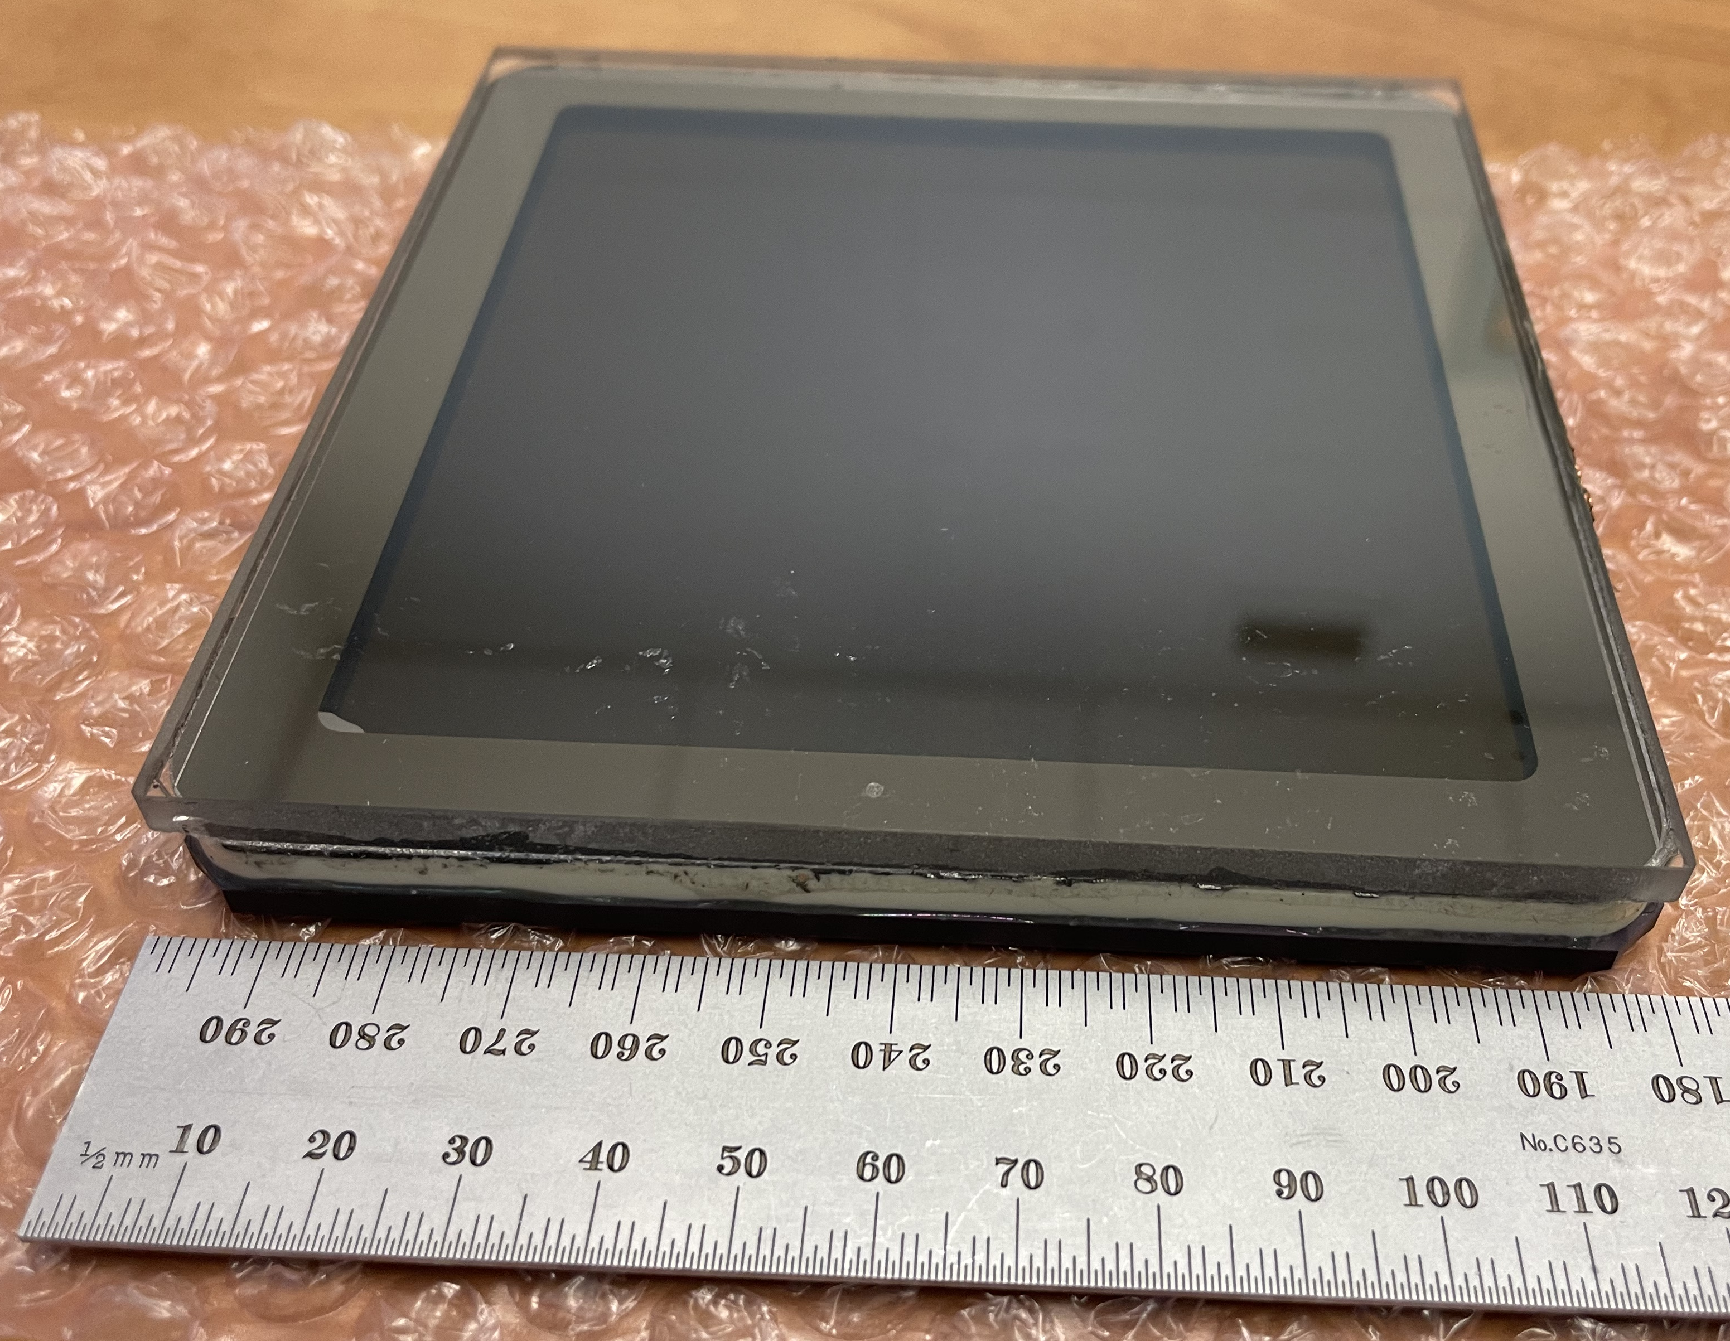
Capacitively coupled HRPPD
Both designs can seemingly be improved
DC-coupled HRPPD
Need a design more suitable for a gap-free flat surface coverage ...
... yet with minimal modifications
Window tapering (optional) may be required to improve the geometric efficiency

Slide 9
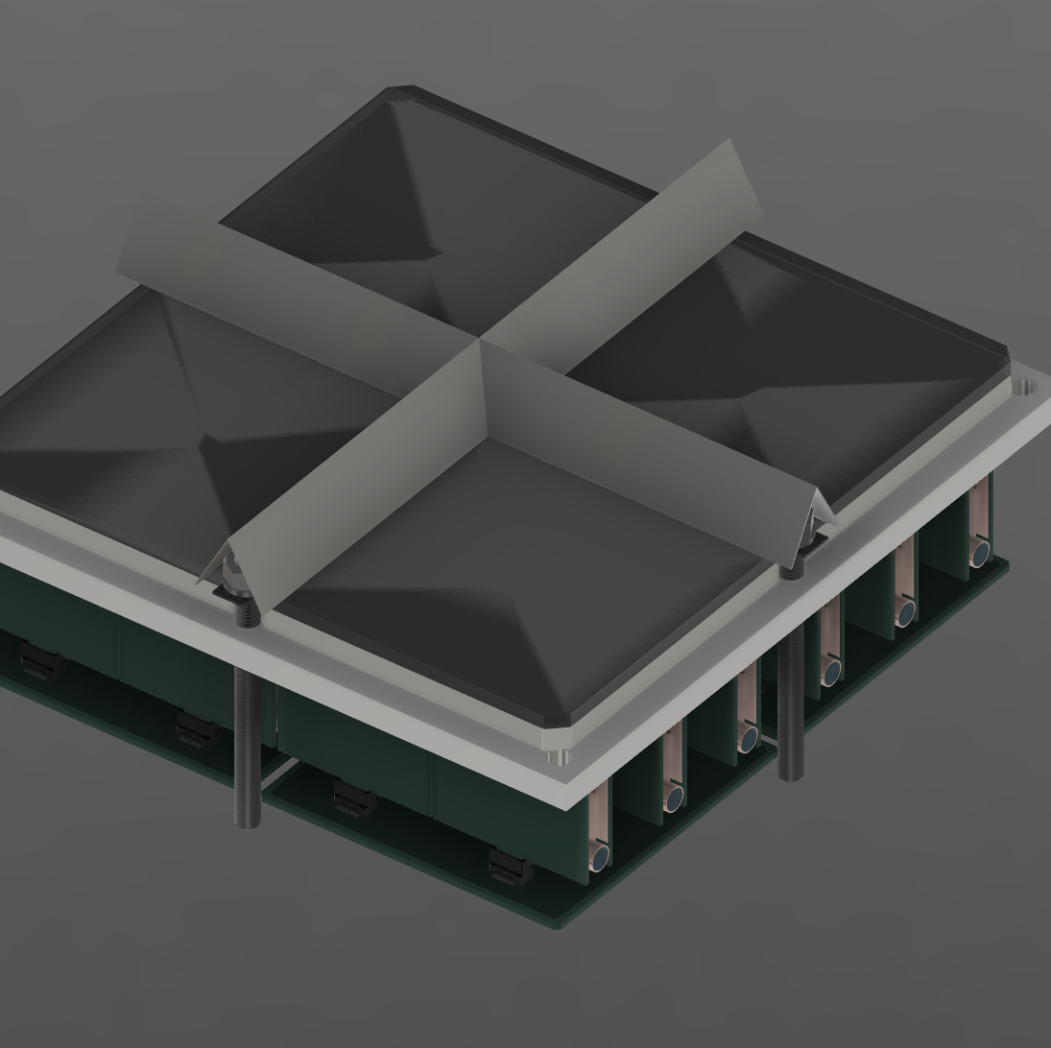
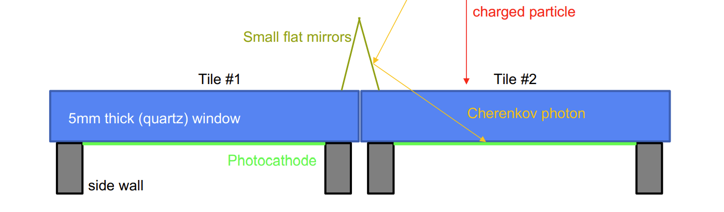
Sensor Tiling Support Concept
Create a backing plate to hold multiple sensors and pass-through hardware in the cut-out corners
Make a small, thin, and rigid grid on the sensor front side to provide a larger surface area for the hardware
Backing Plate

Slide 10
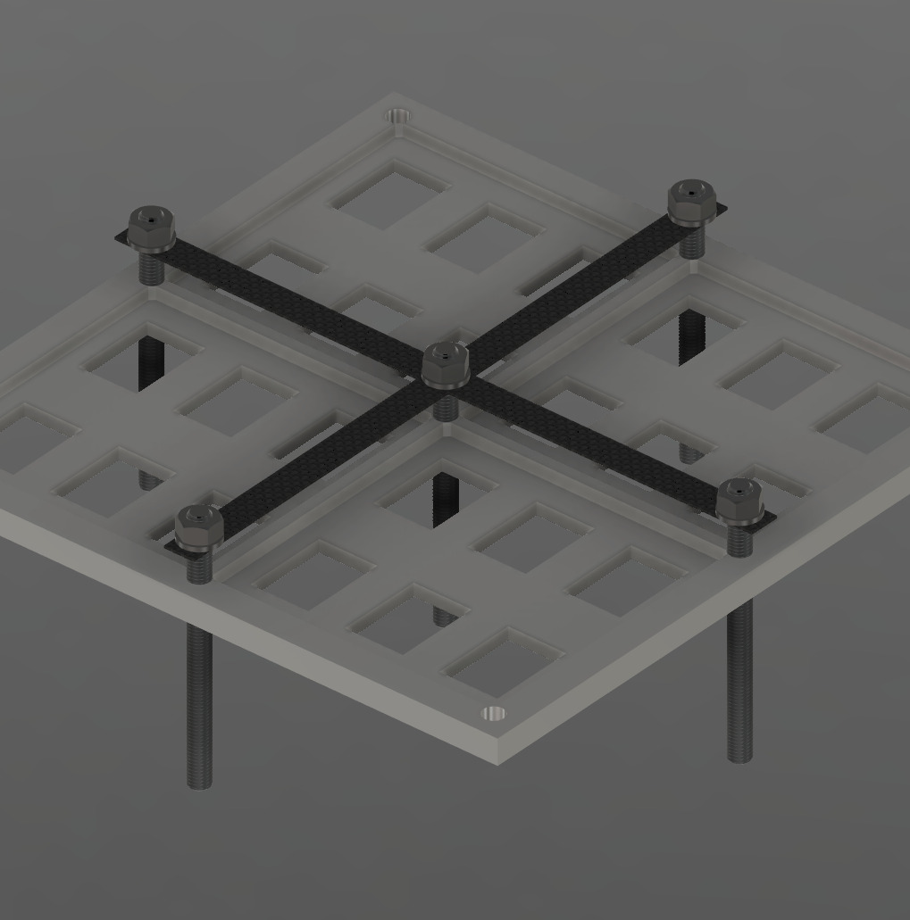
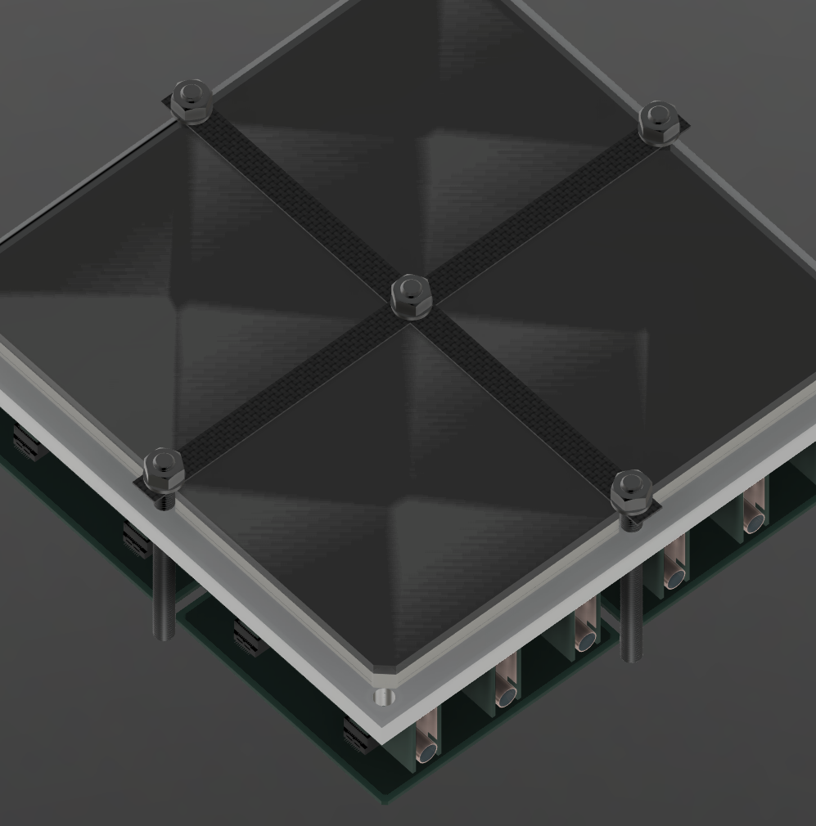

Slide 11
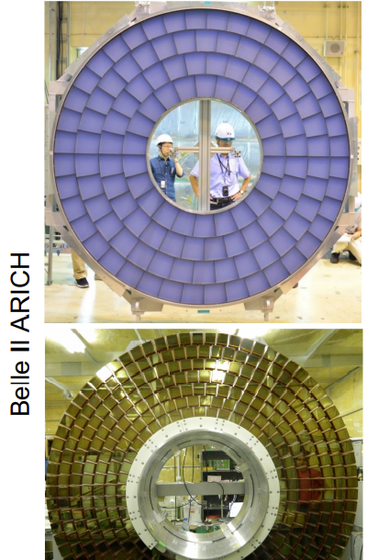
Aerogel Segmentation
Considering a radial arrangement like Belle II ARICH
Still needs to be worked out in CAD to fit within the 12-sided DIRC support
Needs to segment to split around the beam pipe (installation/removal/maintenance)

Slide 12
Looking Forward
Expansion volume: how to keep it air and light-tight while maintaining halves and quadrants
Determine where mirrors will be placed and build support plans
Continue working on full support structure
How to incorporate half-level tiling in the current scheme
Determine material choices in key locations
Determine local services paths
Continue to consider installation/removal/maintenance

Slide 13
Questions?

