Slide 1

Topics in Small-x DIS: From diffractive/elastic scattering to nuclear TMDs
Yuri Kovchegov
The Ohio State University

Slide 2
Outline
Diffraction in DIS at small x:
  Diffractive scattering in the black disk limit.
  Low-mass diffraction.
  High-mass diffraction: small-x evolution for diffractive scattering in DIS.
Nuclear TMDs:
  The nuclear Sivers function and its relations to the TMDs of a nucleon.

Slide 3
Diffraction at Small x

Slide 4
Black Disk Limit
Start with basic scattering theory: the final and initial states are related by the S-matrix operator,
Write it as
The total cross section is
where the forward matrix element of the S-matrix operator is
and we have used unitarity of the S-matrix

Slide 5
Black Disk Limit
Now, since
the elastic cross section is
The inelastic cross section can be found via
In the end, for scattering with impact parameter b we write

Slide 6
Unitarity Limit
Unitarity implies that
Therefore
leading to the unitarity bound on the total cross section
Notice that when S=-1 the inelastic cross section is zero and
This limit is realized in low-energy scattering!

Slide 7
Black Disk Limit
At high energy inelastic processes dominate over elastic. Imposing
we get
The bound on the total cross section is (aka the black disk limit)
The inelastic and elastic cross sections at the black disk limit are

Slide 8
Dipole picture of DIS
In the dipole picture of DIS the virtual photon splits into a quark-antiquark pair, which then interacts with the target.
The total DIS cross section and structure functions are calculated via:

Slide 9
Dipole Amplitude
The total DIS cross section is expressed in terms of the (Im part of the) forward quark dipole amplitude N:
b is the Fourier conjugate to q
with t = - q², making the dipole
amplitude N similar to the GPDs
at zero skewedness.
with rapidity Y=ln(1/x)

Slide 10
Notation
At high energies
while the dipole amplitude N is the imaginary part of the T-matrix (S=1+iT), such that
The cross sections are
We see that N=1 is the black disk limit. Hence .

Slide 11
Dipole Amplitude
The dipole-nucleus amplitude
as a function of the dipole size is
Black disk
limit,
Color
transparency
1/Q_{S}

Slide 12
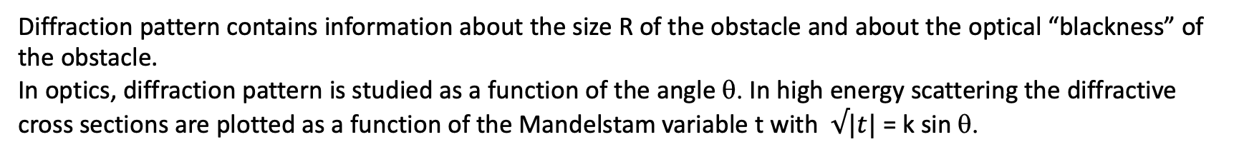
Diffraction in optics
Diffraction pattern contains information about the size R of the obstacle and about the optical “blackness” of the obstacle.
In optics, diffraction pattern is studied as a function of the angle θ. In high energy scattering the diffractive cross sections are plotted as a function of the Mandelstam variable t with $√|t|$ = k sin θ.

Slide 13
Optical Analogy
Diffraction in high energy scattering is not very different from diffraction in optics:
both have diffractive maxima and minima:
Coherent: target stays intact;
Incoherent: target nucleus breaks up, but nucleons are intact.

Slide 14
Diffraction terminology

Slide 15
Low-Mass Diffraction

Slide 16
Quasi-elastic DIS
Consider the case when nothing but the quark-antiquark pair is produced:
The quasi-elastic cross section is then
Buchmuller et al ‘97, McLerran and Yu.K. ‘99

Slide 17
Diffraction on a black disk
For low Q² (large dipole sizes) the black disk limit is reached with N=1
Diffraction (elastic scattering) becomes a half of the total cross section
Large fraction of diffractive events in DIS is a signature of reaching the black disk limit!
HERA: ~15% (unexpected!) ; EIC: ~25% expected from saturation

Slide 18
Diffractive over total cross sections
Here’s an EIC measurement which may distinguish saturation from non-saturation approaches (from the 2012 EIC White Paper):
sat = Kowalski et al ‘08, plots generated by Marquet
no-sat = Leading Twist Shadowing (LTS), Frankfurt, Guzey, Strikman ‘04, plots by Guzey

Slide 19
Exclusive Vector Meson Production
An important diffractive process which can be measured at EIC is exclusive vector meson production:

Slide 20
Exclusive VM Production:
Probe of Spatial Gluon Distribution
Differential exclusive VM production cross section is
the T-matrix is related to the dipole amplitude N:
Can study t-dependence of the dσ/dt and look at different mesons to find the dipole amplitude N(x,b,Y) (Munier, Stasto, Mueller ’01).
Learn about the gluon distribution in space. Again, similar to GPDs.
Brodsky et al ‘94, Ryskin ‘93

Slide 21
Exclusive VM Production as a Probe of Saturation
Plots by T. Toll and T. Ullrich using the Sartre event generator
(b-Sat (=GBW+b-dep+DGLAP) + WS + MC, from the 2012 EIC White Paper).
J/psi is smaller, less sensitive to saturation effects
Phi meson is larger, more sensitive to saturation effects

Slide 22
High-Mass Diffraction

Slide 23
What if M_{x} is large?
If ln(M_{X}/Q) is large, need an evolution equation that re-sums all those gluon emissions contributing to M_{X}.
One can ask questions like whether large M_{X} or small M_{X} are more probable?
Also, what happens in the black disk limit? Only completely elastic and inelastic (no rapidity gaps) processes
should remain, with 50% probability each.

Slide 24
Diffraction with fixed M_{X}
Consider the differential cross section
for diffractive dissociation
with the fixed mass M_{X}.
It can be written as
where S_{D} is the (exclusive) dipole S-matrix with the rapidity gap greater than Y₀.

Slide 25
Evolution equation for diffraction
The “diffractive S-matrix”
obeys the following evolution
equation (YK, E. Levin, 2000):
The initial condition is given by
with the dipole amplitude N found from the standard nonlinear dipole evolution.

Slide 26
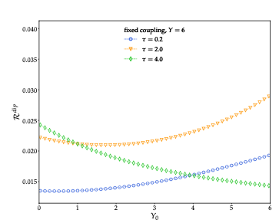
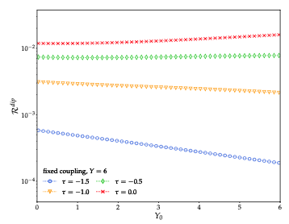
Can we measure high-mass diffraction at EIC?
Need large rapidity gap and large mass M_{X}. This is tough at the EIC.
Perhaps A-dependence may help reveal evolution signatures?
Dependence on M_{X} may also signal effects of nonlinear small-x
evolution and saturation
(see A.D. Le, A. H. Mueller, S. Munier, 2021, 2103.10088 [hep-ph];
A.D. Le, 2103.07724 [hep-ph]).
outside
saturation
region:
inside
saturation
region:

Slide 27
Quasi-Classical Sivers Function
based on YK, M. Sievert, Phys.Rev.D 89 (2014) 5, 054035; e-Print: 1310.5028 [hep-ph]

Slide 28
Motivation
Are nuclear TMDs simply proportional to the nucleon TMDs, with some shadowing coefficients, like the PDFs?
We want to evaluate TMDs in the Glauber-Mueller (GM)/McLerran-Venugopalan (MV) quasi-classical approximation.
This approximation is valid for a large nucleus or a “dense” proton.
I will talk about the nucleus simply because the nuclear atomic number A allows for a controlled approximation: quasi-classical physics resums powers of
Note that the GM/MV quasi-classics is not just a model but is a valid QCD asymptotics in the high-energy & large-A limit.

Slide 29
Quark Production
Start with the SIDIS cross section at large or moderate x:
The kinematics is the standard TMD one,
The result is
Wigner distribution of nucleons
LO cross sect
Wilson lines (SIDIS staple)

Slide 30
Quasi-Classical STSA in SIDIS
To generate Single Transverse Spin Asymmetry (STSA) we need spin-dependence and a complex phase (J. Qiu). They may come from three sources:
  Sivers functions of the (polarized) nucleons: transversity channel
  Orbital rotation due to OAM (just gives real OAM-dependence)
  Going beyond classical approximation in D_{xy} by including extra rescatterings per nucleon (the odderon): this gives a phase but is A-suppressed. Hence, we will drop it.

Slide 31
Quasi-Classical STSA in SIDIS
When the dust settles one gets
J = L+S = total spin of the nucleus (analogue of proton spin)
L = net OAM of the nucleons (analogue of quark and gluon OAM)
S = net spin of all nucleons (analogue of net spin of quarks and gluons)
S_{xy} = dipole rescattering S-matrix
W = Wigner distributions of nucleons, unp = unpolarized (may have <S>=0), trans = transversely polarized, with T-even and T-odd nucleon Wigner functions

Slide 32
OAM and Transversity channels
The final formula is a sum of the contributions of the OAM and Transversity (Sivers function density) channels:
The non-perturbative input comes though the Wigner functions and LO TMDs: the dipole scattering is perturbative due to Q_{s} >> Λ_{QCD}.
Note that the nuclear Sivers function depends on both the nucleon Sivers function and on the unpolarized quark TMD in a nucleon! Not like PDFs.
OAM
channel
Transversity channel

Slide 33
Quasi-Classical STSA in DY
The DY process in the quasi-classical approximation looks as follows:
Note that ordering interactions along the x⁻ direction makes the reversal of the Wilson line direction between SIDIS and DY explicit.

Slide 34
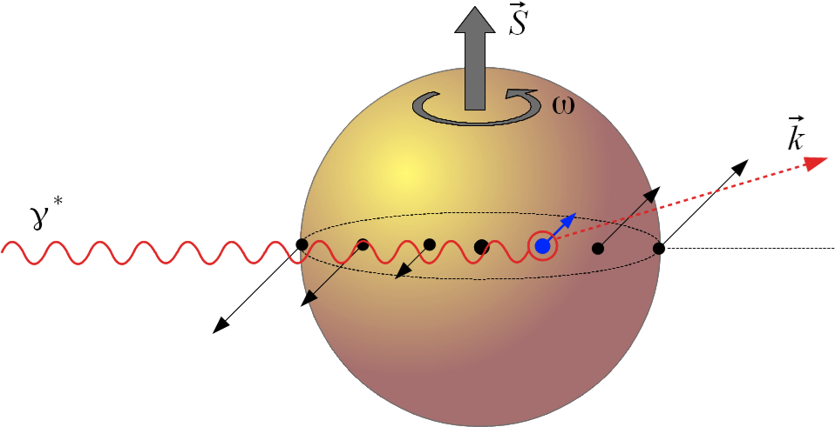
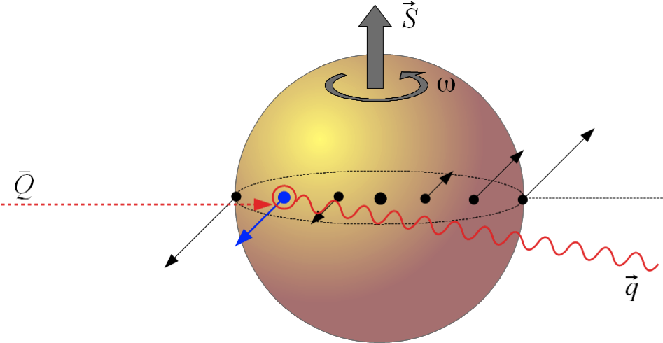
Origin of Sign Reversal
In the transversity (Sivers density) channel the origin of the sign reversal (Brodsky, Hwang, Schmidt ‘02; Collins ‘02) is simple: the (LO) Sivers function of the nucleon changes sign, and multiple rescatterings do not affect this.
In the OAM channel the reversal ultimately happens for the simple reason pictured here:

Slide 35
Classical picture of STSA in Drell-Yan
Think of a transversely polarized proton/nuceus as a rotating disk with the axis perpendicular to the collision axis
The proton/nucleus is not transparent: it has some amount of screening/shadowing (e.g. gray disk, black disk, etc.)
Incoming anti-quark (in DY) is more likely to interact near the “front” of the proton/nucleus: hence, due to the rotation, the outgoing virtual photon is more likely to be produced left-of-beam, thus generating STSA.

Slide 36
Classical picture of STSA in SIDIS
Ditto for SIDIS: except now the incoming virtual photon is more likely to interact near the “back” of the proton/nucleus, for the produced quark to be able to escape out of the proton/nuclear remnants.
Owing to the same rotation, the outgoing quark is more likely to be produced right-of-beam, thus generating STSA in SIDIS with the opposite sign compared to STSA in DY!

Slide 37
Summary
It appears that STSA can be easily interpreted as a combination of OAM and some amount of (anti-)shadowing.
Sign-flip between STSA and DY has a very simple interpretation in this framework too.
More generally, nuclear TMDs are build out of nucleon TMDs, with the mixing among the latter to produce the former. Different from nuclear PDFs.

Slide 38
Conclusions
Too early for conclusions…
Diffraction:
  Saturation evidence can be found by studying the M_{X} and, possibly, A-dependence of the diffractive dissociation cross section.
  High-mass diffraction: interesting, but can we do it at EIC? If yes, how?
  Studying the detailed structure of the final state with the rapidity gap may help us better understand and detect the onset of saturation.
Nuclear TMDs:
  Not related to nucleon TMDs in a simple way, mixing.
  Can this be measured at the EIC?
  Can we learn something about the dynamical origin of proton TMDs from the nuclear TMDs?

Slide 39
Backup Slides

Slide 40
Wilson lines
Here
is the quark dipole scattering S-matrix with
denoting Wilson lines.
In the quasi-classical approximation D_{xy} is real!

Slide 41
Dipole scattering in the GM/MV limit
The dipole S-matrix
taken in the symmetrized form
in the GM/MV approximation is (note – all real)
This corresponds to multiple rescatterings as shown here:
x
y

Slide 42
Forward quark production
The eikonal quark propagator is given by the Wilson line
with the light cone coordinates

Slide 43
Forward quark production
Dumitru, Jalilian ‘02
The amplitude squared is
The quark dipole scattering amplitude is
Hence quark production is related to the dipole amplitude! Valid both in the quasi-classical Glauber-Mueller/McLerran-Venugopalan multiple-rescattering approximation and for the LLA small-x evolution (BFKL/BK/JIMWLK).

Slide 44
LO TMDs
and are the LO unpolarized quark TMD (in a nucleon) and the “nucleon” Sivers function:
They can be arbitrary non-perturbative objects.
Resulting quasi-classical Sivers function can be used as initial condition for evolution equations (e.g. CSS for s ~Q² or small-x evolution if s>>Q²).

Slide 45
Rigid Rotator Model
To get the feel for what the result is like, our main formula can be evaluated using a rigid-rotator nucleus with simple (powers of k_{T}) models of LO TMDs.
The result is (for k_{T} not much larger than Q_{s})
Note a “new” functional form for Sivers function due to the OAM channel (not a Gaussian).
OAM channel
Transversity channel

Slide 46
Rigid Rotator Model
The OAM contribution in this model (!) calculation is shown below (arbitrary units). It changes sign as a function of k_{T}.

Slide 47
Rigid Rotator Model
The transversity (Sivers density) contribution comes out to be a simple Gaussian (in this calculation); units are again arbitrary:

Slide 48
STSA at Large-k_{T}
For k_{T} >> Q_{s} we get
At high-k_{T} the transversity (Sivers density) channel dominates over the OAM one.
However, the OAM channel dominates over a fairly broad range
(if p_{T} ~ m_{N}).
OAM channel
Transversity channel

