Slide 1

Exclusive Scattering on Nuclei
CFNS Workshop on a Second EIC Detector
6–8 December 2022
Stony Brook University
Charles E. Hyde
Old Dominion University

Slide 2
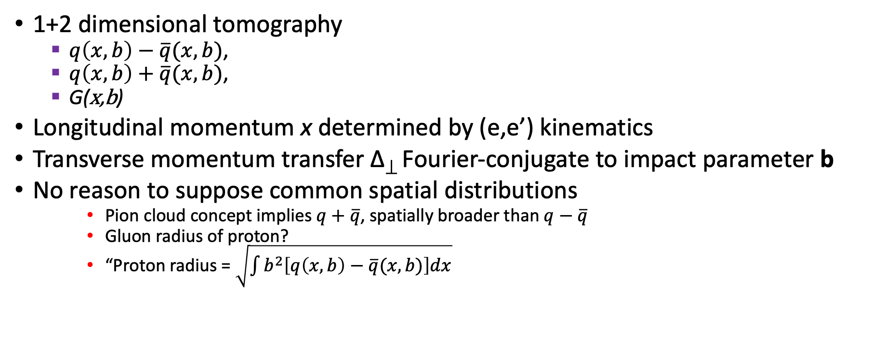
Spatial Properties of the Nucleon
1+2 dimensional tomography
  $q\left(x,b\right)−\overline{q}(x,b)$,
  $q\left(x,b\right)+\overline{q}(x,b)$,
  G(x,b)
Longitudinal momentum x determined by (e,e’) kinematics
Transverse momentum transfer Δ⟘ Fourier-conjugate to impact parameter b
No reason to suppose common spatial distributions
    Pion cloud concept implies $q+\overline{q}$, spatially broader than $q−\overline{q}$
    Gluon radius of proton?
    “Proton radius = $\sqrt{\int{b^{2}\left[q\left(x,b\right)−\overline{q}(x,b)\right]dx}}$
t=Δ²

Slide 3
Exclusive scattering on the Nucleon
eN→eN𝛾
eN→eNV, V = 𝝆⁰, 𝜙, J/𝛹, …etc.
No direct measurement of q(x,b), but strong constraints, (dispersive integrals, etc.)
Flavor sensitivity (u,d,s) from
  ep→ ep𝛾 vs. en→ en𝛾
  ep→ ep 𝝆⁰ vs. ep→en𝝆⁺ or ep→epω
  ep→ eK⁺𝛬
Quark vs. Gluon sensitivity
  ep→ ep𝛾 ,
  ep→ ep𝜙,
  ep→ ep J/𝛹

Slide 4
Exclusive Scattering on Nuclei
e ^{Z}A→ e ^{Z}A𝛾, e ^{Z}A→ e ^{Z}A𝜙, e ^{Z}A→ e ^{Z}AJ/𝛹, etc.
Convolution of nucleon spectral functions in nuclei
with nucleon GPDs
  R.Dupre, S.Scopetta EPJA 52 (2016) 159 →
  S.Fucini, S.Scopetta, M. Viviani, PRC 98 (2016) 015203
    TOPEG Event generator
  S. Liuti, S. Taneja, PRC 72 (2005) 034902.
  V. Guzey, arXiv.org:0907.4124 [hep-ph]

Slide 5
Nuclei as quark-gluon structures
Effects are not necessarily small
Nuclear Hadrodynamics:
  Relativistic N, 𝜌, ω, 𝜎, 𝜋 fields;
  Proton mass modified in nuclear medium by ≈ factor of 2!
Nuclear Effects vary with flavor (q, g) and with momentum (x).
  Some non-nucleon dynamics in S. Liuti, S. Taneja, PRC 72 (2005) 034902

Slide 6
Quark-Gluon
Structure of Nuclei
EMC, Anti-shadowing, Shadowing, Saturation to be studied at EIC with Jets, SIDIS, TMDs, etc
  Phenomenology suggest anti-shadowing is primarily glue.
Exclusive scattering has an important role to play
Shadowing is the reference against which we must assess signals of Saturation.
Spectator tagging on d, ³He, etc provides a reference “nearly on-shell” neutron, and enables the study of medium effects in those same nuclei

Slide 7
Challenges of Exclusive Scattering
Exclusivity
  Recoil nucleus lost in 10𝜎 beam envelope
  Need near hermetic veto on inelastic/break-up channels
    Forward p, n, even 𝛾
      3-layer ZDC: High resolution PreCAL of ~5X₀ for photons < 100 MeV
      20X₀ EMCal for high energy gammas,
      HCal for neutrons
    Daughter nuclei: Rigidity K = P_{A}/Q_{A}
      Secondary focus extends tag/veto to |1–K’/K₀ | ≥ 0.01
      Resolves ΔA ≥ 1 up to Zr and ΔA≥2 up to Pb.
Momentum transfer Δ^{μ} resolution
  Nuclear size ∼ (1 fm) A^{1/3} ➔ Diffractive minima at ∼ 0.2GeV/A^{1/3}
  Medium to heavy nuclei, beam momentum spread is ≥ 0.2GeV/A^{1/3}

Slide 8
Exclusivity Tagging or Inclusive Veto?
Proton, 275 GeV
  Maximal luminosity tune
    Beam rms p⊥ at IP = 0.040 GeV/c
    10𝜎 beam envelope = 0.400 GeV/c
  Maximal acceptance tune
    10𝜎 beam envelope ≈ 0.200 GeV/c
  IP-6 Acceptance for exclusivity tag of final state proton:
    p⊥ ≥ 0 for x_{B} ≥ 0.1
    p⊥ ≥ (87%)(10𝜎) for x_{B} ≥ 0.05
    p⊥ ≥ (97%)(10𝜎) for x_{B} ≥ 0.025
  IP-8 with secondary focus: factor of 10 improvement vs x_{B}
    p⊥ ≥ 0 for x_{B} ≥ 0.01
    p⊥ ≥ (87%)(10𝜎) for x_{B} ≥ 0.005
    p⊥ ≥ (97%)(10𝜎) for x_{B} ≥ 0.0025

Slide 9
Nuclear Exclusivity
4He P = 137.5 GeV per nucleon
  Beam envelope: 10𝜎 in P⊥ (He) ≈ 1.2 GeV/c
  First Diffractive minimum in ⁴He ≈ 0.6 GeV/c
Veto breakup channels in all nuclei ≥ ⁴He

Slide 10
Incoherent / Inelastic tag/veto
Ejected nucleons, nuclear fragments, residual nuclei
Spectator or “active” nucleons ejected in incoherent ep→epV reactions in nuclei detected in “off-momentum” detectors and ZDC.
  Approx 20% of nucleons in nuclei have intrinsic momenta > p_{F} ≈ 0.27 GeV/c
  In a heavy nucleus with P = 110 GeV/c, this is an emission cone > 2.7 mrad
    Start to lose acceptance in far-forward trackers and ZDC
Tag the residual nuclei !
  Nuclear magnetic rigidity K = (ZP₀) A/Z. (P₀ = storage ring setting for proton)
  Daughter nucleus ^{A’}Z’ ➔ K’ = (ZP₀) A’/Z’
  ¹⁶O to ⁹⁰Zr, A-1 daughter nuclei:
    1%<|K-K’|/K < 7%
    100% tagging with secondary focus proposed for IR-8, 0% tagging in IR-6

Slide 11
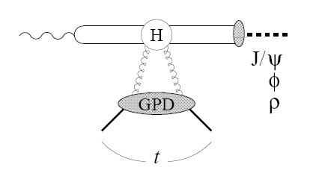
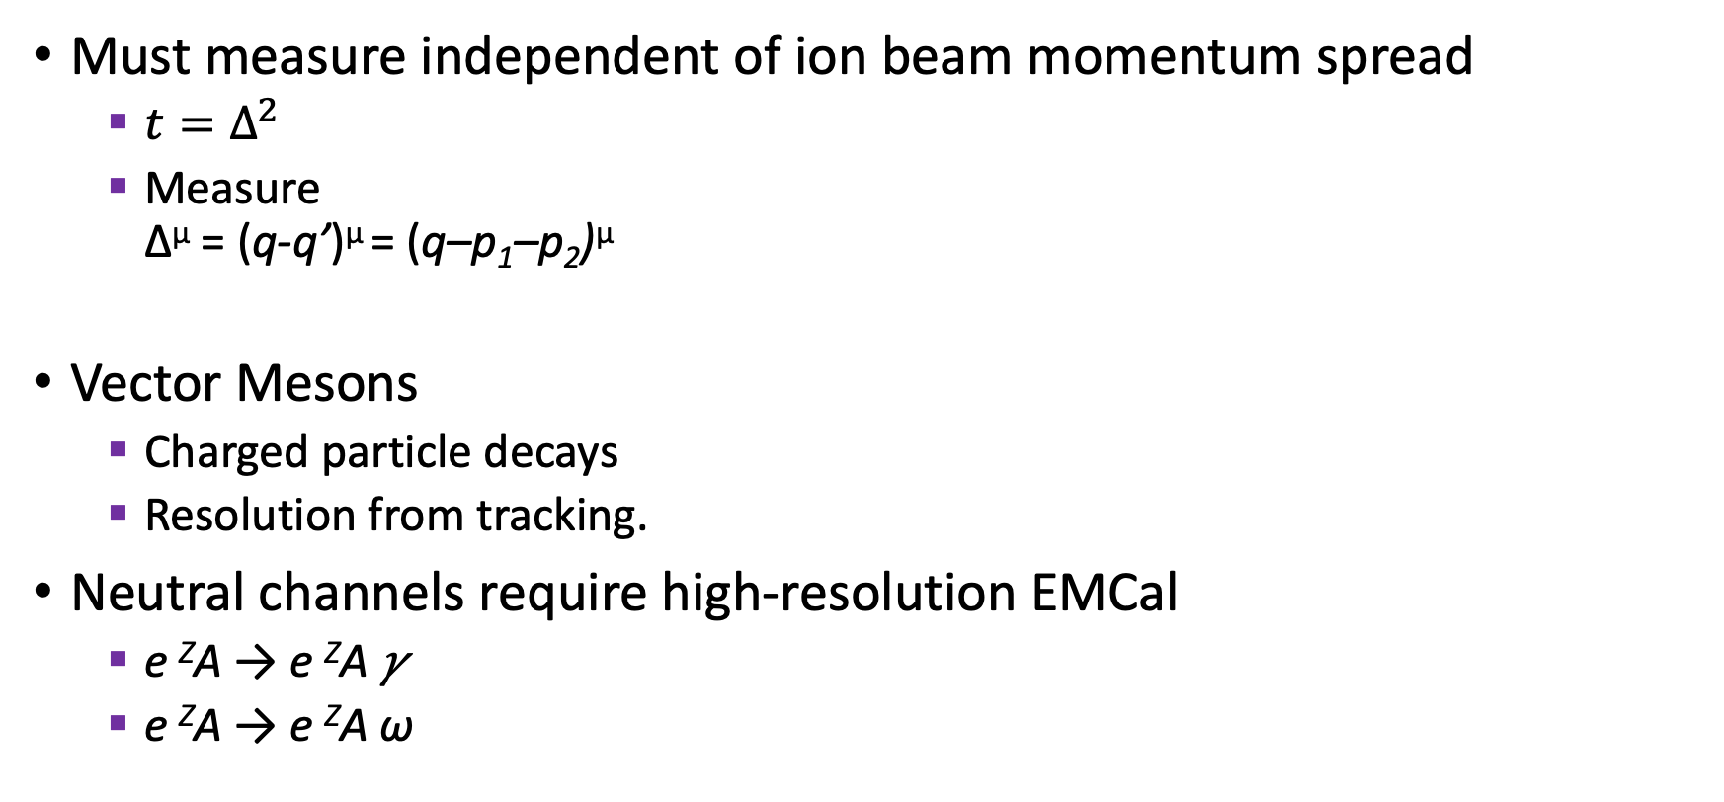
Resolving momentum transfer to nucleus
Must measure independent of ion beam momentum spread
  $t=Δ^{2}$
  Measure
  Δ^{μ} = (q-q’)^{μ} = (q–p₁–p₂)^{μ}
Vector Mesons
  Charged particle decays
  Resolution from tracking.
Neutral channels require high-resolution EMCal
  e ^{Z}A → e ^{Z}A 𝛾
  e ^{Z}A → e ^{Z}A ω
p₁
q
p₂
^{A}Z
^{A}Z

Slide 12
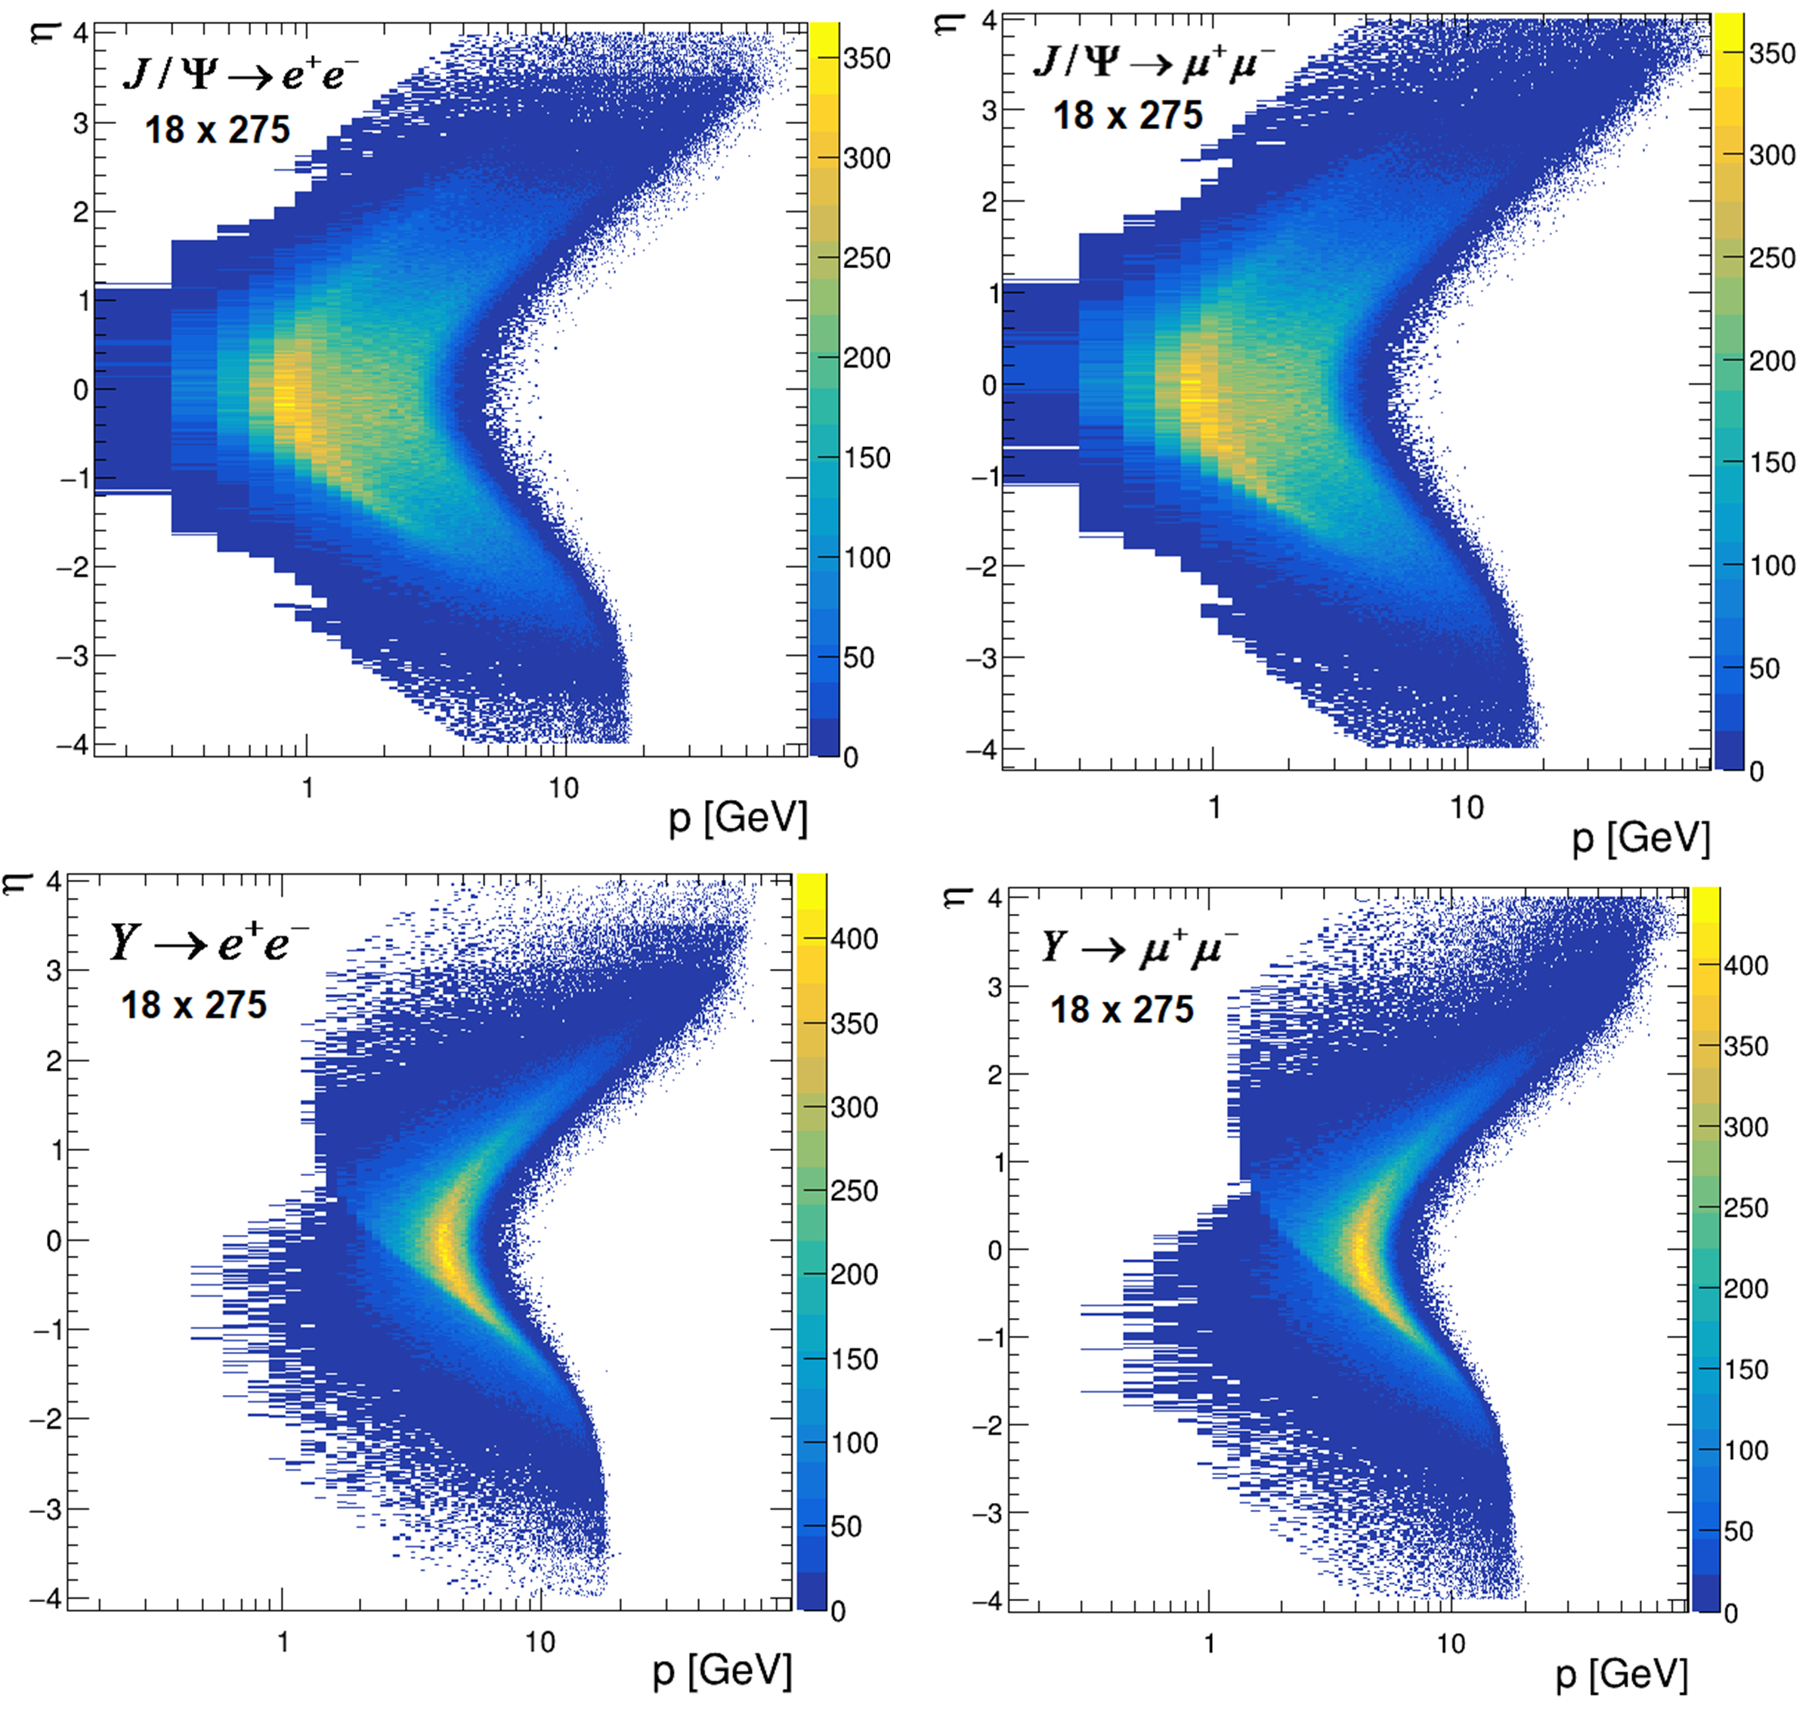
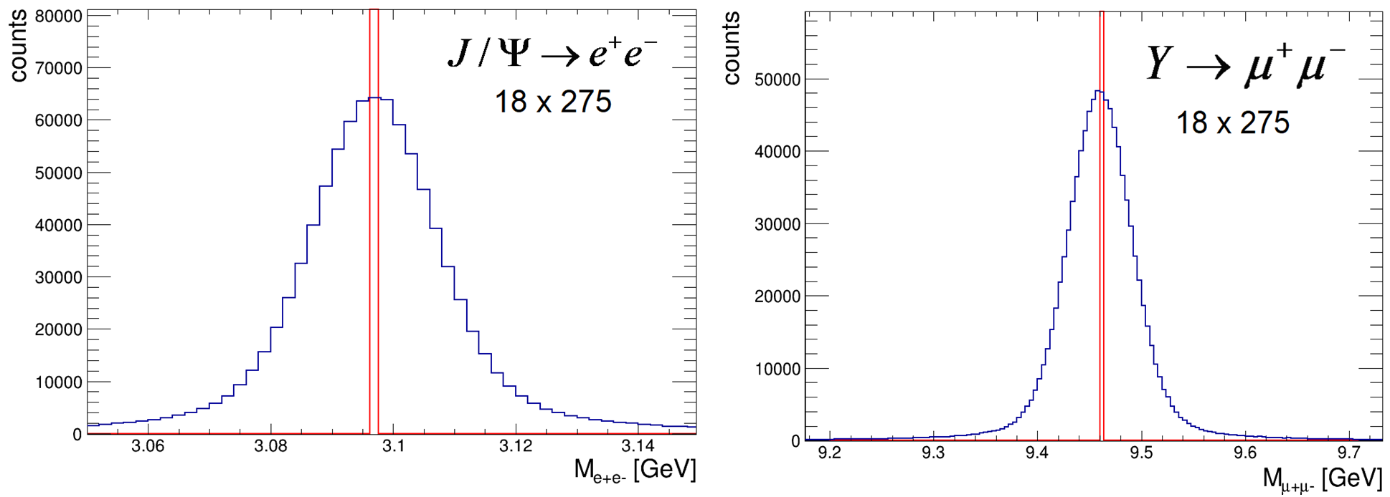
J/𝛹, 𝚼 Production
STARLIGHT generator: ep → epV
  Cf talk for Stefan Diehl
μ⁺μ– channel
  Doubles statistics;
  Different systematics;
  Enables DDVCS without scattered electron coherent interference
    Cross sections grow at low-x_{B}
Resolution in CORE

Slide 13
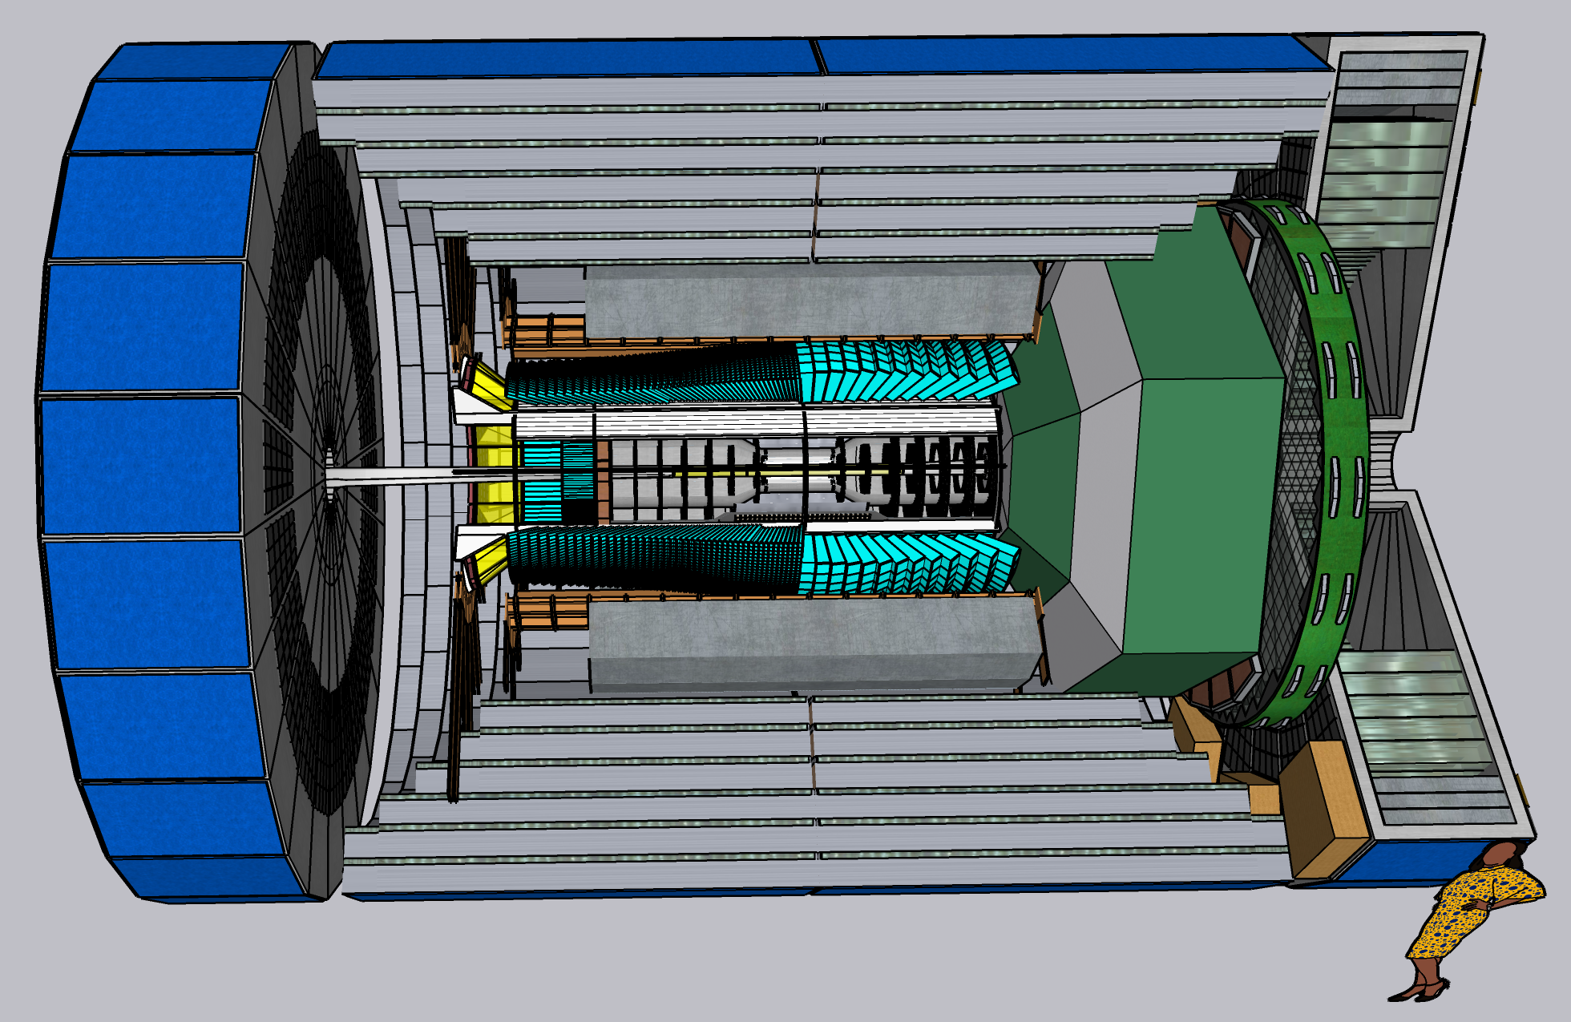
CORE as a Candidate 2nd Detector https://arxiv.org/abs/2209.00496

Slide 14
CORE as a Candidate 2nd Detector https://arxiv.org/abs/2209.00496
Muon ID, HCal, EMCal for |η|≤ 3.5
High resolution PbWO₄ EMCal –3.5 < η ≤ 0
  Catches all DVCS electrons and photons
Single technology Si (MAPS) tracker
Full PID
Flexible integration with accelerator lattice
  ±4m length
Tracker / DIRC / EMCal same dimensions as PANDA

Slide 15
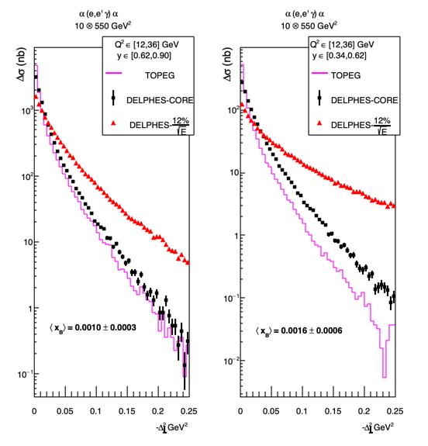
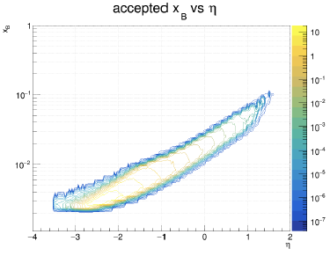

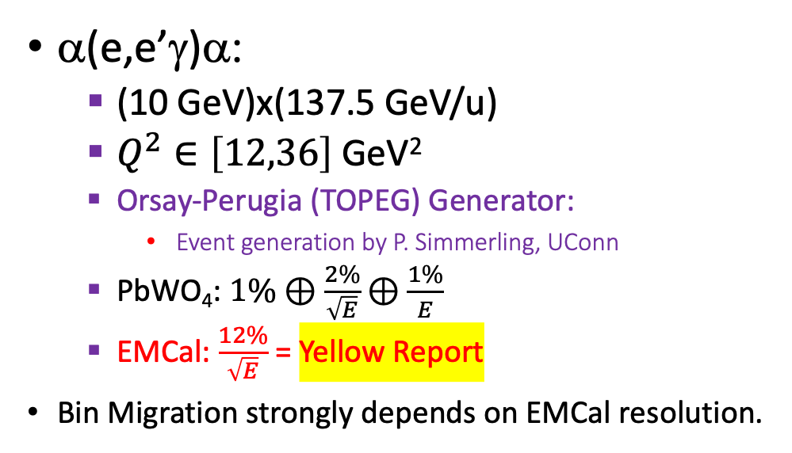

DVCS Bin Migration Comparison
x_{B}
α(e,e’γ)α:
  (10 GeV)x(137.5 GeV/u)
  $Q^{2}∈\left[12,36\right]$ GeV²
  Orsay-Perugia (TOPEG) Generator:
    Event generation by P. Simmerling, UConn
  PbWO₄: $1\%⊕\frac{2\%}{\sqrt{E}}⊕\frac{1\%}{E}$
  EMCal: $\frac{12\%}{\sqrt{E}}$ = Yellow Report
Bin Migration strongly depends on EMCal resolution.
𝜂
$\left\langle x_{B}\right\rangle$=0.004
$\left\langle x_{B}\right\rangle$=0.0064

Slide 16
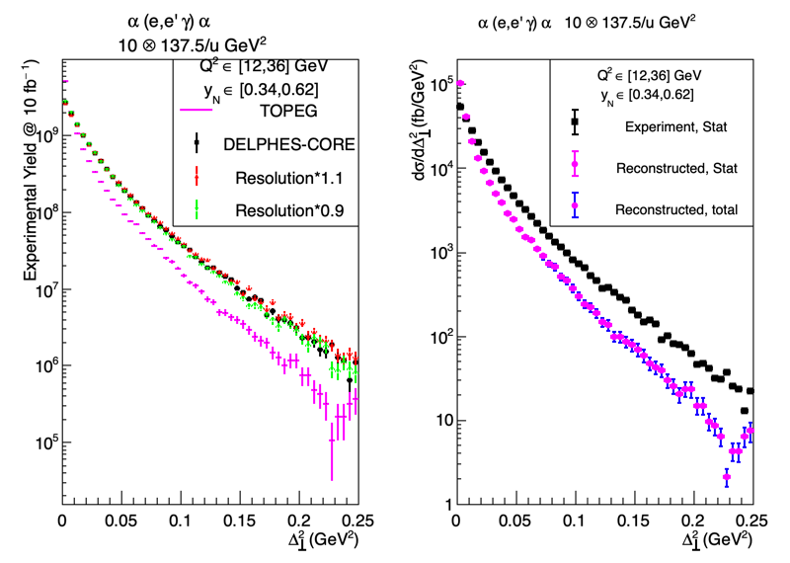



Coherent DVCS on light nuclei. Unfolding the Bin Migration
P-2, p.2
TOPEG event generator
DELPHES FastMC
Systematic uncertainty in reconstructed cross section estimated by varying PbWO₄ resolution event-by-event ±10%
Error bars from uncertainty of bin-migration remain small.
$$“truth”$$
$$reconstruction$$
$\left\langle x_{B}\right\rangle$=0.0016

Slide 17
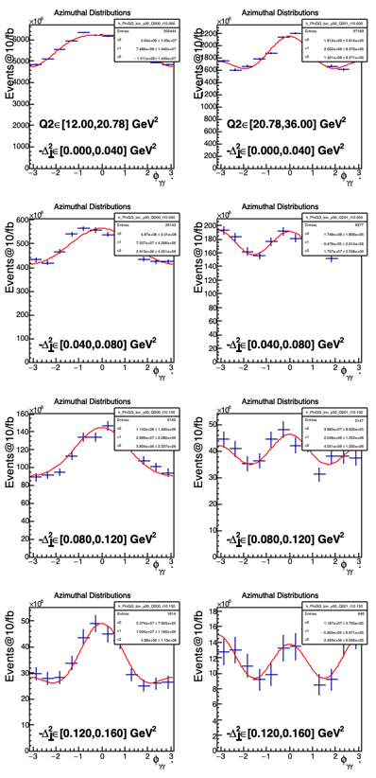
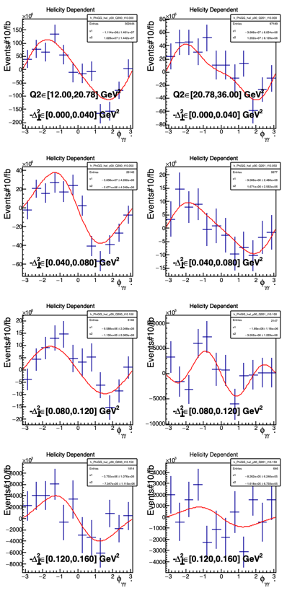
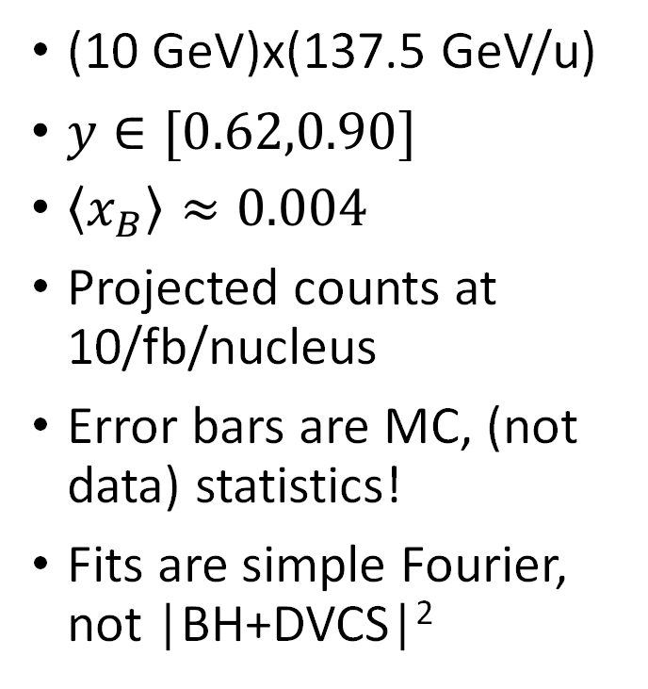

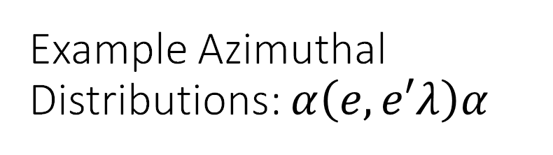

Example Azimuthal Distributions: $α\left(e,e′λ\right)α$
$$σ\left(+\right)+ σ(−)$$
$$σ\left(+\right)− σ(−)$$
(10 GeV)x(137.5 GeV/u)
$y∈[0.62,0.90]$
$\left\langle x_{B}\right\rangle ≈0.004$
Projected counts at 10/fb/nucleus
Error bars are MC, (not data) statistics!
Fits are simple Fourier, not |BH+DVCS|²

Slide 18
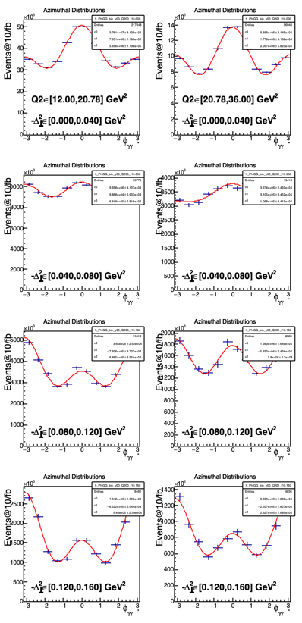
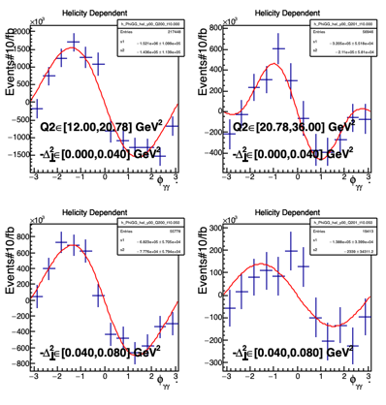
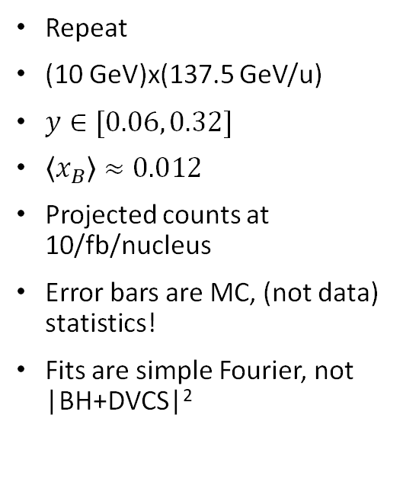



Example Azimuthal Distributions: $α\left(e,e′λ\right)α$
$$σ\left(+\right)+ σ(−)$$
$$σ\left(+\right)− σ(−)$$
Repeat
(10 GeV)x(137.5 GeV/u)
$y∈[0.06, 0.32]$
$\left\langle x_{B}\right\rangle ≈0.012$
Projected counts at 10/fb/nucleus
Error bars are MC, (not data) statistics!
Fits are simple Fourier, not |BH+DVCS|²

Slide 19
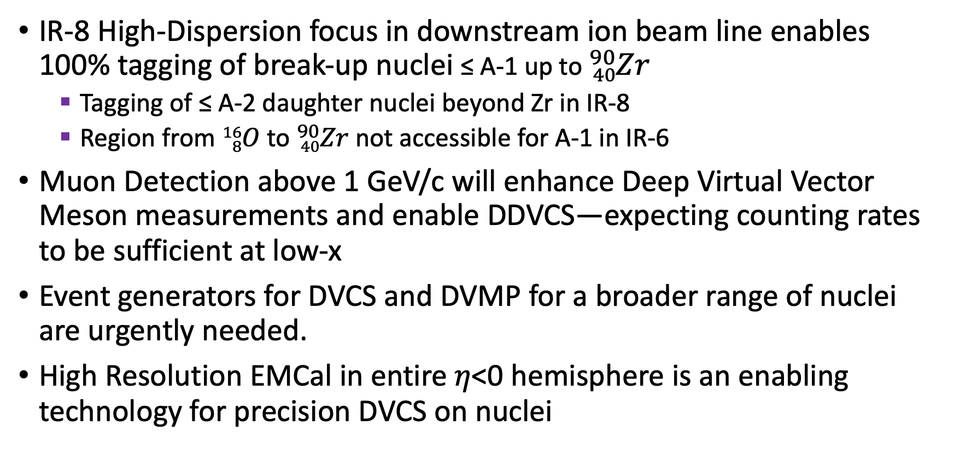
Conclusions
IR-8 High-Dispersion focus in downstream ion beam line enables 100% tagging of break-up nuclei ≤ A-1 up to ${}_{40}^{90}{Zr}$
  Tagging of ≤ A-2 daughter nuclei beyond Zr in IR-8
  Region from ${}_{8}^{16}O$to ${}_{40}^{90}{Zr}$not accessible for A-1 in IR-6
Muon Detection above 1 GeV/c will enhance Deep Virtual Vector Meson measurements and enable DDVCS—expecting counting rates to be sufficient at low-x
Event generators for DVCS and DVMP for a broader range of nuclei are urgently needed.
High Resolution EMCal in entire 𝜂<0 hemisphere is an enabling technology for precision DVCS on nuclei

Slide 20
Additional Slides

Slide 21
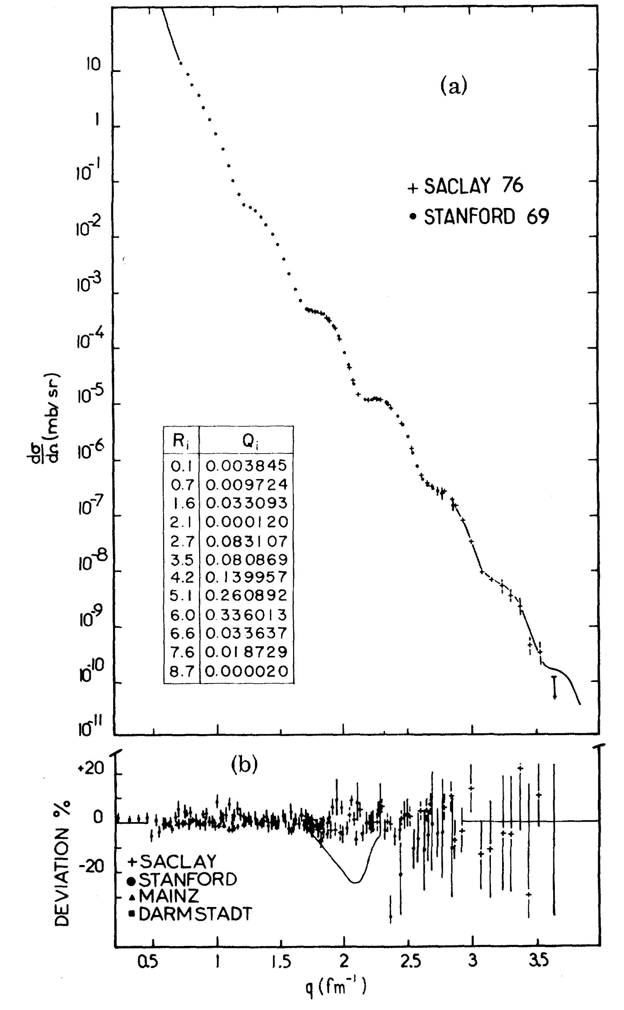
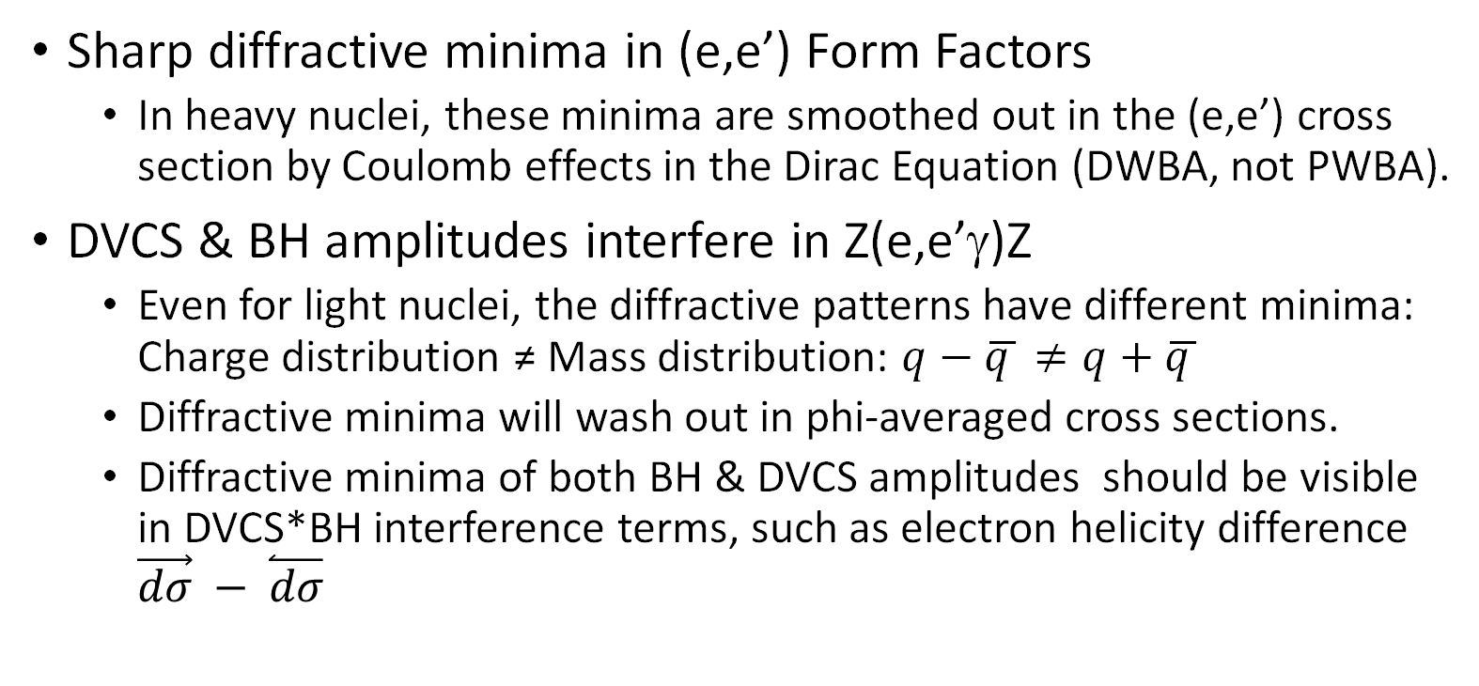
Comment on Diffractive Minima in Nuclear DVCS
Sharp diffractive minima in (e,e’) Form Factors
  In heavy nuclei, these minima are smoothed out in the (e,e’) cross section by Coulomb effects in the Dirac Equation (DWBA, not PWBA).
DVCS & BH amplitudes interfere in Z(e,e’γ)Z
  Even for light nuclei, the diffractive patterns have different minima:
  Charge distribution ≠ Mass distribution: $q−\overline{q }≠q+$ $\overline{q }$
  Diffractive minima will wash out in phi-averaged cross sections.
  Diffractive minima of both BH & DVCS amplitudes should be visible in DVCS*BH interference terms, such as electron helicity difference $\vec{dσ} − \overset{⃐}{dσ}$

Slide 22
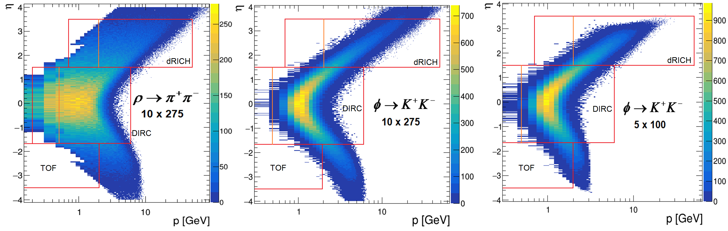
Particle ID Requirements (exclusive vector meson)
𝜋/K separation up to 6 GeV in central region covers full kinematics in high luminosity configuration.

Slide 23
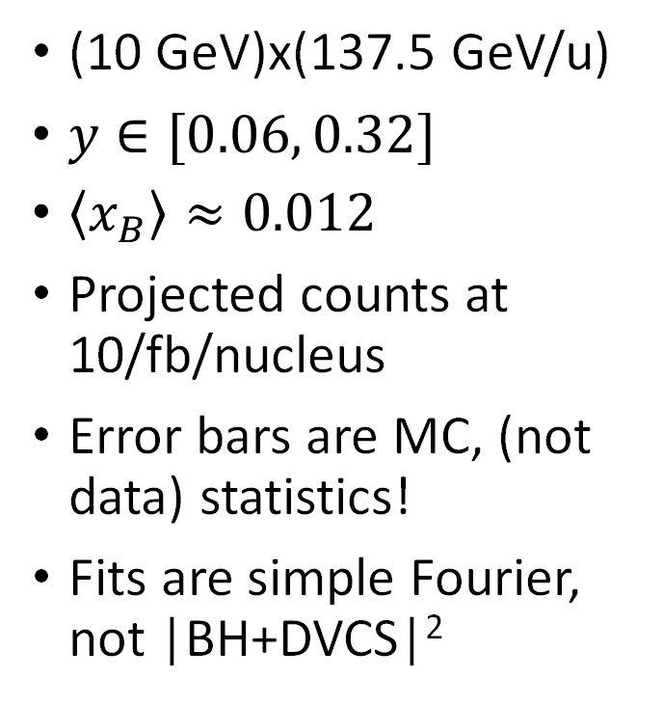
Example Azimuthal Distributions: $α\left(e,e′λ\right)α$
$$σ\left(+\right)+ σ(−)$$
$$σ\left(+\right)− σ(−)$$
(10 GeV)x(137.5 GeV/u)
$y∈[0.06, 0.32]$
$\left\langle x_{B}\right\rangle ≈0.012$
Projected counts at 10/fb/nucleus
Error bars are MC, (not data) statistics!
Fits are simple Fourier, not |BH+DVCS|²

Slide 24
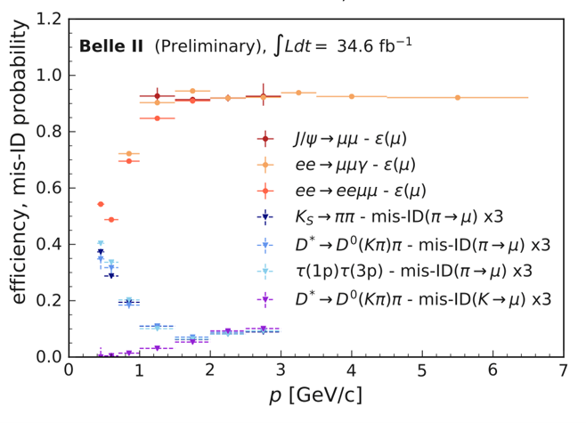
Muon Detection with KLM (BELLE I & II)
Belle II full results
expected soon.
Mis-ID x3

Slide 25
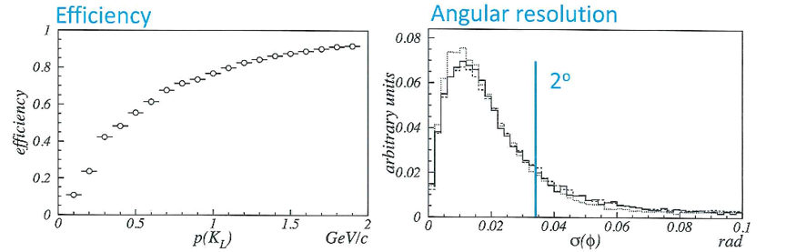
Neutral Hadron detection with KLM
K_{L}

