Slide 1
EIC two detector operation
EICUG 2nd detector meeting Dec. 6, 2022
Angelika Drees (EIC Project)

Slide 2
Why can’t we *just* add another collision point?
Issues to consider:
Deterioration of beam parameters and quality (beam-beam)
- the machine will be tuned for one collision per (e,h) pair
How to share the beam & time
- Exclusive or parallel operation
Pathlength changes coming from a different lattice design for colliding at IP8 (still in progress, B. Gamage talk later)
- depends on latest lattice (can it be taken into account at time of installation of 2nd IR?)
Equipment placement at fixed locations (i.e. snake at IP2 requires snake at IP8 with fixed phase advance between)
Timing synchronizations for colliding bunch pairs
- Different pathlength for ESR and HSR between IP6&IP8

Slide 3
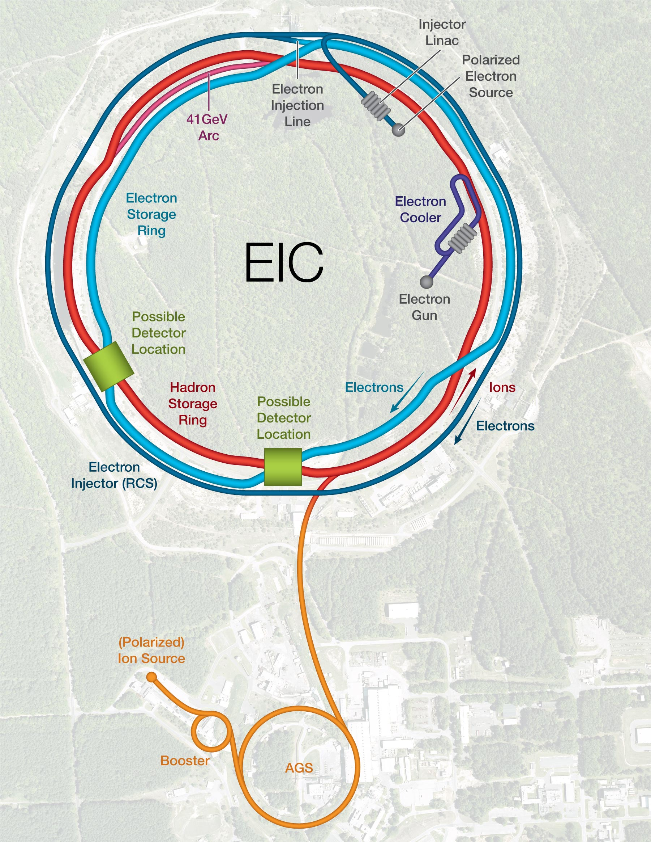
Outline
Snake configurations
Matching ESR & HSR circumferences
Radial Shift
RF parameters
Synchronizing collisions at IP6 & IP8
Adjusting the pathlength
Summary

Slide 4
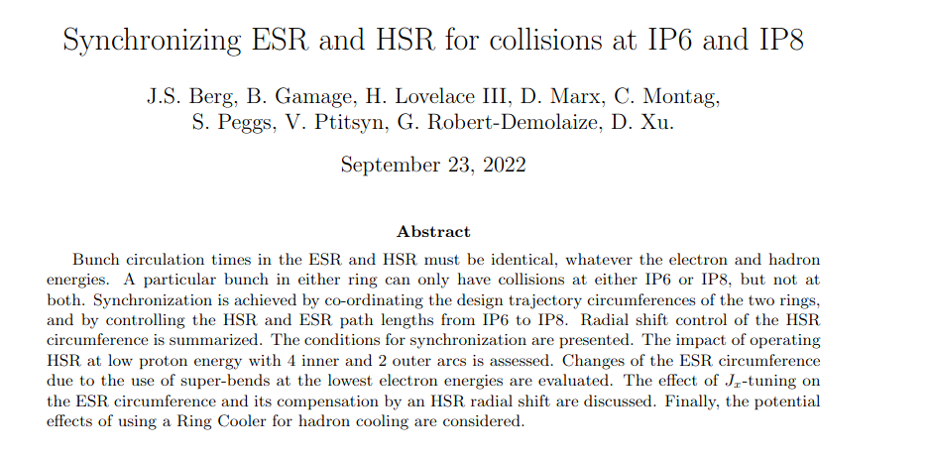
Tech Note
https://technotes.bnl.gov/PDF?publicationId=223427

Slide 5
Avoid snake constraints IP2 IP8 Possible 4 Snake Configurations
IR6, IR10, IR12, IR2
IR6, IR10, IR2, IR4
Preferred,
This implies 2 snake operation at 41 GeV
-45º
alternative
-45º
Still under investigation

Slide 6
Radial Shift: Matching ESR and HSR circumferences
Electrons in the ESR are ultrarelativistic
HSR hadrons are merely relativistic
Time periods of HSR and ESR closed orbits must be the same
In the HSR, proton beams with energy @100 GeV are shifted radially inward in the arcs; @275 GeV beams are shifted outward:
=> HI must operate withing the radial shift range for successful cogging with ESR

Slide 7
RF system parameters
The highest RF frequency in both ESR and HSR is approximately 591 MHz, while crab cavities in the ESR and HSR operate at about 394 MHz and 197 MHz, respectively
2520 buckets are available to accept bunches in both the ESR and the HSR, spaced by ~ 5 ns (= T₀)
At injection into the HSR, bunches are captured in consecutive buckets of a 24.6 MHz system, with a harmonic number of 315 (290 filled)
Injected bunches are later split into 4 parts for a maximum of 1160 bunches, spaced by 2 buckets in the 197 MHz system, i.e. 10 ns

Slide 8
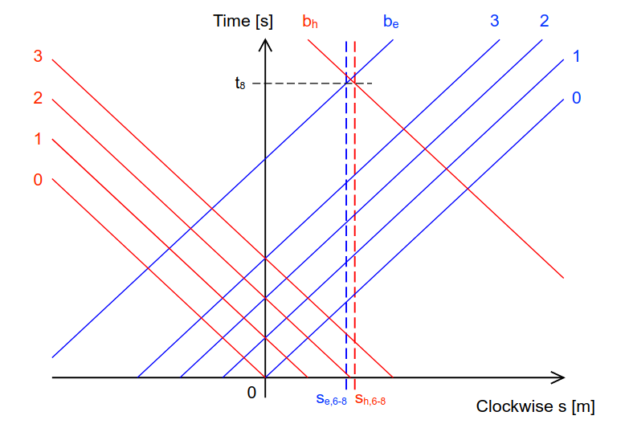
Synchronizing collisions at IP6 and IP8
The bunch intensity is so high that each bunch may only collide once per turn – either at IP6 or at IP8, but not at both (beam beam effects)
Number ESR & HSR bunches by integers b_{e} & b_{h} that vary from 0 to 2519
Hadron bunches will only occupy buckets with b_{h} even

Slide 9
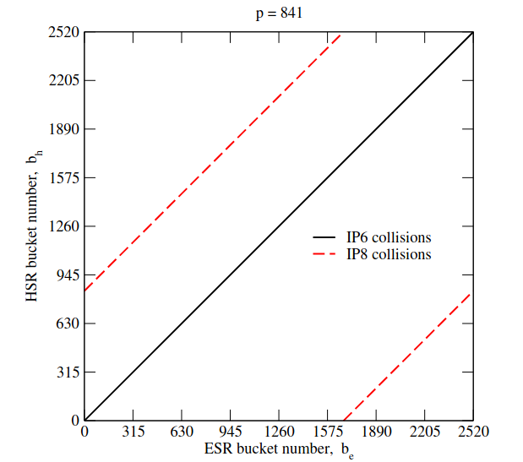
Synchronizing collisions at IP6 and IP8
Collisions at IP8 require:
So
Bunches collide at IP8 when either
b_{e8} > b_{h8}
b_{e8} < b_{h8}
Integer p must be odd if bunches that collide at IP8 do not collide at IP6
We chose p=841
Inject even b_{e}: collide at IP6
Inject odd b_{e}: collide at IP8

Slide 10
Adjusting the path lengths between IP6 and IP8
How to adjust ?
Change the radial position of the ESR arc between IP6 and IP8.
Shift the IP8 collision point and the detector center longitudinally. Space constraints on the counter-clockwise side of IR8 strongly favor moving the IP8 detector clockwise.
Shift the collision point longitudinally within the detector.
need to introduce a longitudinal shift of IP8 by 57.673 mm to achieve p=841
Actually, there is some flexibility, since it is the sum that matters
Situation changes for low energy operation @41 GeV

Slide 11
Summary
EIC bunch intensities are so high that each bunch may only collide once per turn – at IP6 or at IP8, but not at both. This is guaranteed by adjusting the two path lengths from IP6 to IP8.
The IP8 collision point and detector must be adjusted to (p=841)
Bunches in even-numbered buckets b_{e6} and b_{h6} collide at IP6 if
Electrons in odd buckets b_{e8} and hadrons in even buckets b_{h8} collide at IP8 if
It is not yet clear whether HSR operations with 4 inner and 2 outer arcs (with a proton energy of around 41 GeV) can support simultaneous collisions at both IP6 and IP8.

