Slide 1
Opportunities Enabled by 2nd Focus
V.S. Morozov (ORNL)
EICUG 2nd detector meeting
December 6, 2022

Slide 2
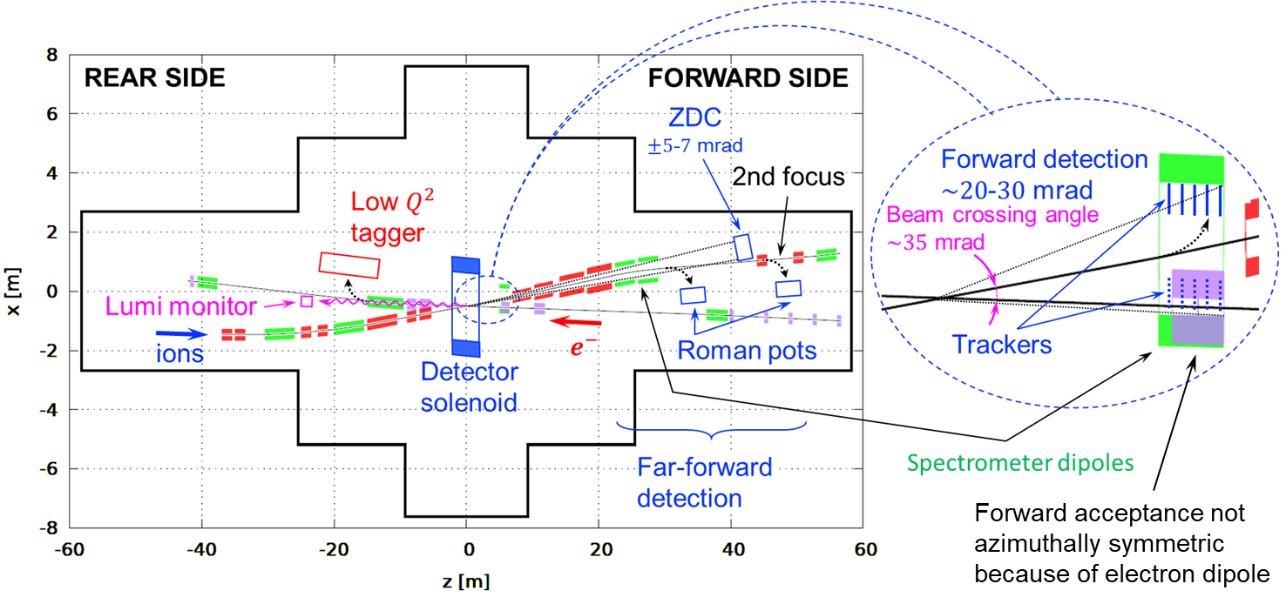
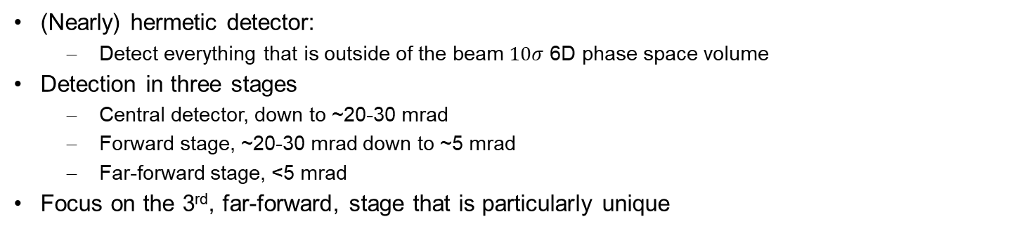
IR8 Schematic
(Nearly) hermetic detector:
  Detect everything that is outside of the beam $10σ$ 6D phase space volume
Detection in three stages
  Central detector, down to ~20-30 mrad
  Forward stage, ~20-30 mrad down to ~5 mrad
  Far-forward stage, <5 mrad
Focus on the 3rd, far-forward, stage that is particularly unique

Slide 3
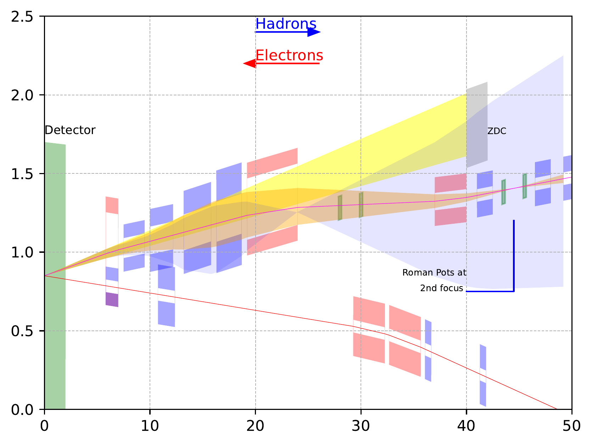
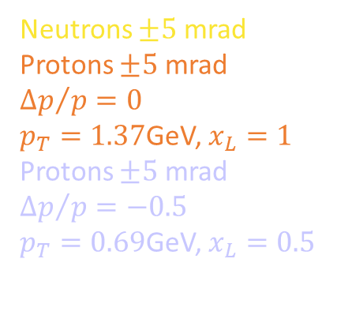
IR8 Far-Forward Acceptance
NbTi magnets
Final focusing quads and dipole placements optimized for forward neutron and proton acceptance
Neutrons $±5$ mrad
Protons $±5$ mrad
$${∆p}/{p=0}$$
$p_{T}=1.37$GeV, $x_{L}=1$
Protons $±5$ mrad
$${∆p}/{p=−0.5}$$
$p_{T}=0.69$GeV, $x_{L}=0.5$

Slide 4
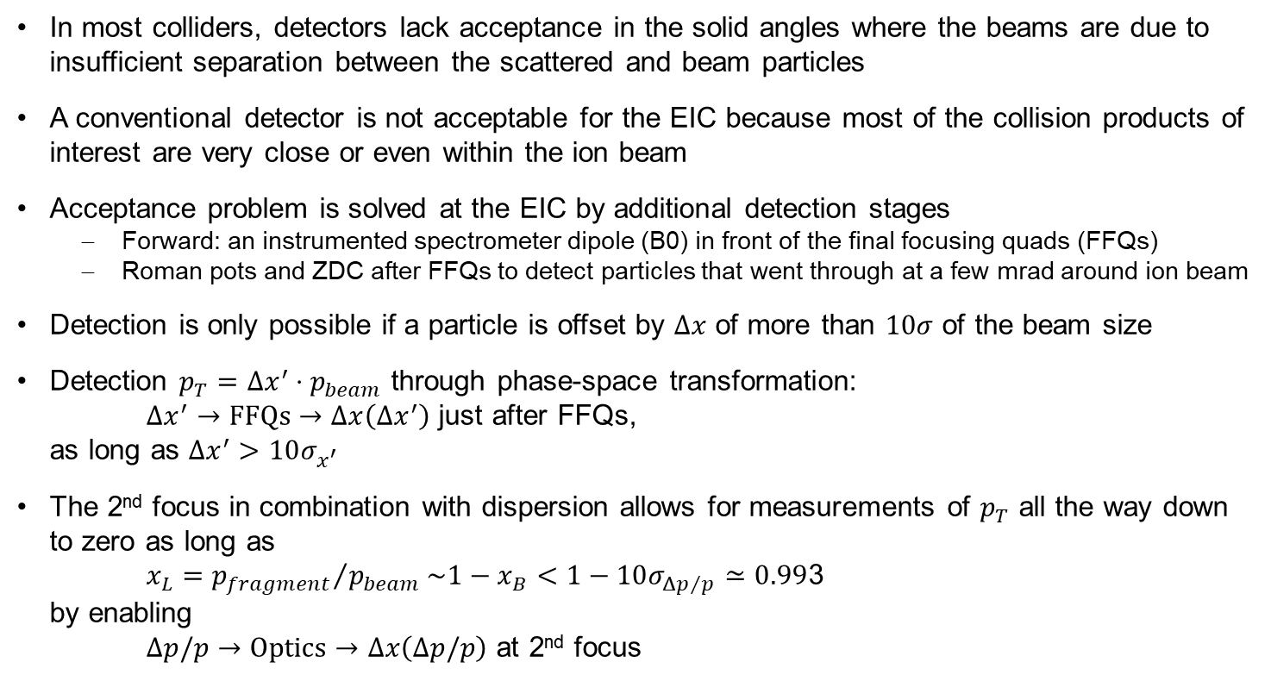
Forward Detection in EIC
In most colliders, detectors lack acceptance in the solid angles where the beams are due to insufficient separation between the scattered and beam particles
A conventional detector is not acceptable for the EIC because most of the collision products of interest are very close or even within the ion beam
Acceptance problem is solved at the EIC by additional detection stages
  Forward: an instrumented spectrometer dipole (B0) in front of the final focusing quads (FFQs)
  Roman pots and ZDC after FFQs to detect particles that went through at a few mrad around ion beam
Detection is only possible if a particle is offset by $Δx$ of more than $10σ$ of the beam size
Detection $p_{T}=Δx^{′}⋅p_{beam}$ through phase-space transformation:
${Δx}^{′}→\text{FFQs}→Δx\left(Δx^{′}\right)$ just after FFQs,
as long as $Δx^{′}>10σ_{x^{′}}$
The 2nd focus in combination with dispersion allows for measurements of $p_{T}$ all the way down to zero as long as
$x_{L}={p_{fragment}}/{p_{beam}}\sim 1−x_{B}<1−10σ_{{Δp}/p}≃0.99$3
by enabling
$Δp/p→\text{Optics}→Δx\left(Δp/p\right)$ at 2nd focus

Slide 5
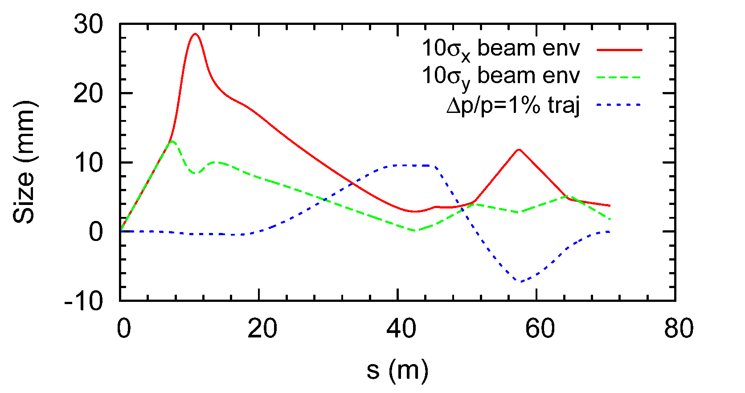
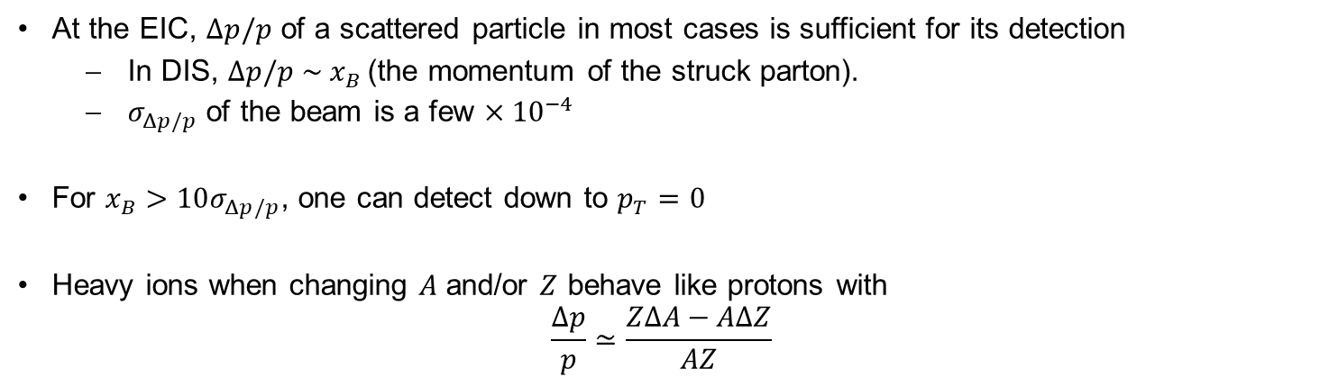
2nd Focus in IR8
At the EIC, $Δp/p$ of a scattered particle in most cases is sufficient for its detection
  In DIS, $Δp/p \sim x_{B}$(the momentum of the struck parton).
  $σ_{Δp/p}$ of the beam is a few $×{10}^{−4}$
For $x_{B}>10σ_{Δp/p}$, one can detect down to $p_{T}=0$
Heavy ions when changing $A$ and/or $Z$ behave like protons with
$\frac{Δp}{p}≃\frac{ZΔA−AΔZ}{AZ}$

Slide 6
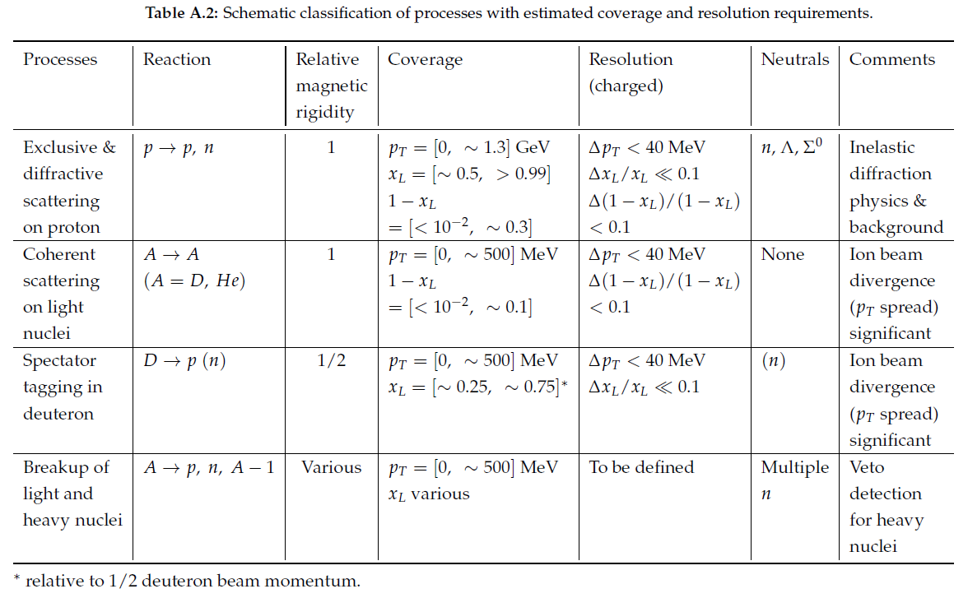
Physics Drivers for Low $(1−x_{L})$ at Small $p_{T}$

Slide 7
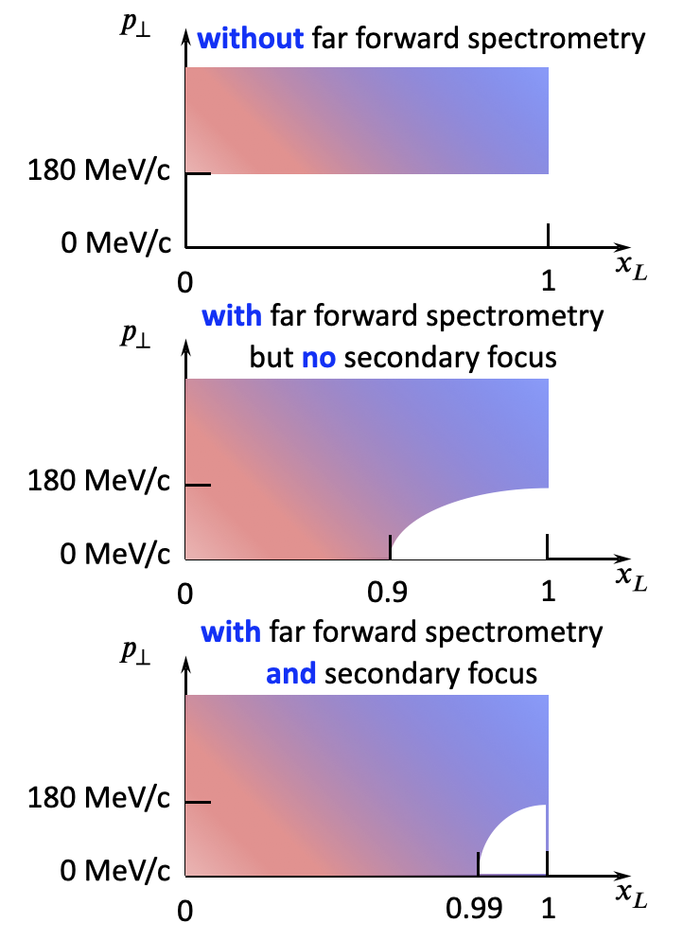
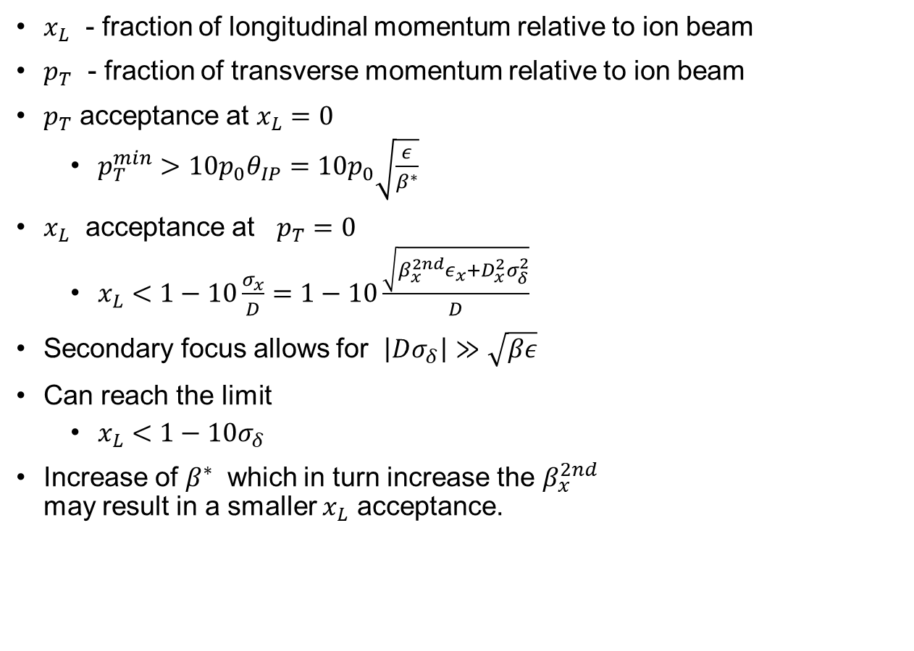
Acceptance as Function of $x_{L}$and $p_{T}$
$x_{L}$ - fraction of longitudinal momentum relative to ion beam
$p_{T}$ - fraction of transverse momentum relative to ion beam
$p_{T}$ acceptance at $x_{L}=0$
  $p_{T}^{min}>10p_{0}θ_{IP}=10p_{0}\sqrt{\frac{ε}{β^{∗}}}$
$x_{L}$ acceptance at $p_{T}=0$
  $x_{L}<1−10\frac{σ_{x}}{D}=1−10\frac{\sqrt{β_{x}^{2nd}ε_{x}+D_{x}^{2}σ_{δ}^{2}}}{D}$
Secondary focus allows for $\left|Dσ_{δ}\right|≫\sqrt{βε}$
Can reach the limit
  $x_{L}<1−10σ_{δ}$
Increase of $β^{∗}$ which in turn increase the $β_{x}^{2nd}$
may result in a smaller $x_{L}$ acceptance.

Slide 8
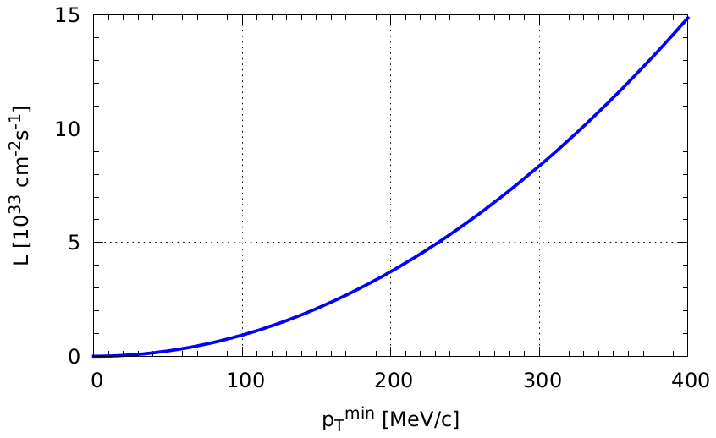
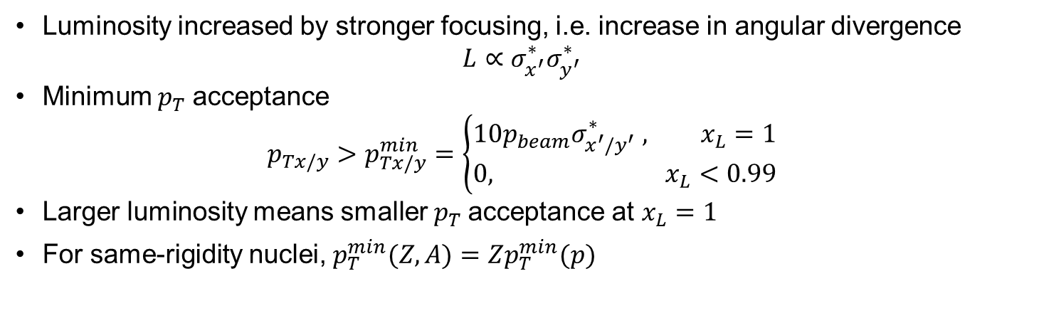



Luminosity and $p_{T}$ Acceptance
Luminosity increased by stronger focusing, i.e. increase in angular divergence
$L∝σ_{x^{′}}^{∗}σ_{y^{′}}^{∗}$
Minimum $p_{T}$ acceptance
$p_{Tx/y}>p_{Tx/y}^{min}=\left\{\begin{matrix}10p_{beam}σ_{x^{′}/y^{′}}^{∗} , x_{L}=1 \\ 0, x_{L}<0.99\end{matrix}\right.$
Larger luminosity means smaller $p_{T}$ acceptance at $x_{L}=1$
For same-rigidity nuclei, $p_{T}^{min}(Z,A)=Zp_{T}^{min}(p)$
$$x_{L}=1$$
$$x_{L}<0.99$$
Second focus
Highest $L$
High-divergence (CDR)
High-acceptance (CDR)

Slide 9
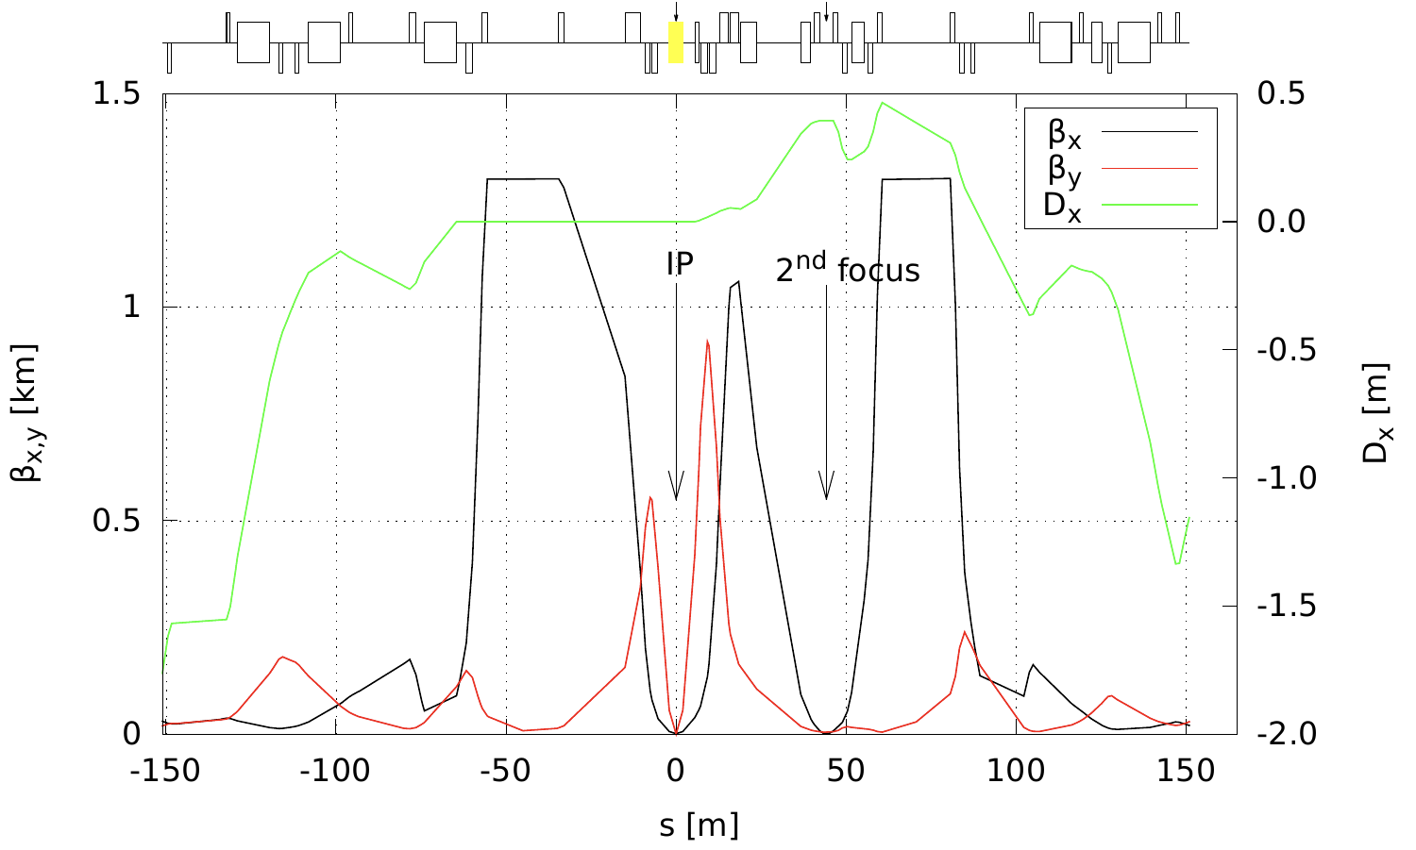
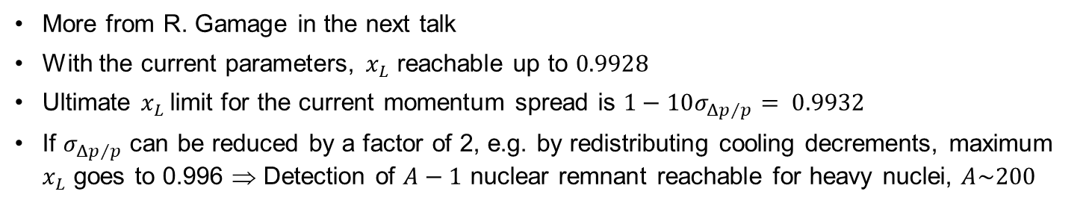
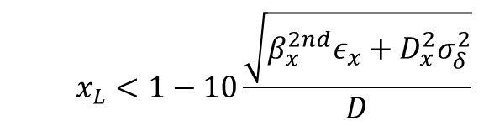
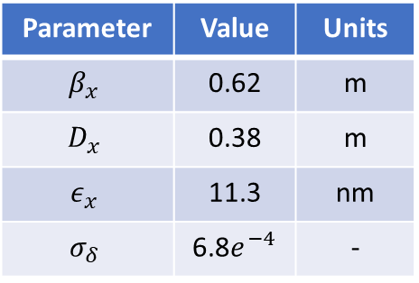
Luminosity and $p_{T}$ Acceptance
More from R. Gamage in the next talk
With the current parameters, $x_{L}$ reachable up to $0.9928$
Ultimate $x_{L}$ limit for the current momentum spread is $1−10σ_{{Δp}/p}= 0.9932$
If $σ_{{Δp}/p}$ can be reduced by a factor of 2, e.g. by redistributing cooling decrements, maximum $x_{L}$ goes to 0.996 ⇒ Detection of $A−1$ nuclear remnant reachable for heavy nuclei, $A\sim 200$
Protons
Parameters at the 2nd focus
Parameter | Value | Units
$$β_{x}$$ | 0.62 | m
$$D_{x}$$ | 0.38 | m
$$ε_{x}$$ | 11.3 | nm
$$σ_{δ}$$ | 6.8$e^{−4}$ | -
  $$x_{L}<1−10\frac{\sqrt{β_{x}^{2nd}ε_{x}+D_{x}^{2}σ_{δ}^{2}}}{D}$$
Rear
Forward

Slide 10




Far-Forward Acceptance with and without 2nd Focus
Ion fragments from ²³⁸U
Exclusive protons
$$p_{⊥}$$
(x_{L} = p’ / p_{beam} ~ 1 – x)
Excluded
Without 2nd focus: (EPIC @IR6)
Detected
Detected
Detected
Excluded
⬅ Z’ vs x_{RP}
$p_{⊥}$vs x_{L}➔
0.9
1
$$x_{L}$$
0
Limited by D and 2nd focus (β₂)
Limited by angular acceptance (β*)
With 2nd focus: (Detector 2 @ IR8)
$$p_{⊥}$$
Order-of-magnitude improvement in forward acceptance
Detected
Excluded
0
0.99
1
$$x_{L}$$

Slide 11
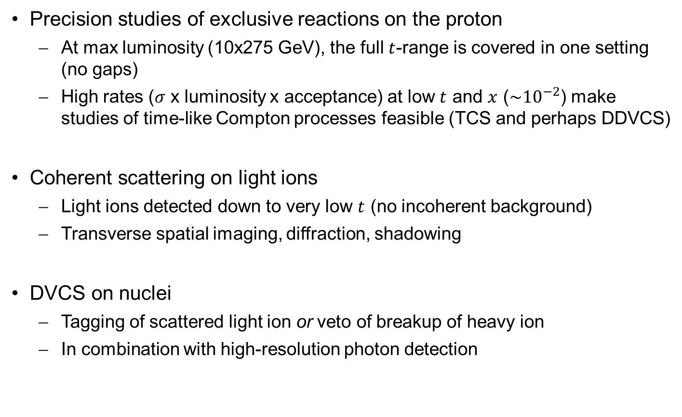
2nd Focus – Examples of Physics Opportunities
Precision studies of exclusive reactions on the proton
  At max luminosity (10x275 GeV), the full $t$-range is covered in one setting (no gaps)
  High rates ($σ$ x luminosity x acceptance) at low $t$ and $x$ ($\sim {10}^{−2}$) make studies of time-like Compton processes feasible (TCS and perhaps DDVCS)
Coherent scattering on light ions
  Light ions detected down to very low $t$ (no incoherent background)
  Transverse spatial imaging, diffraction, shadowing
DVCS on nuclei
  Tagging of scattered light ion or veto of breakup of heavy ion
  In combination with high-resolution photon detection

Slide 12
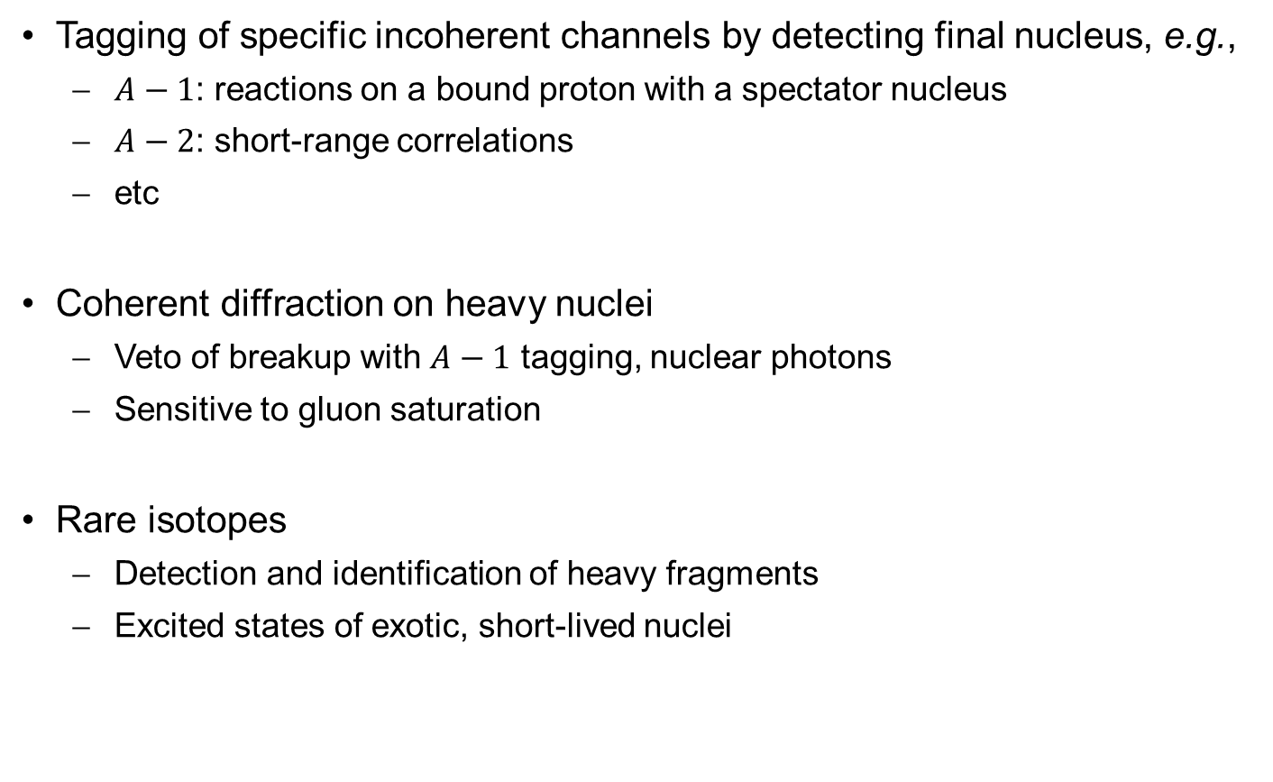
2nd Focus – Examples of Physics Opportunities
Tagging of specific incoherent channels by detecting final nucleus, e.g.,
  $A−1$: reactions on a bound proton with a spectator nucleus
  $A−2$: short-range correlations
  etc
Coherent diffraction on heavy nuclei
  Veto of breakup with $A−1$ tagging, nuclear photons
  Sensitive to gluon saturation
Rare isotopes
  Detection and identification of heavy fragments
  Excited states of exotic, short-lived nuclei

Slide 13


Exclusive Coherent Scattering on Nuclei
See talk by Charles Hyde at 2 pm today
⁴He
²⁰⁸Pb
With a 2nd focus, recoiling light nuclei at moderate x can be detected for all $t$.
  For heavier nuclei and lower $x$, one can use a hybrid method, vetoing breakup for low $t$ and detecting nuclei in the high-$t$ tail, where incoherent backgrounds are higher
Heavy nuclei never emerge from the beam
  Veto of breakup
  Large incoherent background
    high veto efficiency required.
  $A−1$ tagging important for “high” $t$ tail
  Nuclear photons (veto efficiency and excitation)
1 fm⁻¹ = 0.2 GeV
1 fm⁻² = 0.04 GeV²
10 fm⁻² = 0.4 GeV²
20 fm⁻² = 0.8 GeV²

Slide 14
Geometry Tagging for Heavy Ions
JLab LDRD: 2017-LDRD-6 and 2018-LDRD-4
Team: A. Accardi, M. Baker, W. Brooks, R. Dupre, M. Ehrhart, C. Fogler,
K. Hafidi, C. Hyde, V. Morozov (PI), P. Nadel-Turonski, K. Park, T. Toll, G. Wei, L. Zheng
Goals
  Determine sensitivity of EIC measurements to gluon saturation
    Coherent diffractive events
    Nuclear shadowing (color propagation in light vs heavy nuclei)
  Quantify capability of detector for studying propagation of color charges in nuclear matter and hadronization
Results
  eA event generators tailored to EIC parameters and physics goals
  Simulation of physics processes in full-acceptance detector
  Input to detector design

Slide 15
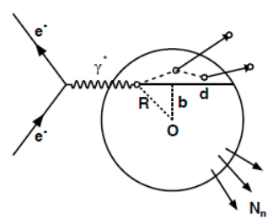
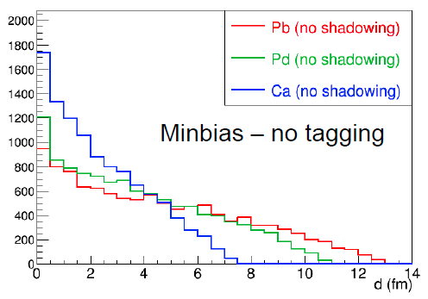
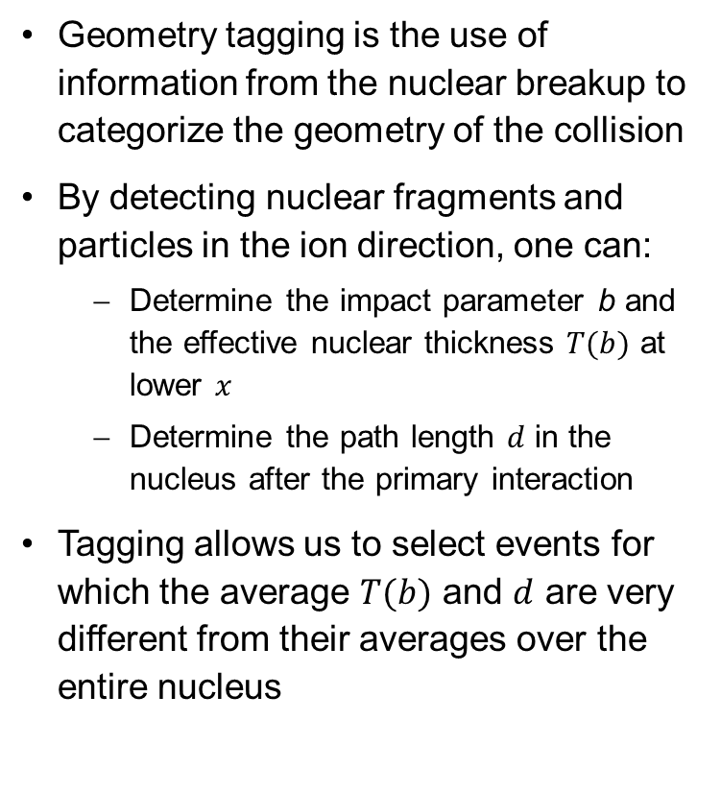
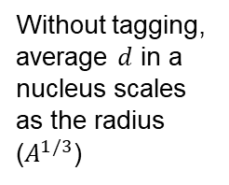
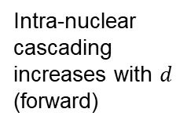
Collision Geometry from Final State
Geometry tagging is the use of information from the nuclear breakup to categorize the geometry of the collision
By detecting nuclear fragments and particles in the ion direction, one can:
  Determine the impact parameter b and the effective nuclear thickness $T(b)$ at lower $x$
  Determine the path length $d$ in the nucleus after the primary interaction
Tagging allows us to select events for which the average $T(b)$ and $d$ are very different from their averages over the entire nucleus
Intra-nuclear cascading increases with $d$ (forward)
Evaporation of neutrons from excited nucleus (very forward)
Without tagging, average $d$ in a nucleus scales as the radius ($A^{1/3}$)

Slide 16
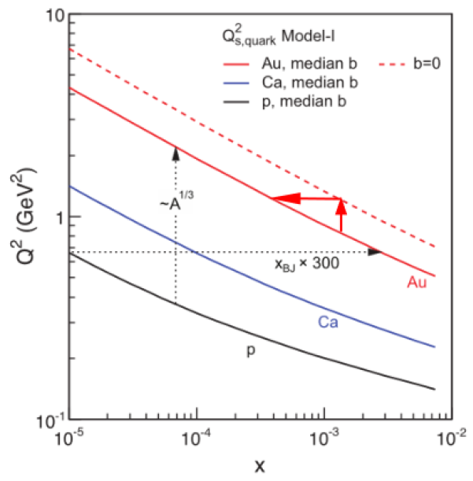
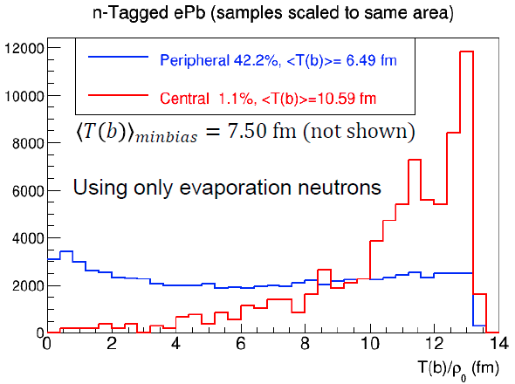
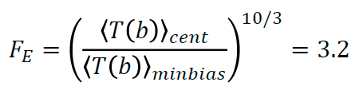
Tagging in $b$ and $T(b)$
Geometry tagging using only evaporation neutrons: can select events with larger average nuclear thickness, at cost of lower statistics
Selecting 1.1% of events with largest average nuclear thickness (measured by evaporation neutrons only) equivalent to increasing the accelerator energy by a factor 3.2
e+Pb²⁰⁸ collisions at 10 x 40 GeV, Q² > 1 GeV², y < 0.95, x < 0.002

Slide 17
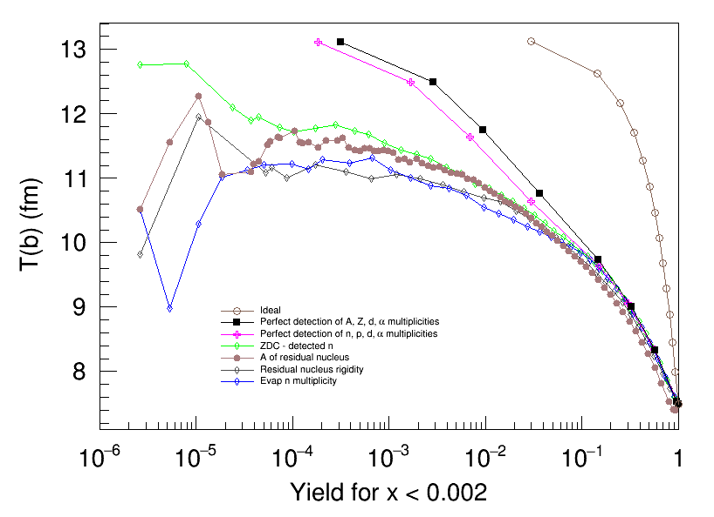
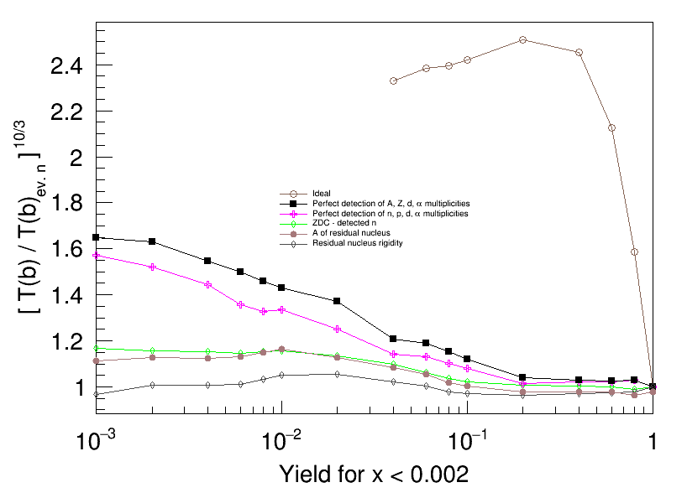

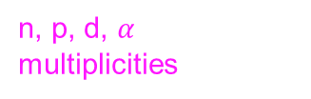
Detect Charged Particles
Detecting protons and light ions ($d$ and $4He$) in addition to neutrons increases the selectivity in $b$ and the effective nuclear thickness $T(b)$
For a 1% yield cut, the increase in equivalent collision energy is about 40% (magenta curve on right) compared with using evaporation neutrons only
n, p, d, $α$ multiplicities

Slide 18

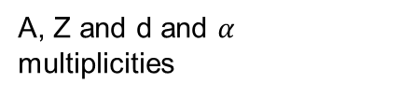
Identify Residual Ion
Kinematic reach extended by detecting residual ion together with charged particles
Best result: measurement of $Z$ in addition to $A/Z$ (inferring $A$) – this would require a PID system for the ion (e.g. additional $dE/dx$if the $dE/dx$ from the tracker is insufficient)
Compared to no geometry tagging, the total energy increase factor is 4.8
A, Z and d and $α$ multiplicities

Slide 19

Detection Requirements
Best results obtained by detecting the residual ion (tracking + $dE/dx$) and light ions (easy for all except $Z = N$ nuclei)
Neutron ZDC provides additional information or useful measurement on its own
Also beneficial to detect protons – requires larger magnet apertures but is also needed for spectator tagging with light nuclei
A, Z and d and $α$ multiplicities

Slide 20
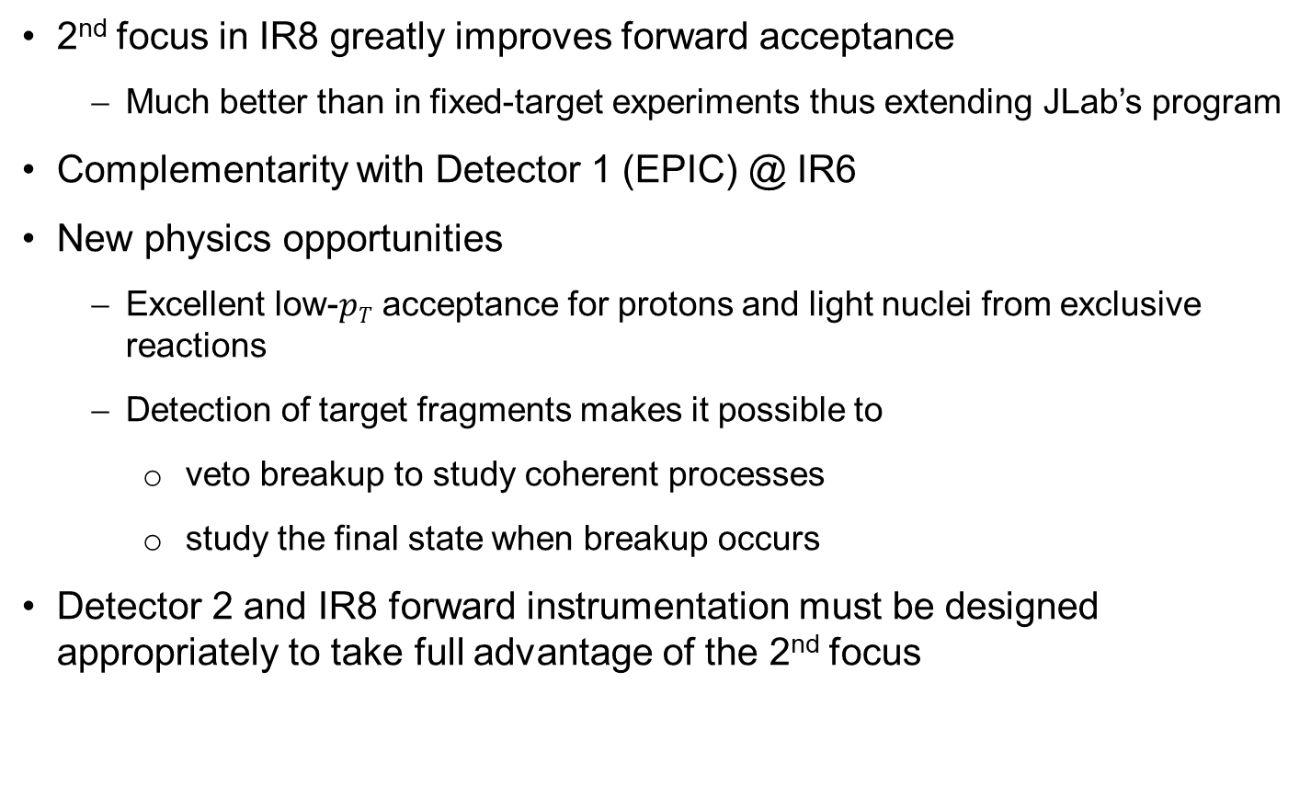
Summary
2nd focus in IR8 greatly improves forward acceptance
  Much better than in fixed-target experiments thus extending JLab’s program
Complementarity with Detector 1 (EPIC) @ IR6
New physics opportunities
  Excellent low-$pT$ acceptance for protons and light nuclei from exclusive reactions
  Detection of target fragments makes it possible to
    veto breakup to study coherent processes
    study the final state when breakup occurs
Detector 2 and IR8 forward instrumentation must be designed appropriately to take full advantage of the 2nd focus

Slide 21
Thank you!

