Slide 1
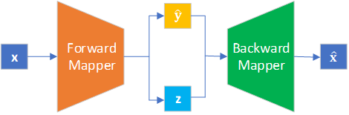
Variational Autoencoder Inverse Mapper
An End-to-End Deep Learning Framework for Inverse Problems and its Application on Compton Form Factor Extraction
Yaohang Li
Department of Computer Science
Old Dominion University
yaohang@cs.odu.edu

Slide 2
Agenda
Ill-posedness of Inverse Problems
Variational Autoencoder Inverse Mapper
Compton Form Factor Extraction as an Inverse Problem
Results

Slide 3
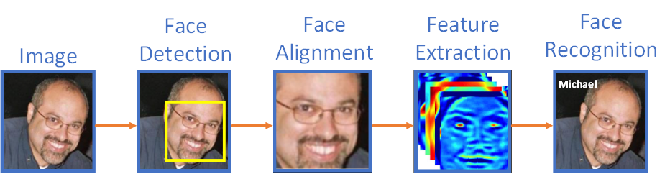
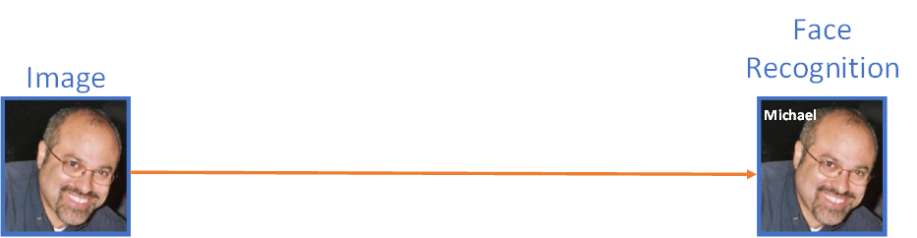
End-to-End Learning
End-to-End Learning
  Machine learning model automatically learns all features
  Directly convert input data into output prediction
Classical Machine Learning
End-to-end Learning

Slide 4
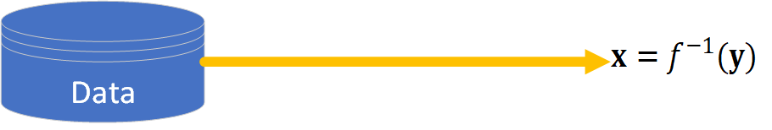
End-to-End Learning for Inverse Problems

Slide 5
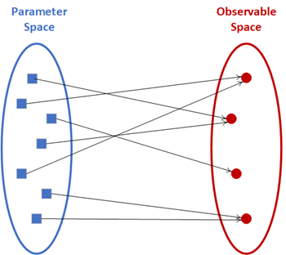
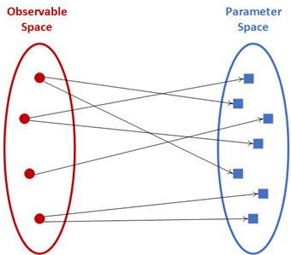



Ill-posedness of Inverse Problems
Forward Mapper
Backward Mapper
well-posed
ill-posed

Slide 6
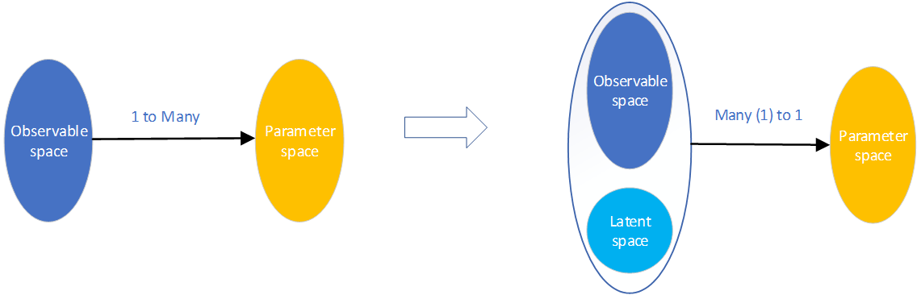
Fundamental Idea
Variational Autoencoder Inverse Mapper
Inverse Problem
VAIM
ill-posed
well-posed

Slide 7
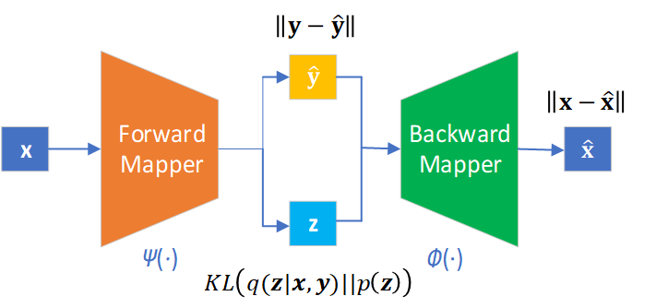
Machine Learning Architecture
Variational Autoencoder Inverse Mapper
Predicted Observables
Parameters
Reconstructed Parameters
Latent Variables

Slide 8
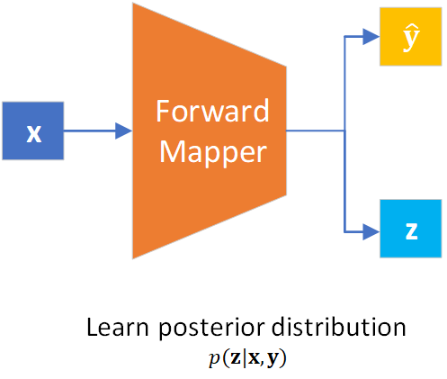
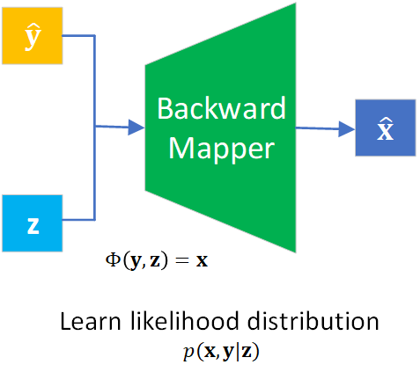

Forward Mapper and Backward Mapper

Slide 9
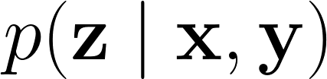
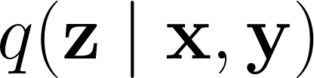
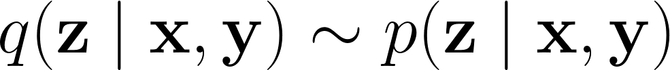
Math behind Variational Autoencoder Inverse Mapper
Approximate
  True posterior distribution
Variational Inference
  Learn an approximate distribution such that
  Minimize the Kullback-Leibler (KL) divergence

Slide 10

Math behind Variational Autoencoder Inverse Mapper (cont.)
Variational Autoencoder Theory
Equivalent to
True prior distribution
  Select tractable distribution easy to generate
    Gaussian
    Uniform

Slide 11
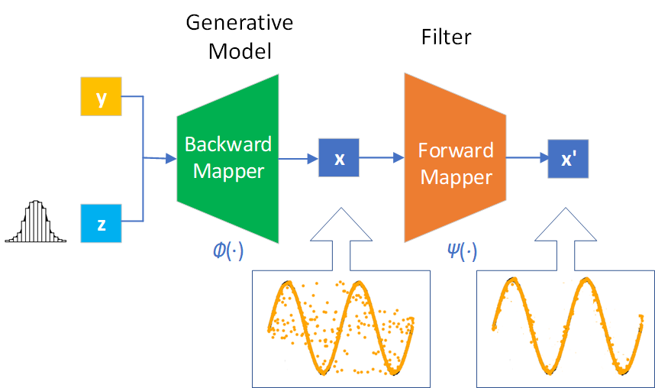
Variational Autoencoder Inverse Mapper Production Mode

Slide 12
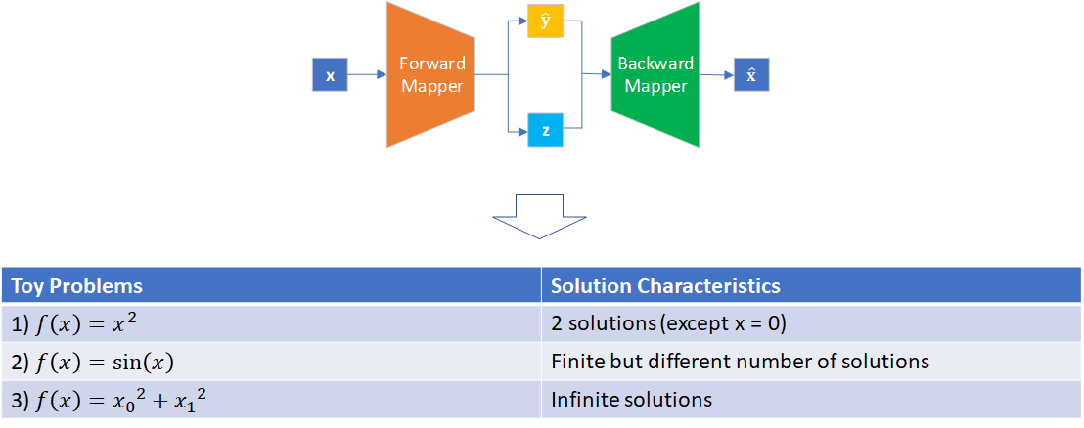
Toy Inverse Problems

Slide 13

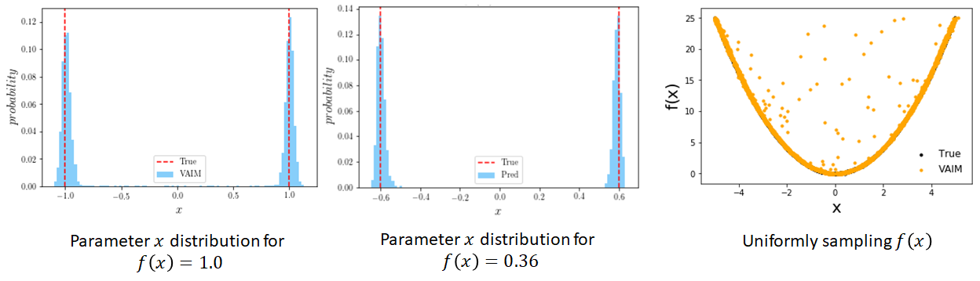
Toy Problem 1)

Slide 14
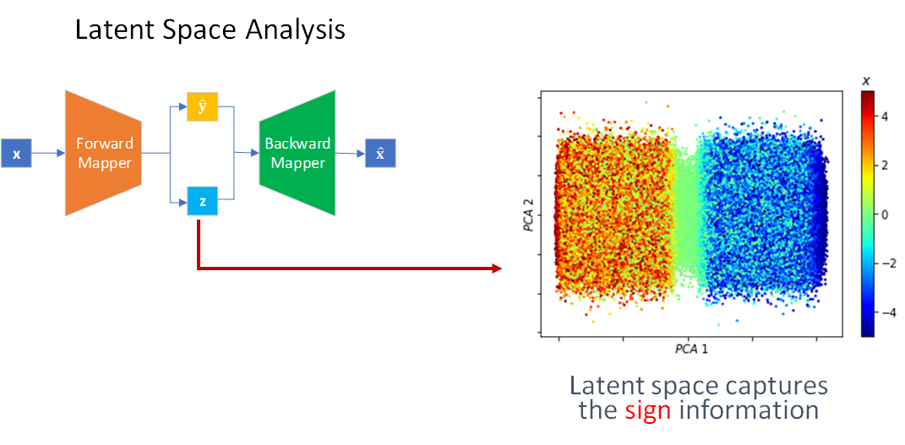
Toy Problem 1)

Slide 15
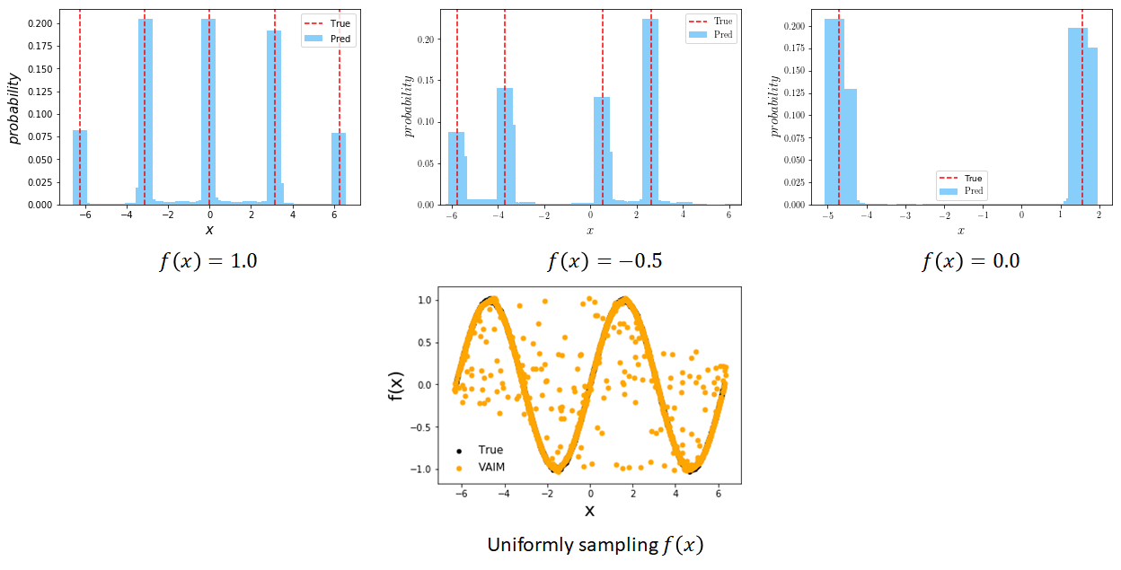
Toy Problem 2)

Slide 16
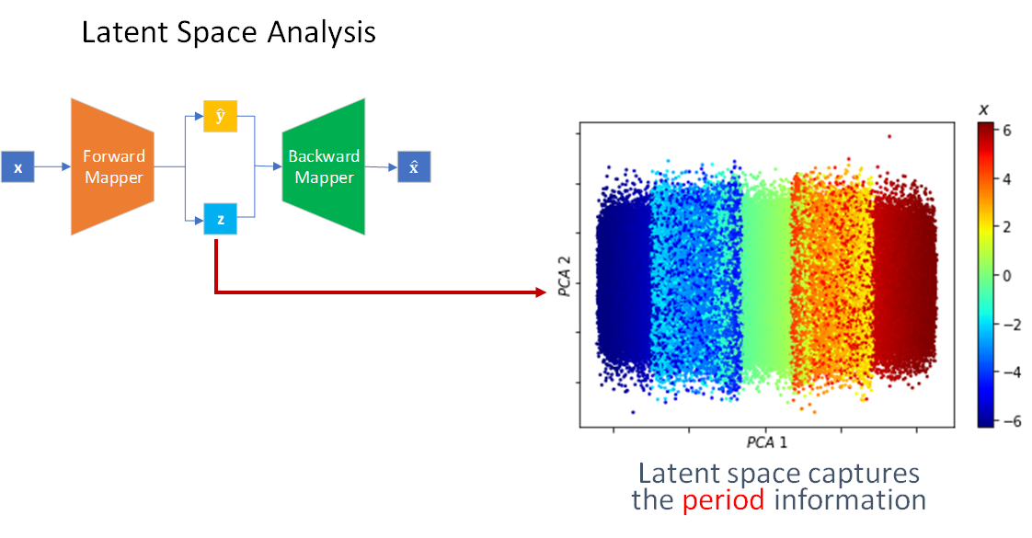
Toy Problem 2)

Slide 17

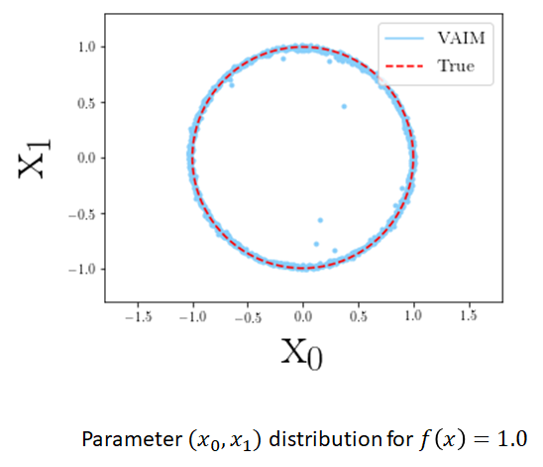
Toy Problem 3)

Slide 18
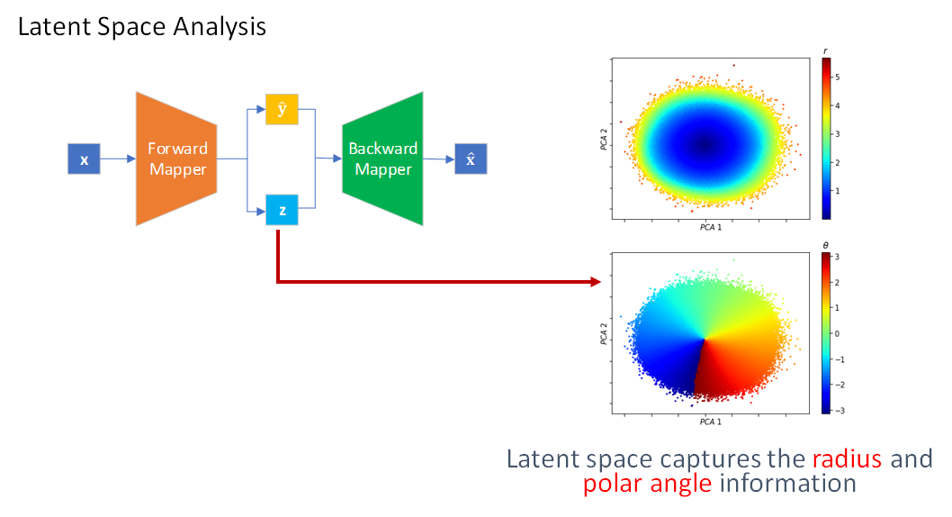
Toy Problem 3)

Slide 19
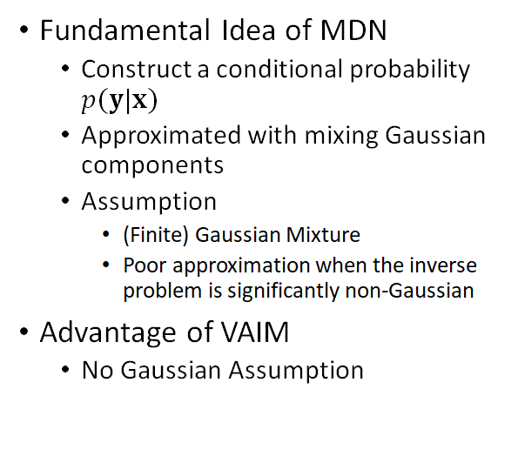
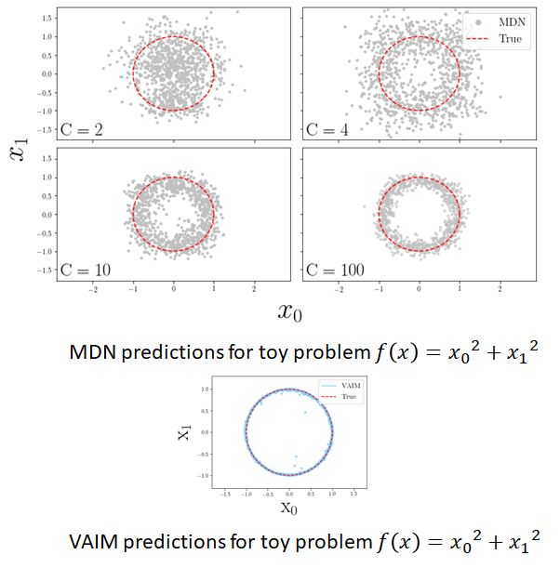
Comparison with Mixture Density Network (MDN)

Slide 20
Comparison with Invertible Neural Networks (INN)
Invertible Neural Networks (INN)
  Maximum Mean Discrepancy (MMD)
  Degrade polynomially at best as dimension increases
VAIM
  KL-divergence
  Degrade constantly as dimension increases
Ardizzone et al., arXiv:188.04730

Slide 21
Extraction of Compton Form factors
Generalized Parton Distributions (GPDs)
  Multi-dimensional descriptions of proton structure
Deeply virtual exclusive scattering processes
  Golden channel for the extraction of information on partonic 3D dynamics in the nucleon
Compton Form Factors (CFFs)
  2D Slices of GPDs
  Measured in Deeply Virtual Compton Scattering (DVCS)
  Contain potentially new information on hadronic structure
  What can we extract from the Jefferson Lab data? What are the associated errors?

Slide 22
Extraction of CFFs as an Inverse Problem
Extraction of 8 CFFs from a single polarization observable
  An inverse problem of extracting 8 unknowns from a single equation
  Quantification of information extracted from experiments
$$Re\left(H\right),Im\left(H\right),Re\left(\tilde{H}\right),Im\left(\tilde{H}\right),Re\left(E\right),Im\left(E\right),Re\left(\tilde{E}\right),Im\left(\tilde{E}\right)$$

Slide 23
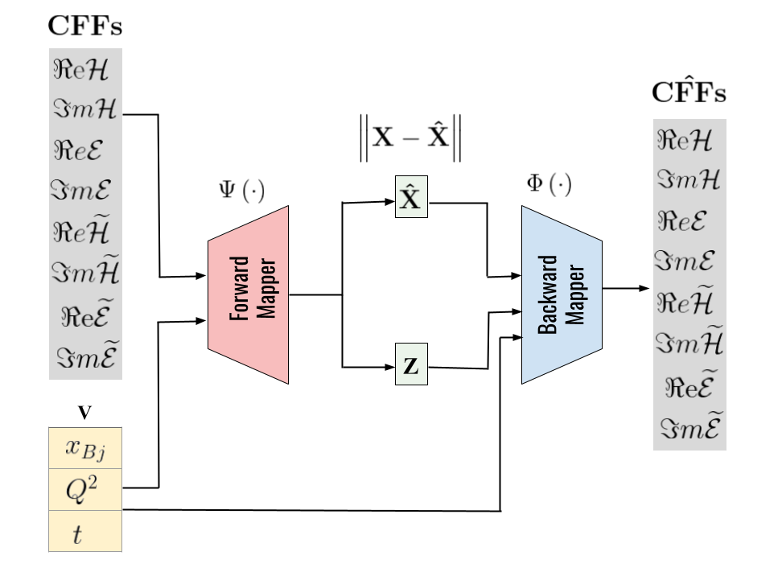
Conditional VAIM Architecture for CFF Extraction
Cross Sections

Slide 24
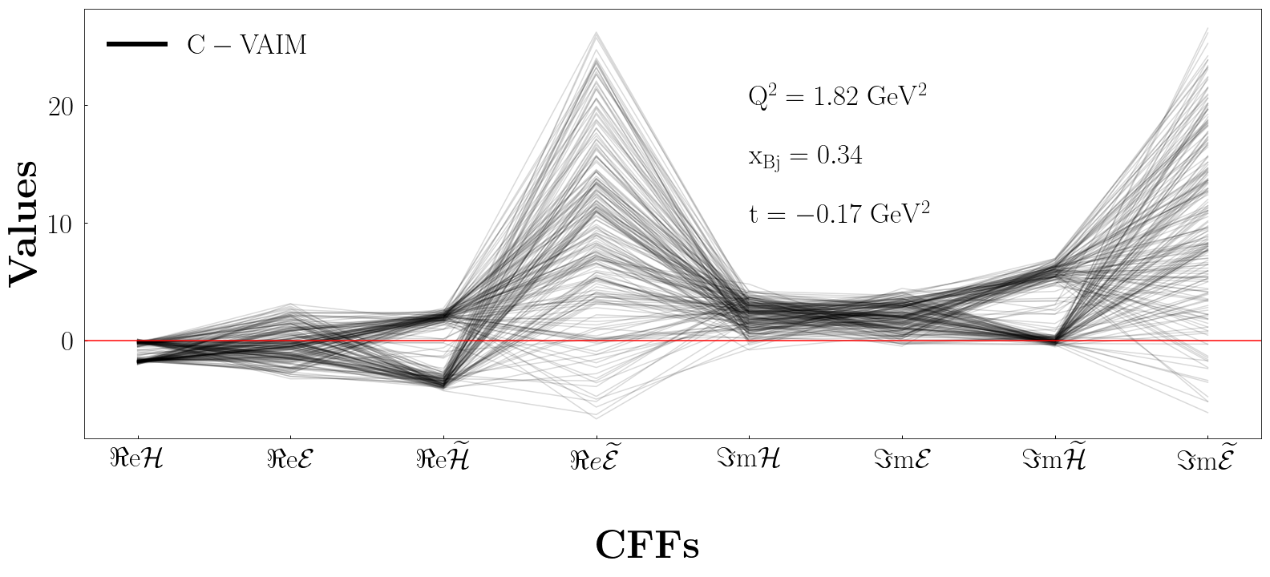
VAIM Results on Extracting CFFs

Slide 25
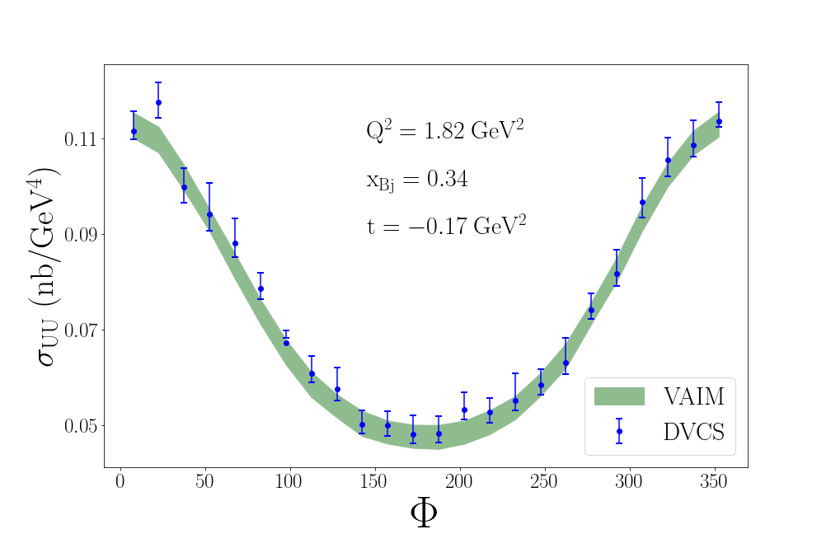
Computed Cross Sections for the Predicted CFFs

Slide 26
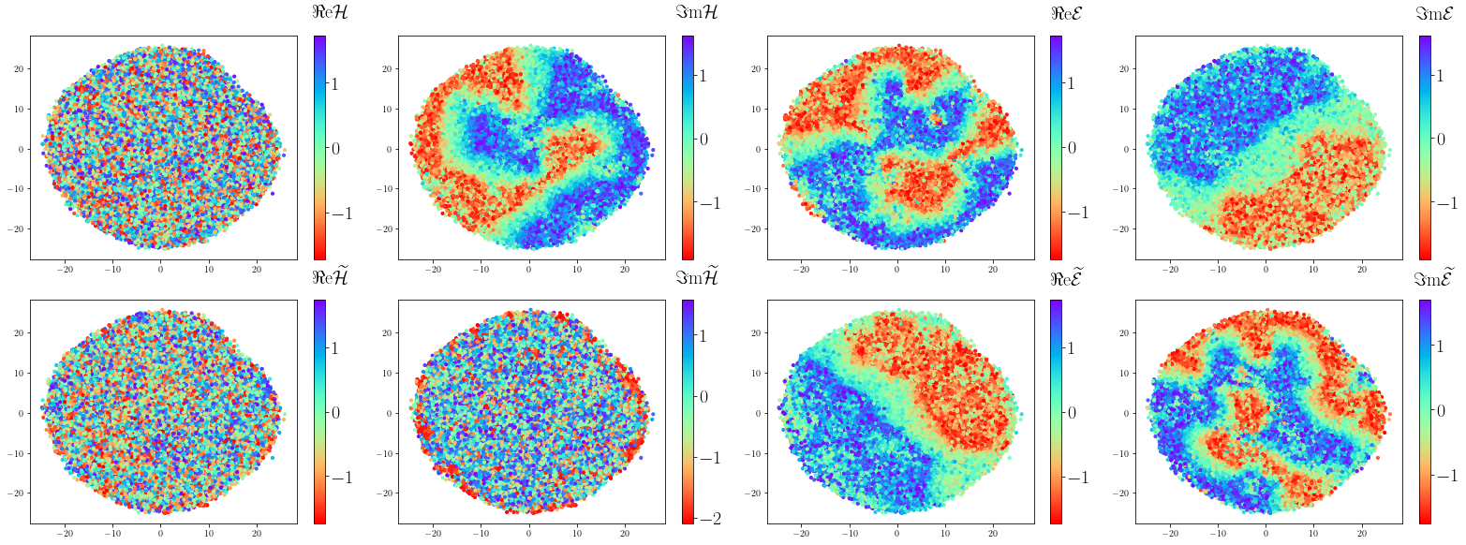
Analysis of Latent Layers
Latent Space
t-SNE 2
t-SNE 1

Slide 27
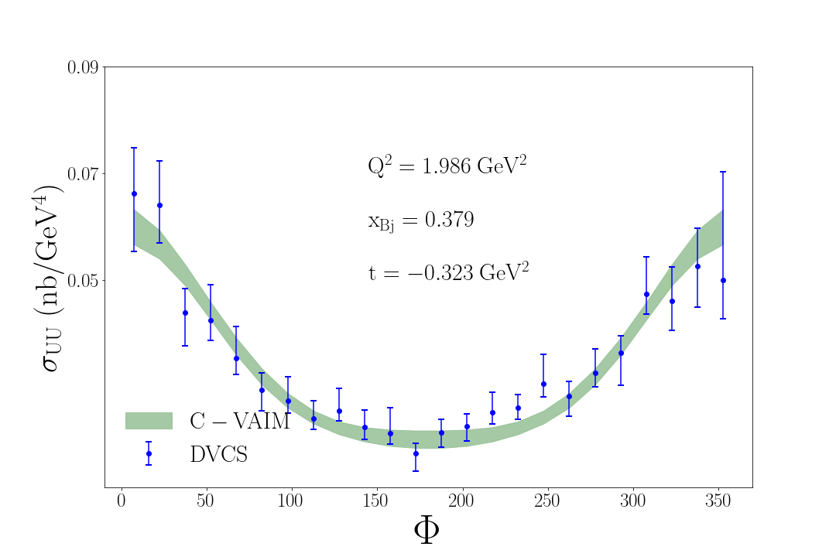
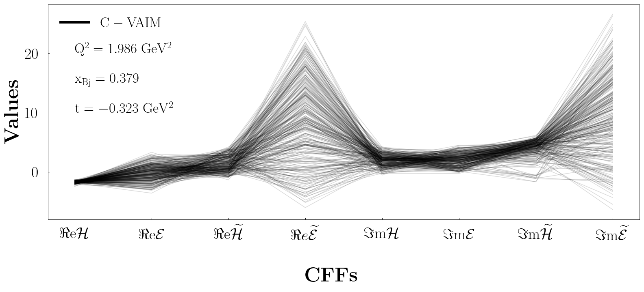
VAIM Results on other Kinematics

Slide 28
References
M. Almaeen, Y. Alanazi, N. Sato, W. Melnitchouk, M. P. Kuchera, Y. Li., “Variational Autoencoder Inverse Mapper: An End-to-End Deep Learning Framework for Inverse Problems.” Proceedings of International Joint Conference on Neural Networks (IJCNN2021), 2021.
M. Almaeen, J. Grigsby, J. Hoskins, B. Kriesten, Y. Li, H-W. Lin, S. Liut, “Benchmarks for a Global Extraction of Information from Deeply Virtual Exclusive Scattering,” arXiv:2207.10766, 2022.
M. Almaeen, J. Hoskins, B. Kriesten, Y. Li, H-W. Lin, S. Liuti, “VAIM - CFF: A variational autoencoder inverse mapper solution to Compton form factor extraction from deeply virtual exclusive reactions,” in preparation, 2022.

Slide 29
Acknowledgements
VAIM
  Nobuo Sato (Jlab)
  Wally Melnitchouk (Jlab)
  Manal Almaeen (ODU)
CFFs Extraction
  Simonetta Liuti (UVA)
  Brandon Kriesten (Jlab, CNF)
  Manal Almaeen (ODU)
  Huey-Wen Lin (MSU)
We thank Jianwei Qiu and Xiangdong Ji for helpful discussions.
This work was supported by the Center for Nuclear Femtography (CNF) 2020, 2021, and 2022 funds, and CNF Graduate Fellowship to Manal Almaeen.

