Slide 1
Electron-Ion Collider –
Project Updates
Jim Yeck, Elke Aschenauer, Rolf Ent
EICUG 2nd Detector Meeting
CFNS Workshop, December 6-8, 2022

Slide 2

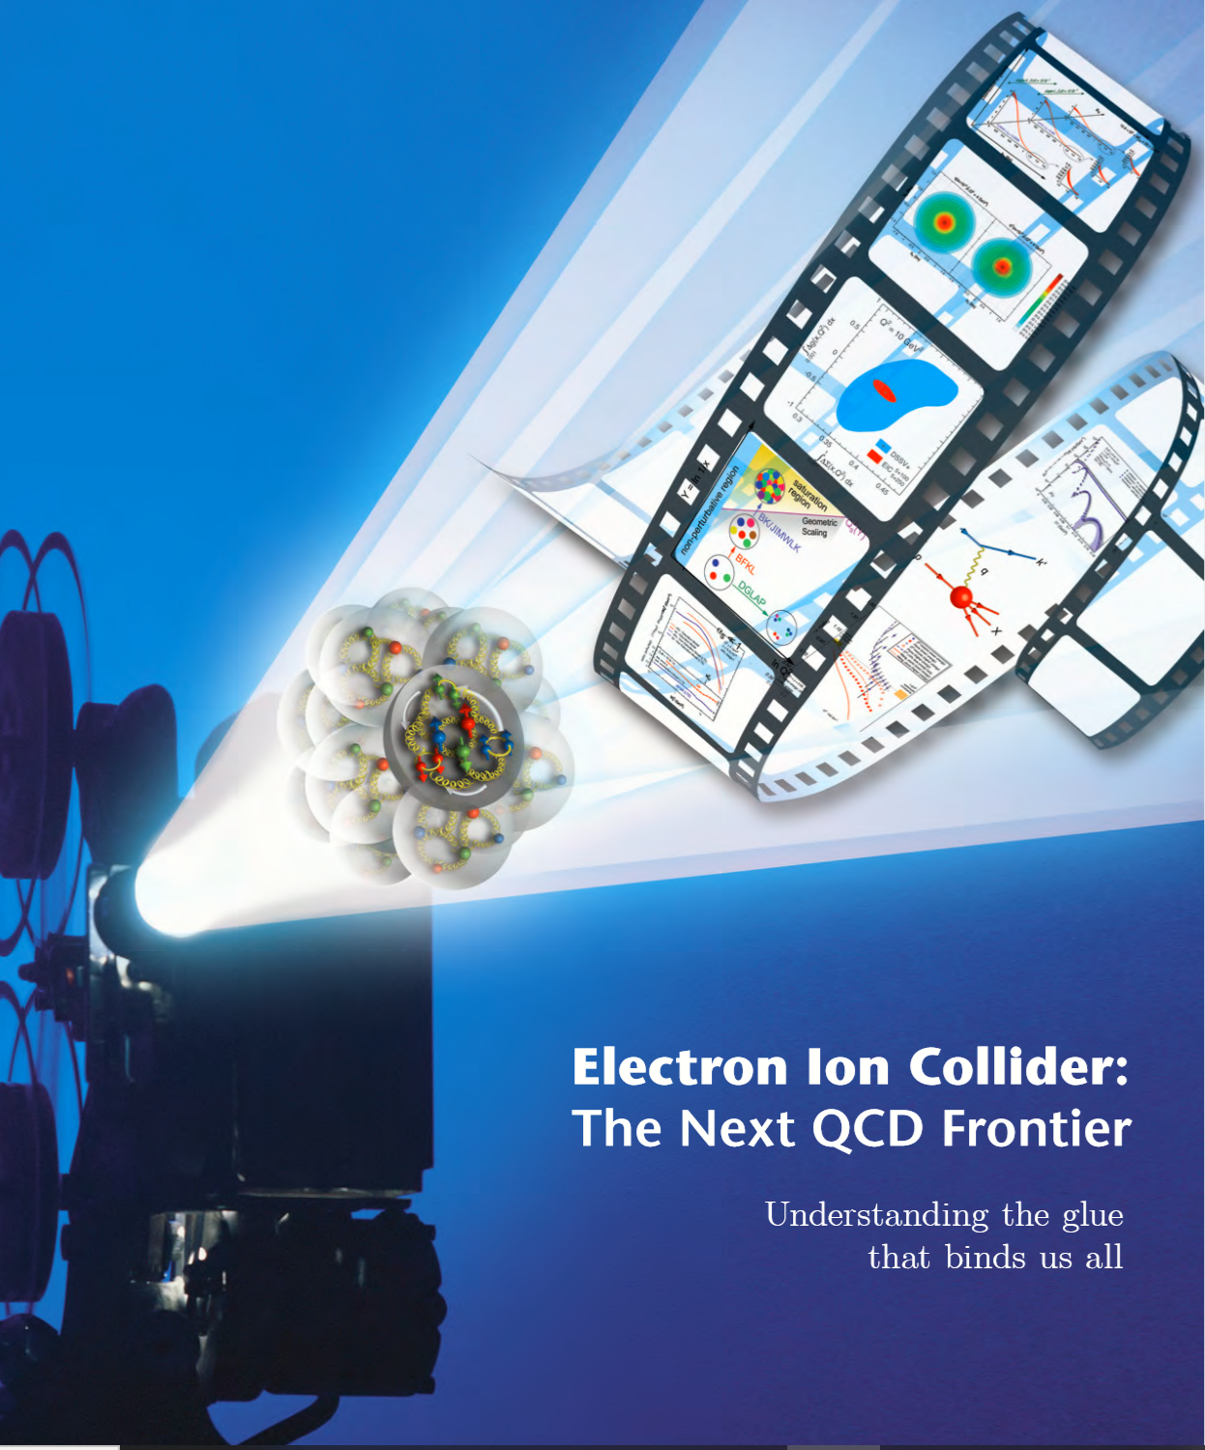
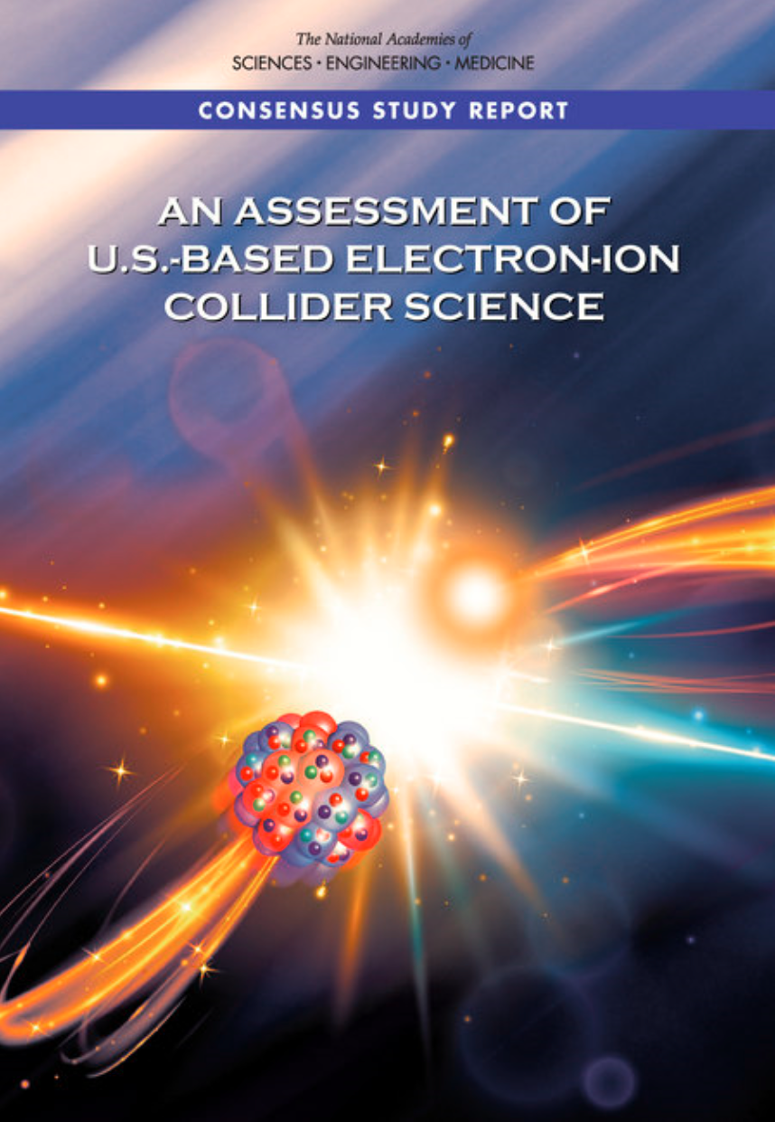

EIC Scope
Project Design Goals
High Luminosity: L= 10³³ – 10³⁴cm⁻²sec⁻¹, 10 – 100 fb⁻¹/year
Highly Polarized Beams: 70%
Large Center of Mass Energy Range: E_{cm} = 29 – 140 GeV
Large Ion Species Range: protons – Uranium
Large Detector Acceptance and Good Background Conditions
Accommodate a Second Interaction Region (IR)
IR-8
IR-6, ePIC Detector
IR-8
p/A beam
e beam
p: 41 GeV, 100 to 275 GeV
e: 5 GeV to 18 GeV

Slide 3
EIC Scope
Project Design Goals
High Luminosity: L= 10³³ – 10³⁴cm⁻²sec⁻¹, 10 – 100 fb⁻¹/year
Highly Polarized Beams: 70%
Large Center of Mass Energy Range: E_{cm} = 29 – 140 GeV
Large Ion Species Range: protons – Uranium
Large Detector Acceptance and Good Background Conditions
Accommodate a Second Interaction Region (IR)
IR-8
IR-6, ePIC Detector
IR-8
Conceptual design scope and expected performance consistent with NSAC Long Range Plan (2015) and the EIC White Paper requirements endorsed by NAS (2018)

Slide 4
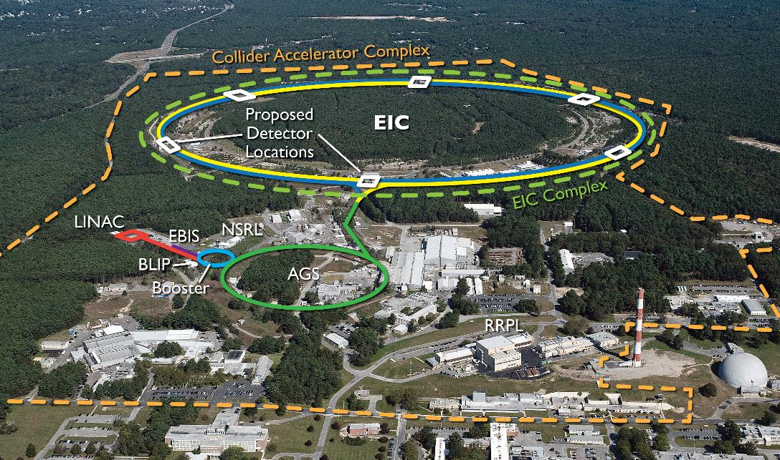
EIC Double Ring Design
Based on Existing RHIC Facility
RHIC Operations Concludes in 2025

Slide 5
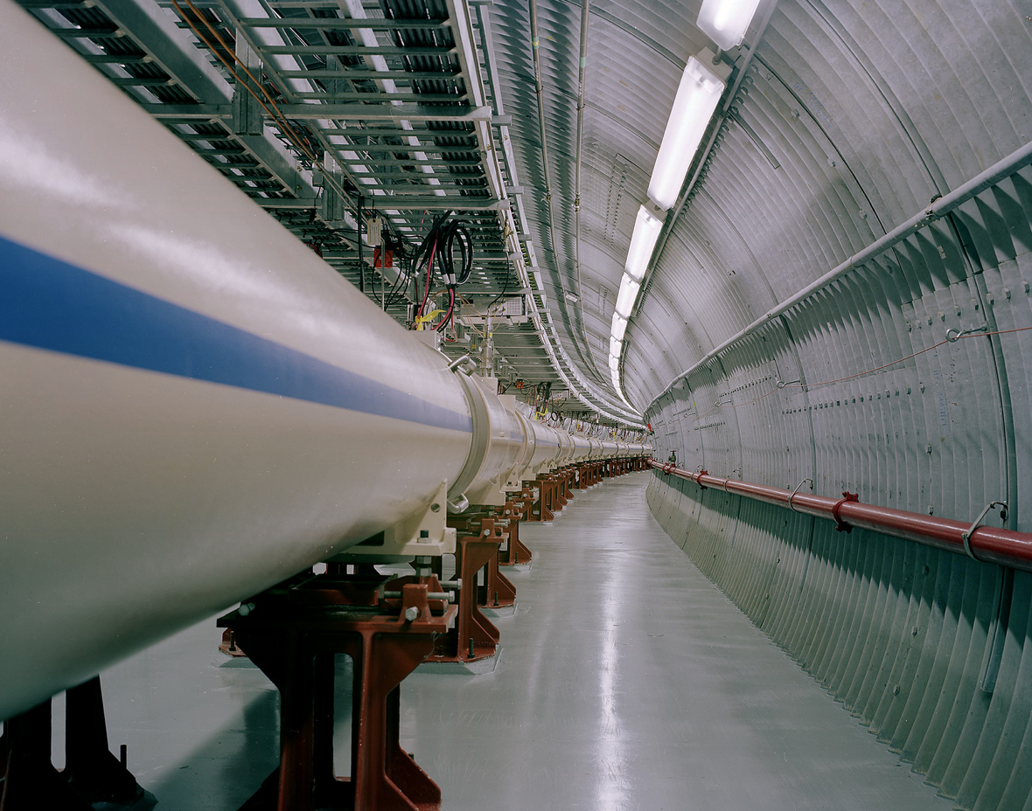
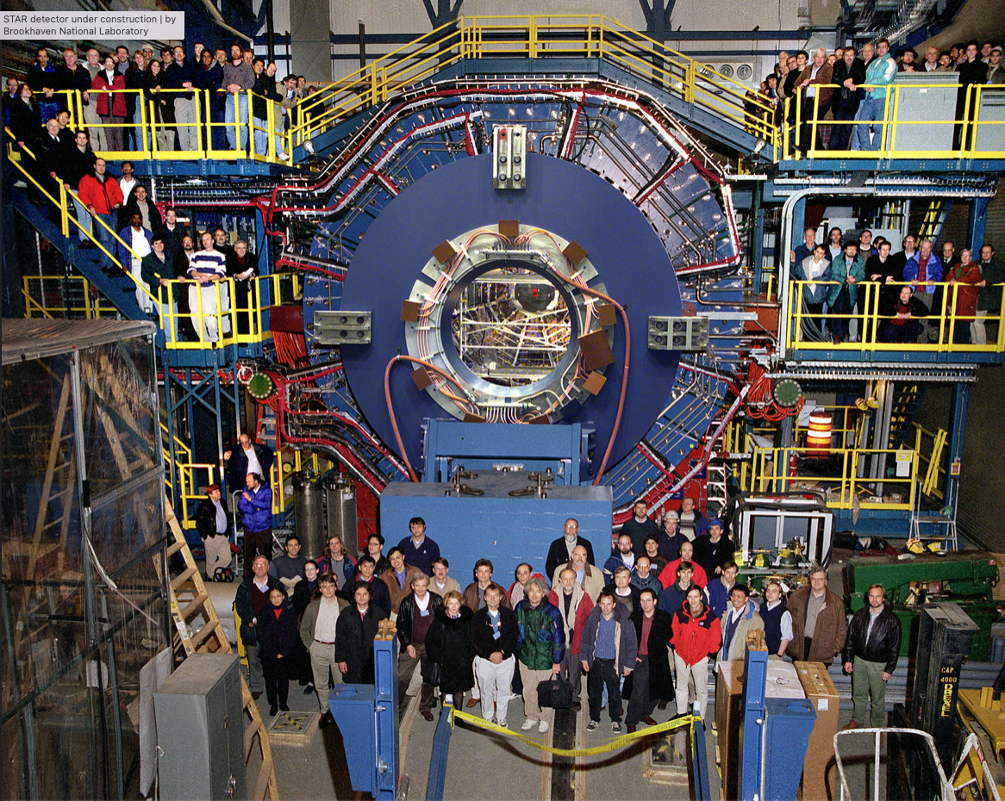
RHIC and BNL / TJNAF Infrastructure and Support

Slide 6
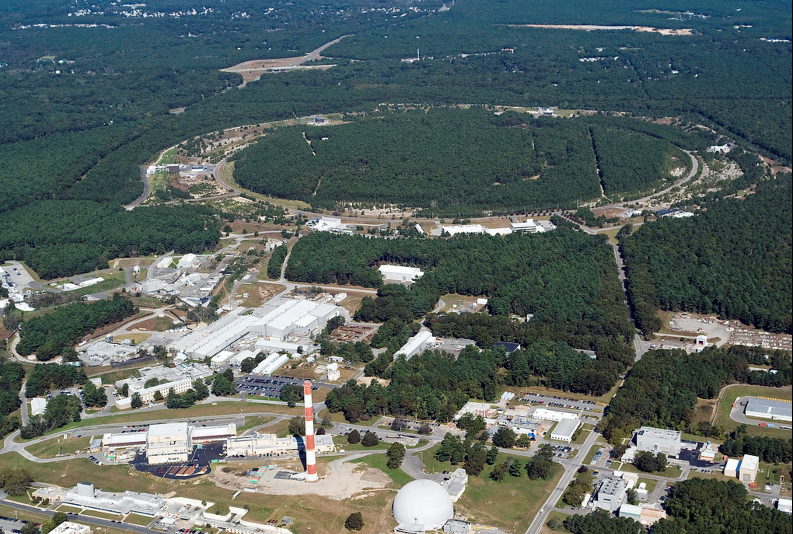

EIC Accelerator Design Overview
Hadron storage ring (HSR): 41-275 GeV (based on RHIC)
  up to 1160 bunches, 1A beam current (3x RHIC)
  bright vertical beam emittance (1.5 nm)
  strong cooling (coherent electron cooling, ERL)
Electron storage ring (ESR): 2.5–18 GeV (new)
  up to 1160 polarized bunches
    high polarization by continual reinjection from RCS
  large beam current (2.5 A) ➔ 9 MW SR power
  superconducting RF cavities
Rapid cycling synchrotron (RCS): 0.4-18 GeV (new)
  2 bunches at 1 Hz; spin transparent due to high periodicity
High luminosity interaction region(s) (new)
  L = 10³⁴ cm⁻²s⁻¹
  superconducting magnets
  25 mrad crossing angle with crab cavities
  spin rotators (produce longitudinal spin at IP)
EIC

Slide 7
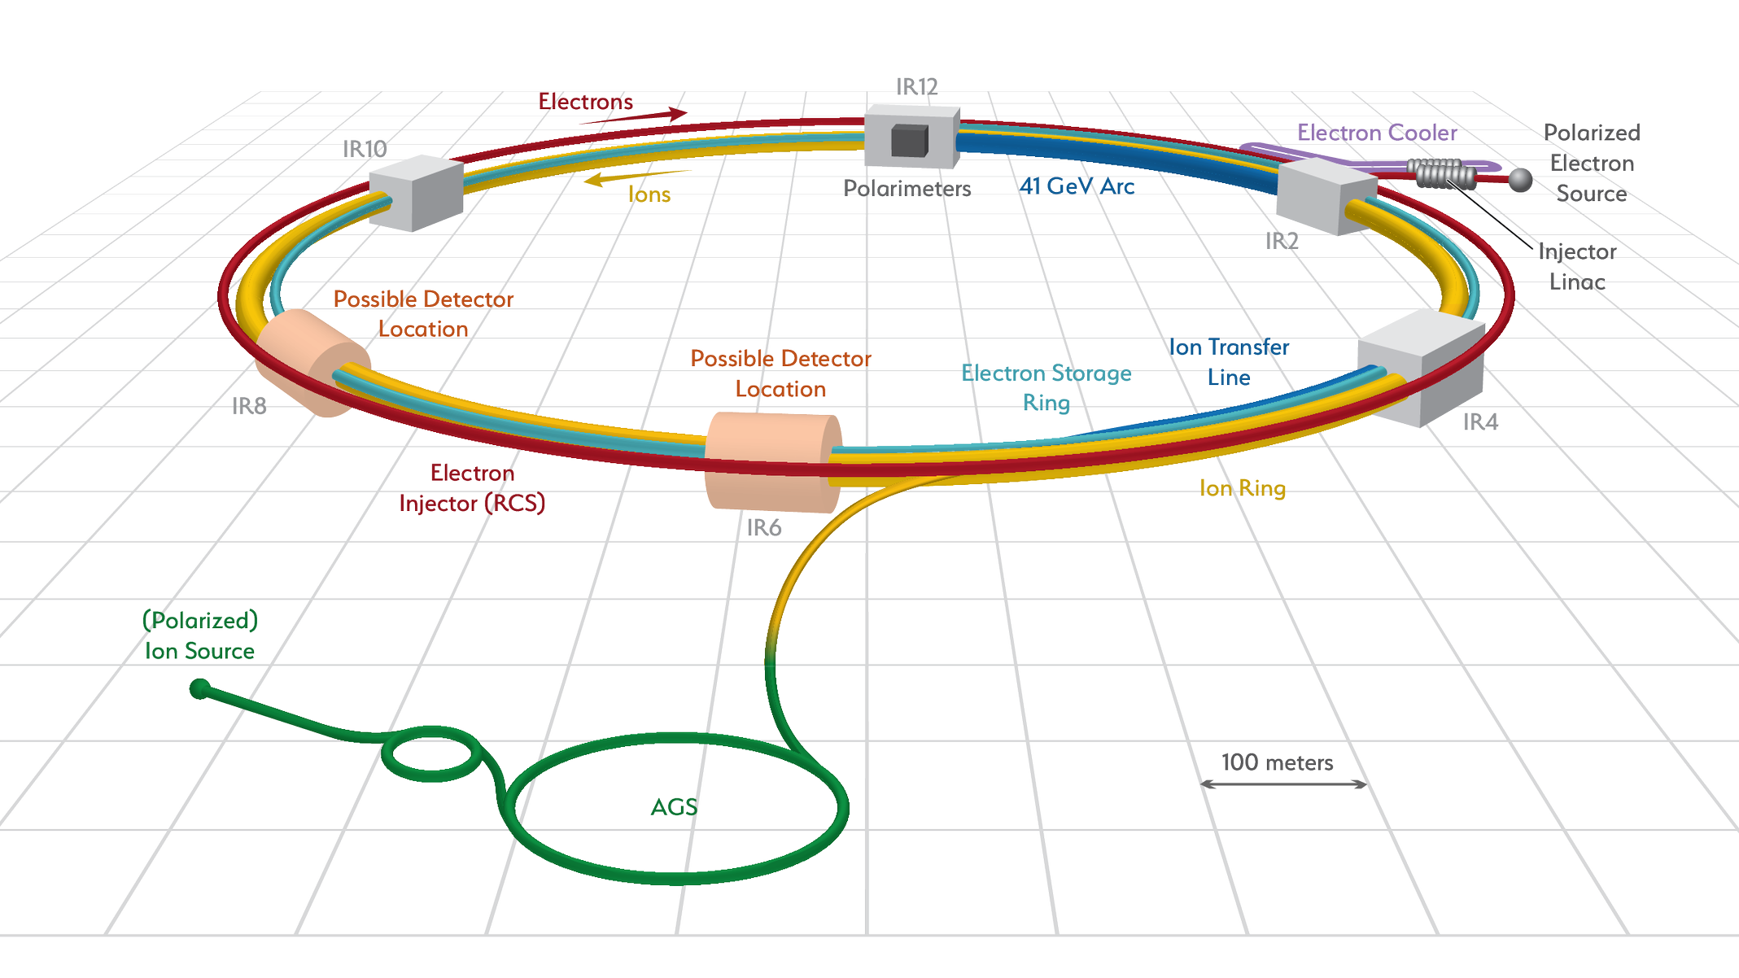
Accelerator Science and Technology – Ongoing EIC R&D
Cooler Electron Source
ESR
Vacuum R&D
Electron Injection
Fast Kicker
Strong Cooling
Polarized e⁻ Source
ESR Cavity
Prototype
HSR Vacuum Upgrade
ESR RF 500kW FPC
2nd IR
ePIC
Hadron Polarimetry
ESR RF HOM Damper
Crab Cavity
Prototype
Proton Injection
Fast Kicker
IR Design and Magnet Prototyping
IR Vacuum Chamber
Existing tunnel and
experiment halls
EIC is the ONLY new collider in foreseeable future! Allows to remain at frontier of Accelerator S&T.
… and enable applications (isotopes, space radiation, water treatment, etc.)

Slide 8
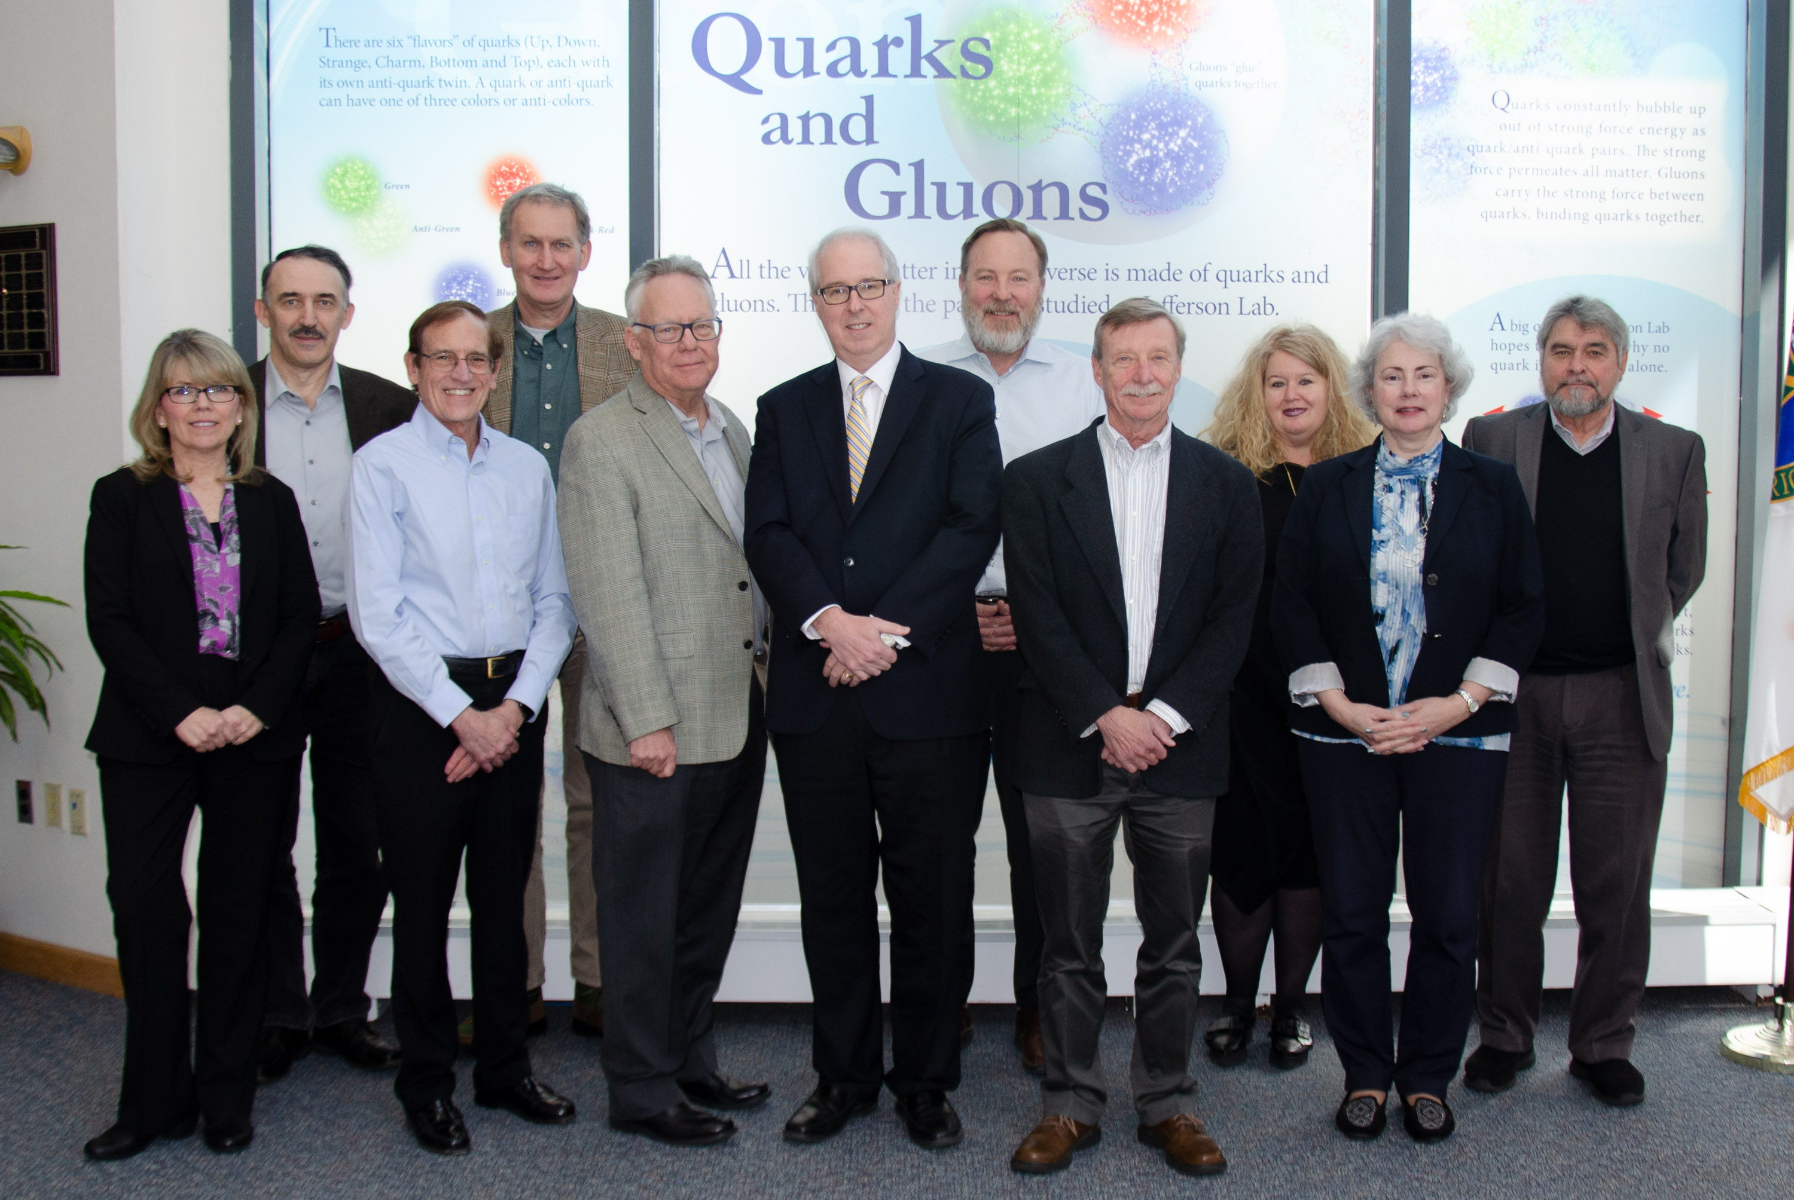
BNL/TJNAF Special Partnership
BNL/JLab partnership established in early 2020
Serve together as hosts for the EIC experimental program
Integrated project scope responsibilities defined

Slide 9
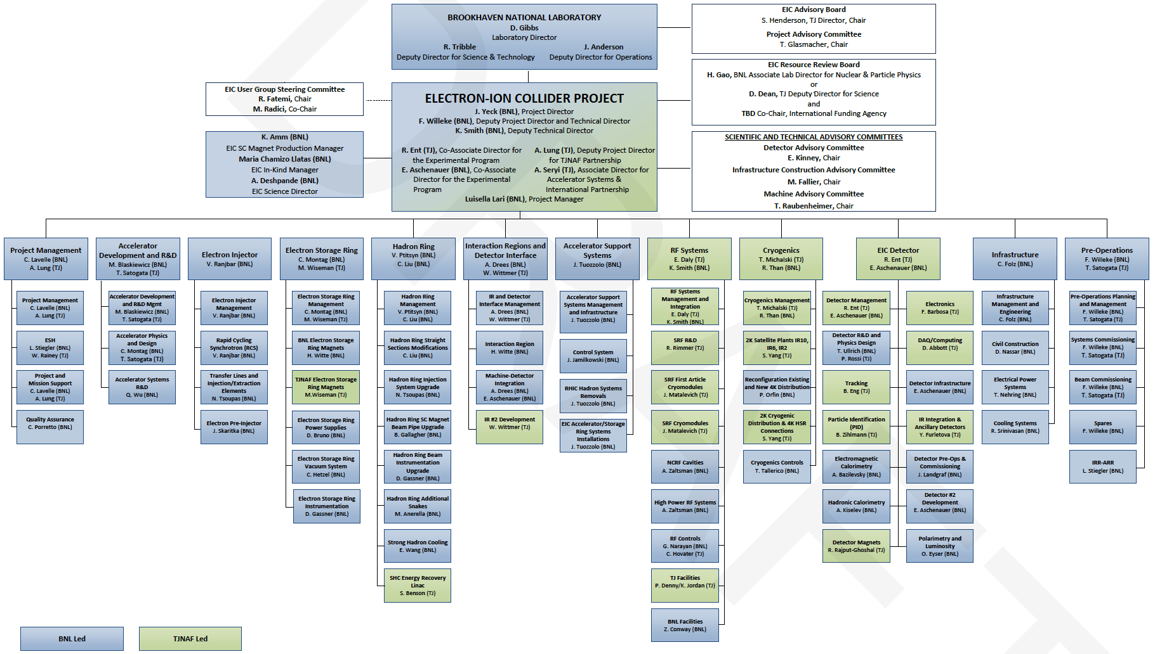
EIC Project Organization

Slide 10
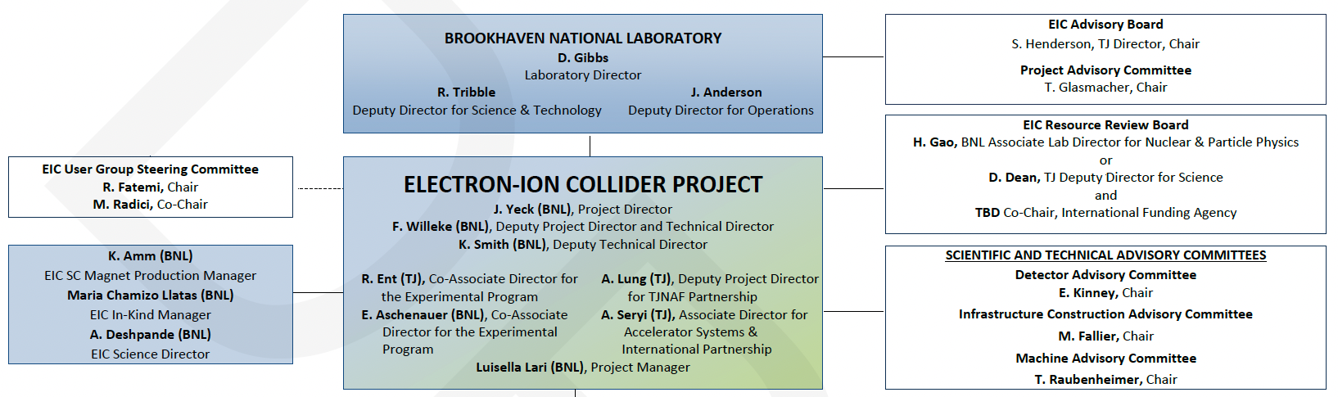
EIC Project – BNL/JLab, Boards, Advisory Committees
DOE, together with BNL and JLab, envision an EIC facility that is “fully international in character.”
EIC Advisory Board provides oversight and advice on the construction of the facility, focusing on the accelerator (BNL, TJNAF, LBNL, ANL, TRIUMF, IN2P3, CEA, STFC, INFN).
EIC Project Advisory Committee provides advice on the successful delivery of the DOE Project (management, scope, schedule, cost, and performance).
EIC Resource Review Board (RRB) to provide oversight of the experiments.

Slide 11
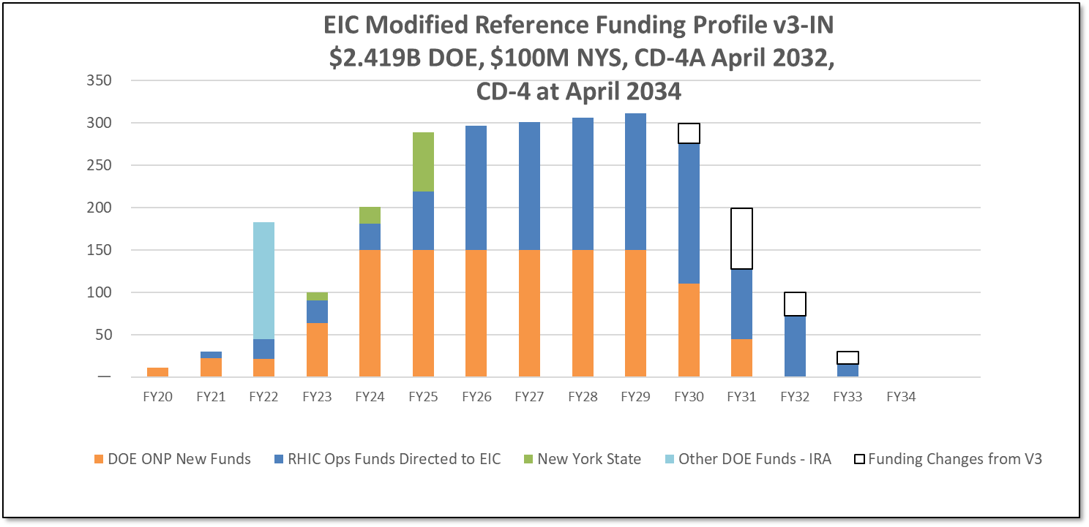
DOE Funding Plan
Inflation Reduction Act funding of $138.24M is a game changer and mitigates risk of slower than optimum ramp of new funding to the $150M/year needed.
Possibility of significant package of long lead procurement items (CD-3A) helping to mitigate risks including procurement, supply chain, inflation and schedule.

Slide 12
EIC Reference Schedule - V3

Slide 13
Experimental program preparation
Year-long EIC User Group driven EIC Yellow Report activity
  Science Requirements and Detector Concepts for the EIC – Drives the requirements of EIC detectors
  arXiv:2103.05419 & Nucl. Phys. A 1026 (2022) 122447 – 418 citations (12/06/22)
BNL and TJNAF Jointly Leading Efforts Towards Experimental Program | BNL and TJNAF Jointly Leading Process to Select Project Detector
2020 | Call for Expressions of Interest (EOI) https://www.bnl.gov/eic/EOI.php | May 2020
 | EOI Responses Submitted | November 2020
 | Assessment of EOI Responses | On-going&
2021 | Call for Collaboration Proposals for Detectors https://www.bnl.gov/eic/CFC.php | March 2021
 | BNL/TJNAF Proposal Evaluation Committee | Spring 2021
 | Collaboration Proposals for Detectors Submitted | December 2021
2022 | Decision on Project Detector – “ECCE” | March 2022
 | Guide process to joint “Detector-1” Collaboration | Spring 2022
 | EPIC Collaboration* Formed – 160 institutions | July 2022
 | EIC Software Infrastructure Review | August 2022
&Remains ongoing until formal agreements are in place – it originally led to confirmation that in-kind level assumed for the EIC detector was in range.
*Merger of two large ATHENA and ECCE proposals

Slide 14
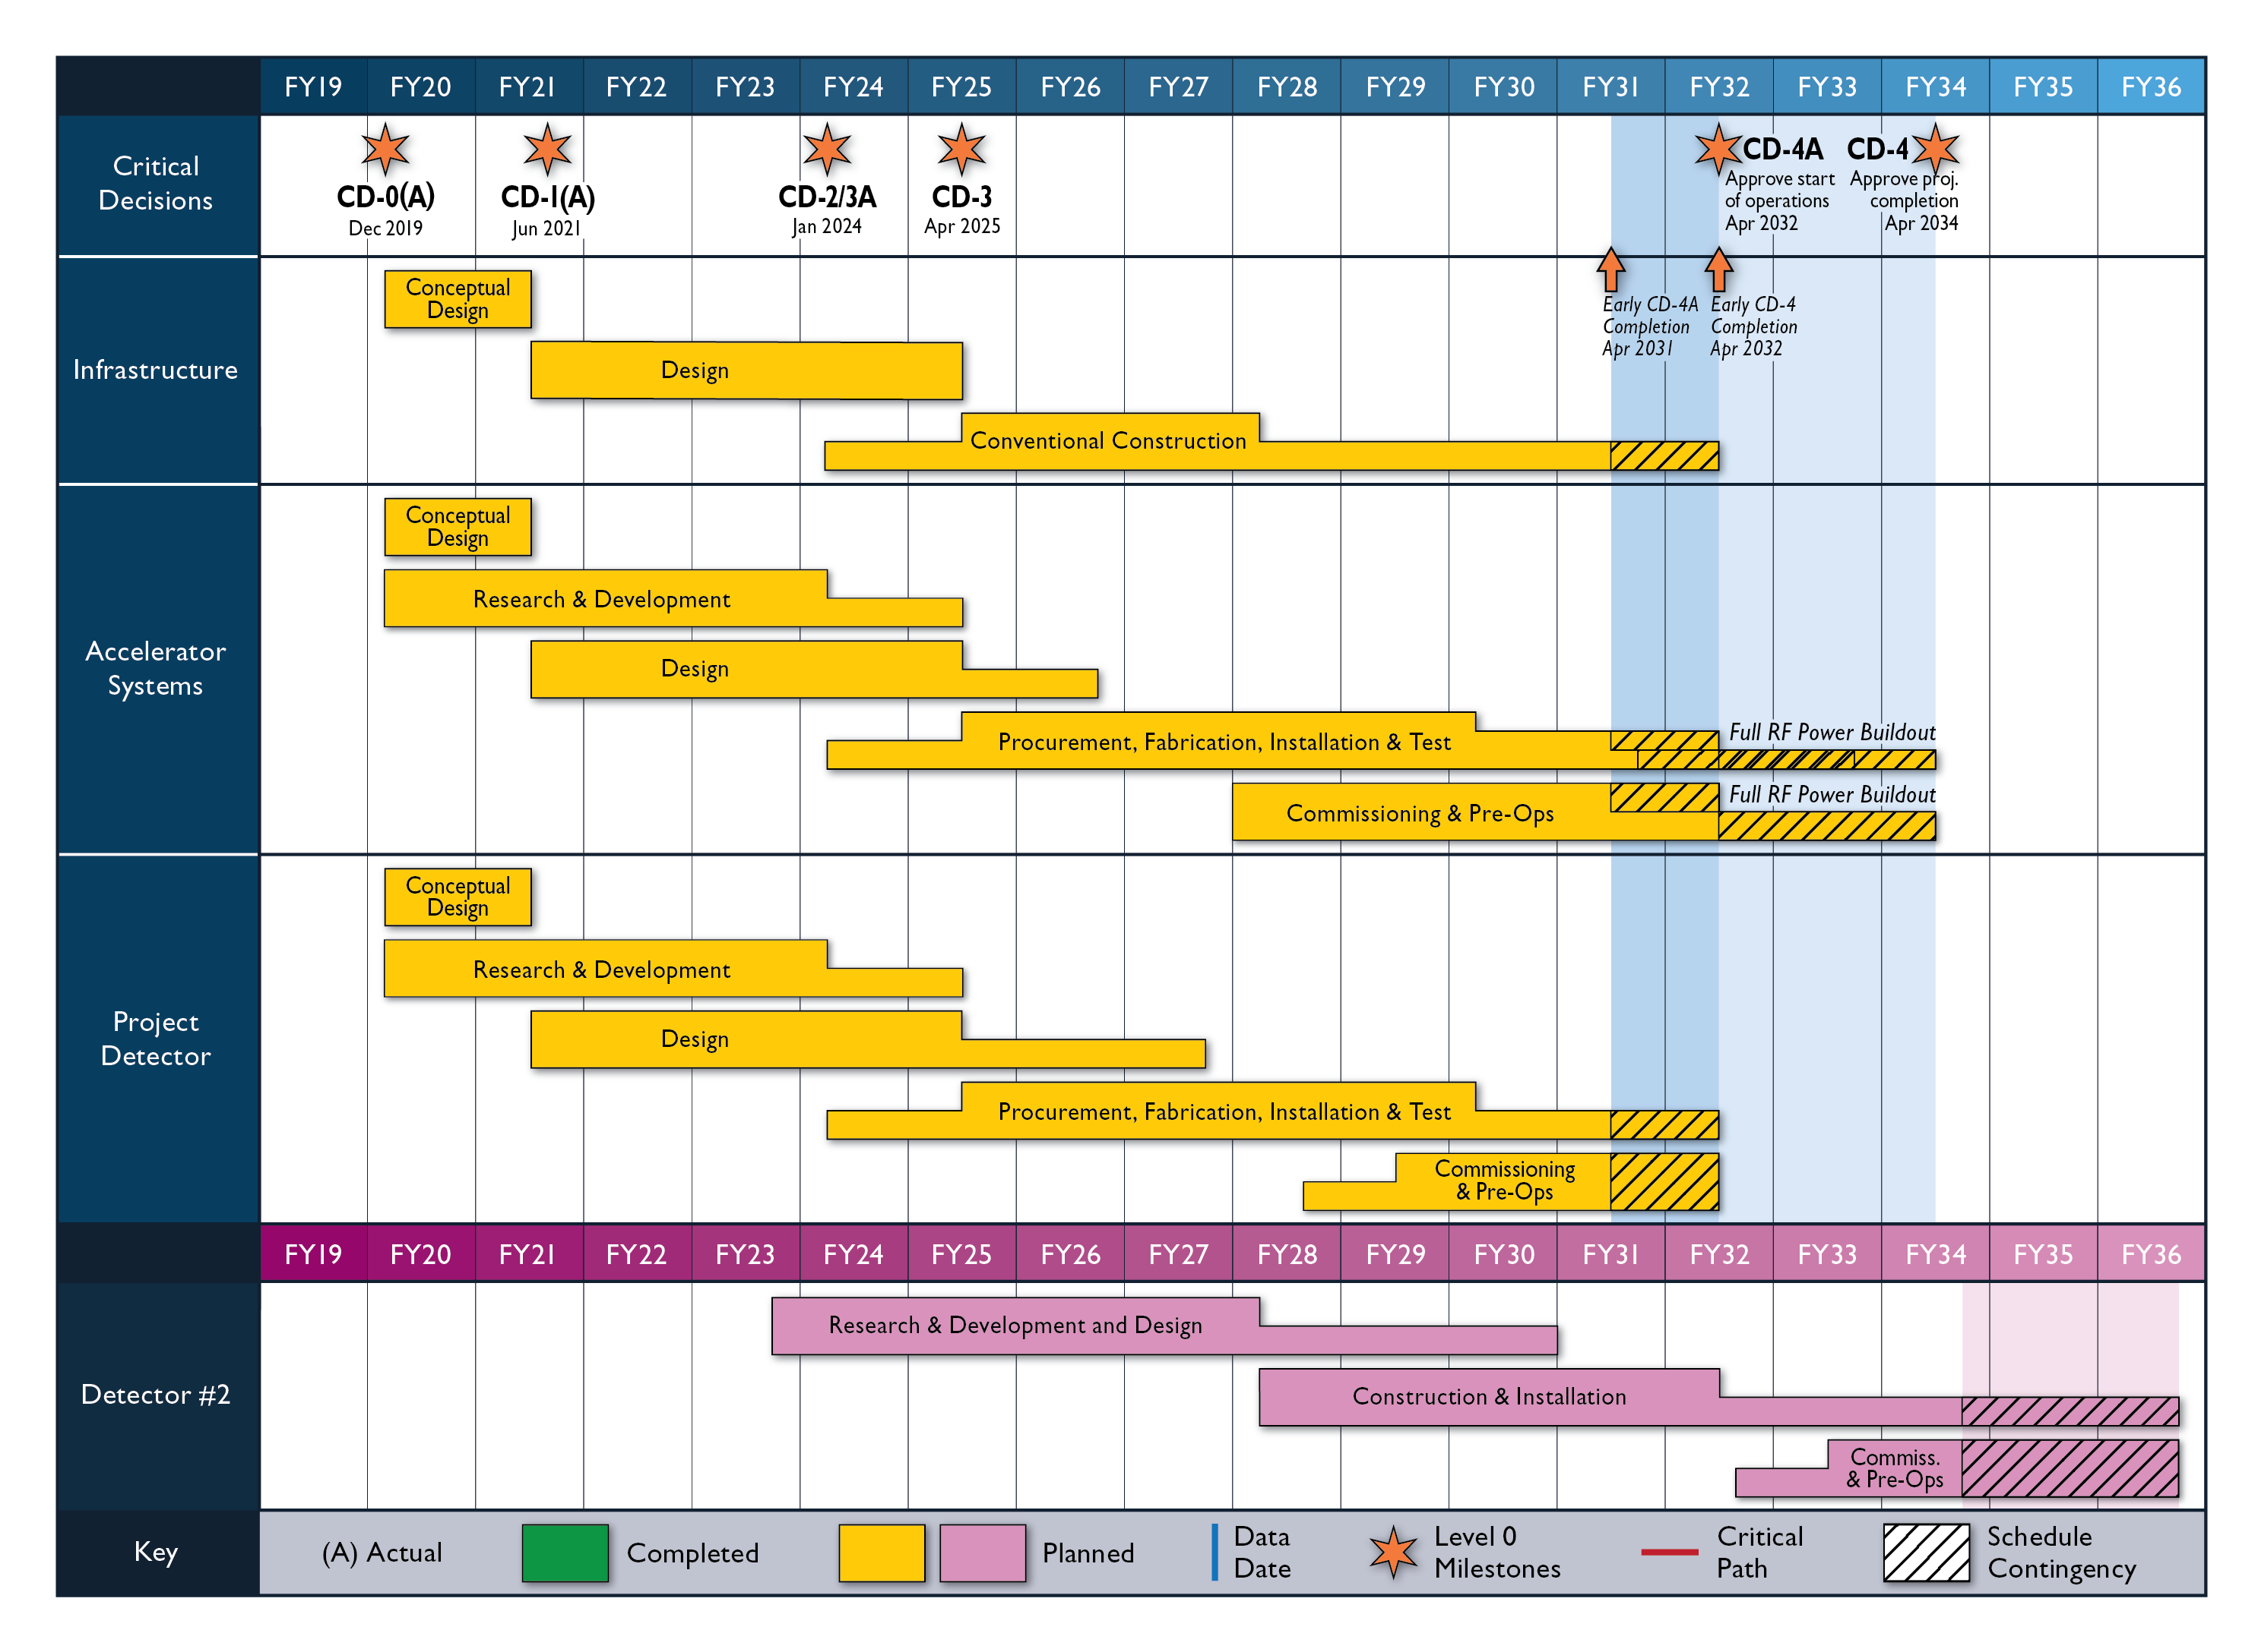
Reference Schedule for 2nd IR and Detector
Construction Phase
Science Phase
Notional Schedule
2nd IR and
Schedule
Generic Detector R&D

Slide 15
International Boards
EIC Advisory Board
  Includes leaders of international and domestic partner institutions
  BNL Director welcoming new members interested in contributing to the EIC accelerator facility
Resource Review Board (RRB) for the EIC experiments
  Similar to the LHC RRBs, includes funding agency reps
  EIC RRB pre-planning meeting October 12-13, 2022
  1st EIC RRB meeting is April 3-4, 2023
  ePIC collaboration forming now

Slide 16
DOE Project Phases
EIC
*
Operating* Funds
Project Engineering and Design (PED) Funds
Construction & PED
Funds
Operating Funds
Initiation
Definition
Execution
Closeout
Conceptual Design
Preliminary Design
Final Design
Construction
Critical
Decisions
CD-0
Approve Mission Need
CD-1
Approve Alternative Selection
and Cost
Range
CD-2
Approve Performance Baseline (PB)
CD-3
Approve Start of Construction or Execution
CD-4
Approve
Start of Operations or Project Completion
Formal Process of DOE Gateway Reviews
CD-0, Mission Need ✓
CD-1, Alternative Selection and Cost Range ✓
Partner and collaboration engagement needed to establish the baseline
CD-2, Performance Baseline
CD-3a, Long Lead Procurement

Slide 17
EIC Project – Path to CD-2/3A and CD-3
DOE OPA Status Review (Remote) October 19-21, 2021(A)
Funding Discussion at DOE ONP (In-Person) April 26, 2022 (A)
FPD Status Update at BNL (Hybrid) June 28-30, 2022 (A)
Cost and Schedule Scrutiny Meetings July - September 2022
Project Detector Meetings 2022
  Technical Subsystem Reviews Feb. – Dec. 2022
  Pre-Resource Review Board Kickoff Meeting October 2022
DOE OPA Status Review - Confirm CD-2/3A Plans Jan. 31 – Feb. 2, 2023
Preliminary Design and Director’s Reviews June 2023
DOE CD 2/3A OPA Review and ICR, requires pre-TDR October 2023
DOE CD 2/3A ESAAB Approval January 2024
DOE CD 3 OPA Review, requires TDR ~January 2025
DOE CD 3 ESAAB Approval ~April 2025
OPA = Office of Project Assessment
FPD = Federal Project Director
ICR = Independent Cost Review
ESAAB = Energy Systems Acquisition Advisory Board
TDR = Technical Design Report

Slide 18
EIC Project Organization
W. Wittmer → Y. Zhang

Slide 19
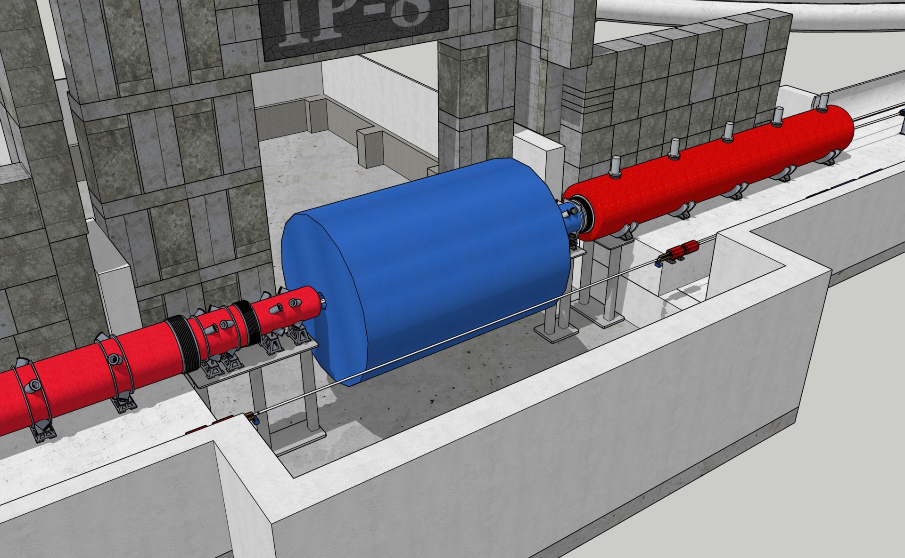
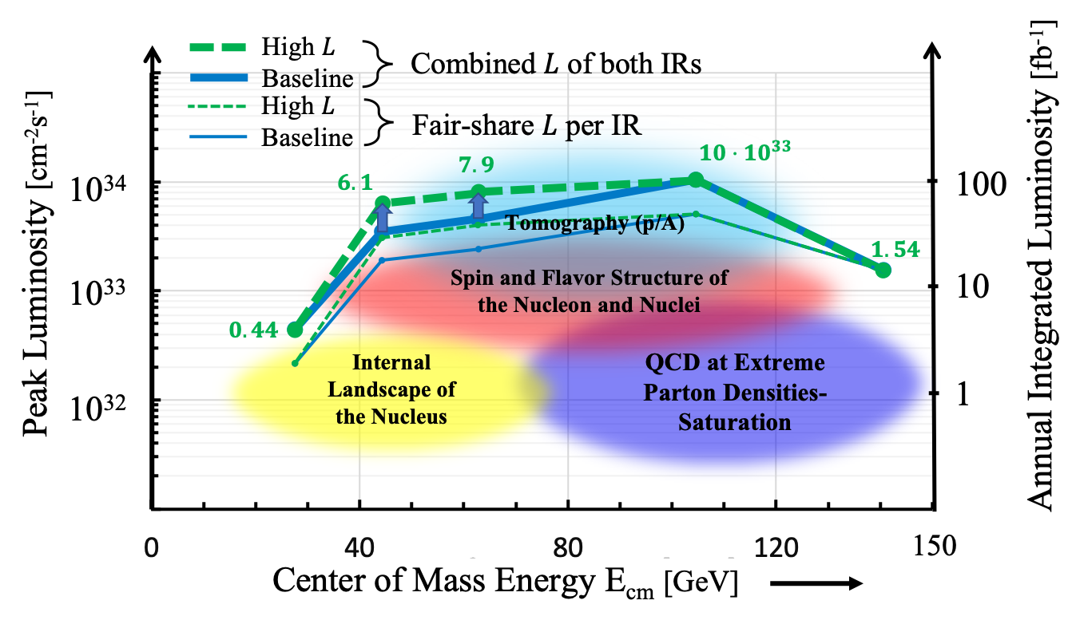
EIC 2nd Detector and IR work
Scope: Ensure feasibility of two simultaneous IRs
  Recall that the luminosity is (at best) shared
Updates on IR layout and detector impacts –
  Randy Gamage and Alex Jentsch
Updates on 3D CAD – Karim Hamdi
Integration in SketchUp – Walt Akers
(also instrumental to bring up need for generic detector R&D with DOE)
Typical in ad-hoc meetings by
E. Aschenauer, S. Berg, A. Drees,
R. Ent, R. Gamage, A. Jentsch,
V. Morozov, T. Satogata,
W. Wittmer (now Y. Zhang)
Detector = Blue cylinder of 838 cm

Slide 20
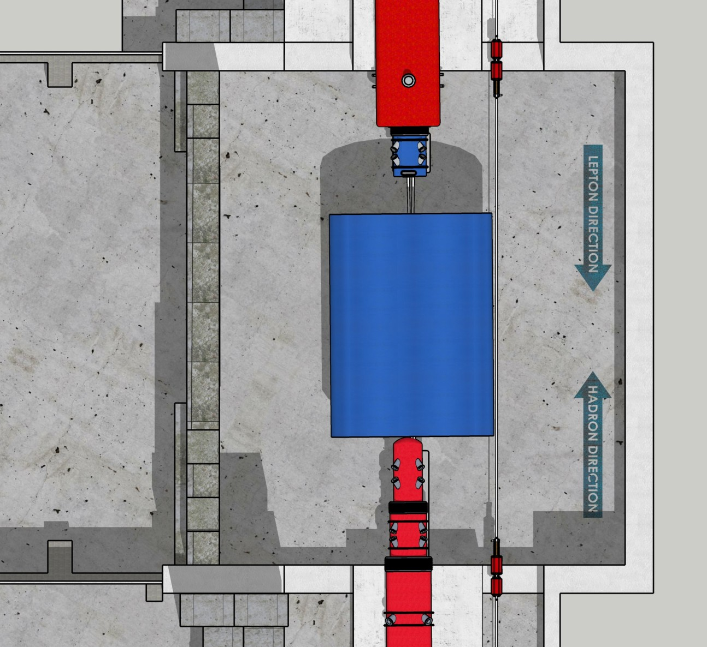
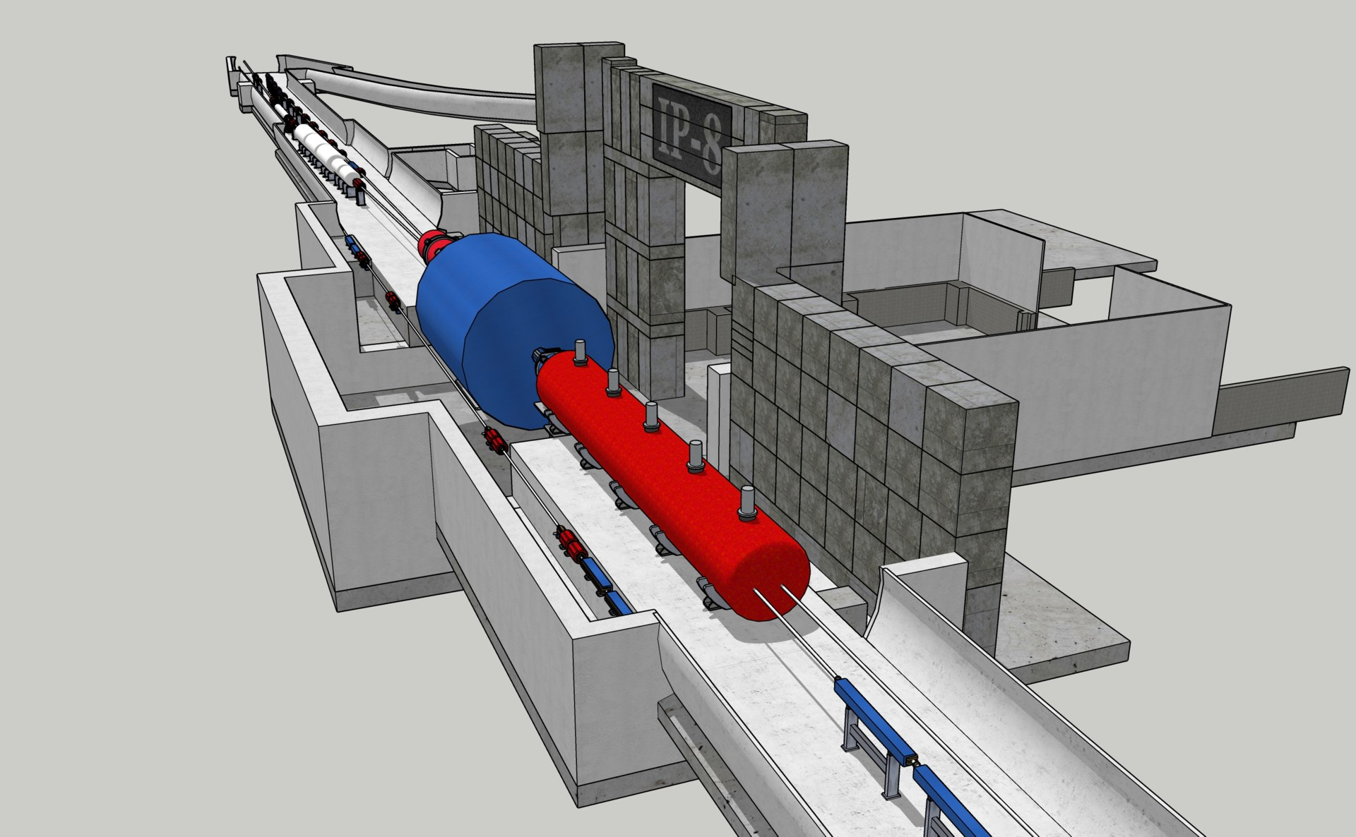
EIC 2nd Detector and IR Work
Detector = Blue cylinder of 838 cm
→ Does not fit through the door
Can develop “handmade” beam pipe (or take the one Alex Jentsch did for his detector acceptance studies)

Slide 21
EIC 2nd Detector and IR – new EIC WP (for US Nuclear Science Long Range Planning activity, driven by EICUG and accompanied by similar efforts for NuPECC long-range plan)
Advantages of 2nd focus recognized by DPAP and folded in EIC White Paper – Now we need to develop a bullet proof science case of a 2nd detector with both unique science and complementarity, by proper choice of 2nd EIC detector technologies and gathering wide and growing community interest.

Slide 22
Summary
DOE Inflation Reduction Act funding is a game changer – shift from progress constrained by availability of early DOE funding to technical progress determined by ability to advance the design, hiring, partnering, collaboration, and procurement – bringing on people!
Priority is to secure DOE CD-2/3a in early 2024 and CD-3 before RHIC concludes operations in 2025.
  CD-3a, Long Lead Procurement Approval, key factor in mitigating risk and determining overall project schedule and cost.
  CD-2, Performance Baseline Approval, establishes Total Project Cost, schedule, performance, and annual funding profile.
Excellent progress defining the EIC project detector, ePIC, and establishing the collaboration responsible for the experiment.
Engage now in the world-wide effort to build a collider facility and detectors designed to meet EIC performance and science goals.

Slide 23
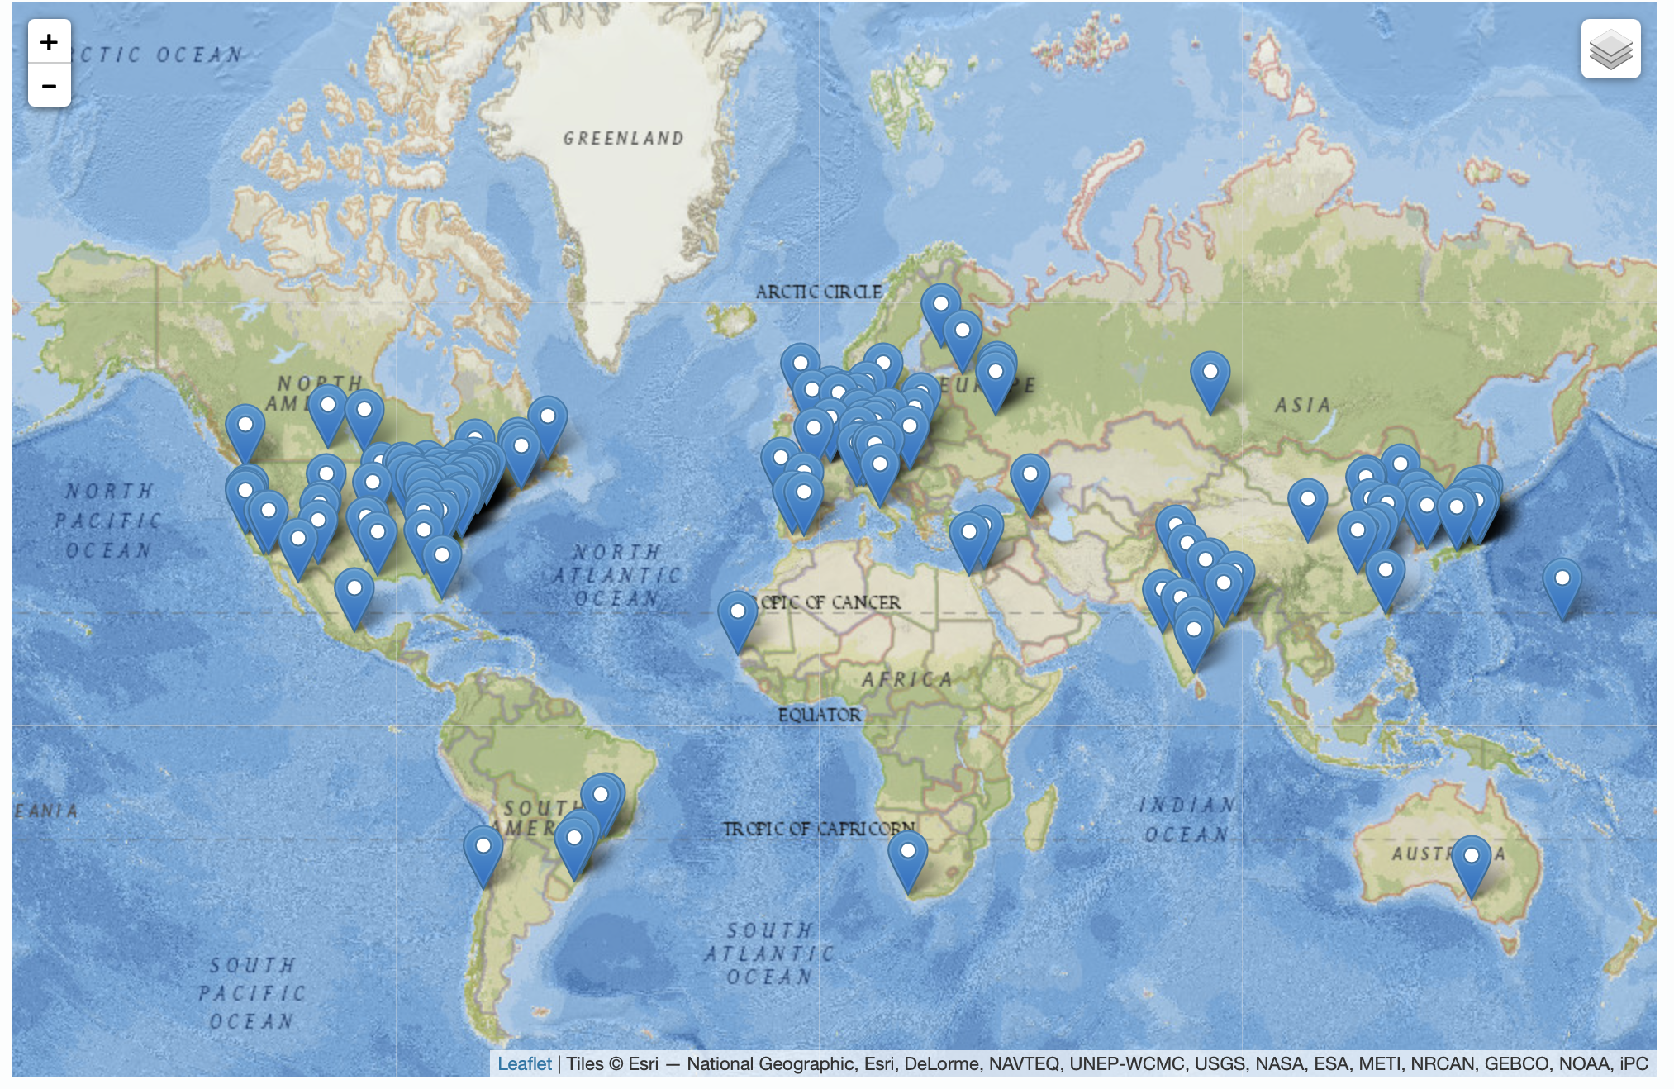
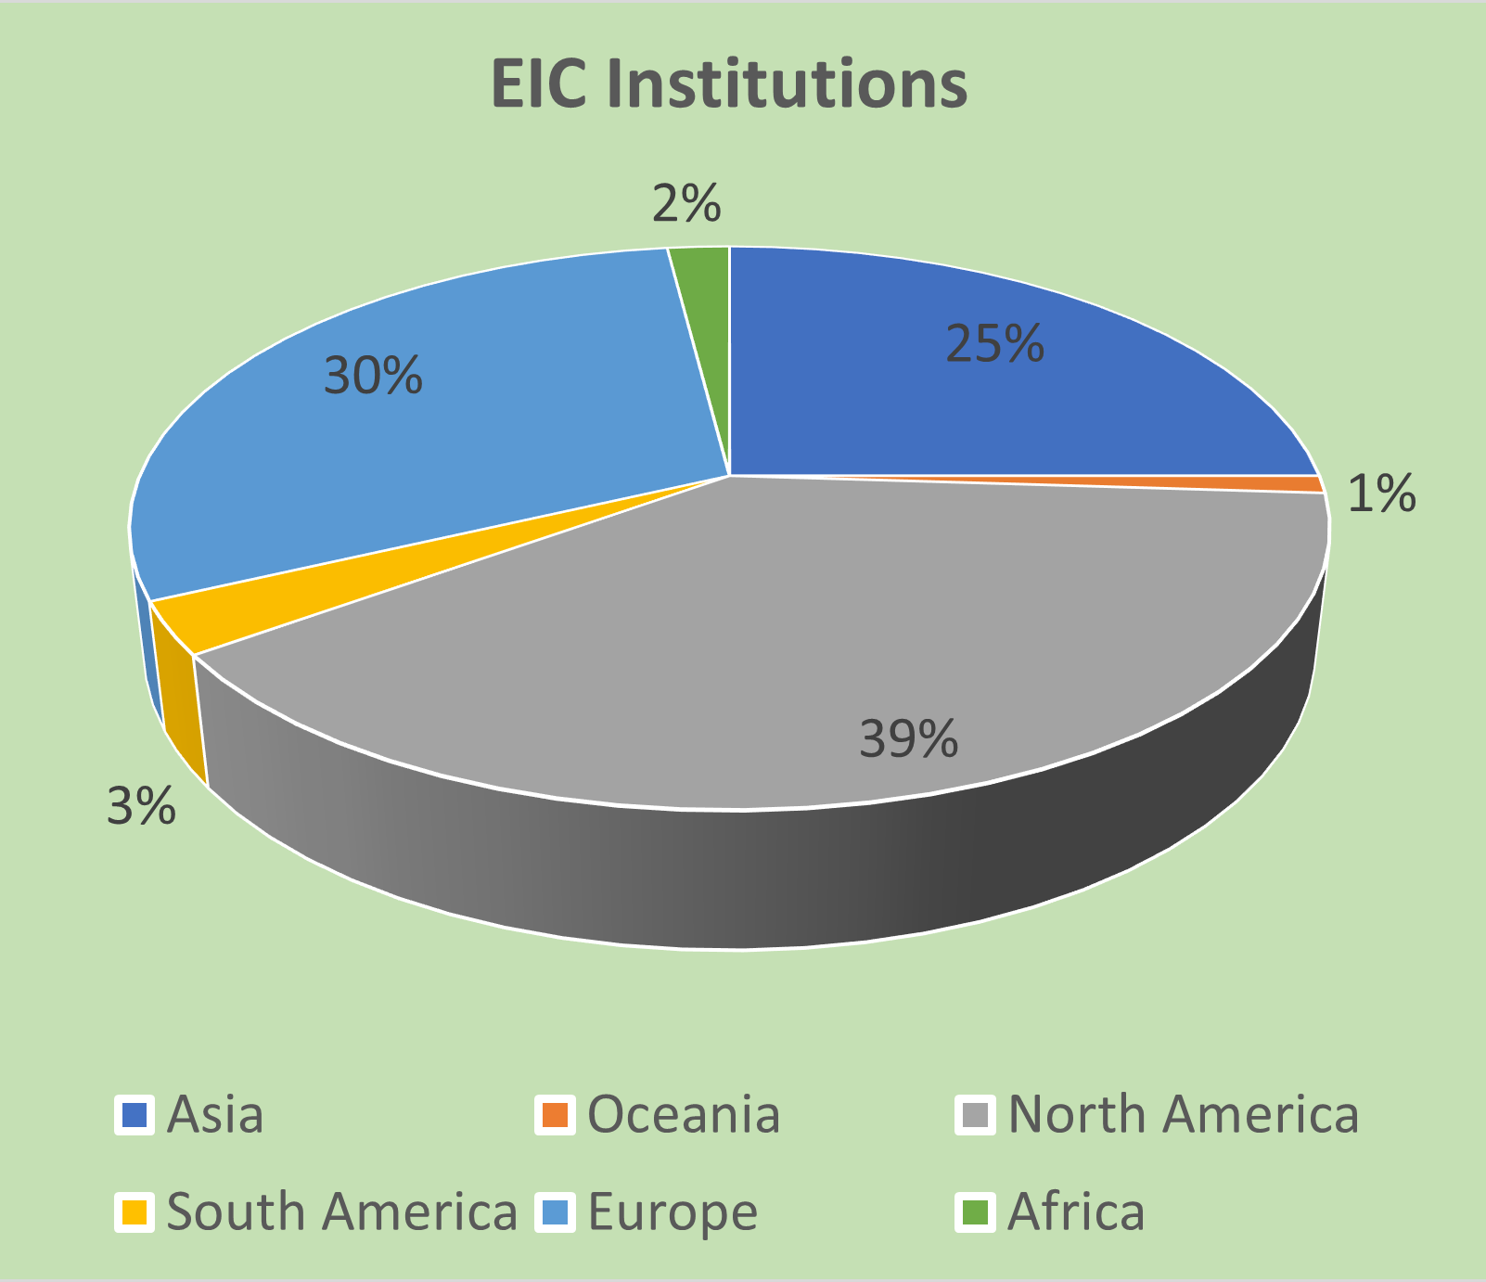
Institutions
The EIC User Group: https://eicug.github.io/
Formed in 2016, Currently:
1369 collaborators,
36 countries,
267 institutions
International Participation
Growing
Annual EICUG meeting
2016 UC Berkeley, CA
2016 Argonne, IL
2017 Trieste, Italy
2018 CUA, Washington, DC
2019 Paris, France
2020 Miami, FL
2021 VUU, VA & UCR, CA
2022 Stony Brook U, NY
2023 Warsaw, Poland
23

Slide 24
Collaboration Topics with DOE Laboratories: Accelerator
ANL
  RCS Quadrupole and sextupole preliminary engineering design, status: in progress
  Prototype and first article cavity processing (TJ), status: under discussion
LBNL:
  Beam dynamics, status: in progress
  Superconducting cable production, design (and possibly production) of superconducting dipole magnets, status: agreement in principle, details to be worked out
SLAC:
  Beam dynamics, IR design, status: in progress
FNAL
  Beam dynamics (ESR polarization), status: in progress
  Design of collared s.c. IR magnet, status: under discussion
  Design s.c. cavity (of 5-cell?), status: preliminary discussion
  RCS dipoles & ESR quads design (TJ), status: under discussion
ORNL
  Polarization and Beam dynamics (TJ), status: in progress
  EIC instrumentation, status: under discussion

Slide 25
Collaboration Topics with International Partners: Accelerator
Italy / INFN:
  Beam screens for HSR, prototyping, design, manufacturing,
status: agreement in principle; EIC L2&L3 ready to finalize the scope of work
Canada / TRIUMF:
  Crab cavity system, 394 MHz, design, prototype, manufacturing (TJ), status: agreement in principle; EIC L2&L3 are ready to finalize the scope of work
  Pulsed devices, status: agreement in principle, details to be worked out
France / CEA Saclay:
  SC spin rotator solenoids, status: under discussion
France / IJCLAB:
  ERL diagnostics, status: under discussion
UK / CI, JAI, Daresbury Lab, …
  Crab cavity system phase stabilization, status: under discussion
  ERL (TJ), status: under discussion
CERN:
  Joint work working groups on variety of FCCee-EIC topics, SRF, polarization, impedances, feedbacks, etc., status: in progress

