Slide 1
sPHENIX KPP Demonstration and
WBS Dictionary
November 18, 2022
BNL

Slide 2
sPHENIX MIE Deliverables
A Time Projection Chamber (TPC), Electromagnetic Calorimeter (EMCal), and a Hadronic Calorimeter (HCal) all covering 2π in azimuth. The TPC and HCal have pseudorapidity coverage of -1.1 ≤ η ≤ 1.1. The EMCal has pseudorapidity coverage of -0.85 ≤ η ≤ 0.85.
A Minimum Bias Trigger Detector (MBD).
Readout electronics to fully instrument the TPC, EMCal, HCal and MBD.
A data acquisition (DAQ) system with the capability to read out the TPC, EMCal, HCal, and MBD with an event rate and data-logging rate commensurate with the sPHENIX physics goals.
A DAQ/Trigger system that can provide minimum bias and energy cluster triggers at a rate necessary to carry out the sPHENIX physics program in A, pA and pp collisions at RHIC.
Project Management to carry out the project scope through to a successful on time and on budget completion.

Slide 3
WBS Dictionary and Deliverables
The sPHENIX WBS and WBS Dictionary are posted on the Indico page for the review
The Resource Loaded Schedule (“P6”) based on the WBS with progress taken through the end of October 2022 is also posted on the Indico page for the review
The talk covers the WBS Dictionary for each Level-2 system (e.g. WBS 1.2 is the Time Projection Chamber) and presents a few photos of the deliverables
After this are listed the Key Performance Parameters for that WBS Level-2 area and demonstration plots. The KPPs are listed on the next two slides.

Slide 4
sPHENIX WBS at Level-2
WBS 1.1: Management
WBS 1.2: Time Projection Chamber
WBS 1.3: Electromagnetic Calorimeter
WBS 1.4: Hadronic Calorimeter
WBS 1.5: Calorimeter Electronics
WBS 1.6: DAQ & Trigger
WBS 1.7: Min Bias Trigger Detector
Full WBS Dictionary is posted on Indico site

Slide 5
sPHENIX MIE KPP’s (1)
System | Demonstration or Measurement | Threshold KPP’s | Objective KPP’s
Time Projection Chamber | Preinstall, Bench tests | ≥ 90% live channels based on laser, pulser, cosmics | ≥ 95% live channels based on laser, pulser, cosmics
Time Projection Chamber | Preinstall, Bench tests | Ion back flow ≤ 2% per GEM module avgd over active area of ea GEM module | Same
Time Projection Chamber | Preinstall, Bench tests w/ cosmics | ≥ 90% single hit efficiency/mip track, averaged over active TPC volume | ≥ 95% single hit efficiency/mip track, averaged over active TPC volume
Time Projection Chamber Front End Electronics | Preinstall, FEE stand alone bench tests | Cross talk ≤ 2% per channel averaged over all channels | Same
EM Calorimeter | Preinstall, Bench tests | ≥ 90% live channels based on LED, cosmics | ≥ 95% live channels based on LED, cosmics
Hadronic Calorimeter | Preinstall, Bench tests | ≥ 90% live channels based on LED, cosmics | ≥ 95% live channels based on LED, cosmics

Slide 6
sPHENIX MIE KPP’s (2)
System | Demonstration or Measurement | Threshold KPP’s | Objective KPP’s
EM Calorimeter | Preinstall, Bench tests | Each sector w/ an absolute energy precalibration of ≤ 35% RMS | Same
Hadronic Calorimeter | Preinstall, Bench tests | Each sector w/ an absolute energy precalibration of ≤ 20% RMS | Same
Min Bias Trigger Detector | Preinstall, Bench tests | ≥ 90% live channels based on laser. 120 ps/channel timing resolution w/ bench test | ≥ 95% live channels based on laser. 100 ps/channel timing resolution w/ bench test
DAQ/Trigger | Event rate | 10 kHz w/ random pulser | 15 kHz w/ random pulser
DAQ/Trigger | Data Logging rate | 10 Gbit/s with pulser | Same

Slide 7
WBS 1.1 Project Management

Slide 8
Management was Level-Of-Effort task
27K hours personnel effort
FY2017-FY2022 duration
Level-of-effort EVMS tracking
$32K for project travel
Completed

Slide 9
WBS 1.2 TPC – 1.2.1 TPC Mechanics (& Assembly)

Slide 10
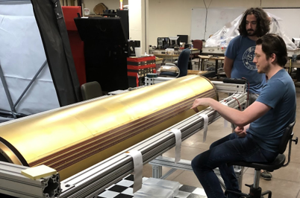
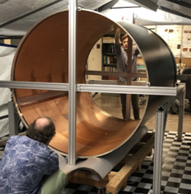
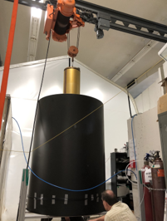
WBS 1.2.1: Field Cages
Inner Field Cage
Cage
Insertion
Outer Field Cage
The inner and outer field cages were formed on mandrels
Tested to 10% above operating voltage for one hour.
They were made concentric before assembly.

Slide 11
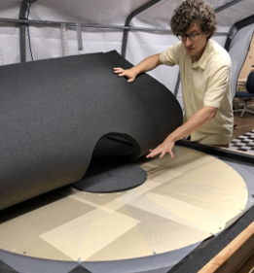
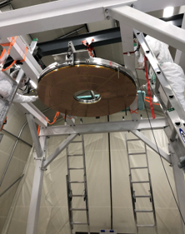
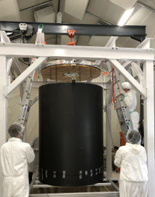
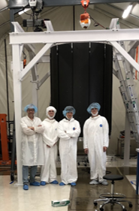
WBS 1.2.1: Central Membrane and Full TPC
Central Membrane with evaporated Aluminum stripes
TPC Assembly in vertical orientation.

Slide 12
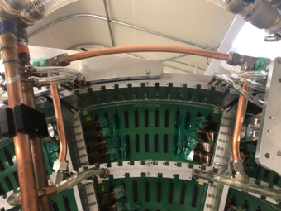
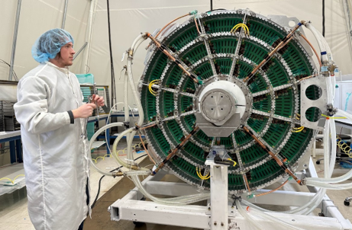



WBS 1.2.1: Wagon Wheel with Cooling and Gas
Gas Lines
Complete Gas and Cooling Services
Wide Tubes
Laser Port
No water leaks.
99.4% gas return at full flow.
Narrow Tubes

Slide 13
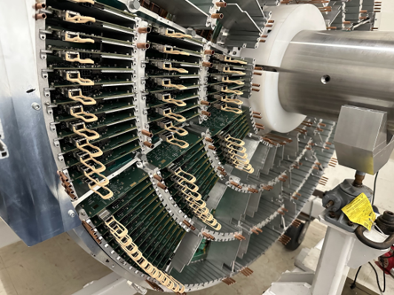
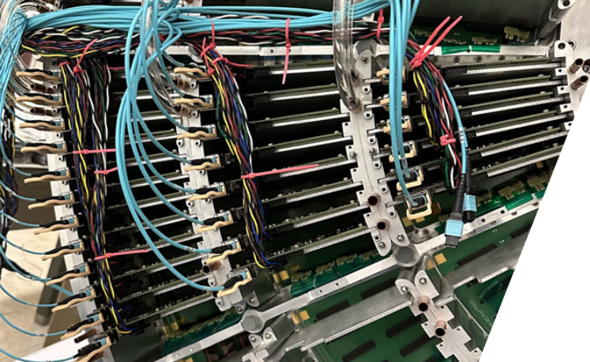
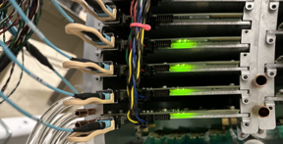
WBS 1.2.1: TPC Instrumented with FEE Cards
Cables w/ Optical/Electrical
Powered
Stuffed with FEE Cards
FEE cards are cooled by cooling blocks.
FEE cards require one optical and one LV connector.

Slide 14
WBS 1.2 TPC – 1.2.2, 1.2.3, 1.2.4 GEM Modules

Slide 15
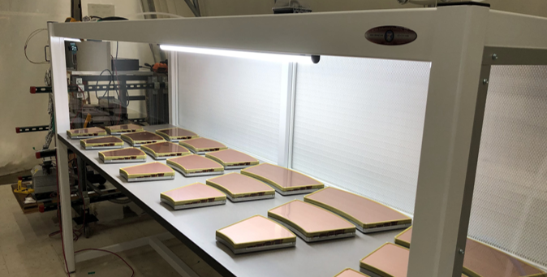
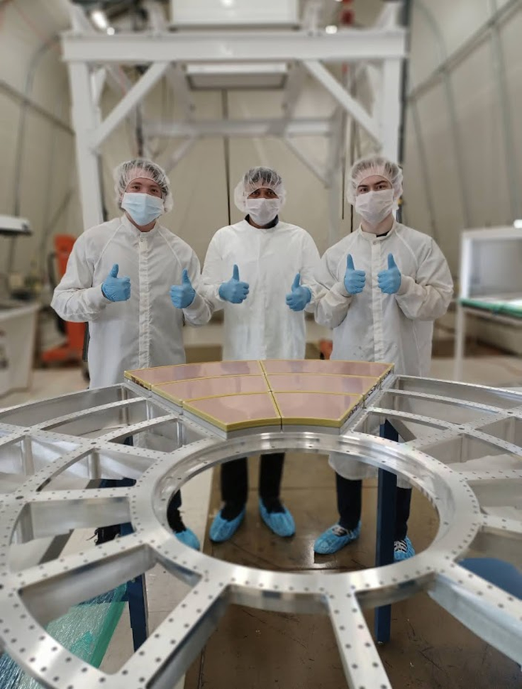
WBS 1.2.2, 1.2.3, 1.2.4: R1, R2, R3 GEM Modules
R2
R3
R1
Earliest Completed TPC Modules.
72 Modules total
Three sizes: R1, R2, R3
Gain * IBF Mapped using X-ray Source.
Module Test Fit to Wagon Wheel

Slide 16
WBS 1.2 TPC – 1.2.5 TPC FEE, 1.2.6 TPC DAM

Slide 17
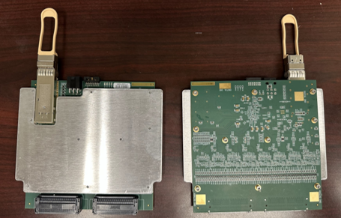
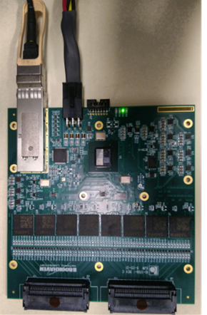
WBS 1.2.5: TPC FEE status
312 FEE boards (one-end of TPC) have been delivered to TPC assembly site as of 11/03/2022
6+8+12 = 26 FEE boards needed to instrument one sector; 24 sectors total
416 Boards burnt-in (16-sectors’ worth) as of 11/07/2022
FEE w/o Cooling Plate
FEE with Cooling Plate

Slide 18
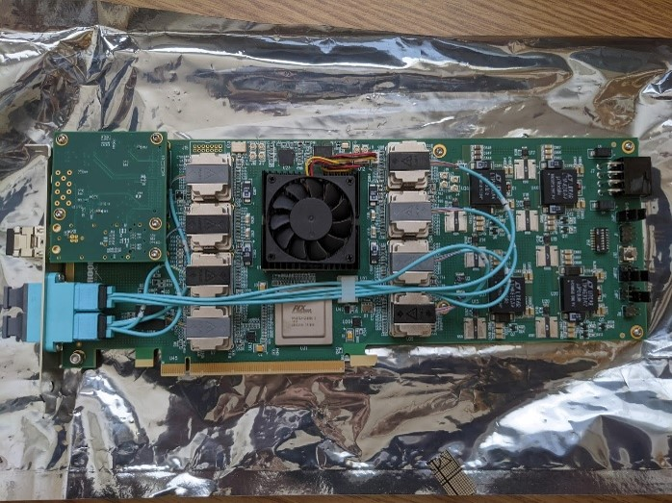
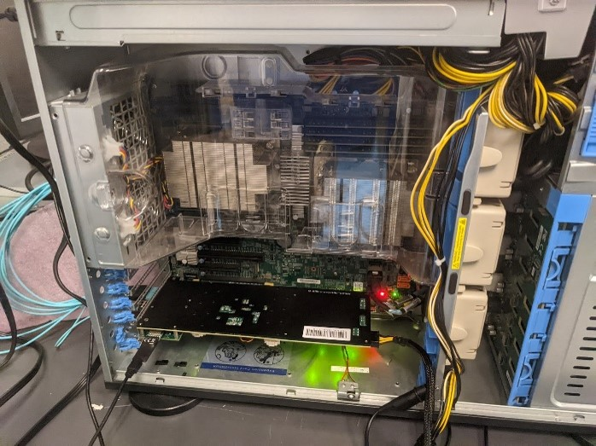
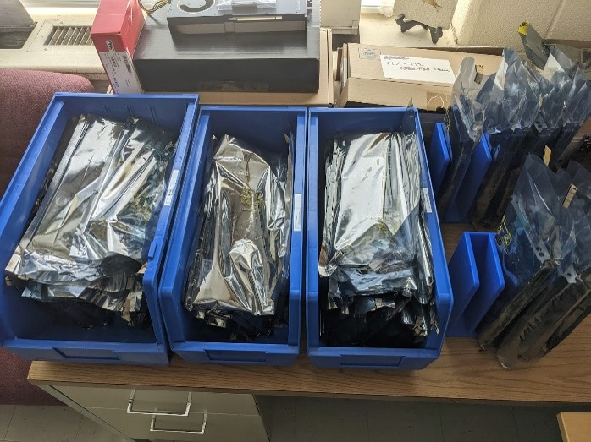
WBS 1.2.6: 24 TPC DAM boards + spares
Completed sPHENIX TPC DAM Testing server setup Completed DAMs

Slide 19
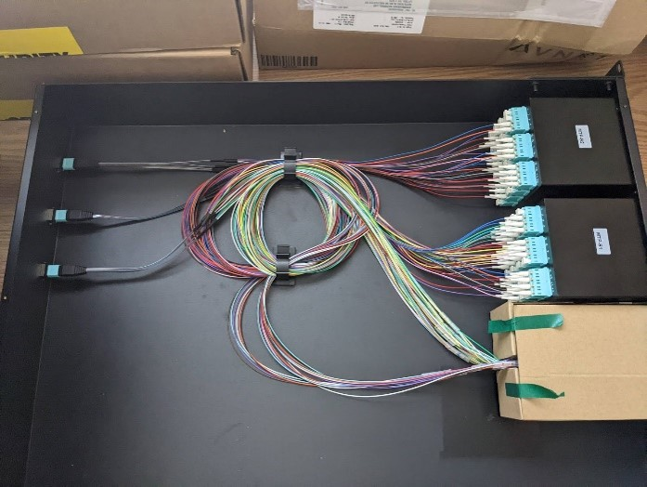
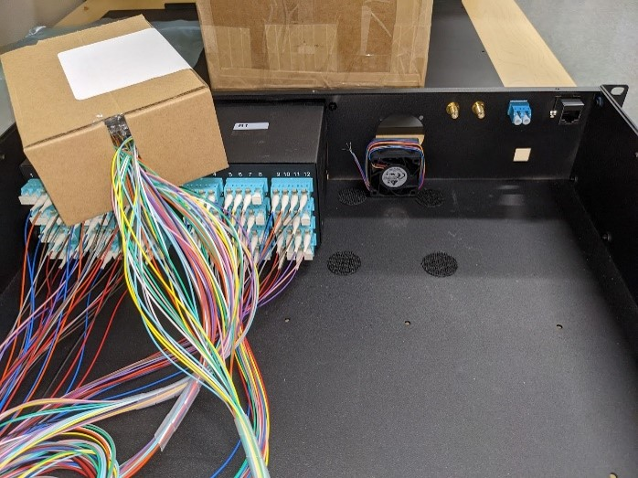
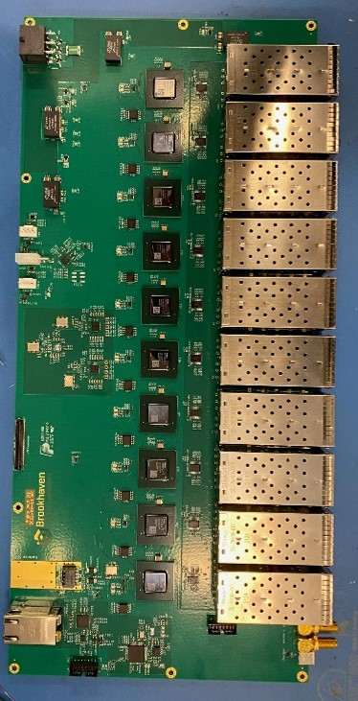
WBS 1.2.6: 24 Fiber Sort-Out Box (SOB)
SOB internal fiber routing SOB front panel past fitting test JACK Board

Slide 20
WBS 1.2 TPC – 1.2.7 TPC Support Systems

Slide 21

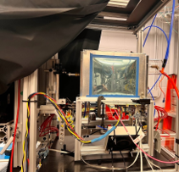
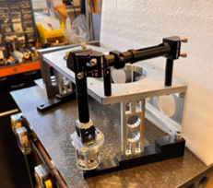

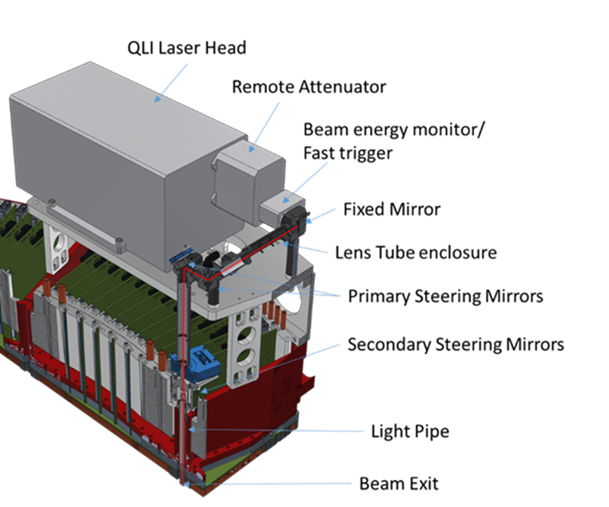
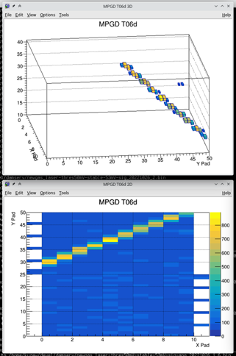
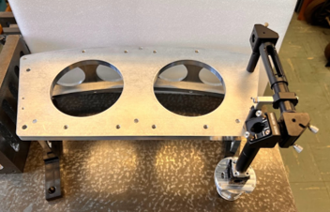
WBS 1.2.7.1: TPC Line Laser Status - Nov. 2022
TPC Line Laser Tested with “miniTPC” proto.
LP Entrance
→Same laser, optics, gas, FEE, avalanche, fields
All design work complete
All lasers stress tested
Proof of concept successful
Procurement of parts ~95%
Assembly to be completed by Dec. 2022
Laser Bench
Light Pipe + Secondary Steering Device
MiniTPC Proto Event Display of Laser Track
Laser Bench optics

Slide 22
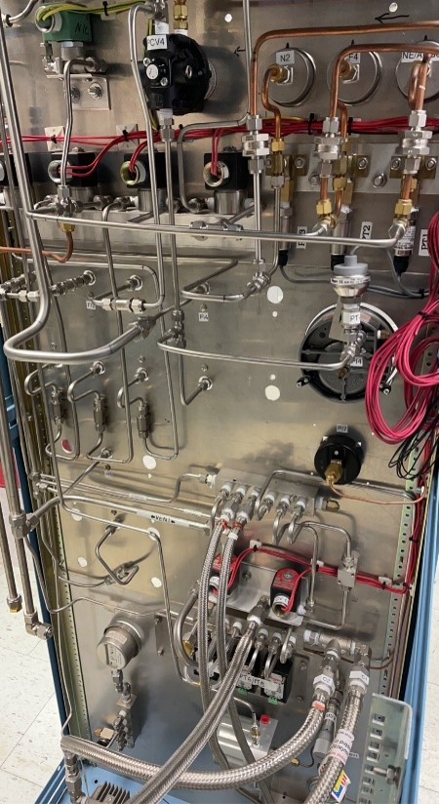
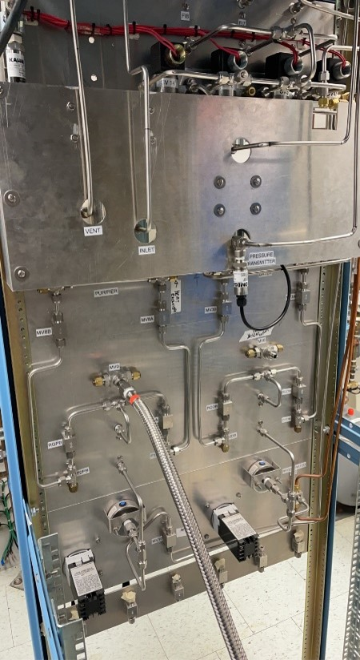
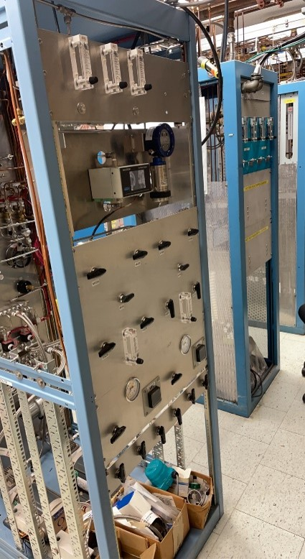
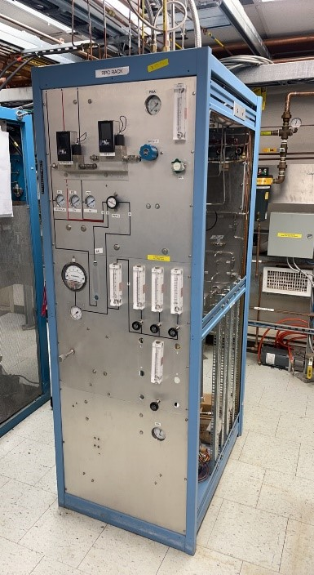

WBS 1.2.7.2: TPC Gas Rack Status
All design work complete
All Major components mounted and plumbed
Flow controllers, Gas Analyzer, H20 Monitor, O2 Meter, Pumps, etc
Purifiers and Driers built.

Slide 23
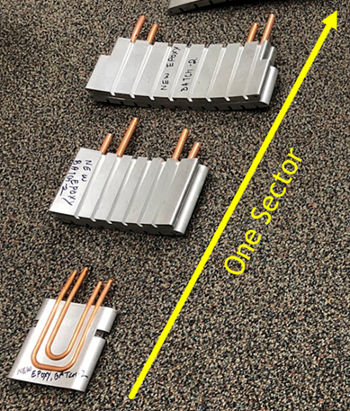
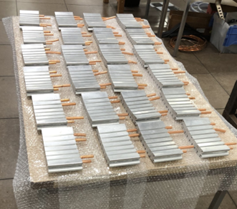
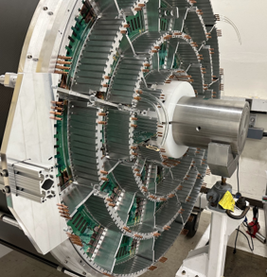
WBS 1.2.7.3: TPC FEE Cooling Blocks
All 24 of the R3 cooling blocks
End cap w/ cooling blocks mounted
Cooling plate on FEE engages “cooling blocks”.
Cooling blocks act as both FEE card guide and heat sink.

Slide 24
Time Projection Chamber KPP – Live Channels (1)
Demonstration or Measurement: Preinstall, bench tests
Threshold KPP’s: ≥ 90% live channels based on Laser, pulser, cosmics
Objective KPP’s: ≥ 95% live channels based on Laser, pulser, cosmics
Live channels checking needs all FEE cards mounted. The test involves pulsing a given GEM module and checking that all channels respond through the FEE card.

Slide 25
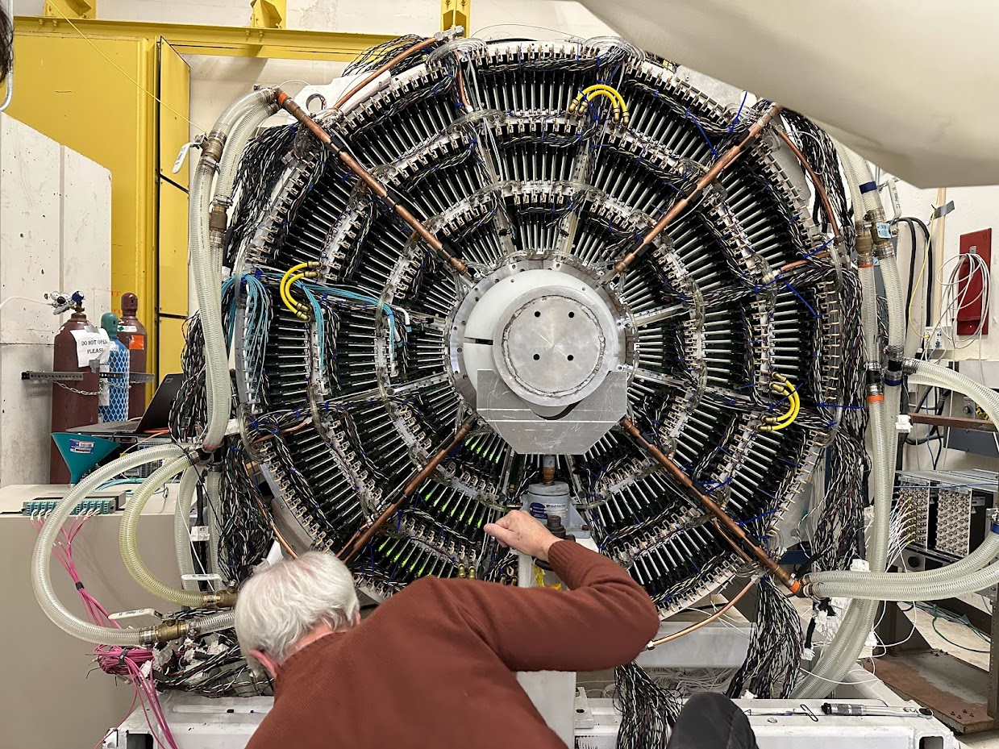
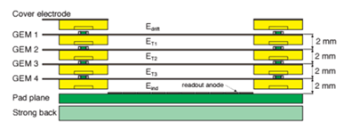
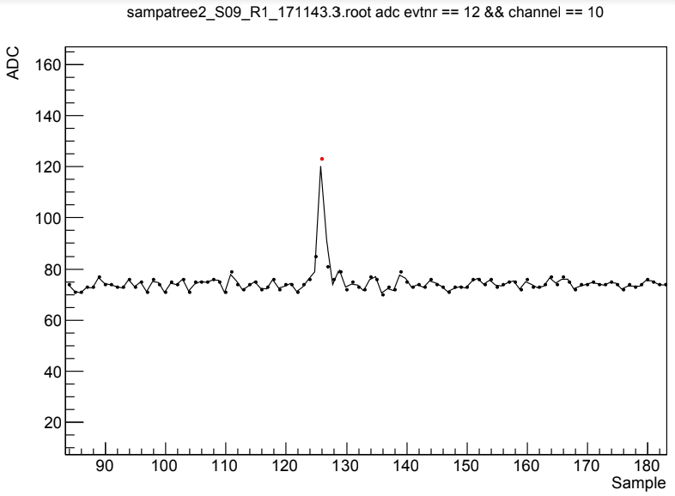
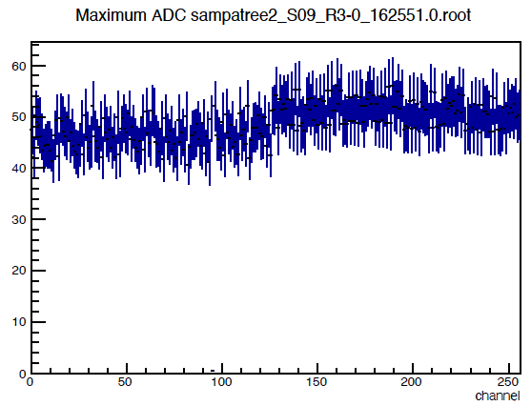
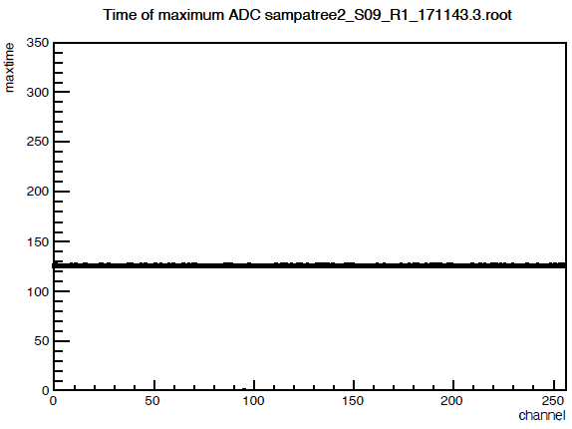
Time Projection Chamber KPP – Live Channels (2)
South Side (all services)
Coolant ✓
Gas ✓
High Voltage ✓
Low Voltage ✓
FEE ✓
Injected pulse couples through all pads to all FEE channels.
Pulse
Injected
ADC
height
height
Single pulse
Single Channel
Many pulses
One Card
Process delayed by supply chain crisis of high voltage card (must install before FEE).
Full data collected for all 312 cards on TPC South.
Live visual monitor clearly indicates that each and every card is at or close to 100% live.
90% live KPP clearly and easily met (next slide)
Full post-processing of all data will show the exact result of the live count exercise.
time
time
Many pulses
One Card
A live channel fires at the correct pulse height.
A live channel fires at the correct time.

Slide 26
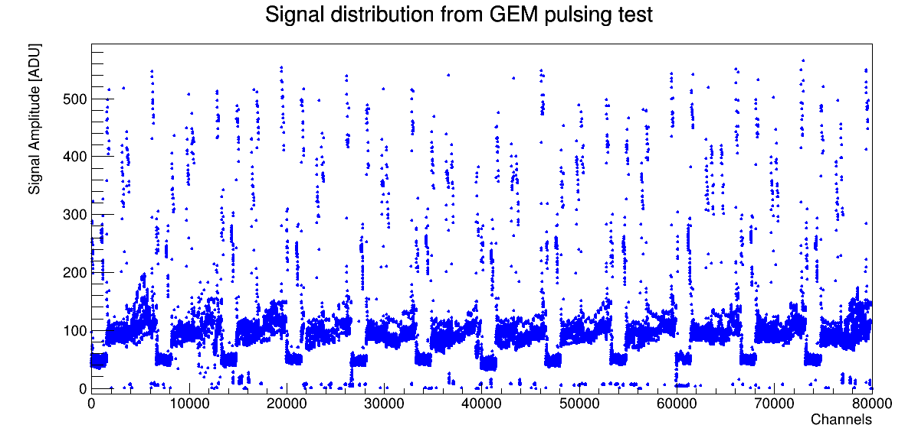
Time Projection Chamber KPP – Live Channels (3)
3746 channels dead out of 79872 channels (thus 95.3% live) of first endcap
  Of these 3136 channels appear to be due to SAMPA readout error (fixable)
610 channels are absolutely suspicious or dead
Result: 99.2% live channels. Second endcap remains to be finished.

Slide 27
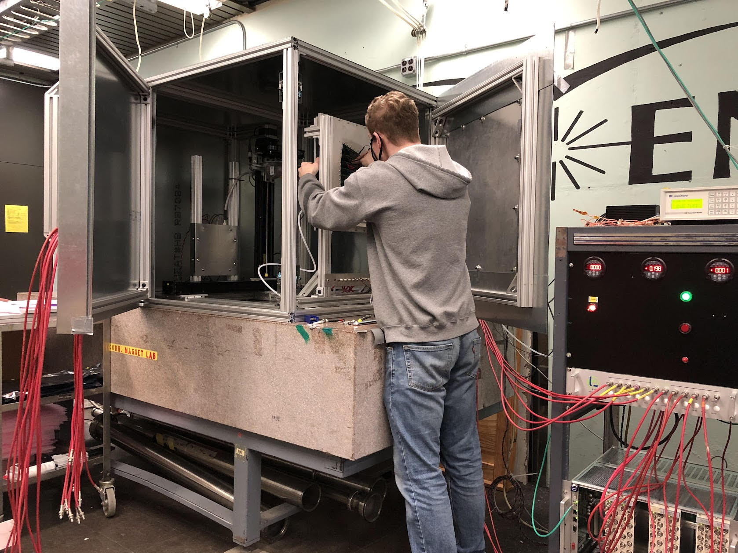
Time Projection Chamber KPP – Ion Back Flow
Demonstration or Measurement: Preinstall, bench tests
Threshold KPP’s: Ion back flow ≤ 2% per GEM module averaged over the active area of each GEM module
Objective KPP’s: Same
IBF measurements were performed using the gain characterization apparatus, with minor modifications to measure the very small induced current on the cathode plane.
Measured IBF fractions were significantly better than required by the KPP.

Slide 28
Time Projection Chamber KPP: Ion Back Flow Results
MAX
Acceptable modules would have an IBF below 2%.
All modules passed this threshold very easily.

Slide 29
Time Projection Chamber KPP – Single Hit Efficiency (1)
Demonstration or Measurement: Preinstall, bench tests w/cosmics
Threshold KPP’s: ≥ 90% single hit efficiency/mip track, averaged over active TPC volume
Objective KPP’s: ≥ 95% single hit efficiency/mip track, averaged over active TPC volume
MIPs can be seen with one sector FEE and the HV, gas and cooling, all of which are now in hand and in place. Results expected by mid-November for the actual TPC. Earlier results exist but for test chambers hooked to actual TPC FEE.

Slide 30
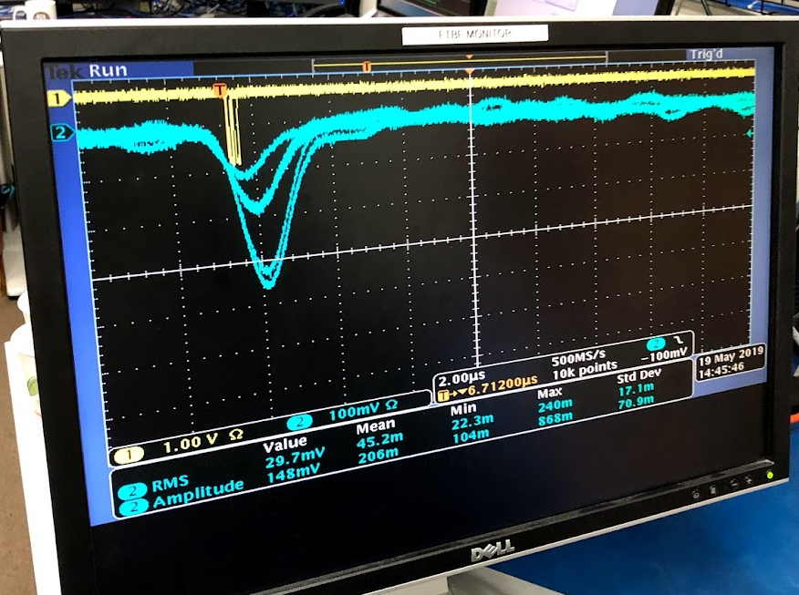
Time Projection Chamber KPP – Single Hit Efficiency (2)
South Side (all services)
Coolant ✓
Gas ✓
High Voltage ✓
Low Voltage ✓
FEE ✓
North Side ✗
GEM4 pulse triggers same DAQ as used by pulser tests
Charge
Pulse
Output
Central Membrane bias requires all HV cards (won’t risk modules)
HV card count (as of yesterday 11-17-2022):
  Main HV cards: 63/72 = 87.5% of the required.
  Mirror cards (R3 only): 24/24 = 100% of the required.
  Balance of HV cards picked up today, Friday 11-18-2022.
Anticipated Schedule:
  HV cards installed by the end of Monday Nov 21.
  Gas flow will begin Nov 25 (Friday following Thanksgiving).
  HV application will be initiated on Monday Nov 28
  We expect to have MIP results before Friday Dec 2.
R2 Cosmic Signals
Pickoff signals were observed from R2 module in test beam
Signals large because ~20 cm of track contributes.
Data collection basically identical to pulser test.
Analysis asks a row to fire when both the neighbors fire.

Slide 31
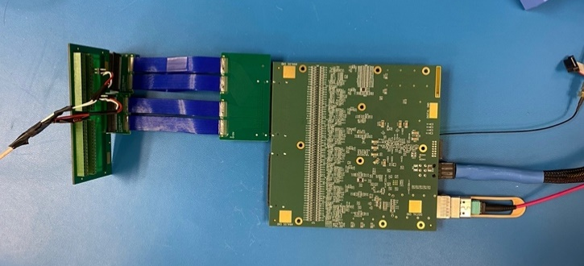
Time Projection Chamber KPP – Cross Talk (1)
Demonstration or Measurement: Preinstall, FEE stand alone bench tests
Threshold KPP’s: Cross talk ≤ 2% per channel averaged over all channels
Objective KPP’s: Same
We injected signal charges into two channels only out of 128 manually at a time using the setup shown. The two channels are separated by 16 channels. We repeated this measurement 32 times, thus 64 channels out of 128 channels were measured in total. This is sufficient to assess the crosstalk level on the FEE.

Slide 32
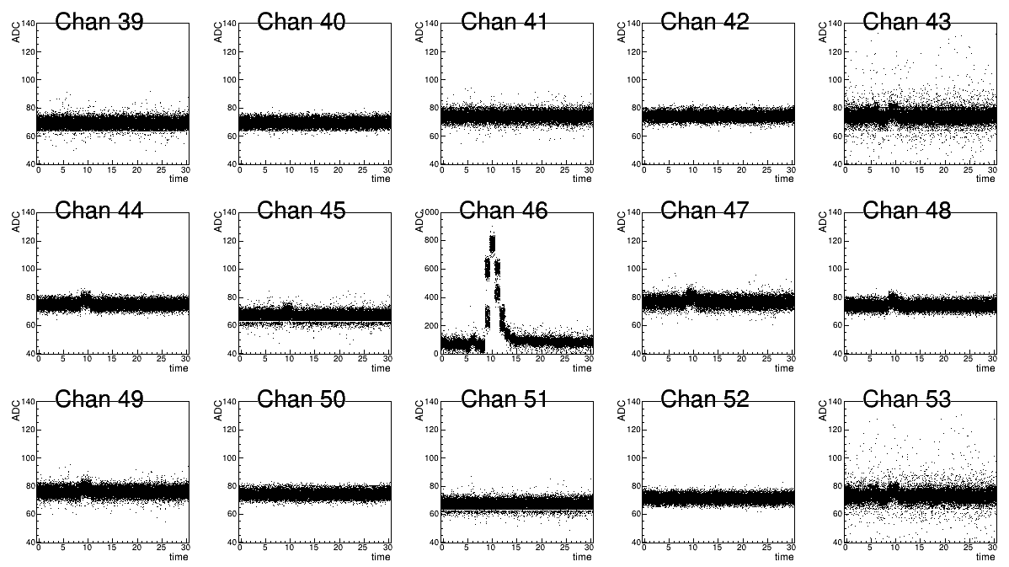
Time Projection Chamber KPP – Cross Talk (2)
The input signal is adjusted so that it yields an ADC count of 900-1000 out of the full ADC range of 0-1024, making the crosstalk in the neighboring channels maximally measurable. The figure shows the ADC vs sampling time for the channel (Ch. 46) where charges are fed in and for the +/- 7 neighboring channels. Note the vertical scale is set to 0-1000 for the signal channel, and 40-140 for neighboring channels, respectively.

Slide 33
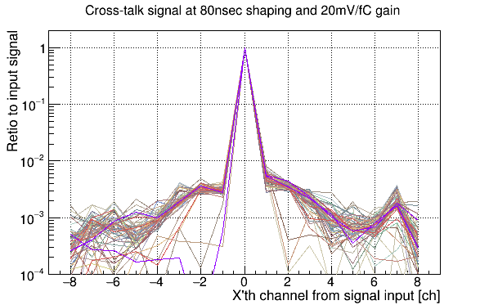
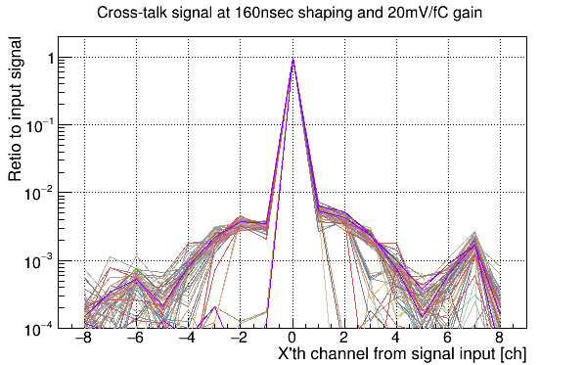
Time Projection Chamber KPP – Cross Talk (3)
We quantified the level of crosstalk in a given channel with respect to the magnitude of signal channel by the ratio of their respective ADC counts. The figures below show the level of crosstalk for neighboring +/-8 channels for two shaping times (80 and 160 nsec). Both gains are 20mV/fC. It is seen that the crosstalk is a little larger in the 80nsec case than that of the 160nsec case (as seen by the difference in the width of the distributions). This trend is consistent with expectation. It was found that no channel has crosstalk level larger than 1% in either case.

Slide 34
WBS 1.3 EMCAL – 1.3.1 EMCAL Blocks

Slide 35
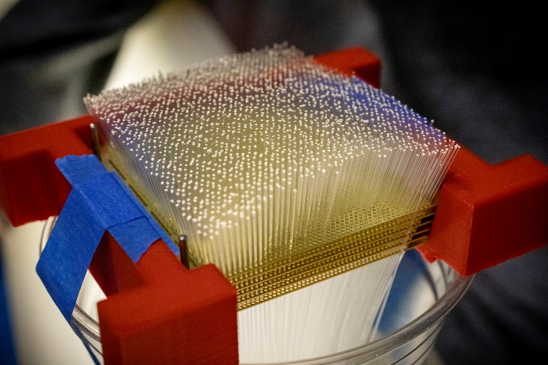
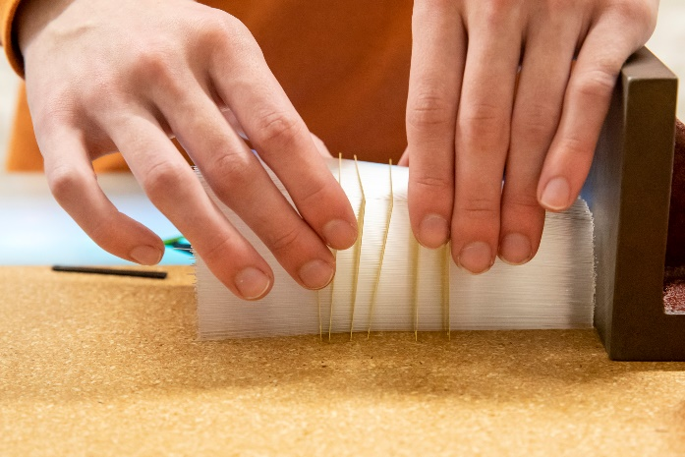
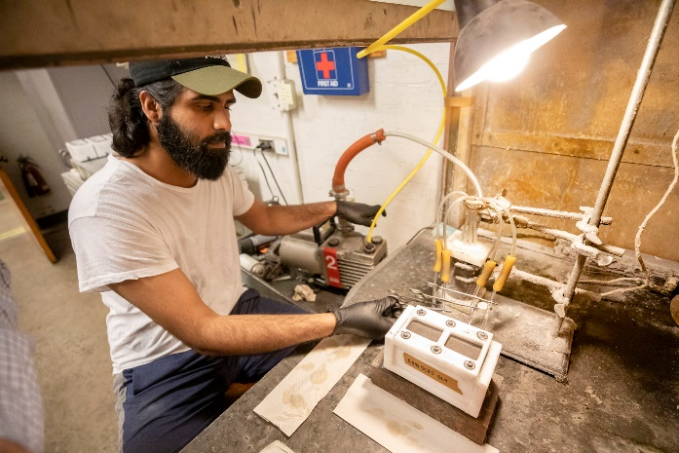
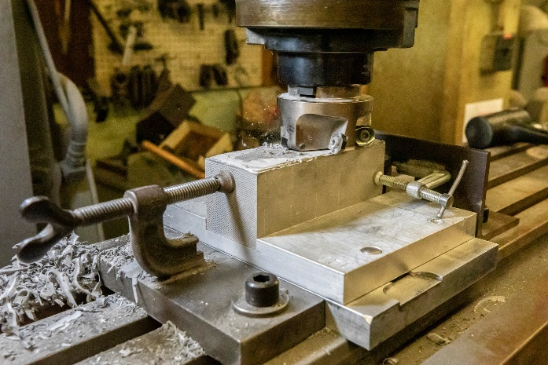


WBS 1.3.1 EMCal Block Construction (U. Illinois)
Scintillating Fibers Loaded into Brass Screens
Separating Brass Screens Prior to Placing in Mold
Block In Mold with Tungsten Powder, Readying for Epoxy Impregnation
Molded Epoxy-Impregnated Block Being Machined to Dimensions
Block Storage and Inventorying prior to Shipment to BNL
Initial Inspection of Completed Block

Slide 36
WBS 1.3 EMCAL – 1.3.2 EMCAL Modules & Sectors

Slide 37







WBS 1.3.2 EMCal Module & Sector Construction (1)
Block with 4 Lightguides (thus 4 towers) and 4 SiPM Daughtercards (16 SiPMs total)
Blocks Epoxied onto Strongbacks
SiPM Daughtercard Cooling Loop Added
Preamp Cards and Cooling Loop Added
Cables and Interface Cards Added; Ready for Outer Skins

Slide 38





WBS 1.3.2 EMCal Module & Sector Construction (2)
Finished Sectors in the Rotating Test Fixture for Cosmic Tests
Completed Sectors under Extended Burn-In Test
Finished Sectors in Bldg 510 Awaiting Installation

Slide 39
Electromagnetic Calorimeter KPP – Live Channels (1)
Demonstration or Measurement: Preinstall, bench tests
Threshold KPP’s: ≥ 90% live channels based on LED, cosmics
Objective KPP’s: ≥ 95% live channels based on LED, cosmics
The LEDs are driven by a variable pulse width driver that can vary the amplitude of the LED signal from each channel.
Due to variations in the amount of LED light seen by each channel, no single pulse width can put the LED signal in the nominal ADC range for all channels simultaneously. However, there is an appropriate pulse width for each channel that can be used to calibrate and monitor each channel during normal data taking.
For the purpose of satisfying the EMCAL KPPs using the LEDs, all channels were driven into saturation using a long pulse width. An example of several channels being driven into saturation is shown in the next plot.

Slide 40
Electromagnetic Calorimeter KPP – Live Channels (2)
Left hand plot shows ADC value vs channel number when the LEDs are driven into saturation
Right hand plot is a frequency histogram showing most channels are driven into ADC saturation, and are thus “live”. Fewer than 80 channels, or 0.3%, do not show full ADC response

Slide 41
Electromagnetic Calorimeter KPP – Live Channels (3)
Live channels can also be checked by observing the amplitude of cosmic ray peaks in individual towers. The plot below shows better than 95% of channels respond.

Slide 42
Electromagnetic Calorimeter KPP – Absolute Energy Precalibration (1)
Demonstration or Measurement: Preinstall, bench tests
Threshold KPP’s: Each sector w/ an absolute energy precalibration of ≤ 35% RMS
Objective KPP’s: Same
Individual towers were pre-calibrated following a two-step process:
1. Each channel MPV is corrected for differences in gain observed in the single pixel gap (spg) measurements; Correction factor = 30 / measured spg
2. Each channel MPV is corrected for differences in the observed light output from different scintillating fiber production batches. Correction factor = 350 / ⟨𝑀𝑃𝑉⟩ determined for each fiber batch
Once the simulation study completes a third correction factor will be applied to convert from ADC to energy for MIPs. Will be position dependent and is expected to further reduce the RMS

Slide 43
Electromagnetic Calorimeter KPP – Absolute Energy Precalibration (2)
For the full 24,576 channels in the EMCal the RMS/mean for the pre-calibrated MPVs is 18.1%. Pre-calibration is about a factor 2 below the KPP requirement of precalibration for each sector to within an RMS of 35%

Slide 44
WBS 1.4 HCAL

Slide 45


WBS 1.4: Hadronic Calorimeter Deliverables
32 assembled, tested and calibrated Outer HCAL sectors
InnerHCAL support structure (32 sectors)
All deliverables completed and installed in sPHENIX
Inner HCAL assembled support structure being installed in sPHENIX
(32 sectors)
Inner HCAL detector instrumentation supplied by separate capital project
Completed 4/2022
Outer HCAL instrumented sectors assembled into barrel on sPHENIX platform.
(32 sectors)
Installation completed 3/2022

Slide 46





WBS 1.4: Hadronic Calorimeter components
Scintillator tiles with embedded WLS fibers are used to instrument the steel absorber of the Outer HCAL. The tiles were produced by UNIPLAST and checked at Georgia State U before being shipped to BNL for insertion in the steel absorber structures for the Outer HCAL.
Tile/WLS layout for half of one OHCal Sampling Layer
Scintillating Tile exit edge at SiPM location
Scintillating Tile with WLS Excited
Wrapped Scintillating Tile being dimension checked
Several Wrapped Scintillating Tiles being checked in the cosmic ray test fixture

Slide 47



Additional Photos - Hadronic Calorimeter Deliverables
Partially completed assembly of Inner HCAL barrel
support structure.
Outer HCAL sectors in Bldg. 912 factory, undergoing burn-in testing
Two Inner HCAL sectors under assembly

Slide 48
Hadronic Calorimeter KPP – Live Channels
Demonstration or Measurement: Preinstall, bench tests
Threshold KPP’s: ≥ 90% live channels based on LED, cosmics
Objective KPP’s: ≥ 95% live channels based on LED, cosmics
All towers in all sectors were verified with electronics test pulse, LED test pulse, and cosmic rays at assembly.
In addition, all towers in all sectors were verified using an LED test pulse after barrel assembly in 1008.

Slide 49

System | Demonstration or Measurement | Threshold KKP’s | Objective KPP’s
Hadronic Calorimeter | Preinstall, Bench tests | ≥ 90% live channels based on LED, cosmics | ≥ 95% live channels based on LED, cosmics
All towers in all sectors were verified with electronics test pulse, LED test pulse, and cosmic rays at assembly.
In addition, all towers in all sectors were verified using an LED test pulse after barrel assembly in 1008.
As of 5/17/2022 all oHCAL towers are fully functional – the oHCAL has 100% live towers.
All sector test data is archived at: https://sphenix-intra.sdcc.bnl.gov/WWW/subsystem/hcal/test/sector/
As an example, below is the LED test data for Sector 12:
ADC (Ped. Subtracted)
Time Sample

Slide 50
Hadronic Calorimeter KPP – Absolute Energy Precalibration
Demonstration or Measurement: Preinstall, bench tests
Threshold KPP’s: Each sector w/ an absolute energy precalibration of ≤ 20% RMS
Objective KPP’s: Same
All towers are precalibrated initially using the Landau peak in cosmic ray data. The location of this peak is used to normalize the gains between the towers and fix the initial absolute energy scale. The accuracy of this precalibration is determined by how well we know the location of the Landau peak.

Slide 51

System | Demonstration or Measurement | Threshold KKP’s | Objective KPP’s
Hadronic Calorimeter | Preinstall, Bench tests | Each sector w/ an absolute energy precalibration of ≤ 20% RMS | Same
All towers are precalibrated initially using the Landau peak in cosmic ray data. The location of this peak is used to normalize the gains between the towers and fix the initial absolute energy scale. The accuracy of this precalibration is determined by how well we know the location of the Landau peak.
We estimate this by plotting the ratio of the error on the mean to the mean for every HCAL tower. This ratio is less than a percent for all towers, indicating we have achieved the threshold and objective KPP of <20%.

Slide 52
WBS 1.5 CALORIMETER ELECTRONICS

Slide 53
WBS 1.5 Executive Summary
No KPP’s specific to WBS 1.5
WBS 1.5.1: SiPMs for EMCal and for Outer HCal
WBS 1.5.2: Calorimeter daughterboards, preamps, interfaces, test boards, control boards, cables, Low Voltage power supplies, SiPM bias supplies for EMCal and Outer HCal
WBS 1.5.3: Digitizers and supporting boards, crates and power supplies for EMCal and Outer HCal
All deliverables for WBS 1.5 are in hand and deployed
WBS 1.5 is complete

Slide 54
WBS 1.5.1, 1.5.2: Preproduction + Production - EMCal
EMCal Requirements:
Item | Quantity Required | Quantity Delivered | Status
SiPMs | 78336 | 81712 | Delivered
EMCal SiPM DBS | 4896 | 5107 | Delivered
EMCal preamps | 1224 | 1318 | Delivered
EMCal interfaces | 332 | 346 | Delivered
EMCal cables | 64 Sets | 65 Sets | Delivered
EMCal controllers | 64 | 70 | Delivered
EMCal power system | 1 | 1 | Delivered
EMCal signal cables | 1224 | 1236 | Delivered

Slide 55




WBS 1.5.1: SiPMs for EMCal and Outer HCal
One of sixteen monthly shipments of SiPMs from Hamamatsu
Nine SiPM Daughterboards for EMCal under test; total of 144 SiPMs
Initial Trays received of Production SiPMs

Slide 56



WBS 1.5 Details – EMCAL FEE example items in use
EMCal Block (4 Towers) with SiPMs and SiPM Daughterboards Mounted
EMCal Sector (96 Towers) with PreAmps, Interface Boards and Cabling Mounted
EMCal Sector (96 Towers) with SiPMs and SiPM Daughterboards Mounted

Slide 57
WBS 1.5.1, 1.5.2: Preproduction + Production – Outer HCal
Outer HCal Requirements:
Item | Quantity Required | Quantity Delivered | Status
SiPMs | 7680 | 7998 | Delivered
oHCal SiPM DBS | 7680 | 8000 | Delivered
oHCal preamps | 1536 | 1695 | Delivered
oHCal interfaces | 64 | 87 | Delivered
LED Boards and Backplanes | 64 | 70 | Delivered
oHCal cables | 32 Sets | 33 Sets | Delivered
oHCal controllers | 8 | 10 | Delivered
oHCal power system | 1 | 1 | Delivered
oHCal signal cables | 96 | 100 | Delivered

Slide 58
WBS 1.5 Preproduction + Production
EMCal/Outer HCal Digitizer Requirements:
Item | Quantity Required | Quantity Delivered | Status
Digitizer Boards | 332 | 342 | Delivered
XMIT Boards | 140 | 145 | Delivered
Controllers | 34 | 37 | Delivered
JSEBC-II | 17 | 20 | Delivered
Crate | 34 | 35 | Delivered
Optical Fibers | 1276 | 1400 | Delivered
Clock Master | 10 | 12 | Delivered

Slide 59

WBS 1.5.3: Digitizers – EMCal and Outer HCal
Full Rack of sPHENIX Digitizers assembled and under test

Slide 60
WBS 1.5 Summary
COVID-19 provided a significant challenge but had minimal impact on delivery schedule.
Lots of testing support from UMichigan, LehighU, UColorado and ColumbiaU to complete this portion of the project on time.
Failure rate of electronics was less then 3% on average.
Components were delivered to EMCal and HCal groups in a timely manner to keep assembly pipelines running.
All components in WBS 1.5 were completed and delivered by July 1, 2022

Slide 61
WBS 1.6 DAQ/TRIGGER – 1.6.1 DAQ & 1.6.2 Local Level-1

Slide 62
WBS 1.6 DAQ/TRIGGER – 1.6.3 Global Level-1 and 1.6.4 Timing

Slide 63







WBS 1.6 DAQ/Trigger Deliverables
WBS 1.6.1 DAQ
Network switch
WBS 1.6.3 Global Level-1
WBS 1.6.4 Timing
WBS 1.6.2 Local-Level-1
EBDCs
Disk Enclosure (102 14TB disks)
EBDCs (Under WBS 1.2.6)
Disk Enclosure (102 14TB disks)
Disk Enclosure (102 14TB disks)
SEBs
Gl1/GTM unit
SEBs
Local Level-1 Trigger Module
Local Level-1 Trigger Module
BufferBoxes
BufferBoxes

Slide 64
DAQ/Trigger KPP – Event Rate (1)
Demonstration or Measurement: Event Rate
Threshold KPP’s: 10 kHz w/ random pulser
Objective KPP’s: 15 kHz w/ random pulser
The event-rate limit results from re-use of the existing DCM-2 modules to read out the calorimeter digitizers. This is a legacy backplane-based system, which in turn is read out via the legacy “jSEB2” readout card, which is a 4-lane PCIExpress “Generation 1” device.
We used both a BNC pulser that can generate random pulses for a random trigger, as well as a large scintillator paddle connected to a Constant Fraction Discriminator (CFD). The CFD threshold was adjusted to generate random triggers at a rate of about 30KHz.
We used the number of samples that we read out as a proxy for the achieved level of zero-suppression. We will nominally read out 16 waveform samples. The achievable zero-suppression with an occupancy of about 25% in the electromagnetic calorimeter correspond to a reduction to 4 readout samples.
We note here that 25% is higher than the expected occupancy.
We did not adjust the number of samples in the demonstration test to below 6, corresponding to an occupancy of about 35%, which is a very conservative assumption for the operation of the sPHENIX detectors.

Slide 65

DAQ/Trigger KPP – Event Rate (2)
For each number of waveform samples, we took exactly 3 million events and measured how long this takes. For the full 16 samples for each event, this took 619 seconds, resulting in an event rate of 4.8 KHz. The table shows the measure rated as a function of the number of waveform samples, with the start and ending times measured in terms of the readout PC’s Unix time. We cross the 10KHz event rate threshold between 8 and 7 samples, corresponding to zero-suppression levels of 50% and 44%, respectively.
Table 1: Achieved readout rates with different number of samples, corresponding to various levels of achieved zero-suppression in the calorimeters. We cross the 10KHz threshold between 8 and 7 samples, corresponding to zero-suppression levels of 50% and 44%, respectively.

Slide 66


DAQ/Trigger KPP – Data Logging Rate (1)
Demonstration or Measurement: Data Logging Rate
Threshold KPP’s: 10 Gbit/s with pulser
Objective KPP’s: Same
To demonstrate this, we configured the data acquisition system for a special running mode where the actual detector (that is not yet available in its entirety) is replaced with a setup that delivers data as the real detector would, just without any practical limits on the rate of delivered events. This setup, informally called “unlimited data detector”, therefore tests the capabilities and limits of the network and data logging system. It uses 42 SEBs/EBDCs, 7 per Buffer Box, same load for each Buffer Box.
The data logging system consists of 6 so-called “Buffer Boxes”, high-end file servers that collectively provide 6PB of RAID disk space. The detectors are read out with Front-End Modules (FEM/FEE) that in turn are read out with DCM2 modules or FELIX cards, that in turn transfer data to buffer boxes that temporarily store the data before sending them to the SDCC computing center for permanent storage. The buffer boxes level the variable data rate from the detector; this rate changes during a RHIC store with the available RHIC luminosity. The buffer boxes also allow us to ride out a storage system downtime at the SDCC side for about 4-5 days. The right-side figure shows how the actual detector readout is replaced with the “unlimited data detector”. This system still uses all parts of the DAQ system, except the actual detector front-ends.
For logging test

Slide 67

DAQ/Trigger KPP – Data Logging Rate (2)
15 GB/s
10 GB/s
The achieved aggregate logging rate to the buffer boxes when running the “unlimited data detector” configuration is shown.
The test runs for over an hour.

Slide 68



DAQ/Trigger KPP – Data Logging Rate (3)
After the first run shown earlier, we started transferring the data to the SDCC, and started a new DAQ run
This is the actual way we will operate the system, take new data while transferring the older data
The achieved logging rate with concurrent access of previously acquired data to transfer to the SDCC is shown. (Left: 90 minutes; Right: 24 hours)
Gap to start simultaneous data-taking and transfer to SDCC
22.5GB/s
21GB/s with simultaneous transfers to the SDCC
Expanded scale to show even transfer gaps. Artificial 3-min breaks between 1hr runs.
Required
Mock Data Challenge
~24 hours

Slide 69
WBS 1.7 MIN BIAS TRIGGER DETECTOR

Slide 70



WBS 1.7 Min Bias Trigger Detector and Discriminator/Shaper
Four MBD Sections –
Two Each for North and South
Discriminator/Shaper Boards (2 of 16)
Three MBD Sections in Storage
One MBD Section under test

Slide 71
Min Bias Trigger Detector KPP – Live Channels, Timing
Demonstration or Measurement: Preinstall, bench tests
Threshold KPP’s: ≥ 90% live channels based on laser. 120 ps/channel timing resolution w/ bench test
Objective KPP’s: ≥ 95% live channels based on laser. 100 ps/channel timing resolution w/ bench test

Slide 72


Min Bias Trigger Detector KPP – Live Channels, Timing (1)
Demonstration or Measurement: Preinstall, bench tests
Threshold KPP’s: ≥ 90% live channels based on laser. 120 ps/channel timing resolution w/ bench test
Objective KPP’s: ≥ 95% live channels based on laser. 100 ps/channel timing resolution w/ bench test
MBD Channel #
Each of the 128 MBD PMTs was flashed with a laser and the mean amplitude recorded.
The figure on the right shows these amplitudes vs channel number. The variation comes from the differences in the laser split to each channel. All 128 channels (100%) are alive and show good signal.

Slide 73


Min Bias Trigger Detector KPP – Live Channels, Timing (2)
MBD Clock-Fanout
MBD Disc/Shapers
Objective KPP is out at 100 ps
sPHENIX Digitizers
Using the time difference between two channels seeing a passively split signal, we determined a range for the time resolution of the electronics from 20-50 ps
  The time extraction technique uses the same algorithm that will be used by the LL1 trigger
Combined with the known time resolution of the PHENIX BBC PMTs of 40 ps, we will get a total time resolution of at most 64 ps.

Slide 74
Summary
The technical scope noted in the WBS Dictionary has been built.
Remaining effort needed to add FEE to the TPC, testing as this is done
Nine of the 11 KPPs are met. Two remain open:
  live channels for the TPC – complete for South end, to be completed for North end
  single hit efficiency for the TPC – expect complete by December 2, 2022
  There is a plan in place to demonstrate these open KPPs before the TPC is delivered to BNL in December.
The sPHENIX project cost and schedule have stayed within the baseline.
Closeout report structure is proposed, with draft elements of the report in hand

Slide 75
Back Up

Slide 76


sPHENIX Status
18 EMCal sector-pairs installed
As of 10/6/22
EMCal Installation in progress
Magnet mapping equipment installed 11/1/22;
Mapping complete 11/13/2022

Slide 77
Project Status
1 month of float from early completion to PD-4 based on P6 (third week of Nov to end Dec 2022)
  Outstanding project deliverables are the TPC completion (testing) and JACK boards.
  Have removed DCMII, diffuse lasers, diffuse laser fiber bundles from project scope.
SPI=1.00, CPI=1.00 both excellent
TPC completion is the Critical Path.
EVMS processing complete.
Have completed an EAC in October. Will repeat EAC exercise each month until project is done.
No PCR in October
Continue monthly EVMS process and Change Control.

Slide 78
Remaining Work
Complete the MIE deliverables (TPC and JACK board)
Complete the KPP reports for TPC Live Channels, TPC single hit efficiency
Complete the Project report.

Slide 79
sPHENIX Has Two PEMP Notables in 2023
NP: Initiate commissioning of the super Pioneering High Energy Nuclear Interaction Experiment (sPHENIX) and demonstrate successful integration of all detector subsystems.(Objective 1.2)
BHSO/SC: Continue to effectively execute and successfully deliver the 2023 scope for the SC projects equal to or less than $50 million designated to the Laboratory Director by SC [Super Pioneering High Energy Nuclear Interaction (sPHENIX)]. (Objective 7.2)
  Complete PD-4 Review 31-Dec-2022 (proposed)

Slide 80

TPC Status – November 4 2022
Figures counter clockwise from upper left:
Gas fitting installation
TPC cabling
HV distribution cards
TPC FEE pedestals
Powered TPC FEEs
LV power supplies
TPC gas system
Recent two week delay due to late delivery of the HV cards from the assembly house.

Slide 81

Performance Indices – sPHENIX MIE
Cumulative SPI | Cumulative CPI
1.00 | 1.00
Cumulative BCWS (Scheduled) | $25,587,693
Cumulative BCWP (Performed) | $25,587,693
Cumulative ACWP (Actual) | $25,643,752
DOE SPI or CPI Value Thresholds
0.90 to 1.15
0.85 to 0.89 or 1.16 to 1.25
<0.85 or >1.25

Slide 82

Cost Performance Report (CPR) – sPHENIX MIE
DOE SPI or CPI Value Thresholds
0.90 to 1.15
0.85 to 0.89 or 1.16 to 1.25
<0.85 or >1.25
*Highlights in table above takes variance $ into consideration, not just Indices

Slide 83

Milestones Status – sPHENIX MIE

Slide 84

Summary Schedule – sPHENIX MIE

Slide 85

Budget Profile
All MIE funds now received

Slide 86

EAC and Contingency Profile – sPHENIX MIE

Slide 87

Baseline/Contingency Log and ETC adjustment Log - MIE
ETC Adjustments
Control Account | Aug’21 | Sep’21 | Oct’21 | Nov’21 | Dec’21 | Jan’22 | Feb’22 | Mar’22 | Apr’22 | May 22 | June 22 | July 22 | Aug’22 | Sep’22 | Oct’22
1.02 | 326,377 | 556,377 | 716,238 | 725,089 | 722,064 | 703,567 | 244,065 | 228,272 | 250,324 | 344,847 | 332,160 | 606,391 | 311,838 | 407,032 | 388,640
1.03 |  |  |  | 34,439 | 18,420 | 17,328 | 67,559 | 9,776 | 9,766 | 5,999 | 5,999 | 5,999 | 5,999 | 2,887 | 2,887
1.05 | $22,833 | $22,833 | 219,343 | 414,468 | 250,807 | -6,101 | 87,313 | 11,509 | 10,098 | 3,112 | 3,112 | 3,112 | 1,855 | 1,855 | 1,855
1.06 | $79,352 | $79,352 | $26,259 | -62,490 | -63,278 | -63,278 | -45,001 | -45,001 | -43,839 | -81,200 | -81,870 | 111,590 | 140,218 | 129,421 | 161,958
1.07 | $25,705 | $25,705 | $16,041 | 16,575 | 8,731 | 8,731 | -7,013 | -1,748 | -1,747 | -11,118 | -11,333 | -18,835 | -9,693 | -16,096 | 11,746
Total | 454,267 | 684,267 | 977,880 | 1,128,081 | 936,744 | 660,247 | 346,923 | 202,798 | 224,602 | 261,640 | 248,068 | 708,257 | 450,217 | 525,099 | 567,087

